Slide 1
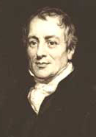







Ricardomodell – A general Argument against Donald Trump
David Ricardo:
Two countries benefit from trade if both countries specialize according to their comparative cost advantages. This is particularly true if one country has an absolute cost advantage in the production of all goods.
Quelle: David Ricardo (1817): The Principles of Political Economy and Taxation. John Murray, London
Mathematician
Natural Scientist
Politician
Stock Broker: He went “all in” with a bet on the defeat of Napoleon at Waterloo in 1815
Economist
Philosopher
One of the richest person in his time!
* 18. April 1772 in London; † 11. September 1823 in Gatcombe Park

Slide 2
Ricardomodell
Due to the very strict assumptions in the model and the simple functional relationship via a linear production function, the model also appears very simple. However, do not underestimate the difficulty behind it
An Ankedote Paul Samuelson (2. Nobel prize winner in economics 1970 and the guy who started all the mathematization of economics you have to go through ☺):
Paul Samuelson (Nobel laureate ) was once challenged by the mathematician Stanislaw Ulam (Co-developer of the H₂ bomb) to "name me one proposition in all of the social sciences which is both true and non-trivial." It was several years later than he thought of the correct response: comparative advantage. "That it is logically true need not be argued before a mathematician; that it is not trivial is attested by the thousands of important and intelligent men who have never been able to grasp the doctrine for themselves or to believe it after it was explained to them.“
Quelle: P.A. Samuelson (1969), "The Way of an Economist," in P.A. Samuelson, ed., International Economic Relations: Proceedings of the Third Congress of the International Economic Association, Macmillan: London, pp. 1-11.

Slide 3
Definitions
Definition:
An absolute cost advantage exists when A can produce a good more cost-effectively than B with the same input resources (i.e. time).

Slide 4
Definitions
Definition:
Opportunity costs are the maximum alternative earnings that might have been obtained if a productive good, service or capacity had been applied to some alternative use

Slide 5


Definitions
Definition:
A producer has a comparative advantage over another in the production of a good or if he can produce that product at lower
opportunity costs
Example:
You are about to take the decisive exam for your degree on March 6, 2025 and have three alternative courses of action on the Wednesday beforehand
You watch the CL-match between Bayern Munich and Bayer Leverkusen, drink a few beers and don't study
You go to your waiter's job in the cultural restaurant, where there is definitely no football being shown and will probably receive a tip of 150 euros for it and don't study
You lock your TV in the cellar, throw away the key and study all evening

Slide 6






Ricardomodel
Two Goods A und B
Two Producers 1 and 2
One production factor (time)
Linear production technology with constant returns to scale
→ opportunity costs within this model are measured via units of the other good
→ How much less of good A can I produce if I increase the production of good B by one unit

Slide 7




Ricardomodel
Assumptions:
Labor is the only input factor
Countries differ only in terms of labor productivity or the labor coefficients:
→ linear production function through the origin
$y=F\left(L\right)=AL=\frac{1}{a}L$ (y: Output; F(.): Production function; L: labor; a labor coefficients)
labor coefficients = $a:=\frac{labor input}{Output}$ productivity of labor = $A=\frac{Output}{labor input}=\frac{1}{a}$
Labor is completely flexible between the production sectors
Linearity and only one factor of production result in constant returns to scale in production

Slide 8

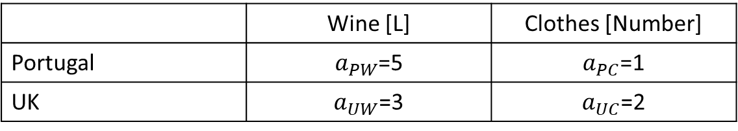
Ricardomodel – Example
Labor input (i.e. hours) per unit good (i.e Liter/number)
Labor coefficient: $a_{country,good}$
 | Wine [L] | Clothes [Number]
Portugal | $a_{PW}$=5 | $a_{PC}$=1
UK | $a_{UW}$=3 | $a_{UC}$=2
Absolute cost advantages?

Slide 9
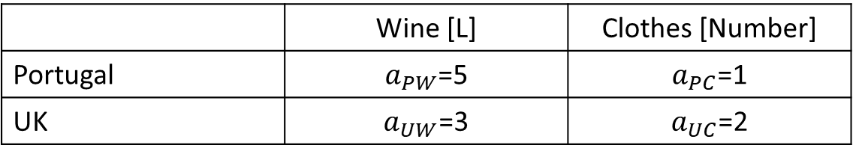
Ricardomodel
 | Wine [L] | Clothes [Number]
Portugal | $a_{PW}$=5 | $a_{PC}$=1
UK | $a_{UW}$=3 | $a_{UC}$=2
Comparative advantage?
Opportunity costs of wine in units of clothes
Opportunity costs of clothes in units of wine

Slide 10




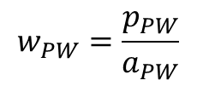

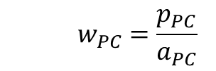



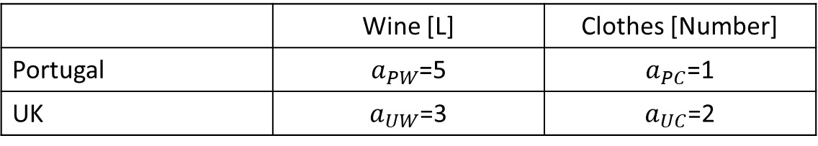




Ricardomodel
No Trade
 | Wine [L] | Clothes [Number]
Portugal | $a_{PW}$=5 | $a_{PC}$=1
UK | $a_{UW}$=3 | $a_{UC}$=2
Profit optimization (p: price, w: wage):
Profit = revenue – costs $\text{py}\text{−}\text{wL}\text{ = }\text{pL}\text{/}\text{a}\text{−}\text{wL}\text{⇒ }\text{p}\text{/}\text{a}\text{=}\text{w}$ in optimum (Marginal value product =factor prize, see Microeconomics)
Portugal
$$w_{PW}=\frac{p_{PW}}{a_{PW}}$$
Wine
Clothes
$${ w}_{PC} =\frac{p_{PC}}{a_{PC}}$$
S$ince labor is totally flexible between sectors{\text{⇒} w}_{PW}=w_{PC}$
→ $\frac{p_{PW}}{a_{PW}}=w_{PW}=w_{PC}=\frac{p_{PC}}{a_{PC}}$ or $\frac{P_{PW}}{P_{PC}}=\frac{a_{PW}}{a_{PC}}=\frac{5}{1}$ und $\frac{P_{UW}}{P_{UC}}=\frac{a_{UW}}{a_{UC}}=\frac{3}{2}$
→ Prices equal opportunity costs!

Slide 11
Ricardomodel
Interpretation of relative prices:
→ 1 L$wine in Portugal equals \frac{5}{1}$ clothes
→ 1 L $wine in UK equals\frac{3}{2}$ clothes
→ Relative prices= Exchange ratio of goods

Slide 12



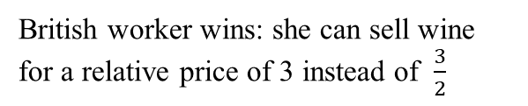

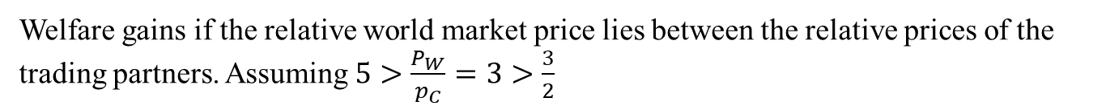

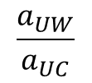

Ricardo model after specialization according to comparative cost advantage
Welfare gains if the relative world market price lies between the relative prices of the trading partners. Assuming $5>\frac{P_{W}}{p_{C}}=3>\frac{3}{2}$
Portugal:
relative price
$$\frac{a_{PW}}{a_{PC}}$$
$$5$$
Portuguese consumer wins: he can buy wine for a relative price of 3 instead of 5
Relative world market price
3
British worker wins: she can sell wine for a relative price of 3 instead of $\frac{3}{2}$
UK:
relative price
$$\frac{a_{UW}}{a_{UC}}$$
$$\frac{3}{2}$$

Slide 13


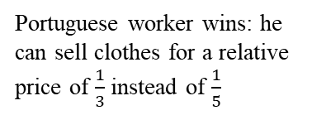

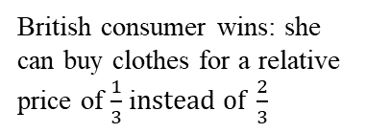





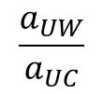





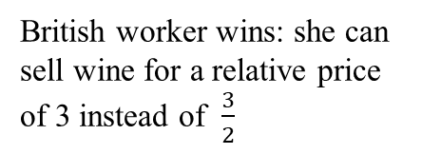
Ricardo model by specialization according to comparative cost advantages
UK is producing Wine
Portugal is producing clothes
W$orld market\frac{P_{C}}{p_{W}}=3$
W$orld market\frac{P_{W}}{p_{C}}=\frac{1}{3}$
1 Liter wine for 3 clothes
1 c$lothes for \frac{1}{3}=0,\overline{3}$ Liter Wine
Portugal:
$$\frac{a_{PW}}{a_{PC}}$$
British consumer wins: she can buy clothes for a relative price of $\frac{1}{3}$ i$nstead of \frac{2}{3}$
$$\frac{2}{3}$$
$\frac{a_{UC}}{a_{UW}}$
UK:
$$5$$
Portuguese consumer wins: he can buy wine for a relative price of 3 instead of 5
World market
3
$$\frac{1}{3}$$
World market
British worker wins: she can sell wine for a relative price of 3 instead of $\frac{3}{2}$
UK:
$$\frac{a_{UW}}{a_{UC}}$$
Portuguese worker wins: he can sell clothes for a relative price of $\frac{1}{3}$ instead of $\frac{1}{5}$
$$\frac{3}{2}$$
$$\frac{1}{5}$$
$\frac{a_{PC}}{a_{PW}}$
Portugal:
→ UK produces wine and Portugal produces clothes!!!
→ Both countries win if they specialize according to their comparative cost advantages: Both as producers and as consumers

Slide 14

Ricardomodell – Example
Friday (Production per day)
Fish | Coconuts
0 | 30
2 | 24
4 | 18
6 | 12
8 | 6
10 | 0
Robinson (Production per day)
Fish | Coconuts
0 | 9
2 | 6
4 | 3
6 | 0

Slide 15
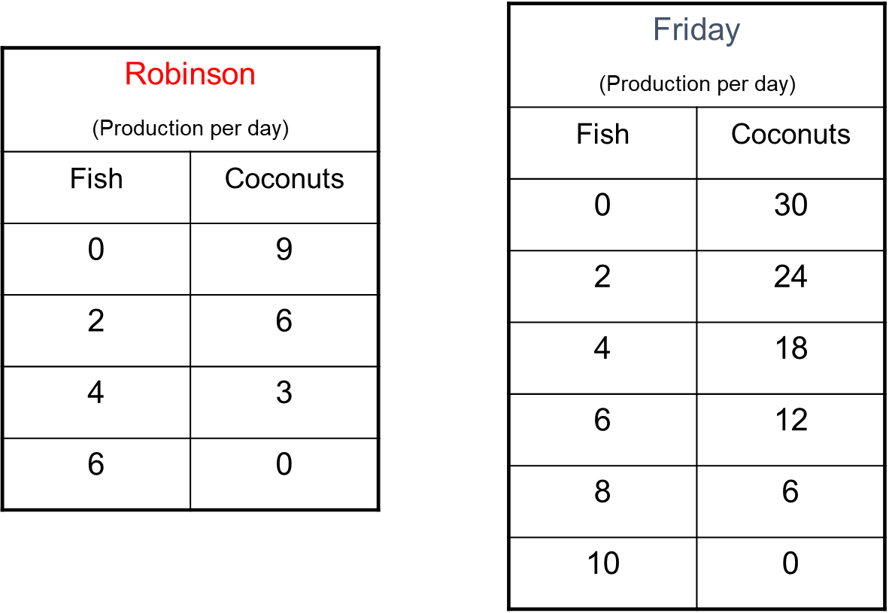


























Slide 16










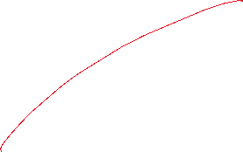



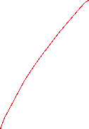


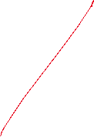







Ricardomodell

Slide 17












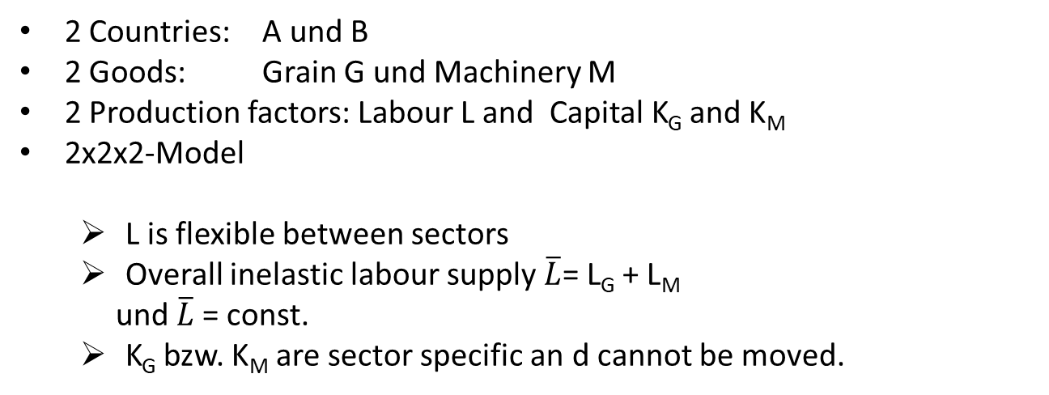

If trade is fundamentally good for an economy, why is there so much opposition to opening up?
  Trade influences the income distribution
Main reasons:
    Exchange of production factors between sectors is not cost-free
    Sectors differ in their demand for production factors
Model: Specific Factors
Assumptions:
In the short term some production factors cannot be exchanged between sectors, e.g.
  land
  Industry-specific capital
  High-skilled labour
2 Countries: A und B
2 Goods: Grain G und Machinery M
2 Production factors: Labour L and Capital K_{G} and K_{M}
2x2x2-Model
  L is flexible between sectors
  Overall inelastic labour supply $\overline{L}$= L_{G} + L_{M}
  und $\overline{L}$= const.
  K_{G} bzw. K_{M} are sector specific an d cannot be moved.

Slide 18
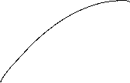
Neoclassical production function
positive but decreasing marginal products
constant returns to scale
$$Y=G,M$$
$$Y$$
$$L$$

Slide 19












Transformationcurve (production possibility frontier)
G
L_{G}
$$\overline{L}$$
M
$$\overline{L}$$
L_{M}

Slide 20



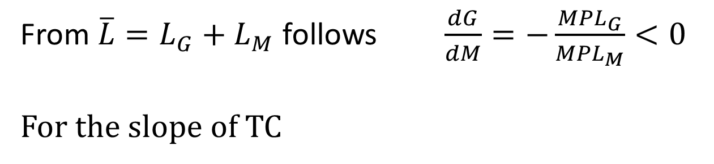

Marginal product of labor(MPL) and the slope of the transformation curve TC
MPL
L
From $\overline{L}=L_{G}+L_{M}$ follows $\frac{dG}{dM}=−\frac{{MPL}_{G}}{{MPL}_{M}}<0$
For the slope of TC

Slide 21






Labour market
P_{G}* MPL_{G}
P_{M}*MPL_{M}
Value of MPL,
wage
Value of MPL,
wage
L_{M}
$$\overline{L}$$
L_{G}
Due to the mobility of labour, wages have to coincide in both sectors→
$\frac{dG}{dM}=−\frac{\text{M}\text{P}\text{L}\text{G}}{\text{MP}\text{L}\text{M}}=−\frac{\text{P}\text{M}}{\text{P}\text{G}}$ slope of TC = negative price ratio

Slide 22
Increase of the price of M
P_{M}*GPL_{M}
P_{G}* GPL_{G} = Value of MPL
w=wage
P_{M}*GPL_{M} =Value of MPL
w=wage
P_{G}* GPL_{G}
w*
L_{M}
L*
L_{G}

Slide 23
Einkommensverteilung nach der Preisänderung
Capital owners in the machinery sector: Goods prices rise in nominal terms and also relative to the wage rate and relative to the grain sector. This increases income in this sector overall
→ Better off
Capital owners in the grain sector: the prices of goods remain unchanged in nominal terms, but they fall relative to the wage rate and relative to the machinery sector. This reduces income in this sector overall
→ Worse off
Workers: Wages are rising in nominal terms. However, they fall relative to the machinery sector, while they rise relative to the grain sector.
→ Better or worse off depends on preferences (ambiguity)

Slide 24
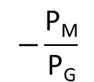
Production and consumption after foreign trade and a relative price increase of M
Price ratio for autarky
G
$$−\frac{\text{P}\text{M}}{\text{P}\text{G}}$$
●
Production point for autarky
M

Slide 25
Results:
Specific factors model
Export sector wins
Import sector loses
The effects on the mobile factor are ambivalent
BUT: Overall, the country wins!
→ There is a redistribution mechanism so that all sectors can be better off compared to the situation without trade
The outcome could be reversible under specific welfare function
-> Kaldor/Hicks/Scitovsky

