Slide 1
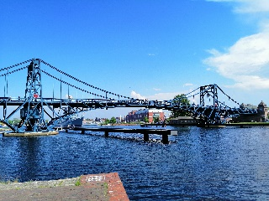

International Trade und Policy
Wilhelmshaven
This lecture will be recorded and
Subsequently uploaded in the
world-wide-web
Prof. Dr. Bernhard Köster
Jade-Hochschule Wilhelmshaven
http://www.bernhardkoester.de/vorlesungen/inhalt.html

Slide 2

International Trade and Policy
Summer term 2026
Prof. Dr. Bernhard Köster

Slide 3
Literature
Appleyard, D. und A. Field International Economics
Feenstra, R. und A Taylor, International Economics
Gandolfo, G., Elements of International Economics
Gandolfo, G., International Finance and Open-Economy Macroeconomics
Krugman, P., Obstfeld, M. und M. Melitz, International Economics

Slide 4
Data
WTO
Unctad ITC
UN Comtrade
Destatis → Genesis-Data → Germant rade data
Bundesbank → Statistics → Current Accout/Exchange rates
ECB → General EU data → ECB data portal
Eurostat → Internationale Trade
IMF Data
World bank data

Slide 5
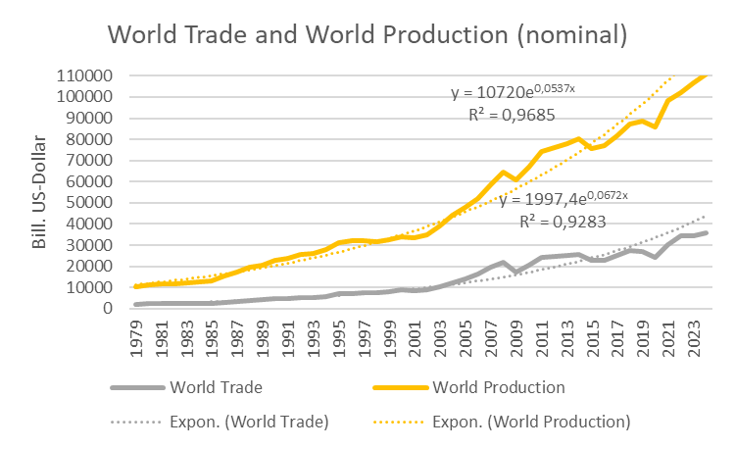














World Trade and World Production (nominal)
Source:
World Bank

Slide 6
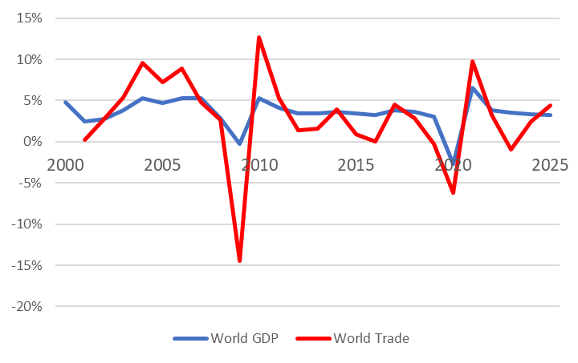







World Trade and World Production (real)
Quelle: IMF, CPB, own calculation

Slide 7

Global trade relations
Quelle: World Bank, own calculation
Openess: (Ex+Im)/GDP (nominal values)

