Slide 1
Balance of payments
Balance of Payments
=
Current Account + Capital Accout = 0
Notes:
1

Slide 2
Exchange rates and Currency markets
The exchange rate of two currencies describes the exchange ratio between these currencies, i.e. the price of one currency expressed in another currency.
Quantity quotation:
The quantity quotation indicates how many units of foreign currency you get for one unit of domestic currency (e.g. 1€ = 1.37$)
Price Quotation:
The price quotation indicates how many units of the domestic currency one unit of the foreign currency costs (e.g. 1$ = 0.73€)
We usually specify the exchange rate of the euro in price quotation. Attention: The USA does the same → reciprocal value!

Slide 3
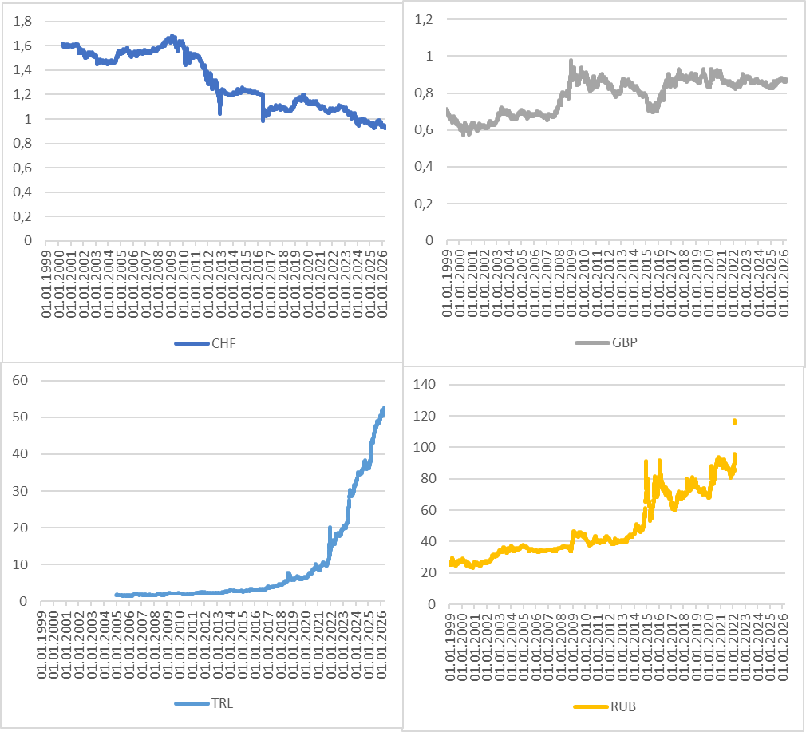
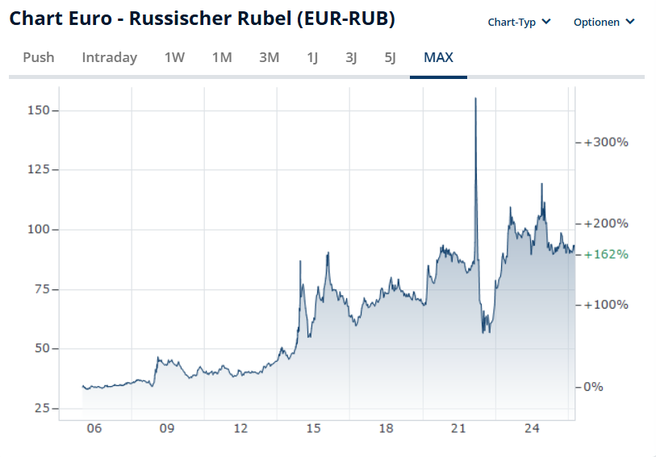
Exchange rates
Source: Finanzen.net
Source: Bundesbank

Slide 4
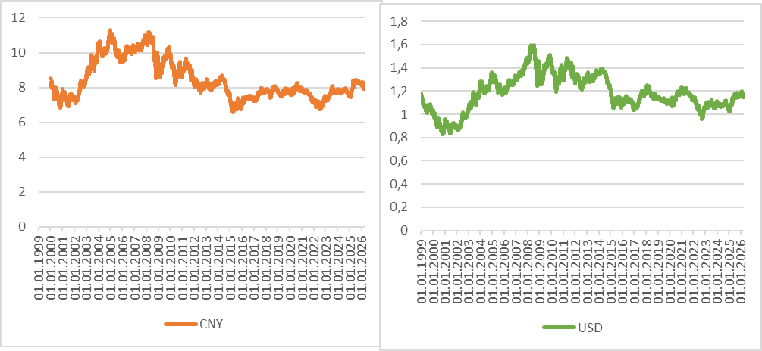
Exchange rates
Source: Bundesbank

Slide 5
Dollar-Euro Market
Demand Euro | Supply Euro
Exports of goods and services from the eurozone to the USA | Imports of goods and services from the eurozone to the USA
US-Tourists Europe in 10 Days | Germans down in the Grand Canyon
US-Direct Investments in Germany | EU-Direct Investments in the USA
For the international exchange of goods, services and capital, an offsetting entry in dollars or euros is always necessary in the background. Even if the money does not necessarily have to flow explicitly, the objects of exchange are valued mutually via the exchange rate

Slide 6
Balance of Payments and Currency markets
Suppy Dollar – Demand Euro | Demand Dollar – Supply Euro
Export of goods to USA | Import of goods from USA
Capital import | Capital export
Exports + Capitalimport = Imports + Capitalexport
Demand for home currency ↑↓ | Supply home currency↑↓
Exports of goods ↑↓ | Imports of goods ↑↓
Capital imports ↑↓ | Capital exports ↑↓
Note that exports of goods and imports of capital, or imports of goods and exports of capital, are on the same side of the balance sheet, as they represent the respective offsetting entry

Slide 7

Uncovered interest rate parity
$i_{€}, i_{\$}$ : interest rates €- and $-investments
$e_{0}$: nominalr $/€ exchange rate t=0
$E{(e}_{1})$: expected $/€ exchange rate in t=1
http://www.bernhardkoester.de/video/inhalt.html
oder direkt unter
https://www.youtube.com/watch?v=S5PVHRQZe1E&feature=youtu.be
1 €
Investment Euro
InvestmentUS-Dollar

Slide 8

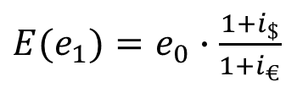
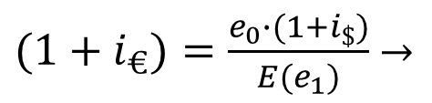
Exchange rate forecast
Efficient market hypothesis: Asset prices contain all publicly available information that determines the value of an investment.
→ $E{(e}_{1})$ is the best forecast for $/€ exchange rate and mirrors all market information
$(1+i_{€})=\frac{e_{0}∙(1+i_{\$})}{{E(e}_{1})}$ $→$
${E(e}_{1})=e_{0}∙$ $\frac{1+i_{\$}}{1+i_{€}}$
Empirical studies have so far shown that no model approach can improve the “naive” forecast (cf. the note on the efficiency market hypothesis above!). Ex post, models can beat the “naive” forecast, but ex ante you don't know which model to choose!

Slide 9
Purchase Power Parity (PPP)
Purchasing power parity is based on the assumption that one unit of a currency can buy the same amount of goods all over the world after exchange.
Principle of one price around the world
In the short term, this is certainly not the case, but in the long term, exchange rates should adjust in line with purchasing power parities.

Slide 10
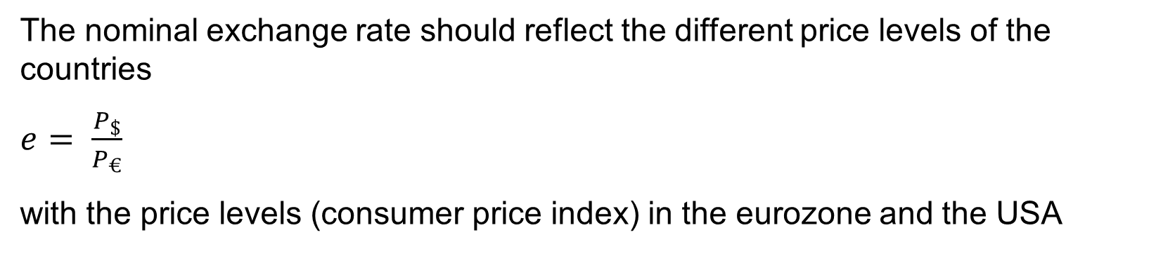
PPP
The nominal exchange rate should reflect the different price levels of the countries
$e= \frac{P_{\$}}{P_{€}}$
with the price levels (consumer price index) in the eurozone and the USA
However, there are many goods that cannot be traded directly
Many tradable goods are not perfect substitutes
This complicates or calls into question the concept of comparable baskets of goods in different countries

Slide 11

The Big Mac Index
https://statbase.org/datasets/indexes-and-ratings/bigmac-index/#:~:text=Feb%202%2C%202026-,In%20January%202026%2C%20the%20highest%20overvaluation%20of%20local%20currencies%20according,in%202002)%20to%20+22.8.

