Slide 1
Game theory – Nash Equilibrium
A Nash equilibrium is a combination of strategies in which each player chooses a strategy in which no player has an incentive to be the only one to deviate from their chosen strategy.

Slide 2
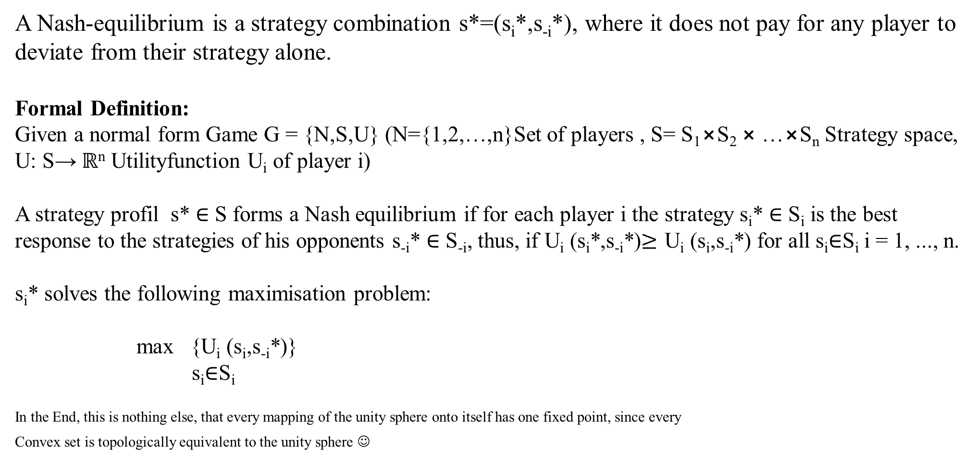
Nash-Equlibrium
Dissertation
Nash, John F. (1950) Equilibrium Points in n-Person Games, PNAS January 1, 1950 36 (1) 48-49
A Nash-equilibrium is a strategy combination s*=(s_{i}*,s_{-i}*), where it does not pay for any player to deviate from their strategy alone.
Formal Definition:
Given a normal form Game G = {N,S,U} (N={1,2,…,n}Set of players , S= S₁$⨯$S₂ $⨯$…$⨯$S_{n} Strategy space, U: S→ $ℝ$^{n} Utilityfunction U_{i} of player i)
A strategy profil s* ∈ S forms a Nash equilibrium if for each player i the strategy s_{i}* ∈ S_{i} is the best response to the strategies of his opponents s_{‑i}* ∈ S_{-i}, thus, if U_{i} (s_{i}*,s_{-i}*)≥ U_{i} (s_{i},s_{-i}*) for all s_{i}∈S_{i} i = 1, ..., n.
s_{i}* solves the following maximisation problem:
max {U_{i} (s_{i},s_{-i}*)}
s_{i}∈S_{i}
In the End, this is nothing else, that every mapping of the unity sphere onto itself has one fixed point, since every
Convex set is topologically equivalent to the unity sphere ☺

Slide 3
Example: Prisoners Dilemma and Trade war
Pay-off matrix: (USA, EU)
EU USA |  | Free Trade | Import barriers
 | Free Trade | (10 Mrd. $,10 Mrd. $) | (-10 Mrd. $,20 Mrd. $)
 | Import barriers | (20 Mrd. $,-10 Mrd. $) | (-5 Mrd. $,-5 Mrd. $)

Slide 4
Trade policy – International approach
International negotiations can mobilize exporters to support free trade if they believe that this will increase their sales markets.
Such a policy can counteract a policy of foreclosure through import restrictions imposed by lobby groups.

Slide 5
Trade policy – International approach
International negotiations can prevent trade wars in which countries hinder each other with trade restrictions.
  A trade war can arise if each country has an incentive to introduce restrictions, regardless of what the other country does.
    This can lead to the result that each country introduces restrictions, although it would be in the interest of all countries to achieve the situation of free trade.
      The trading partners need an agreement that prevents trade restrictions.

Slide 6
Prisoners Dilemma
    An excellent example of how to make money with the game-theoretical understanding of the prisoner's dilemma can be found in the English game show Golden Balls
        https://www.youtube.com/watch?v=S0qjK3TWZE8
    Tatort
      „Wir – Ihr – Sie“
      https://www.daserste.de/unterhaltung/krimi/tatort/sendung/wir-ihr-sie-104.html

Slide 7
Trade Conflicts: Another Approach!
There does not always have to be a clear balance or the possibility of a pareto-better state.
Example
See
Internationale Handelskonflikte: eine verhaltensökonomische Analyse
(2024 Köster, Bernhard und Mühe, Felix)
WiSt -- Wirtschaftswissenschaftliches Studium, Heft 5-2024, 26 -- 32
 |  | Country B
 |  | Accept given rule | Setting new rule
Country A | Accept given rule | ( 4 , 4 ) | ( 2 , 8 )
 | Setting new rule | ( 10 , 0 ) | ( -2 ,- 4 )

