Slide 1













































































International Trade und Policy
Wilhelmshaven
This lecture will be recorded and
Subsequently uploaded in the
world-wide-web
Prof. Dr. Bernhard Köster
Jade-Hochschule Wilhelmshaven
http://www.bernhardkoester.de/vorlesungen/inhalt.html

Slide 2

















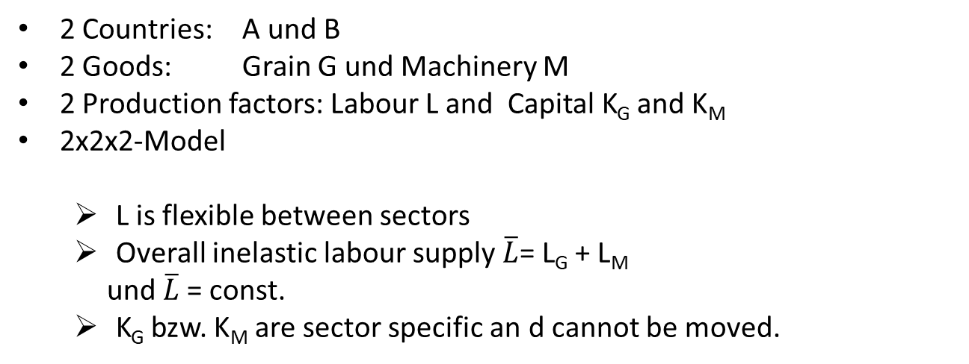











If trade is fundamentally good for an economy, why is there so much opposition to opening up?
Trade influences the income distribution
Main reasons:
Exchange of production factors between sectors is not cost-free
Sectors differ in their demand for production factors
Model: Specific Factors
Assumptions:
In the short term some production factors cannot be exchanged between sectors, e.g.
land
Industry-specific capital
High-skilled labour
2 Countries: A und B
2 Goods: Grain G und Machinery M
2 Production factors: Labour L and Capital K_{G} and K_{M}
2x2x2-Model
L is flexible between sectors
Overall inelastic labour supply $\overline{L}$= L_{G} + L_{M}
und $\overline{L}$= const.
K_{G} bzw. K_{M} are sector specific an d cannot be moved.

Slide 3
















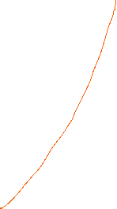







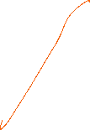




Increase of the price of M
P_{M}*GPL_{M}
P_{G}* GPL_{G} = Value of MPL
w=wage
P_{M}*GPL_{M} =Value of MPL
w=wage
P_{G}* GPL_{G}
w*
L_{M}
L*
L_{G}

Slide 4



Einkommensverteilung nach der Preisänderung
Capital owners in the machinery sector: Goods prices rise in nominal terms and also relative to the wage rate and relative to the grain sector. This increases income in this sector overall
→ Better off
Capital owners in the grain sector: the prices of goods remain unchanged in nominal terms, but they fall relative to the wage rate and relative to the machinery sector. This reduces income in this sector overall
→ Worse off
Workers: Wages are rising in nominal terms. However, they fall relative to the machinery sector, while they rise relative to the grain sector.
→ Better or worse off depends on preferences (ambiguity)

Slide 5












































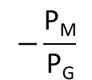




Production and consumption after foreign trade and a relative price increase of M
Price ratio for autarky
G
$$−\frac{\text{P}\text{M}}{\text{P}\text{G}}$$
●
Production point for autarky
M

Slide 6





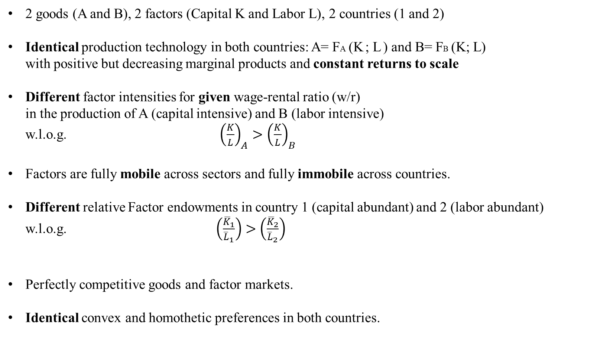
Heckscher Ohlin Model
2 goods (A and B), 2 factors (Capital K and Labor L), 2 countries (1 and 2)
Identical production technology in both countries: A= FA (K ; L ) and B= FB (K; L) with positive but decreasing marginal products and constant returns to scale
Different factor intensities for given wage-rental ratio (w/r) in the production of A (capital intensive) and B (labor intensive) w.l.o.g. ${\left(\frac{K}{L}\right)}_{A}>{\left(\frac{K}{L}\right)}_{B}$
Factors are fully mobile across sectors and fully immobile across countries.
Different relative Factor endowments in country 1 (capital abundant) and 2 (labor abundant) w.l.o.g. $\left(\frac{{\overline{K}}_{1}}{{\overline{L}}_{1}}\right)>\left(\frac{{\overline{K}}_{2}}{{\overline{L}}_{2}}\right)$
Perfectly competitive goods and factor markets.
Identical convex and homothetic preferences in both countries.

Slide 7














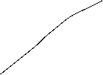
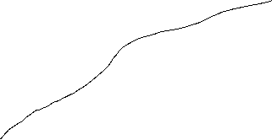



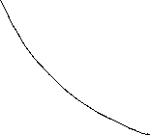


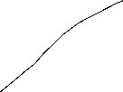
Heckscher Ohlin Model – Cost Minimization – Factor Intensities – Factor Price Ratios -- Edgeworth Box

Slide 8





Heckscher Ohlin Model – Contract Curve – Transformation curve

Slide 9






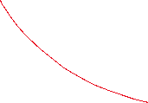













Heckscher Ohlin Model – Factor Market Clearing – Autarky Equilibrium – relative Supply

Slide 10
Heckscher Ohlin Model – Trade Equilibrium

Slide 11
Heckscher Ohlin Model – Factor price equalization theorem
If two countries are engaged in free trade, have identical technologies, and produce both goods, then they must have the same factor prices

Slide 12
Heckscher Ohlin Model – Rybczynski theorem
For given relative goods prices, an increase in the endowment of a factor will increase the output of the industry using this factor intensively and decrease the output of the other industry

Slide 13
Heckscher Ohlin Model – Heckscher Ohlin Theorem
A country exports the good which uses its abundant factor intensively.

Slide 14
Heckscher Ohlin Model – Stolper Samuelson theorem
An increase in the relative price of a good will increase the real return to the factor used intensively in the production of that good, and reduce the real return to the other factor, in terms of both goods

Slide 15
Heckscher Ohlin Model – Overall Effects
Heckscher Ohlin theorem + Stolper Samuelson theorem implies that
the owners of the abundant factor gain and
the owners of the scarce factor lose from trade
The gains from trade for the winners is lager than the losses of the losers
There exists as in the specific factors model a compensation mechanism for an overall gain
The overall gains follows similar to the Ricardian and the specific factors model from the reason that consumption possibilities are larger under trade than under autarky because production and consumption choices then no longer have to coincide
In all three models, the main reason for the gains from trade is comparative advantage

