Slide 1





































































International Trade und Policy
Wilhelmshaven
This lecture will be recorded and
Subsequently uploaded in the
world-wide-web
Prof. Dr. Bernhard Köster
Jade-Hochschule Wilhelmshaven
http://www.bernhardkoester.de/vorlesungen/inhalt.html

Slide 2
















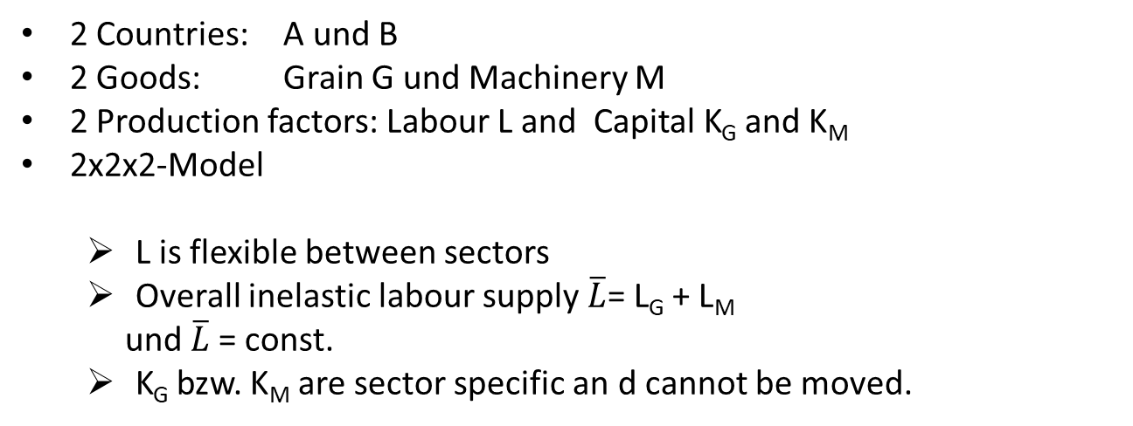










If trade is fundamentally good for an economy, why is there so much opposition to opening up?
  Trade influences the income distribution
Main reasons:
    Exchange of production factors between sectors is not cost-free
    Sectors differ in their demand for production factors
Model: Specific Factors
Assumptions:
In the short term some production factors cannot be exchanged between sectors, e.g.
  land
  Industry-specific capital
  High-skilled labour
2 Countries: A und B
2 Goods: Grain G und Machinery M
2 Production factors: Labour L and Capital K_{G} and K_{M}
2x2x2-Model
  L is flexible between sectors
  Overall inelastic labour supply $\overline{L}$= L_{G} + L_{M}
  und $\overline{L}$= const.
  K_{G} bzw. K_{M} are sector specific an d cannot be moved.

Slide 3



















Neoclassical production function
positive but decreasing marginal products
constant returns to scale
$$Y=G,M$$
$$Y$$
$$L$$

Slide 4












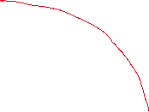











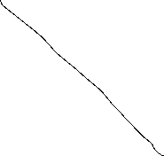












Transformationcurve (production possibility frontier)
G
L_{G}
M
L_{M}

Slide 5
















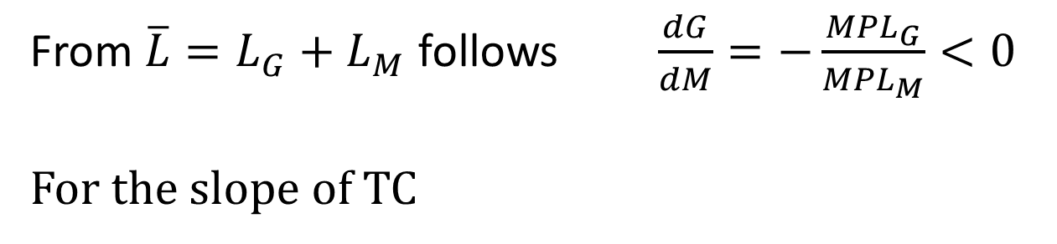






Marginal product of labor(MPL) and the slope of the transformation curve TC
MPL
L
From $\overline{L}=L_{G}+L_{M}$ follows $\frac{dG}{dM}=−\frac{{MPL}_{G}}{{MPL}_{M}}<0$
For the slope of TC

Slide 6



































Labour market
P_{G}* MPL_{G}
P_{M}*MPL_{M}
Value of MPL,
wage
Value of MPL,
wage
L_{M}
$$\overline{L}$$
L_{G}
Due to the mobility of labour, wages have to coincide in both sectors→
$\frac{dG}{dM}=−\frac{\text{M}\text{P}\text{L}\text{G}}{\text{MP}\text{L}\text{M}}=−\frac{\text{P}\text{M}}{\text{P}\text{G}}$ slope of TC = negative price ratio

Slide 7
Increase of the price of M
P_{M}*GPL_{M}
P_{G}* GPL_{G} = Value of MPL
w=wage
P_{M}*GPL_{M} =Value of MPL
w=wage
P_{G}* GPL_{G}
w*
L_{M}
L*
L_{G}

Slide 8
Einkommensverteilung nach der Preisänderung
Capital owners in the machinery sector: Goods prices rise in nominal terms and also relative to the wage rate and relative to the grain sector. This increases income in this sector overall
→ Better off
Capital owners in the grain sector: the prices of goods remain unchanged in nominal terms, but they fall relative to the wage rate and relative to the machinery sector. This reduces income in this sector overall
→ Worse off
Workers: Wages are rising in nominal terms. However, they fall relative to the machinery sector, while they rise relative to the grain sector.
→ Better or worse off depends on preferences (ambiguity)

Slide 9
Production and consumption after foreign trade and a relative price increase of M
Price ratio for autarky
G
$$−\frac{\text{P}\text{M}}{\text{P}\text{G}}$$
●
Production point for autarky
M

Slide 10

Results:
Specific factors model
Export sector wins
Import sector loses
The effects on the mobile factor are ambivalent
BUT: Overall, the country wins!
→ There is a redistribution mechanism so that all sectors can be better off compared to the situation without trade
The outcome could be reversible under specific welfare function
-> Kaldor/Hicks/Scitovsky

Slide 11
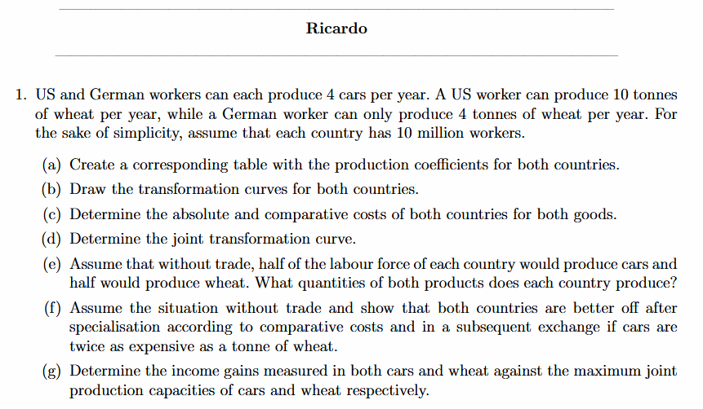




Slide 12





Slide 13
