Slide 1

International Trade und Policy
Wilhelmshaven
This lecture will be recorded and
Subsequently uploaded in the
world-wide-web

Slide 2




De-Risking and De-coupling in International Economic relation
–
Volatile Times for Investment Decisions
Thursday 15.04.2025
Hybrid: Zoom + Lecture Hall
Jade Hochschule Wilhelmshaven
10:15 – 11:45 Uhr: S123
Wilhelmshaven
Dr. Jörg Rahn
Chief Investment Officer
Tertium Family Office
Dr. Wolfgang Kornprobst
Senior Economist (Strategy)
Siemens AG
Prof. Dr. Bernhard Köster
Economics
Jade Hochschule
Kontakt:
Prof. Dr. Bernhard Köster
bernhard.koester@jade-hs.de
Zoom-link:
https://jade-hs.zoom-x.de/j/69403756953?pwd=u1b9J7DWcCPv1y3abm6Y8N8YkU6hXK.1

Slide 3
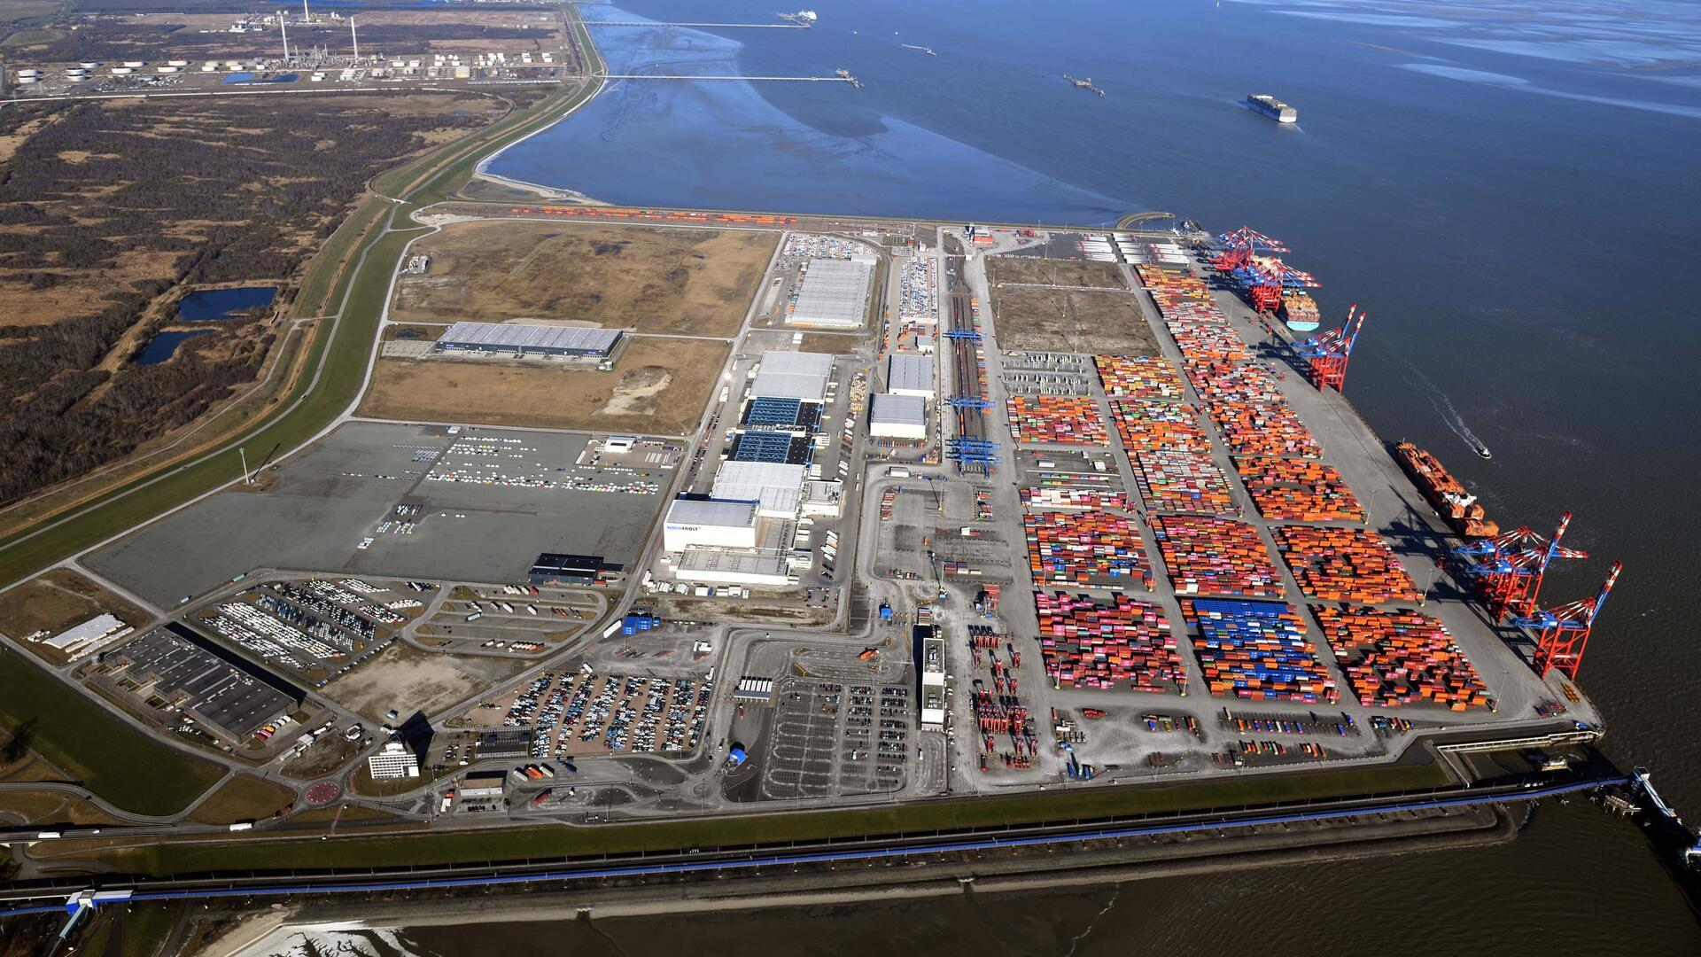
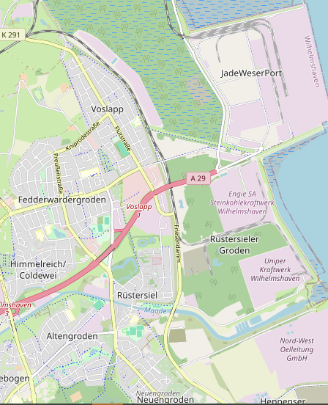
Excursion
Jade Weser Port
Wilhelmshaven
InfoCenter
x
Thursday 22.05.2025 JadeWeserPort InfoCenter
10:30 Uhr – 11:30 Uhr Harbour Tour
11:30 Uhr – 12:00 Uhr Short Presentation
12:00 Uhr – 12:30 Uhr Film about the construction of the JadeWeserPort
12:30 Uhr – 13:00 Uhr Visit to the exhibition in the JadeWeserPort InfoCenter
Kontakt:
Prof. Dr. Bernhard Köster
bernhard.koester@jade-hs.de
JHS
x

Slide 4
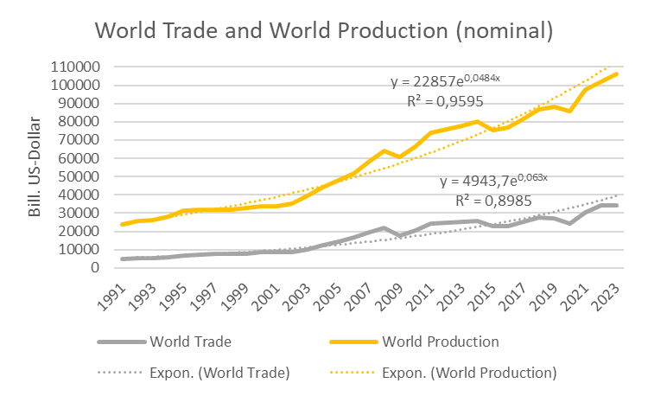


World Trade and World Production (nominal)
Source:
World Bank

Slide 5
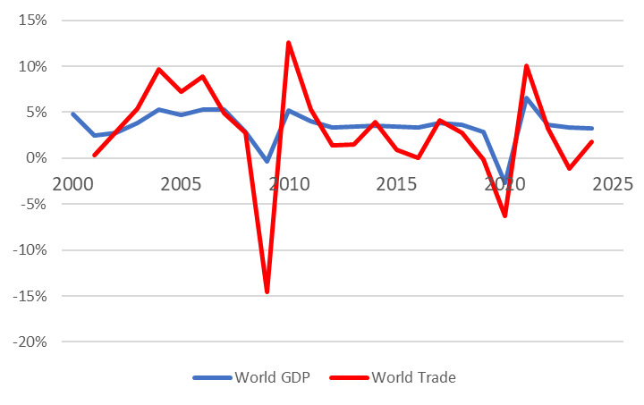

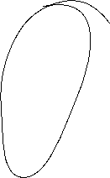


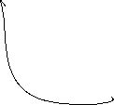












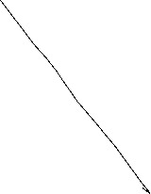




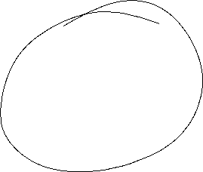
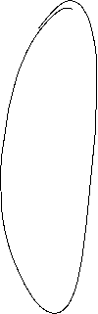

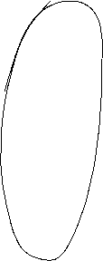
World Trade and World Production (real)
Quelle: IMF, CPB, own calculation

Slide 6












Global trade relations
Quelle: World Bank, own calculation
Openess: (Ex+Im)/GDP

Slide 7
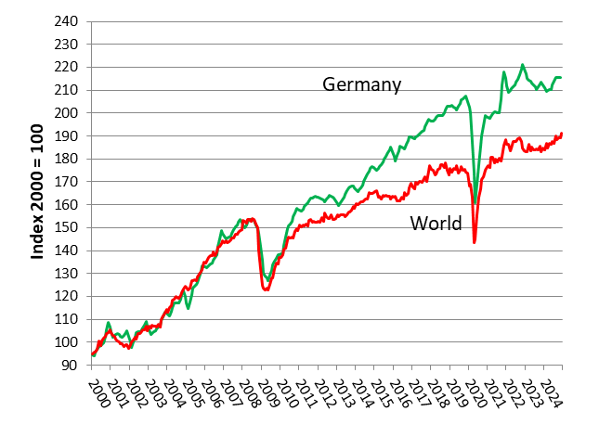
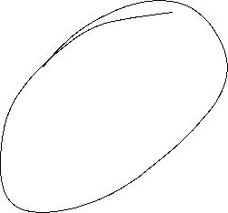

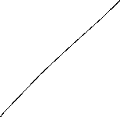
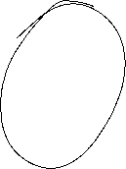







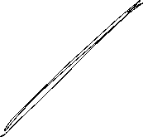

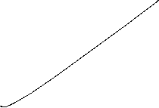
International Trade Germany vs World (real)
Source: Destatis, CPB

Slide 8
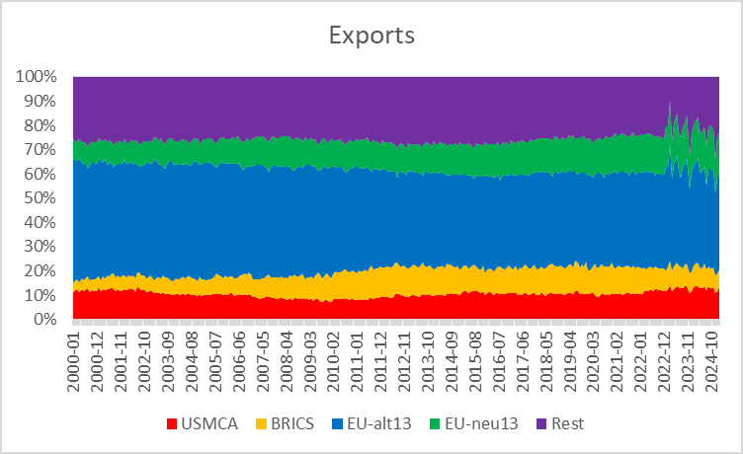
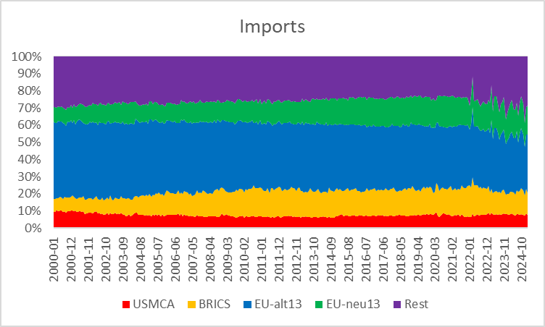










German Trade Regions
USMCA: USA, Mexiko, Kanada; BRICS: Brasilien, Rußland, Portugal, China, Südafrika
EU-alt: BEL, DNK, FIN, FRA, GRE, IRL, ITA, LUX, NDL, AUT, POR, SWE, ESP
EU-neu: BUL, EST, CRO, LET, LIT, MLT, POL, ROM, SVL, SLO, CZE, HUN, CYP

Slide 9






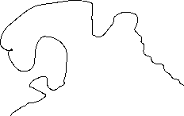



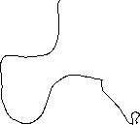








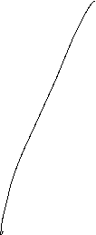



20 largest Economies (GDP) with their largest trading partners
Source: ITC

Slide 10













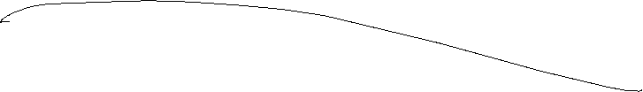

German Trade
Quelle: Destatis

Slide 11
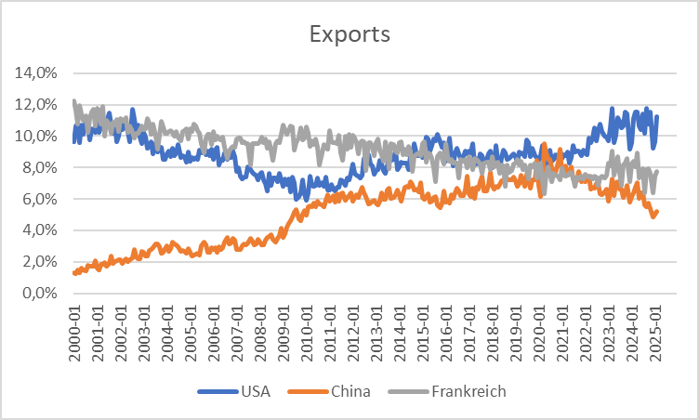
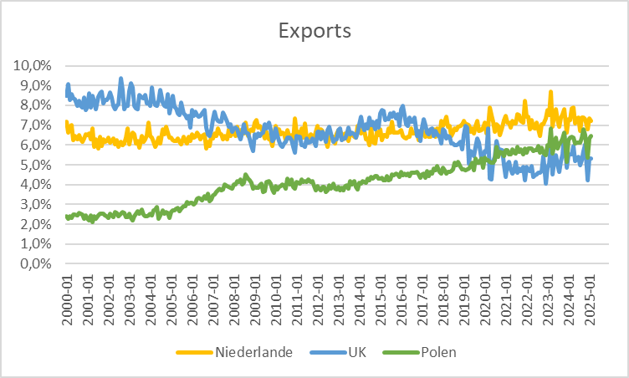
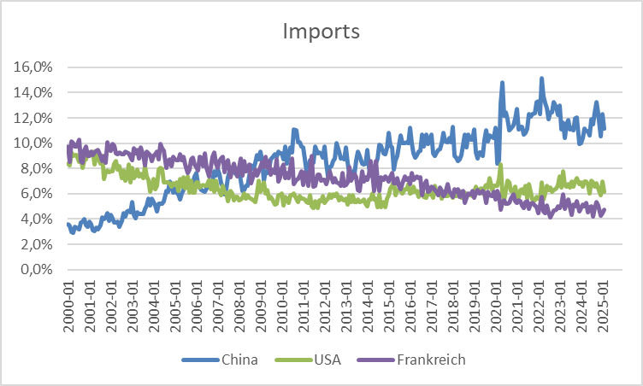
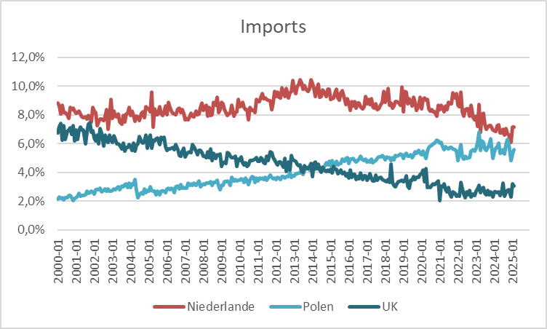













German Trade
Quelle: Destatis

Slide 12
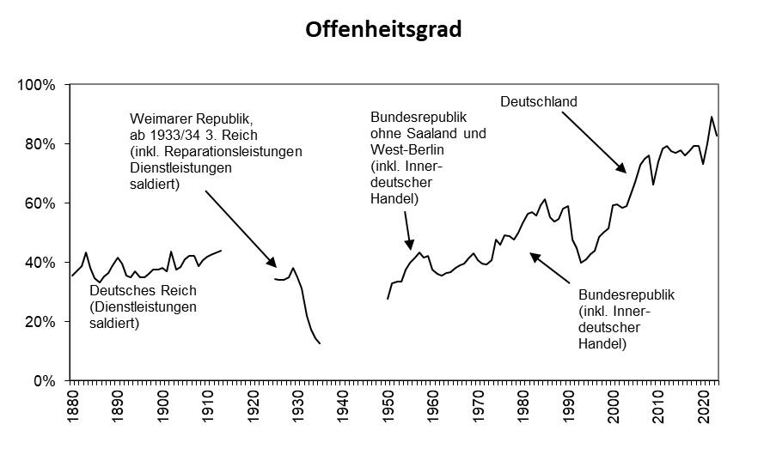

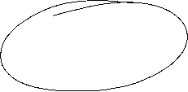

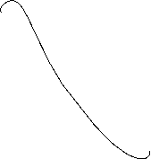






Germany Openess (Ex+Im)/GDP
Quelle: Statistisches Bundesamt, Hoffmann

Slide 13
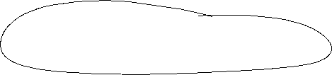

Game theory – Nash Equilibrium
A Nash equilibrium is a combination of strategies in which each player chooses a strategy in which no player has an incentive to be the only one to deviate from their chosen strategy.

Slide 14


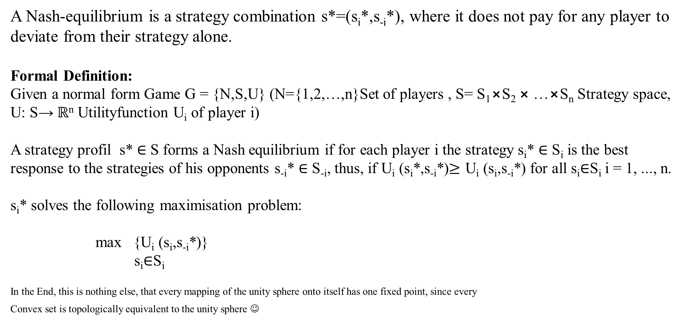






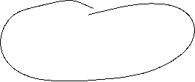






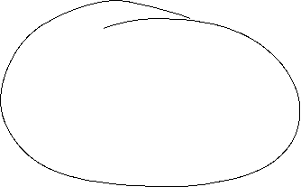


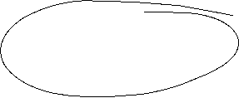

Nash-Equlibrium
Dissertation
Nash, John F. (1950) Equilibrium Points in n-Person Games, PNAS January 1, 1950 36 (1) 48-49
A Nash-equilibrium is a strategy combination s*=(s_{i}*,s_{-i}*), where it does not pay for any player to deviate from their strategy alone.
Formal Definition:
Given a normal form Game G = {N,S,U} (N={1,2,…,n}Set of players , S= S₁$⨯$S₂ $⨯$…$⨯$S_{n} Strategy space, U: S→ $ℝ$^{n} Utilityfunction U_{i} of player i)
A strategy profil s* ∈ S forms a Nash equilibrium if for each player i the strategy s_{i}* ∈ S_{i} is the best response to the strategies of his opponents s_{‑i}* ∈ S_{-i}, thus, if U_{i} (s_{i}*,s_{-i}*)≥ U_{i} (s_{i},s_{-i}*) for all s_{i}∈S_{i} i = 1, ..., n.
s_{i}* solves the following maximisation problem:
max {U_{i} (s_{i},s_{-i}*)}
s_{i}∈S_{i}
In the End, this is nothing else, that every mapping of the unity sphere onto itself has one fixed point, since every
Convex set is topologically equivalent to the unity sphere ☺

Slide 15


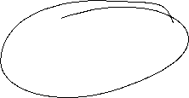








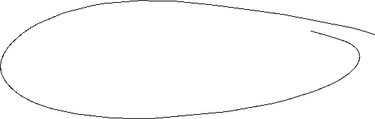



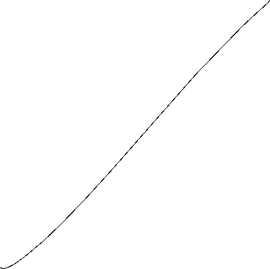



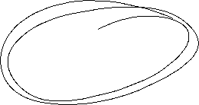
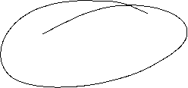






Example: Prisoners Dilemma and Trade war
Pay-off matrix: (USA, EU)
EU USA |  | Free Trade | Import barriers
 | Free Trade | (10 Mrd. $,10 Mrd. $) | (-10 Mrd. $,20 Mrd. $)
 | Import barriers | (20 Mrd. $,-10 Mrd. $) | (-5 Mrd. $,-5 Mrd. $)

Slide 16
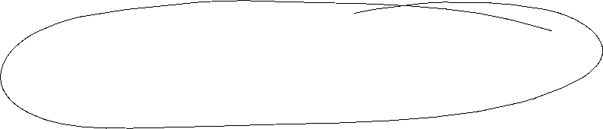
Trade policy – International approach
International negotiations can mobilize exporters to support free trade if they believe that this will increase their sales markets.
Such a policy can counteract a policy of foreclosure through import restrictions imposed by lobby groups.

Slide 17
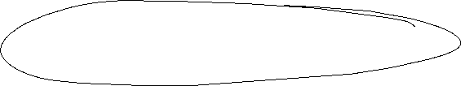

Trade policy – International approach
International negotiations can prevent trade wars in which countries hinder each other with trade restrictions.
  A trade war can arise if each country has an incentive to introduce restrictions, regardless of what the other country does.
    This can lead to the result that each country introduces restrictions, although it would be in the interest of all countries to achieve the situation of free trade.
      The trading partners need an agreement that prevents trade restrictions.

Slide 18



Prisoners Dilemma
    An excellent example of how to make money with the game-theoretical understanding of the prisoner's dilemma can be found in the English game show Golden Balls
        https://www.youtube.com/watch?v=S0qjK3TWZE8
    Tatort
      „Wir – Ihr – Sie“
      https://www.daserste.de/unterhaltung/krimi/tatort/sendung/wir-ihr-sie-104.html

Slide 19




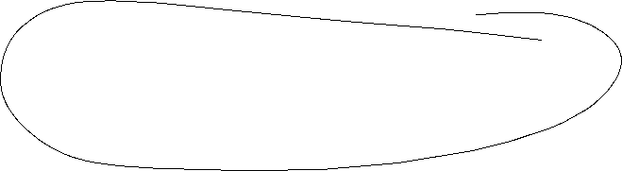




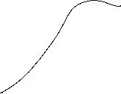
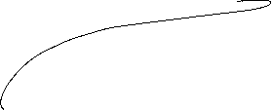



Trade Conflicts: Another Approach!
There does not always have to be a clear balance or the possibility of a pareto-better state.
Example
See
Internationale Handelskonflikte: eine verhaltensökonomische Analyse
(2024 Köster, Bernhard und Mühe, Felix)
WiSt -- Wirtschaftswissenschaftliches Studium, Heft 5-2024, 26 -- 32
 |  | Country B
 |  | Accept given rule | Setting new rule
Country A | Accept given rule | ( 4 , 4 ) | ( 2 , 8 )
 | Setting new rule | ( 10 , 0 ) | ( -2 ,- 4 )

