Slide 1

International Trade und Policy
Wilhelmshaven
This lecture will be recorded and
Subsequently uploaded in the
world-wide-web

Slide 2
Economies of Scale
CRS:
Y=F(L): 2L↑ → 2Y↑
IRS:
Y=F(L): 2L↑ → 3Y↑
DRS:
Y=F(L): 2L↑ → 1Y↑

Slide 3
Economies of Scale
CRS
Marginal costs MC
Y
Production
K
Costs
MC
L
Y
Y
Production
DRS
Y
K
MC
Marginal costs MC
Costs
L
Y
Y
IRS
MC
Marginal costs MC
Y
K
Costs
Production
L
Y
Y

Slide 4
Economies of Scale and Trade: New Trade Theory
Is there trade if countries do not differ in their productivities?
New assumption:
Increasing returns to scale: Y=F(L) leads e.g. 2L↑ → 3Y↑
With constant factor prices,
average costs fall as production increases

Slide 5
Economies of Scale and Trade
Consumers have a preference for the differentiation of a product (variants of a product)
Each country specialises in one product variant, produces the entire demand for the global market and uses its resources for this.
Due to the increasing economies of scale, the average production costs for each country fall
Consequences:
Each country has specialised, but the number of product variants on the world market has not decreased.
Overall, global production is produced at lower average costs than when individual countries are self-sufficient and producers can exploit economies of scale
Due to the economies of scale, a country specialises in the production of some products and imports the others
Trade also takes place between countries with comparable production conditions

Slide 6
Internal and External Economies of Scale
Internal economies of scale:
Average costs fall due to the size of the company
Due to high fixed costs, a certain size is necessary for efficient production (e.g. car sector/pharmaceutical sector)
Large companies produce differentiated products for which prices can vary.
Competition under monopolistic competition
External economies of scale:
Average costs fall due to the number of companies (depend on the size of the industrial sector)
In principle, small companies that offer the same product under favourable conditions (geography/tax environment) at the same price (clustering of suppliers/e.g. souvenir shops or start-ups for similar products)
Competition under perfect competition

Slide 7
Internal Economies of Scale
Cost function:
Costs = Fixed costs + variable costs
K(x)=KF+k∙x
Average costs =
DK(x)=KF/x+k
Marinal costs =
GK=dK/dx=K‘(x)=k

Slide 8
Internal Economies of Scale
DK
GK
DK(x)=KF/x+k=KF/x+GK
GK=dK/dx=K‘(x)=k
x
Due to the fixed cost degression, the average costs decrease with increasing output quantity, but are above the marginal costs (e.g. with constant marginal costs).

Slide 9
Monoplistic competition
Assumptions:
Few companies produce different product variants
Quasi-monopolies in the product variant (cf. monopoly)
However, the price is based on the industry average
Different and independent prices
Each company takes the prices of the other companies as given (cf. Cournot competition)
All companies have the same cost structure and face the same demand structure, even if they produce differentiated products

Slide 10
Monopolistic Competition
Demand
x = S(1/n –b(p-P))
Demand of the sector in increasing in (S):
Demand increases if the Average Price (P) increases (other firms).
if p = P, ever firms sells the same share S/n
The more (p) overtakes (P) the less is the market share of the firm.
The size of the sector(S) is not price dependent
x = Quantity of a single firm
S = Size of the sector
n = Number of the firms
p = Price of a single firm
P = Average price of the sector
b = Pricesensivity

Slide 11
Monopolistic competition: Equilibrium
Number of firms and average costs:
Since all firms are symmetrical, all must produce at the same price in equilibrium
→ p*=p=P
→ Für p*=p=P -> market share of every firm x*=S/n
→ put into cost function:
DK = K/x = KF/x+k = KF/(S/n)+k = n∙KF/S+k
→ since KF, k, S The average costs increase constantly as the number of companies n increases. KF/S is the gradient of the straight line of average costs
→ The more companies n in the sector, the smaller the share of each company in sector turnover S
→ The higher the average costs, the more difficult it will be to exploit increasing economies of scale

Slide 12
Monopolistic competition: Equilibrium
Number of firms an price:
Demand: x = S(1/n –b(p-P)) = S/n + SbP – Sbp
Every firms takes the price of the other firms as given (see. Cournot):
→ A:= S/n + SbP und B:=Sb
→ x = A-Bp (Monopoly) → dx=-Bdp →dp/dx= -1/B
GE = p’(x)x+p(x)=p – x/B = p – x/(Sb) (Marginal revenue monopoly)
GE = GK = k (Optimum condition)
→ p = k + x/Sb = k + (S/n)/(Sb) (Equilibrium)
→ p = k + 1/(nb) → 1/nb (Mark-up vs
perfect competition)
If the number of companies (n) increases, competition increases and
the price (p) that an individual company can charge decreases.

Slide 13
Monopolistic competition: Equilibrium
Number of firms in equilibrium:
PP-Curve p = k + 1/(nb) average price in the sector
CC-Curve DK = n∙KF/S+k Average cost in the sector
DK
p
CC-Curve
p*
PP-Curve
n*
n

Slide 14
Monopolistic Competition and Trade
Under monopolistic competition without trade, a small country (limited production capacity) must choose betweenmore product variants or higher production
DK
p
CC-Curve (autarky)
pA*
CC-Kurve (Trade)
pH*
PP-Curve
nA*
nH*
n

Slide 15
Monopolistic competition vs. comparative cost advantages
Inter-industry Trade:
  Comparative advantage
  Specializationin Sectors
  Direction of Trade flows given
  Industrial goods Cloth (Germany/Vietnam)
Intra-industry Trade:
  Internal Economies of Scale
  Exchange of product variants
  Direction of trade flows is not given
  z.B. Automotive sector (Germany/Japan)

Slide 16
External Economies of Scales: Reasons
Specialized Suppliers
In many industries, production requires the use of highly specialised equipment or supporting services.
The market offered by a single company is too small to ensure the survival of its suppliers.
A geographically concentrated industry cluster brings together many companies that together form a large market.

Slide 17
External Economies of Scales: Reasons
Labor-Pooling
A company cluster can create a pool of highly qualified labour for precisely this production sector.
Benefit for
producers:
the likelihood of labour shortages is reduced
employees:
the risk of unemployment decreases

Slide 18
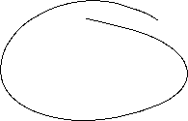

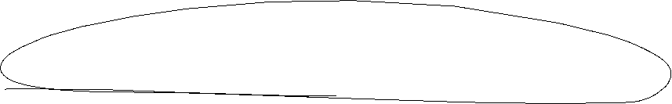
External Economies of Scales: Reasons
Knowledge externalities
Knowledge is an important production factor in highly innovative industries.
The specialised knowledge that determines success in innovative industries comes from research and
development work analysing the design of third-party products
the informal exchange of information and ideas
These spill-over effects are more likely to occur in clusters

Slide 19
External Economies of Scale and Trade
A country with large-scale production in a particular industry usually has
low production costs for the good in question.
Foreign trade expands the market and leads to a lower price due to increasing economies of scale
Countries that are large producers in certain sectors from the outset usually remain so even if another country has the potential to produce these goods more cheaply.

Slide 20









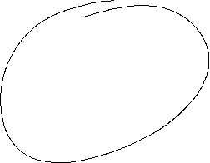


External Economies of Scale
↑ Number of firms
→ ↑ Output
→ ↓ Average Costs
→ falling demand curve cuts the falling average cost curve due to external economies of scale
Equilibrium
Costs
price
p*
AC=Supply
Demand D
x*
x

Slide 21






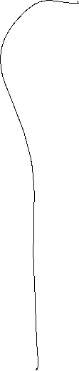

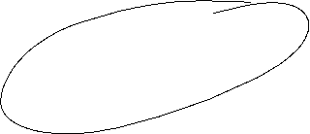



External Economies of Scale and Trade
Watches
Thailand
Switzerland
AC
P
AC
P
$\overline{AC}$_{THAI}
p_{THAI}
AC_{CH}
AC_{THAI}
D_{THAI}
D_{Welt}
x
x

Slide 22

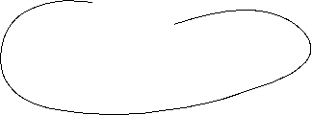
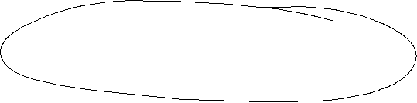

Examples of external economies of scale
    New York/Frankfurt: Investment Banking/Financial sector
    Silicon Valley: Digitale Technologiies
    Hollywood/Bollywood: Movies
    Historical Example: “Musecon Valley” Until WW II Klingenthal und Graslitz (Kraslice) were leaders in manufactoring musical instruments with small and medium-sized companies
Clustering
Starting point for an economic geographic analysis

Slide 23
External Economies of Scale and Welfare
Foreign trade based on external economies of scale is less clear in its impact on national welfare than foreign trade caused by comparative advantages or economies of scale at the firm level.
External economies of scale mean that historical development and chance can play a decisive role in the formation of the trade pattern.

Slide 24








External Economies of Scale and Trade
“When an industry has thus chosen a locality for itself, it is likely
to stay there long: so great are the advantages which people
following the same skilled trade get from near neighborhood to
one another. The mysteries of the trade become no mysteries;
but are as it were in the air,... Good work is rightly appreciated,
inventions and improvements in machinery, in processes and the
general organization of the business have their merits promptly
discussed: if one man starts a new idea, it is taken up by others
and combined with suggestions of their own; and thus it becomes
the source of further new ideas.
Marshall (Principles of Economics, London: MacMillan, 1920)

Slide 25

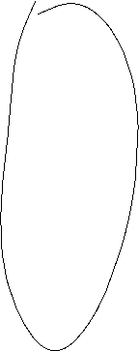


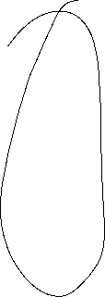
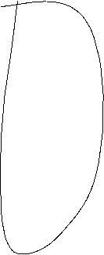

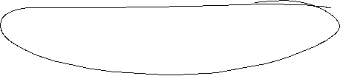
Intra-Industry-Trade Germany – USA
Quelle: Destatis, eigene Berechnungen
The Grubel-Lloyd Index is used as a measure of the split between inter- and intra-industry trade:
GLI = 1 means that exports and imports are balanced in an industry and there is therefore a high level of intra-industry trade!
GLI → 0 means that either exports significantly exceed imports, or vice versa. This means that trade is primarily in one direction only and is inter-industry trade
Grubel-Lloyd-Index: $GLI=1−\left[\frac{|Export−Import|}{Export+Import}\right]$

Slide 26
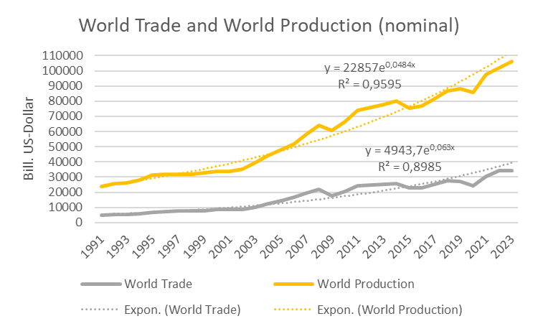

World Trade and World Production (nominal)
Source:
World Bank

Slide 27
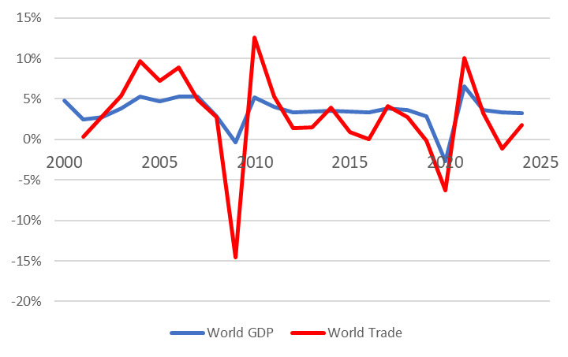



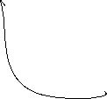










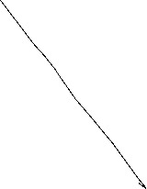


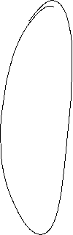
World Trade and World Production (real)
Quelle: IMF, CPB, own calculation

Slide 28
Global trade relations
Quelle: World Bank, own calculation
Openess: (Ex+Im)/GDP

Slide 29
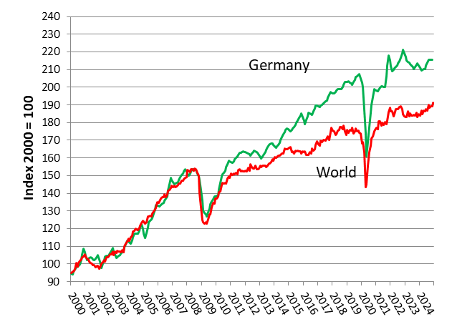
International Trade Germany vs World (real)
Source: Destatis, CPB

Slide 30
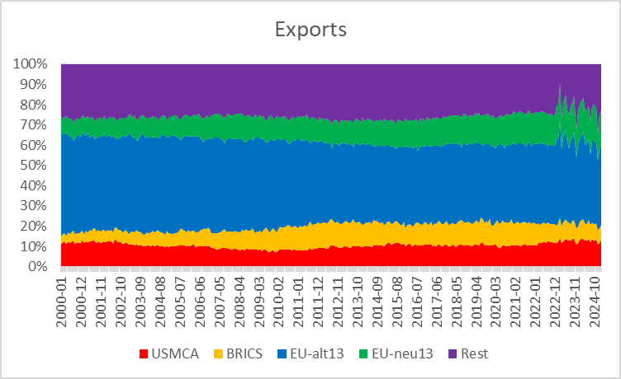
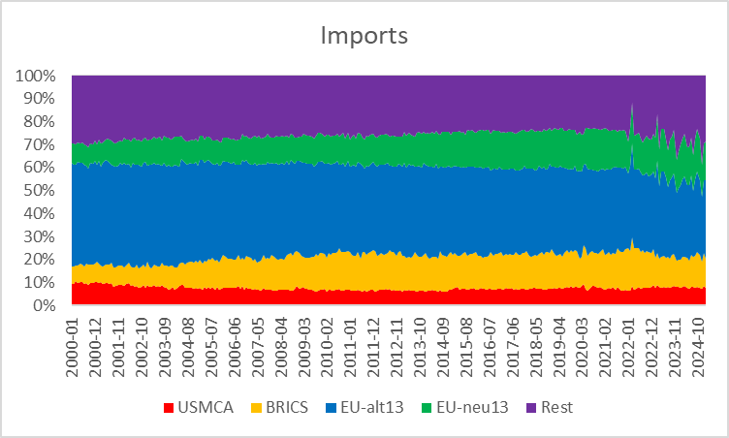
German Trade Regions
USMCA: USA, Mexiko, Kanada; BRICS: Brasilien, Rußland, Portugal, China, Südafrika
EU-alt: BEL, DNK, FIN, FRA, GRE, IRL, ITA, LUX, NDL, AUT, POR, SWE, ESP
EU-neu: BUL, EST, CRO, LET, LIT, MLT, POL, ROM, SVL, SLO, CZE, HUN, CYP

Slide 31
German Trade
Quelle: Destatis

Slide 32
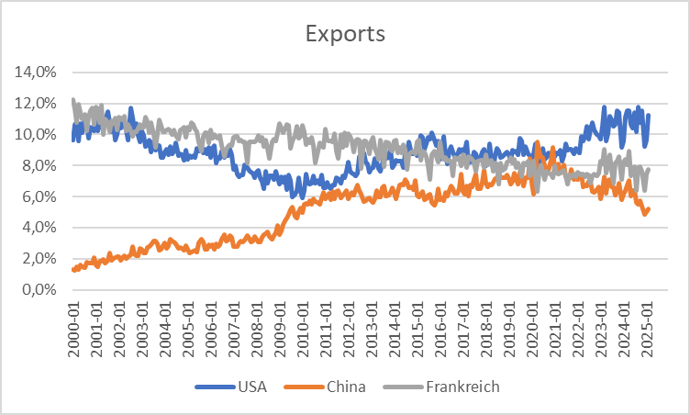
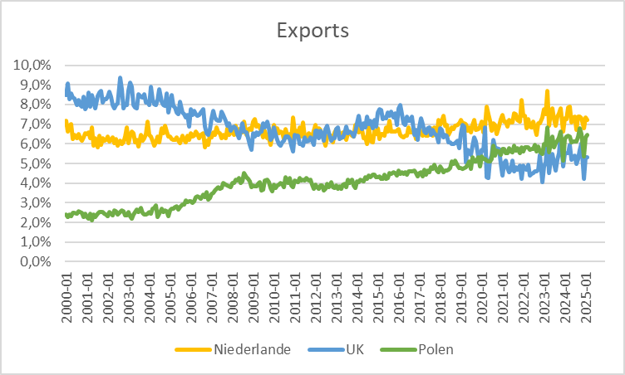
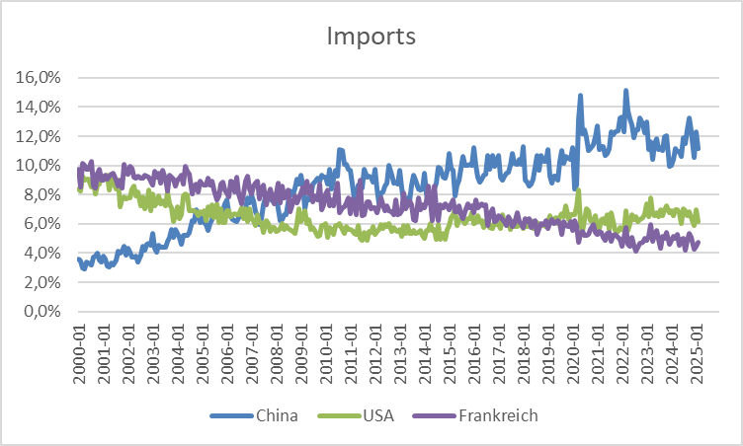
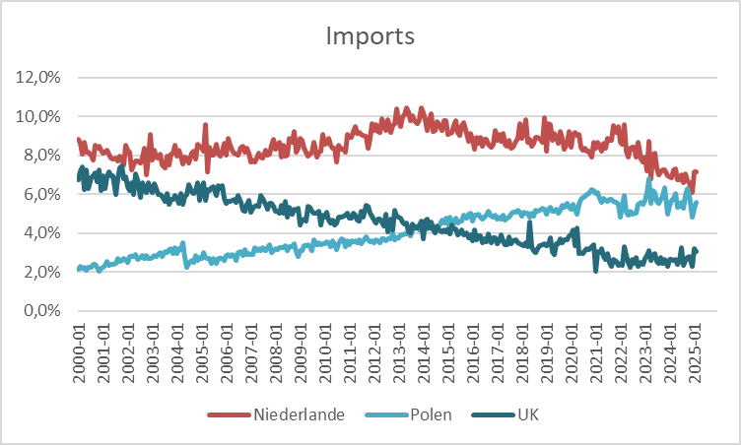
German Trade
Quelle: Destatis

Slide 33
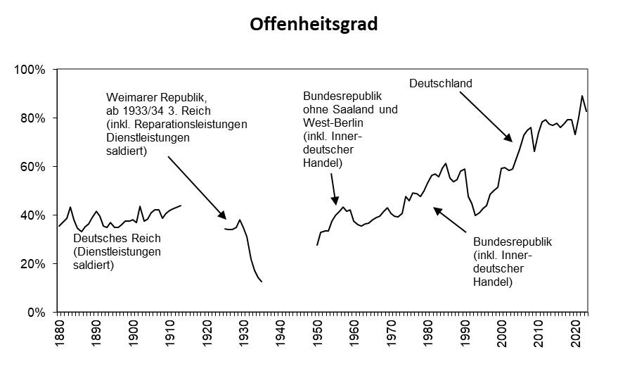
Germany Openess (Ex+Im)/GDP
Quelle: Statistisches Bundesamt, Hoffmann

Slide 34
20 largest Economies (GDP) with their largest trading partners
Source: ITC

Slide 35
Internationale Trade
Quelle: World Bank, eigene Berechnungen
Openess: (Ex+Im)/GDP

Slide 36
Game theory – Nash Equilibrium
A Nash equilibrium is a combination of strategies in which each player chooses a strategy in which no player has an incentive to be the only one to deviate from their chosen strategy.

Slide 37
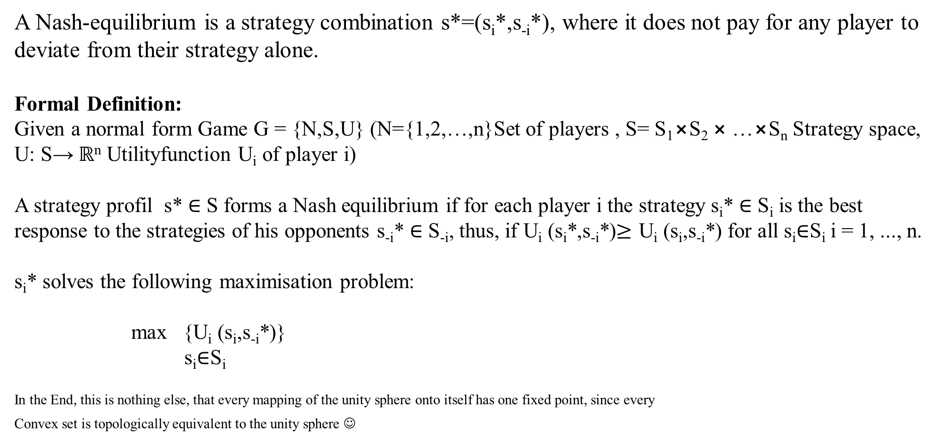
Nash-Equlibrium
Dissertation
Nash, John F. (1950) Equilibrium Points in n-Person Games, PNAS January 1, 1950 36 (1) 48-49
A Nash-equilibrium is a strategy combination s*=(s_{i}*,s_{-i}*), where it does not pay for any player to deviate from their strategy alone.
Formal Definition:
Given a normal form Game G = {N,S,U} (N={1,2,…,n}Set of players , S= S₁$⨯$S₂ $⨯$…$⨯$S_{n} Strategy space, U: S→ $ℝ$^{n} Utilityfunction U_{i} of player i)
A strategy profil s* ∈ S forms a Nash equilibrium if for each player i the strategy s_{i}* ∈ S_{i} is the best response to the strategies of his opponents s_{‑i}* ∈ S_{-i}, thus, if U_{i} (s_{i}*,s_{-i}*)≥ U_{i} (s_{i},s_{-i}*) for all s_{i}∈S_{i} i = 1, ..., n.
s_{i}* solves the following maximisation problem:
max {U_{i} (s_{i},s_{-i}*)}
s_{i}∈S_{i}
In the End, this is nothing else, that every mapping of the unity sphere onto itself has one fixed point, since every
Convex set is topologically equivalent to the unity sphere ☺

Slide 38
Example: Prisoners Dilemma and Trade war
Pay-off matrix: (USA, EU)
EU USA |  | Free Trade | Import barriers
 | Free Trade | (10 Mrd. $,10 Mrd. $) | (-10 Mrd. $,20 Mrd. $)
 | Import barriers | (20 Mrd. $,-10 Mrd. $) | (-5 Mrd. $,-5 Mrd. $)

Slide 39
Trade policy – International approach
International negotiations can mobilize exporters to support free trade if they believe that this will increase their sales markets.
Such a policy can counteract a policy of foreclosure through import restrictions imposed by lobby groups.

Slide 40
Trade policy – International approach
International negotiations can prevent trade wars in which countries hinder each other with trade restrictions.
  A trade war can arise if each country has an incentive to introduce restrictions, regardless of what the other country does.
    This can lead to the result that each country introduces restrictions, although it would be in the interest of all countries to achieve the situation of free trade.
      The trading partners need an agreement that prevents trade restrictions.

Slide 41
Prisoners Dilemma
    An excellent example of how to make money with the game-theoretical understanding of the prisoner's dilemma can be found in the English game show Golden Balls
        https://www.youtube.com/watch?v=S0qjK3TWZE8
    Tatort
      „Wir – Ihr – Sie“
      https://www.daserste.de/unterhaltung/krimi/tatort/sendung/wir-ihr-sie-104.html

Slide 42
Trade Conflicts: Another Approach!
There does not always have to be a clear balance or the possibility of a pareto-better state.
Example
See
Internationale Handelskonflikte: eine verhaltensökonomische Analyse
(2024 Köster, Bernhard und Mühe, Felix)
WiSt -- Wirtschaftswissenschaftliches Studium, Heft 5-2024, 26 -- 32
 |  | Country B
 |  | Accept given rule | Setting new rule
Country A | Accept given rule | ( 4 , 4 ) | ( 2 , 8 )
 | Setting new rule | ( 10 , 0 ) | ( -2 ,- 4 )

