Slide 1




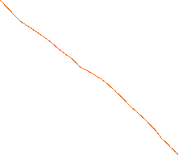



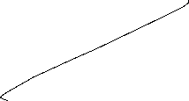









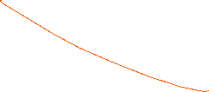
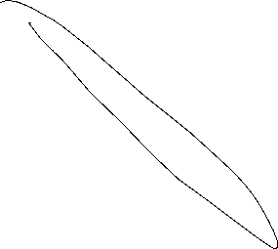

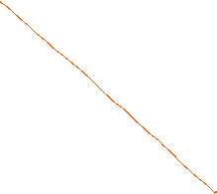





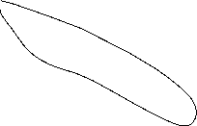



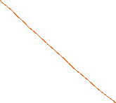
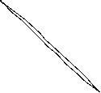




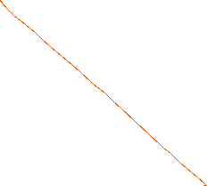





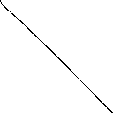












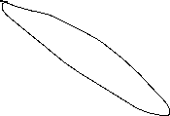







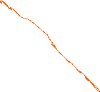

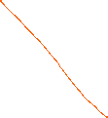










International Trade und Policy
Wilhelmshaven
This lecture will be recorded and
Subsequently uploaded in the
world-wide-web
Prof. Dr. Bernhard Köster
Jade-Hochschule Wilhelmshaven
http://www.bernhardkoester.de/vorlesungen/inhalt.html

Slide 2
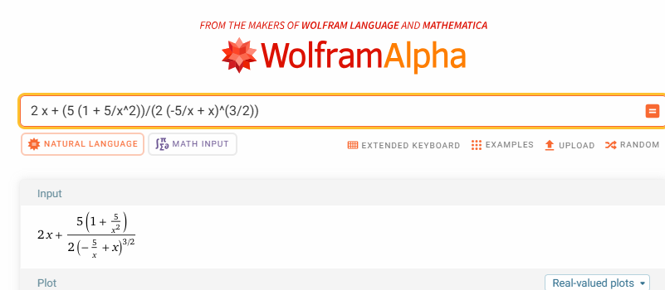














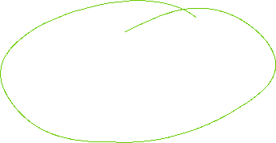
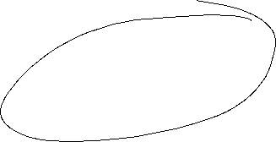
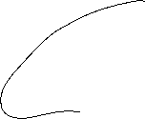

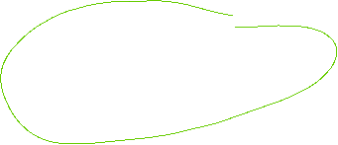



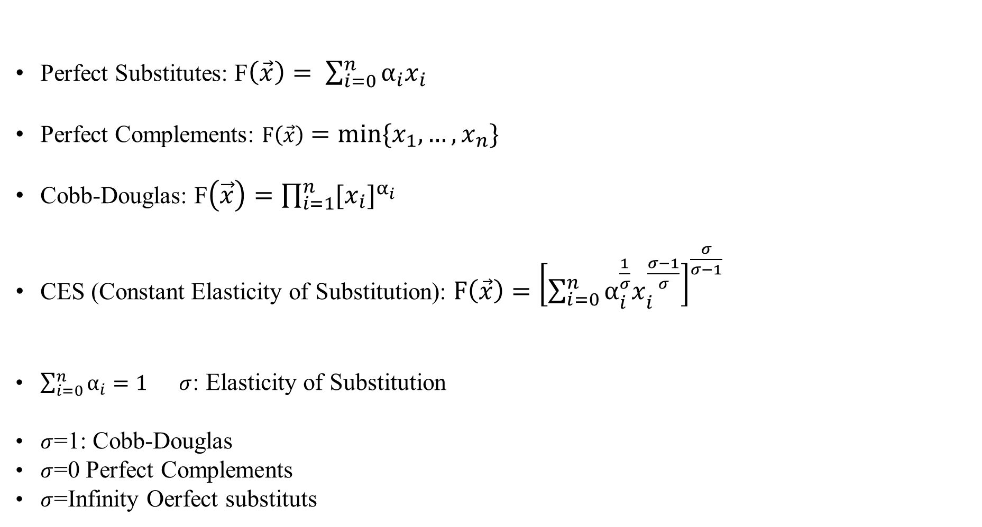







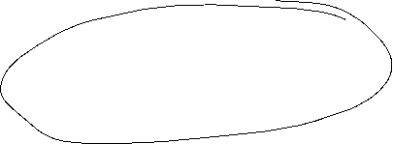

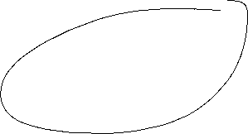








Production Functions
Perfect Substitutes: F$\left(\vec{x}\right)= \sum_{i=0}^{n}{α_{i}x_{i}}$
Perfect Complements: $F\left(\vec{x}\right)={min⁡\{x}_{1},…,x_{n}\}$
Cobb-Douglas: $\text{F}\left(\vec{x}\right)=\prod_{i=1}^{n}{{{[x}_{i}]}^{α_{i}}}$
CES (Constant Elasticity of Substitution): $F\left(\vec{x}\right)={\left[\sum_{i=0}^{n}{α_{i}^{\frac{1}{σ}}x_{i}^{\frac{σ−1}{σ}}}\right]}^{\frac{σ}{σ−1}}$
$\sum_{i=0}^{n}{α_{i}=1}$ $σ$: Elasticity of Substitution
$σ$=1: Cobb-Douglas
$σ$=0 Perfect Complements
$σ$=Infinity Oerfect substituts

Slide 3
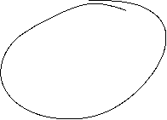
Perfect Substitutes: F$\left(\vec{x}\right)= \sum_{i=0}^{n}{α_{i}x_{i}}$
Perfect Complements: $F\left(\vec{x}\right)={min⁡\{x}_{1},…,x_{n}\}$
Cobb-Douglas: $\text{F}\left(\vec{x}\right)=\prod_{i=1}^{n}{{{[x}_{i}]}^{α_{i}}}$
CES (Constant Elasticity of Substitution): $F\left(\vec{x}\right)={\left[\sum_{i=0}^{n}{α_{i}^{\frac{1}{σ}}x_{i}^{\frac{σ−1}{σ}}}\right]}^{\frac{σ}{σ−1}}$
$\sum_{i=0}^{n}{α_{i}=1}$ $σ$: Elasticity of Substitution
$σ$=1: Cobb-Douglas
$σ$=0 Perfect Complements
$σ$=Infinity Oerfect substituts

Slide 4
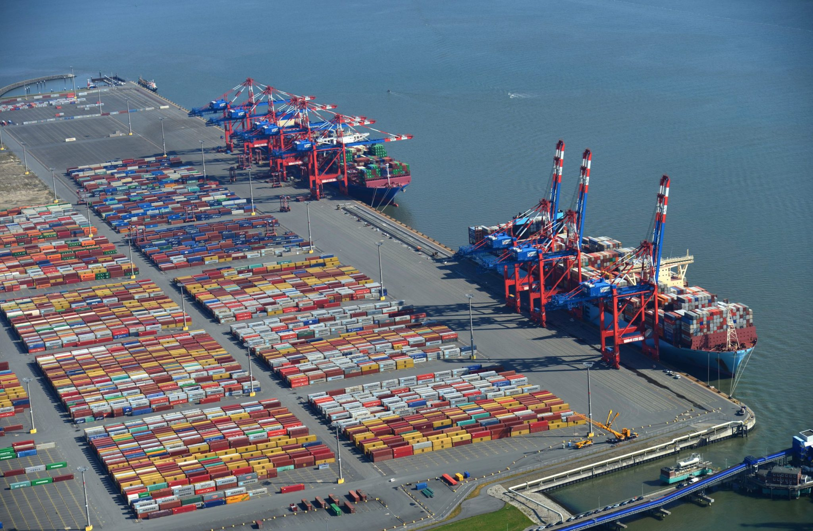


Proction Functions
De Risking and Decoupling of International Trade: New times Investment decisions
Dr. Jörg Rahn Tertium Family office/ Dr. Wolfgang Kornprobst Siemens
  15th of May 10:15 – 11:45
Jade Weser Port Thursday 22th of May 10:30 around 2-3 hours

Slide 5
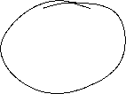


Trade Policy Instruments
Tariffs and Quota
Small country
Model of general trade

Slide 6









Traiffs and quotas in a small country
Assumptions:
Small country relative to the global market
Normal demand and supply structure on the domestic market
Completely price-elastic supply on the global market

Slide 7
Tariff: Small country
p
P_{w}
x

Slide 8


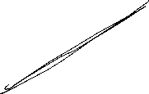





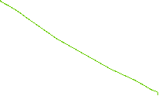
























Tariff: Small country
p
P_{w}
x

Slide 9





















Tariff: Small country
p
P_{w}
x

Slide 10
Zoll: kleines Land (Zusammenassung)
Effects:
A: Producers Surplus ↑
A+B+C+D: Cosumers Surplus ↓
C: Tariff revenue ↑
B + D: Change in Welfare ↓
P
Supply
P_{w}+t (tarif)
A
B
C
D
P_{w}
Demand
IM
X

Slide 11














Import quota: Small country
p
P_{w}
x

Slide 12
Import quota: Small country
Effects:
A: Producers Surplus ↑
A+B+ C`+C``+D : Cosumers Surplus ↓
C`+C``: Quota rent ↑
B + D: Change in Welfare ↓
P
Supply S
Supply S`
p_{w}^{Q}
A
B
C`
D
C``
P_{w}
Demand D
{
{
X
Import quota Q
IM

Slide 13


Differences between tariffs and quota
In general, the effects of tariffs and quotas are the same, but they differ in their practical effects:
Rent seeking: lobby expenditure to obtain an import quota ties up resources, whereas with a tariff all market participants can calculate directly with the surcharge
A quota has a direct influence on the quantity, whereas with a tariff the effect can only be estimated due to a demand structure that is unknown in principle
The tariff has a direct price effect, whereas the price is only indirectly influenced by a quota.

Slide 14
Model of general trade
The supply and demand structure of a trading partner has a relevant size relative to the world market
To simplify matters, only two countries A and B are considered.
W.o.l.g. we assume, that we have higher equilibrium price of the good in country A than in country B in the case without trade relations

Slide 15







Equlibrium on the world market
Country A
World market
Country B
P
,P
P
S
S*
D
D*
X
X
X

Slide 16
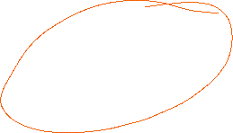








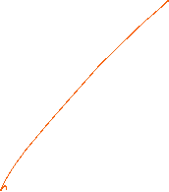


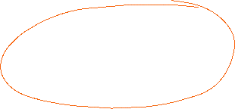
Tariff on the world market
Country A
World market
Country B
P
P
P
S
S*
S^{W}
D
D^{W}
D*
X
X
X

Slide 17
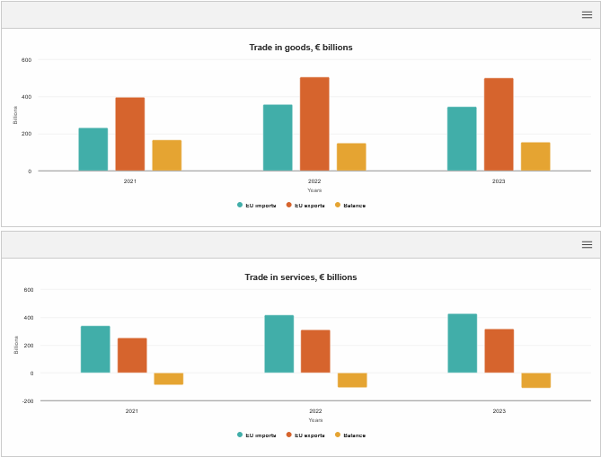















Reciprocal tariffs on the world market of two similar countries trading two goods with similar volumes
Country A
World market
Country B
P
S
,P
P
S^{W}
S*
D
D^{W}
D*
X
X
X
Country A
World market
Country B
P
,P
P
S
S*
S^{W}
D*
D^{W}
D
X
X
X
https://policy.trade.ec.europa.eu/eu-trade-relationships-country-and-region/countries-and-regions/united-states_en

Slide 18
Reciprocal tariffs on the world market of two similar countries trading two goods with similar volumes
https://ocw.mit.edu/courses/14-581-international-economics-i-spring-2013/download/

