Slide 1






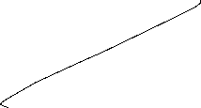







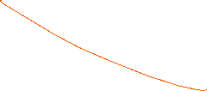
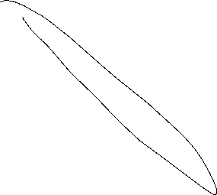

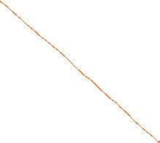









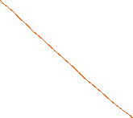
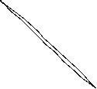




























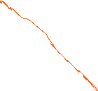

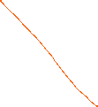









International Trade und Policy
Wilhelmshaven
This lecture will be recorded and
Subsequently uploaded in the
world-wide-web
Prof. Dr. Bernhard Köster
Jade-Hochschule Wilhelmshaven
http://www.bernhardkoester.de/vorlesungen/inhalt.html

Slide 2







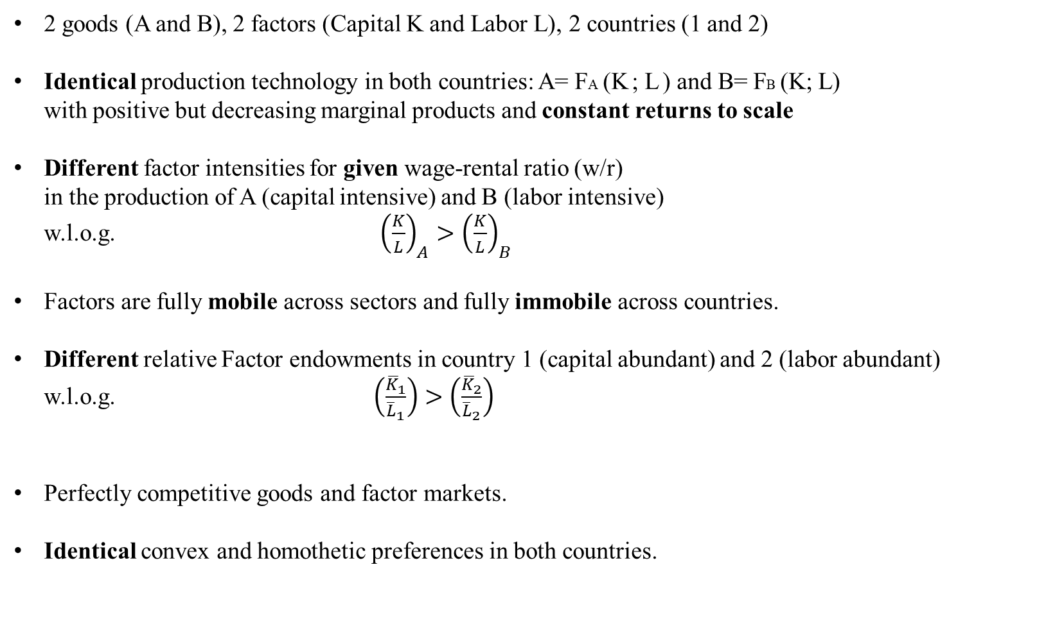
Heckscher Ohlin Model
2 goods (A and B), 2 factors (Capital K and Labor L), 2 countries (1 and 2)
Identical production technology in both countries: A= FA (K ; L ) and B= FB (K; L) with positive but decreasing marginal products and constant returns to scale
Different factor intensities for given wage-rental ratio (w/r) in the production of A (capital intensive) and B (labor intensive) w.l.o.g. ${\left(\frac{K}{L}\right)}_{A}>{\left(\frac{K}{L}\right)}_{B}$
Factors are fully mobile across sectors and fully immobile across countries.
Different relative Factor endowments in country 1 (capital abundant) and 2 (labor abundant) w.l.o.g. $\left(\frac{{\overline{K}}_{1}}{{\overline{L}}_{1}}\right)>\left(\frac{{\overline{K}}_{2}}{{\overline{L}}_{2}}\right)$
Perfectly competitive goods and factor markets.
Identical convex and homothetic preferences in both countries.

Slide 3
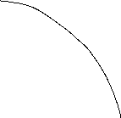









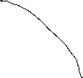








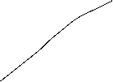
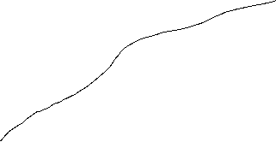



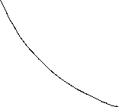




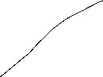
Heckscher Ohlin Model – Cost Minimization – Factor Intensities – Factor Price Ratios -- Edgeworth Box

Slide 4
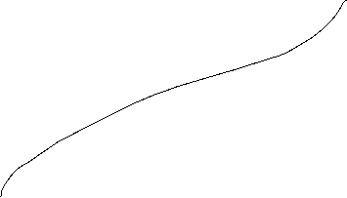





Heckscher Ohlin Model – Contract Curve – Transformation curve

Slide 5


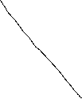




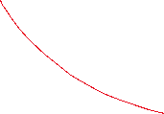









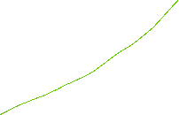












Heckscher Ohlin Model – Factor Market Clearing – Autarky Equilibrium – relative Supply

Slide 6


Heckscher Ohlin Model – Trade Equilibrium

Slide 7
Heckscher Ohlin Model – Factor price equalization theorem
If two countries are engaged in free trade, have identical technologies, and produce both goods, then they must have the same factor prices

Slide 8
Heckscher Ohlin Model – Rybczynski theorem
For given relative goods prices, an increase in the endowment of a factor will increase the output of the industry using this factor intensively and decrease the output of the other industry

Slide 9
Heckscher Ohlin Model – Heckscher Ohlin Theorem
A country exports the good which uses its abundant factor intensively.

Slide 10
































Heckscher Ohlin Model – Stolper Samuelson theorem
An increase in the relative price of a good will increase the real return to the factor used intensively in the production of that good, and reduce the real return to the other factor, in terms of both goods

Slide 11
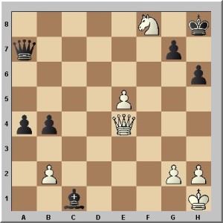











Slide 12






























Stolper-Samuelson

Slide 13






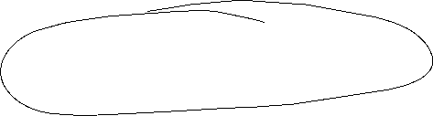






Heckscher Ohlin Model – Overall Effects
Heckscher Ohlin theorem + Stolper Samuelson theorem implies that
  the owners of the abundant factor gain and
  the owners of the scarce factor lose from trade
The gains from trade for the winners is lager than the losses of the losers
  There exists as in the specific factors model a compensation mechanism for an overall gain
The overall gains follows similar to the Ricardian and the specific factors model from the reason that consumption possibilities are larger under trade than under autarky because production and consumption choices then no longer have to coincide
In all three models, the main reason for the gains from trade is comparative advantage

Slide 14
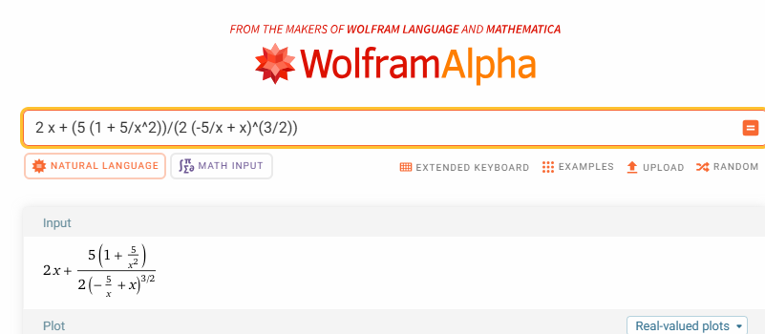





























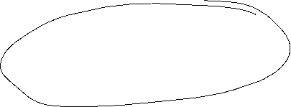










Production Functions
Perfect Substitutes: F$\left(\vec{x}\right)= \sum_{i=0}^{n}{α_{i}x_{i}}$
Perfect Complements: $F\left(\vec{x}\right)={min⁡\{x}_{1},…,x_{n}\}$
Cobb-Douglas: $\text{F}\left(\vec{x}\right)=\prod_{i=1}^{n}{{{[x}_{i}]}^{α_{i}}}$
CES (Constant Elasticity of Substitution): $F\left(\vec{x}\right)={\left[\sum_{i=0}^{n}{α_{i}^{\frac{1}{σ}}x_{i}^{\frac{σ−1}{σ}}}\right]}^{\frac{σ}{σ−1}}$
$\sum_{i=0}^{n}{α_{i}=1}$ $σ$: Elasticity of Substitution
$σ$=1: Cobb-Douglas
$σ$=0 Perfect Complements
$σ$=Infinity Oerfect substituts

Slide 15
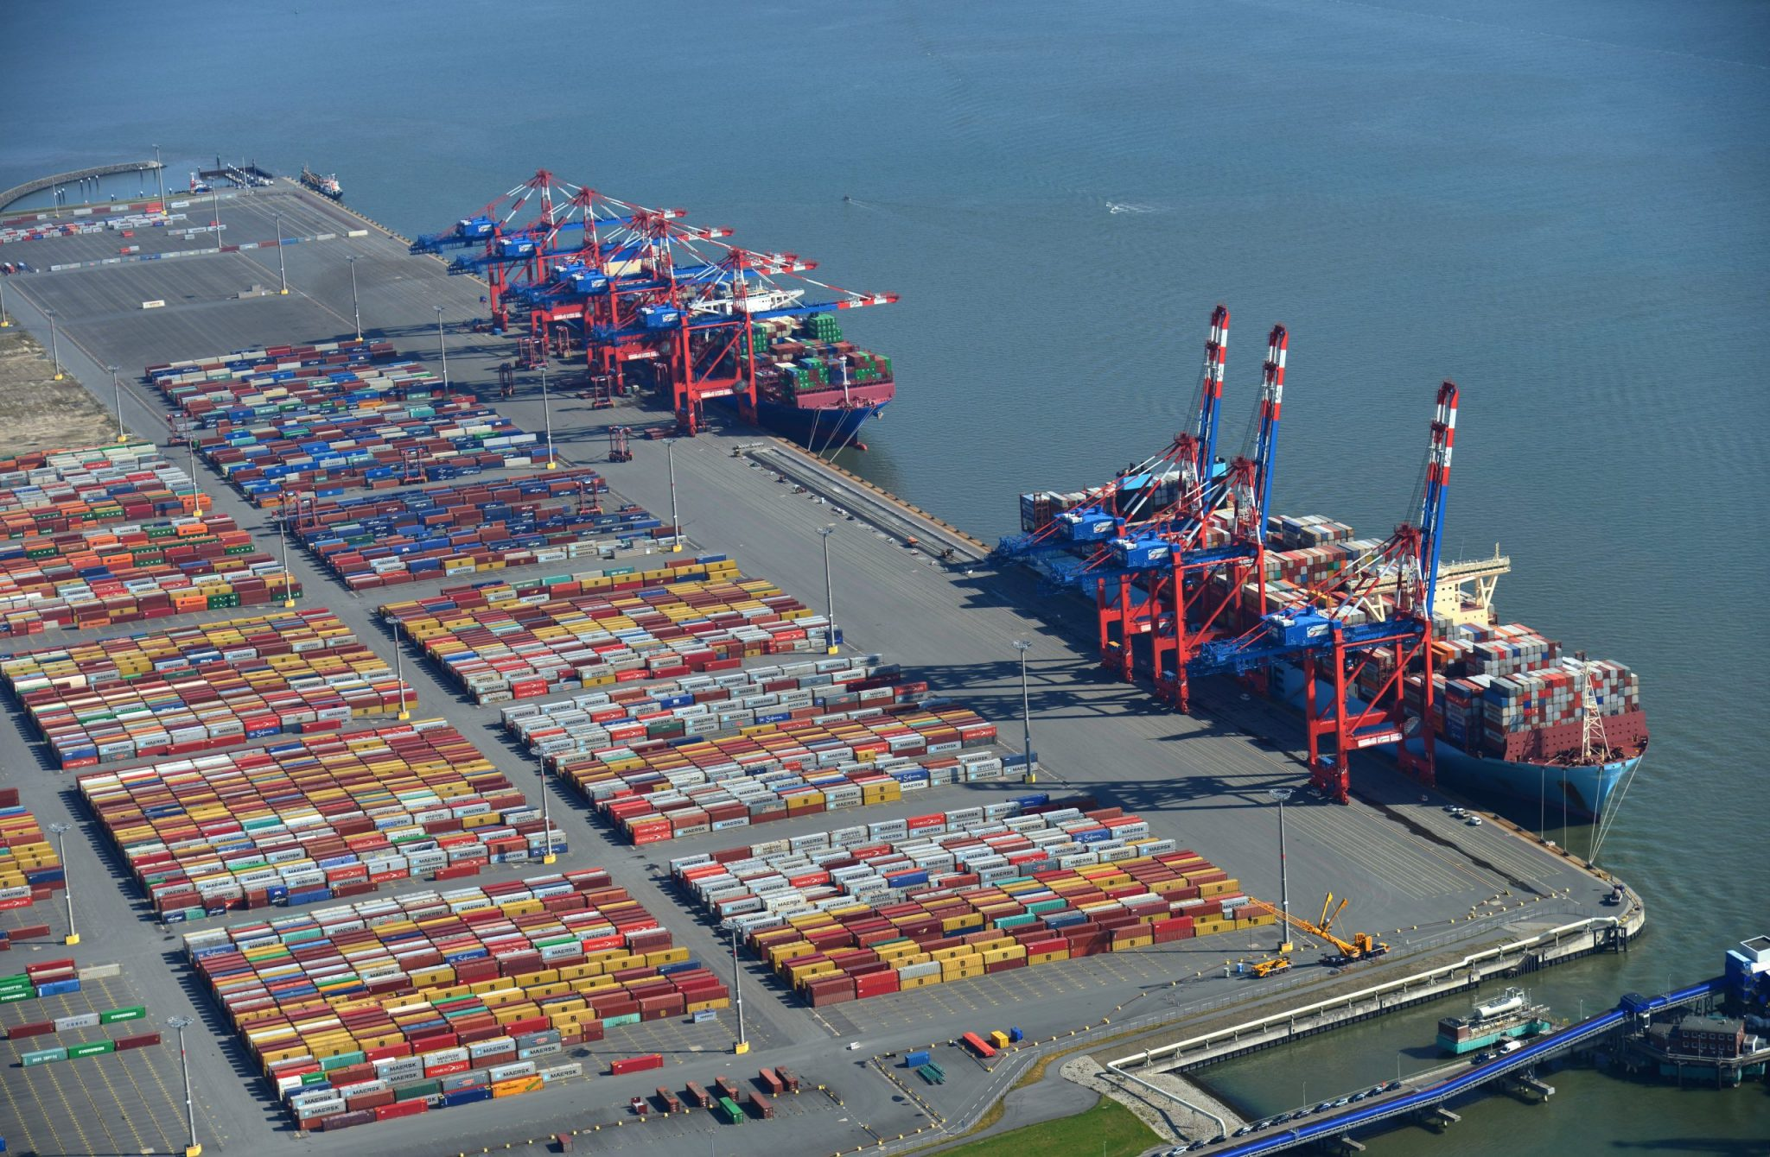


Proction Functions
De Risking and Decoupling of International Trade: New times Investment decisions
Dr. Jörg Rahn Tertium Family office/ Dr. Wolfgang Kornprobst Siemens
  15/22th of May 10:15 – 11:45
Jade Weser Port Thursday 15/22th of May 10:30 around 2-3 hours

Slide 16
Trade Policy Instruments
Tariffs and Quota
Small country
Model of general trade

Slide 17
Traiffs and quotas in a small country
Assumptions:
Small country relative to the global market
Normal demand and supply structure on the domestic market
Completely price-elastic supply on the global market

Slide 18
Tariff: Small country
p
P_{w}
x

Slide 19
Zoll: kleines Land (Zusammenassung)
Effects:
A: Producers Surplus ↑
A+B+C+D: Cosumers Surplus ↓
C: Tariff revenue ↑
B + D: Change in Welfare ↓
P
Supply
P_{w}+t (tarif)
A
B
C
D
P_{w}
Demand
IM
X

Slide 20
Import quota: Small country
p
P_{w}
x

Slide 21
Import quota: Small country
Effects:
A: Producers Surplus ↑
A+B+ C`+C``+D : Cosumers Surplus ↓
C`+C``: Quota rent ↑
B + D: Change in Welfare ↓
P
Supply S
Supply S`
p_{w}^{Q}
A
B
C`
D
C``
P_{w}
Demand D
{
{
X
Import quota Q
IM

Slide 22
Differences between tariffs and quota
In general, the effects of tariffs and quotas are the same, but they differ in their practical effects:
Rent seeking: lobby expenditure to obtain an import quota ties up resources, whereas with a tariff all market participants can calculate directly with the surcharge
A quota has a direct influence on the quantity, whereas with a tariff the effect can only be estimated due to a demand structure that is unknown in principle
The tariff has a direct price effect, whereas the price is only indirectly influenced by a quota.

Slide 23
Model of general trade
The supply and demand structure of a trading partner has a relevant size relative to the world market
To simplify matters, only two countries A and B are considered.
W.o.l.g. we assume, that we have higher equilibrium price of the good in country A than in country B in the case without trade relations

Slide 24
Equlibrium on the world market
Country A
Weltmarkt
Country B
P
,P
P
S
S*
D
D*
X
X
X

Slide 25
Tariff on the world market
Country A
World market
Country B
P
P
P
S
S*
S^{W}
D
D^{W}
D*
X
X
X

Slide 26
Tariff on the world market
Country A
World market
Country B
P
,P
P
S
S*
S^{W}
D
D^{W}
D*
X
X
X
Country A
World market
Country B
P
,P
P
S*
S
S^{W}
D*
D^{W}
D
X
X
X

Slide 27
Reciprocal tariffs on the world market of two similar countries trading two goods with similar volumes

