Slide 1

Statistics B
Wilhelmshaven
This lecture will be recorded and
subsequently uploaded in the
world-wide-web
Function translator (webpage)
Function translator Excel 1 (add in)
c
Prof. Dr. Bernhard Köster
Jade-Hochschule Wilhelmshaven
http://www.bernhardkoester.de/vorlesungen/inhalt.html

Slide 2

(Advanced) Statistics B
c
Winter Term 2024
Prof. Dr. Bernhard Köster

Slide 3
Prof. Dr. Bernhard Köster
Room: S 113
Street: Friedrich-Paffrath-Straße 101
location: 26389 Wilhelmshaven
Tel. +49 4421 985-2766
Email: bernhard.koester@jade-hs.de
Consultation hour: by arrangement
or just have a look into my office!
or Webex/Zoom …
c

Slide 4
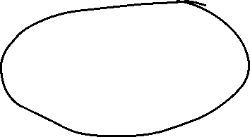
Literature
Statistics for Business and Economics, Anderson, Sweeney, Williams, Camm, Cochran
Mathematical Statistics for Economics and Business, Mittelhammer
Statistics for Business and Economics, Global Edition, Newbold, Thorne, Carlson
A Guide to Modern Econometrics, Verbeek
Applied Econometrics, Asteriou and Hall
Econometrics by Example, Gujarati, D.
Linear Regression Analysis: Theory and Computing, Yan and Gang Su
Some open access resources
  OpenIntro Statistics
  Statistical Thinking for the 21st Century
  MIT OPENCOURSEWARE
→ there is much more! Search the net in a sensible way !
c

Slide 5
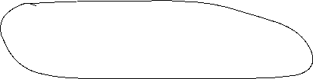
Content
Revision Random Variables
Descriptive Statistics
  Parameters of a distribtion
Linear Regression
  Simple and multilinear
  Hypothesis testing
  Multicollinarity
  Heteroskedasticity
  Autocorrelation
Inequality metrics
Time series analysis
  Price adjustment
  Forecasting
    Moving average
    Exponential smoothing
    Average growth rate
    Simple seasonal adjustment
c

Slide 6
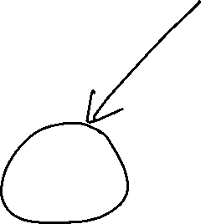
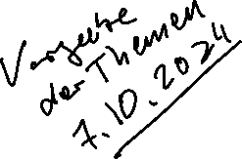
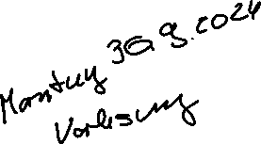
Berufungsvorträge
Professur:
VWL & International Economics
Montag 30.09.2024
8:15 – 8:45 S122
10:15 – 10:45 S421

Slide 7
Presentation for an Professurship:
International Economics
Monday 30.09.2024
8:15 – 8:45 S122
10:15 – 10:45 S421

Slide 8

^{Random Variable}
Definition:
A Random Variable X is the mapping of the sample space Ω into the real numbers R. That means every elementary event A_{i} maps onto a real number x_{i} and the probability p_{i} = P(A_{i}) = P(X=x_{i}) = p(x_{i}) is known.
→ p_{i} ist the probality that random variable X equals the outcome x_{i}.
c

Slide 9
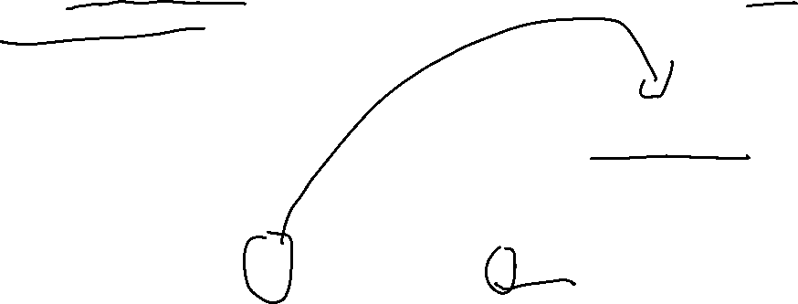
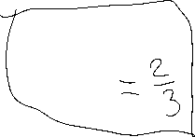
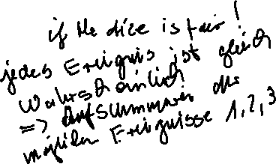
Random Variable – Explainations
Every possible event of a random experiment can be expressed via a random variable.
Random variables are expressed in capital letters.
Example: dice with sample space X is element of {1,2,3,4,5,6}
The realization of a random variable is expressed in lowercase letters:
Example rolling dice: X realizes the value x = 5
Probality in the example of rolling dice:
P(x < 5) = ??
c

Slide 10
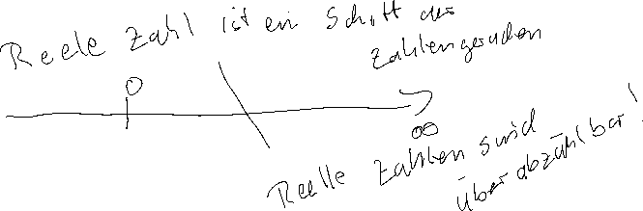
Discrete and continous random variables (RV)
Discrete RV:
RV, which have only a finite or countably infinite realizations.
Continous RV:
RV which can realize within an intervall every possible real number.
c

Slide 11

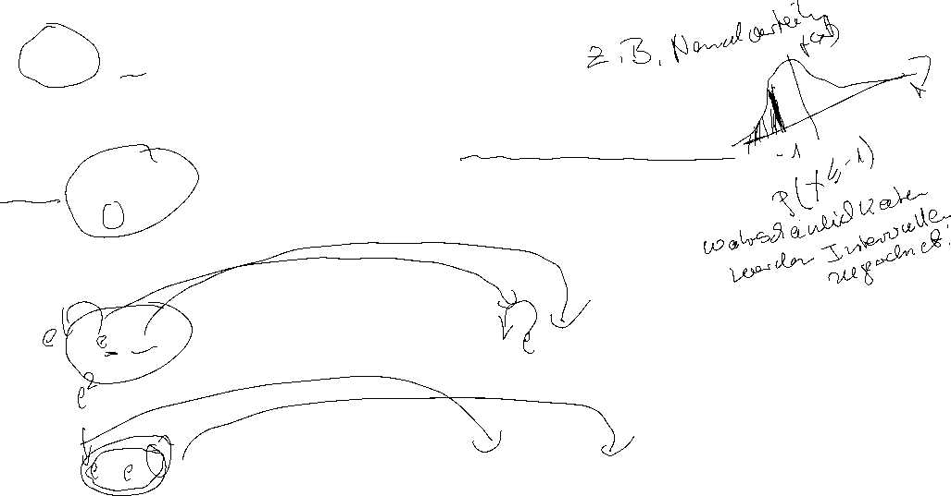
Discret
Probability mass function:
Cumulative distribution function:
Expected value:
Variance:
Continous
Probability density function:
Cumulative distribution function:
Expected value :
Variance:
c

Slide 12
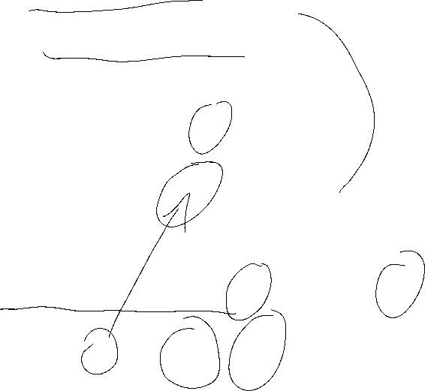
Calculating with Expectated Value and Variance
Constant:
Constant factor:
Linear Transformation:
c

Slide 13
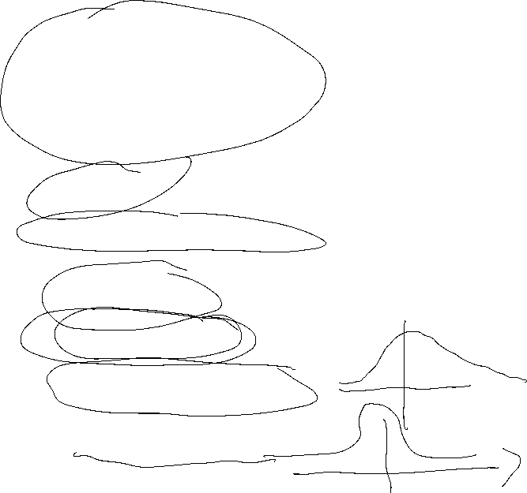

Sample Parameters
Median
Arithmetic mean (first moment)
Geometric mean
Harmonic mean
Range
Mean absolute deviation
Sample Variance: biased and unbiased (second moment)
Standard deviation
Skewness (third moment)
Kurtosis (fourth moment)
c

Slide 14

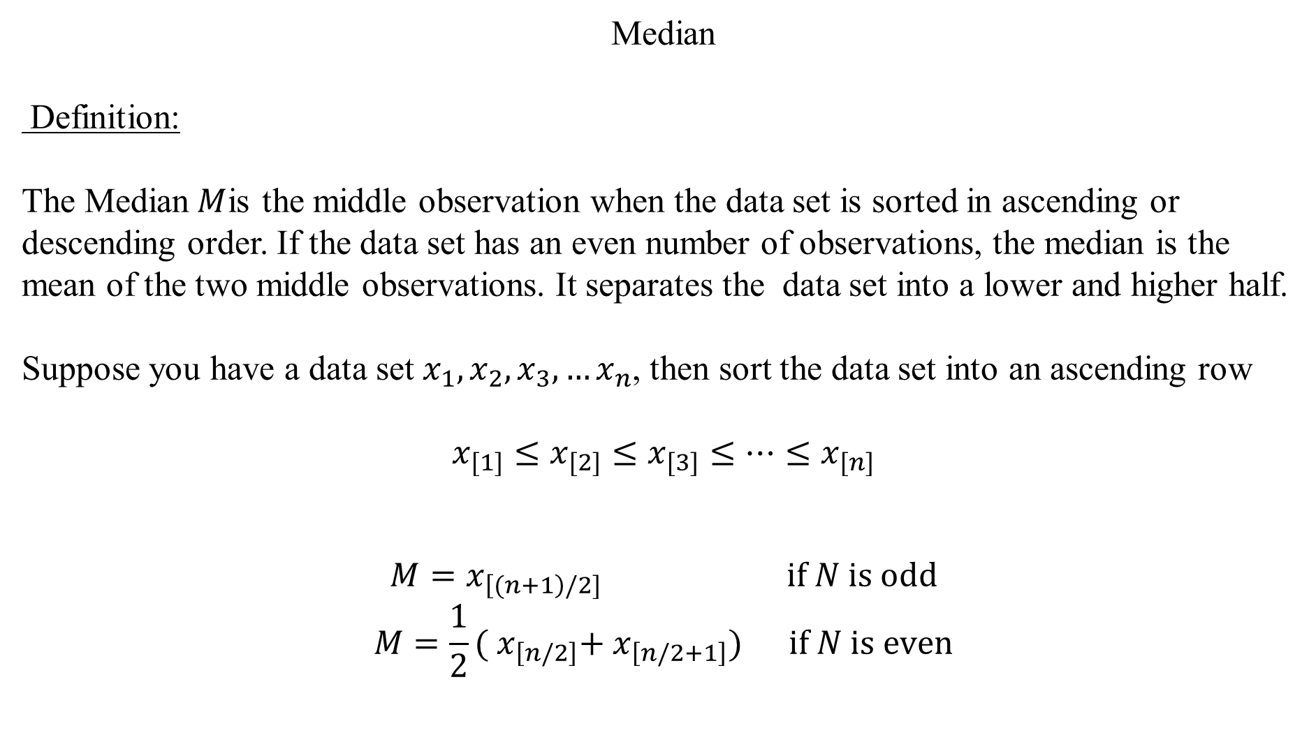



Median
Definition:
The Median$M$is the middle observation when the data set is sorted in ascending or descending order. If the data set has an even number of observations, the median is the mean of the two middle observations. It separates the data set into a lower and higher half.
Suppose you have a data set $x_{1},x_{2},x_{3},…x_{n}$, then sort the data set into an ascending row
$$x_{[1]}≤x_{[2]}≤x_{[3]}≤…{≤x}_{[n]}$$
$$M=x_{\left[(n+1\right)/2]} \text{if} N \text{is} \text{odd}$$
$$M=\frac{1}{2}({ x}_{\left[n/2\right]}+{ x}_{\left[n/2+1\right]}) \text{if} N \text{is} \text{even}$$
c

Slide 15







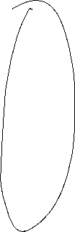

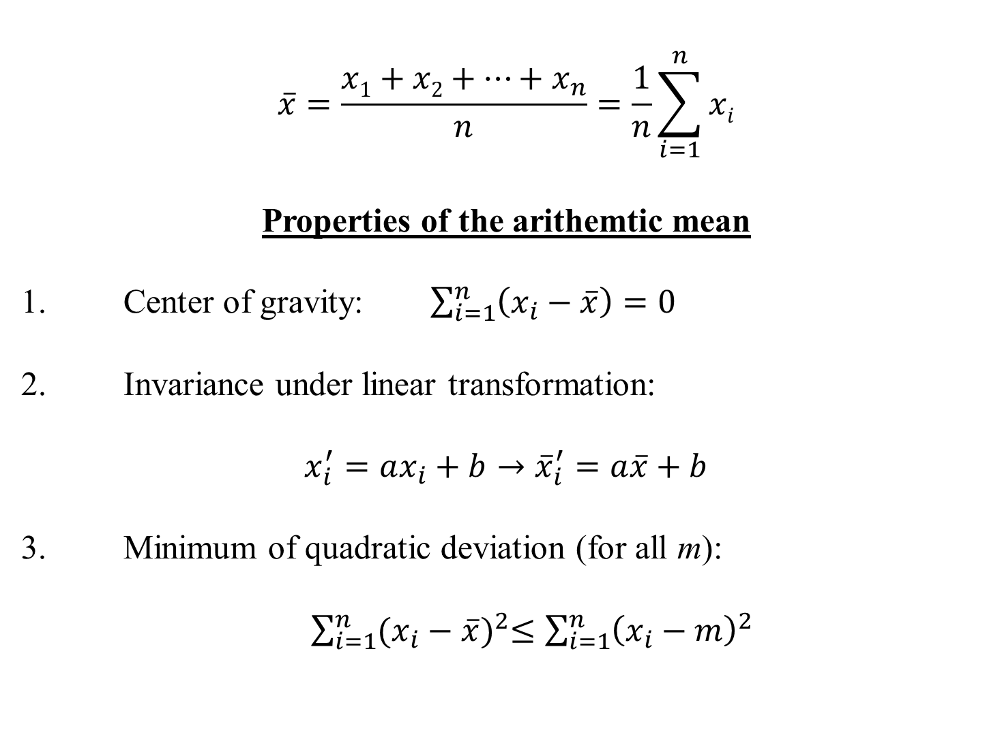





Arithmethic Mean
$$\overline{x}=\frac{x1+x2+…+x_{n}}{n}=\frac{1}{n}\sum_{i=1}^{n}{xi}$$
Properties of the arithemtic mean
1. Center of gravity: $\sum_{i=1}^{n}{\left(x_{i}−\overline{x}\right)=0}$
2. Invariance under linear transformation:
$$x_{i}^{′}=ax_{i}+b→{\overline{x}}_{i}^{′}=a\overline{x}+b$$
3. Minimum of quadratic deviation (for all m):
$\sum_{i=1}^{n}{{(x_{i}−\overline{x})}^{2}≤\sum_{i=1}^{n}{{\left(x_{i}−m\right)}^{2}} }$
c

Slide 16







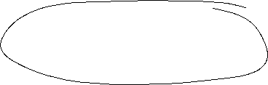


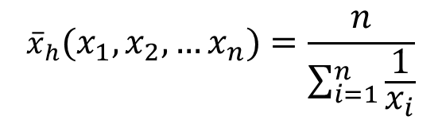



Geometric mean
${\overline{x}}_{g}=\sqrt[n]{{{x_{1}∙x}_{2}∙ … ∙x}_{n}}=({{x_{1}∙x}_{2}∙ … ∙x}_{n})^{\frac{1}{n}}{ x}_{i}>0$
Harmonic mean
$${\overline{x}}_{h}(x_{1},x_{2},…x_{n})=\frac{n}{\sum_{i=1}^{n}{\frac{1}{x_{i}}}}$$
c

Slide 17


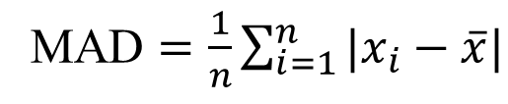


Range
Definition:
The difference between the lowest and highest values of a data set
Mean absolute deviation
c
MAD $=\frac{1}{n}\sum_{i=1}^{n}{|x_{i}−\overline{x}|}$

Slide 18







Variance
  Biased Variance
  $${\tilde{σ}}^{2}=\frac{1}{n}\sum_{i=1}^{n}{{\left(x_{i}−\overline{x}\right)}^{2}}$$
  Unbiased Variance
  $${\hat{σ}}^{2}=\frac{1}{n−1}\sum_{i=1}^{n}{{\left(x_{i}−\overline{x}\right)}^{2}}$$
c

Slide 19
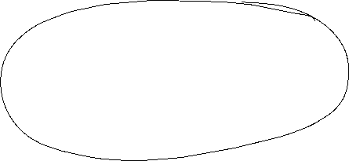



Standard deviation
Uncorrected standard deviation:
$$\tilde{σ}=\sqrt{\frac{1}{n}\sum_{i=1}^{n}{{\left(x_{i}−\overline{x}\right)}^{2}}}$$
Corrected standard deviation:
$$\hat{σ}=\sqrt{\frac{1}{n−1}\sum_{i=1}^{n}{{\left(x_{i}−\overline{x}\right)}^{2}}}$$
c

Slide 20




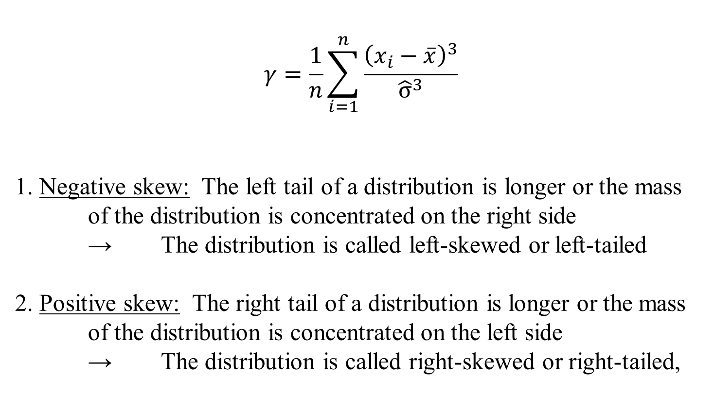




Skewness (third moment)
$$γ=\frac{1}{n}\sum_{i=1}^{n}{\frac{{\left(x_{i}−\overline{x}\right)}^{3}}{{\hat{σ}}^{3}}}$$
1. Negative skew: The left tail of a distribution is longer or the mass of the distribution is concentrated on the right side
→ The distribution is called left-skewed or left-tailed
2. Positive skew: The right tail of a distribution is longer or the mass of the distribution is concentrated on the left side
→ The distribution is called right-skewed or right-tailed,
c

Slide 21
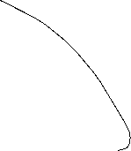
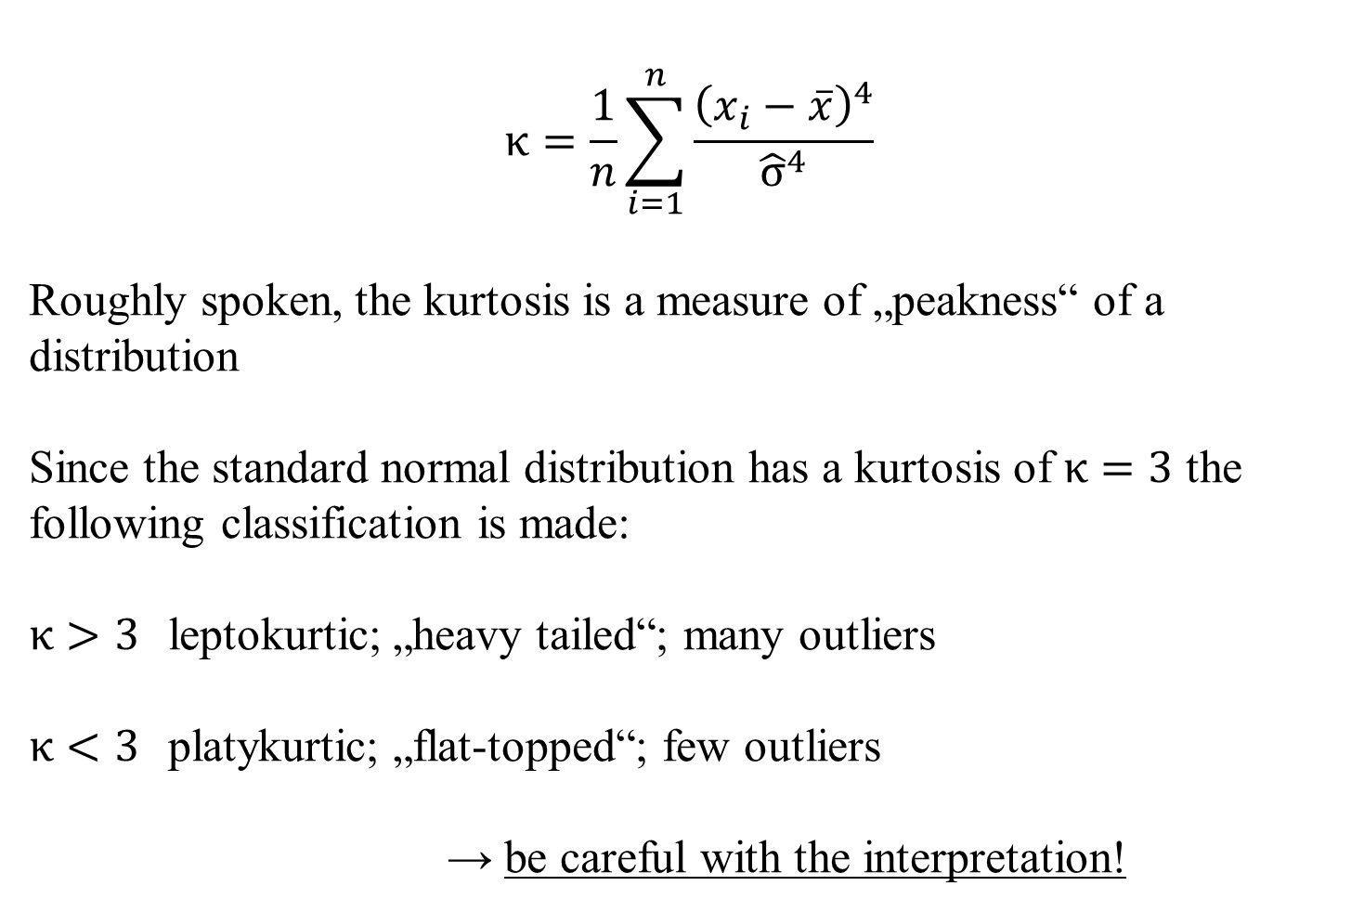



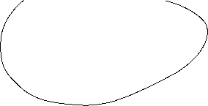


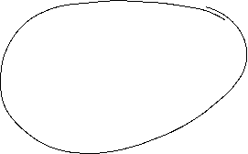
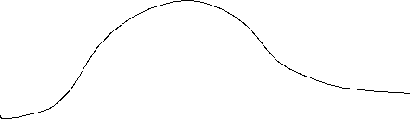
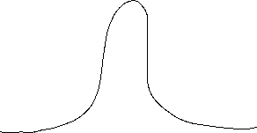

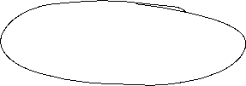
Kurtosis (fourth moment)
$$κ=\frac{1}{n}\sum_{i=1}^{n}{\frac{{\left(x_{i}−\overline{x}\right)}^{4}}{{\hat{σ}}^{4}}}$$
Roughly spoken, the kurtosis is a measure of „peakness“ of a distribution
Since the standard normal distribution has a kurtosis of $κ=3$ the following classification is made:
$κ>3$ leptokurtic; „heavy tailed“; many outliers
$κ<3$ platykurtic; „flat-topped“; few outliers
→ be careful with the interpretation!
c

Slide 22
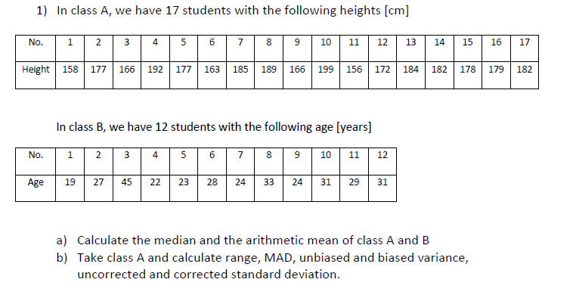





c

Slide 23
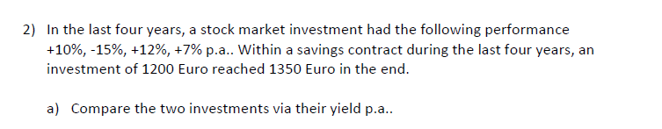

c

Slide 24
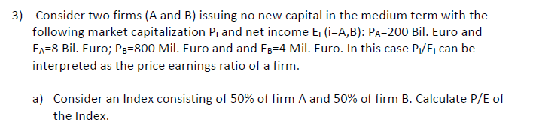




c

Slide 25
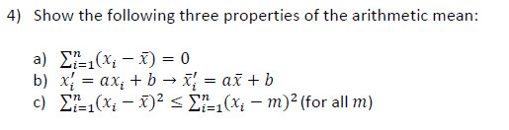



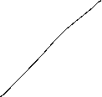






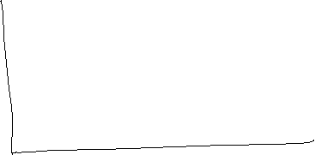



c

Slide 26
c

Slide 27
c

