Slide 1

Statistics B
Wilhelmshaven
This lecture will be recorded and
subsequently uploaded in the
world-wide-web
Function translator (webpage)
Function translator Excel 1 (add in)
c
Prof. Dr. Bernhard Köster
Jade-Hochschule Wilhelmshaven
http://www.bernhardkoester.de/vorlesungen/inhalt.html

Slide 2

(Advanced) Statistics B
c
Winter Term 2023
Prof. Dr. Bernhard Köster

Slide 3
Prof. Dr. Bernhard Köster
Room: S 113
Street: Friedrich-Paffrath-Straße 101
location: 26389 Wilhelmshaven
Tel. +49 4421 985-2766
Email: bernhard.koester@jade-hs.de
Consultation hour: by arrangement
or just have a look into my office!
or Webex/Zoom …
c

Slide 4
Literature
Statistics for Business and Economics, Anderson, Sweeney, Williams, Camm, Cochran
Mathematical Statistics for Economics and Business, Mittelhammer
Statistics for Business and Economics, Global Edition, Newbold, Thorne, Carlson
A Guide to Modern Econometrics, Verbeek
Applied Econometrics, Asteriou and Hall
Econometrics by Example, Gujarati, D.
Linear Regression Analysis: Theory and Computing, Yan and Gang Su
Some open access resources
  OpenIntro Statistics
  Statistical Thinking for the 21st Century
  MIT OPENCOURSEWARE
→ there is much more! Search the net in a sensible way !
c

Slide 5
Content
Revision Random Variables
Descriptive Statistics
  Parameters of a distribtion
Linear Regression
  Simple and multilinear
  Hypothesis testing
  Multicollinarity
  Heteroskedasticity
  Autocorrelation
Inequality metrics
Time series analysis
  Price adjustment
  Forecasting
    Moving average
    Exponential smoothing
    Average growth rate
    Simple seasonal adjustment
c

Slide 6
^{Random Variable}
Definition:
A Random Variable X is the mapping of the sample space Ω into the real numbers R. That means every elementary event A_{i} maps onto a real number x_{i} and the probability p_{i} = P(A_{i}) = P(X=x_{i}) = p(x_{i}) is known.
→ p_{i} ist the probality that random variable X equals the outcome x_{i}.
c

Slide 7



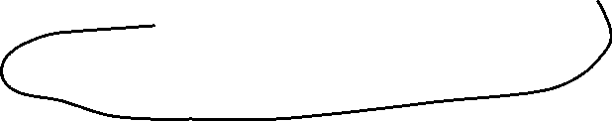
Random Variable – Explainations
Every possible event of a random experiment can be expressed via a random variable.
Random variables are expressed in capital letters.
Example: dice with sample space X is element of {1,2,3,4,5,6}
The realization of a random variable is expressed in lowercase letters:
Example rolling dice: X realizes the value x = 5
Probality in the example of rolling dice:
P(x < 5) = ??
c

Slide 8


Discrete and continous random variables (RV)
Discrete RV:
RV, which have only a finite or countably infinite realizations.
Continous RV:
RV which can realize within an intervall every possible real number.
c

Slide 9


















Discret
Probability mass function:
Cumulative distribution function:
Expected value:
Variance:
Continous
Probability density function:
Cumulative distribution function:
Expected value :
Variance:
c

Slide 10








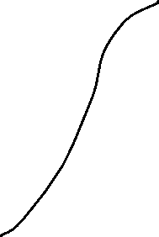

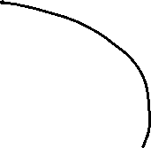









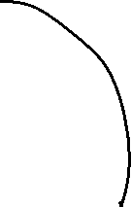




Calculating with Expectated Value and Variance
Constant:
Constant factor:
Linear Transformation:
c

Slide 11

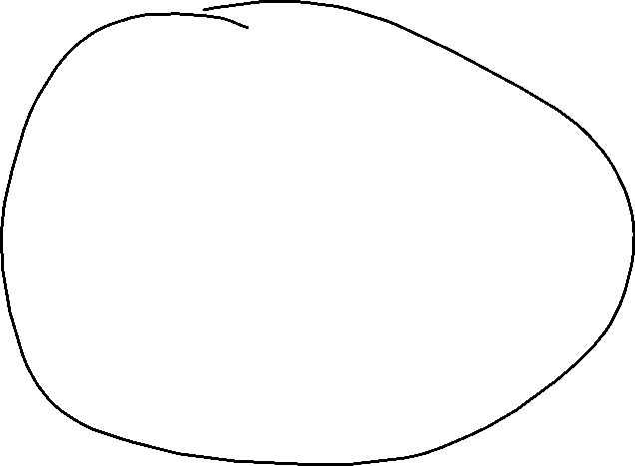






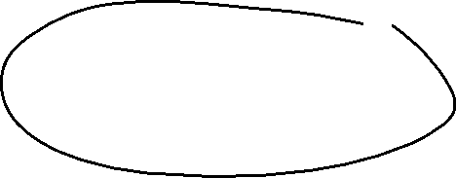


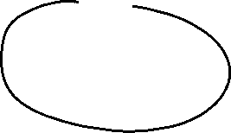

Sample Parameters
Median
Arithmetic mean (first moment)
Geometric mean
Harmonic mean
Range
Mean absolute deviation
Sample Variance: biased and unbiased (second moment)
Standard deviation
Skewness (third moment)
Kurtosis (fourth moment)
c

Slide 12
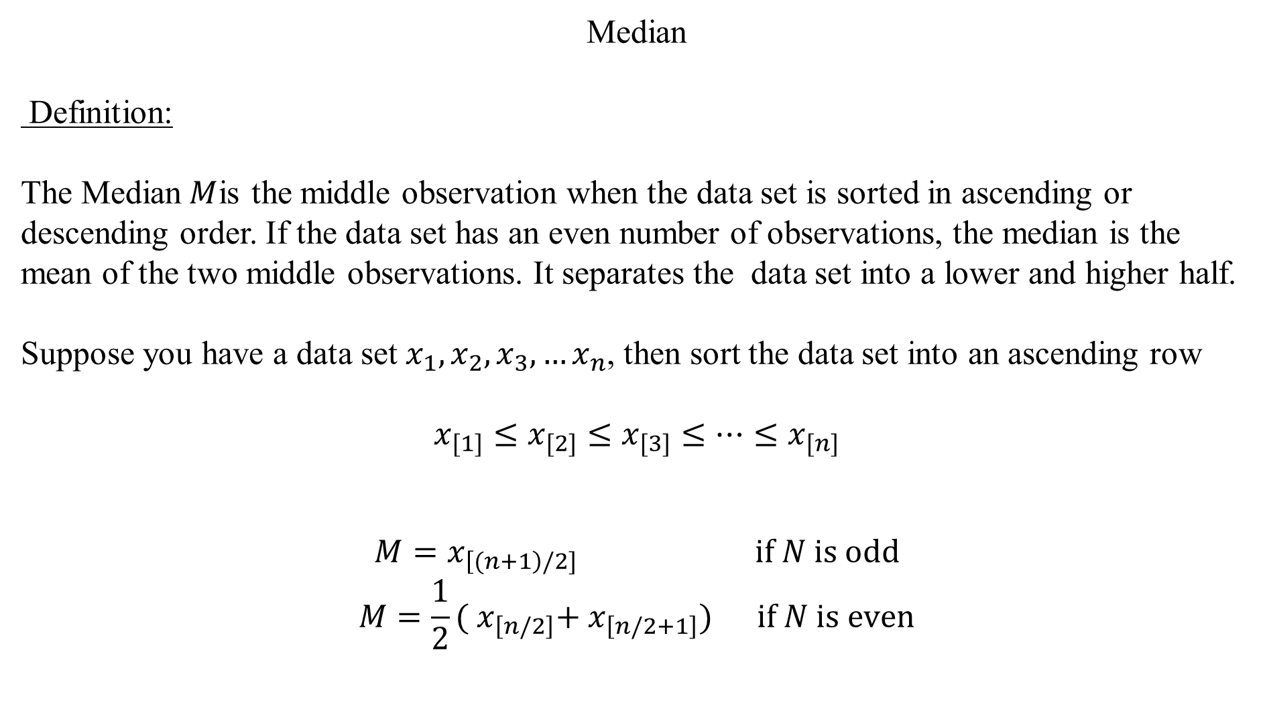
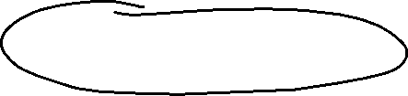
Median
Definition:
The Median$M$is the middle observation when the data set is sorted in ascending or descending order. If the data set has an even number of observations, the median is the mean of the two middle observations. It separates the data set into a lower and higher half.
Suppose you have a data set $x_{1},x_{2},x_{3},…x_{n}$, then sort the data set into an ascending row
$$x_{[1]}≤x_{[2]}≤x_{[3]}≤…{≤x}_{[n]}$$
$$M=x_{\left[(n+1\right)/2]} \text{if} N \text{is} \text{odd}$$
$$M=\frac{1}{2}({ x}_{\left[n/2\right]}+{ x}_{\left[n/2+1\right]}) \text{if} N \text{is} \text{even}$$
c

Slide 13
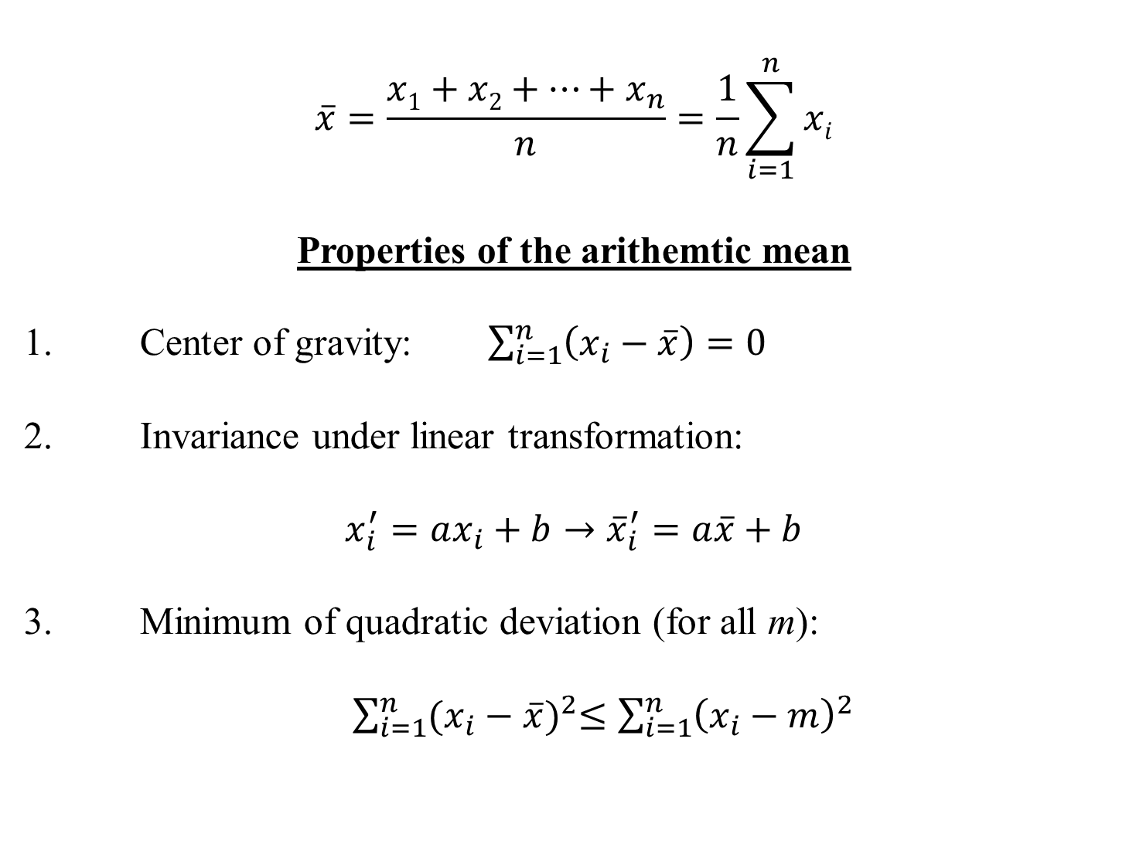
Arithmethic Mean
$$\overline{x}=\frac{x1+x2+…+x_{n}}{n}=\frac{1}{n}\sum_{i=1}^{n}{xi}$$
Properties of the arithemtic mean
1. Center of gravity: $\sum_{i=1}^{n}{\left(x_{i}−\overline{x}\right)=0}$
2. Invariance under linear transformation:
$$x_{i}^{′}=ax_{i}+b→{\overline{x}}_{i}^{′}=a\overline{x}+b$$
3. Minimum of quadratic deviation (for all m):
$\sum_{i=1}^{n}{{(x_{i}−\overline{x})}^{2}≤\sum_{i=1}^{n}{{\left(x_{i}−m\right)}^{2}} }$
c

Slide 14



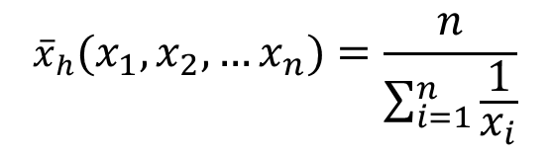

Geometric mean
${\overline{x}}_{g}=\sqrt[n]{{{x_{1}∙x}_{2}∙ … ∙x}_{n}}=({{x_{1}∙x}_{2}∙ … ∙x}_{n})^{\frac{1}{n}}{ x}_{i}>0$
Harmonic mean
$${\overline{x}}_{h}(x_{1},x_{2},…x_{n})=\frac{n}{\sum_{i=1}^{n}{\frac{1}{x_{i}}}}$$
c

Slide 15






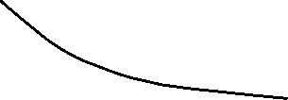









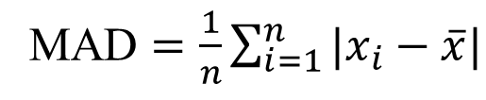







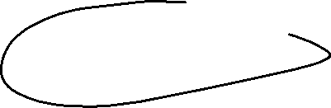


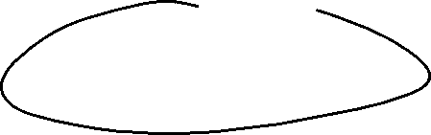


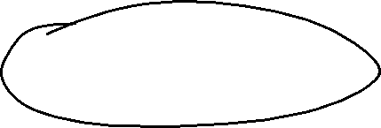
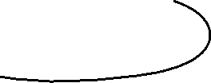
Range
Definition:
The difference between the lowest and highest values of a data set
Mean absolute deviation
c
MAD $=\frac{1}{n}\sum_{i=1}^{n}{|x_{i}−\overline{x}|}$

Slide 16



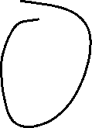

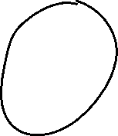



Variance
  Biased Variance
  $${\tilde{σ}}^{2}=\frac{1}{n}\sum_{i=1}^{n}{{\left(x_{i}−\overline{x}\right)}^{2}}$$
  Unbiased Variance
  $${\hat{σ}}^{2}=\frac{1}{n−1}\sum_{i=1}^{n}{{\left(x_{i}−\overline{x}\right)}^{2}}$$
c

Slide 17
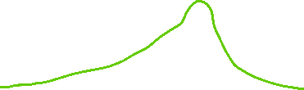


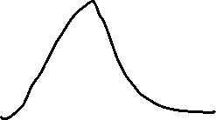


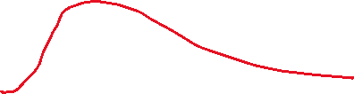




Standard deviation
Uncorrected standard deviation:
$$\tilde{σ}=\sqrt{\frac{1}{n}\sum_{i=1}^{n}{{\left(x_{i}−\overline{x}\right)}^{2}}}$$
Corrected standard deviation:
$$\hat{σ}=\sqrt{\frac{1}{n−1}\sum_{i=1}^{n}{{\left(x_{i}−\overline{x}\right)}^{2}}}$$
c

Slide 18





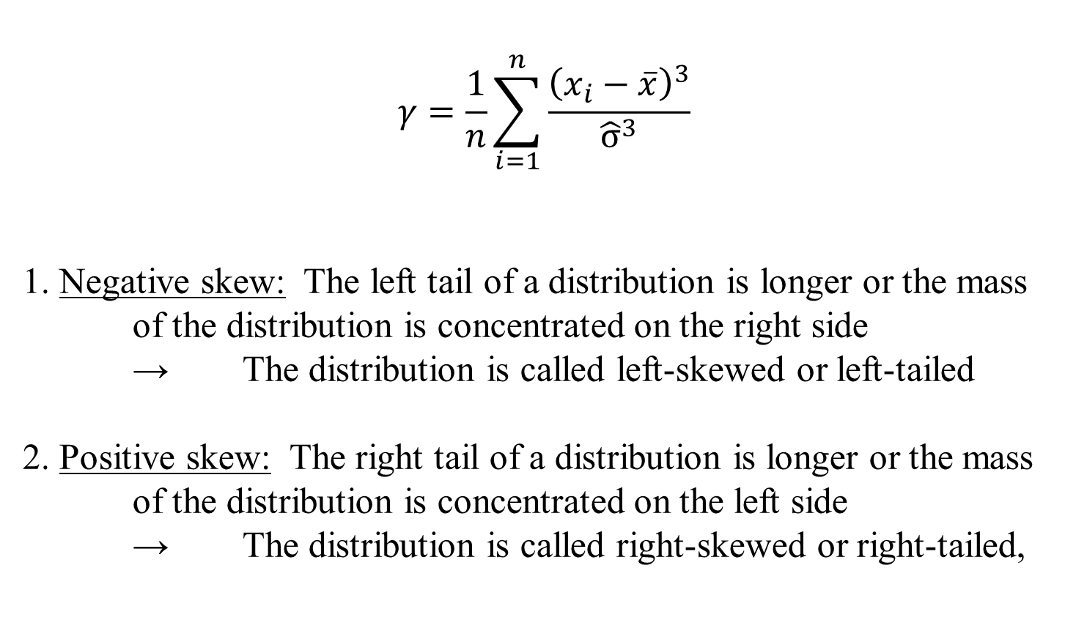

Skewness (third moment)
$$γ=\frac{1}{n}\sum_{i=1}^{n}{\frac{{\left(x_{i}−\overline{x}\right)}^{3}}{{\hat{σ}}^{3}}}$$
1. Negative skew: The left tail of a distribution is longer or the mass of the distribution is concentrated on the right side
→ The distribution is called left-skewed or left-tailed
2. Positive skew: The right tail of a distribution is longer or the mass of the distribution is concentrated on the left side
→ The distribution is called right-skewed or right-tailed,
c

Slide 19
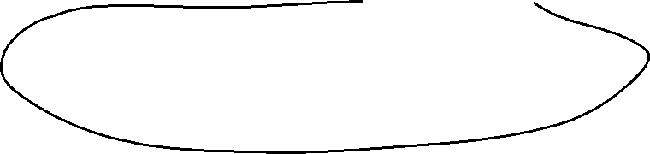
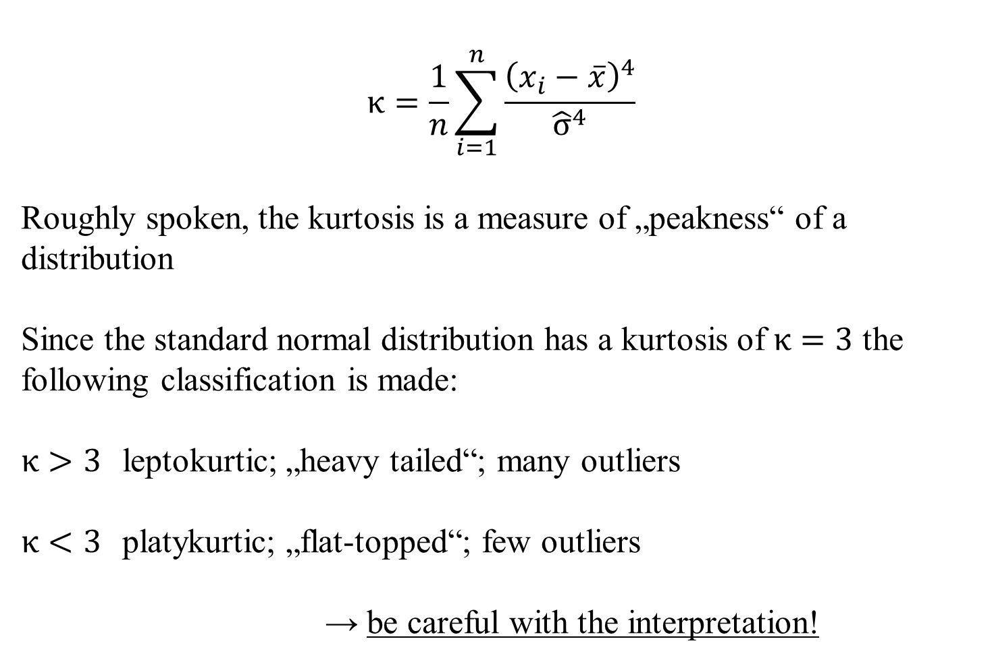

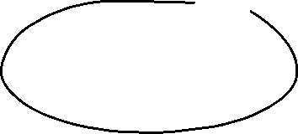


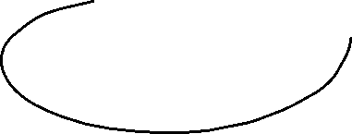
Kurtosis (fourth moment)
$$κ=\frac{1}{n}\sum_{i=1}^{n}{\frac{{\left(x_{i}−\overline{x}\right)}^{4}}{{\hat{σ}}^{4}}}$$
Roughly spoken, the kurtosis is a measure of „peakness“ of a distribution
Since the standard normal distribution has a kurtosis of $κ=3$ the following classification is made:
$κ>3$ leptokurtic; „heavy tailed“; many outliers
$κ<3$ platykurtic; „flat-topped“; few outliers
→ be careful with the interpretation!
c

Slide 20
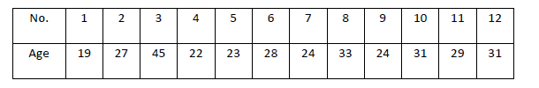


Excercise 1
c

Slide 21
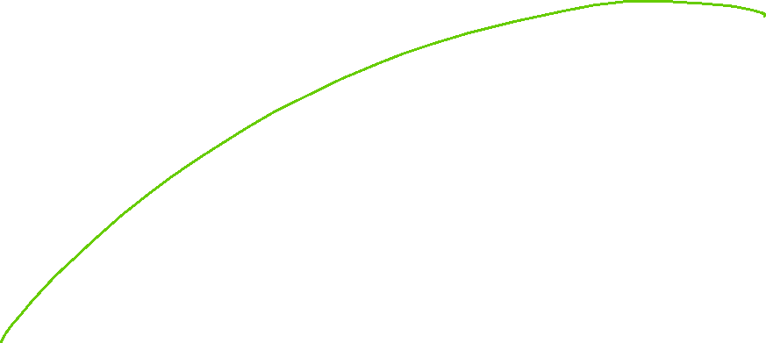










Excercise 1
c

Slide 22















Excercise 1
c

Slide 23












Excercise 1
c

Slide 24






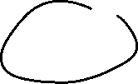






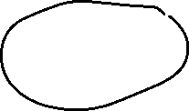
Excercise 1
c

Slide 25


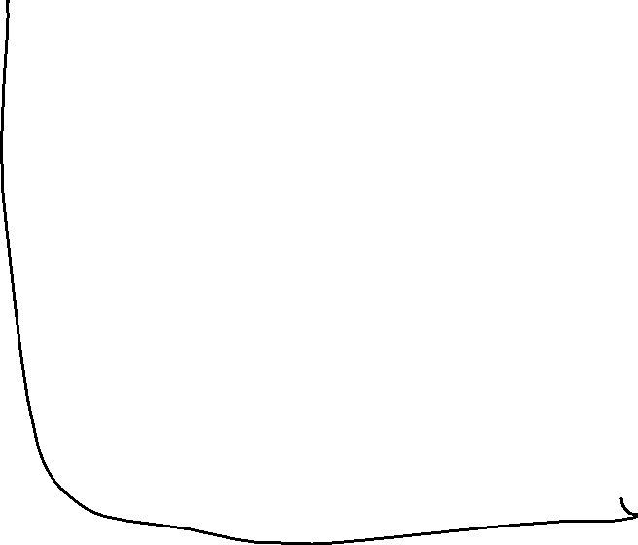

















Excercise 1
c

Slide 26
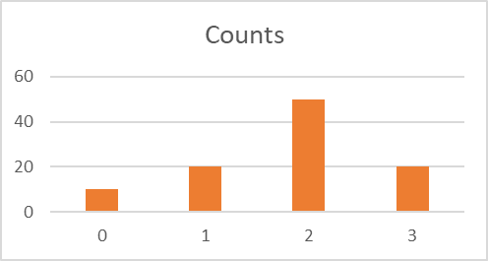
Excercise 1
c

Slide 27

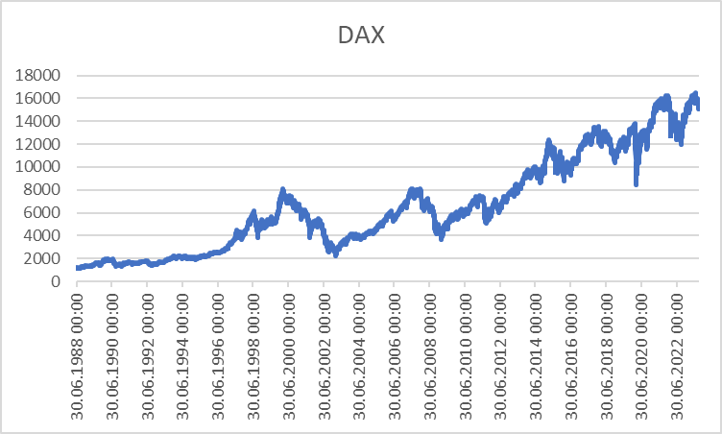
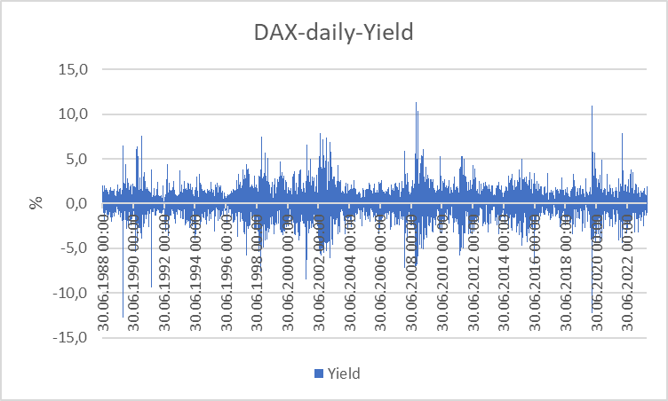
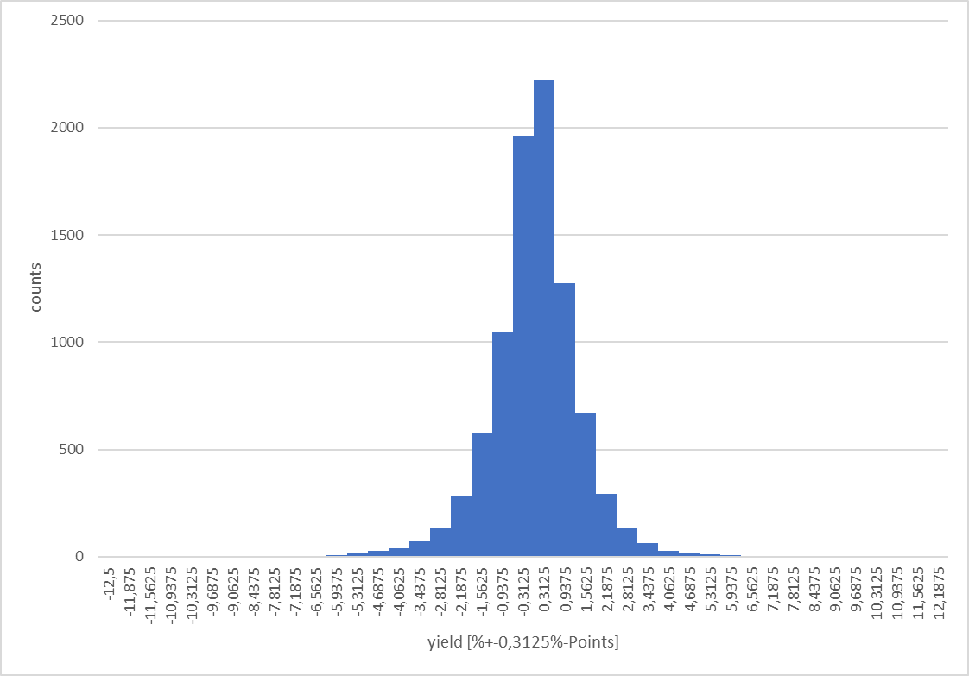
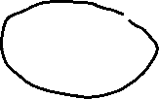










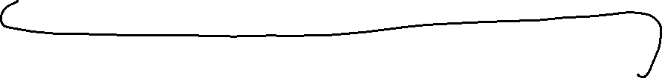

Excercise 1
c

Slide 28
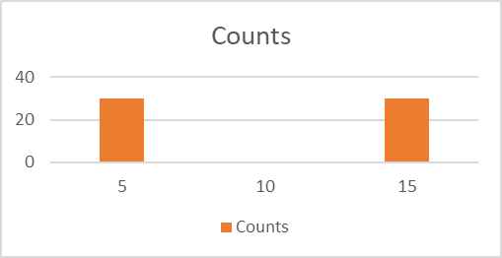
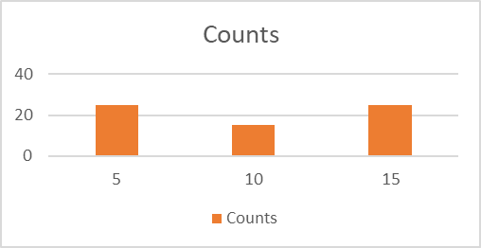
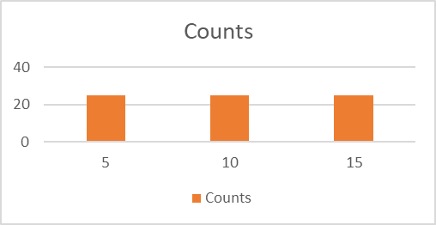
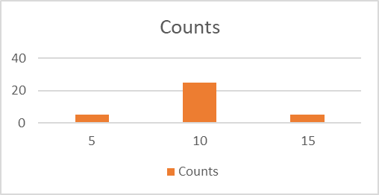
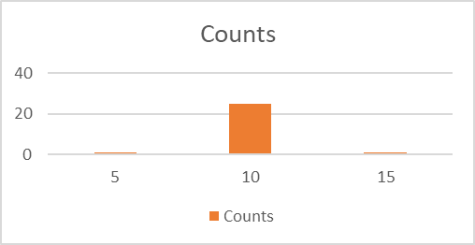
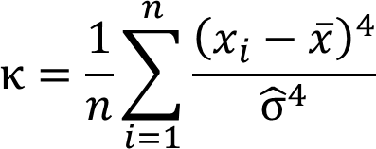



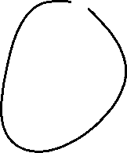










Excercise 1
c

Slide 29
Scatterplot
Graphical representation of the attributes of two variables within a two-dimensional coordinate-system.
Number | 1 | 2 | 3 | 4 | 5 | 6 | 7 | 8 | 9 | 10 | 11 | 12 | 13 | 14 | 15 | 16 | 17 | 18 | 19 | 20 | 21 | 22
Order | 2 | 4 | 3 | 6 | 2 | 1 | 5 | 3 | 4 | 2 | 2 | 7 | 4 | 3 | 2 | 1 | 5 | 4 | 3 | 3 | 1 | 6
Volume [€] | 36 | 44 | 30 | 67 | 21 | 8 | 62 | 35 | 33 | 37 | 22 | 72 | 65 | 45 | 23 | 17 | 44 | 56 | 32 | 37 | 22 | 48
c

Slide 30
Scatterplot
X-coordinate: order
Y-coordinate: Volume [Euro]
c

Slide 31
Linear Regression
Example 2:
A company wants to know how the sales volume depends on visits of representatives.
The company has collected the following data
c
We also want to answer the question, from a descriptive point of view, which sales volume we can expect, if we increase the visits up to x=30

Slide 32
Linear Regression
Via a linear regression we want to analyse the dependence between two variables
We distinguish between a dependent variable (y) and an independent variable (x)
(x) is also called the explanatory variable
A change of (x) implicates a change (y)
The linear regression defines an empirical relation via a linear function
i.e. y = f(x) = 3 + 2x or generally y = a + bx
c

Slide 33
Simple Examples
c
Determine graphically a regression line for the blue and red data points. What kind of
dependence do we have?

Slide 34
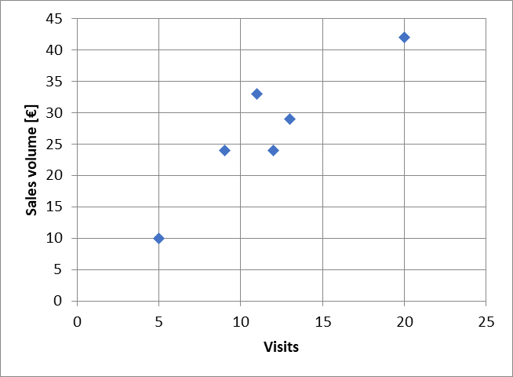
Example
c
Try to fit graphically (by eye) a regression line through the data points

Slide 35
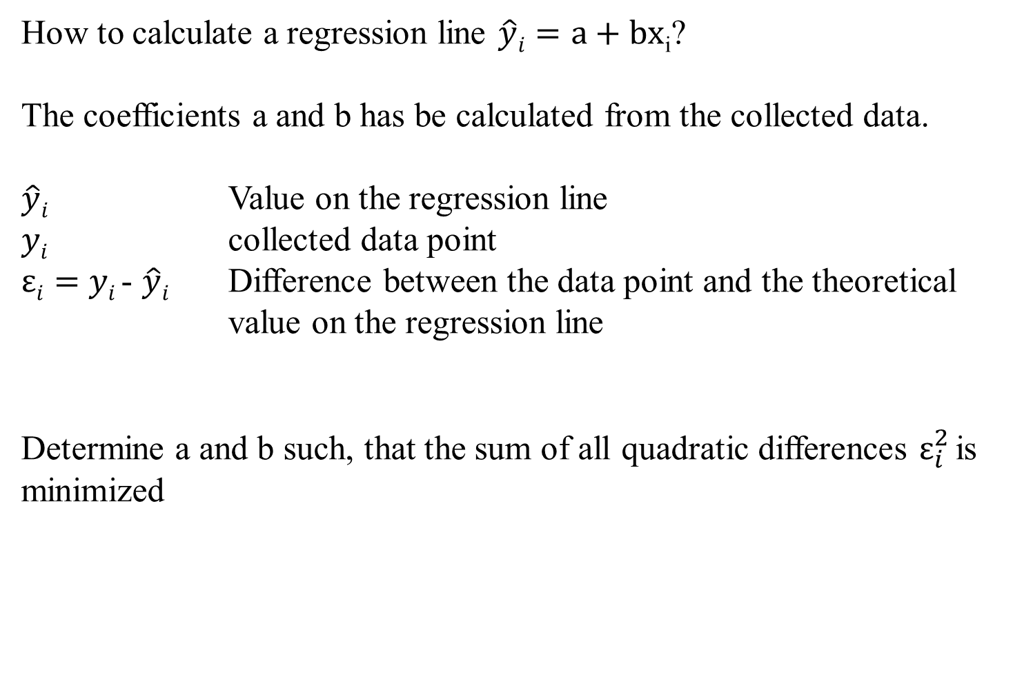
Optimizing problem
How to calculate a regression line $\hat{y}i=a+bx$_{i}?
The coefficients a and b has be calculated from the collected data.
$\hat{y}i$ Value on the regression line
$yi$ collected data point
$εi=$ $yi$- $\hat{y}i$ Difference between the data point and the theoretical value on the regression line
Determine a and b such, that the sum of all quadratic differences $ε_{i}^{2}$is minimized
c

Slide 36
Least squared method
The formal optimizing problem
c

Slide 37
Least squared method
The formal optimizing problem
FOC:
2 dimensional linear system which can directly be solved
c

Slide 38
Least squared method
c

Slide 39
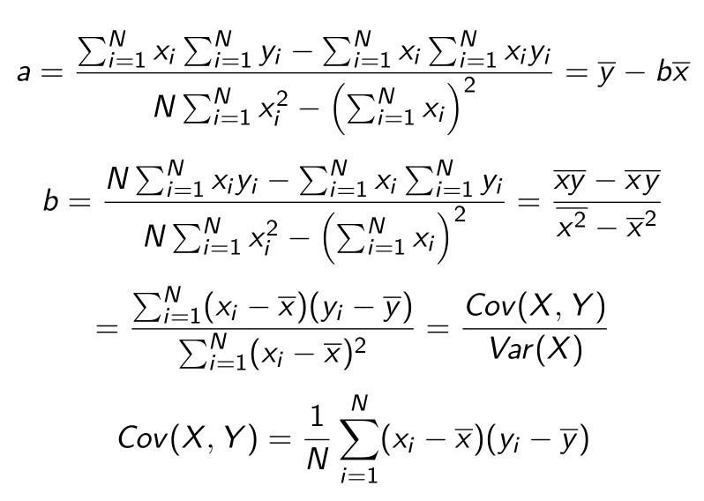
Formulas
:
c

Slide 40
Linear Regression
 | Visits | Sales volume [€]
year | x | y | xy | x^2
2008 | 9 | 24
2009 | 11 | 33
2010 | 5 | 10
2011 | 13 | 29
2012 | 20 | 42
2013 | 12 | 24
c
b=
a=

Slide 41
Extrapolation for x=30
 | Visits | Sales volume [€]
year | x | y | xy | x^2 | yhat
2008 | 9 | 24
2009 | 11 | 33
2010 | 5 | 10
2011 | 13 | 29
2012 | 20 | 42
2013 | 12 | 24
c
yhat(30)=

Slide 42



Calulating the regression line from empirical data
$$ei2$$
$\hat{y}i=a+bx$_{i}
c

Slide 43
Regressions coefficients
Regressions coefficient b
  Slope of the regression line.
  Determines the marginal effect of a change of one unit of the independent variable x onto the dependet variable y
Regressions coefficient a
  The value of the dependent variable if the independent variable x=0
    → intercept of the vertical axes
c

Slide 44
Linear regression
Measures the linear dependence between two variables
This dependence can be interpreted, that one variable is quantitatively influencing another variable
The linear regression is an instrument for forecasting
c

