Slide 1


Statistics B
Wilhelmshaven
This lecture will be recorded and
subsequently uploaded in the
world-wide-web
Function translator (webpage)
Function translator Excel 1 (add in)
c
Prof. Dr. Bernhard Köster
Jade-Hochschule Wilhelmshaven
http://www.bernhardkoester.de/vorlesungen/inhalt.html

Slide 2








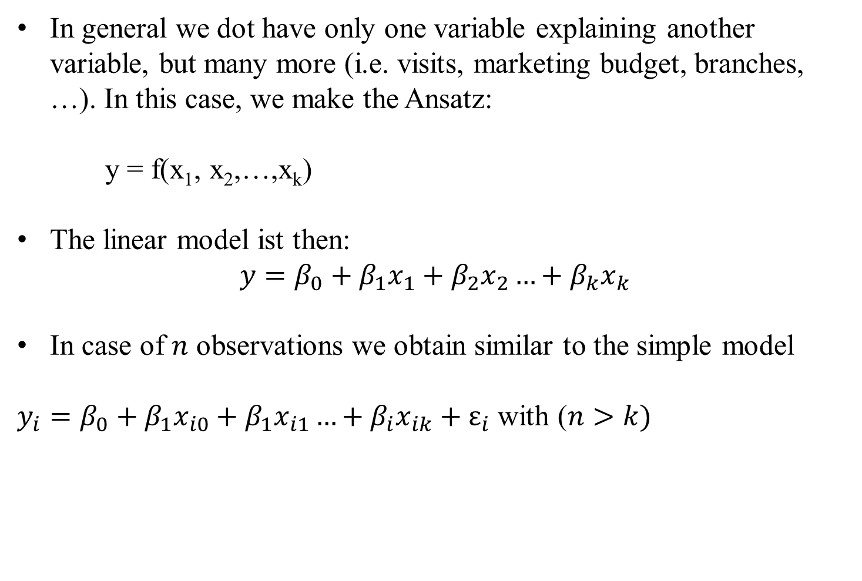
























Multiple linear Regression
In general we dot have only one variable explaining another variable, but many more (i.e. visits, marketing budget, branches, …). In this case, we make the Ansatz:
y = f(x₁, x₂,…,x_{k})
The linear model ist then:
$$y=β_{0}+β_{1}x_{1}+β_{2}x_{2}…+β_{k}x_{k}$$
In case of $n$ observations we obtain similar to the simple model
$y_{i}=β_{0}+β_{1}x_{i0}+β_{1}x_{i1}…+β_{i}x_{ik}+ε_{i}$ with ($n>k)$
c

Slide 3









Multiple linear Regression: Matrix notation
c

Slide 4















Multiple linear Regression
The estimators $β$ will again be obtained via minimizing the sum of the squared errors:
with
c

Slide 5























Multiple linear Regression
From the first order condition (FOC) we obtain:
c

Slide 6
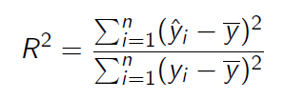

Multiple linear Regression
For the coefficiant of determination we obtain equivalently:
with
and
c

Slide 7












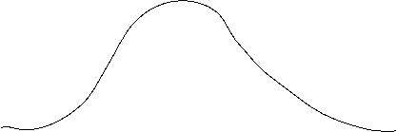















Multiple linear Regression – Hypothesis-Testing – Assumptions
c

Slide 8








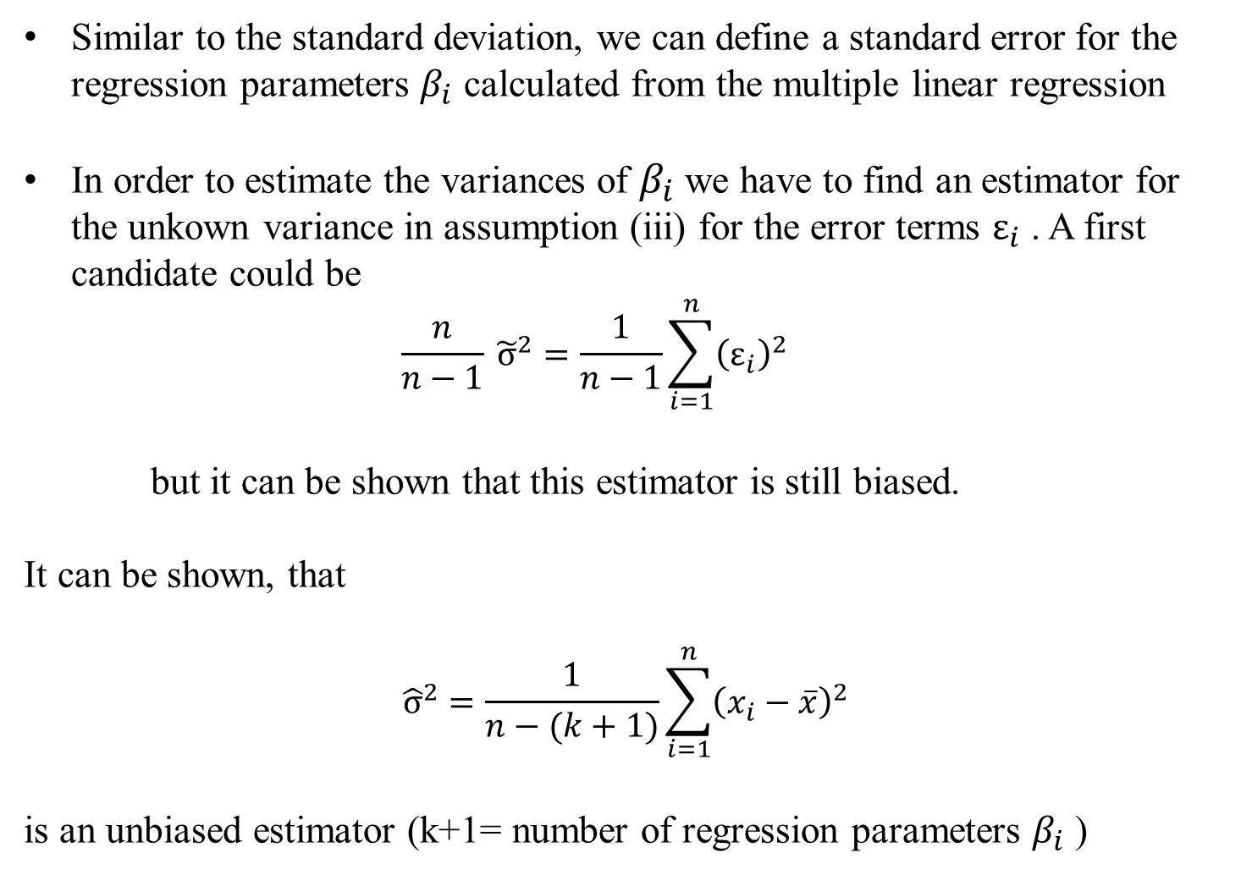











Multiple linear Regression – Standard error
Similar to the standard deviation, we can define a standard error for the regression parameters $β_{i}$ calculated from the multiple linear regression
In order to estimate the variances of $β_{i}$ we have to find an estimator for the unkown variance in assumption (iii) for the error terms $ε_{i}$ . A first candidate could be
  $$\frac{n}{n−1} {\tilde{σ}}^{2}=\frac{1}{n−1}\sum_{i=1}^{n}{{\left(ε_{i}\right)}^{2}}$$
but it can be shown that this estimator is still biased.
It can be shown, that
$${\hat{σ}}^{2}=\frac{1}{n−(k+1)}\sum_{i=1}^{n}{{\left(x_{i}−\overline{x}\right)}^{2}}$$
is an unbiased estimator (k+1= number of regression parameters $β_{i}$ )
c

Slide 9









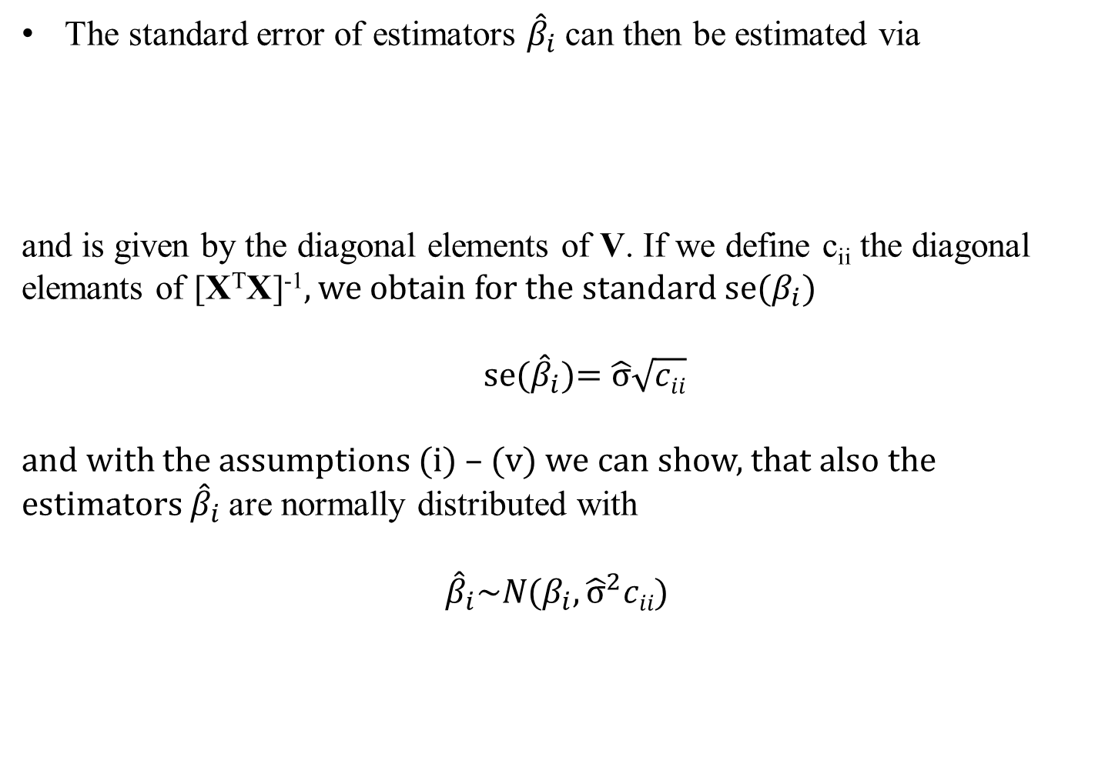




Multiple linear Regression – Standard error
The standard error of estimators ${\hat{β}}_{i}$ can then be estimated via
and is given by the diagonal elements of V. If we define c_{ii} the diagonal elemants of [X^{T}X]⁻¹, we obtain for the standard se($β_{i}$)
se(${\hat{β}}_{i}$)= $\hat{σ}\sqrt{cii}$
and with the assumptions (i) – (v) we can show, that also the estimators ${\hat{β}}_{i}$are normally distributed with
$${\hat{β}}_{i}\sim N(β_{i},{\hat{σ}}^{2}cii)$$
c

Slide 10

c

Slide 11


c

Slide 12

c

Slide 13


c

Slide 14





Slide 15














Slide 16
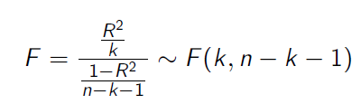




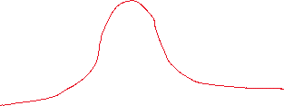















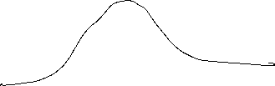



Multiple linear Regression – Hypothesis-Testing
With the assumptions and the derived properties we can calculate the following test statistics:
and
With F and T, we can make probability statements about the goodness of the estimators calculated from the multiple linear regression.
c

Slide 17




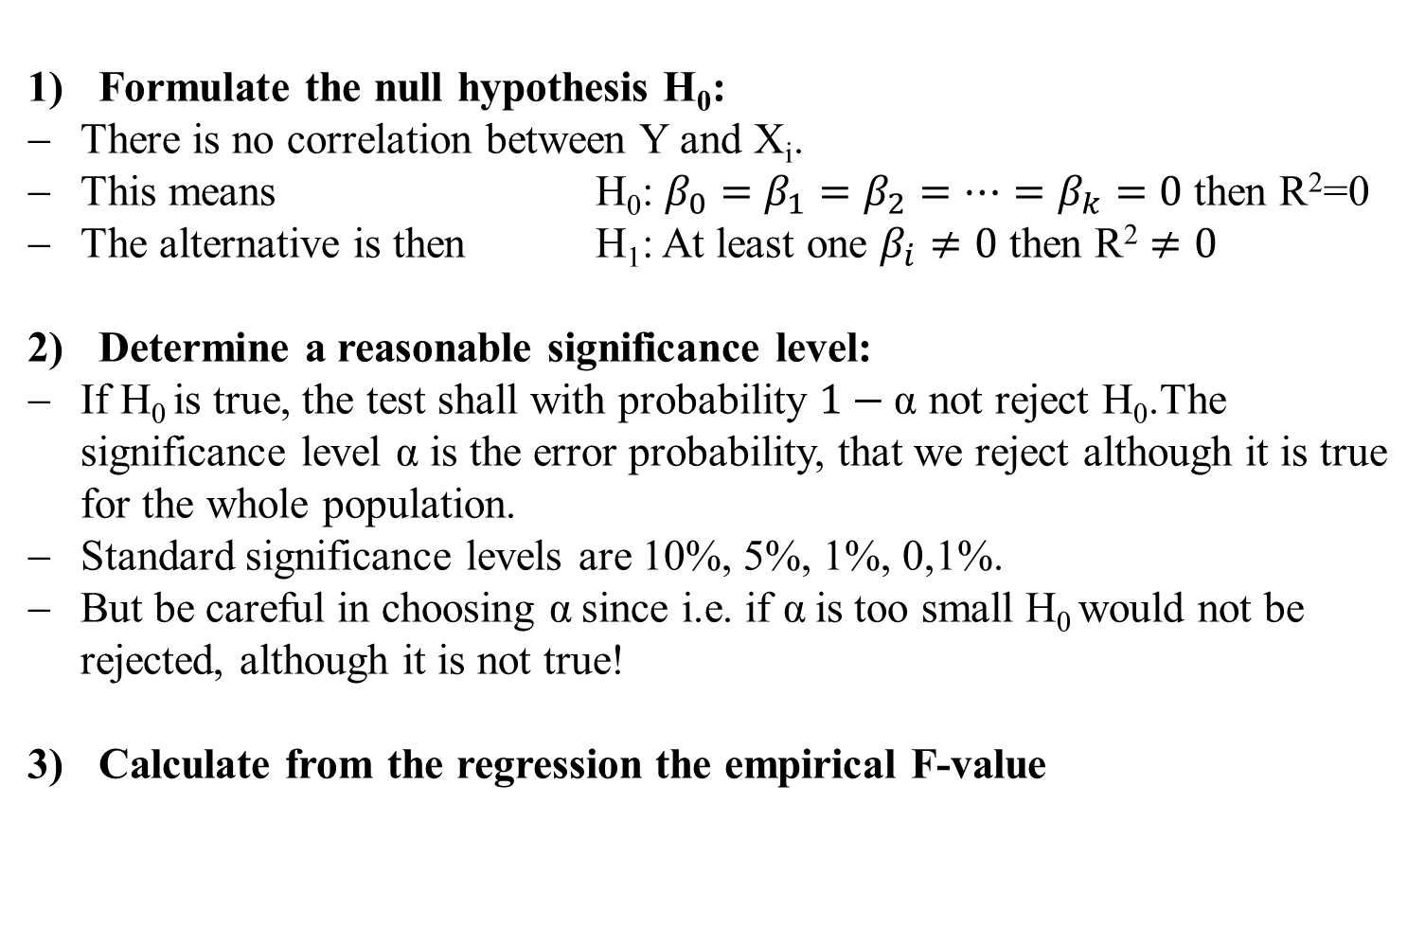




Multiple linear Regression – F-Test
Formulate the null hypothesis H₀:
There is no correlation between Y and X_{i}.
This means H₀: $β_{0}=β_{1}=β_{2}=…=β_{k}=0$ then R²=0
The alternative is then H₁: At least one $β_{i}≠0$ then $\text{R}\text{2}≠0$
Determine a reasonable significance level:
If H₀ is true, the test shall with probability $1−\text{α}$ not reject H₀.The significance level $\text{α}$ is the error probability, that we reject although it is true for the whole population.
Standard significance levels are 10%, 5%, 1%, 0,1%.
But be careful in choosing $\text{α}$since i.e. if $\text{α}$is too small H₀ would not be rejected, although it is not true!
Calculate from the regression the empirical F-value
c

Slide 18
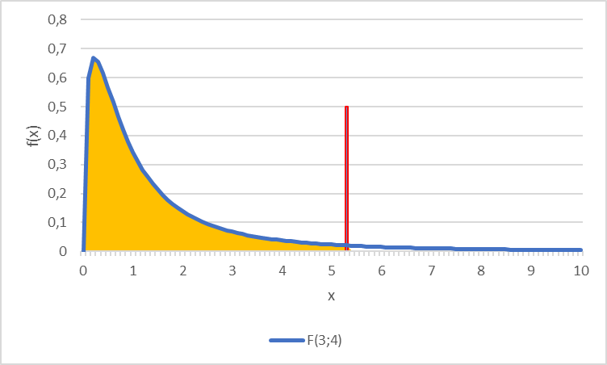
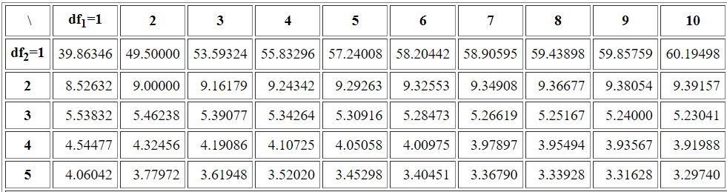
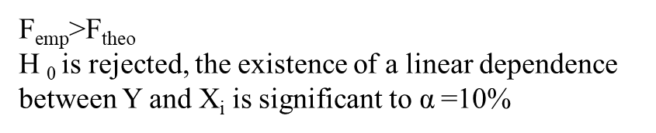












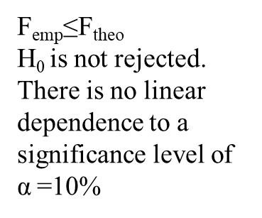


Multiple linear Regression – F-Test
Determine the theoretical F-value
Given the significance level the F-value represents the value for which for which the accumulated probability of an F-distributed variable equals $1−\text{α}$. i.e. in our example we have a
$F\left(k=3;n−k−1=8−3−1=4\right)=F(3,4)$ distribution and thus $F\text{9}\text{0}\text{\%}=5,34$
Compare theoretical and empirical F-value
F_{emp}>F_{theo}
H ₀ is rejected, the existence of a linear dependence between Y and X_{i} is significant to $\text{α}$=10%
F_{emp}≤F_{theo}
H₀ is not rejected. There is no linear dependence to a significance level of $\text{α}$=10%
$$F\text{9}\text{0}\text{\%}=5,34$$
90%
c
Table F-Distribution

Slide 19

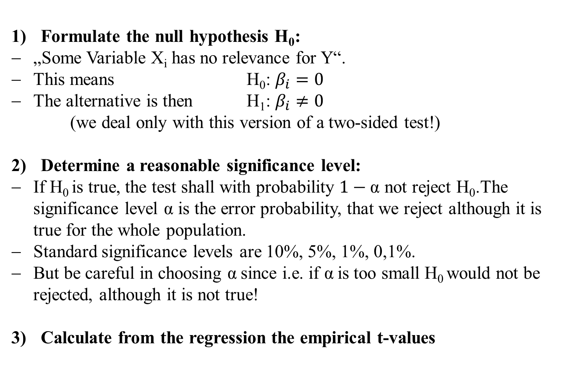







Multiple linear Regression – t-Test
Formulate the null hypothesis H₀:
„Some Variable X_{i} has no relevance for Y“.
This means H₀: $β_{i}=0$
The alternative is then H₁: $β_{i}≠0$
(we deal only with this version of a two-sided test!)
Determine a reasonable significance level:
If H₀ is true, the test shall with probability $1−\text{α}$ not reject H₀.The significance level $\text{α}$ is the error probability, that we reject although it is true for the whole population.
Standard significance levels are 10%, 5%, 1%, 0,1%.
But be careful in choosing $\text{α}$since i.e. if $\text{α}$is too small H₀ would not be rejected, although it is not true!
Calculate from the regression the empirical t-values
c

Slide 20
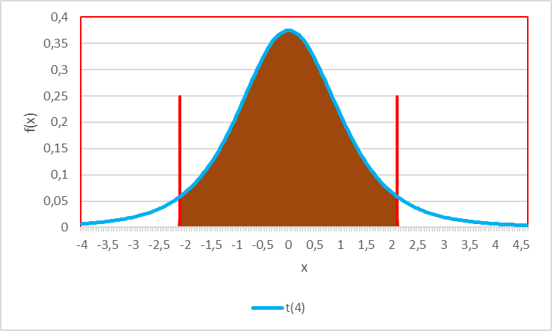



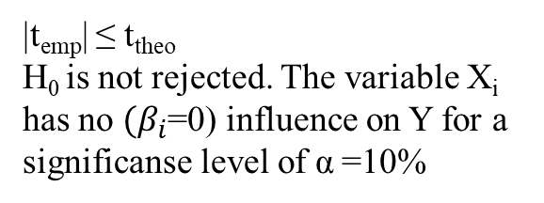



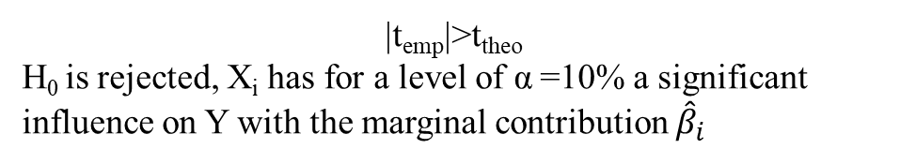
Multiple linear Regression – t-Test
Determine the theoretical t-value
Given the significance level the t-value represents the value for which for which the accumulated probability of an F-distributed variable equals $1−\text{α}$. i.e. in our example we have a t$\left(n−k−1=8−3−1=4\right)=t(4)$ distribution and thus $t\text{9}\text{5}\text{\%}=2,13$
Compare theoretical and empirical F-value
|t_{emp}| ≤ t_{theo}
H₀ is not rejected. The variable X_{i} has no $(β_{i}$=0) influence on Y for a significanse level of $\text{α}$=10%
$$t\text{5}\text{\%}=−2,13$$
$$t\text{9}\text{5}\text{\%}=2,13$$
90%
c
|t_{emp}|>t_{theo}
H₀ is rejected, X_{i} has for a level of $\text{α}$=10% a significant influence on Y with the marginal contribution ${\hat{β}}_{i}$

Slide 21
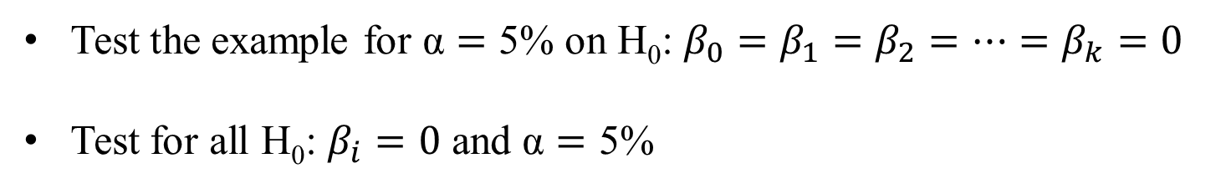

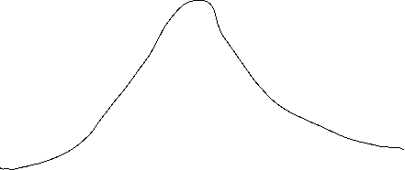




Example
Test the example for $\text{α}=\text{5\%}$ on H₀: $β_{0}=β_{1}=β_{2}=…=β_{k}=0$
Test for all H₀: $β_{i}=0$ and $\text{α}=\text{5\%}$
beta0 | beta1 | beta2 | beta3
10,669 | 1,484 | 0,718 | 9,008
se(b0) | se(b1) | se(b2) | se(b3)
7,579 | 0,911 | 0,199 | 4,150
c

Slide 22
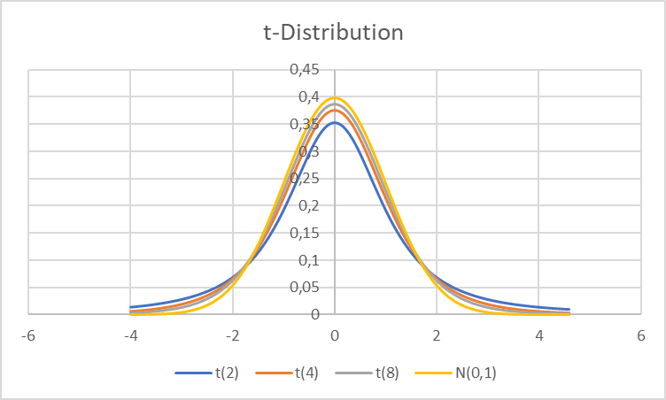
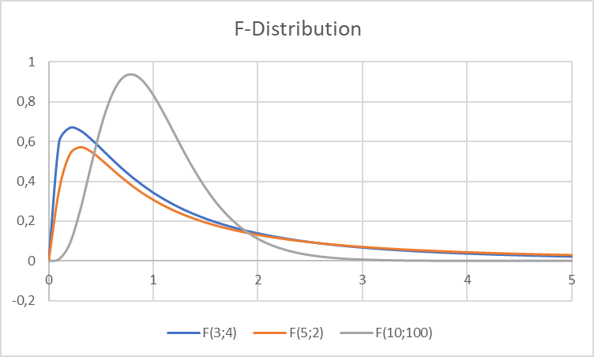
















You want to see F an t ??
t-Dirstibution
F-Dirstibution
c

Slide 23












c

Slide 24




















c

