Slide 1


Statistics B
Wilhelmshaven
This lecture will be recorded and
subsequently uploaded in the
world-wide-web
Function translator (webpage)
Function translator Excel 1 (add in)
c
Prof. Dr. Bernhard Köster
Jade-Hochschule Wilhelmshaven
http://www.bernhardkoester.de/vorlesungen/inhalt.html

Slide 2








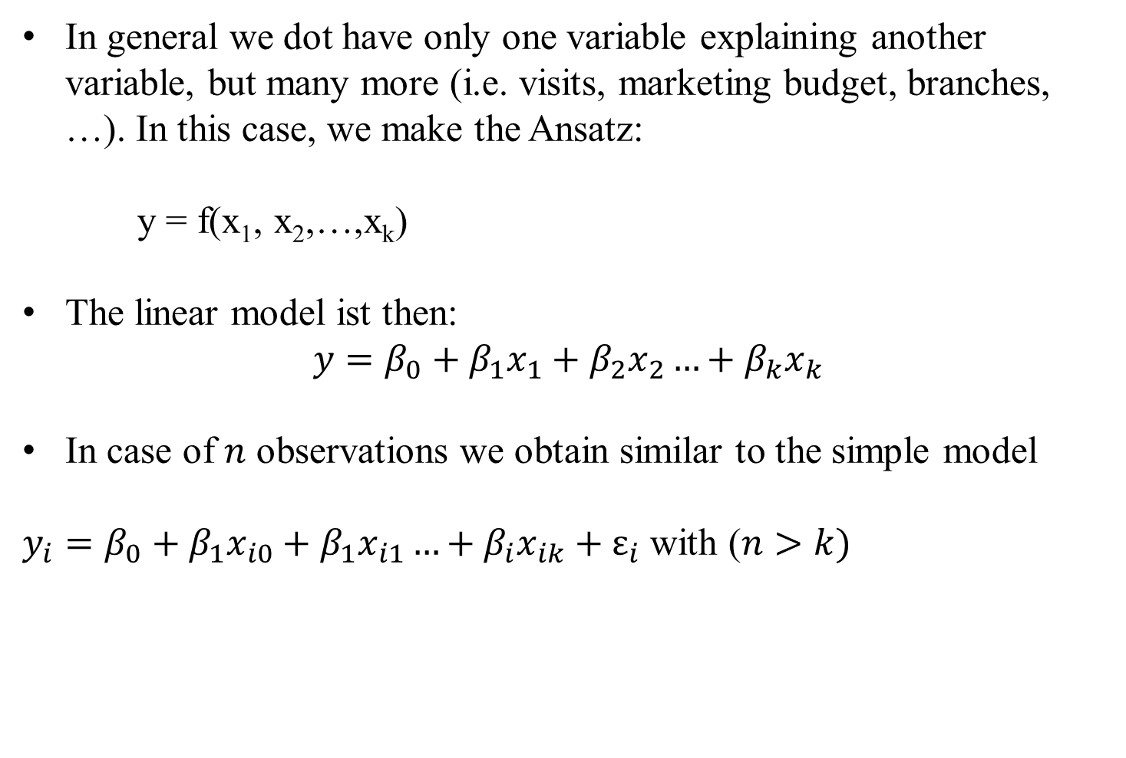
























Multiple linear Regression
In general we dot have only one variable explaining another variable, but many more (i.e. visits, marketing budget, branches, …). In this case, we make the Ansatz:
y = f(x₁, x₂,…,x_{k})
The linear model ist then:
$$y=β_{0}+β_{1}x_{1}+β_{2}x_{2}…+β_{k}x_{k}$$
In case of $n$ observations we obtain similar to the simple model
$y_{i}=β_{0}+β_{1}x_{i0}+β_{1}x_{i1}…+β_{i}x_{ik}+ε_{i}$ with ($n>k)$
c

Slide 3









Multiple linear Regression: Matrix notation
c

Slide 4















Multiple linear Regression
The estimators $β$ will again be obtained via minimizing the sum of the squared errors:
with
c

Slide 5























Multiple linear Regression
From the first order condition (FOC) we obtain:
c

Slide 6
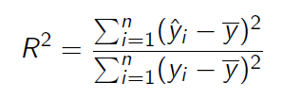

Multiple linear Regression
For the coefficiant of determination we obtain equivalently:
with
and
c

Slide 7

Example
Suppose in our one-dimensional example, we are also interested if our results are transferable to other regions, looking at the sales volume depending on
  number of visits
  how the marketing budget influences sales
  and the impact, if a branch is located in the region or not
Thus we have now three variables, which influences sales
  Question is now, how to quantify the third variable, if a branch is located in the region or not
    Introduction of a dummy variable with
    1 = branch 0 = no branch
c

Slide 8










Example
 | visits | marketing | branch | sales
A | 11 | 33 | 1 | 30 | 24,3
B | 8 | 30 | 0 | 27 | 24,6
C | 6 | 9 | 1 | 12 | 11,1
D | 16 | 27 | 0 | 28 | 26,7
E | 13 | 42 | 1 | 25 | 29,3
F | 11 | 25 | 1 | 17 | 20,6
G | 7 | 18 | 0 | 15 | 18,7
H | 10 | 26 | 1 | 22 | 20,7
c
Calculate ${\hat{β}}_{i}$ and R²

Slide 9














Example
 | visits | marketing | branch | sales
 | x1 | x2 | x3 | y | yhat | (yhat-y)^2 | (yhat-ybar)^2 | (y-ybar)^2
A | 11 | 33 | 1 | 30 | 24,3 | 5,309395914 |  | 64
B | 8 | 30 | 0 | 27 | 24,6 | 6,982237793 |  | 25
C | 6 | 9 | 1 | 12 | 11,1 | 118,3593599 |  | 100
D | 16 | 27 | 0 | 28 | 26,7 | 21,79100321 |  | 36
E | 13 | 42 | 1 | 25 | 29,3 | 53,3086052 |  | 9
F | 11 | 25 | 1 | 17 | 20,6 | 1,90554302 |  | 25
G | 7 | 18 | 0 | 15 | 18,7 | 10,95925068 |  | 49
H | 10 | 26 | 1 | 22 | 20,7 | 1,81108072 |  | 0
sum |  |  |  |  |  | 220,4264764 |  | 308
average
c
beta0 | beta1 | beta2 | beta3
7,41761619 | 0,42592826 | 0,46057834 | -2,99769958

Slide 10


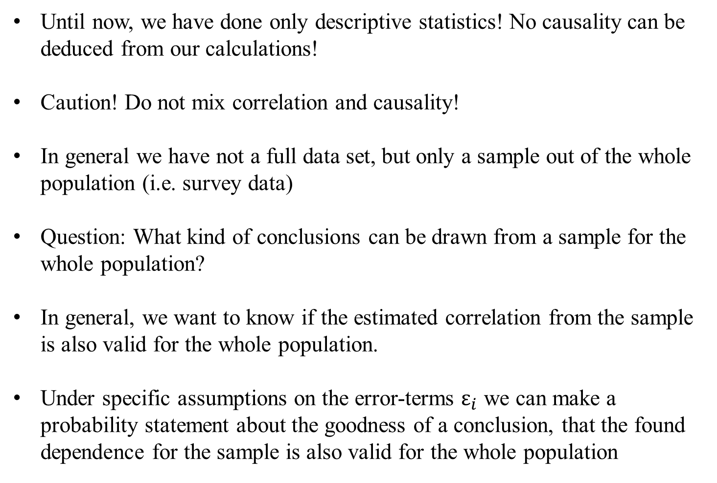







Multiple linear Regression – Hypothesis-Testing
Until now, we have done only descriptive statistics! No causality can be deduced from our calculations!
Caution! Do not mix correlation and causality!
In general we have not a full data set, but only a sample out of the whole population (i.e. survey data)
Question: What kind of conclusions can be drawn from a sample for the whole population?
In general, we want to know if the estimated correlation from the sample is also valid for the whole population.
Under specific assumptions on the error-terms $ε_{i}$ we can make a probability statement about the goodness of a conclusion, that the found dependence for the sample is also valid for the whole population
c

Slide 11












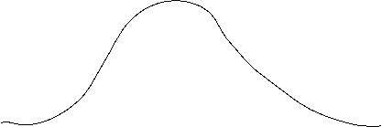















Multiple linear Regression – Hypothesis-Testing – Assumptions
c

Slide 12
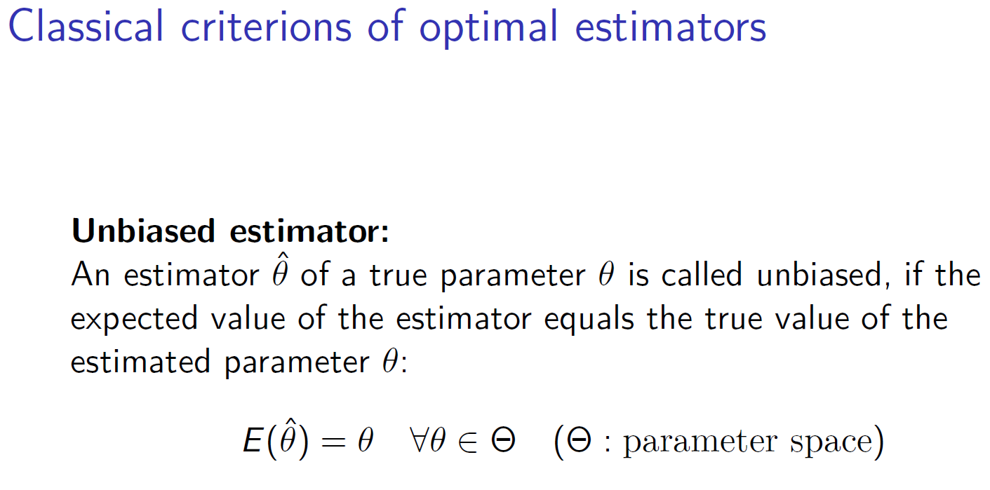



c

Slide 13
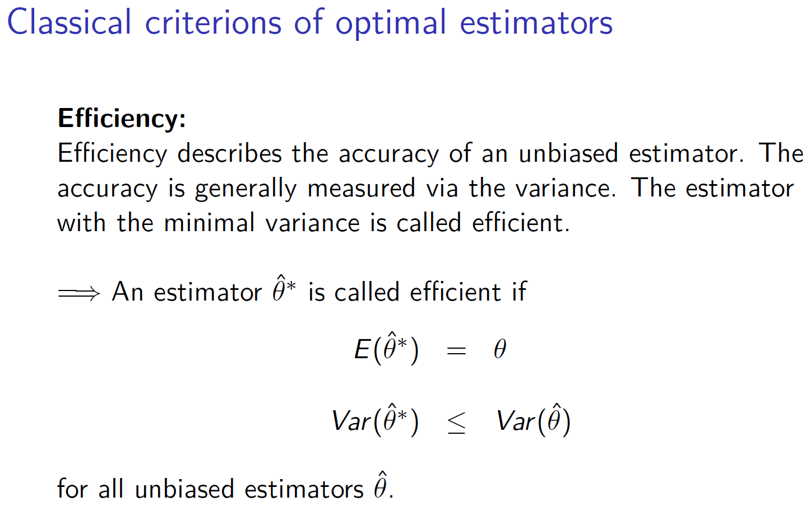


c

Slide 14

Further desired criterions for an estimator
Asymptotically unbiased (if there ist no unbiased candidate)
Consistency (stochastic convergence)
Sufficiency (Estimator should use only the relevant information about the true parameter)
c

Slide 15








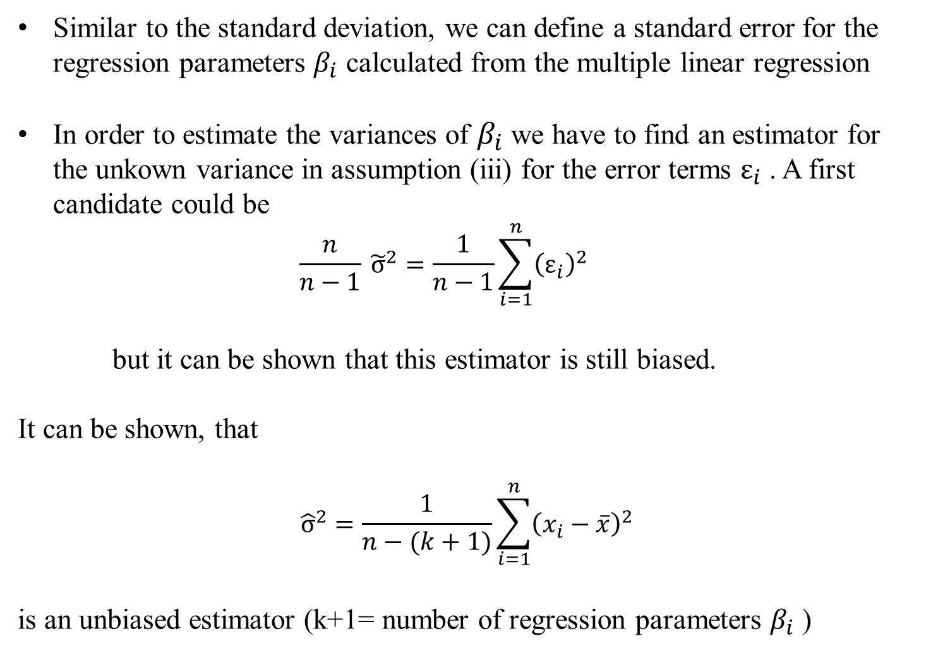











Multiple linear Regression – Standard error
Similar to the standard deviation, we can define a standard error for the regression parameters $β_{i}$ calculated from the multiple linear regression
In order to estimate the variances of $β_{i}$ we have to find an estimator for the unkown variance in assumption (iii) for the error terms $ε_{i}$ . A first candidate could be
  $$\frac{n}{n−1} {\tilde{σ}}^{2}=\frac{1}{n−1}\sum_{i=1}^{n}{{\left(ε_{i}\right)}^{2}}$$
but it can be shown that this estimator is still biased.
It can be shown, that
$${\hat{σ}}^{2}=\frac{1}{n−(k+1)}\sum_{i=1}^{n}{{\left(x_{i}−\overline{x}\right)}^{2}}$$
is an unbiased estimator (k+1= number of regression parameters $β_{i}$ )
c

Slide 16









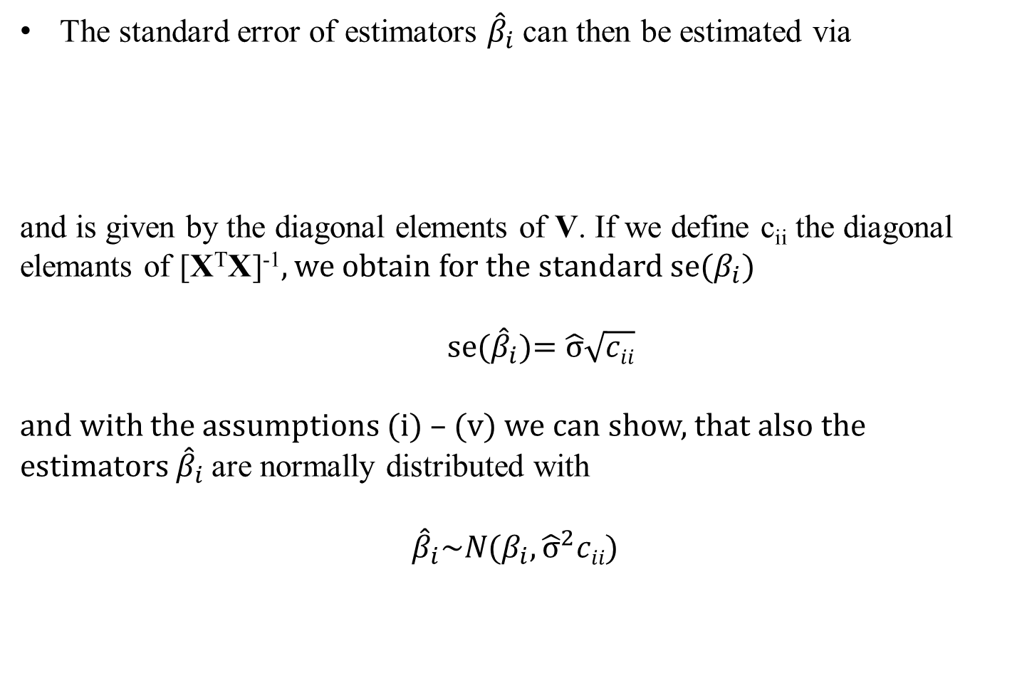




Multiple linear Regression – Standard error
The standard error of estimators ${\hat{β}}_{i}$ can then be estimated via
and is given by the diagonal elements of V. If we define c_{ii} the diagonal elemants of [X^{T}X]⁻¹, we obtain for the standard se($β_{i}$)
se(${\hat{β}}_{i}$)= $\hat{σ}\sqrt{cii}$
and with the assumptions (i) – (v) we can show, that also the estimators ${\hat{β}}_{i}$are normally distributed with
$${\hat{β}}_{i}\sim N(β_{i},{\hat{σ}}^{2}cii)$$
c

Slide 17

c

Slide 18


c

Slide 19

c

Slide 20


c

Slide 21





Slide 22




Slide 23
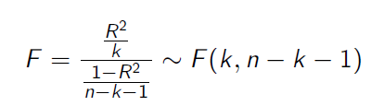




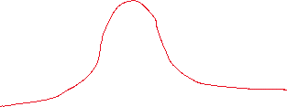















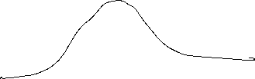



Multiple linear Regression – Hypothesis-Testing
With the assumptions and the derived properties we can calculate the following test statistics:
and
With F and T, we can make probability statements about the goodness of the estimators calculated from the multiple linear regression.
c

Slide 24




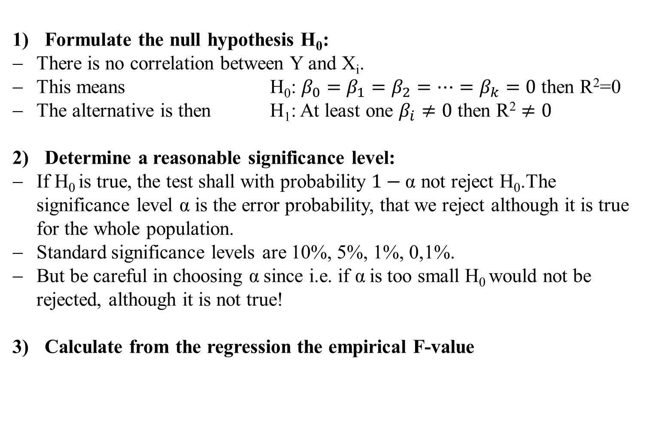

Multiple linear Regression – F-Test
Formulate the null hypothesis H₀:
There is no correlation between Y and X_{i}.
This means H₀: $β_{0}=β_{1}=β_{2}=…=β_{k}=0$ then R²=0
The alternative is then H₁: At least one $β_{i}≠0$ then $\text{R}\text{2}≠0$
Determine a reasonable significance level:
If H₀ is true, the test shall with probability $1−\text{α}$ not reject H₀.The significance level $\text{α}$ is the error probability, that we reject although it is true for the whole population.
Standard significance levels are 10%, 5%, 1%, 0,1%.
But be careful in choosing $\text{α}$since i.e. if $\text{α}$is too small H₀ would not be rejected, although it is not true!
Calculate from the regression the empirical F-value
c

Slide 25
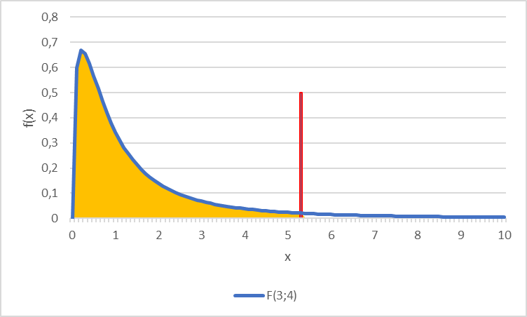
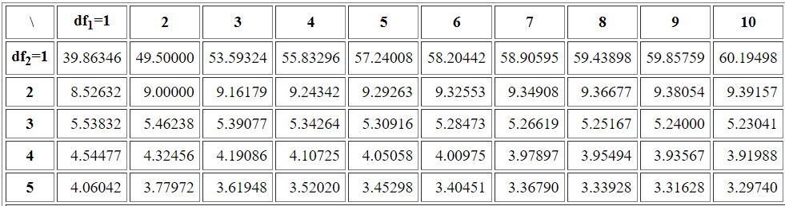
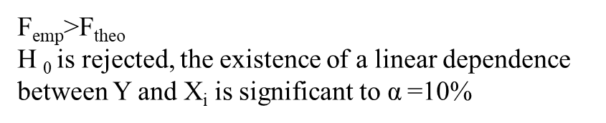








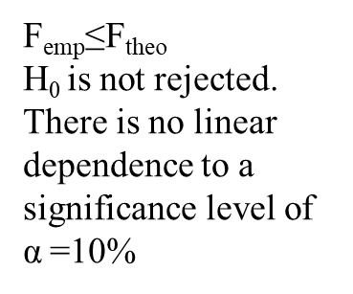
Multiple linear Regression – F-Test
Determine the theoretical F-value
Given the significance level the F-value represents the value for which for which the accumulated probability of an F-distributed variable equals $1−\text{α}$. i.e. in our example we have a
$F\left(k=3;n−k−1=8−3−1=4\right)=F(3,4)$ distribution and thus $F\text{9}\text{0}\text{\%}=5,34$
Compare theoretical and empirical F-value
F_{emp}>F_{theo}
H ₀ is rejected, the existence of a linear dependence between Y and X_{i} is significant to $\text{α}$=10%
F_{emp}≤F_{theo}
H₀ is not rejected. There is no linear dependence to a significance level of $\text{α}$=10%
$$F\text{9}\text{0}\text{\%}=5,34$$
90%
c
Table F-Distribution

Slide 26
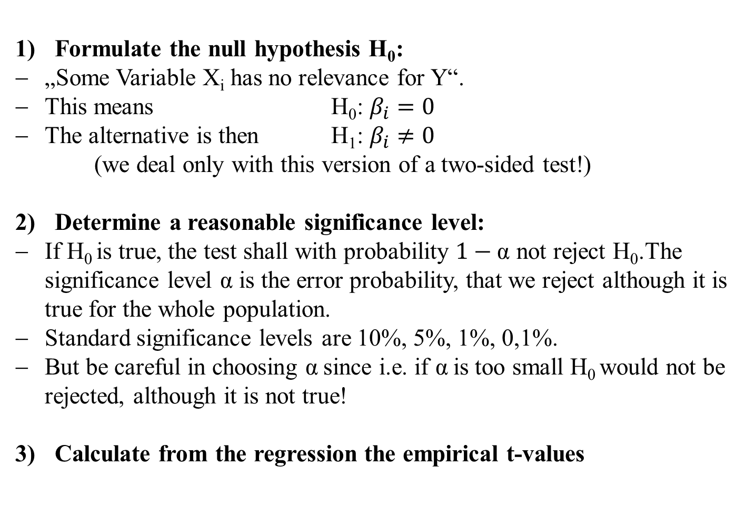
Multiple linear Regression – t-Test
Formulate the null hypothesis H₀:
„Some Variable X_{i} has no relevance for Y“.
This means H₀: $β_{i}=0$
The alternative is then H₁: $β_{i}≠0$
(we deal only with this version of a two-sided test!)
Determine a reasonable significance level:
If H₀ is true, the test shall with probability $1−\text{α}$ not reject H₀.The significance level $\text{α}$ is the error probability, that we reject although it is true for the whole population.
Standard significance levels are 10%, 5%, 1%, 0,1%.
But be careful in choosing $\text{α}$since i.e. if $\text{α}$is too small H₀ would not be rejected, although it is not true!
Calculate from the regression the empirical t-values
c

Slide 27
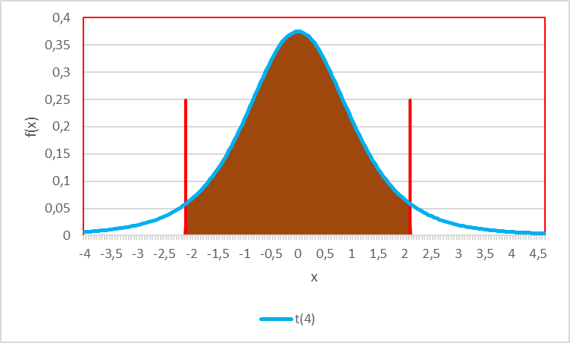


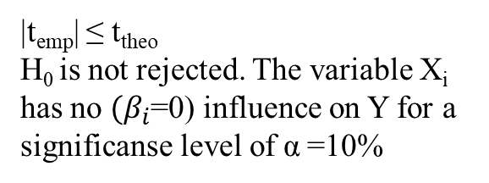
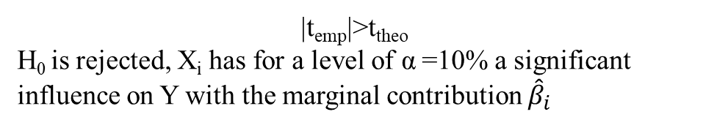

Multiple linear Regression – t-Test
Determine the theoretical t-value
Given the significance level the t-value represents the value for which for which the accumulated probability of an F-distributed variable equals $1−\text{α}$. i.e. in our example we have a t$\left(n−k−1=8−3−1=4\right)=t(4)$ distribution and thus $t\text{9}\text{5}\text{\%}=2,13$
Compare theoretical and empirical F-value
|t_{emp}| ≤ t_{theo}
H₀ is not rejected. The variable X_{i} has no $(β_{i}$=0) influence on Y for a significanse level of $\text{α}$=10%
$$t\text{5}\text{\%}=−2,13$$
$$t\text{9}\text{5}\text{\%}=2,13$$
90%
c
|t_{emp}|>t_{theo}
H₀ is rejected, X_{i} has for a level of $\text{α}$=10% a significant influence on Y with the marginal contribution ${\hat{β}}_{i}$

Slide 28
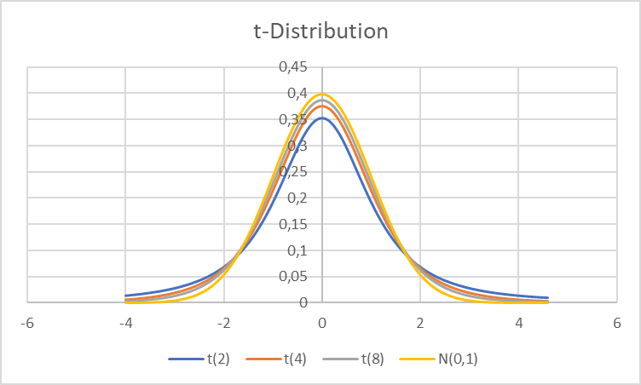
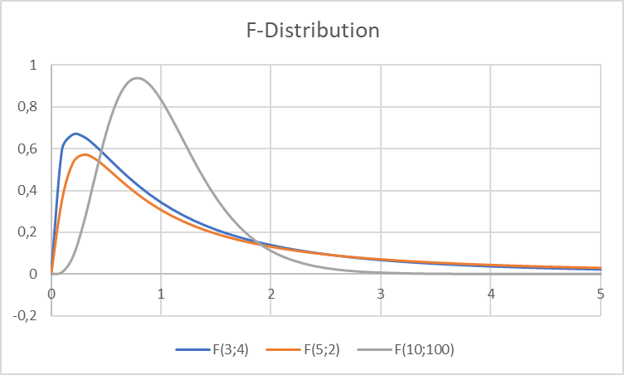
















You want to see F an t ??
t-Dirstibution
F-Dirstibution
c

Slide 29
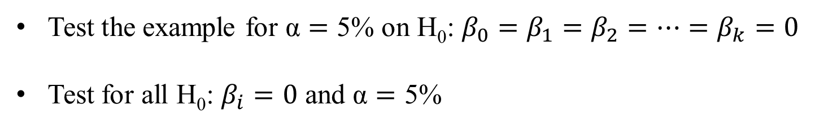
Example
Test the example for $\text{α}=\text{5\%}$ on H₀: $β_{0}=β_{1}=β_{2}=…=β_{k}=0$
Test for all H₀: $β_{i}=0$ and $\text{α}=\text{5\%}$
beta0 | beta1 | beta2 | beta3
10,669 | 1,484 | 0,718 | 9,008
se(b0) | se(b1) | se(b2) | se(b3)
7,579 | 0,911 | 0,199 | 4,150
c

Slide 30
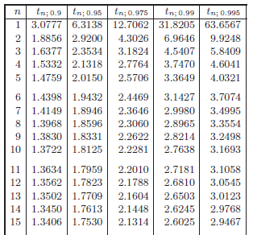
^{t-distribution}
c

Slide 31
F_{95%}
^{F-distribution}
F_{99%}
c

