Slide 1
Statistics B
Wilhelmshaven
This lecture will be recorded and
subsequently uploaded in the
world-wide-web
Function translator (webpage)
Function translator Excel 1 (add in)
c
Prof. Dr. Bernhard Köster
Jade-Hochschule Wilhelmshaven
http://www.bernhardkoester.de/vorlesungen/inhalt.html

Slide 2
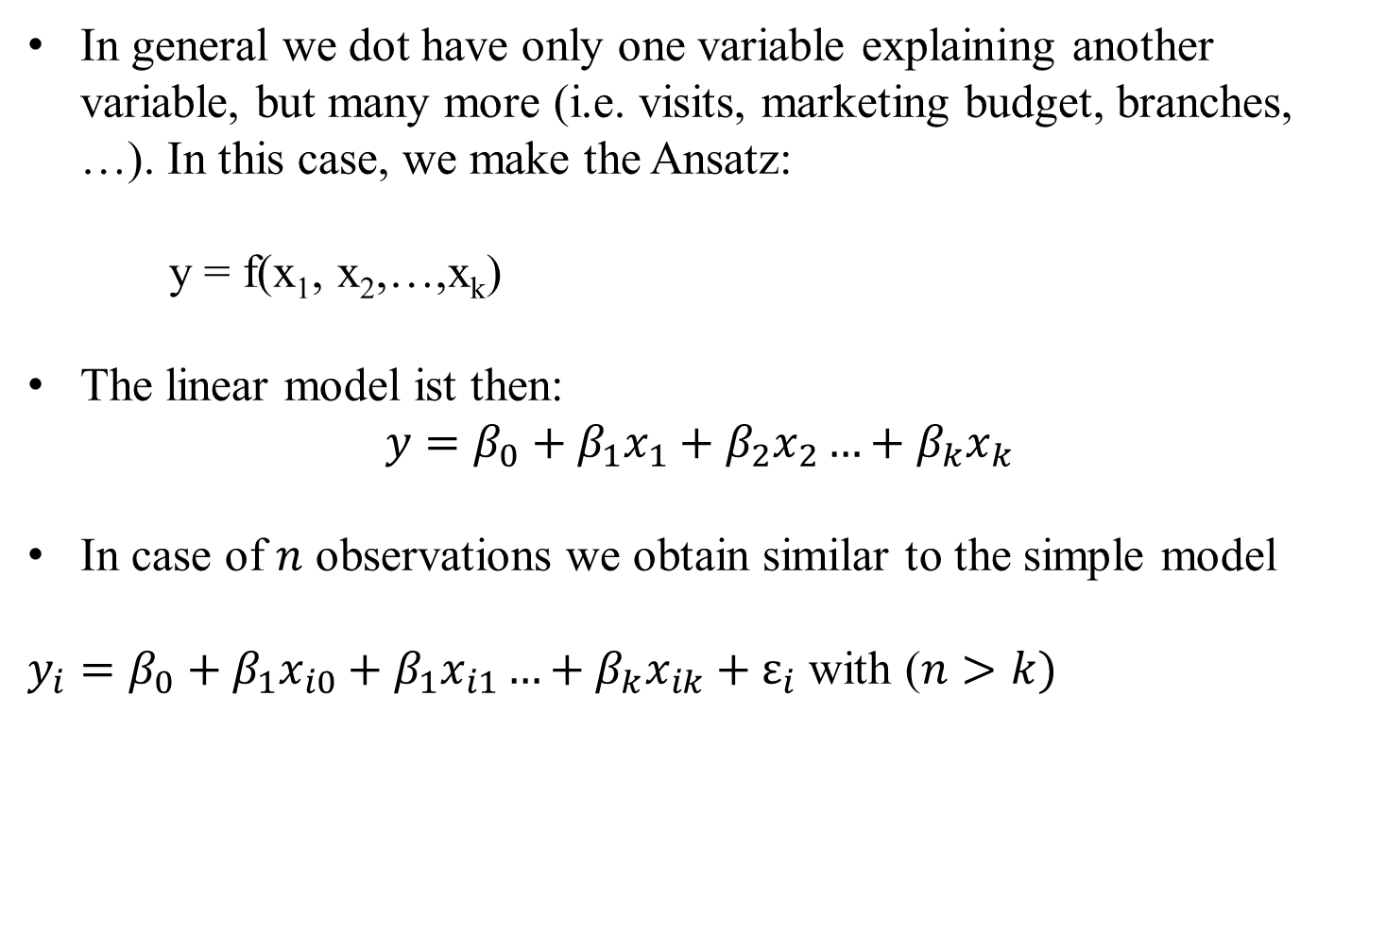
Multiple linear Regression
In general we dot have only one variable explaining another variable, but many more (i.e. visits, marketing budget, branches, …). In this case, we make the Ansatz:
y = f(x₁, x₂,…,x_{k})
The linear model ist then:
$$y=β_{0}+β_{1}x_{1}+β_{2}x_{2}…+β_{k}x_{k}$$
In case of $n$ observations we obtain similar to the simple model
$y_{i}=β_{0}+β_{1}x_{i0}+β_{1}x_{i1}…+β_{k}x_{ik}+ε_{i}$ with ($n>k)$
c

Slide 3
Multiple linear Regression: Matrix notation
c

Slide 4
Multiple linear Regression
The estimators $β$ will again be obtained via minimizing the sum of the squared errors:
with
c

Slide 5
Multiple linear Regression
From the first order condition (FOC) we obtain:
c

Slide 6
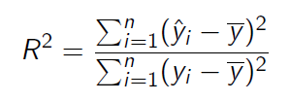
Multiple linear Regression
For the coefficiant of determination we obtain equivalently:
with
and
c

Slide 7
Example
Suppose in our one-dimensional example, we are also interested if our results are transferable to other regions, looking at the sales volume depending on
number of visits
how the marketing budget influences sales
and the impact, if a branch is located in the region or not
Thus we have now three variables, which influences sales
Question is now, how to quantify the third variable, if a branch is located in the region or not
Introduction of a dummy variable with
1 = branch 0 = no branch
c

Slide 8
Example
 | visits | marketing | branch | sales
A | 11 | 33 | 1 | 30
B | 8 | 30 | 0 | 27
C | 6 | 9 | 1 | 12
D | 16 | 27 | 0 | 28
E | 13 | 42 | 1 | 25
F | 11 | 25 | 1 | 17
G | 7 | 18 | 0 | 15
H | 10 | 26 | 1 | 22
c
Calculate ${\hat{β}}_{i}$ and R²

Slide 9
Example
 | visits | marketing | branch | sales
 | x1 | x2 | x3 | y | yhat | (yhat-y)^2 | (yhat-ybar)^2 | (y-ybar)^2
A
B
C
D
E
F
G
H
sum
average
c
beta0 | beta1 | beta2 | beta3

Slide 10
Multiple linear Regression – Hypothesis-Testing
Until now, we have done only descriptive statistics! No causality can be deduced from our calculations!
Caution! Do not mix correlation and causality!
In general we have not a full data set, but only a sample out of the whole population (i.e. survey data)
Question: What kind of conclusions can be drawn from a sample for the whole population?
In general, we want to know if the estimated correlation from the sample is also valid for the whole population.
Under specific assumptions on the error-terms $ε_{i}$ we can make a probability statement about the goodness of a conclusion, that the found dependence for the sample is also valid for the whole population
c

