Slide 1
Discret
Probability mass function:
Cumulative distribution function:
Expected value:
Variance:
Continous
Probability density function:
Cumulative distribution function:
Expected value :
Variance:
c

Slide 2
Calculating with Expectated Value and Variance
Constant:
Constant factor:
Linear Transformation:
c

Slide 3

Median
Definition:
The Median$M$is the middle observation when the data set is sorted in ascending or descending order. If the data set has an even number of observations, the median is the mean of the two middle observations. It separates the data set into a lower and higher half.
Suppose you have a data set $x_{1},x_{2},x_{3},…x_{n}$, then sort the data set into an ascending row
$$x_{[1]}≤x_{[2]}≤x_{[3]}≤…{≤x}_{[n]}$$
$$M=x_{\left[(n+1\right)/2]} \text{if} N \text{is} \text{odd}$$
$$M=\frac{1}{2}({ x}_{\left[n/2\right]}+{ x}_{\left[n/2+1\right]}) \text{if} N \text{is} \text{even}$$
Arithmethic Mean (first moment)
$$\overline{x}=\frac{x1+x2+…+xn}{n}=\frac{1}{n}\sum_{i=1}^{n}{xi}$$
Geometric Mean
$${\overline{x}}_{g}=\sqrt[n]{{{x_{1}∙x}_{2}∙ … ∙x}_{n}}=({{x_{1}∙x}_{2}∙ … ∙x}_{n})^{\frac{1}{n}}{ x}_{i}>0$$
Harmonic mean
$${\overline{x}}_{h}(x_{1},x_{2},…x_{n})=\frac{n}{\sum_{i=1}^{n}{\frac{1}{x_{i}}}}$$
c

Slide 4

Range
The difference between the lowest and highest values of a data set
Mean absolute deviation
MAD $=\frac{1}{n}\sum_{i=1}^{n}{|x_{i}−\overline{x}|}$
  Variance (second moment)
  Biased Variance ${\tilde{σ}}^{2}=\frac{1}{n}\sum_{i=1}^{n}{{\left(x_{i}−\overline{x}\right)}^{2}}$
  Unbiased Variance ${\hat{σ}}^{2}=\frac{1}{n−1}\sum_{i=1}^{n}{{\left(x_{i}−\overline{x}\right)}^{2}}$
c

Slide 5
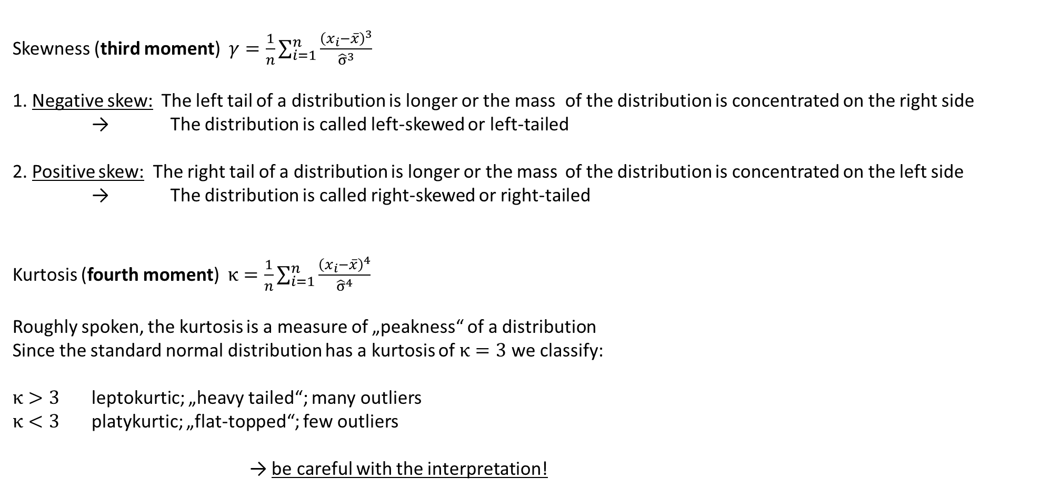
Skewness (third moment) $γ=\frac{1}{n}\sum_{i=1}^{n}{\frac{{\left(x_{i}−\overline{x}\right)}^{3}}{{\hat{σ}}^{3}}}$
1. Negative skew: The left tail of a distribution is longer or the mass of the distribution is concentrated on the right side
→ The distribution is called left-skewed or left-tailed
2. Positive skew: The right tail of a distribution is longer or the mass of the distribution is concentrated on the left side
→ The distribution is called right-skewed or right-tailed
Kurtosis (fourth moment) $κ=\frac{1}{n}\sum_{i=1}^{n}{\frac{{\left(x_{i}−\overline{x}\right)}^{4}}{{\hat{σ}}^{4}}}$
Roughly spoken, the kurtosis is a measure of „peakness“ of a distribution
Since the standard normal distribution has a kurtosis of $κ=3$ we classify:
$κ>3$ leptokurtic; „heavy tailed“; many outliers
$κ<3$ platykurtic; „flat-topped“; few outliers
→ be careful with the interpretation!
c

Slide 6

Concentration ratio
$\text{CR}\text{1}\text{=}\frac{x_{1}}{S_{n}}$ $x_{1}$: Revenue the largest firm, $S_{n}$: Total revenue of the whole sector
$\text{CR}\text{k}\text{=}\frac{{\sum_{j=1}^{k}{x}}_{j}}{S_{n} }$ k: Number of the k-th largest firms in the sector consisting of n firms.
The Herfindahl-Index is the sum of all squared market shares of competitors within a market:
$$\text{HI}\text{:=}\sum_{i=1}^{n}{a_{i}^{2}}$$
with $a_{i}\text{:}\text{=}\frac{x_{i}}{\sum_{j=1}^{n}{x_{j}}}$ Market share of the i-th firm within a market with n firms
c

Slide 7
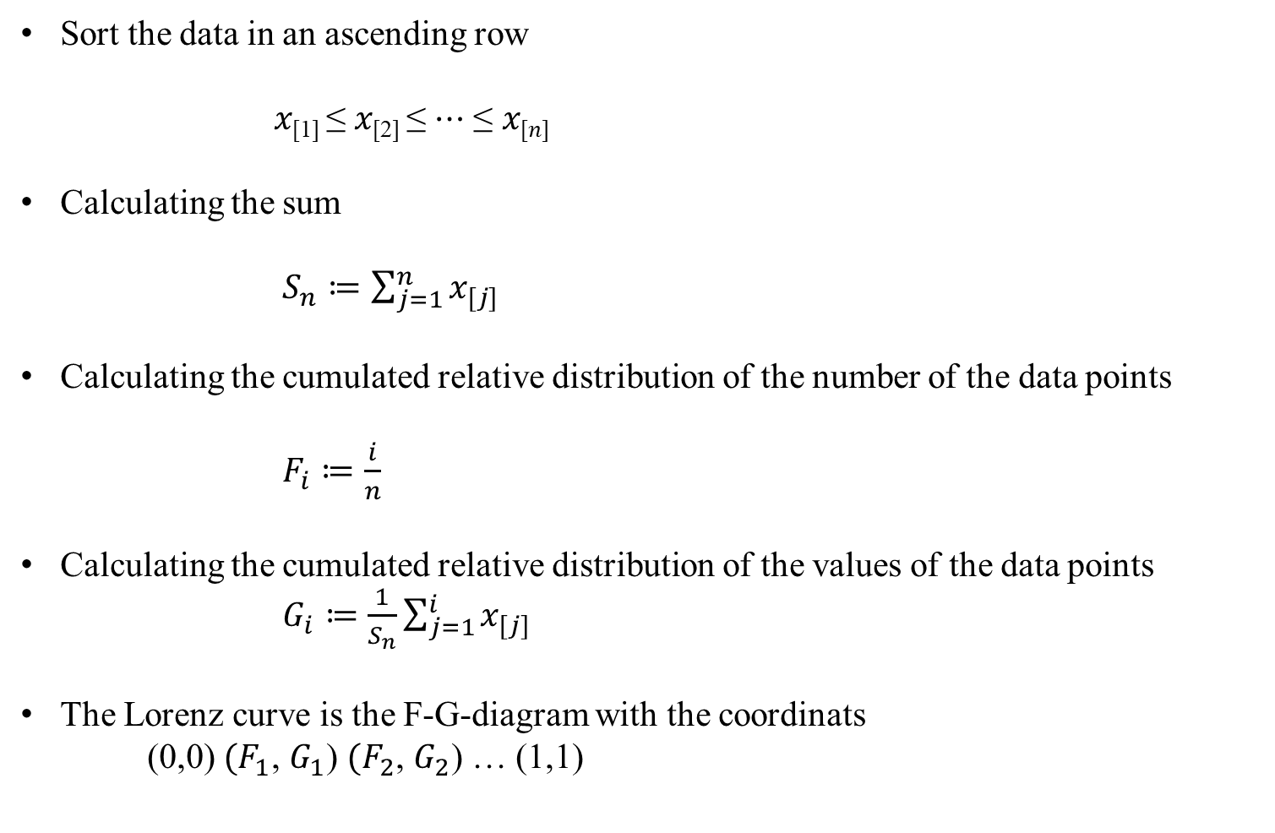
Calculating the Lorenz-curve
Sort the data in an ascending row
𝑥_{[1]} ≤ 𝑥_{[2]} ≤ ⋯ ≤ 𝑥_{[𝑛]}
Calculating the sum
$S_{n}≔\sum_{j=1}^{n}{x_{[j]}}$
Calculating the cumulated relative distribution of the number of the data points
$F_{i}≔\frac{i}{n}$
Calculating the cumulated relative distribution of the values of the data points
$G_{i}≔\frac{1}{S_{n}}\sum_{j=1}^{i}{x_{[j]}}$
The Lorenz curve is the F-G-diagram with the coordinats
(0,0) ${(F}_{1}$, $G_{1}$) ${(F}_{2}$, $G_{2}$) … (1,1)
c

Slide 8
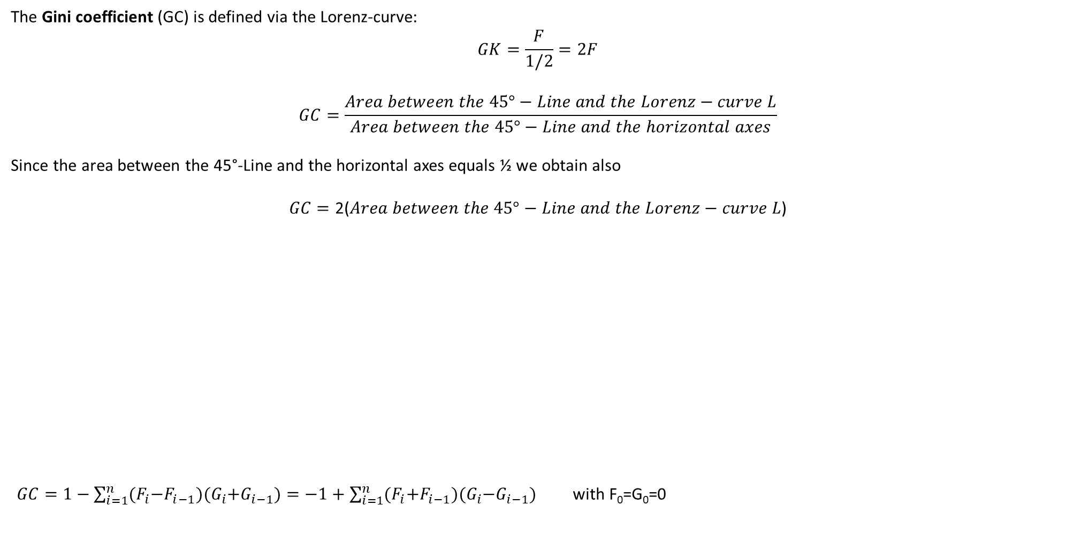
The Gini coefficient (GC) is defined via the Lorenz-curve:
$$GK=\frac{F}{1/2}=2F$$
$$GC=\frac{Area between the 45°−Line and the Lorenz−curve L}{Area between the 45°−Line and the horizontal axes}$$
Since the area between the 45°-Line and the horizontal axes equals ½ we obtain also
$$GC=\text{2(}Area between the 45°−Line and the Lorenz−curve L\text{)}$$
$GC=1−\sum_{i=1}^{n}{{(F}_{i}−F_{i−1}){(G}_{i}+G_{i−1})}=−1+\sum_{i=1}^{n}{{(F}_{i}+F_{i−1}){(G}_{i}−G_{i−1})}$ with F₀=G₀=0
100%
F
45°-Line
Gini-Coefficient = GC =
L
1/2
c
100%

Slide 9
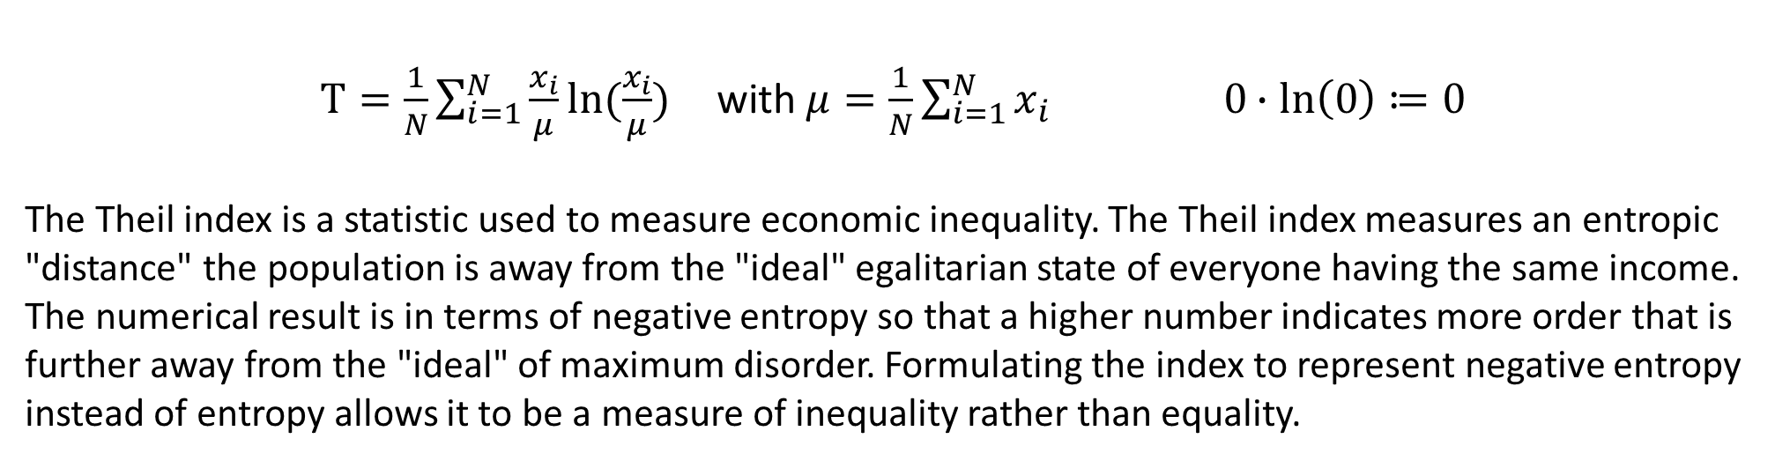
Theil-Index
$T=\frac{1}{N}\sum_{i=1}^{N}{\frac{x_{i}}{μ}ln⁡(\frac{x_{i}}{μ})}$ with $μ=\frac{1}{N}\sum_{i=1}^{N}{x_{i}} 0∙ln\left(0\right)≔0$
The Theil index is a statistic used to measure economic inequality. The Theil index measures an entropic "distance" the population is away from the "ideal" egalitarian state of everyone having the same income. The numerical result is in terms of negative entropy so that a higher number indicates more order that is further away from the "ideal" of maximum disorder. Formulating the index to represent negative entropy instead of entropy allows it to be a measure of inequality rather than equality.
Properties:
For the uniform distribution: T=0
For a distribution with maximum inequality: T=ln(N)
The Theil-Index is decomposable for subgroups of the distirbution
The Theil-Index is very sensitve to redristibutions form poor to rich
c

Slide 10
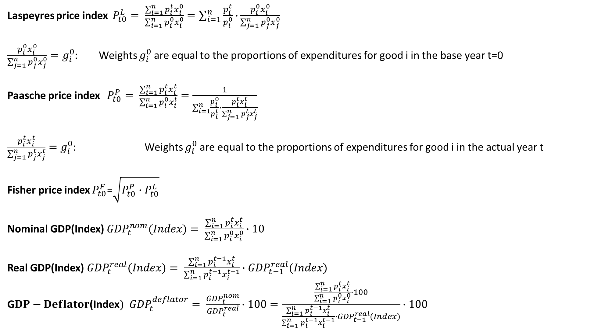
Laspeyres price index $P_{t0}^{L}= \frac{\sum_{i=1}^{n}{p_{i}^{t}x_{i}^{0}}}{\sum_{i=1}^{n}{p_{i}^{0}x_{i}^{0}}}=\sum_{i=1}^{n}{\frac{p_{i}^{t}}{p_{i}^{0}}∙}\frac{p_{i}^{0}x_{i}^{0}}{\sum_{j=1}^{n}{p_{j}^{0}x_{j}^{0}}}$
$\frac{p_{i}^{0}x_{i}^{0}}{\sum_{j=1}^{n}{p_{j}^{0}x_{j}^{0}}}=g_{i}^{0}$: Weights $g_{i}^{0}$are equal to the proportions of expenditures for good i in the base year t=0
Paasche price index $P_{t0}^{P}= \frac{\sum_{i=1}^{n}{p_{i}^{t}x_{i}^{t}}}{\sum_{i=1}^{n}{p_{i}^{0}x_{i}^{t}}}=\frac{1}{\sum_{i=1}^{n}{\frac{p_{i}^{0}}{p_{i}^{t}}∙}\frac{p_{i}^{t}x_{i}^{t}}{\sum_{j=1}^{n}{p_{j}^{t}x_{j}^{t}}}}$
$\frac{p_{i}^{t}x_{i}^{t}}{\sum_{j=1}^{n}{p_{j}^{t}x_{j}^{t}}}=g_{i}^{0}$: Weights $g_{i}^{0}$are equal to the proportions of expenditures for good i in the actual year t
Fisher price index $P_{t0}^{F}$=$\sqrt{P_{t0}^{P}{∙P}_{t0}^{L}}$
Nominal GDP(Index) ${GDP}_{t}^{nom}(Index)= \frac{\sum_{i=1}^{n}{p_{i}^{t}x_{i}^{t}}}{\sum_{i=1}^{n}{p_{i}^{0}x_{i}^{0}}}∙10$
Real GDP(Index) ${GDP}_{t}^{real}(Index)= \frac{\sum_{i=1}^{n}{p_{i}^{t−1}x_{i}^{t}}}{\sum_{i=1}^{n}{p_{i}^{t−1}x_{i}^{t−1}}}∙{GDP}_{t−1}^{real}(Index)$
G$DP−Deflator\text{(}\text{Index})$ ${GDP}_{t}^{deflator}= \frac{{GDP}_{t}^{nom}}{{GDP}_{t}^{real}}∙100=\frac{\frac{\sum_{i=1}^{n}{p_{i}^{t}x_{i}^{t}}}{\sum_{i=1}^{n}{p_{i}^{0}x_{i}^{0}}}∙100}{\frac{\sum_{i=1}^{n}{p_{i}^{t−1}x_{i}^{t}}}{\sum_{i=1}^{n}{p_{i}^{t−1}x_{i}^{t−1}}}∙{GDP}_{t−1}^{real}(Index)}∙100$
c

Slide 11

Simple forecast: Repeat the last data point
Moving average: ${\hat{y}}_{t+1}=\frac{1}{h}⋅\sum_{i=1}^{h}{y_{t−i+1}}$
Smoothing the data with the centered moving average (usually h → odd):
$${\hat{y}}_{t−(h−1)/2}=\frac{1}{h}⋅\sum_{i=1}^{h}{y_{t−i+1}}$$
Exponential smoothing: ${\hat{y}}_{t+1} = α y_{t} + \left(1−α\right) {\hat{y}}_{t}$ $(0≤α≤1$) ${\hat{y}}_{0}=y_{0}$
Average growth rate:
${y_{0}\left(1+g\right)}^{n}=y_{n}$ → $g={\left(\frac{y_{n}}{y_{0}}\right)}^{\frac{1}{n}}−1={\left(\frac{y_{n}}{y_{n−1}}∙\frac{y_{n−1}}{y_{n−2}}∙ .. . ∙\frac{y_{1}}{y_{0}}\right)}^{\frac{1}{n}}−1$
${\hat{y}}_{t+1}=(1+g)y_{n}$ or for $t=n+k$ ${\hat{y}}_{t+k}=y_{n}{\left(1+g\right)}^{k}$
Seasonality
c
Calculate in every year the proportions of q1, q2, … , q4 of the yearly data
Calculate the arithmetic mean for every single quater q1, q2, … , q4 over all years
Using the annual forecasted values, the averaged proportions can be used in order to generate quaterly forecasted data. For this, we use an annual forecast (i.e. average growth rate, exponential smoothing) and apply the averaged growth rates.

Slide 12
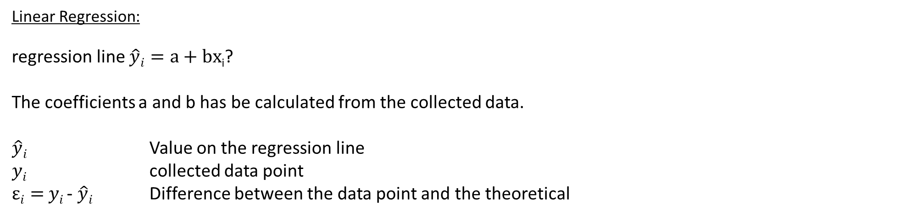
Linear Regression:
regression line $\hat{y}i=a+bx$_{i}?
The coefficients a and b has be calculated from the collected data.
$\hat{y}i$ Value on the regression line
$yi$ collected data point
$εi=$ $yi$- $\hat{y}i$ Difference between the data point and the theoretical
c

Slide 13
Correlation coefficient
c

Slide 14
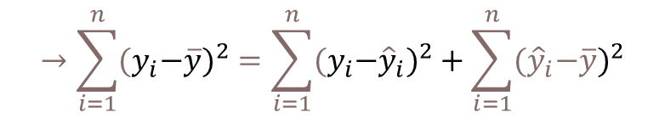




Correlation coefficient
Coefficiant of determination R²
{
${\hat{y}}_{i}−\overline{y}$ explained difference
Total Difference
} Non explained difference
} Explained difference
${y_{i}−\hat{y}}_{i}$ not explained difference
Mean
$y_{i}−\overline{y}$ total difference
$$→\sum_{i=1}^{n}{{{(y}_{i}−\overline{y})}^{2}}=\sum_{i=1}^{n}{{{{(y}_{i}−\hat{y}}_{i})}^{2}}+\sum_{i=1}^{n}{{{(\hat{y}}_{i}−\overline{y})}^{2}}$$
c
Non explained squared difference y_{i}
total squared difference
explained squared difference
Mean
not explained squared difference
explained squared difference y_{i}
Coefficiant of determination $R^{2}=\frac{\sum_{i=1}^{n}{{{(\hat{y}}_{i}−\overline{y})}^{2}}}{\sum_{i=1}^{n}{{{{(y}_{i}−\overline{y}}_{i})}^{2}}}$
Total squared difference of y_{i}

Slide 15
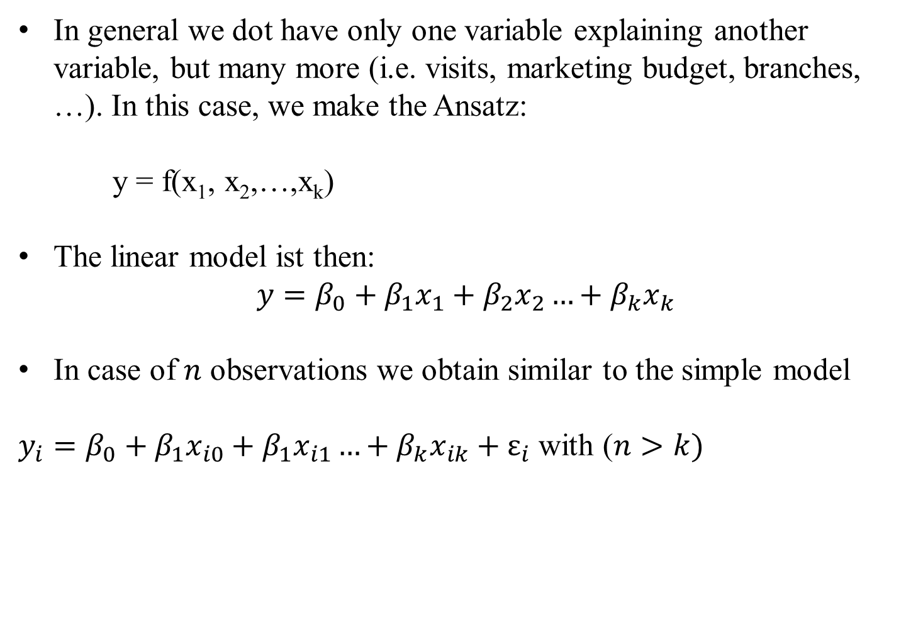
Multiple linear Regression
In general we dot have only one variable explaining another variable, but many more (i.e. visits, marketing budget, branches, …). In this case, we make the Ansatz:
y = f(x₁, x₂,…,x_{k})
The linear model ist then:
$$y=β_{0}+β_{1}x_{1}+β_{2}x_{2}…+β_{k}x_{k}$$
In case of $n$ observations we obtain similar to the simple model
$y_{i}=β_{0}+β_{1}x_{i0}+β_{1}x_{i1}…+β_{k}x_{ik}+ε_{i}$ with ($n>k)$
c

Slide 16

Multiple linear Regression: Matrix notation
c
Estimator for β:

Slide 17
Multiple linear Regression – Hypothesis-Testing – Assumptions
c

Slide 18
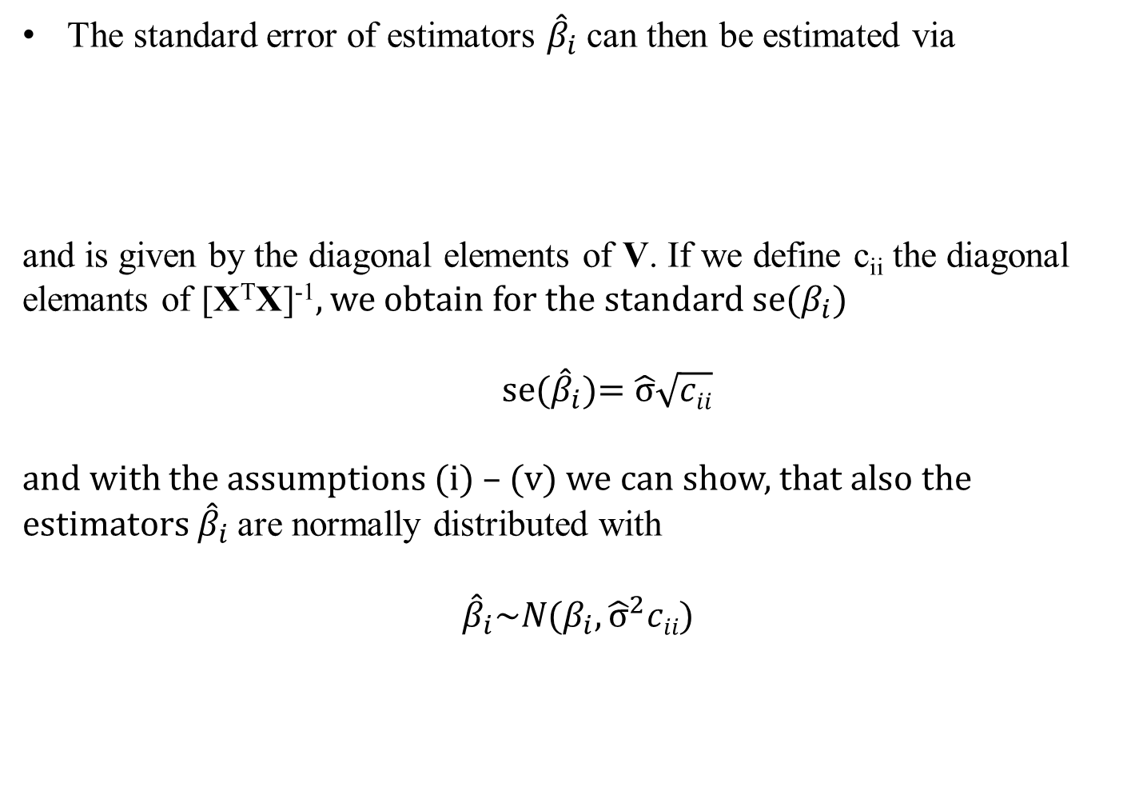
Multiple linear Regression – Standard error
The standard error of estimators ${\hat{β}}_{i}$ can then be estimated via
and is given by the diagonal elements of V. If we define c_{ii} the diagonal elemants of [X^{T}X]⁻¹, we obtain for the standard se($β_{i}$)
se(${\hat{β}}_{i}$)= $\hat{σ}\sqrt{cii}$
and with the assumptions (i) – (v) we can show, that also the estimators ${\hat{β}}_{i}$are normally distributed with
$${\hat{β}}_{i}\sim N(β_{i},{\hat{σ}}^{2}cii)$$
c

Slide 19
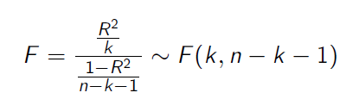

Multiple linear Regression – Hypothesis-Testing
With the assumptions and the derived properties we can calculate the following test statistics:
and
With F and T, we can make probability statements about the goodness of the estimators calculated from the multiple linear regression.
c

Slide 20
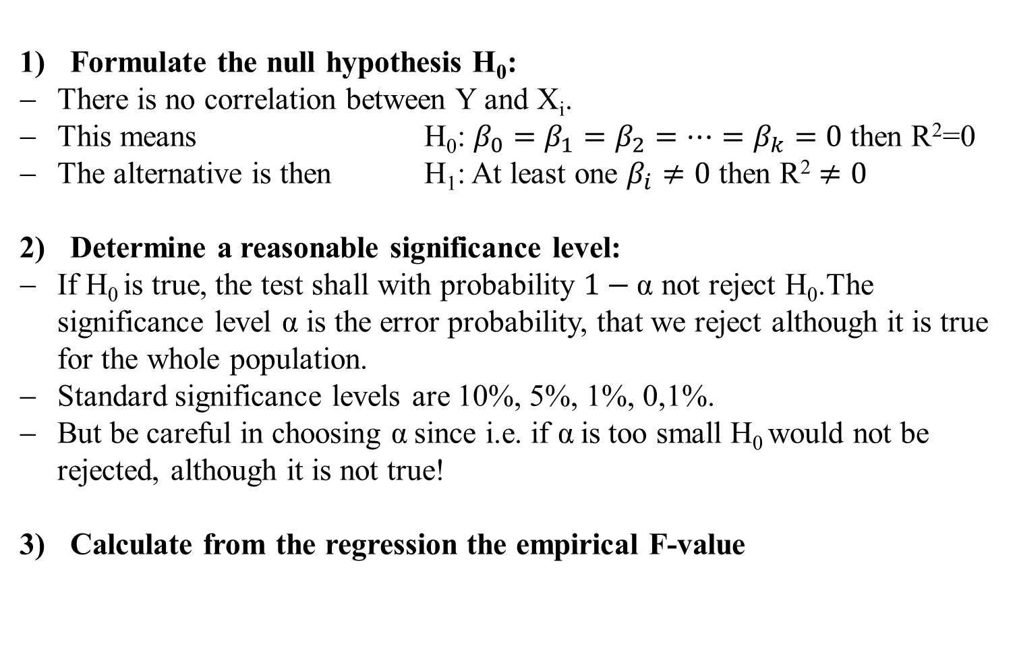
Multiple linear Regression – F-Test
Formulate the null hypothesis H₀:
There is no correlation between Y and X_{i}.
This means H₀: $β_{0}=β_{1}=β_{2}=…=β_{k}=0$ then R²=0
The alternative is then H₁: At least one $β_{i}≠0$ then $\text{R}\text{2}≠0$
Determine a reasonable significance level:
If H₀ is true, the test shall with probability $1−\text{α}$ not reject H₀.The significance level $\text{α}$ is the error probability, that we reject although it is true for the whole population.
Standard significance levels are 10%, 5%, 1%, 0,1%.
But be careful in choosing $\text{α}$since i.e. if $\text{α}$is too small H₀ would not be rejected, although it is not true!
Calculate from the regression the empirical F-value
c

Slide 21
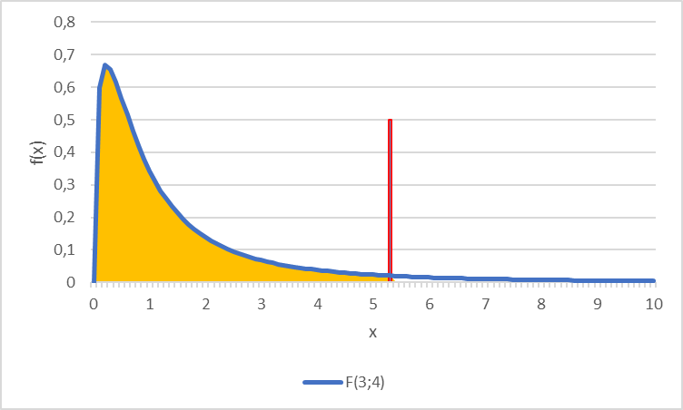
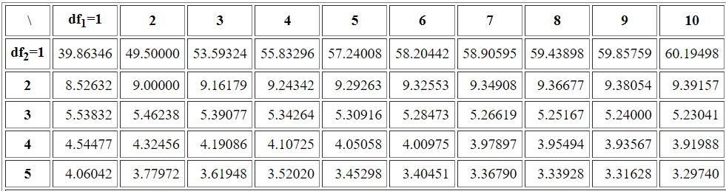

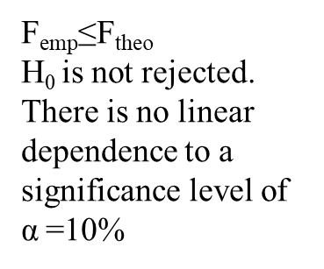
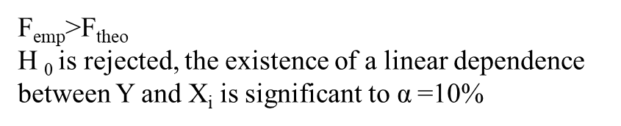

Multiple linear Regression – F-Test
Determine the theoretical F-value
Given the significance level the F-value represents the value for which for which the accumulated probability of an F-distributed variable equals $1−\text{α}$. i.e. in our example we have a
$F\left(k=3;n−k−1=8−3−1=4\right)=F(3,4)$ distribution and thus $F\text{9}\text{0}\text{\%}=5,34$
Compare theoretical and empirical F-value
F_{emp}>F_{theo}
H ₀ is rejected, the existence of a linear dependence between Y and X_{i} is significant to $\text{α}$=10%
F_{emp}≤F_{theo}
H₀ is not rejected. There is no linear dependence to a significance level of $\text{α}$=10%
$$F\text{9}\text{0}\text{\%}=5,34$$
90%
c
Table F-Distribution

Slide 22
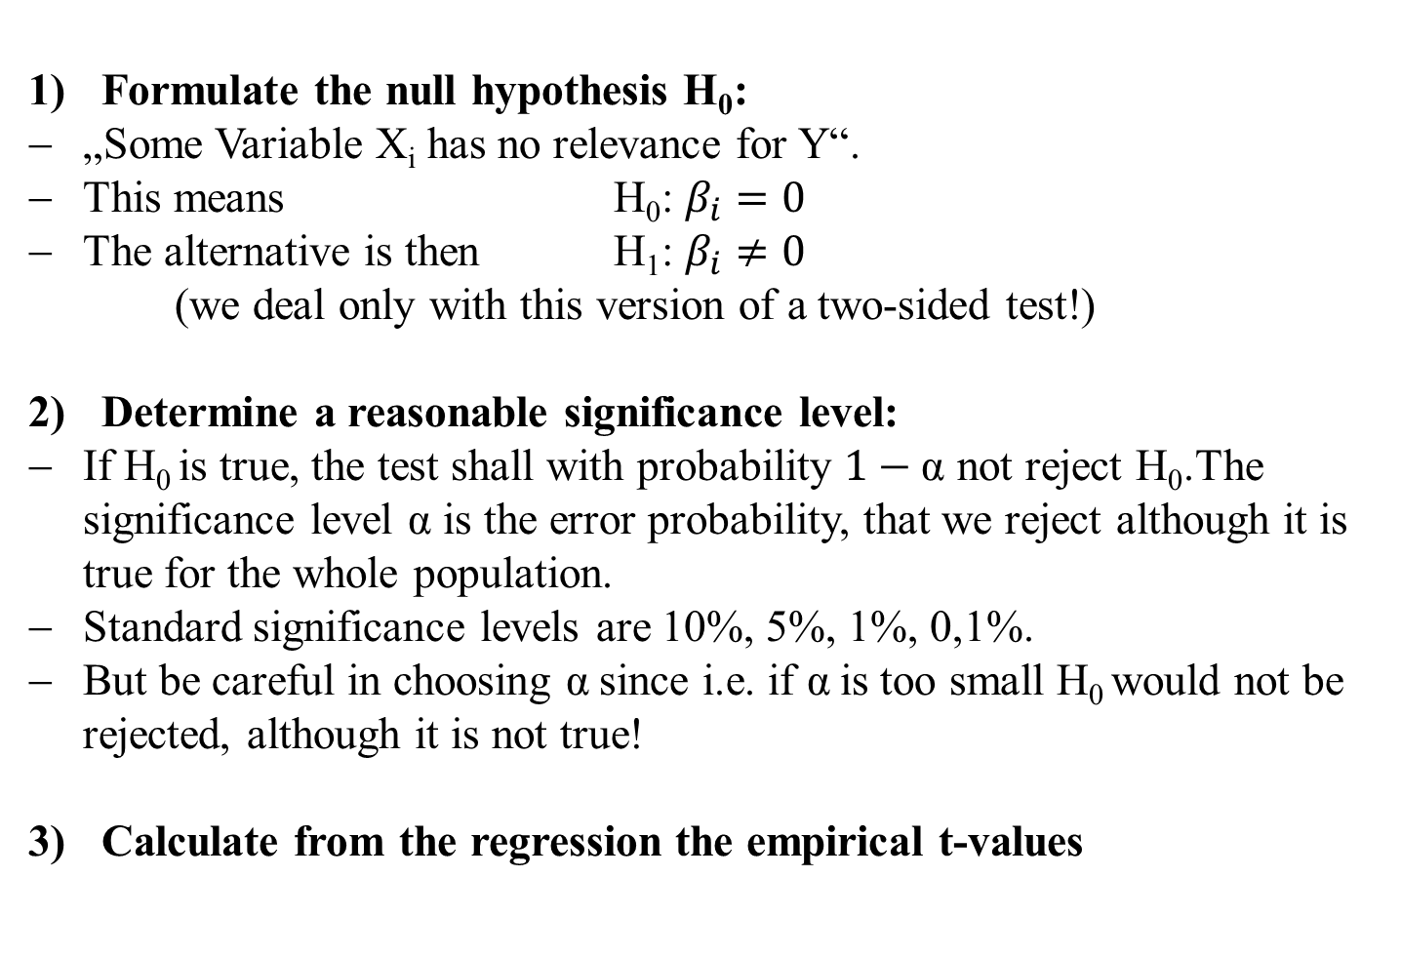
Multiple linear Regression – t-Test
Formulate the null hypothesis H₀:
„Some Variable X_{i} has no relevance for Y“.
This means H₀: $β_{i}=0$
The alternative is then H₁: $β_{i}≠0$
(we deal only with this version of a two-sided test!)
Determine a reasonable significance level:
If H₀ is true, the test shall with probability $1−\text{α}$ not reject H₀.The significance level $\text{α}$ is the error probability, that we reject although it is true for the whole population.
Standard significance levels are 10%, 5%, 1%, 0,1%.
But be careful in choosing $\text{α}$since i.e. if $\text{α}$is too small H₀ would not be rejected, although it is not true!
Calculate from the regression the empirical t-values
c

Slide 23
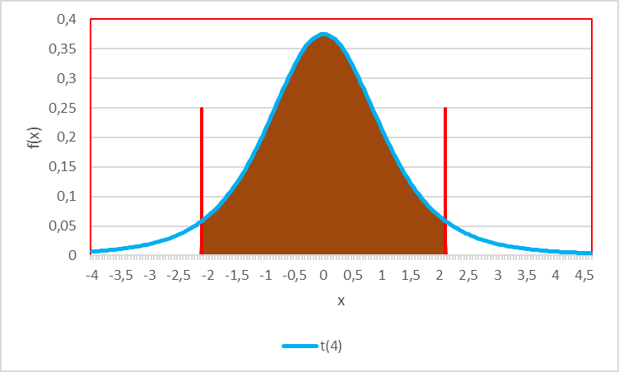


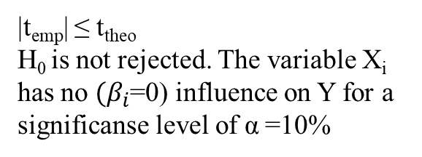
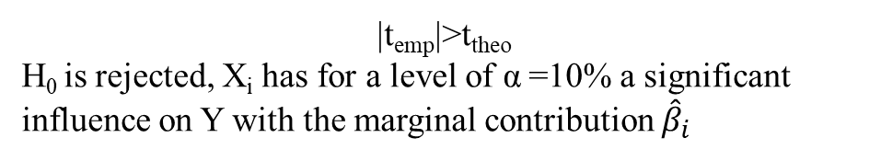

Multiple linear Regression – t-Test
Determine the theoretical t-value
Given the significance level the t-value represents the value for which for which the accumulated probability of an F-distributed variable equals $1−\text{α}$. i.e. in our example we have a t$\left(n−k−1=8−3−1=4\right)=t(4)$ distribution and thus $t\text{9}\text{5}\text{\%}=2,13$
Compare theoretical and empirical F-value
|t_{emp}| ≤ t_{theo}
H₀ is not rejected. The variable X_{i} has no $(β_{i}$=0) influence on Y for a significanse level of $\text{α}$=10%
$$t\text{5}\text{\%}=−2,13$$
$$t\text{9}\text{5}\text{\%}=2,13$$
90%
c
|t_{emp}|>t_{theo}
H₀ is rejected, X_{i} has for a level of $\text{α}$=10% a significant influence on Y with the marginal contribution ${\hat{β}}_{i}$

Slide 24
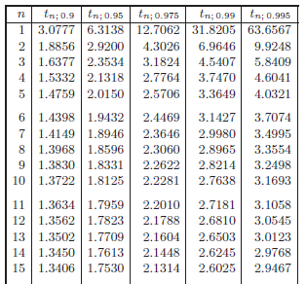
^{T-distribution}
c

Slide 25
F_{95%}
^{F-distribution}
F_{99%}
c

