Slide 1


Statistics B
Wilhelmshaven
This lecture will be recorded and
subsequently uploaded in the
world-wide-web
Function translator (webpage)
Function translator Excel 1 (add in)
c
Prof. Dr. Bernhard Köster
Jade-Hochschule Wilhelmshaven
http://www.bernhardkoester.de/vorlesungen/inhalt.html

Slide 2

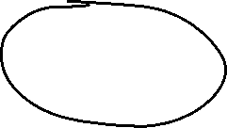
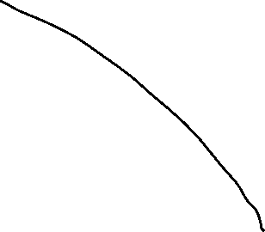
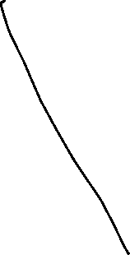



Price-indices
Within a market sector or consumption or even in the total economy, often we want to know, who prices in general have changed.
Problem:
Usually the prices of some goods are changing, while other prices stay constant
→ Question: How has the price level in a sector changed?
→ Solution: Aggregation of the single price changes to index, but how?
c

Slide 3








Example
Change in the price level of consumption
Calculate the average price of 2015 and 2016
Calculate the total consumption in 2015 and 2016
Do the changes of these numbers represent the change in price level?
 | Cinema |  | Book |  | Jeans
 | Price | Quantity | Price | Quantity | Price | Quantity
2015 | 11 | 4 | 10 | 10 | 33 | 2
2016 | 8 | 8 | 18 | 4 | 29 | 3
c

Slide 4















Example
Change in the price level of consumption
Average price: $\overline{P}\left(2015\right)=\frac{11+10+33}{3}=18,0$
$\overline{P}\left(2016\right)=\frac{8+18+29}{3}=18,\overline{3}$
→ $\frac{18,\overline{3}}{18}=1,019$ → 1,9% change in price level for consumption ?
Total consumption: $K\left(2015\right)=11∙4+10∙10+33∙2=210$
$K\left(2016\right)=8∙8+18∙4+29∙3=223$
→ $\frac{223}{210}=1,062$ → 6,2% change in price level for consumption ?
 | Cinema |  | Book |  | Jeans
 | Price | Quantity | Price | Quantity | Price | Quantity
2015 | 11 | 4 | 10 | 10 | 33 | 2
2016 | 8 | 8 | 18 | 4 | 29 | 3
c

Slide 5
Changes in price level I
What is the price of te basket of 2015 in the year 2016?
Compare this with the price of the basket in in year 2015
c

Slide 6

Changes in price level I
What is the price of te basket of 2015 in the year 2016?
$\sum_{i=1}^{3}{p_{i}^{2016}x_{i}^{2015}=}$ $8∙4+18∙10+29∙2=270$
→ Compare the basket of a base with respect to prices in different years
$\sum_{i=1}^{3}{p_{i}^{2015}x_{i}^{2015}=}$ $11∙4+10∙10+33∙2=210$
→ $\frac{270}{210}=1,286$ → Increase of price level by 28,6%
c

Slide 7
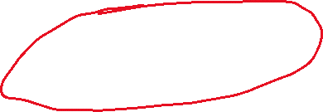


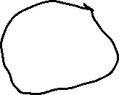

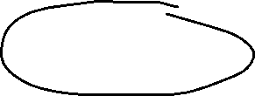



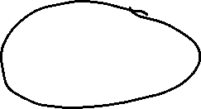








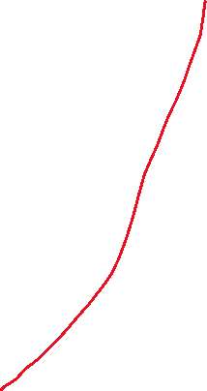






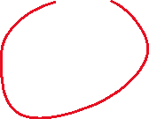










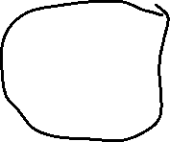


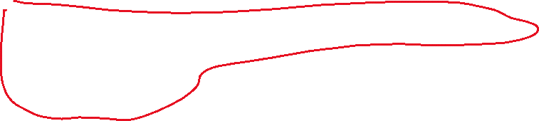

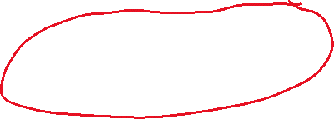
Laspeyres price index
$$P_{t0}^{L}= \frac{\sum_{i=1}^{n}{p_{i}^{t}x_{i}^{0}}}{\sum_{i=1}^{n}{p_{i}^{0}x_{i}^{0}}}=\sum_{i=1}^{n}{\frac{p_{i}^{t}}{p_{i}^{0}}∙}\frac{p_{i}^{0}x_{i}^{0}}{\sum_{j=1}^{n}{p_{j}^{0}x_{j}^{0}}}$$
$\frac{p_{i}^{0}x_{i}^{0}}{\sum_{j=1}^{n}{p_{j}^{0}x_{j}^{0}}}=g_{i}^{0}$: Weights $g_{i}^{0}$are equal to the proportions of expenditures for good i in the base year t=0
The Laspeyres price index is therefore a weighted arithmetic mean of the relative prices $\frac{p_{i}^{t}}{p_{i}^{0}}$.
Usually we calculate inflation following this method
→ HICP!
c

Slide 8
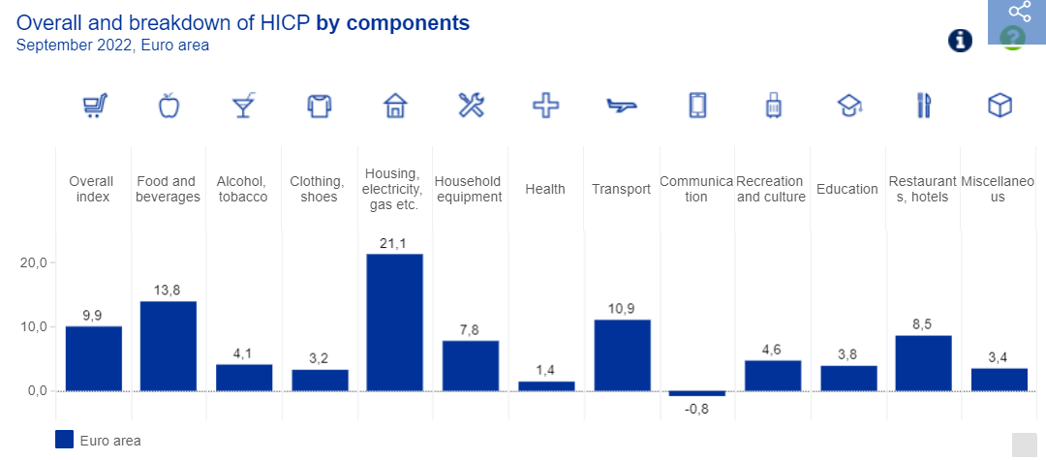
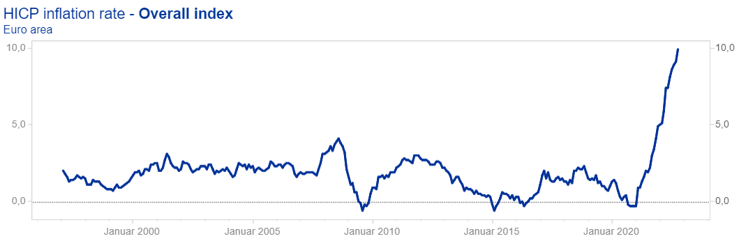



Measuring inflation – the Harmonised Index of Consumer Prices (HICP)
https://www.ecb.europa.eu/stats/macroeconomic_and_sectoral/hicp/html/index.en.html
c

Slide 9
Changes in price level II
What are the costs of the basket of year 2016 with prices of 2015?
Compare this with the price of the basket in in year 2016
c

Slide 10


Changes in price level II
What are the costs of the basket of year 2016 with prices of 2015?
$\sum_{i=1}^{3}{p_{i}^{2015}x_{i}^{2016}=}$ $11∙8+10∙4+33∙3=227$
→ Compare the actual basket valued with actual prices and prices of the year before.
$\sum_{i=1}^{3}{p_{i}^{2016}x_{i}^{2016}=}$ $8∙8+18∙4+29∙3=223$
→ $\frac{223}{227}=0,982$ → price level decrease of 1,8%
c

Slide 11

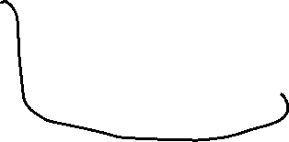



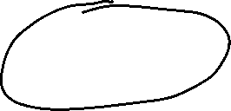


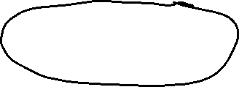






















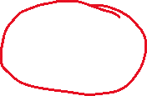
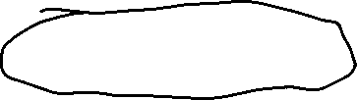

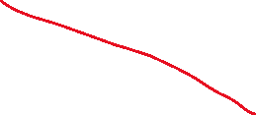

Paasche price index
$$P_{t0}^{P}= \frac{\sum_{i=1}^{n}{p_{i}^{t}x_{i}^{t}}}{\sum_{i=1}^{n}{p_{i}^{0}x_{i}^{t}}}=\frac{1}{\sum_{i=1}^{n}{\frac{p_{i}^{0}}{p_{i}^{t}}∙}\frac{p_{i}^{t}x_{i}^{t}}{\sum_{j=1}^{n}{p_{j}^{t}x_{j}^{t}}}}$$
$\frac{p_{i}^{t}x_{i}^{t}}{\sum_{j=1}^{n}{p_{j}^{t}x_{j}^{t}}}=g_{i}^{0}$: Weights $g_{i}^{0}$are equal to the proportions of expenditures for good i in the actual year t
The Paasche Price index is a weighted harmonic mean of the relative prices $\frac{p_{i}^{t}}{p_{i}^{0}}$.
Usually the Paasche price index is used for the price
adjustment for GDP in order to obtain real GDP growth
→ GDP-Deflator
c

Slide 12













Different averages
c

Slide 13








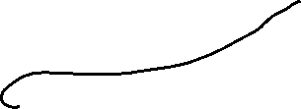









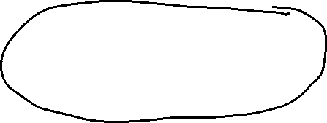





Fundamental problems: Price level measurement
Substitution effect: Quantity of consumption or demand in general depends on prices.
New goods
Quality change of goods
$P_{t0}^{P}<P_{t0}^{L}$ if $\frac{p_{i}^{t}}{p_{i}^{0}}$ and $\frac{x_{i}^{t}}{x_{i}^{0}}$ negatively correlated assuming the usual behavior of consumption
  Laspeyres index overestimates in general the price level increase
  Paasche index underestimates in general the price level increase
c

Slide 14




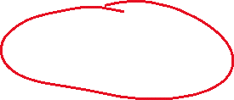



Fisher Price index
$P_{t0}^{P}$=$\sqrt{P_{t0}^{P}{∙P}_{t0}^{L}}$
The Fisher-Index is the geometric mean of Laspeyres- and Paasche-Index.
Example: $P_{t0}^{P}$=$\sqrt{\frac{223}{227}∙\frac{270}{210}}=\sqrt{0,982∙1,286}=1,263$
The Fisher-Index is used for the price adjustment of GDP in the USA
  In general, one has to be careful to compare real variables (i.e. economic growth) if different methods of price adjustement are used!
c

Slide 15


Chain-index
Until now, we always used a base year t=0 → thus, we reset the base year usually every 5 years (i.e. consumer price index cpi)
Problem: economic behaviour is changing over time. If the base year is to far behind in history, the calculation does not reflect the current situation in the right way.
This problem is tackled via a chain index:
  → real GDP is calculated by multiplying the current produced quantities with the prices of the former period.
    Reducing the substitution effects
    With a fixed base year, every time the base year is adjusted all growth rates in history has to be changed → the time series is not stable
c

Slide 16





Nominal and real GDP − GDP-Deflator
Der GDP-Deflator is defined as an Paasche-Chainindex
$${BIP−Deflator}_{t}= \frac{{BIP}_{t}^{nom}}{{BIP}_{t}^{real}}100= \frac{{BIP}_{t}^{nom}(Index)}{{BIP}_{t}^{real}(Index)}100$$
c

Slide 17

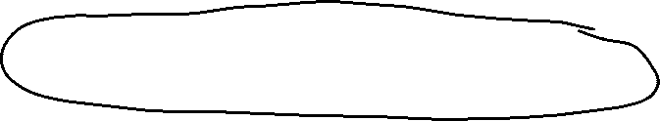















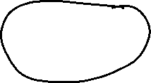




Nominal and real GDP − GDP-Deflator
Nominal GDP(Index)
$${GDP}_{t}^{nom}(Index)= \frac{Quantity\left(t\right)∙Price(t)}{Quantity\left(0\right)∙Price(0)}∙100$$
$${GDP}_{t}^{nom}(Index)= \frac{\sum_{i=1}^{n}{p_{i}^{t}x_{i}^{t}}}{\sum_{i=1}^{n}{p_{i}^{0}x_{i}^{0}}}∙100$$
Real GDP(Index)
$${GDP}_{t}^{real}(Index)= \frac{Quantity\left(t\right)∙Price(t−1)}{Quantity\left(t−1\right)∙Price(t−1)}∙{GDP}_{t−1}^{real}(Index)$$
$${GDP}_{t}^{real}(Index)= \frac{\sum_{i=1}^{n}{p_{i}^{t−1}x_{i}^{t}}}{\sum_{i=1}^{n}{p_{i}^{t−1}x_{i}^{t−1}}}∙{GDP}_{t−1}^{real}(Index)$$
c

Slide 18
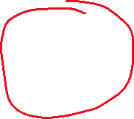

GDP-Deflator
$${GDP}_{t}^{deflator}= \frac{{GDP}_{t}^{nom}}{{GDP}_{t}^{real}}∙100=\frac{\frac{\sum_{i=1}^{n}{p_{i}^{t}x_{i}^{t}}}{\sum_{i=1}^{n}{p_{i}^{0}x_{i}^{0}}}∙100}{\frac{\sum_{i=1}^{n}{p_{i}^{t−1}x_{i}^{t}}}{\sum_{i=1}^{n}{p_{i}^{t−1}x_{i}^{t−1}}}∙{GDP}_{t−1}^{real}(Index)}∙100$$
c

Slide 19
Example GDP-Deflator
 | Private Consumption |  | Government Consumption |  | Gross Investment |  | Exports |  | Imports |  | Nominal GDP | Real GDP | GDP Defla- tor
 | P | Q | P | Q | P | Q | P | Q | P | Q
2018 | 1,1 | 10 | 1 | 3 | 0,9 | 3 | 1 | 12 | 1,1 | 10
2019 | 1,2 | 11 | 1,05 | 3,5 | 0,95 | 4 | 1,2 | 13 | 1,2 | 12
2020 | 1,25 | 8 | 1,1 | 5 | 1 | 3,5 | 1 | 10 | 1 | 9
2021 | 1,2 | 10 | 1,2 | 5,5 | 1,05 | 3,5 | 1,05 | 11 | 1,1 | 10
Calculate the growth rate of GDP-Deflator 2019-2021
Calculate the average growth rate of GDP-Deflator p.a.
c

Slide 20
Example
 | A |  | B
 | P | Q | P | Q
2018 | 2 | 20 | 3 | 2
2019 | 2,5 | 15 | 1,8 | 6
Calculate the Laspeyres, Paasche and Fisher Index
c

Slide 21
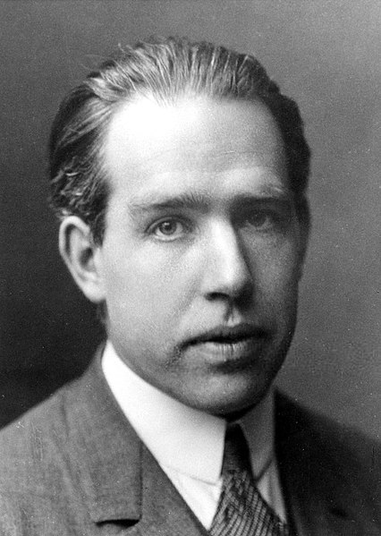
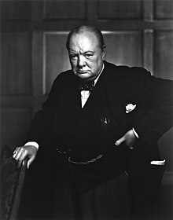

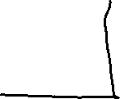

Forecasting
“Prediction is very difficult, especially if it’s about the future!”
Nils Bohr (1885 – 1962, Nobel Laureate 1922 in Physics)
Source: The American Institute of Physics
“Do not believe any statistic that you haven't forged yourself“
Winston Chruchill (1874 – 1965, UK Prime Minister)
c
Source: Library and Archives Canada

Slide 22
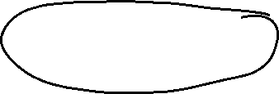
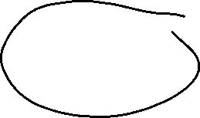
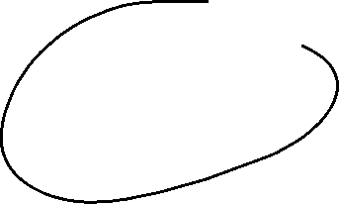
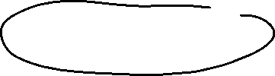


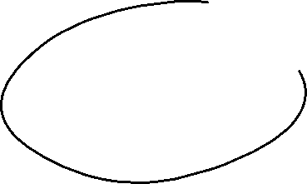



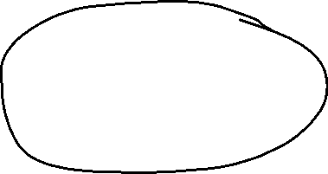
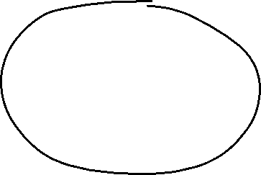

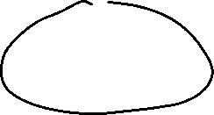
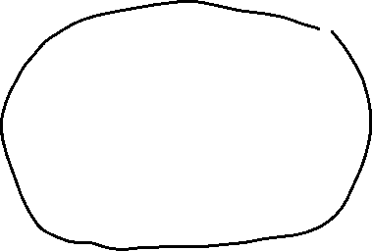
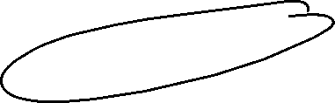
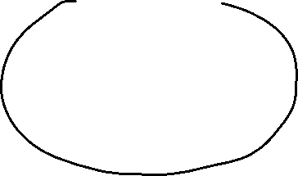

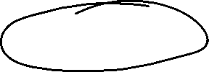
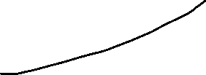

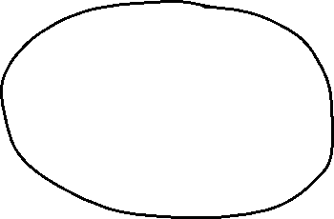


Components of a Time Series
Revenue, Quantity
Development of Demand over time
Business cycle
c
Seasonal fluctuation during a year
Not explainable
random fluctuation
Stochastic error

Slide 23
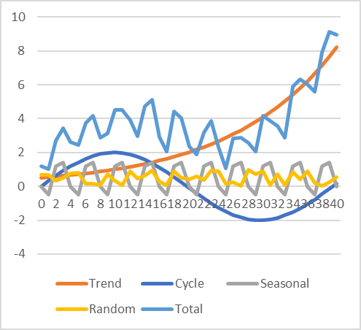
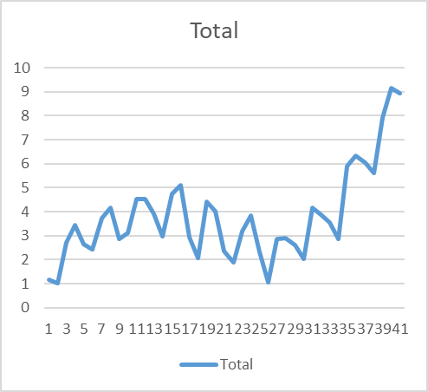
Exercise
Create a time series composite of a trend, cyclical, seasonal and random data
c

Slide 24
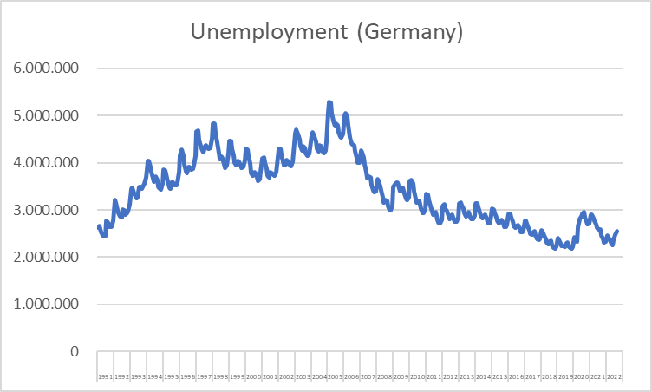
Example: Unemployment data
c
Source: BA

Slide 25
Forecasting
Enterprise A has the following development of revenue during the last years
Frequency: Quaterly data
Task: Forecast the revenue of the next quarter and the next year
Quarter | Revenue [Mio. Euro] | Quarter | Revenue [Mio. Euro]
2018q1 | 330 | 2021q1 | 378
2018q2 | 345 | 2021q2 | 405
2018q3 | 390 | 2021q3 | 498
2018q4 | 354 | 2021q4 | 420
2019q1 | 345 | 2022q1 | 429
2019q2 | 357 | 2022q2 | 495
2019q3 | 420 | 2022q3 | 540
2019q4 | 360 | 2022q4 | 510
2020q1 | 366
2020q2 | 390
2020q3 | 468
2020q4 | 402
c

Slide 26
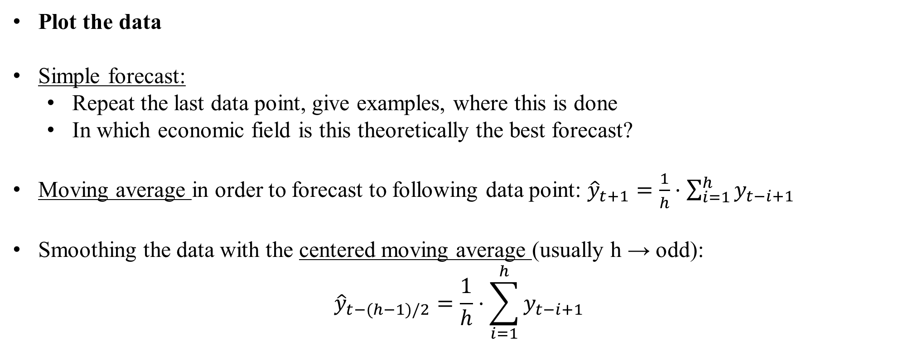
Forecasting
Plot the data
Simple forecast:
  Repeat the last data point, give examples, where this is done
  In which economic field is this theoretically the best forecast?
Moving average in order to forecast to following data point: ${\hat{y}}_{t+1}=\frac{1}{h}⋅\sum_{i=1}^{h}{y_{t−i+1}}$
Smoothing the data with the centered moving average (usually h → odd):
$${\hat{y}}_{t−(h−1)/2}=\frac{1}{h}⋅\sum_{i=1}^{h}{y_{t−i+1}}$$
c

Slide 27
Forecasting
Calculate the moving average in order to forecast the revenue for 2023q1 n=1,3,5,7
Calculate the centered moving average for n=1,3,5,7 an plot the data compared to the original data
Why do we show the data of daily confirmed new cases of Corona with a 7-days moving average?
c

Slide 28
Forecasting with moving average
Properties of moving average data:
  Smoothing original data
  Underestimating within an increasing trend of the data
  Overestimating within an decreasing trend of the data
  No incorporation seasonality effects
    Useful for short-term forecasts
c

Slide 29
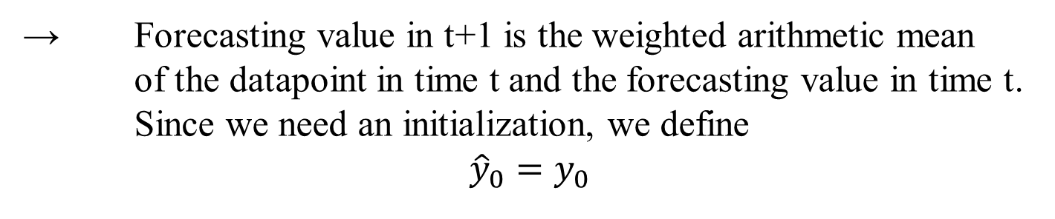
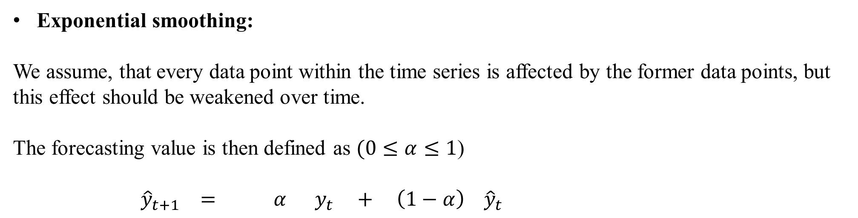
Forecasting
Exponential smoothing:
We assume, that every data point within the time series is affected by the former data points, but this effect should be weakened over time.
The forecasting value is then defined as $(0≤α≤1$)
${\hat{y}}_{t+1} = α y_{t} + \left(1−α\right) {\hat{y}}_{t}$
Forecasting value in t+1
Data point in t
Forecasting value in t
c
→ Forecasting value in t+1 is the weighted arithmetic mean of the datapoint in time t and the forecasting value in time t. Since we need an initialization, we define
$${\hat{y}}_{0}=y_{0}$$

Slide 30
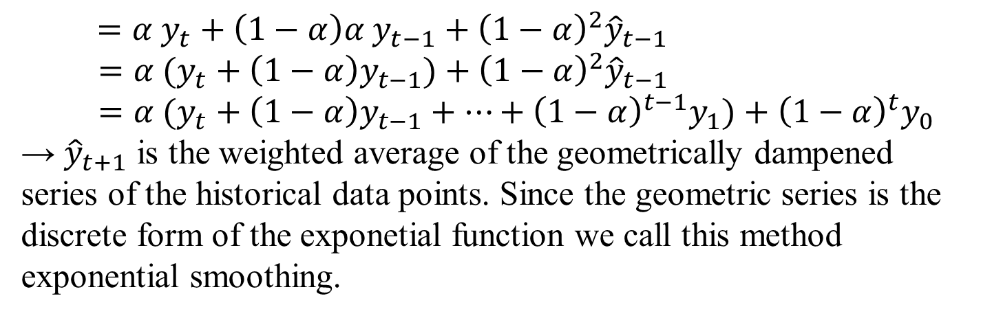

Exponential smoothing
Another view: ${\hat{y}}_{t+1}=α y_{t}+\left(1−α\right){\hat{y}}_{t}=α y_{t}+{\hat{y}}_{t}−α{\hat{y}}_{t}={\hat{y}}_{t}+{α(y_{t}−\hat{y}}_{t})$
→ Forecasting value in time t+1 is the former forecasting value corrected by the forecasting error of the former period ${(y_{t}−\hat{y}}_{t})$ weighted with parameter $α$.
Why exponetial smoothing?
Iterating the definition we obtain:
${\hat{y}}_{t+1}=α y_{t}+\left(1−α\right){\hat{y}}_{t}=α y_{t}+\left(1−α\right)[\left(α y_{t−1}+\left(1−α\right){\hat{y}}_{t−1}\right)]$
$=α y_{t}+\left(1−α\right)α y_{t−1}+{\left(1−α\right)}^{2}{\hat{y}}_{t−1}$
$=α (y_{t}+\left(1−α\right)y_{t−1})+{\left(1−α\right)}^{2}{\hat{y}}_{t−1}$
$=α (y_{t}+\left(1−α\right)y_{t−1}+…+{\left(1−α\right)}^{t−1}y_{1})+{\left(1−α\right)}^{t}y_{0}$
→ ${\hat{y}}_{t+1}$ is the weighted average of the geometrically dampened series of the historical data points. Since the geometric series is the discrete form of the exponetial function we call this method exponential smoothing.
c

Slide 31

Exponential smoothing
Interpretation of $α:$
$${\hat{y}}_{t+1}=α y_{t}+\left(1−α\right){\hat{y}}_{t}$$
$α ∈[0,1]$ is the weighting of the convex mixture (compare utility in microeconomics!) of the data point and the former forecasting value
High $α$ means only a slight smoothing and a high relevance of latest data points.
low $α$ means a strong smoothing and a high relevance of older data points.
c

Slide 32

Exponential smoothing
Calculate the exponential smoothing of the time series with $α=0,3$ and $α=0,8$including the forecasting values of 2023q1… q4
What kind of series do we obtain with $α=0$?
Calculate the revenues per year an redo the exponential smoothing for the yearly data.
Plot all your results compared to the original time series
c

Slide 33

Forecasting with exponetial smoothing
Properties and applications of exponetial smoothing and applications:
  Mainly usable if data has no clear trend or has random character
  Often used for short term forecasts
  Choosing a „good“$α$ might be complicated
  Current data can be better incorporated into the forecast compared to a classical averaging process
c

Slide 34
Average growth rate
In many economic models, we assume some kind of growth processes. Therefore we often calculate the average growth rate.
This growth rate is assumed to represent a general trend of a time series and is therefore used to continue the data
Intuitively often only the arithmetic mean of growth rates is used, but this is wrong. Consider the following example:
Jahr | Stock price A | Growth rate | Stock price B | Growth rate
2019 | 5 | -- | 5 | --
2020 | 10 |  | 7,5
2021 | 10 |  | 11,25
Arithmetic Mean
c

Slide 35


Average growth rate
Suppose, we have a time series $y_{0}$, $y_{1}$, … $y_{n}$ then, the average growth rate is calculated via the consideration that we ask: Which constant growth rate over time do we need that
$${y_{0}\left(1+g\right)}^{n}=y_{n}$$
→ $g={\left(\frac{y_{n}}{y_{0}}\right)}^{\frac{1}{n}}−1={\left(\frac{y_{n}}{y_{n−1}}∙\frac{y_{n−1}}{y_{n−2}}∙ .. . ∙\frac{y_{1}}{y_{0}}\right)}^{\frac{1}{n}}−1$
→ The average growth factor (1 + growth rate) is the geometric mean of the growth factors of every period.
c
The forecasting value in time $t=n+1$ is then calculated by
$${\hat{y}}_{t+1}=(1+g)y_{n}$$
or for $t=n+k$
$${\hat{y}}_{t+k}=y_{n}{\left(1+g\right)}^{k}$$

Slide 36
Average growth rate
Calculate via the quaterly average growth rate the forecasting values of 2023q1-q4
Calculate the historical „trended“ data by applying the average quaterly average growth rate starting with the revenue of 2018q1
Calculate the aggregate revenue per year and calculate subsequently via the annual growth rate the forecasting value of the year 2023. Compare this result with the value for 2023 you obtain by aggregation of the quaterly data calculated in (a)
c

Slide 37
Average growth rate
Properties and applications of Average growth rate:
  For data with a clear trend, this method is applicable for long-term forecasts
  Since the method is very easy to calculate, it is often used for a „first“ estimation
  This method ignors outliers in the middle of the time series
  Very sensitive if the first or the last data point is an outlier!
c

Slide 38
Seasonality
Within a year economic data shows often periodic patterns due to the weather cycle or economic cylces
Distinguishing between seasonly adjusted data and trend data can improve the forecast
The component of seasonality can be simply calculated via the proportions of the (monthly) quaterly data relative to the annual data.
In general seasonaly adjusted data is calculated via more advanced filter methods.
The world-wide standard method for economic time series is X13 developed by the U.S. Census Bureau
c

Slide 39
Seasonality
Calculate in every year the proportions of q1, q2, … , q4 of the yearly data
Calculate the arithmetic mean for every single quater q1, q2, … , q4 over all years
Using the annual forecasted values, the averaged proportions can be used in order to generate quaterly forecasted data. For this, we use an annual forecast (i.e. average growth rate, exponential smoothing) and apply the averaged growth rates.
c

