Slide 1

Statistics B
Wilhelmshaven
This lecture will be recorded and
subsequently uploaded in the
world-wide-web
Function translator (webpage)
Function translator Excel 1 (add in)
c
Prof. Dr. Bernhard Köster
Jade-Hochschule Wilhelmshaven
http://www.bernhardkoester.de/vorlesungen/inhalt.html

Slide 2







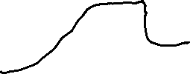

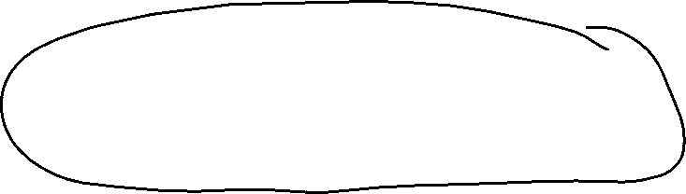
Inequlity Metrics
Definition:
Within a random sample, it is possible, that we have an unequal distribution.
This inequality can be measured in an absolute or relative way:
Examples:
Income distribution or distribution of wealth
  The poorest 10% of the population receive 1% of national income
  The richest 10% of the population receive 25% of national income
Market structure (Polypol – Oligopol – Monopol)
  Number of suppliers
  Market share
c

Slide 3




Concentration ratio
Definition:
The concentration ratio (CR) is the sum of the percentage market shares of a pre-specified number of the largest firms in an industry.
Example
The three largest firms have a market share of 90%.
c

Slide 4

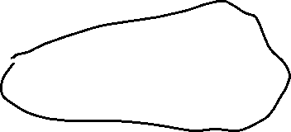



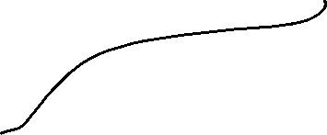




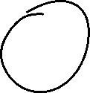




Concentration ratio
$\text{CR}\text{1}\text{=}\frac{x_{1}}{S_{n}}$ $x_{1}$: Revenue the largest firm, $S_{n}$: Total revenue of the whole sector
$\text{CR}\text{k}\text{=}\frac{{\sum_{j=1}^{k}{x}}_{j}}{S_{n} }$ k: Number of the k-th largest firms in the sector consisting of n firms.
c

Slide 5




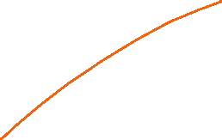





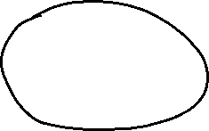
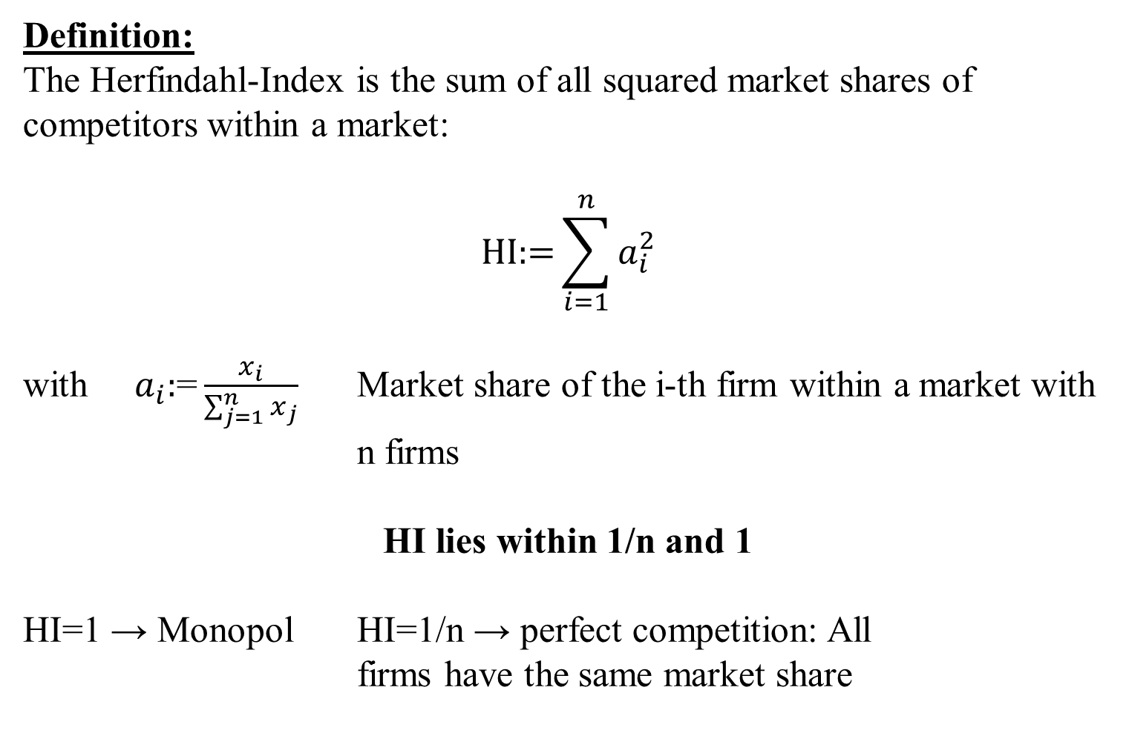







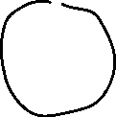








Herfindahl-Index
Definition:
The Herfindahl-Index is the sum of all squared market shares of competitors within a market:
$$\text{HI}\text{:=}\sum_{i=1}^{n}{a_{i}^{2}}$$
with $a_{i}\text{:}\text{=}\frac{x_{i}}{\sum_{j=1}^{n}{x_{j}}}$ Market share of the i-th firm within a market with n firms
HI lies within 1/n and 1
HI=1 → Monopol HI=1/n → perfect competition: All
firms have the same market share
c

Slide 6



















Application of the Herfindahl-Index
Economics:
  Herfindahl-Index is applied by a Antitrust authorities, in order to evaluate how M&A affects the market concentration.
  Under Cournot-competition of n-firms, the Herfindahl-index is equal to the demand elasticity times weighted average of profit margins of the firms in the market (Excercise)
Market Research:
  The Herfindahl-Index can be interpreted as a measure for customer loyality
Politics:
  The Herfindahl-Index represents the fragmentation of a party system, especially the inverse is called, the effective number of parties.
c

Slide 7




Market share in a sector
No. | A | B | C | D
1 | 70 | 200 | 0 | 30
2 | 120 | 200 | 0 | 30
3 | 190 | 200 | 0 | 30
4 | 250 | 200 | 0 | 30
5 | 370 | 200 | 1000 | 30
6 |  |  |  | 150
7 |  |  |  | 150
8 |  |  |  | 150
9 |  |  |  | 200
10 |  |  |  | 200
Sum
c

Slide 8

Excercise
Determine if possible for A-D
C$on\text{centration} \text{ratios} \text{CR}\text{1}$ $\text{CR}\text{2}$ $\text{CR}\text{3}$
The Herfindahl-Index
c

Slide 9








































c

Slide 10





Lorenz-curve:
  The Lorenz-curve is a Probability-Plot (P-P-Plot) comparing the relative distribution of a variable with the uniform distribution.
    → We plot the cumulated propotion of the value of the variable against the cumulated propotion of the population.
  → The Lorenzcurve is a graphical representation of the relative concentration of the value of the variable.
c

Slide 11









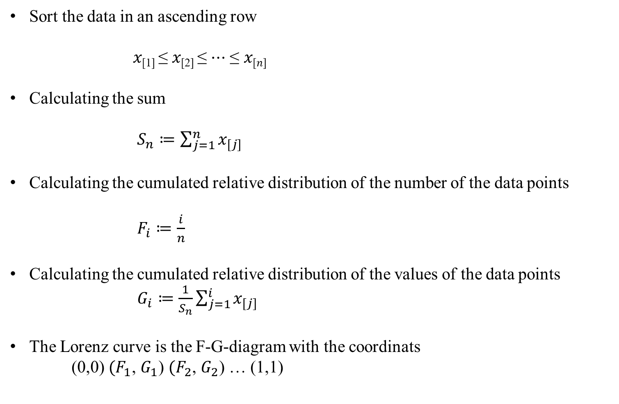

Calculating the Lorenz-curve
Sort the data in an ascending row
𝑥_{[1]} ≤ 𝑥_{[2]} ≤ ⋯ ≤ 𝑥_{[𝑛]}
Calculating the sum
$S_{n}≔\sum_{j=1}^{n}{x_{[j]}}$
Calculating the cumulated relative distribution of the number of the data points
$F_{i}≔\frac{i}{n}$
Calculating the cumulated relative distribution of the values of the data points
$G_{i}≔\frac{1}{S_{n}}\sum_{j=1}^{i}{x_{[j]}}$
The Lorenz curve is the F-G-diagram with the coordinats
(0,0) ${(F}_{1}$, $G_{1}$) ${(F}_{2}$, $G_{2}$) … (1,1)
c

Slide 12
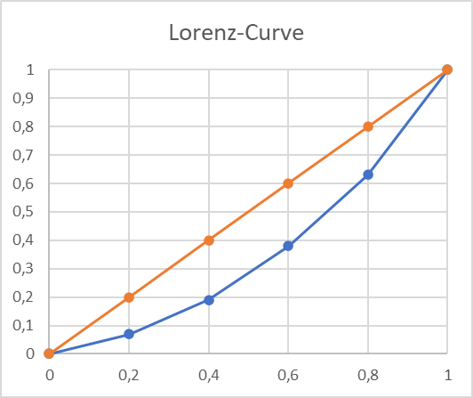
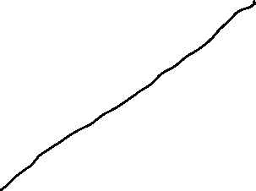

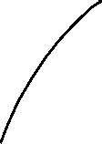










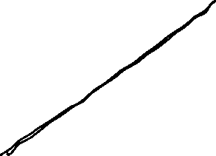



Example A
U-Nr. | A | Fi | Gi
 |  | 0 | 0
1 | 70
2 | 120
3 | 190
4 | 250
5 | 370 | 1 | 1
Sum | 1000
c
Calculate the Lorenz-curve between (0,0) und (1,1)

Slide 13
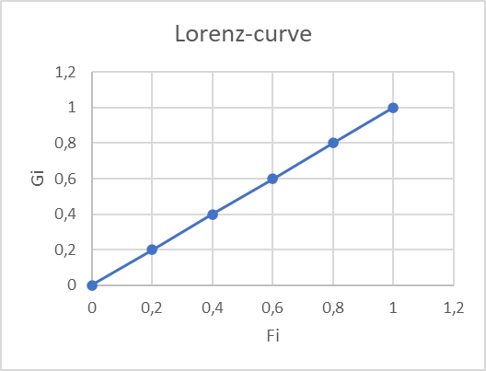

Example B
U-Nr. | B | Fi | Gi
 |  | 0 | 0
1 | 200 | 0,2 | 0,2
2 | 200 | 0,4 | 0,4
3 | 200 | 0,6 | 0,6
4 | 200 | 0,8 | 0,8
5 | 200 | 1 | 1
Summe | 1000
c
Lorenz-curve for a uniform distribution between (0,0) und (1,1).

Slide 14
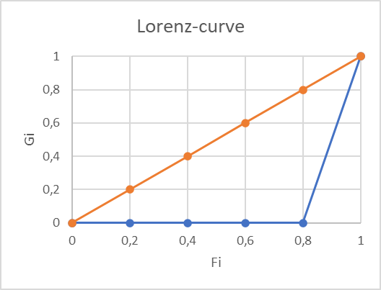




Example C
U-Nr. | C | Fi | Gi
 |  | 0 | 0
1 | 0 | 0,2 | 0
2 | 0 | 0,4 | 0
3 | 0 | 0,6 | 0
4 | 0 | 0,8 | 0
5 | 1000 | 1 | 1
Summe | 1000
c
Lorenz-curve if the total value is centered at one data point in between(0,0) (1,1).

Slide 15
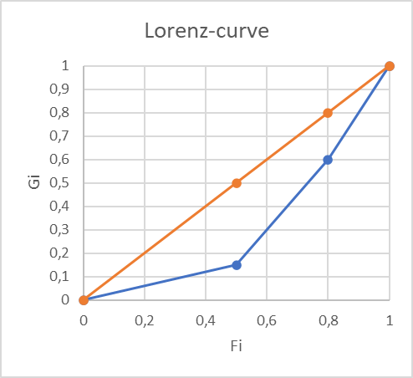
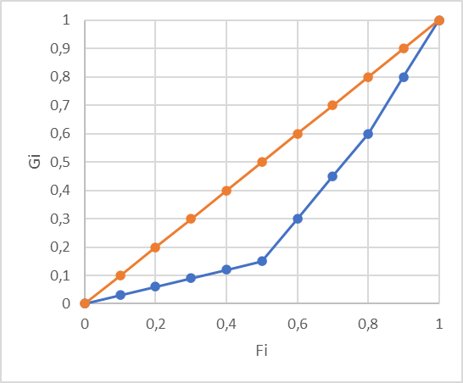


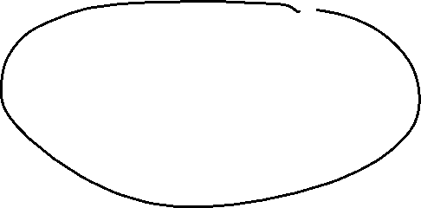



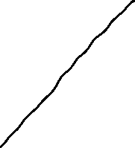







Example D
U-Nr. | D | Fi | Gi
 |  | 0 | 0
1 | 30 | 0,1 | 0,03
2 | 30 | 0,2 | 0,06
3 | 30 | 0,3 | 0,09
4 | 30 | 0,4 | 0,12
5 | 30 | 0,5 | 0,15
6 | 150 | 0,6 | 0,3
7 | 150 | 0,7 | 0,45
8 | 150 | 0,8 | 0,6
9 | 200 | 0,9 | 0,8
10 | 200 | 1 | 1
Sum | 1000
c
Value | Counts | Fj | Gj
 |  | 0 | 0
30
150
200 |  | 1 | 1
Lorenz-curve with multiple counts for one value in between (0,0) (1,1).

Slide 16
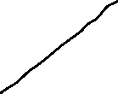










Properties of the Lorenz-curve
The Lorenz-curve is monotonically increasing
The Lorenz-curve is konvex
Die Lorenzkurve ist abschnittsweise linear
The Lorenz-curve is in beetween (0,0) und (1,1)
For the uniform distribution, the Lorenz-curve is is a straight line form (0,0) und (1,1)
If within a sample of n data points, the total value is centered at only one data point, the Lorenz-curve is represented by (0,0) (0,(n-1)/n) (1,1)
Usually the Lorenz-curve is plotted relativ to the uniform distribution.
c

Slide 17
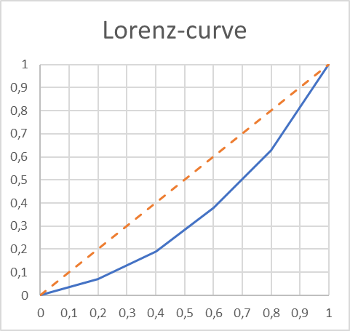
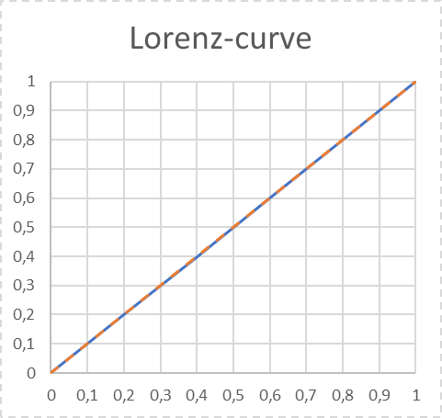
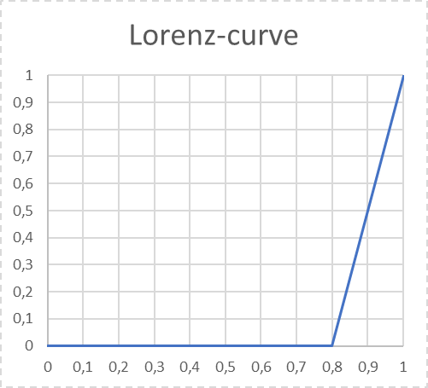
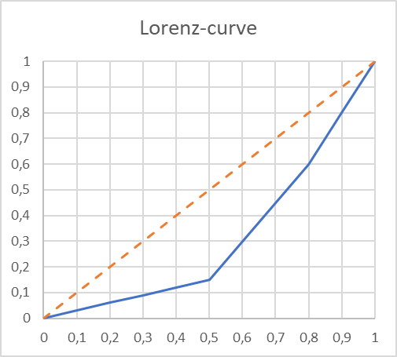
Lorenz-curve and the uniform distirbution
A
B
C
D
c

Slide 18
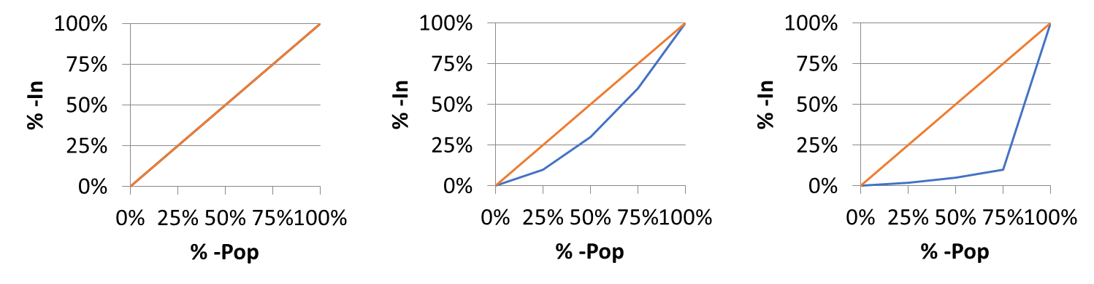



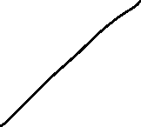


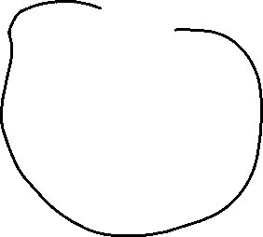


Case Study: Lorenz-curve and Income distribution
In an ascending ordered sample, we plot the accumulated relative income with respect to accumulated proportion of the population.
The more, the Lorenz-curve runs below the 45°-Line the more concentrated is the income distribution
i.e. Which proportion of national income is earned by the poorest of the popupation?
Uniform distribution
Right skewed
Bill-Gates
% -Pop | %-In
Q-25% | 25%
Q-50% | 50%
Q-75% | 75%
Q-100% | 100%
% -Pop | %-In
Q-25% | 10%
Q-50% | 30%
Q-75% | 60%
Q-100% | 100%
% -Pop | %-In
Q-25% | 1%
Q-50% | 2%
Q-75% | 3%
Q-100% | 97%
c

Slide 19

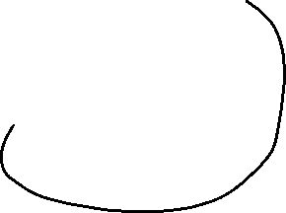
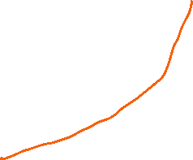

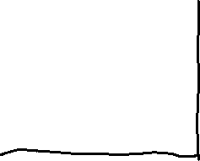
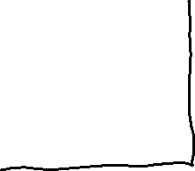
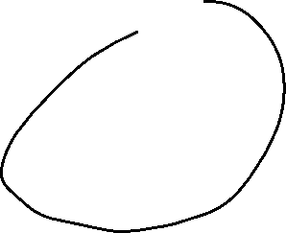

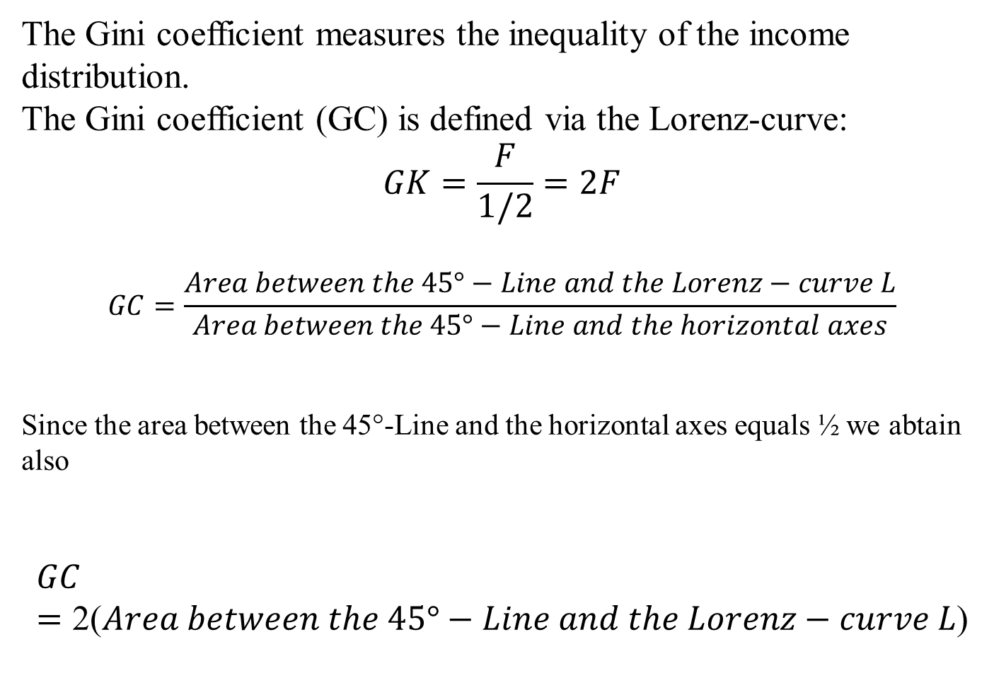

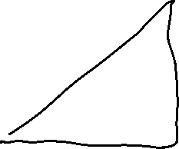

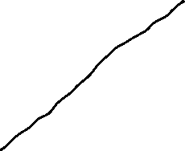


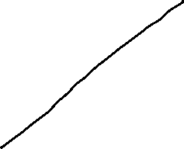
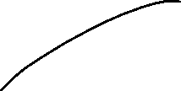

^{The Gini-Coefficient}
The Gini coefficient measures the inequality of the income distribution.
The Gini coefficient (GC) is defined via the Lorenz-curve:
$$GK=\frac{F}{1/2}=2F$$
$$GC=\frac{Area between the 45°−Line and the Lorenz−curve L}{Area between the 45°−Line and the horizontal axes}$$
Since the area between the 45°-Line and the horizontal axes equals ½ we abtain also
$$GC=\text{2(}Area between the 45°−Line and the Lorenz−curve L\text{)}$$
c

Slide 20
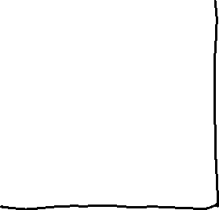


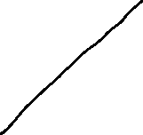
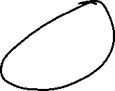








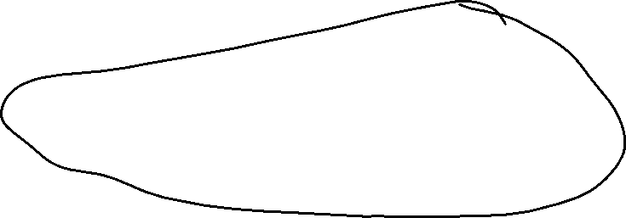


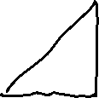
Der Gini-Koeffizient und Lorenzkurve
100%
45°-Line
L
100%
c
Gini-Koeffizient = GC =

Slide 21
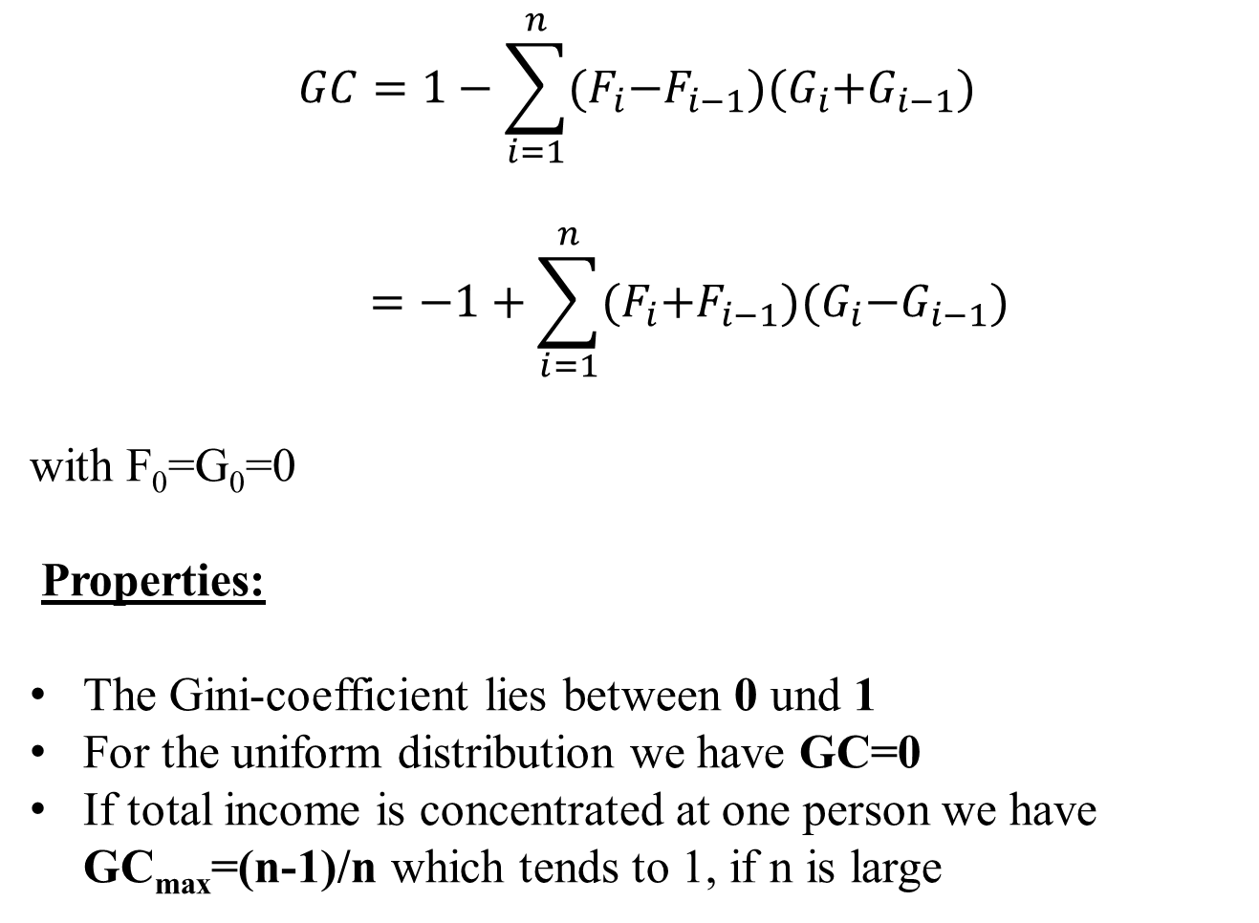

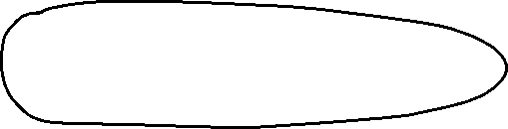


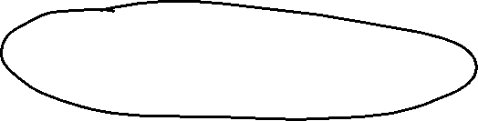
Calculation of the Gini-coefficient
$$GC=1−\sum_{i=1}^{n}{{(F}_{i}−F_{i−1}){(G}_{i}+G_{i−1})}$$
$$=−1+\sum_{i=1}^{n}{{(F}_{i}+F_{i−1}){(G}_{i}−G_{i−1})}$$
with F₀=G₀=0
Properties:
The Gini-coefficient lies between 0 und 1
For the uniform distribution we have GC=0
If total income is concentrated at one person we have GC_{max}=(n-1)/n which tends to 1, if n is large
c

Slide 22





Calculate the Gini-coefficients of distributions A-D
$$GC=1−\sum_{i=1}^{n}{{(F}_{i}−F_{i−1}){(G}_{i}+G_{i−1})}$$
U-Nr. | A | Fi | Gi
 |  | 0 | 0
1 | 70 | 0,2 | 0,07
2 | 120 | 0,4 | 0,19
3 | 190 | 0,6 | 0,38
4 | 250 | 0,8 | 0,63
5 | 370 | 1 | 1
Sum | 1000
c

Slide 23










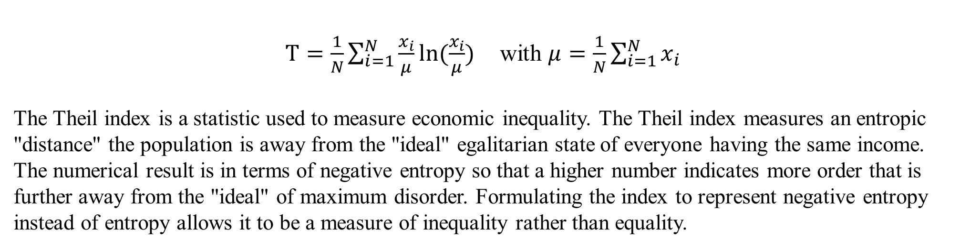






Theil-Index
$T=\frac{1}{N}\sum_{i=1}^{N}{\frac{x_{i}}{μ}ln⁡(\frac{x_{i}}{μ})}$ with $μ=\frac{1}{N}\sum_{i=1}^{N}{x_{i}}$
The Theil index is a statistic used to measure economic inequality. The Theil index measures an entropic "distance" the population is away from the "ideal" egalitarian state of everyone having the same income. The numerical result is in terms of negative entropy so that a higher number indicates more order that is further away from the "ideal" of maximum disorder. Formulating the index to represent negative entropy instead of entropy allows it to be a measure of inequality rather than equality.
Properties:
For the uniform distribution: T=0
For a distribution with maximum inequality: T=ln(N)
The Theil-Index is decomposable for subgroups of the distirbution
The Theil-Index is very sensitve to redristibutions form poor to rich
c

Slide 24






Calculate the Gini-coefficients of distributions A-D
c

Slide 25


Example A
U-Nr. | A | Fi | Gi
 |  | 0 | 0
1 | 70
2 | 120
3 | 190
4 | 250
5 | 370 | 1 | 1
Sum | 1000
Calculate the Lorenz-curve between (0,0) und (1,1)
c

Slide 26
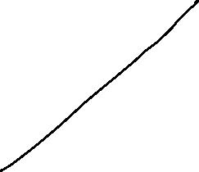

Example B
U-Nr. | B | Fi | Gi
 |  | 0 | 0
1 | 200
2 | 200
3 | 200
4 | 200
5 | 200 | 1 | 1
Summe | 1000
c
Gini-coefficient

Slide 27







Example C
U-Nr. | C | Fi | Gi
 |  | 0 | 0
1 | 0 | 0,2 | 0
2 | 0 | 0,4 | 0
3 | 0 | 0,6 | 0
4 | 0 | 0,8 | 0
5 | 1000 | 1 | 1
Summe | 1000
c

Slide 28













Example D
U-Nr. | D | Fi | Gi
 |  | 0 | 0
1 | 30 | 0,1 | 0,03
2 | 30 | 0,2 | 0,06
3 | 30 | 0,3 | 0,09
4 | 30 | 0,4 | 0,12
5 | 30 | 0,5 | 0,15
6 | 150 | 0,6 | 0,3
7 | 150 | 0,7 | 0,45
8 | 150 | 0,8 | 0,6
9 | 200 | 0,9 | 0,8
10 | 200 | 1 | 1
Sum | 1000
c
Value | Counts | Fj | Gj
 |  | 0 | 0
30 | 5 | 0,5 | 0,15
150 | 3 | 0,8 | 0,6
200 | 2 | 1 | 1
Lorenz-curve with multiple counts for one value in between (0,0) (1,1).

Slide 29





U-Nr. | D | Fi | Gi
 |  | 0 | 0
1 | 30 | 0,1 | 0,03
2 | 30 | 0,2 | 0,06
3 | 30 | 0,3 | 0,09
4 | 30 | 0,4 | 0,12
5 | 30 | 0,5 | 0,15
6 | 150 | 0,6 | 0,3
7 | 150 | 0,7 | 0,45
8 | 150 | 0,8 | 0,6
9 | 200 | 0,9 | 0,8
10 | 200 | 1 | 1
Sum | 1000
Value | Counts | Fj | Gj
 |  | 0 | 0
30 | 5 | 0,5 | 0,15
150 | 3 | 0,8 | 0,6
200 | 2 | 1 | 1

Slide 30















Gini-Coefficient international development
c
Source: OECD

Slide 31
















Example Gini-Coefficient (Germany)
Top income quantils
c
Source: C. Bartels and Jenderny, K. (2015)

Slide 32




Example Gini-Coefficient (Germany)
c
Gini-SVR = 0,28
Gini-Bartels-Jenderney = 0,35
Source: SVR, C. Bartels and Jenderny, K. (2015), eigene Berechnungen

Slide 33
Price-indices
Within a market sector or consumption or even in the total economy, often we want to know, who prices in general have changed.
Problem:
Usually the prices of some goods are changing, while other prices stay constant
→ Question: How has the price level in a sector changed?
→ Solution: Aggregation of the single price changes to index, but how?
c

Slide 34
Example
Change in the price level of consumption
Calculate the average price of 2015 and 2016
Calculate the total consumption in 2015 and 2016
Do the changes of these numbers represent the change in price level?
 | Cinema |  | Book |  | Jeans
 | Price | Quantity | Price | Quantity | Price | Quantity
2015 | 11 | 4 | 10 | 10 | 33 | 2
2016 | 8 | 8 | 18 | 4 | 29 | 3
c

Slide 35
Example
Change in the price level of consumption
Average price: $\overline{P}\left(2015\right)=\frac{11+10+33}{3}=18,0$
$\overline{P}\left(2016\right)=\frac{8+18+29}{3}=18,\overline{3}$
→ $\frac{18,\overline{3}}{18}=1,019$ → 1,9% change in price level for consumption ?
Total consumption: $K\left(2015\right)=11∙4+10∙10+33∙2=210$
$K\left(2016\right)=8∙8+18∙4+29∙3=223$
→ $\frac{223}{210}=1,062$ → 6,2% change in price level for consumption ?
 | Cinema |  | Book |  | Jeans
 | Price | Quantity | Price | Quantity | Price | Quantity
2015 | 11 | 4 | 10 | 10 | 33 | 2
2016 | 8 | 8 | 18 | 4 | 29 | 3
c

Slide 36
Changes in price level I
What is the price of te basket of 2015 in the year 2016?
Compare this with the price of the basket in in year 2015
c

Slide 37
Changes in price level I
What is the price of te basket of 2015 in the year 2016?
$\sum_{i=1}^{3}{p_{i}^{2016}x_{i}^{2015}=}$ $8∙4+18∙10+29∙2=270$
→ Compare the basket of a base with respect to prices in different years
$\sum_{i=1}^{3}{p_{i}^{2015}x_{i}^{2015}=}$ $11∙4+10∙10+33∙2=210$
→ $\frac{270}{210}=1,286$ → Increase of price level by 28,6%
c

Slide 38
Laspeyres price index
$$P_{t0}^{L}= \frac{\sum_{i=1}^{n}{p_{i}^{t}x_{i}^{0}}}{\sum_{i=1}^{n}{p_{i}^{0}x_{i}^{0}}}=\sum_{i=1}^{n}{\frac{p_{i}^{t}}{p_{i}^{0}}∙}\frac{p_{i}^{0}x_{i}^{0}}{\sum_{j=1}^{n}{p_{j}^{0}x_{j}^{0}}}$$
$\frac{p_{i}^{0}x_{i}^{0}}{\sum_{j=1}^{n}{p_{j}^{0}x_{j}^{0}}}=g_{i}^{0}$: Weights $g_{i}^{0}$are equal to the proportions of expenditures for good i in the base year t=0
The Laspeyres price index is therefore a weighted arithmetic mean of the relative prices $\frac{p_{i}^{t}}{p_{i}^{0}}$.
Usually we calculate inflation following this method
→ HICP!
c

Slide 39


Measuring inflation – the Harmonised Index of Consumer Prices (HICP)
https://www.ecb.europa.eu/stats/macroeconomic_and_sectoral/hicp/html/index.en.html
c

Slide 40
Changes in price level II
What are the costs of the basket of year 2016 with prices of 2015?
Compare this with the price of the basket in in year 2016
c

Slide 41
Changes in price level II
What are the costs of the basket of year 2016 with prices of 2015?
$\sum_{i=1}^{3}{p_{i}^{2015}x_{i}^{2016}=}$ $11∙8+10∙4+33∙3=227$
→ Compare the actual basket valued with actual prices and prices of the year before.
$\sum_{i=1}^{3}{p_{i}^{2016}x_{i}^{2016}=}$ $8∙8+18∙4+29∙3=223$
→ $\frac{223}{227}=0,982$ → price level decrease of 1,8%
c

Slide 42
Paasche price index
$$P_{t0}^{P}= \frac{\sum_{i=1}^{n}{p_{i}^{t}x_{i}^{t}}}{\sum_{i=1}^{n}{p_{i}^{0}x_{i}^{t}}}=\frac{1}{\sum_{i=1}^{n}{\frac{p_{i}^{0}}{p_{i}^{t}}∙}\frac{p_{i}^{t}x_{i}^{t}}{\sum_{j=1}^{n}{p_{j}^{t}x_{j}^{t}}}}$$
$\frac{p_{i}^{t}x_{i}^{t}}{\sum_{j=1}^{n}{p_{j}^{t}x_{j}^{t}}}=g_{i}^{0}$: Weights $g_{i}^{0}$are equal to the proportions of expenditures for good i in the actual year t
The Paasche Price index is a weighted harmonic mean of the relative prices $\frac{p_{i}^{t}}{p_{i}^{0}}$.
Usually the Paasche price index is used for the price
adjustment for GDP in order to obtain real GDP growth
→ GDP-Deflator
c

Slide 43
Fundamental problems: Price level measurement
Substitution effect: Quantity of consumption or demand in general depends on prices.
New goods
Quality change of goods
$P_{t0}^{P}<P_{t0}^{L}$ if $\frac{p_{i}^{t}}{p_{i}^{0}}$ and $\frac{x_{i}^{t}}{x_{i}^{0}}$ negatively correlated assuming the usual behavior of consumption
  Laspeyres index overestimates in general the price level increase
  Paasche index underestimates in general the price level increase
c

Slide 44
Fisher Price index
$P_{t0}^{P}$=$\sqrt{P_{t0}^{P}{∙P}_{t0}^{L}}$
The Fisher-Index is the geometric mean of Laspeyres- and Paasche-Index.
Example: $P_{t0}^{P}$=$\sqrt{\frac{223}{227}∙\frac{270}{210}}=\sqrt{0,982∙1,286}=1,263$
The Fisher-Index is used for the price adjustment of GDP in the USA
  In general, one has to be careful to compare real variables (i.e. economic growth) if different methods of price adjustement are used!
c

Slide 45
Chain-index
Until now, we always used a base year t=0 → thus, we reset the base year usually every 5 years (i.e. consumer price index cpi)
Problem: economic behaviour is changing over time. If the base year is to far behind in history, the calculation does not reflect the current situation in the right way.
This problem is tackled via a chain index:
  → real GDP is calculated by multiplying the current produced quantities with the prices of the former period.
    Reducing the substitution effects
    With a fixed base year, every time the base year is adjusted all growth rates in history has to be changed → the time series is not stable
c

Slide 46
Nominal and real GDP − GDP-Deflator
Der GDP-Deflator is defined as an Paasche-Chainindex
$${BIP−Deflator}_{t}= \frac{{BIP}_{t}^{nom}}{{BIP}_{t}^{real}}100= \frac{{BIP}_{t}^{nom}(Index)}{{BIP}_{t}^{real}(Index)}100$$
c

Slide 47
Nominal and real GDP − GDP-Deflator
Nominal GDP(Index)
$${GDP}_{t}^{nom}(Index)= \frac{Quantity\left(t\right)∙Price(t)}{Quantity\left(0\right)∙Price(0)}∙100$$
$${GDP}_{t}^{nom}(Index)= \frac{\sum_{i=1}^{n}{p_{i}^{t}x_{i}^{t}}}{\sum_{i=1}^{n}{p_{i}^{0}x_{i}^{0}}}∙100$$
Real GDP(Index)
$${GDP}_{t}^{real}(Index)= \frac{Quantity\left(t\right)∙Price(t−1)}{Quantity\left(t−1\right)∙Price(t−1)}∙{GDP}_{t−1}^{real}(Index)$$
$${GDP}_{t}^{real}(Index)= \frac{\sum_{i=1}^{n}{p_{i}^{t−1}x_{i}^{t}}}{\sum_{i=1}^{n}{p_{i}^{t−1}x_{i}^{t−1}}}∙{GDP}_{t−1}^{real}(Index)$$
c

Slide 48
GDP-Deflator
$${GDP}_{t}^{deflator}= \frac{{GDP}_{t}^{nom}}{{GDP}_{t}^{real}}∙100=\frac{\frac{\sum_{i=1}^{n}{p_{i}^{t}x_{i}^{t}}}{\sum_{i=1}^{n}{p_{i}^{0}x_{i}^{0}}}∙100}{\frac{\sum_{i=1}^{n}{p_{i}^{t−1}x_{i}^{t}}}{\sum_{i=1}^{n}{p_{i}^{t−1}x_{i}^{t−1}}}∙{GDP}_{t−1}^{real}(Index)}∙100$$
c

Slide 49
Example GDP-Deflator
 | Private Consumption |  | Government Consumption |  | Gross Investment |  | Exports |  | Imports |  | Nominal GDP | Real GDP | GDP Defla- tor
 | P | Q | P | Q | P | Q | P | Q | P | Q
2018 | 1,1 | 10 | 1 | 3 | 0,9 | 3 | 1 | 12 | 1,1 | 10
2019 | 1,2 | 11 | 1,05 | 3,5 | 0,95 | 4 | 1,2 | 13 | 1,2 | 12
2020 | 1,25 | 8 | 1,1 | 5 | 1 | 3,5 | 1 | 10 | 1 | 9
2021 | 1,2 | 10 | 1,2 | 5,5 | 1,05 | 3,5 | 1,05 | 11 | 1,1 | 10
Calculate the growth rate of GDP-Deflator 2019-2021
Calculate the average growth rate of GDP-Deflator p.a.
c

