Slide 1

Statistics B
Wilhelmshaven
This lecture will be recorded and
subsequently uploaded in the
world-wide-web
Function translator (webpage)
Function translator Excel 1 (add in)
c
Prof. Dr. Bernhard Köster
Jade-Hochschule Wilhelmshaven
http://www.bernhardkoester.de/vorlesungen/inhalt.html

Slide 2



Formulas
:

Slide 3





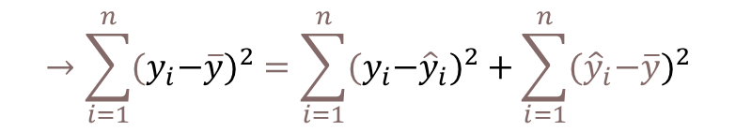
Coefficiant of determination R²
{
${\hat{y}}_{i}−\overline{y}$ explained difference
Total Difference
} Non explained difference
} Explained difference
${y_{i}−\hat{y}}_{i}$ not explained difference
Mean
$y_{i}−\overline{y}$ total difference
$$→\sum_{i=1}^{n}{{{(y}_{i}−\overline{y})}^{2}}=\sum_{i=1}^{n}{{{{(y}_{i}−\hat{y}}_{i})}^{2}}+\sum_{i=1}^{n}{{{(\hat{y}}_{i}−\overline{y})}^{2}}$$
Non explained squared difference y_{i}
total squared difference
explained squared difference
Mean
not explained squared difference
explained squared difference y_{i}
Total squared difference of y_{i}
Coefficiant of determination $R^{2}=\frac{\sum_{i=1}^{n}{{{(\hat{y}}_{i}−\overline{y})}^{2}}}{\sum_{i=1}^{n}{{{{(y}_{i}−\overline{y}}_{i})}^{2}}}$

Slide 4









Multiple linear Regression
From the first order condition (FOC) we obtain:
c

Slide 5
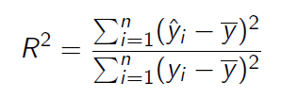



Multiple linear Regression
For the coefficiant of determination we obtain equivalently:
with
and
c

Slide 6









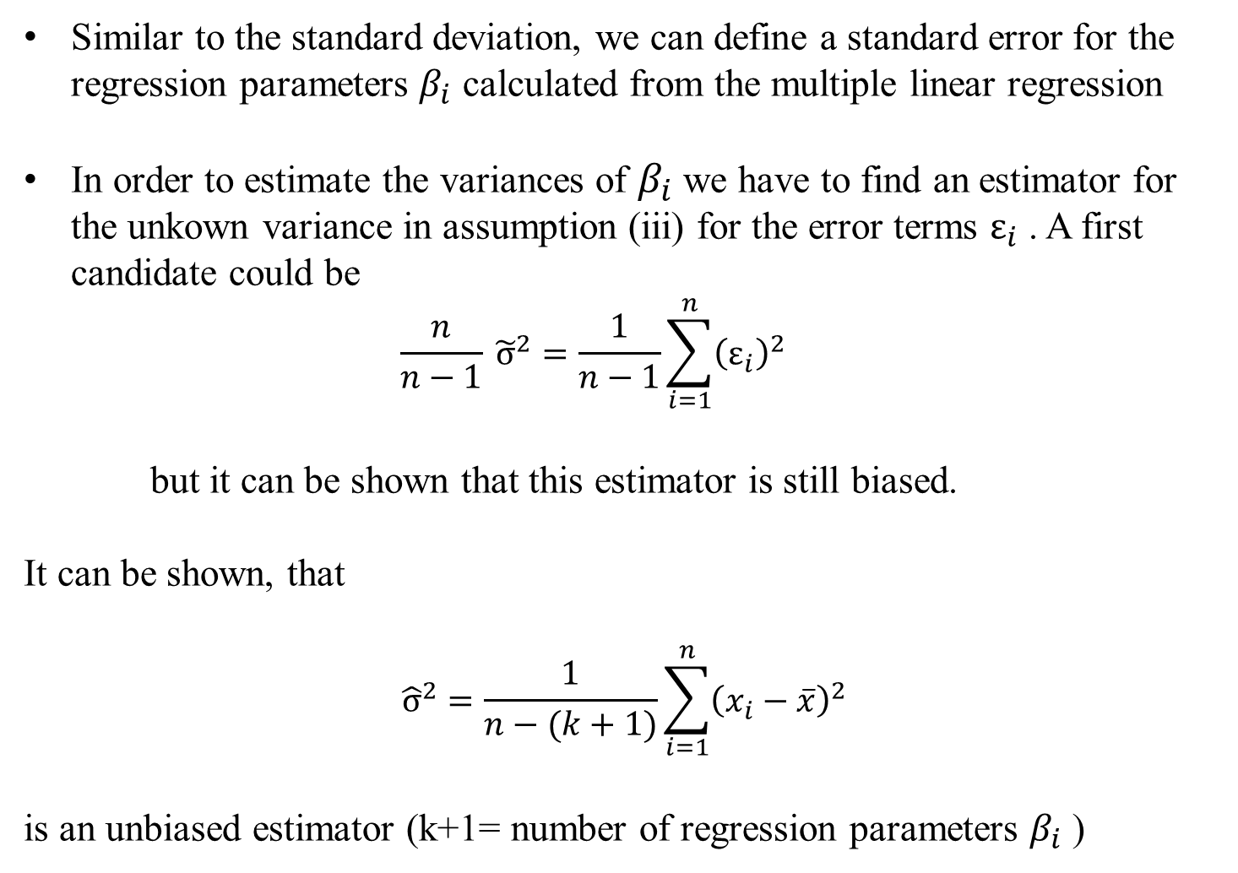







Multiple linear Regression – Standard error
Similar to the standard deviation, we can define a standard error for the regression parameters $β_{i}$ calculated from the multiple linear regression
In order to estimate the variances of $β_{i}$ we have to find an estimator for the unkown variance in assumption (iii) for the error terms $ε_{i}$ . A first candidate could be
$$\frac{n}{n−1} {\tilde{σ}}^{2}=\frac{1}{n−1}\sum_{i=1}^{n}{{\left(ε_{i}\right)}^{2}}$$
but it can be shown that this estimator is still biased.
It can be shown, that
$${\hat{σ}}^{2}=\frac{1}{n−(k+1)}\sum_{i=1}^{n}{{\left(x_{i}−\overline{x}\right)}^{2}}$$
is an unbiased estimator (k+1= number of regression parameters $β_{i}$ )
c

Slide 7













Multiple linear Regression – Standard error
The standard error of estimators ${\hat{β}}_{i}$ can then be estimated via
and is given by the diagonal elements of V. If we define c_{ii} the diagonal elemants of [X^{T}X]⁻¹, we obtain for the standard se($β_{i}$)
se(${\hat{β}}_{i}$)= $\hat{σ}\sqrt{cii}$
and with the assumptions (i) – (v) we can show, that also the estimators ${\hat{β}}_{i}$are normally distributed with
$${\hat{β}}_{i}\sim N(β_{i},{\hat{σ}}^{2}cii)$$
c

Slide 8
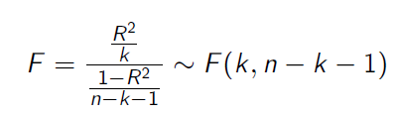























Multiple linear Regression – Hypothesis-Testing
With the assumptions and the derived properties we can calculate the following test statistics:
and
With F and t, we can make probability statements about the goodness of the estimators calculated from the multiple linear regression.
c

Slide 9







Multiple linear Regression – F-Test
Formulate the null hypothesis H₀:
There is no correlation between Y and X_{i}.
This means H₀: $β_{0}=β_{1}=β_{2}=…=β_{k}=0$ then R²=0
The alternative is then H₁: At least one $β_{i}≠0$ then $\text{R}\text{2}≠0$
Determine a reasonable significance level:
If H₀ is true, the test shall with probability $1−\text{α}$ not reject H₀.The significance level $\text{α}$ is the error probability, that we reject although it is true for the whole population.
Standard significance levels are 10%, 5%, 1%, 0,1%.
But be careful in choosing $\text{α}$since i.e. if $\text{α}$is too small H₀ would not be rejected, although it is not true!
Calculate from the regression the empirical F-value
c

Slide 10
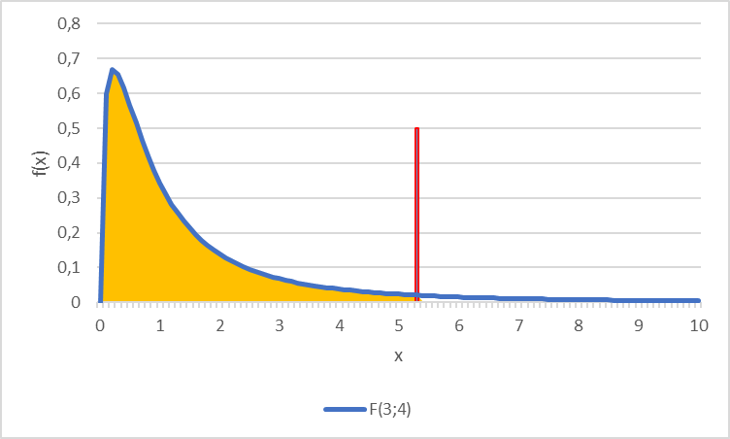
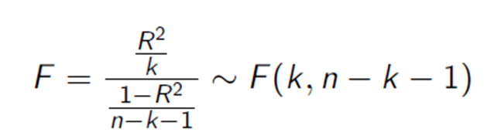
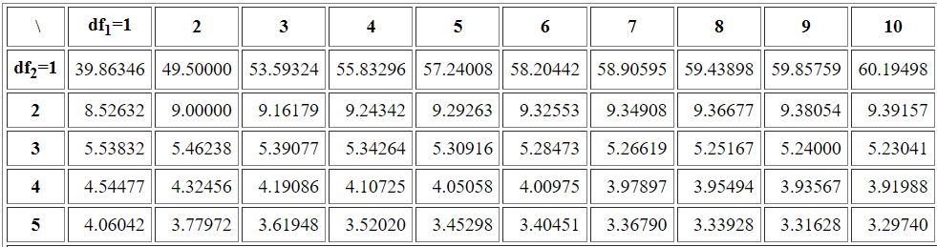





Multiple linear Regression – F-Test
Determine the theoretical F-value
Given the significance level the F-value represents the value for which for which the accumulated probability of an F-distributed variable equals $1−\text{α}$. i.e. in our example we have a
$F\left(k=3;n−k−1=8−3−1=4\right)=F(3,4)$ distribution and thus $F\text{9}\text{0}\text{\%}=5,34$
Compare theoretical and empirical F-value
F_{emp}>F_{theo}
H ₀ is rejected, the existence of a linear dependence between Y and X_{i} is significant to $\text{α}$=10%
F_{emp}≤F_{theo}
H₀ is not rejected. There is no linear dependence to a significance level of $\text{α}$=10%
$$F\text{9}\text{0}\text{\%}=5,34$$
90%
c
Table F-Distribution

Slide 11





Multiple linear Regression – t-Test
Formulate the null hypothesis H₀:
„Some Variable X_{i} has no relevance for Y“.
This means H₀: $β_{i}=0$
The alternative is then H₁: $β_{i}≠0$
(we deal only with this version of a two-sided test!)
Determine a reasonable significance level:
If H₀ is true, the test shall with probability $1−\text{α}$ not reject H₀.The significance level $\text{α}$ is the error probability, that we reject although it is true for the whole population.
Standard significance levels are 10%, 5%, 1%, 0,1%.
But be careful in choosing $\text{α}$since i.e. if $\text{α}$is too small H₀ would not be rejected, although it is not true!
Calculate from the regression the empirical t-values
c

Slide 12
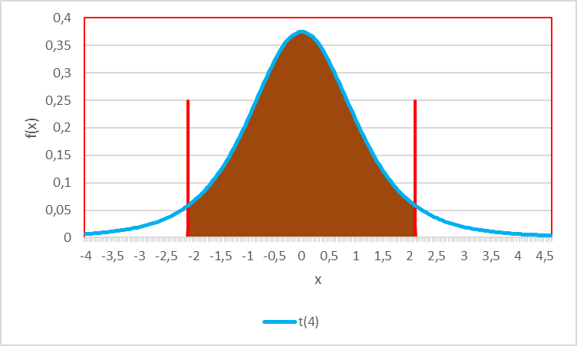
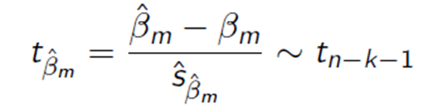




Multiple linear Regression – t-Test
Determine the theoretical t-value
Given the significance level the t-value represents the value for which for which the accumulated probability of an F-distributed variable equals $1−\text{α}$. i.e. in our example we have a t$\left(n−k−1=8−3−1=4\right)=t(4)$ distribution and thus $t\text{9}\text{5}\text{\%}=2,13$
Compare theoretical and empirical F-value
|t_{emp}| ≤ t_{theo}
H₀ is not rejected. The variable X_{i} has no $(β_{i}$=0) influence on Y for a significanse level of $\text{α}$=10%
$$t\text{5}\text{\%}=−2,13$$
$$t\text{9}\text{5}\text{\%}=2,13$$
90%
c
|t_{emp}|>t_{theo}
H₀ is rejected, X_{i} has for a level of $\text{α}$=10% a significant influence on Y with the marginal contribution ${\hat{β}}_{i}$

Slide 13














Example
Test the example for $\text{α}=\text{5\%}$ on H₀: $β_{0}=β_{1}=β_{2}=…=β_{k}=0$
Test for all H₀: $β_{i}=0$ and $\text{α}=\text{5\%}$
beta0 | beta1 | beta2 | beta3
10,669 | 1,484 | 0,718 | 9,008
se(b0) | se(b1) | se(b2) | se(b3)
7,579 | 0,911 | 0,199 | 4,150
t(b0) | t(b1) | t(b2) | t(b3)
1,408 | 1,630 | 3,606 | 2,171
c

Slide 14
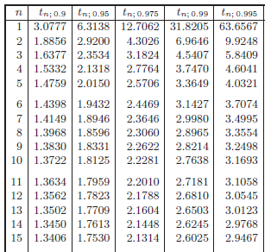


^{T-distribution}
c

Slide 15

F_{95%}
^{F-distribution}
F_{99%}
c

Slide 16
Forecasting
Plot the data
Simple forecast:
Repeat the last data point, give examples, where this is done
In which economic field is this theoretically the best forecast?
Moving average in order to forecast to following data point: ${\hat{y}}_{t+1}=\frac{1}{h}⋅\sum_{i=1}^{h}{y_{t−i+1}}$
Smoothing the data with the centered moving average (usually h → odd):
$${\hat{y}}_{t−(h−1)/2}=\frac{1}{h}⋅\sum_{i=1}^{h}{y_{t−i+1}}$$
c

Slide 17

Forecasting
Exponential smoothing:
We assume, that every data point within the time series is affected by the former data points, but this effect should be weakened over time.
The forecasting value is then defined as $(0≤α≤1$)
${\hat{y}}_{t+1} = α y_{t} + \left(1−α\right) {\hat{y}}_{t}$
Forecasting value in t+1
Data point in t
Forecasting value in t
c
→ Forecasting value in t+1 is the weighted arithmetic mean of the datapoint in time t and the forecasting value in time t. Since we need an initialization, we define
$${\hat{y}}_{0}=y_{0}$$

Slide 18
Average growth rate
Suppose, we have a time series $y_{0}$, $y_{1}$, … $y_{n}$ then, the average growth rate is calculated via the consideration that we ask: Which constant growth rate over time do we need that
$${y_{0}\left(1+g\right)}^{n}=y_{n}$$
→ $g={\left(\frac{y_{n}}{y_{0}}\right)}^{\frac{1}{n}}−1={\left(\frac{y_{n}}{y_{n−1}}∙\frac{y_{n−1}}{y_{n−2}}∙ .. . ∙\frac{y_{1}}{y_{0}}\right)}^{\frac{1}{n}}−1$
→ The average growth factor (1 + growth rate) is the geometric mean of the growth factors of every period.
c
The forecasting value in time $t=n+1$ is then calculated by
$${\hat{y}}_{t+1}=(1+g)y_{n}$$
or for $t=n+k$
$${\hat{y}}_{t+k}=y_{n}{\left(1+g\right)}^{k}$$

Slide 19
Seasonality
Calculate in every year the proportions of q1, q2, … , q4 of the yearly data
Calculate the arithmetic mean for every single quater q1, q2, … , q4 over all years
Using the annual forecasted values, the averaged proportions can be used in order to generate quaterly forecasted data. For this, we use an annual forecast (i.e. average growth rate, exponential smoothing) and apply the averaged growth rates.
c

Slide 20


$${\hat{y}}_{0}=y_{0}$$
${\hat{y}}_{t+1} = α y_{t} + \left(1−α\right) {\hat{y}}_{t}$
y = 43,765x - 21,25 R² = 0,917
c

Slide 21









c

Slide 22







y = 5,8652x + 3500,3 R² = 0,8721
c

Slide 23





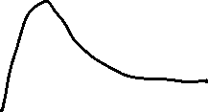




c

Slide 24









c

