Slide 1

Statistics B
Wilhelmshaven
This lecture will be recorded and
subsequently uploaded in the
world-wide-web
Function translator (webpage)
Function translator Excel 1 (add in)
c
Prof. Dr. Bernhard Köster
Jade-Hochschule Wilhelmshaven
http://www.bernhardkoester.de/vorlesungen/inhalt.html

Slide 2
Scatterplot
Graphical representation of the attributes of two variables within a two-dimensional coordinate-system.
Number | 1 | 2 | 3 | 4 | 5 | 6 | 7 | 8 | 9 | 10 | 11 | 12 | 13 | 14 | 15 | 16 | 17 | 18 | 19 | 20 | 21 | 22
Order | 2 | 4 | 3 | 6 | 2 | 1 | 5 | 3 | 4 | 2 | 2 | 7 | 4 | 3 | 2 | 1 | 5 | 4 | 3 | 3 | 1 | 6
Volume [€] | 36 | 44 | 30 | 67 | 21 | 8 | 62 | 35 | 33 | 37 | 22 | 72 | 65 | 45 | 23 | 17 | 44 | 56 | 32 | 37 | 22 | 48

Slide 3
Scatterplot
X-coordinate: order
Y-coordinate: Volume [Euro]

Slide 4
Linear Regression
Example 2:
A company wants to know how the sales volume depends on visits of representatives.
The company has collected the following data
We also want to answer the question, from a descriptive point of view, which sales volume we can expect, if we increase the visits up to x=30

Slide 5
Linear Regression
Via a linear regression we want to analyse the dependence between two variables
We distinguish between a dependent variable (y) and an independent variable (x)
(x) is also called the explanatory variable
A change of (x) implicates a change (y)
The linear regression defines an empirical Die lineare Regression stellt einen solchen empirisch beobachteten relation via a linear function
i.e. y = f(x) = 3 + 2x or generally y = a + bx

Slide 6
Simple Examples
Determine graphically a regression line for the blue and red data points. What kind of
dependence do we have?

Slide 7
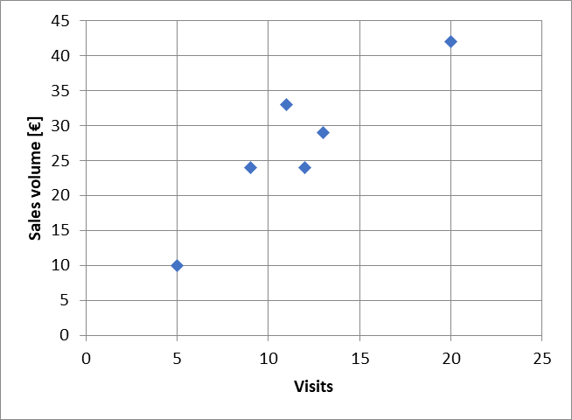
Example
Try to fit graphically (by eye) a regression line through the data points

Slide 8
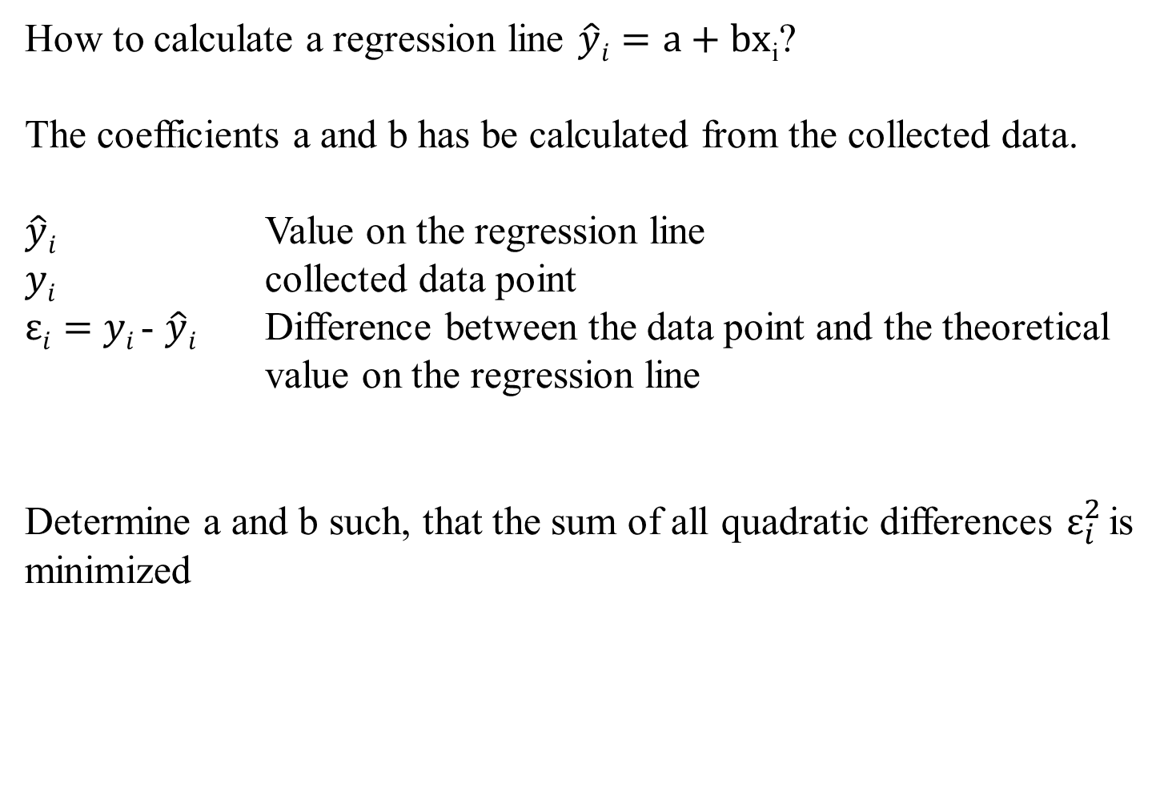
Optimizing problem
How to calculate a regression line $\hat{y}i=a+bx$_{i}?
The coefficients a and b has be calculated from the collected data.
$\hat{y}i$ Value on the regression line
$yi$ collected data point
$εi=$ $yi$- $\hat{y}i$ Difference between the data point and the theoretical value on the regression line
Determine a and b such, that the sum of all quadratic differences $ε_{i}^{2}$is minimized

Slide 9
Least squared method
The formal optimizing problem

Slide 10


Least squared method
The formal optimizing problem
FOC:
2 dimensional linear system which can directly be solved

Slide 11
Least squared method

Slide 12
Formulas
:

Slide 13
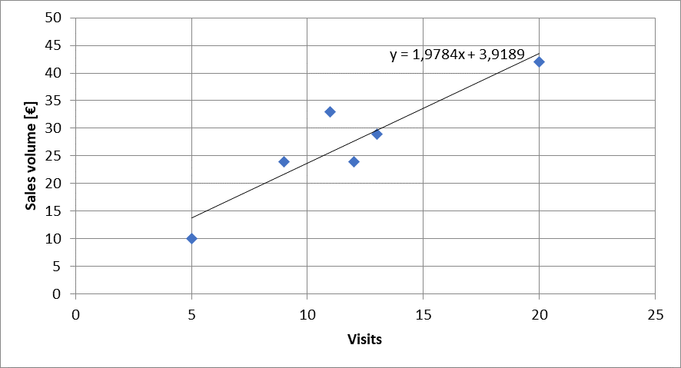


Calulating the regression line from empirical data
$$ei2$$
$\hat{y}i=a+bx$_{i}

Slide 14
Lineare Regression
 | Visits | Sales volume [€]
year | x | y | xy | x^2
2008 | 9 | 24
2009 | 11 | 33
2010 | 5 | 10
2011 | 13 | 29
2012 | 20 | 42
2013 | 12 | 24
b=
a=

Slide 15
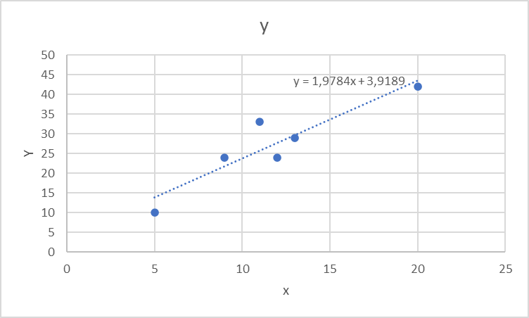
Extrapolation for x=30
 | Visits | Sales volume [€]
year | x | y | xy | x^2 | yhat
2008 | 9 | 24
2009 | 11 | 33
2010 | 5 | 10
2011 | 13 | 29
2012 | 20 | 42
2013 | 12 | 24
yhat(30)=

Slide 16
Regressions coefficients
Regressions coefficient b
  Slope of the regression line.
  Determines the marginal effect of a change of one unit of the independent variable x onto the dependet variable y
Regressions coefficient a
  The value of the dependent variable if the independent variable x=0
    → intercept of the vertical axes

Slide 17
Linear regression
Measures the linear dependence between two variables
This dependence can be interpreted, that one variable is quantitatively influencing another variable
The linear regression is an instrument for forecasting

Slide 18

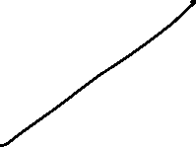
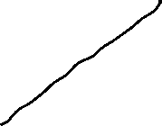

Correlation analysis
In principle for all data sets, we can calculate a regression line.
But we are also interested in the question meaningful is this calculated dependence?.
For this, we use the correlation analysis, wich gives the possibility to measure the strength of the dependence
For this, we use the correlation coefficient of Bravais-Pearson which is lying between -1 and +1

Slide 19

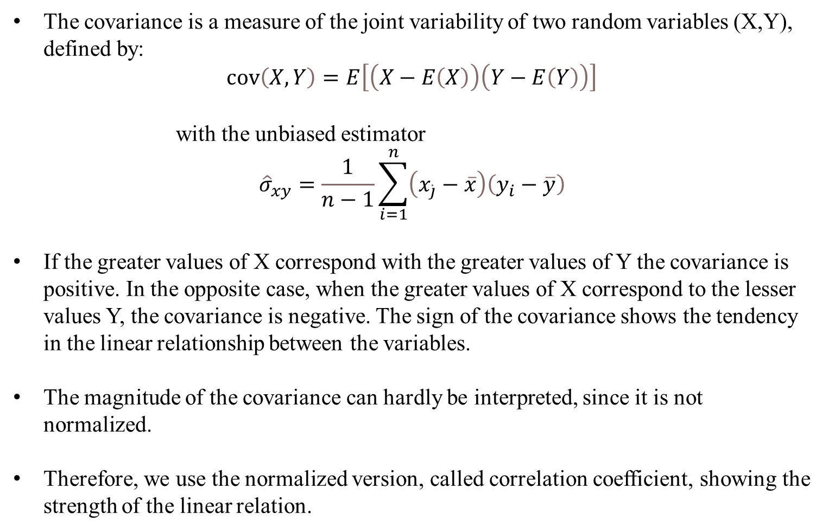
Covariance
The covariance is a measure of the joint variability of two random variables (X,Y), defined by:
$$\operatorname{cov}\left(X,Y\right)=E\left[\left(X−E\left(X\right)\right)\left(Y−E\left(Y\right)\right)\right]$$
with the unbiased estimator
$${\hat{σ}}_{xy}=\frac{1}{n−1}\sum_{i=1}^{n}{\left(x_{\dot{j}}−\overline{x}\right)\left(y_{i}−\overline{y}\right)}$$
If the greater values of X correspond with the greater values of Y the covariance is positive. In the opposite case, when the greater values of X correspond to the lesser values Y, the covariance is negative. The sign of the covariance shows the tendency in the linear relationship between the variables.
The magnitude of the covariance can hardly be interpreted, since it is not normalized.
Therefore, we use the normalized version, called correlation coefficient, showing the strength of the linear relation.

Slide 20






Correlation coefficient
General intervals for R
(0,0;0,2) → almost no dependence
[0,2;0,4) → low dependence
[0,4;0,6) → medium dependence
[0,6;0,8) → high dependence
[0,8;1,0) → almost full dependence

Slide 21











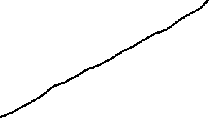





Correlation coefficiant examples
R=?
R=?
R=?
R=?

Slide 22

Coefficiant of determination R²
The squared correlation coefficiant R² is called coefficiant of determination.
In quantitative analysis, we often use the coefficiant of determination R², because it can be intuitively interpreted
But R² does not distinguish between + and – anymore.
R² is in the interval [0,1]
R² grafical interpretation:
  R² equals the proportion of variance explained by the model in relation to the total variance, i.e. how much percent is explained by the regression line
  (1-R²) equals the proportion of Variance not explained by the model in relation to the total variance, and has to be explained by other influencing factors

Slide 23


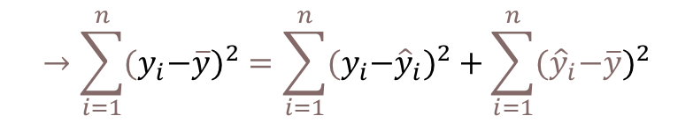




Coefficiant of determination R²
{
${\hat{y}}_{i}−\overline{y}$ explained difference
Total Difference
} Non explained difference
} Explained difference
${y_{i}−\hat{y}}_{i}$ not explained difference
Mean
$y_{i}−\overline{y}$ total difference
$$→\sum_{i=1}^{n}{{{(y}_{i}−\overline{y})}^{2}}=\sum_{i=1}^{n}{{{{(y}_{i}−\hat{y}}_{i})}^{2}}+\sum_{i=1}^{n}{{{(\hat{y}}_{i}−\overline{y})}^{2}}$$
Non explained squared difference y_{i}
total squared difference
explained squared difference
Mean
not explained squared difference
explained squared difference y_{i}
Total squared difference of y_{i}
Coefficiant of determination $R^{2}=\frac{\sum_{i=1}^{n}{{{(\hat{y}}_{i}−\overline{y})}^{2}}}{\sum_{i=1}^{n}{{{{(y}_{i}−\hat{y}}_{i})}^{2}}}$

Slide 24

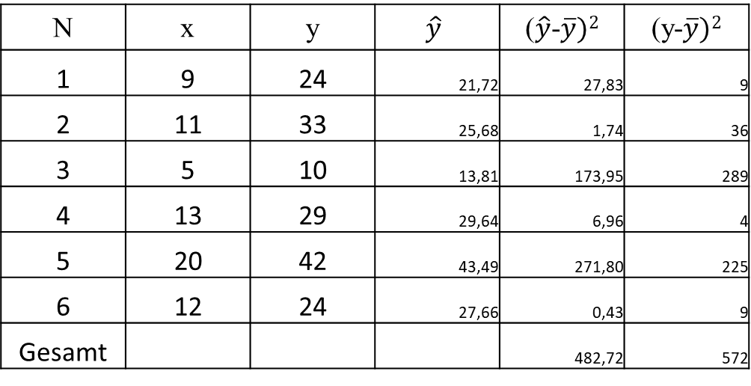

Coefficiant of determination R²
N | x | y | $$\hat{y}$$ | ($\hat{y}$-$\overline{y})2$ | (y-$\overline{y})2$
1 | 9 | 24 | 21,72 | 27,83 | 9
2 | 11 | 33 | 25,68 | 1,74 | 36
3 | 5 | 10 | 13,81 | 173,95 | 289
4 | 13 | 29 | 29,64 | 6,96 | 4
5 | 20 | 42 | 43,49 | 271,80 | 225
6 | 12 | 24 | 27,66 | 0,43 | 9
Gesamt |  |  |  | 482,72 | 572
R²= R=

Slide 25
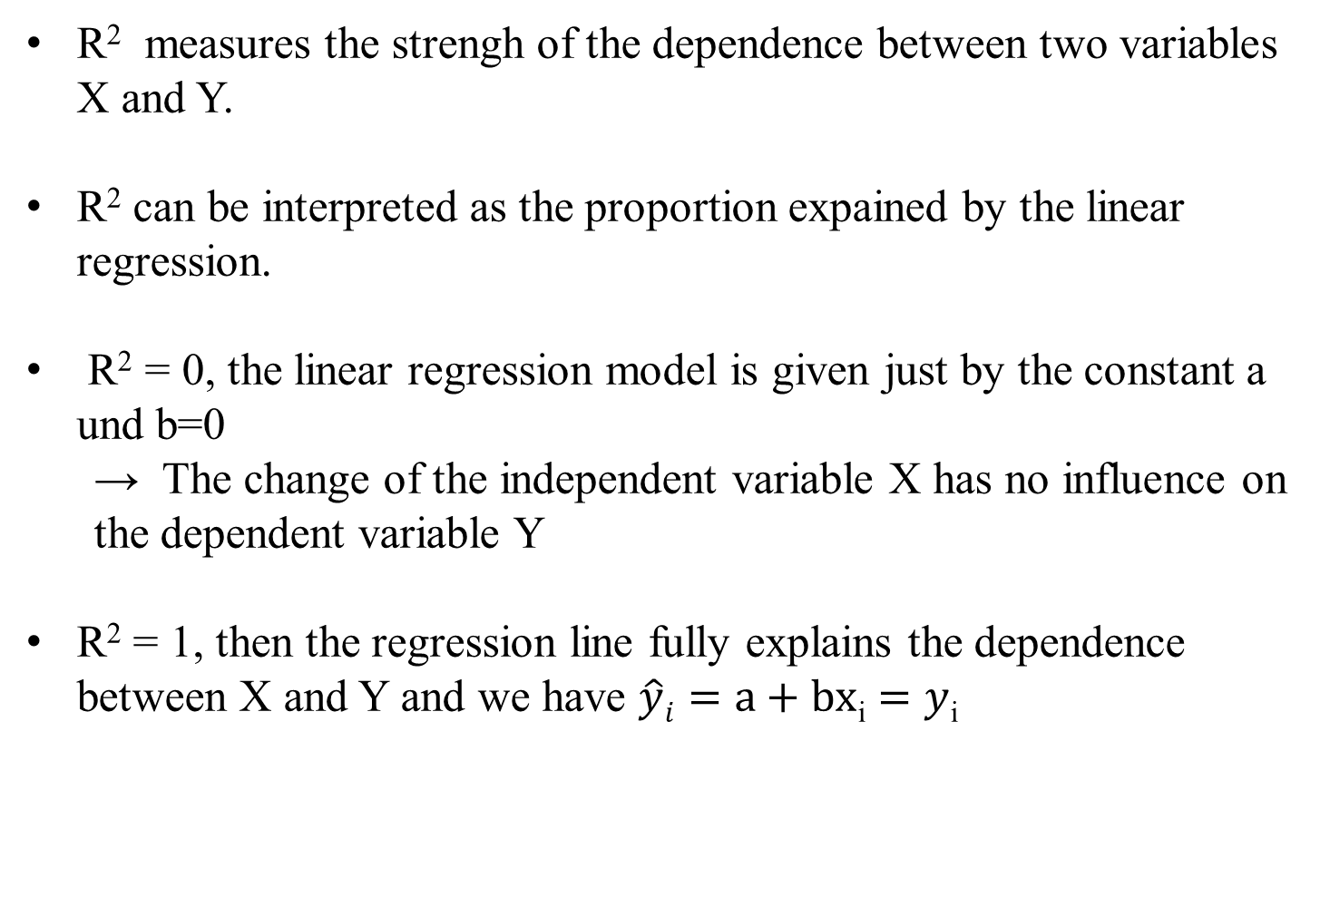
Interpretation of R²
R² measures the strengh of the dependence between two variables X and Y.
R² can be interpreted as the proportion expained by the linear regression.
R² = 0, the linear regression model is given just by the constant a und b=0
  → The change of the independent variable X has no influence on the dependent variable Y
R² = 1, then the regression line fully explains the dependence between X and Y and we have $\hat{y}i=a+bx$_{i} $=y$_{i}

Slide 26











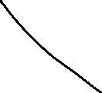











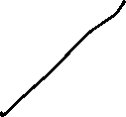




Multiple linear Regression
In general we dot have only one variable explaining another variable, but many more (i.e. visits, marketing budget, branches, …). In this case, we make the Ansatz:
y = f(x₁, x₂,…,x_{k})
The linear model ist then:
$$y=β_{0}+β_{1}x_{1}+β_{2}x_{2}…+β_{k}x_{k}$$
In case of $n$ observations we obtain similar to the simple model
$y_{i}=β_{0}+β_{1}x_{i0}+β_{1}x_{i1}…+β_{k}x_{ik}+ε_{i}$ with ($n>k)$
c

Slide 27


Multiple linear Regression: Matrix notation
c

Slide 28

Multiple linear Regression
The estimators $β$ will again be obtained via minimizing the sum of the squared errors:
with
c

Slide 29





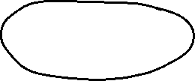



Multiple linear Regression
From the first order condition (FOC) we obtain:
c

Slide 30
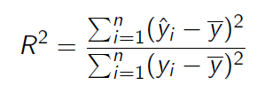


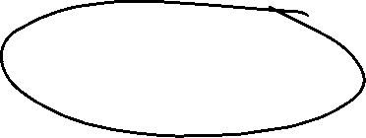
Multiple linear Regression
For the coefficiant of determination we obtain equivalently:
with
and
c

Slide 31
Example
Suppose in our one-dimensional example, we are also interested if our results are transferable to other regions, looking at the sales volume depending on
  number of visits
  how the marketing budget influences sales
  and the impact, if a branch is located in the region or not
Thus we have now three variables, which influences sales
  Question is now, how to quantify the third variable, if a branch is located in the region or not
    Introduction of a dummy variable with
    1 = branch 0 = no branch
c

Slide 32
Example
 | visits | marketing | branch | sales
A | 11 | 33 | 1 | 30
B | 8 | 30 | 0 | 27
C | 6 | 9 | 1 | 12
D | 16 | 27 | 0 | 28
E | 13 | 42 | 1 | 25
F | 11 | 25 | 1 | 17
G | 7 | 18 | 0 | 15
H | 10 | 26 | 1 | 22
c
Calculate ${\hat{β}}_{i}$ and R²

Slide 33

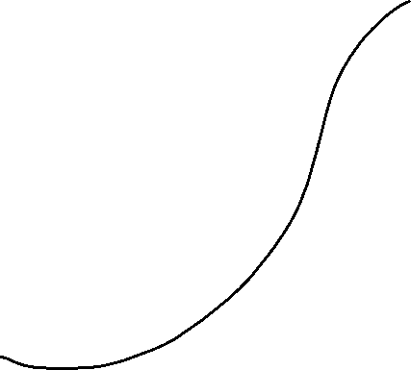





























Example
 | visits | marketing | branch | sales
 | x1 | x2 | x3 | y | yhat | (yhat-y)^2 | (yhat-ybar)^2 | (y-ybar)^2
A | 11 | 22 | 1 | 56 | 51,79 | 17,70 | 0,29 | 22,56
B | 8 | 25 | 0 | 34 | 40,49 | 42,07 | 115,86 | 297,56
C | 6 | 9 | 1 | 36 | 35,04 | 0,92 | 262,71 | 232,56
D | 16 | 35 | 0 | 60 | 59,54 | 0,22 | 68,66 | 76,56
E | 13 | 60 | 1 | 84 | 82,04 | 3,85 | 947,93 | 1072,56
F | 11 | 25 | 1 | 50 | 53,95 | 15,58 | 7,27 | 1,56
G | 7 | 18 | 0 | 40 | 33,98 | 36,27 | 298,34 | 126,56
H | 10 | 26 | 1 | 50 | 53,18 | 10,12 | 3,73 | 1,56
sum | 82 | 220 | 5 | 410 | 410,00 | 126,71 | 1704,79 | 1831,50
average | 10,25 | 27,5 | 0,625 | 51,25 | 51,25 | 0,93
c
beta0 | beta1 | beta2 | beta3
10,669 | 1,484 | 0,718 | 9,008

Slide 34




Multiple linear Regression – Hypothesis-Testing
Until now, we have done only descriptive statistics! No causality can be deduced from our calculations!
Caution! Do not mix correlation and causality!
In general we have not a full data set, but only a sample out of the whole population (i.e. survey data)
Question: What kind of conclusions can be drawn from sample for the whole population?
In general, we want to know if the estimated correlation from the sample is also valid for the whole population.
Under specific assumptions on the error-terms $ε_{i}$ we can make a probability statement about the goodness of a conclusion, that the found dependence for the sample is also valid for the whole population
c

Slide 35






























Multiple linear Regression – Hypothesis-Testing – Assumptions
c

Slide 36









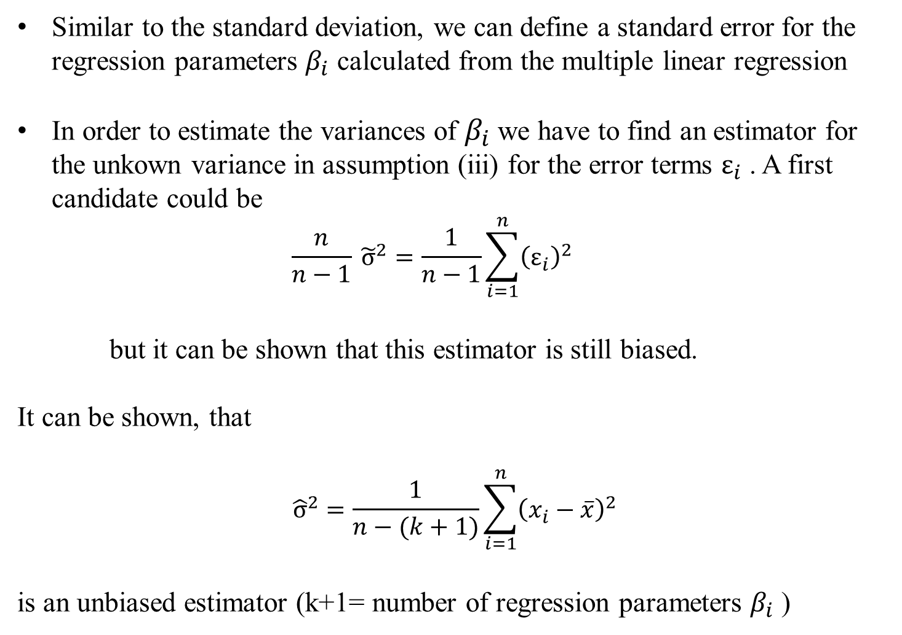







Multiple linear Regression – Standard error
Similar to the standard deviation, we can define a standard error for the regression parameters $β_{i}$ calculated from the multiple linear regression
In order to estimate the variances of $β_{i}$ we have to find an estimator for the unkown variance in assumption (iii) for the error terms $ε_{i}$ . A first candidate could be
  $$\frac{n}{n−1} {\tilde{σ}}^{2}=\frac{1}{n−1}\sum_{i=1}^{n}{{\left(ε_{i}\right)}^{2}}$$
but it can be shown that this estimator is still biased.
It can be shown, that
$${\hat{σ}}^{2}=\frac{1}{n−(k+1)}\sum_{i=1}^{n}{{\left(x_{i}−\overline{x}\right)}^{2}}$$
is an unbiased estimator (k+1= number of regression parameters $β_{i}$ )
c

Slide 37













Multiple linear Regression – Standard error
The standard error of estimators ${\hat{β}}_{i}$ can then be estimated via
and is given by the diagonal elements of V. If we define c_{ii} the diagonal elemants of [X^{T}X]⁻¹, we obtain for the standard se($β_{i}$)
se(${\hat{β}}_{i}$)= $\hat{σ}\sqrt{cii}$
and with the assumptions (i) – (v) we can show, that also the estimators ${\hat{β}}_{i}$are normally distributed with
$${\hat{β}}_{i}\sim N(β_{i},{\hat{σ}}^{2}cii)$$
c

Slide 38
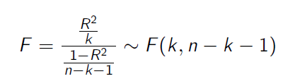























Multiple linear Regression – Hypothesis-Testing
With the assumptions and the derived properties we can calculate the following test statistics:
and
With F and t, we can make probability statements about the goodness of the estimators calculated from the multiple linear regression.
c

Slide 39







Multiple linear Regression – F-Test
Formulate the null hypothesis H₀:
There is no correlation between Y and X_{i}.
This means H₀: $β_{0}=β_{1}=β_{2}=…=β_{k}=0$ then R²=0
The alternative is then H₁: At least one $β_{i}≠0$ then $\text{R}\text{2}≠0$
Determine a reasonable significance level:
If H₀ is true, the test shall with probability $1−\text{α}$ not reject H₀.The significance level $\text{α}$ is the error probability, that we reject although it is true for the whole population.
Standard significance levels are 10%, 5%, 1%, 0,1%.
But be careful in choosing $\text{α}$since i.e. if $\text{α}$is too small H₀ would not be rejected, although it is not true!
Calculate from the regression the empirical F-value
c

Slide 40
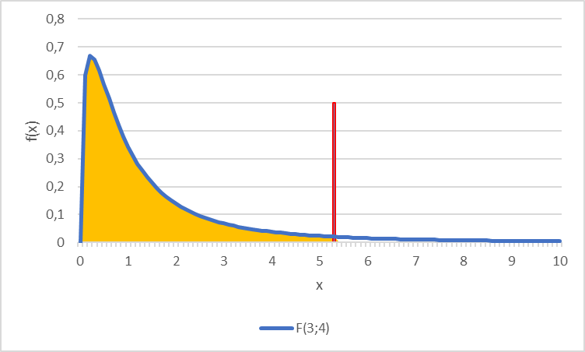
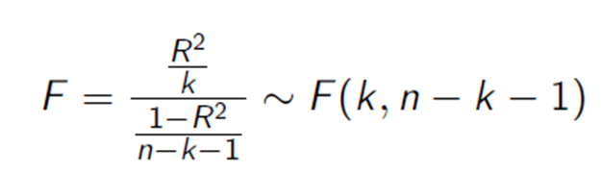
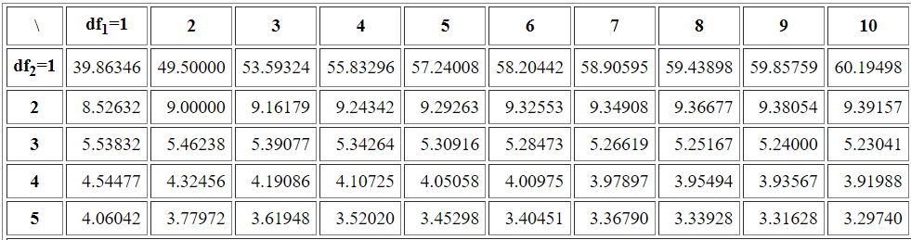





Multiple linear Regression – F-Test
Determine the theoretical F-value
Given the significance level the F-value represents the value for which for which the accumulated probability of an F-distributed variable equals $1−\text{α}$. i.e. in our example we have a
$F\left(k=3;n−k−1=8−3−1=4\right)=F(3,4)$ distribution and thus $F\text{9}\text{0}\text{\%}=5,34$
Compare theoretical and empirical F-value
F_{emp}>F_{theo}
H ₀ is rejected, the existence of a linear dependence between Y and X_{i} is significant to $\text{α}$=10%
F_{emp}≤F_{theo}
H₀ is not rejected. There is no linear dependence to a significance level of $\text{α}$=10%
$$F\text{9}\text{0}\text{\%}=5,34$$
90%
c
Table F-Distribution

Slide 41





Multiple linear Regression – t-Test
Formulate the null hypothesis H₀:
„Some Variable X_{i} has no relevance for Y“.
This means H₀: $β_{i}=0$
The alternative is then H₁: $β_{i}≠0$
(we deal only with this version of a two-sided test!)
Determine a reasonable significance level:
If H₀ is true, the test shall with probability $1−\text{α}$ not reject H₀.The significance level $\text{α}$ is the error probability, that we reject although it is true for the whole population.
Standard significance levels are 10%, 5%, 1%, 0,1%.
But be careful in choosing $\text{α}$since i.e. if $\text{α}$is too small H₀ would not be rejected, although it is not true!
Calculate from the regression the empirical t-values
c

Slide 42
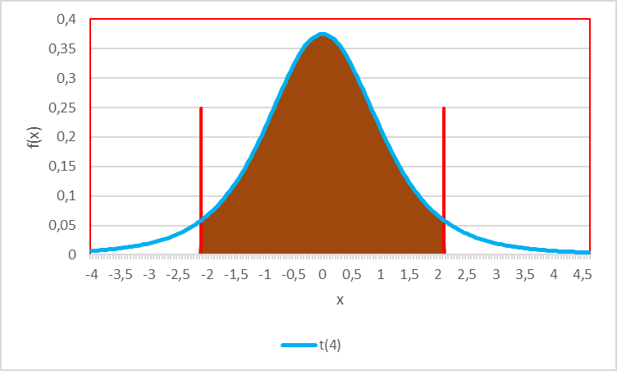
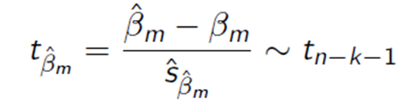
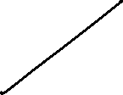



Multiple linear Regression – t-Test
Determine the theoretical t-value
Given the significance level the t-value represents the value for which for which the accumulated probability of an F-distributed variable equals $1−\text{α}$. i.e. in our example we have a t$\left(n−k−1=8−3−1=4\right)=t(4)$ distribution and thus $t\text{9}\text{5}\text{\%}=2,13$
Compare theoretical and empirical F-value
|t_{emp}| ≤ t_{theo}
H₀ is not rejected. The variable X_{i} has no $(β_{i}$=0) influence on Y for a significanse level of $\text{α}$=10%
$$t\text{5}\text{\%}=−2,13$$
$$t\text{9}\text{5}\text{\%}=2,13$$
90%
c
|t_{emp}|>t_{theo}
H₀ is rejected, X_{i} has for a level of $\text{α}$=10% a significant influence on Y with the marginal contribution ${\hat{β}}_{i}$

Slide 43











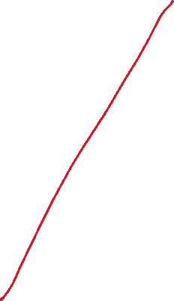





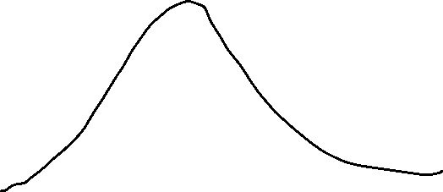

t(b0) | t(b1) | t(b2) | t(b3)
1,408 | 1,630 | 3,606 | 2,171
c

Slide 44
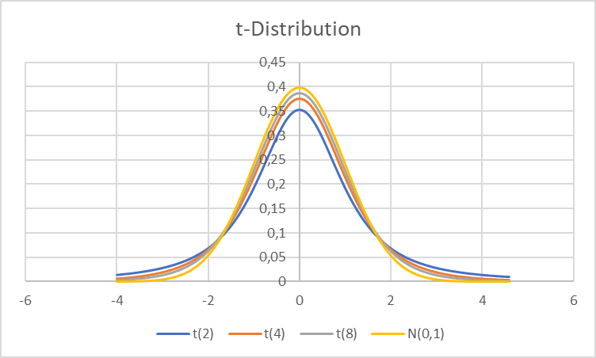
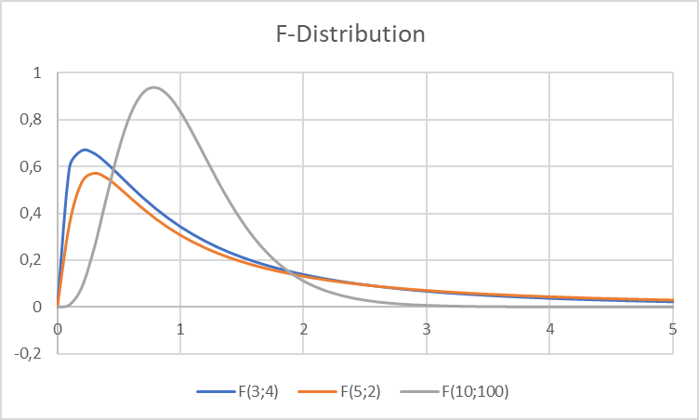








You want to see F an t ??
t-Dirstibution
F-Dirstibution
c

Slide 45














Example
Test the example for $\text{α}=\text{5\%}$ on H₀: $β_{0}=β_{1}=β_{2}=…=β_{k}=0$
Test for all H₀: $β_{i}=0$ and $\text{α}=\text{5\%}$
beta0 | beta1 | beta2 | beta3
10,669 | 1,484 | 0,718 | 9,008
se(b0) | se(b1) | se(b2) | se(b3)
7,579 | 0,911 | 0,199 | 4,150
t(b0) | t(b1) | t(b2) | t(b3)
1,408 | 1,630 | 3,606 | 2,171
c

Slide 46
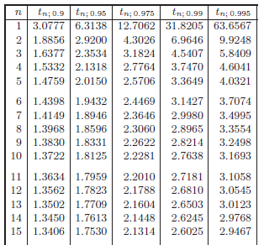


^{T-distribution}
c

Slide 47

F_{95%}
^{F-distribution}
F_{99%}
c

