Slide 1

Statistics B
Wilhelmshaven
This lecture will be recorded and
subsequently uploaded in the
world-wide-web
Function translator (webpage)
Function translator Excel 1 (add in)
c
Prof. Dr. Bernhard Köster
Jade-Hochschule Wilhelmshaven
http://www.bernhardkoester.de/vorlesungen/inhalt.html

Slide 2


c

Slide 3
























c

Slide 4

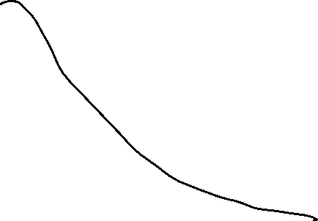















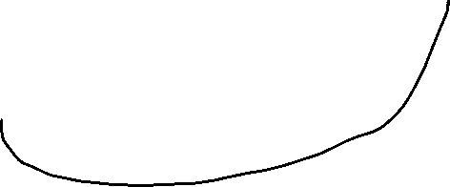













c

Slide 5

































c

Slide 6
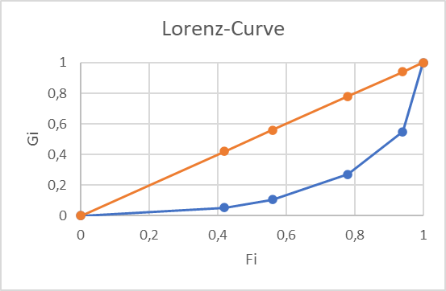





c

Slide 7
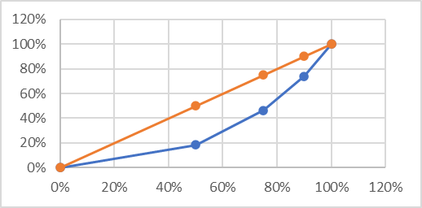

c

Slide 8










c

Slide 9














c

Slide 10




c

Slide 11






c

Slide 12










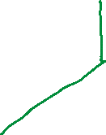



























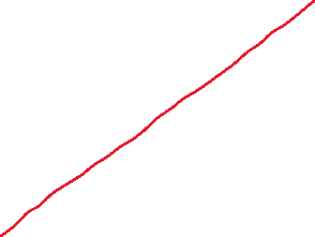




c

Slide 13












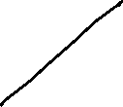










c

Slide 14
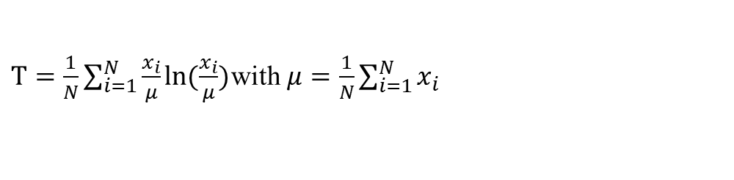





$T=\frac{1}{N}\sum_{i=1}^{N}{\frac{x_{i}}{μ}ln⁡(\frac{x_{i}}{μ})}$ with $μ=\frac{1}{N}\sum_{i=1}^{N}{x_{i}}$
c

