Slide 1

Statistics B
Wilhelmshaven
This lecture will be recorded and
subsequently uploaded in the
world-wide-web
Function translator (webpage)
Function translator Excel 1 (add in)
c
Prof. Dr. Bernhard Köster
Jade-Hochschule Wilhelmshaven
http://www.bernhardkoester.de/vorlesungen/inhalt.html

Slide 2


c

Slide 3
























c

Slide 4

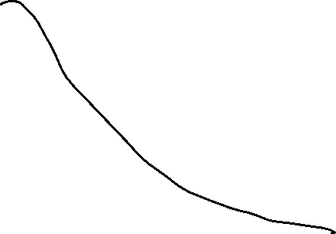





























c

Slide 5

































c

