Slide 1

Statistics B
Wilhelmshaven
This lecture will be recorded and
subsequently uploaded in the
world-wide-web
Function translator (webpage)
Function translator Excel 1 (add in)
c
Prof. Dr. Bernhard Köster
Jade-Hochschule Wilhelmshaven
http://www.bernhardkoester.de/vorlesungen/inhalt.html

Slide 2
Scatterplot
Graphical representation of the attributes of two variables within a two-dimensional coordinate-system.
Number | 1 | 2 | 3 | 4 | 5 | 6 | 7 | 8 | 9 | 10 | 11 | 12 | 13 | 14 | 15 | 16 | 17 | 18 | 19 | 20 | 21 | 22
Order | 2 | 4 | 3 | 6 | 2 | 1 | 5 | 3 | 4 | 2 | 2 | 7 | 4 | 3 | 2 | 1 | 5 | 4 | 3 | 3 | 1 | 6
Volume [€] | 36 | 44 | 30 | 67 | 21 | 8 | 62 | 35 | 33 | 37 | 22 | 72 | 65 | 45 | 23 | 17 | 44 | 56 | 32 | 37 | 22 | 48

Slide 3
Scatterplot
X-coordinate: order
Y-coordinate: Volume [Euro]

Slide 4
Linear Regression
Example 2:
A company wants to know how the sales volume depends on visits of representatives.
The company has collected the following data
We also want to answer the question, from a descriptive point of view, which sales volume we can expect, if we increase the visits up to x=30

Slide 5
Linear Regression
Via a linear regression we want to analyse the dependence between two variables
We distinguish between a dependent variable (y) and an independent variable (x)
(x) is also called the explanatory variable
A change of (x) implicates a change (y)
The linear regression defines an empirical Die lineare Regression stellt einen solchen empirisch beobachteten relation via a linear function
i.e. y = f(x) = 3 + 2x or generally y = a + bx

Slide 6
Simple Examples
Determine graphically a regression line for the blue and red data points. What kind of
dependence do we have?

Slide 7
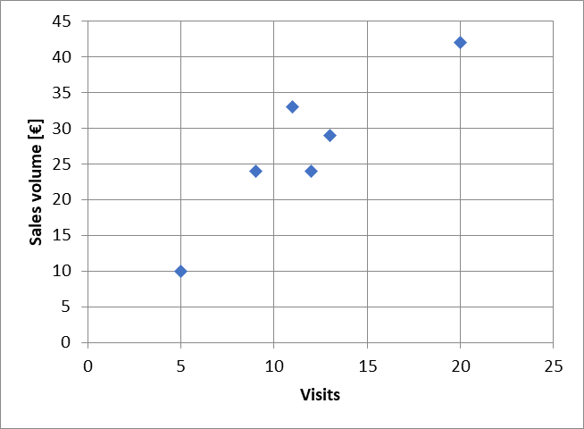
Example
Try to fit graphically (by eye) a regression line through the data points

Slide 8
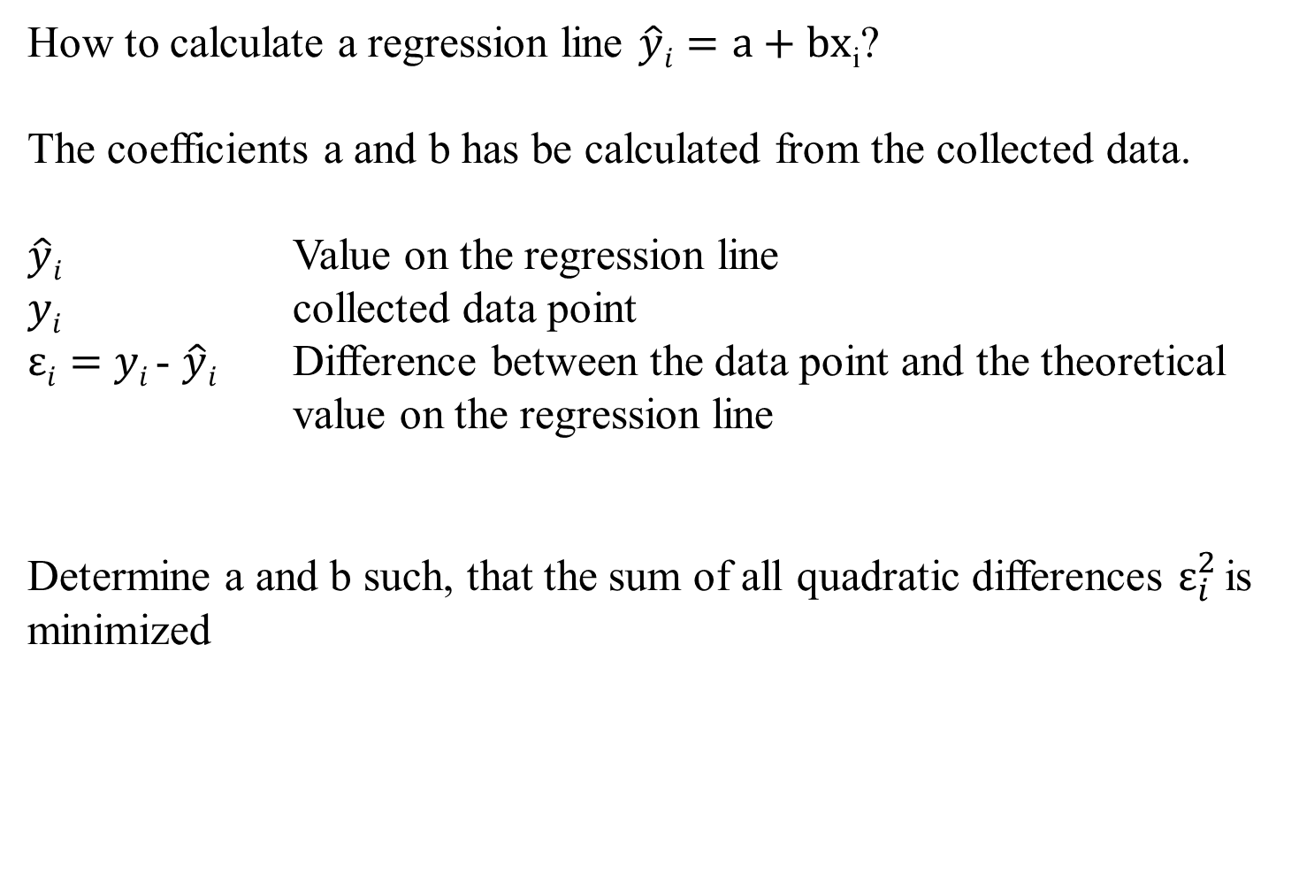
Optimizing problem
How to calculate a regression line $\hat{y}i=a+bx$_{i}?
The coefficients a and b has be calculated from the collected data.
$\hat{y}i$ Value on the regression line
$yi$ collected data point
$εi=$ $yi$- $\hat{y}i$ Difference between the data point and the theoretical value on the regression line
Determine a and b such, that the sum of all quadratic differences $ε_{i}^{2}$is minimized

Slide 9
Least squared method
The formal optimizing problem

Slide 10
Least squared method
The formal optimizing problem
FOC:
2 dimensional linear system which can directly be solved

Slide 11
Least squared method

Slide 12
Formulas
:

Slide 13
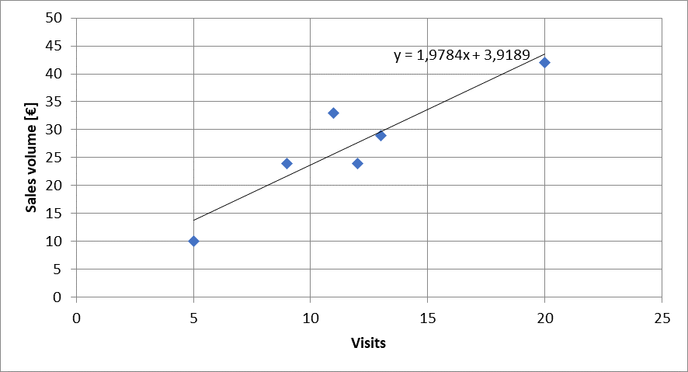


Calulating the regression line from empirical data
$$ei2$$
$\hat{y}i=a+bx$_{i}

Slide 14
Lineare Regression
 | Visits | Sales volume [€]
year | x | y | xy | x^2
2008 | 9 | 24
2009 | 11 | 33
2010 | 5 | 10
2011 | 13 | 29
2012 | 20 | 42
2013 | 12 | 24
b=
a=

Slide 15
Extrapolation for x=30
 | Visits | Sales volume [€]
year | x | y | xy | x^2 | yhat
2008 | 9 | 24
2009 | 11 | 33
2010 | 5 | 10
2011 | 13 | 29
2012 | 20 | 42
2013 | 12 | 24
yhat(30)=

Slide 16
Regressions coefficients
Regressions coefficient b
  Slope of the regression line.
  Determines the marginal effect of a change of one unit of the independent variable x onto the dependet variable y
Regressions coefficient a
  The value of the dependent variable if the independent variable x=0
    → intercept of the vertical axes

Slide 17
Linear regression
Measures the linear dependence between two variables
This dependence can be interpreted, that one variable is quantitatively influencing another variable
The linear regression is an instrument for forecasting

Slide 18
Correlation analysis
In principle for all data sets, we can calculate a regression line.
But we are also interested in the question meaningful is this calculated dependence?.
For this, we use the correlation analysis, wich gives the possibility to measure the strength of the dependence
For this, we use the correlation coefficient of Bravais-Pearson which is lying between -1 and +1

Slide 19
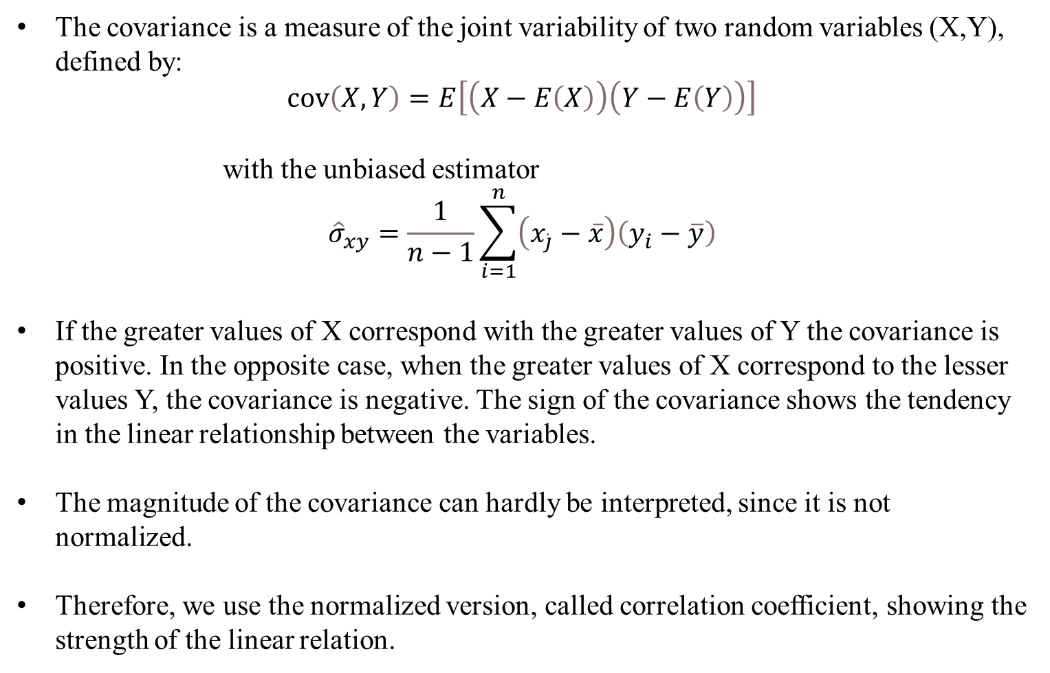
Covariance
The covariance is a measure of the joint variability of two random variables (X,Y), defined by:
$$\operatorname{cov}\left(X,Y\right)=E\left[\left(X−E\left(X\right)\right)\left(Y−E\left(Y\right)\right)\right]$$
with the unbiased estimator
$${\hat{σ}}_{xy}=\frac{1}{n−1}\sum_{i=1}^{n}{\left(x_{\dot{j}}−\overline{x}\right)\left(y_{i}−\overline{y}\right)}$$
If the greater values of X correspond with the greater values of Y the covariance is positive. In the opposite case, when the greater values of X correspond to the lesser values Y, the covariance is negative. The sign of the covariance shows the tendency in the linear relationship between the variables.
The magnitude of the covariance can hardly be interpreted, since it is not normalized.
Therefore, we use the normalized version, called correlation coefficient, showing the strength of the linear relation.

Slide 20
Correlation coefficient
General intervals for R
(0,0;0,2) → almost no dependence
[0,2;0,4) → low dependence
[0,4;0,6) → medium dependence
[0,6;0,8) → high dependence
[0,8;1,0) → almost full dependence

Slide 21
Correlation coefficiant examples
R=?
R=?
R=?
R=?

Slide 22
Coefficiant of determination R²
The squared correlation coefficiant R² is called coefficiant of determination.
In quantitative analysis, we often use the coefficiant of determination R², because it can be intuitively interpreted
But R² does not distinguish between + and – anymore.
R² is in the interval [0,1]
R² grafical interpretation:
  R² equals the proportion of variance explained by the model in relation to the total variance, i.e. how much percent is explained by the regression line
  (1-R²) equals the proportion of Variance not explained by the model in relation to the total variance, and has to be explained by other influencing factors

Slide 23
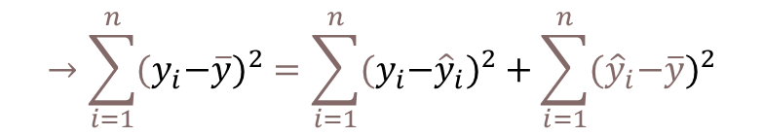




Coefficiant of determination R²
{
${\hat{y}}_{i}−\overline{y}$ explained difference
Total Difference
} Non explained difference
} Explained difference
${y_{i}−\hat{y}}_{i}$ not explained difference
Mean
$y_{i}−\overline{y}$ total difference
$$→\sum_{i=1}^{n}{{{(y}_{i}−\overline{y})}^{2}}=\sum_{i=1}^{n}{{{{(y}_{i}−\hat{y}}_{i})}^{2}}+\sum_{i=1}^{n}{{{(\hat{y}}_{i}−\overline{y})}^{2}}$$
Non explained squared difference y_{i}
total squared difference
explained squared difference
Mean
not explained squared difference
explained squared difference y_{i}
Total squared difference of y_{i}
Coefficiant of determination $R^{2}=\frac{\sum_{i=1}^{n}{{{(\hat{y}}_{i}−\overline{y})}^{2}}}{\sum_{i=1}^{n}{{{{(y}_{i}−\hat{y}}_{i})}^{2}}}$

Slide 24
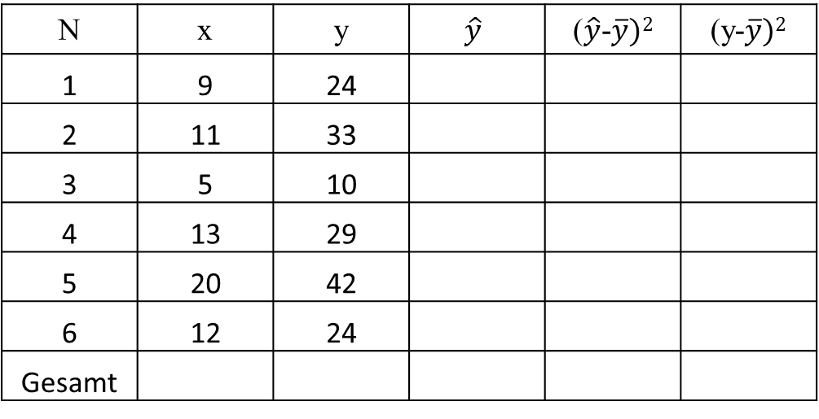
Coefficiant of determination R²
N | x | y | $$\hat{y}$$ | ($\hat{y}$-$\overline{y})2$ | (y-$\overline{y})2$
1 | 9 | 24
2 | 11 | 33
3 | 5 | 10
4 | 13 | 29
5 | 20 | 42
6 | 12 | 24
Gesamt
R²= R=

Slide 25
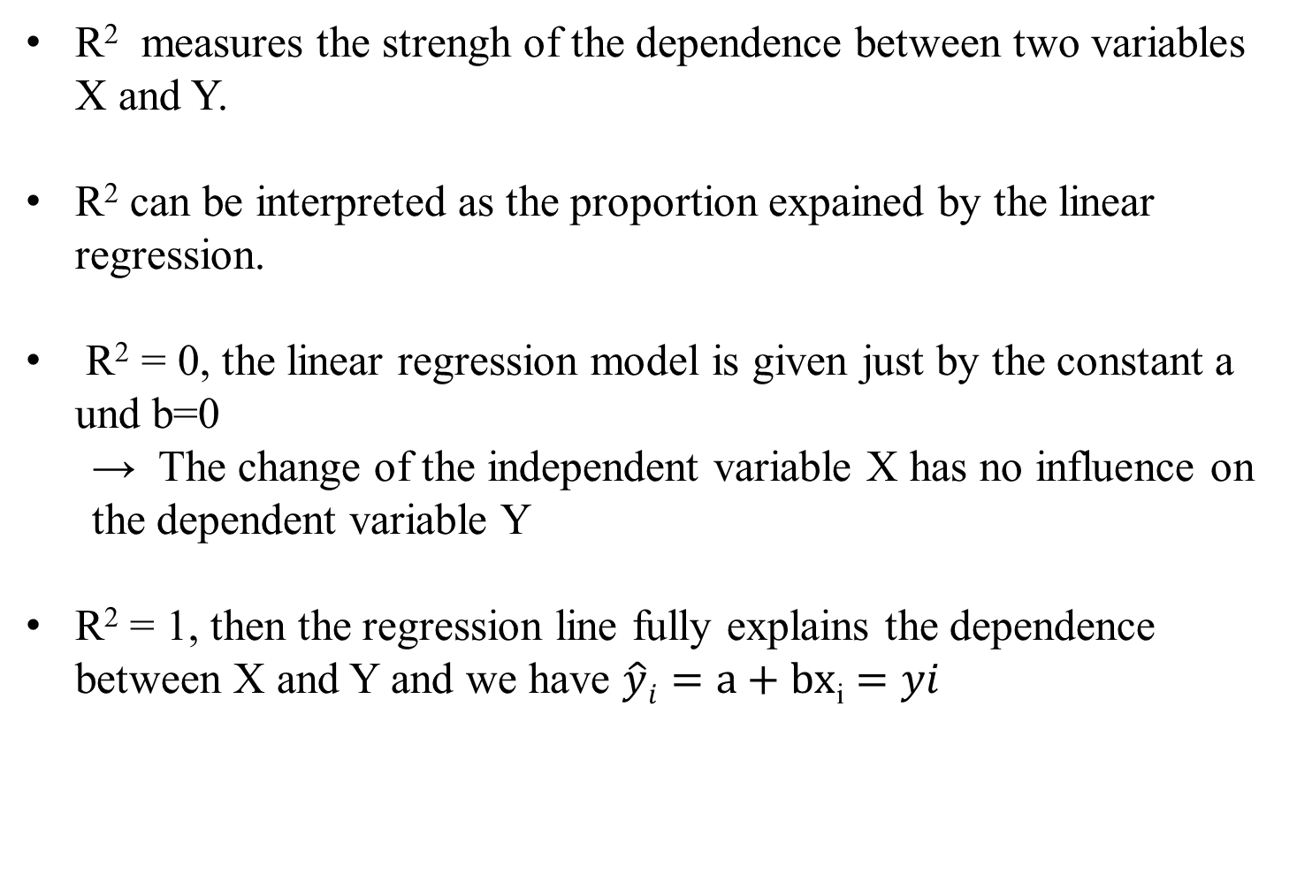
Interpretation of R²
R² measures the strengh of the dependence between two variables X and Y.
R² can be interpreted as the proportion expained by the linear regression.
R² = 0, the linear regression model is given just by the constant a und b=0
  → The change of the independent variable X has no influence on the dependent variable Y
R² = 1, then the regression line fully explains the dependence between X and Y and we have $\hat{y}i=a+bx$_{i} $=yi$

