Slide 1
Statistics B
Wilhelmshaven
This lecture will be recorded and
subsequently uploaded in the
world-wide-web
Function translator (webpage)
Function translator Excel 1 (add in)
c
Prof. Dr. Bernhard Köster
Jade-Hochschule Wilhelmshaven
http://www.bernhardkoester.de/vorlesungen/inhalt.html

Slide 2
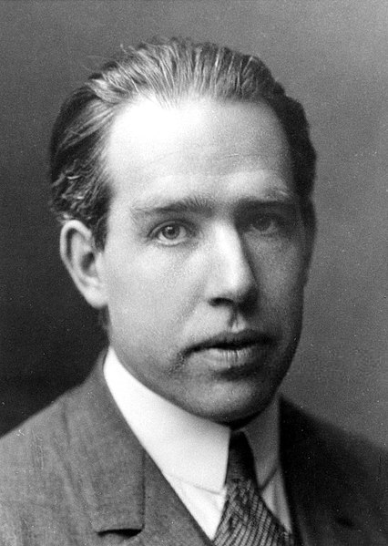
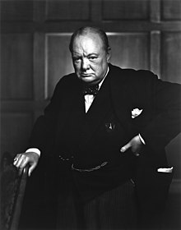
Forecasting
“Prediction is very difficult, especially if it’s about the future!”
Nils Bohr (1885 – 1962, Nobel Laureate 1922 in Physics)
Source: The American Institute of Physics
“Do not believe any statistic that you haven't forged yourself“
Winston Chruchill (1874 – 1965, UK Prime Minister)
c
Source: Library and Archives Canada

Slide 3
Components of a Time Series
Revenue, Quantity
Development of Demand over time
Business cycle
c
Seasonal fluctuation during a year
Not explainable
random fluctuation
Stochastic error

Slide 4
Exercise
Create a time series composite of a trend, cyclical, seasonal and random data
c

Slide 5
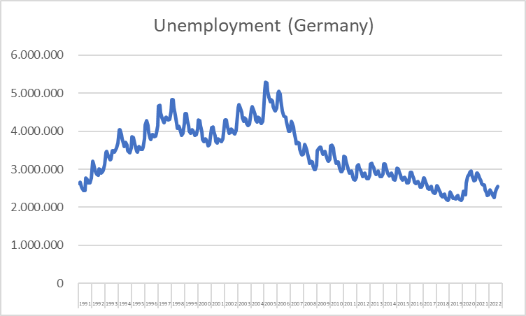
Example: Unemployment data
c
Source: BA

Slide 6
Forecasting
Enterprise A has the following development of revenue during the last years
Frequency: Quaterly data
Task: Forecast the revenue of the next quarter and the next year
Quarter | Revenue [Mio. Euro] | Quarter | Revenue [Mio. Euro]
2018q1 | 330 | 2021q1 | 378
2018q2 | 345 | 2021q2 | 405
2018q3 | 390 | 2021q3 | 498
2018q4 | 354 | 2021q4 | 420
2019q1 | 345 | 2022q1 | 429
2019q2 | 357 | 2022q2 | 495
2019q3 | 420 | 2022q3 | 540
2019q4 | 360 | 2022q4 | 510
2020q1 | 366
2020q2 | 390
2020q3 | 468
2020q4 | 402
c

Slide 7
Forecasting
Plot the data
Simple forecast:
Repeat the last data point, give examples, where this is done
In which economic field is this theoretically the best forecast?
Moving average in order to forecast to following data point: ${\hat{y}}_{t+1}=\frac{1}{h}⋅\sum_{i=1}^{h}{y_{t−i+1}}$
Smoothing the data with the centered moving average (usually h → odd):
$${\hat{y}}_{t−(h−1)/2}=\frac{1}{h}⋅\sum_{i=1}^{h}{y_{t−i+1}}$$
c

Slide 8
Forecasting
Calculate the moving average in order to forecast the revenue for 2023q1 n=1,3,5,7
Calculate the centered moving average for n=1,3,5,7 an plot the data compared to the original data
Why do we show the data of daily confirmed new cases of Corona with a 7-days moving average?
c

Slide 9
Forecasting with moving average
Properties of moving average data:
Smoothing original data
Underestimating within an increasing trend of the data
Overestimating within an decreasing trend of the data
No incorporation seasonality effects
Useful for short-term forecasts
c

