Slide 1

Statistics B
Wilhelmshaven
This lecture will be recorded and
subsequently uploaded in the
world-wide-web
Function translator (webpage)
Function translator Excel 1 (add in)
c
Prof. Dr. Bernhard Köster
Jade-Hochschule Wilhelmshaven
http://www.bernhardkoester.de/vorlesungen/inhalt.html

Slide 2
Lorenz-curve:
  The Lorenz-curve is a Probability-Plot (P-P-Plot) comparing the relative distribution of a variable with the uniform distribution.
    → We plot the cumulated propotion of the value of the variable against the cumulated propotion of the population.
  → The Lorenzcurve is a graphical representation of the relative concentration of the value of the variable.
c

Slide 3
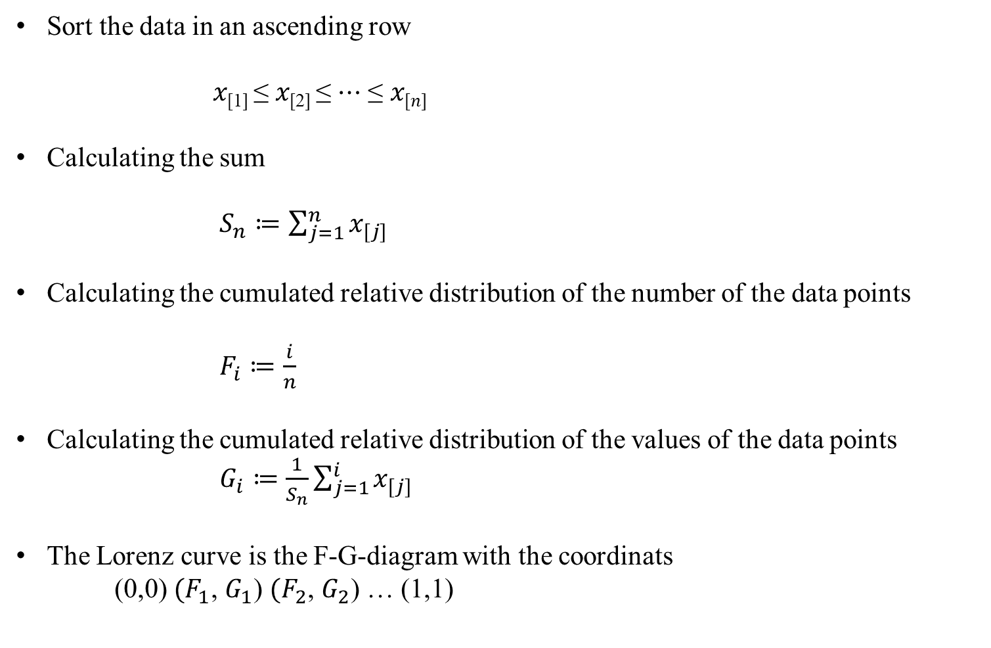
Calculating the Lorenz-curve
Sort the data in an ascending row
𝑥_{[1]} ≤ 𝑥_{[2]} ≤ ⋯ ≤ 𝑥_{[𝑛]}
Calculating the sum
$S_{n}≔\sum_{j=1}^{n}{x_{[j]}}$
Calculating the cumulated relative distribution of the number of the data points
$F_{i}≔\frac{i}{n}$
Calculating the cumulated relative distribution of the values of the data points
$G_{i}≔\frac{1}{S_{n}}\sum_{j=1}^{i}{x_{[j]}}$
The Lorenz curve is the F-G-diagram with the coordinats
(0,0) ${(F}_{1}$, $G_{1}$) ${(F}_{2}$, $G_{2}$) … (1,1)
c

Slide 4
Example A
U-Nr. | A | Fi | Gi
 |  | 0 | 0
1 | 70
2 | 120
3 | 190
4 | 250
5 | 370 | 1 | 1
Sum | 1000
c
Calculate the Lorenz-curve between (0,0) und (1,1)

Slide 5
Example B
U-Nr. | B | Fi | Gi
 |  | 0 | 0
1 | 200
2 | 200
3 | 200
4 | 200
5 | 200 | 1 | 1
Summe | 1000
c
Lorenz-curve for a uniform distribution between (0,0) und (1,1).

Slide 6
Example C
U-Nr. | C | Fi | Gi
 |  | 0 | 0
1 | 0 | 0,2 | 0
2 | 0 | 0,4 | 0
3 | 0 | 0,6 | 0
4 | 0 | 0,8 | 0
5 | 1000 | 1 | 1
Summe | 1000
c
Lorenz-curve if the total value is centered at one data point in between(0,0) (1,1).

Slide 7
Example D
U-Nr. | D | Fi | Gi
 |  | 0 | 0
1 | 30
2 | 30
3 | 30
4 | 30
5 | 30
6 | 150
7 | 150
8 | 150
9 | 200
10 | 200 | 1 | 1
Summe | 1000
c
Value | Counts | Fj | Gj
 |  | 0 | 0
30
150
200 |  | 1 | 1
Lorenz-curve with multiple counts for one value in between (0,0) (1,1).

Slide 8
Properties of the Lorenz-curve
The Lorenz-curve is monotonically increasing
The Lorenz-curve is konvex
Die Lorenzkurve ist abschnittsweise linear
The Lorenz-curve is in beetween (0,0) und (1,1)
For the uniform distribution, the Lorenz-curve is is a straight line form (0,0) und (1,1)
If within a sample of n data points, the total value is centered at only one data point, the Lorenz-curve is represented by (0,0) (0,(n-1)/n) (1,1)
Usually the Lorenz-curve is plotted relativ to the uniform distribution.
c

Slide 9
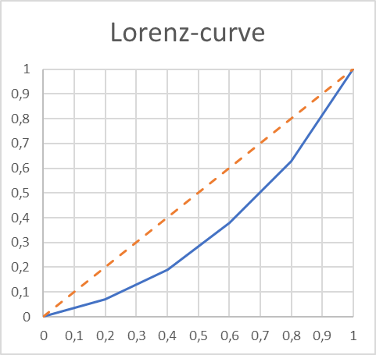
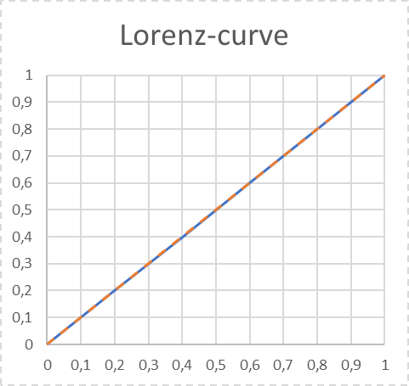
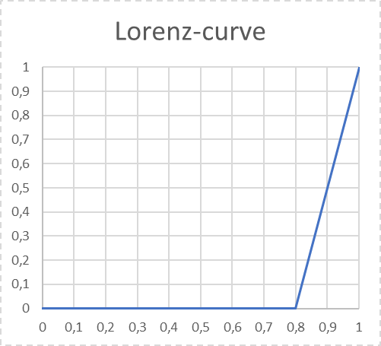
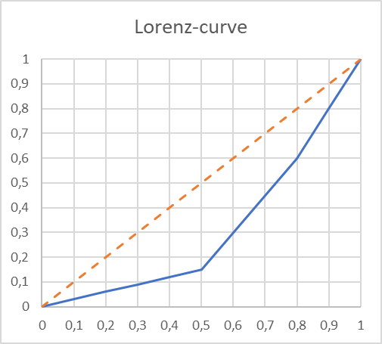
Lorenz-curve and the uniform distirbution
A
B
C
D
c

Slide 10
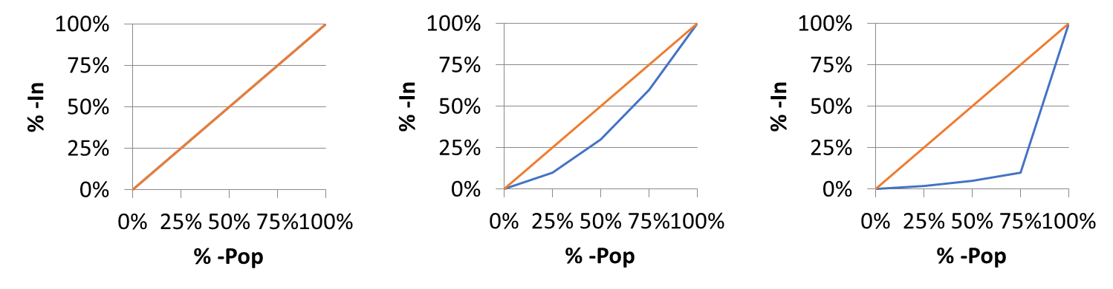
Case Study: Lorenz-curve and Income distribution
In an ascending ordered sample, we plot the accumulated relative income with respect to accumulated proportion of the population.
The more, the Lorenz-curve runs below the 45°-Line the more concentrated is the income distribution
i.e. Which proportion of national income is earned by the poorest of the popupation?
Uniform distribution
Right skewed
Bill-Gates
% -Pop | %-In
Q-25% | 25%
Q-50% | 50%
Q-75% | 75%
Q-100% | 100%
% -Pop | %-In
Q-25% | 10%
Q-50% | 30%
Q-75% | 60%
Q-100% | 100%
% -Pop | %-In
Q-25% | 1%
Q-50% | 2%
Q-75% | 3%
Q-100% | 97%
c

Slide 11
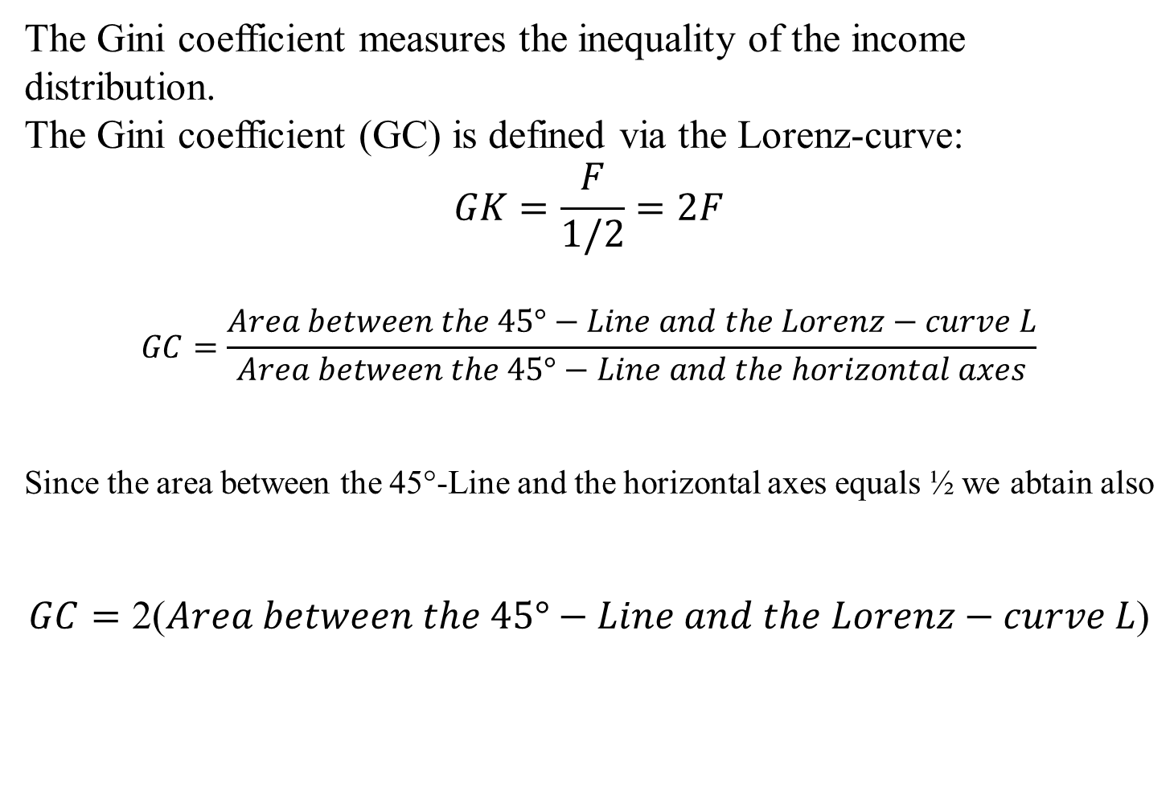
^{The Gini-Coefficient}
The Gini coefficient measures the inequality of the income distribution.
The Gini coefficient (GC) is defined via the Lorenz-curve:
$$GK=\frac{F}{1/2}=2F$$
$$GC=\frac{Area between the 45°−Line and the Lorenz−curve L}{Area between the 45°−Line and the horizontal axes}$$
Since the area between the 45°-Line and the horizontal axes equals ½ we abtain also
$$GC=\text{2(}Area between the 45°−Line and the Lorenz−curve L\text{)}$$
c

Slide 12
Der Gini-Koeffizient und Lorenzkurve
100%
45°-Line
L
100%
c
Gini-Koeffizient = GK =

Slide 13
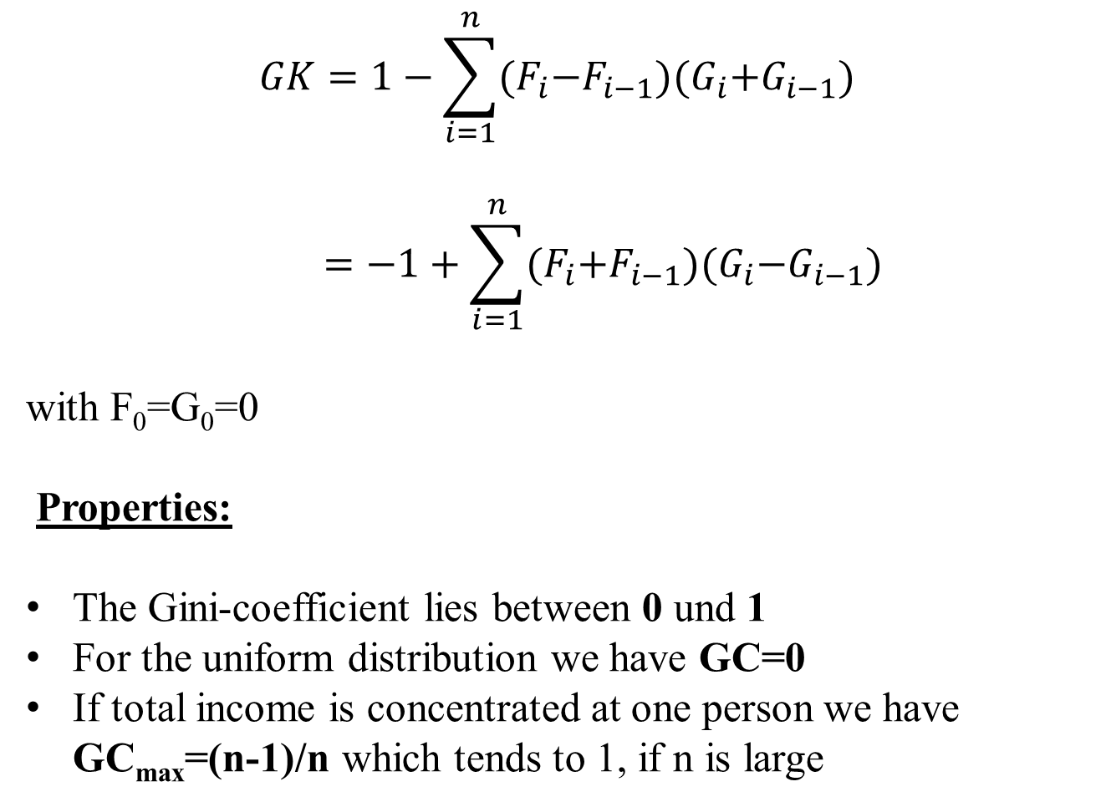
Calculation of the Gini-coefficient
$$GK=1−\sum_{i=1}^{n}{{(F}_{i}−F_{i−1}){(G}_{i}+G_{i−1})}$$
$$=−1+\sum_{i=1}^{n}{{(F}_{i}+F_{i−1}){(G}_{i}−G_{i−1})}$$
with F₀=G₀=0
Properties:
The Gini-coefficient lies between 0 und 1
For the uniform distribution we have GC=0
If total income is concentrated at one person we have GC_{max}=(n-1)/n which tends to 1, if n is large
c

Slide 14
Calculate the Gini-coefficients of distributions A-D
c

Slide 15
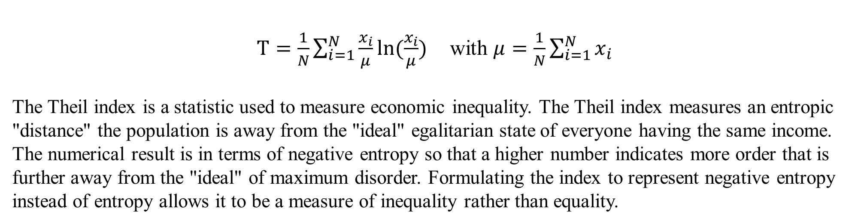
Theil-Index
$T=\frac{1}{N}\sum_{i=1}^{N}{\frac{x_{i}}{μ}ln⁡(\frac{x_{i}}{μ})}$ with $μ=\frac{1}{N}\sum_{i=1}^{N}{x_{i}}$
The Theil index is a statistic used to measure economic inequality. The Theil index measures an entropic "distance" the population is away from the "ideal" egalitarian state of everyone having the same income. The numerical result is in terms of negative entropy so that a higher number indicates more order that is further away from the "ideal" of maximum disorder. Formulating the index to represent negative entropy instead of entropy allows it to be a measure of inequality rather than equality.
Properties:
For the uniform distribution: T=0
For a distribution with maximum inequality: T=ln(N)
The Theil-Index is decomposable for subgroups of the distirbution
The Theil-Index is very sensitve to redristibutions form poor to rich
c

Slide 16
Calculate the Gini-coefficients of distributions A-D
c

