Slide 1
Inequlity Metrics
Definition:
Within a random sample, it is possible, that we have an unequal distribution.
This inequality can be measured in an absolute or relative way:
Examples:
Income distribution or distribution of wealth
The poorest 10% of the population receive 1% of national income
The richest 10% of the population receive 25% of national income
Market structure (Polypol – Oligopol – Monopol)
Number of suppliers
Market share
c

Slide 2
Concentration ratio
Definition:
The concentration ratio (CR) is the sum of the percentage market shares of a pre-specified number of)the largest firms in an industry.
Example
The three largest firms have a market share of 90%.
c

Slide 3




Concentration ratio
$\text{CR}\text{1}\text{=}\frac{x_{1}}{S_{n}}$ $x_{1}$: Revenue the largest firm, $S_{n}$: Total revenue of the whole sector
$\text{CR}\text{k}\text{=}\frac{{\sum_{j=1}^{k}{x}}_{j}}{S_{n} }$ k: Number of the k-th largest firms in the sector consisting of n firms.
c

Slide 4





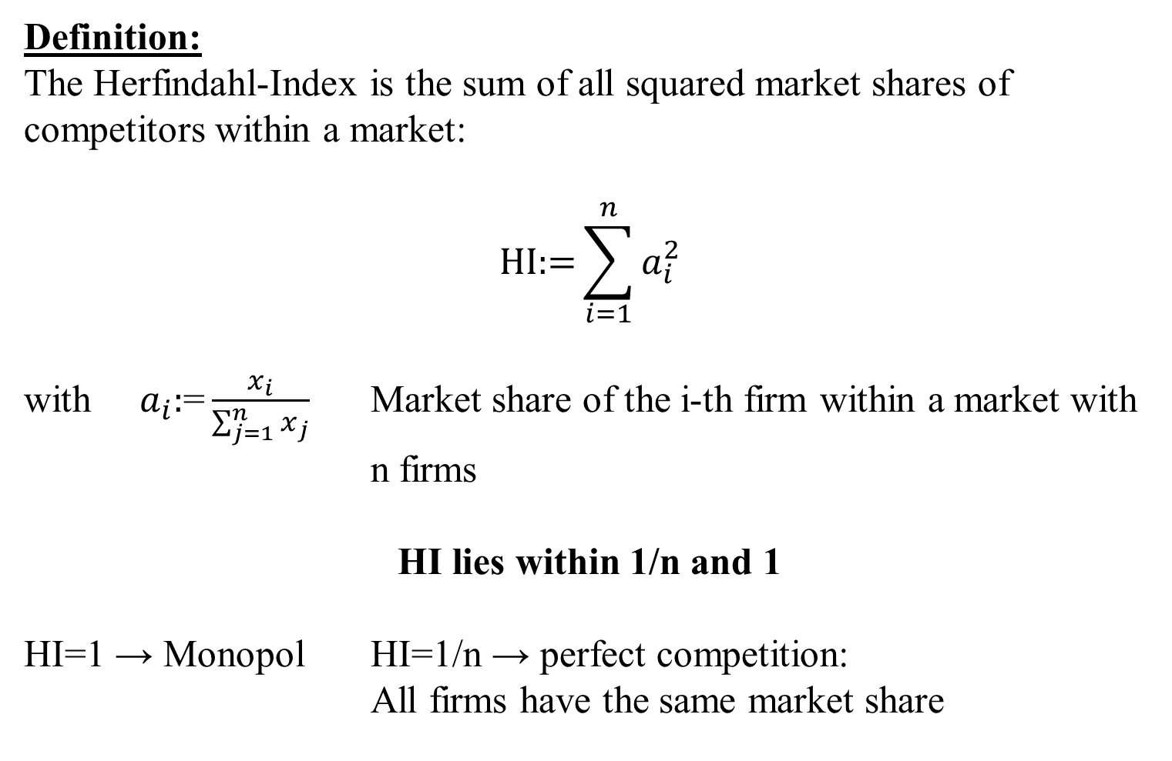
Herfindahl-Index
Definition:
The Herfindahl-Index is the sum of all squared market shares of competitors within a market:
$$\text{HI}\text{:=}\sum_{i=1}^{n}{a_{i}^{2}}$$
with $a_{i}\text{:}\text{=}\frac{x_{i}}{\sum_{j=1}^{n}{x_{j}}}$ Market share of the i-th firm within a market with n firms
HI lies within 1/n and 1
HI=1 → Monopol HI=1/n → perfect competition:
All firms have the same market share
c

Slide 5
Application of the Herfindahl-Index
Economics:
Herfindahl-Index is applied by a Antitrust authorities, in order to evaluate how M&A affects the market concentration.
Under Cournot-competition of n-firms, the Herfindahl-index is equal to the demand elasticity times weighted average of profit margins of the firms in the market (Excercise)
Market Research:
The Herfindahl-Index can be interpreted as a measure for customer loyality
Politics:
The Herfindahl-Index represents the fragmentation of a party system, especially the inverse is called, the effective number of parties.
c

Slide 6






Theil-Index
$T=\frac{1}{N}\sum_{i=1}^{N}{\frac{x_{i}}{μ}ln⁡(\frac{x_{i}}{μ})}$ with $μ=\frac{1}{N}\sum_{i=1}^{N}{x_{i}}$
The Theil index is a statistic used to measure economic inequality. The Theil index measures an entropic "distance" the population is away from the "ideal" egalitarian state of everyone having the same income. The numerical result is in terms of negative entropy so that a higher number indicates more order that is further away from the "ideal" of maximum disorder. Formulating the index to represent negative entropy instead of entropy allows it to be a measure of inequality rather than equality.
Properties:
For the uniform distribution: T=0
For a distribution with maximum inequality: T=ln(N)
The Theil-Index is decomposable for subgroups of the distirbution
The Theil-Index is very sensitve to redristibutions form poor to rich
c

Slide 7
Market share in a sector
No. | A | B | C | D
1 | 70 | 200 | 0 | 30
2 | 120 | 200 | 0 | 30
3 | 190 | 200 | 0 | 30
4 | 250 | 200 | 0 | 30
5 | 370 | 200 | 1000 | 30
6 |  |  |  | 150
7 |  |  |  | 150
8 |  |  |  | 150
9 |  |  |  | 200
10 |  |  |  | 200
Sum
c

Slide 8













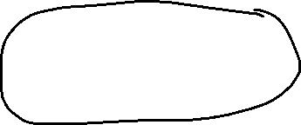
Excercise
Determine if possible for A-D
C$on\text{centration} \text{ratios} \text{CR}\text{1}$ $\text{CR}\text{2}$ $\text{CR}\text{3}$
The Herfindahl-Index
The Theil-Index
c

Slide 9
Lorenz-curve:
The Lorenz-curve is a Probability-Plot (P-P-Plot) comparing the relative distribution of a variable with the uniform distribution.
→ We plot the cumulated propotion of the value of the variable against the cumulated propotion of the population.
→ The Lorenzcurve is a graphical representation of the relative concentration of the value of the variable.
c

Slide 10
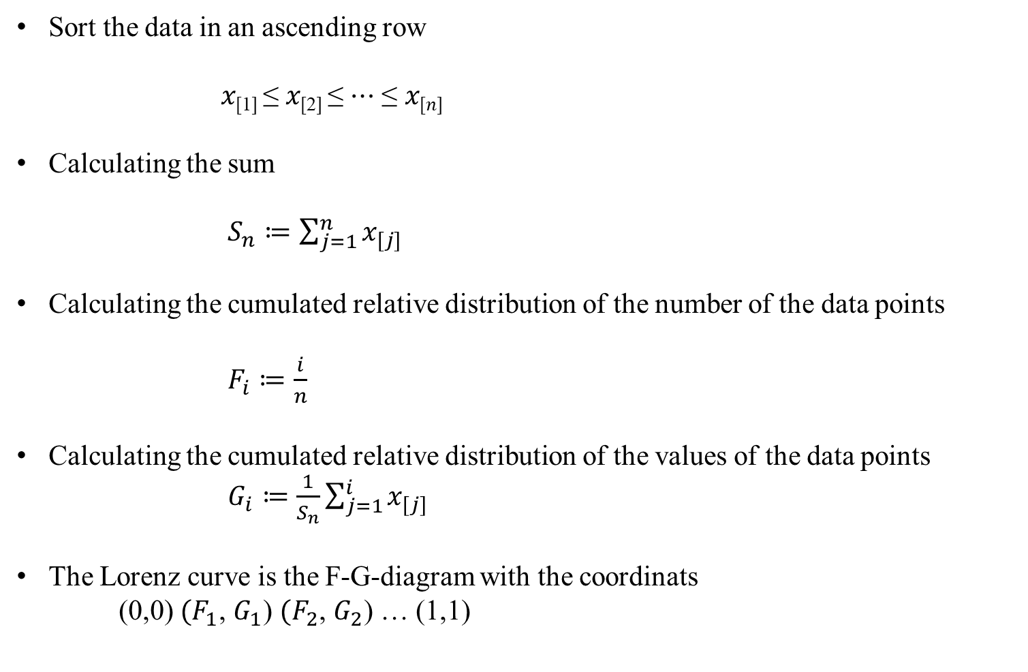
Calculating the Lorenz-curve
Sort the data in an ascending row
𝑥_{[1]} ≤ 𝑥_{[2]} ≤ ⋯ ≤ 𝑥_{[𝑛]}
Calculating the sum
$S_{n}≔\sum_{j=1}^{n}{x_{[j]}}$
Calculating the cumulated relative distribution of the number of the data points
$F_{i}≔\frac{i}{n}$
Calculating the cumulated relative distribution of the values of the data points
$G_{i}≔\frac{1}{S_{n}}\sum_{j=1}^{i}{x_{[j]}}$
The Lorenz curve is the F-G-diagram with the coordinats
(0,0) ${(F}_{1}$, $G_{1}$) ${(F}_{2}$, $G_{2}$) … (1,1)
c

Slide 11
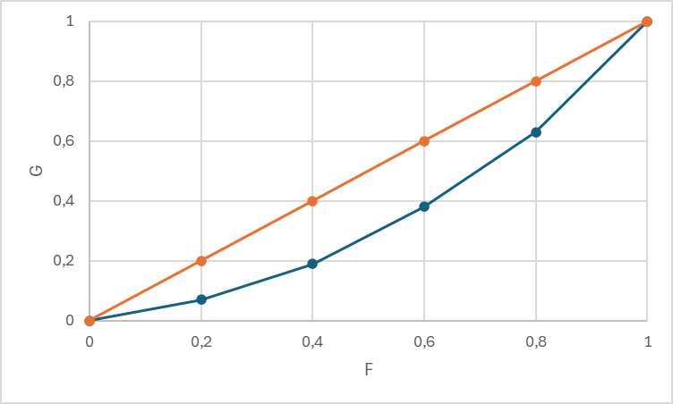
Example A
U-Nr. | A | Fi | Gi
 |  | 0 | 0
1 | 70
2 | 120
3 | 190
4 | 250
5 | 370 | 1 | 1
Sum | 1000
c
Calculate the Lorenz-curve between (0,0) und (1,1)

Slide 12
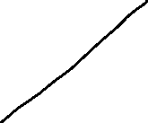
Example B
U-Nr. | B | Fi | Gi
 |  | 0 | 0
1 | 200
2 | 200
3 | 200
4 | 200
5 | 200 | 1 | 1
Summe | 1000
c
Lorenz-curve for a uniform distribution between (0,0) und (1,1).

Slide 13
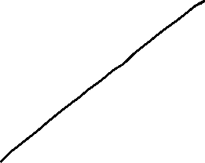

Example C
U-Nr. | C | Fi | Gi
 |  | 0 | 0
1 | 0 | 0,2 | 0
2 | 0 | 0,4 | 0
3 | 0 | 0,6 | 0
4 | 0 | 0,8 | 0
5 | 1000 | 1 | 1
Summe | 1000
c
Lorenz-curve if the total value is centered at one data point in between(0,0) (1,1).

Slide 14
Example D
U-Nr. | D | Fi | Gi
 |  | 0 | 0
1 | 30
2 | 30
3 | 30
4 | 30
5 | 30
6 | 150
7 | 150
8 | 150
9 | 200
10 | 200 | 1 | 1
Summe | 1000
c
Value | Counts | Fj | Gj
 |  | 0 | 0
30
150
200 |  | 1 | 1
Lorenz-curve with multiple counts for one value in between (0,0) (1,1).

Slide 15
Properties of the Lorenz-curve
The Lorenz-curve is monotonically increasing
The Lorenz-curve is konvex
The Lorenz-curve is in beetween (0,0) und (1,1)
For the uniform distribution, the Lorenz-curve is is a straight line form (0,0) und (1,1)
If within a sample of n data points, the total value is centered at only one data point, the Lorenz-curve is represented by (0,0) (0,(n-1)/n) (1,1)
Usually the Lorenz-curve is plotted relativ to the uniform distribution.
c

Slide 16
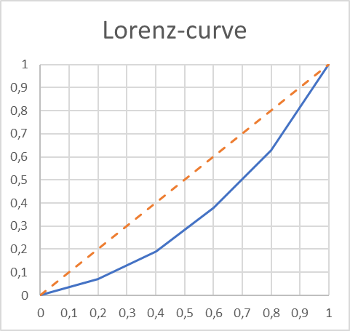
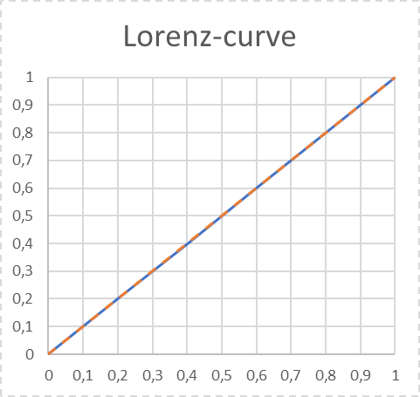
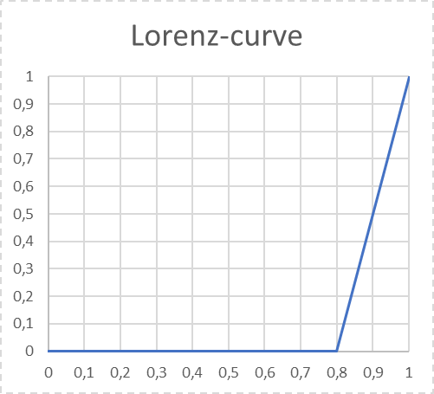
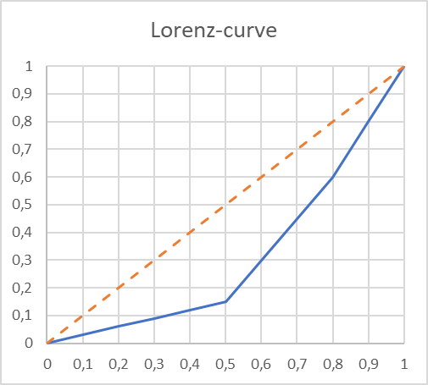















Lorenz-curve and the uniform distirbution
A
B
C
D
c

Slide 17
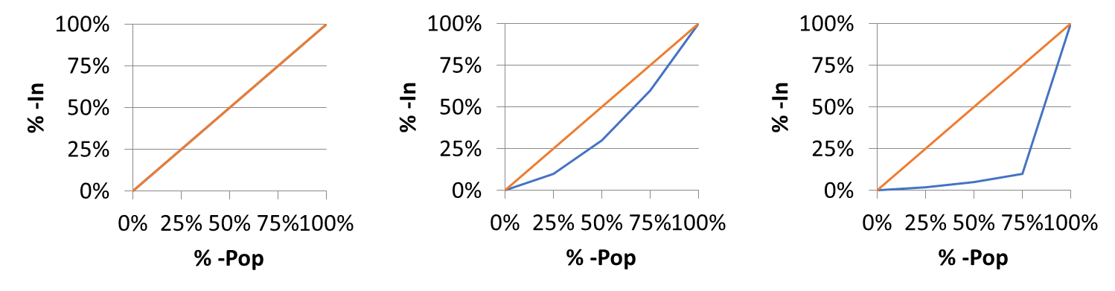
Case Study: Lorenz-curve and Income distribution
In an ascending ordered sample, we plot the accumulated relative income with respect to accumulated proportion of the population.
The more, the Lorenz-curve runs below the 45°-Line the more concentrated is the income distribution
i.e. Which proportion of national income is earned by the poorest of the popupation?
Uniform distribution
Right skewed
Bill-Gates
% -Pop | %-In
Q-25% | 25%
Q-50% | 50%
Q-75% | 75%
Q-100% | 100%
% -Pop | %-In
Q-25% | 10%
Q-50% | 30%
Q-75% | 60%
Q-100% | 100%
% -Pop | %-In
Q-25% | 1%
Q-50% | 2%
Q-75% | 3%
Q-100% | 97%
c

Slide 18
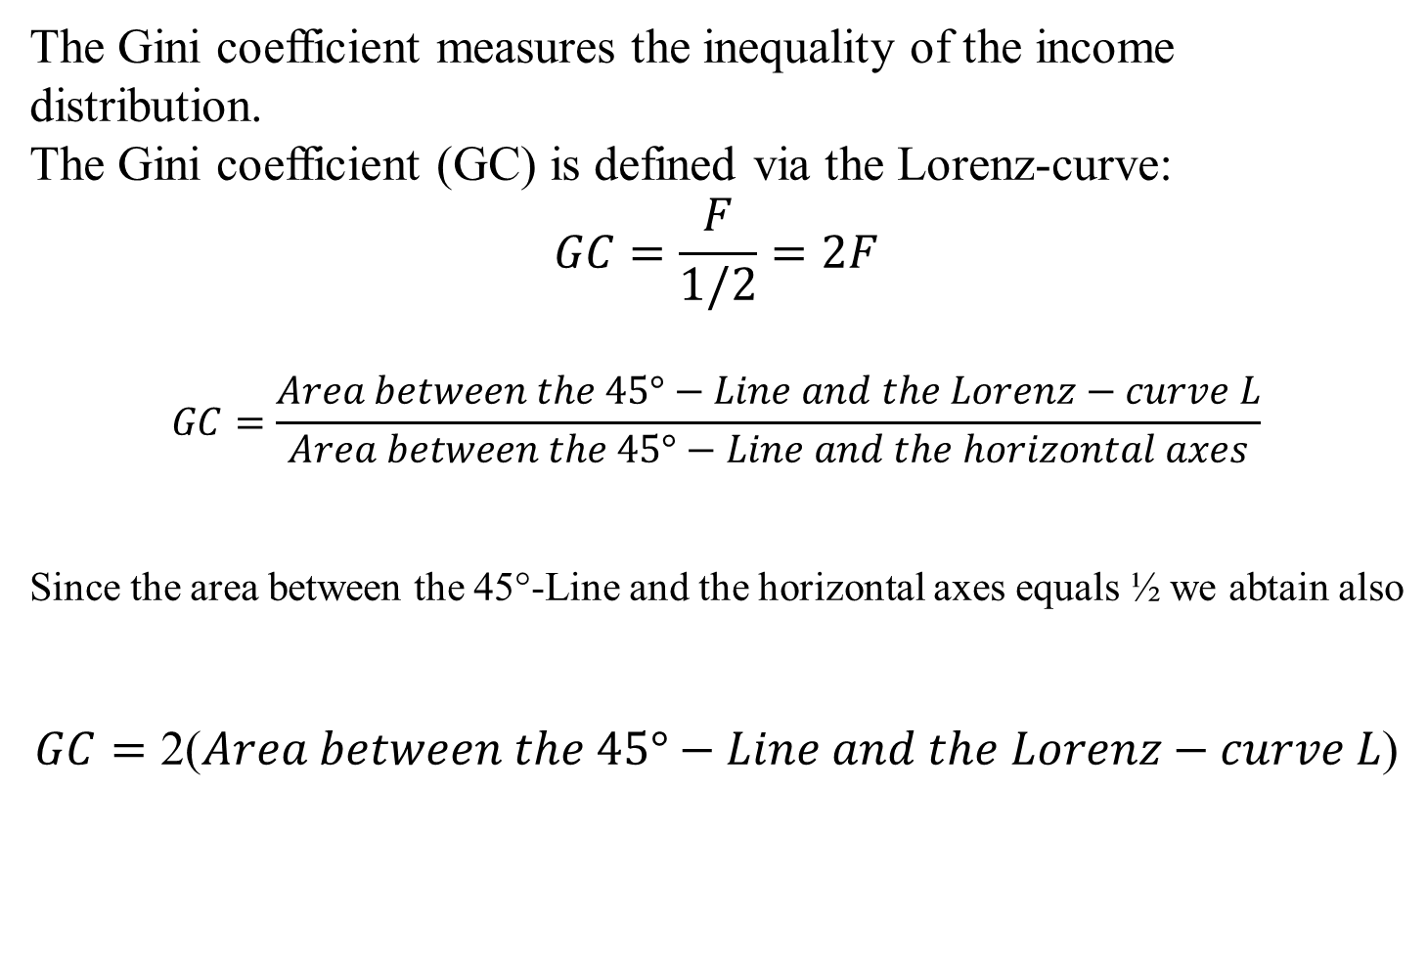
^{The Gini-Coefficient}
The Gini coefficient measures the inequality of the income distribution.
The Gini coefficient (GC) is defined via the Lorenz-curve:
$$GC=\frac{F}{1/2}=2F$$
$$GC=\frac{Area between the 45°−Line and the Lorenz−curve L}{Area between the 45°−Line and the horizontal axes}$$
Since the area between the 45°-Line and the horizontal axes equals ½ we abtain also
$$GC=\text{2(}Area between the 45°−Line and the Lorenz−curve L\text{)}$$
c

Slide 19
Der Gini-Coefficient and Lorenzcurve
100%
45°-Line
L
100%
c
Gini-Coeffizient = GC =

Slide 20
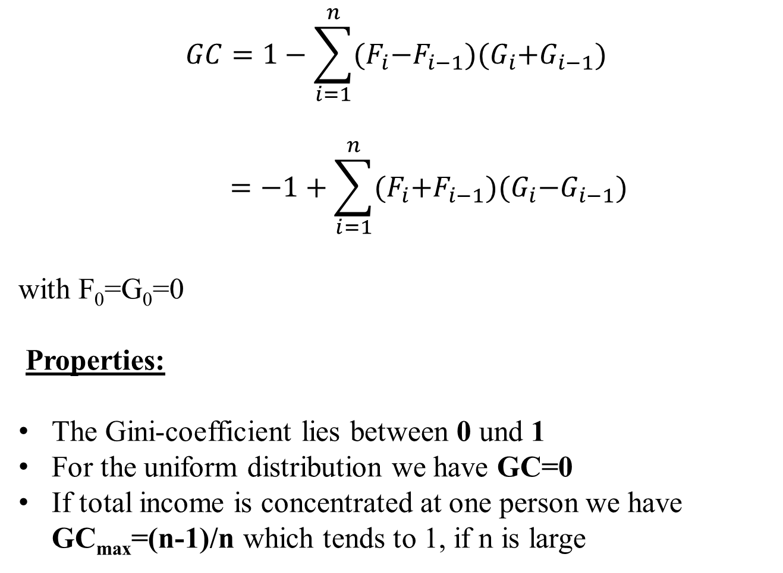
Calculation of the Gini-coefficient
$$GC=1−\sum_{i=1}^{n}{{(F}_{i}−F_{i−1}){(G}_{i}+G_{i−1})}$$
$$=−1+\sum_{i=1}^{n}{{(F}_{i}+F_{i−1}){(G}_{i}−G_{i−1})}$$
with F₀=G₀=0
Properties:
The Gini-coefficient lies between 0 und 1
For the uniform distribution we have GC=0
If total income is concentrated at one person we have GC_{max}=(n-1)/n which tends to 1, if n is large
c

Slide 21
Calculate the Gini-coefficients of distributions A-D
c

Slide 22
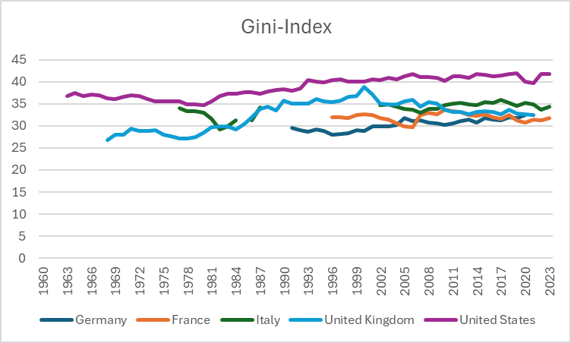




Gini-Coefficient international development
c
Source: World Bank

Slide 23
Example Gini-Coefficient (Germany)
Top income quantils
c
Source: C. Bartels and Jenderny, K. (2015)

Slide 24


Example Gini-Coefficient (Germany)
c
Gini-SVR = 0,28
Gini-Bartels-Jenderney = 0,35
Source: SVR, C. Bartels and Jenderny, K. (2015), eigene Berechnungen

