Slide 1

Statistics B
Wilhelmshaven
This lecture will be recorded and
subsequently uploaded in the
world-wide-web
Function translator (webpage)
Function translator Excel 1 (add in)
c
Prof. Dr. Bernhard Köster
Jade-Hochschule Wilhelmshaven
http://www.bernhardkoester.de/vorlesungen/inhalt.html

Slide 2

(Advanced) Statistics B
c
Summer Term 2026
Prof. Dr. Bernhard Köster

Slide 3
Prof. Dr. Bernhard Köster
Room: S 113
Street: Friedrich-Paffrath-Straße 101
location: 26389 Wilhelmshaven
Tel. +49 4421 985-2766
Email: bernhard.koester@jade-hs.de
Consultation hour: by arrangement
or just have a look into my office!
or Webex/Zoom …
c

Slide 4
Literature
Statistics for Business and Economics, Anderson, Sweeney, Williams, Camm, Cochran
Mathematical Statistics for Economics and Business, Mittelhammer
Statistics for Business and Economics, Global Edition, Newbold, Thorne, Carlson
A Guide to Modern Econometrics, Verbeek
Applied Econometrics, Asteriou and Hall
Econometrics by Example, Gujarati, D.
Linear Regression Analysis: Theory and Computing, Yan and Gang Su
Some open access resources
  OpenIntro Statistics
  Statistical Thinking for the 21st Century
  MIT OPENCOURSEWARE
→ there is much more! Search the net in a sensible way !
c

Slide 5
Content
Revision Random Variables
Descriptive Statistics
  Parameters of a distribution
Linear Regression
  Simple and multilinear
  Hypothesis testing
  Multicollinarity
  Heteroskedasticity
  Autocorrelation
Inequality metrics
Time series analysis
  Price adjustment
  Forecasting
    Moving average
    Exponential smoothing
    Average growth rate
    Simple seasonal adjustment
c

Slide 6




^{Random Variable}
Definition:
A Random Variable X is the mapping of the sample space Ω into the real numbers R. That means every elementary event A_{i} maps onto a real number x_{i} and the probability p_{i} = P(A_{i}) = P(X=x_{i}) = p(x_{i}) is known.
→ p_{i} ist the probality that random variable X equals the outcome x_{i}.
c

Slide 7



Random Variable – Explanations
Every possible event of a random experiment can be expressed via a random variable.
Random variables are expressed in capital letters.
Example: dice with sample space X is element of {1,2,3,4,5,6}
The realization of a random variable is expressed in lowercase letters:
Example rolling dice: X realizes the value x = 5
Probality in the example of rolling dice:
P(X < 5) = ??
c

Slide 8


Discrete and continous random variables (RV)
Discrete RV:
RV, which have only a finite or countably infinite realizations.
Continous RV:
RV which can realize within an intervall every possible real number.
c

Slide 9










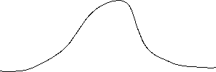



Discret
Probability mass function:
Cumulative distribution function:
Expected value:
Variance:
Continous
Probability density function:
Cumulative distribution function:
Expected value :
Variance:
c

Slide 10






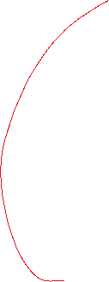




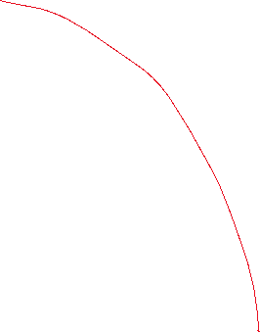

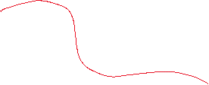




Calculating with Expectated Value and Variance
Constant:
Constant factor:
Linear Transformation:
c

Slide 11
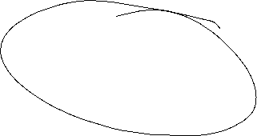




Sample Parameters
Median
Arithmetic mean (first moment)
Geometric mean
Harmonic mean
Range
Mean absolute deviation
Sample Variance: biased and unbiased (second moment)
Standard deviation
Skewness (third moment)
Kurtosis (fourth moment)
c

Slide 12
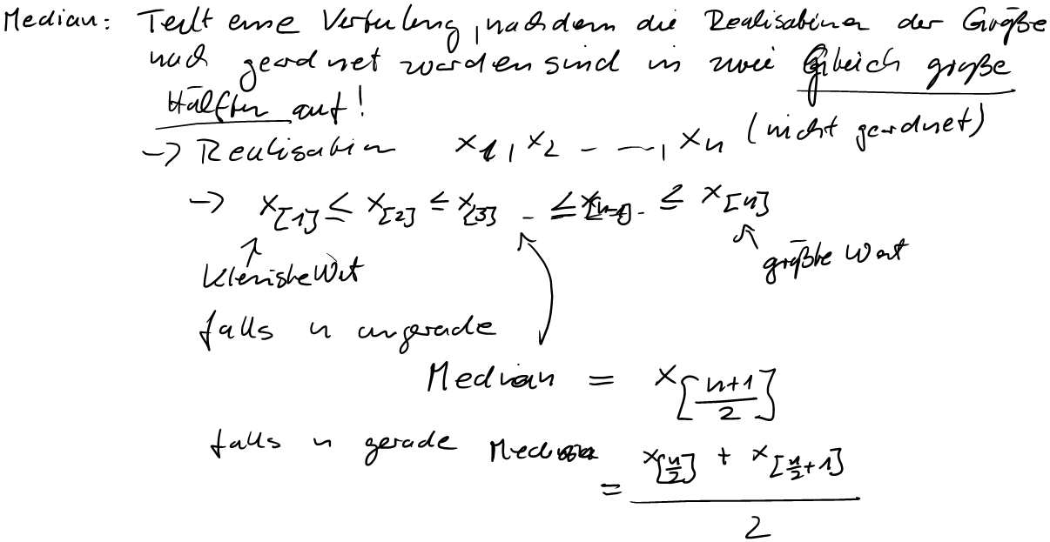
Sample Parameters
Median
Arithmetic mean (first moment)
Geometric mean
Harmonic mean
Range
Mean absolute deviation
Sample Variance: biased and unbiased (second moment)
Standard deviation
Skewness (third moment)
Kurtosis (fourth moment)

Slide 13


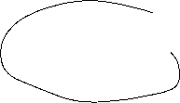












Sample Parameters
Median
Arithmetic mean (first moment)
Geometric mean
Harmonic mean
Range
Mean absolute deviation
Sample Variance: biased and unbiased (second moment)
Standard deviation
Skewness (third moment)
Kurtosis (fourth moment)

Slide 14












Sample Parameters
Median
Arithmetic mean (first moment)
Geometric mean
Harmonic mean
Range
Mean absolute deviation
Sample Variance: biased and unbiased (second moment)
Standard deviation
Skewness (third moment)
Kurtosis (fourth moment)

Slide 15
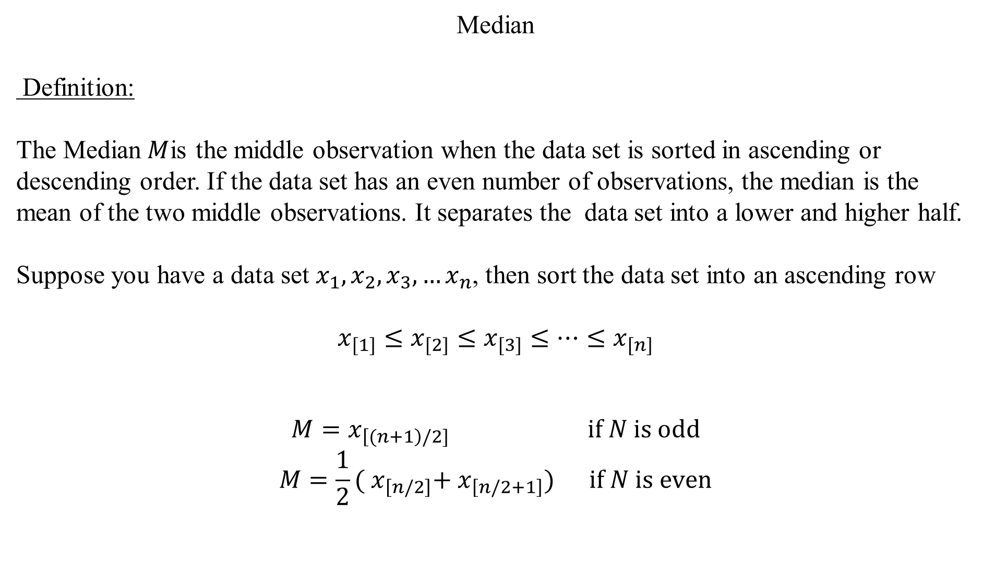
Median
Definition:
The Median$M$is the middle observation when the data set is sorted in ascending or descending order. If the data set has an even number of observations, the median is the mean of the two middle observations. It separates the data set into a lower and higher half.
Suppose you have a data set $x_{1},x_{2},x_{3},…x_{n}$, then sort the data set into an ascending row
$$x_{[1]}≤x_{[2]}≤x_{[3]}≤…{≤x}_{[n]}$$
$$M=x_{\left[(n+1\right)/2]} \text{if} N \text{is} \text{odd}$$
$$M=\frac{1}{2}({ x}_{\left[n/2\right]}+{ x}_{\left[n/2+1\right]}) \text{if} N \text{is} \text{even}$$
c

Slide 16
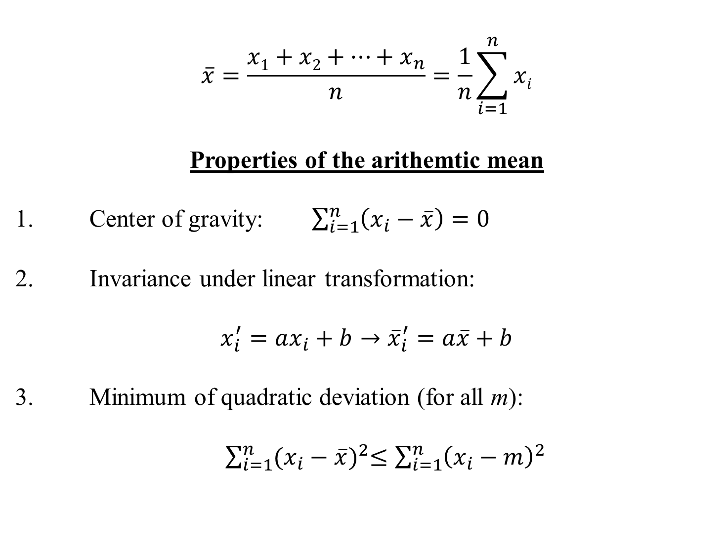
Arithmethic Mean
$$\overline{x}=\frac{x1+x2+…+x_{n}}{n}=\frac{1}{n}\sum_{i=1}^{n}{xi}$$
Properties of the arithemtic mean
1. Center of gravity: $\sum_{i=1}^{n}{\left(x_{i}−\overline{x}\right)=0}$
2. Invariance under linear transformation:
$$x_{i}^{′}=ax_{i}+b→{\overline{x}}_{i}^{′}=a\overline{x}+b$$
3. Minimum of quadratic deviation (for all m):
$\sum_{i=1}^{n}{{(x_{i}−\overline{x})}^{2}≤\sum_{i=1}^{n}{{\left(x_{i}−m\right)}^{2}} }$
c

Slide 17

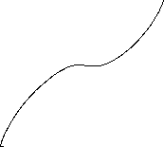
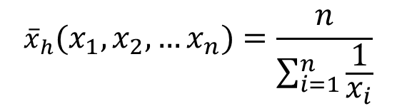
Geometric mean
${\overline{x}}_{g}=\sqrt[n]{{{x_{1}∙x}_{2}∙ … ∙x}_{n}}=({{x_{1}∙x}_{2}∙ … ∙x}_{n})^{\frac{1}{n}}{ x}_{i}>0$
Harmonic mean
$${\overline{x}}_{h}(x_{1},x_{2},…x_{n})=\frac{n}{\sum_{i=1}^{n}{\frac{1}{x_{i}}}}$$
c

Slide 18
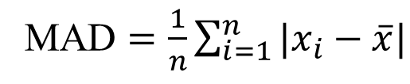
Range
Definition:
The difference between the lowest and highest values of a data set
Mean absolute deviation
c
MAD $=\frac{1}{n}\sum_{i=1}^{n}{|x_{i}−\overline{x}|}$

Slide 19

Variance
  Biased Variance
  $${\tilde{σ}}^{2}=\frac{1}{n}\sum_{i=1}^{n}{{\left(x_{i}−\overline{x}\right)}^{2}}$$
  Unbiased Variance
  $${\hat{σ}}^{2}=\frac{1}{n−1}\sum_{i=1}^{n}{{\left(x_{i}−\overline{x}\right)}^{2}}$$
c

Slide 20



Standard deviation
Uncorrected standard deviation:
$$\tilde{σ}=\sqrt{\frac{1}{n}\sum_{i=1}^{n}{{\left(x_{i}−\overline{x}\right)}^{2}}}$$
Corrected standard deviation:
$$\hat{σ}=\sqrt{\frac{1}{n−1}\sum_{i=1}^{n}{{\left(x_{i}−\overline{x}\right)}^{2}}}$$
c

Slide 21
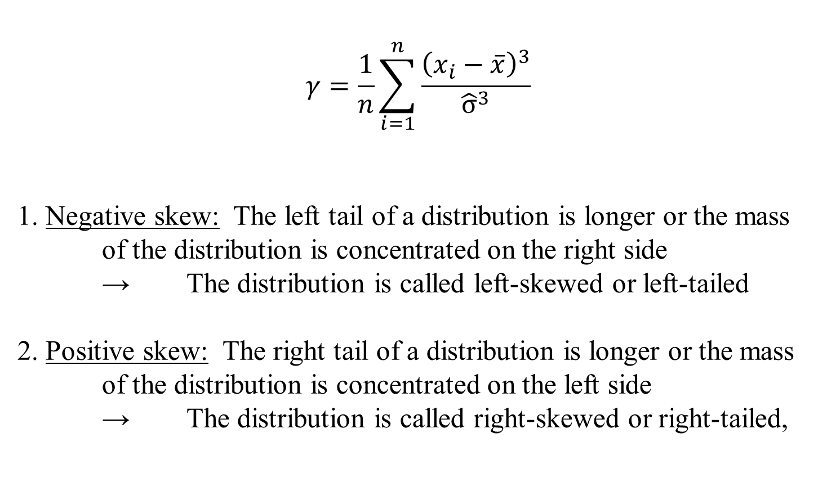
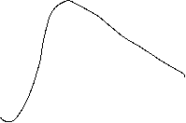
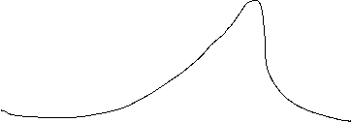


Skewness (third moment)
$$γ=\frac{1}{n}\sum_{i=1}^{n}{\frac{{\left(x_{i}−\overline{x}\right)}^{3}}{{\hat{σ}}^{3}}}$$
1. Negative skew: The left tail of a distribution is longer or the mass of the distribution is concentrated on the right side
→ The distribution is called left-skewed or left-tailed
2. Positive skew: The right tail of a distribution is longer or the mass of the distribution is concentrated on the left side
→ The distribution is called right-skewed or right-tailed,
c

Slide 22

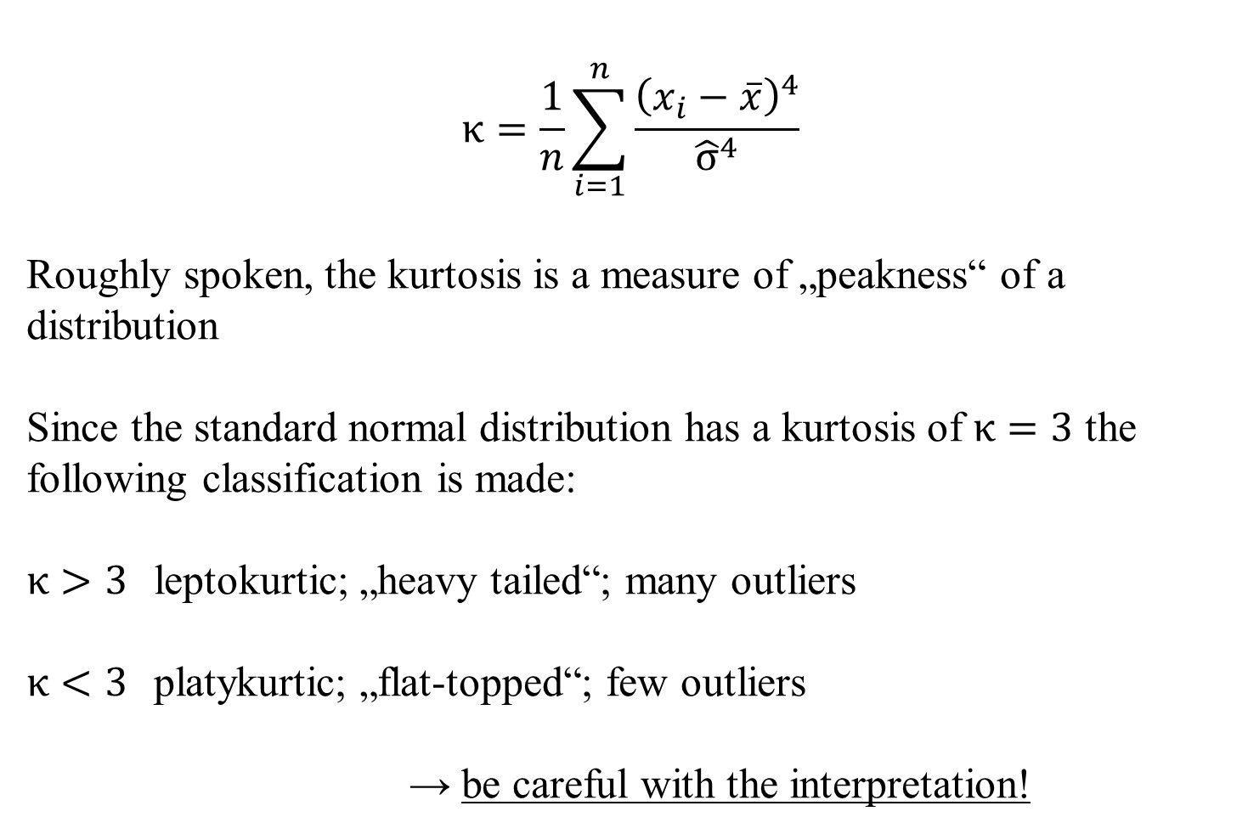

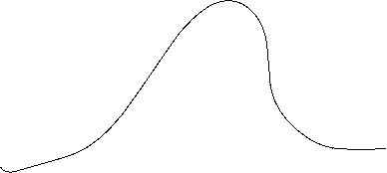




Kurtosis (fourth moment)
$$κ=\frac{1}{n}\sum_{i=1}^{n}{\frac{{\left(x_{i}−\overline{x}\right)}^{4}}{{\hat{σ}}^{4}}}$$
Roughly spoken, the kurtosis is a measure of „peakness“ of a distribution
Since the standard normal distribution has a kurtosis of $κ=3$ the following classification is made:
$κ>3$ leptokurtic; „heavy tailed“; many outliers
$κ<3$ platykurtic; „flat-topped“; few outliers
→ be careful with the interpretation!
c

Slide 23
Scatterplot
Graphical representation of the attributes of two variables within a two-dimensional coordinate-system.
Number | 1 | 2 | 3 | 4 | 5 | 6 | 7 | 8 | 9 | 10 | 11 | 12 | 13 | 14 | 15 | 16 | 17 | 18 | 19 | 20 | 21 | 22
Order | 2 | 4 | 3 | 6 | 2 | 1 | 5 | 3 | 4 | 2 | 2 | 7 | 4 | 3 | 2 | 1 | 5 | 4 | 3 | 3 | 1 | 6
Volume [€] | 36 | 44 | 30 | 67 | 21 | 8 | 62 | 35 | 33 | 37 | 22 | 72 | 65 | 45 | 23 | 17 | 44 | 56 | 32 | 37 | 22 | 48
c

Slide 24
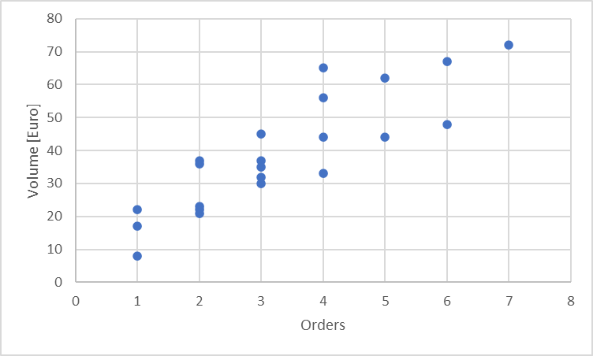
Scatterplot
X-coordinate: order
Y-coordinate: Volume [Euro]
c

Slide 25
Linear Regression
Example 2:
A company wants to know how the sales volume depends on visits of representatives.
The company has collected the following data
c
We also want to answer the question, from a descriptive point of view, which sales volume we can expect, if we increase the visits up to x=30

Slide 26
Linear Regression
Via a linear regression we want to analyse the dependence between two variables
We distinguish between a dependent variable (y) and an independent variable (x)
(x) is also called the explanatory variable
A change of (x) implicates a change (y)
The linear regression defines an empirical relation via a linear function
i.e. y = f(x) = 3 + 2x or generally y = a + bx
c

Slide 27
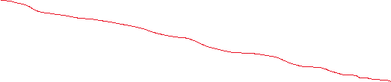



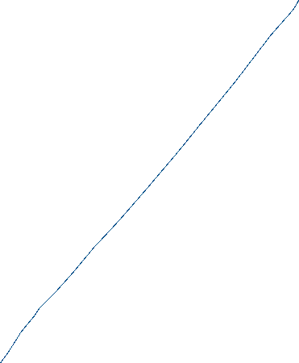
Simple Examples
c
Determine graphically a regression line for the blue and red data points. What kind of
dependence do we have?

Slide 28
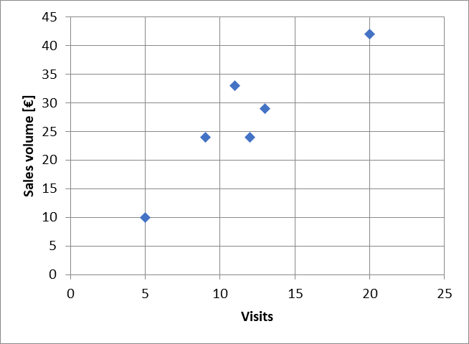






Example
c
Try to fit graphically (by eye) a regression line through the data points

Slide 29







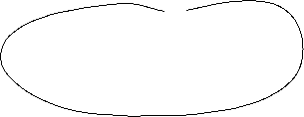
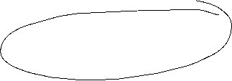
Optimizing problem
How to calculate a regression line $\hat{y}i=a+bx$_{i}?
The coefficients a and b has be calculated from the collected data.
$\hat{y}i$ Value on the regression line
$yi$ collected data point
$εi=$ $yi$- $\hat{y}i$ Difference between the data point and the theoretical value on the regression line
Determine a and b such, that the sum of all quadratic differences $ε_{i}^{2}$is minimized
c

Slide 30







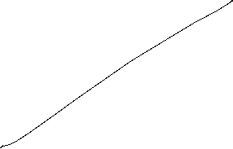












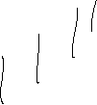



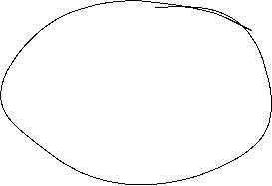




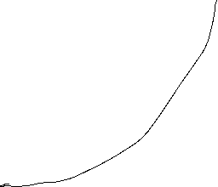





Least squared method
The formal optimizing problem
c

Slide 31
Least squared method
The formal optimizing problem
FOC:
2 dimensional linear system which can directly be solved
c

Slide 32













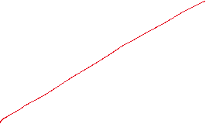

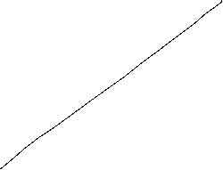

Least squared method
c

Slide 33
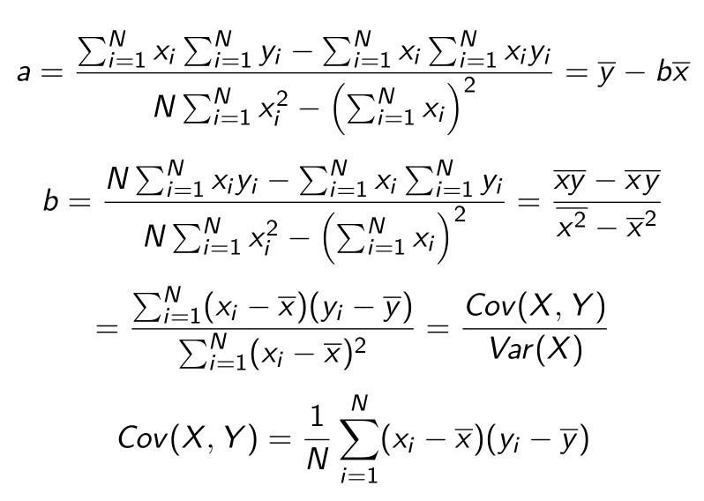











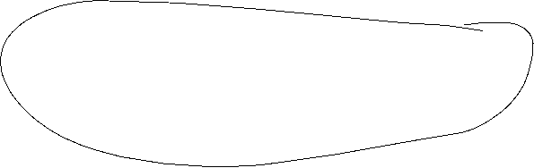














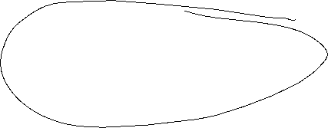

Formulas
:
c

Slide 34

Linear Regression
 | Visits | Sales volume [€]
year | x | y | xy | x^2
2008 | 9 | 24 | 216 | 81
2009 | 11 | 33 | 363 | 121
2010 | 5 | 10 | 50 | 25
2011 | 13 | 29 | 377 | 169
2012 | 20 | 42 | 840 | 400
2013 | 12 | 24 | 288 | 144
c
b=
a=

Slide 35


Extrapolation for x=30
 | Visits | Sales volume [€]
year | x | y | xy | x^2 | yhat
2008 | 9 | 24
2009 | 11 | 33
2010 | 5 | 10
2011 | 13 | 29
2012 | 20 | 42
2013 | 12 | 24
c
yhat(30)=

Slide 36
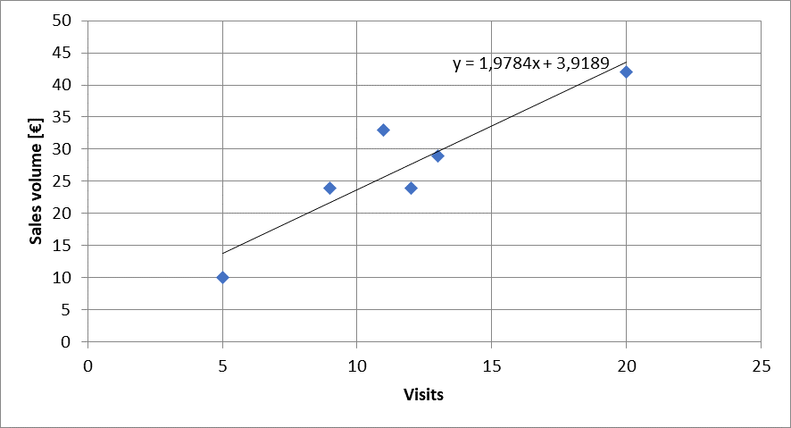



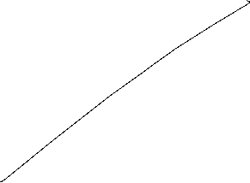






Calulating the regression line from empirical data
$$ei2$$
$\hat{y}i=a+bx$_{i}
c

Slide 37

Regressions coefficients
Regressions coefficient b
  Slope of the regression line.
  Determines the marginal effect of a change of one unit of the independent variable x onto the dependet variable y
Regressions coefficient a
  The value of the dependent variable if the independent variable x=0
    → intercept of the vertical axes
c

Slide 38
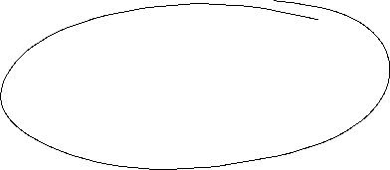
Linear regression
Measures the linear dependence between two variables
This dependence can be interpreted, that one variable is quantitatively influencing another variable
The linear regression is an instrument for forecasting
c

Slide 39

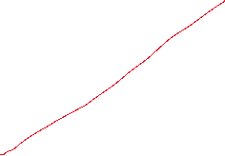
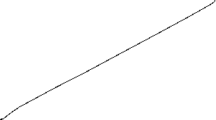

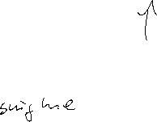


Correlation analysis
In principle for all data sets, we can calculate a regression line.
But we are also interested in the question meaningful is this calculated dependence?.
For this, we use the correlation analysis, wich gives the possibility to measure the strength of the dependence
For this, we use the correlation coefficient of Bravais-Pearson which is lying between -1 and +1
c

Slide 40
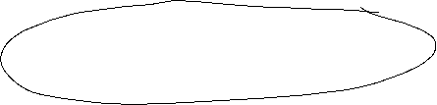
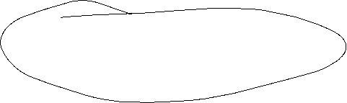

Covariance
The covariance is a measure of the joint variability of two random variables (X,Y), defined by:
$$\operatorname{cov}\left(X,Y\right)=E\left[\left(X−E\left(X\right)\right)\left(Y−E\left(Y\right)\right)\right]$$
with the unbiased estimator
$${\hat{σ}}_{xy}=\frac{1}{n−1}\sum_{i=1}^{n}{\left(x_{\dot{j}}−\overline{x}\right)\left(y_{i}−\overline{y}\right)}$$
If the greater values of X correspond with the greater values of Y the covariance is positive. In the opposite case, when the greater values of X correspond to the lesser values Y, the covariance is negative. The sign of the covariance shows the tendency in the linear relationship between the variables.
The magnitude of the covariance can hardly be interpreted, since it is not normalized.
Therefore, we use the normalized version, called correlation coefficient, showing the strength of the linear relation.
c

Slide 41
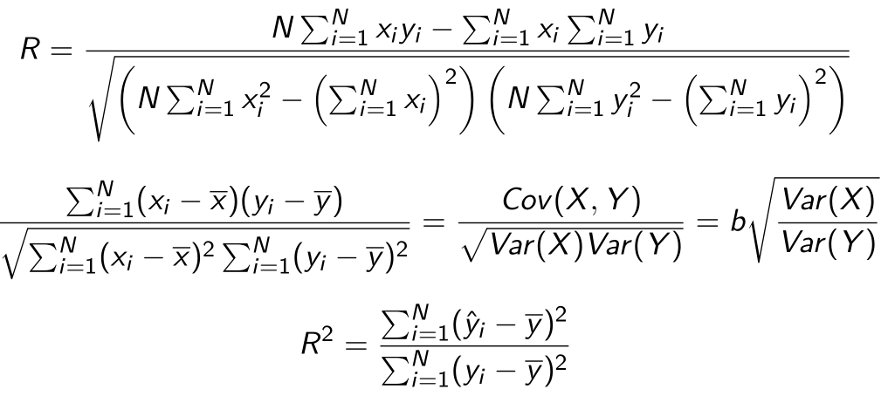





















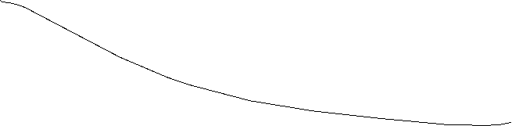



Correlation coefficient
General intervals for R
(0,0;0,2) → almost no dependence
[0,2;0,4) → low dependence
[0,4;0,6) → medium dependence
[0,6;0,8) → high dependence
[0,8;1,0) → almost full dependence
c

Slide 42


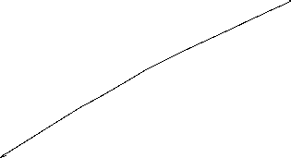




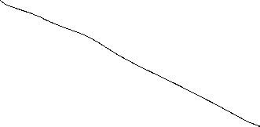
Correlation coefficiant examples
R=?
R=?
c
R=?
R=?

Slide 43

Coefficiant of determination R²
The squared correlation coefficiant R² is called coefficiant of determination.
In quantitative analysis, we often use the coefficiant of determination R², because it can be intuitively interpreted
But R² does not distinguish between + and – anymore.
R² is in the interval [0,1]
R² grafical interpretation:
  R² equals the proportion of variance explained by the model in relation to the total variance, i.e. how much percent is explained by the regression line
  (1-R²) equals the proportion of Variance not explained by the model in relation to the total variance, and has to be explained by other influencing factors
c

Slide 44
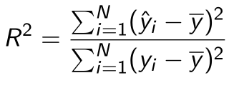
Coefficiant of determination R²
{
${\hat{y}}_{i}−\overline{y}$ explained difference
Total Difference
} Non explained difference
} Explained difference
${y_{i}−\hat{y}}_{i}$ not explained difference
Mean
$y_{i}−\overline{y}$ total difference
$$→\sum_{i=1}^{n}{{{(y}_{i}−\overline{y})}^{2}}=\sum_{i=1}^{n}{{{{(y}_{i}−\hat{y}}_{i})}^{2}}+\sum_{i=1}^{n}{{{(\hat{y}}_{i}−\overline{y})}^{2}}$$
Non explained squared difference y_{i}
total squared difference
explained squared difference
Mean
not explained squared difference
explained squared difference y_{i}
c
Total squared difference of y_{i}

Slide 45
Coefficiant of determination R²
N | x | y | $$\hat{y}$$ | ($\hat{y}$-$\overline{y})2$ | (y-$\overline{y})2$
1 | 9 | 24
2 | 11 | 33
3 | 5 | 10
4 | 13 | 29
5 | 20 | 42
6 | 12 | 24
Gesamt
c
R²= R=

Slide 46
Interpretation of R²
R² measures the strengh of the dependence between two variables X and Y.
R² can be interpreted as the proportion expained by the linear regression.
R² = 0, the linear regression model is given just by the constant a und b=0
  → The change of the independent variable X has no influence on the dependent variable Y
R² = 1, then the regression line fully explains the dependence between X and Y and we have $\hat{y}i=a+bx$_{i} $=yi$
c

Slide 47

















Multiple linear Regression
In general we dot have only one variable explaining another variable, but many more (i.e. visits, marketing budget, branches, …). In this case, we make the Ansatz:
y = f(x₁, x₂,…,x_{k})
The linear model ist then:
$$y=β_{0}+β_{1}x_{1}+β_{2}x_{2}…+β_{k}x_{k}$$
In case of $n$ observations we obtain similar to the simple model
$y_{i}=β_{0}+β_{1}x_{i0}+β_{1}x_{i1}…+β_{k}x_{ik}+ε_{i}$ with ($n>k)$
c

Slide 48












Multiple linear Regression: Matrix notation
c

Slide 49




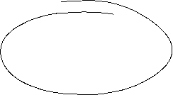
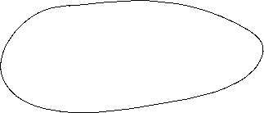


Multiple linear Regression
The estimators $β$ will again be obtained via minimizing the sum of the squared errors:
with
c

Slide 50




























Multiple linear Regression
From the first order condition (FOC) we obtain:
c

Slide 51





Multiple linear Regression
For the coefficiant of determination we obtain equivalently:
with
and
c

Slide 52
Example
Suppose in our one-dimensional example, we are also interested if our results are transferable to other regions, looking at the sales volume depending on
  number of visits
  how the marketing budget influences sales
  and the impact, if a branch is located in the region or not
Thus we have now three variables, which influences sales
  Question is now, how to quantify the third variable, if a branch is located in the region or not
    Introduction of a dummy variable with
    1 = branch 0 = no branch
c

Slide 53









Example
 | visits | marketing | branch | sales
A | 11 | 33 | 1 | 30
B | 8 | 30 | 0 | 27
C | 6 | 9 | 1 | 12
D | 16 | 27 | 0 | 28
E | 13 | 42 | 1 | 25
F | 11 | 25 | 1 | 17
G | 7 | 18 | 0 | 15
H | 10 | 26 | 1 | 22
c
Calculate ${\hat{β}}_{i}$ and R²

Slide 54
Example
 | visits | marketing | branch | sales
 | x1 | x2 | x3 | y | yhat | (yhat-y)^2 | (yhat-ybar)^2 | (y-ybar)^2
A
B
C
D
E
F
G
H
sum
average
c
beta0 | beta1 | beta2 | beta3

Slide 55









Multiple linear Regression – Hypothesis-Testing
Until now, we have done only descriptive statistics! No causality can be deduced from our calculations!
Caution! Do not mix correlation and causality!
In general we have not a full data set, but only a sample out of the whole population (i.e. survey data)
Question: What kind of conclusions can be drawn from a sample for the whole population?
In general, we want to know if the estimated correlation from the sample is also valid for the whole population.
Under specific assumptions on the error-terms $ε_{i}$ we can make a probability statement about the goodness of a conclusion, that the found dependence for the sample is also valid for the whole population
c

Slide 56






Multiple linear Regression – Hypothesis-Testing – Assumptions
c

Slide 57


c

Slide 58


c

Slide 59







Further desired criterions for an estimator
Asymptotically unbiased (if there ist no unbiased candidate)
Consistency (stochastic convergence)
Sufficiency (Estimator should use only the relevant information about the true parameter)
c

Slide 60
Multiple linear Regression – Standard error
Similar to the standard deviation, we can define a standard error for the regression parameters $β_{i}$ calculated from the multiple linear regression
In order to estimate the variances of $β_{i}$ we have to find an estimator for the unkown variance in assumption (iii) for the error terms $ε_{i}$ . A first candidate could be
  $$\frac{n}{n−1} {\tilde{σ}}^{2}=\frac{1}{n−1}\sum_{i=1}^{n}{{\left(ε_{i}\right)}^{2}}$$
but it can be shown that this estimator is still biased.
It can be shown, that
$${\hat{σ}}^{2}=\frac{1}{n−(k+1)}\sum_{i=1}^{n}{{\left(x_{i}−\overline{x}\right)}^{2}}$$
is an unbiased estimator (k+1= number of regression parameters $β_{i}$ )
c

Slide 61
Multiple linear Regression – Standard error
The standard error of estimators ${\hat{β}}_{i}$ can then be estimated via
and is given by the diagonal elements of V. If we define c_{ii} the diagonal elemants of [X^{T}X]⁻¹, we obtain for the standard se($β_{i}$)
se(${\hat{β}}_{i}$)= $\hat{σ}\sqrt{cii}$
and with the assumptions (i) – (v) we can show, that also the estimators ${\hat{β}}_{i}$are normally distributed with
$${\hat{β}}_{i}\sim N(β_{i},{\hat{σ}}^{2}cii)$$
c

Slide 62
c

Slide 63
c

Slide 64
c

Slide 65
c

Slide 68


Multiple linear Regression – Hypothesis-Testing
With the assumptions and the derived properties we can calculate the following test statistics:
and
With F and T, we can make probability statements about the goodness of the estimators calculated from the multiple linear regression.
c

Slide 69
Multiple linear Regression – F-Test
Formulate the null hypothesis H₀:
There is no correlation between Y and X_{i}.
This means H₀: $β_{0}=β_{1}=β_{2}=…=β_{k}=0$ then R²=0
The alternative is then H₁: At least one $β_{i}≠0$ then $\text{R}\text{2}≠0$
Determine a reasonable significance level:
If H₀ is true, the test shall with probability $1−\text{α}$ not reject H₀.The significance level $\text{α}$ is the error probability, that we reject although it is true for the whole population.
Standard significance levels are 10%, 5%, 1%, 0,1%.
But be careful in choosing $\text{α}$since i.e. if $\text{α}$is too small H₀ would not be rejected, although it is not true!
Calculate from the regression the empirical F-value
c

Slide 70


Multiple linear Regression – F-Test
Determine the theoretical F-value
Given the significance level the F-value represents the value for which for which the accumulated probability of an F-distributed variable equals $1−\text{α}$. i.e. in our example we have a
$F\left(k=3;n−k−1=8−3−1=4\right)=F(3,4)$ distribution and thus $F\text{9}\text{0}\text{\%}=5,34$
Compare theoretical and empirical F-value
F_{emp}>F_{theo}
H ₀ is rejected, the existence of a linear dependence between Y and X_{i} is significant to $\text{α}$=10%
F_{emp}≤F_{theo}
H₀ is not rejected. There is no linear dependence to a significance level of $\text{α}$=10%
$$F\text{9}\text{0}\text{\%}=5,34$$
90%
c
Table F-Distribution

Slide 71
Multiple linear Regression – t-Test
Formulate the null hypothesis H₀:
„Some Variable X_{i} has no relevance for Y“.
This means H₀: $β_{i}=0$
The alternative is then H₁: $β_{i}≠0$
(we deal only with this version of a two-sided test!)
Determine a reasonable significance level:
If H₀ is true, the test shall with probability $1−\text{α}$ not reject H₀.The significance level $\text{α}$ is the error probability, that we reject although it is true for the whole population.
Standard significance levels are 10%, 5%, 1%, 0,1%.
But be careful in choosing $\text{α}$since i.e. if $\text{α}$is too small H₀ would not be rejected, although it is not true!
Calculate from the regression the empirical t-values
c

Slide 72

Multiple linear Regression – t-Test
Determine the theoretical t-value
Given the significance level the t-value represents the value for which for which the accumulated probability of an F-distributed variable equals $1−\text{α}$. i.e. in our example we have a t$\left(n−k−1=8−3−1=4\right)=t(4)$ distribution and thus $t\text{9}\text{5}\text{\%}=2,13$
Compare theoretical and empirical F-value
|t_{emp}| ≤ t_{theo}
H₀ is not rejected. The variable X_{i} has no $(β_{i}$=0) influence on Y for a significanse level of $\text{α}$=10%
$$t\text{5}\text{\%}=−2,13$$
$$t\text{9}\text{5}\text{\%}=2,13$$
90%
c
|t_{emp}|>t_{theo}
H₀ is rejected, X_{i} has for a level of $\text{α}$=10% a significant influence on Y with the marginal contribution ${\hat{β}}_{i}$

Slide 73


You want to see F an t ??
t-Dirstibution
F-Dirstibution
c

Slide 74
Example
Test the example for $\text{α}=\text{5\%}$ on H₀: $β_{0}=β_{1}=β_{2}=…=β_{k}=0$
Test for all H₀: $β_{i}=0$ and $\text{α}=\text{5\%}$
beta0 | beta1 | beta2 | beta3
10,669 | 1,484 | 0,718 | 9,008
se(b0) | se(b1) | se(b2) | se(b3)
7,579 | 0,911 | 0,199 | 4,150
c

Slide 75

^{t-distribution}
c

Slide 76
F_{95%}
^{F-distribution}
F_{99%}
c

Slide 77
Inequlity Metrics
Definition:
Within a random sample, it is possible, that we have an unequal distribution.
This inequality can be measured in an absolute or relative way:
Examples:
Income distribution or distribution of wealth
  The poorest 10% of the population receive 1% of national income
  The richest 10% of the population receive 25% of national income
Market structure (Polypol – Oligopol – Monopol)
  Number of suppliers
  Market share
c

Slide 78
Concentration ratio
Definition:
The concentration ratio (CR) is the sum of the percentage market shares of a pre-specified number of)the largest firms in an industry.
Example
The three largest firms have a market share of 90%.
c

Slide 79

Concentration ratio
$\text{CR}\text{1}\text{=}\frac{x_{1}}{S_{n}}$ $x_{1}$: Revenue the largest firm, $S_{n}$: Total revenue of the whole sector
$\text{CR}\text{k}\text{=}\frac{{\sum_{j=1}^{k}{x}}_{j}}{S_{n} }$ k: Number of the k-th largest firms in the sector consisting of n firms.
c

Slide 80

Herfindahl-Index
Definition:
The Herfindahl-Index is the sum of all squared market shares of competitors within a market:
$$\text{HI}\text{:=}\sum_{i=1}^{n}{a_{i}^{2}}$$
with $a_{i}\text{:}\text{=}\frac{x_{i}}{\sum_{j=1}^{n}{x_{j}}}$ Market share of the i-th firm within a market with n firms
HI lies within 1/n and 1
HI=1 → Monopol HI=1/n → perfect competition:
All firms have the same market share
c

Slide 81
Application of the Herfindahl-Index
Economics:
  Herfindahl-Index is applied by a Antitrust authorities, in order to evaluate how M&A affects the market concentration.
  Under Cournot-competition of n-firms, the Herfindahl-index is equal to the demand elasticity times weighted average of profit margins of the firms in the market (Excercise)
Market Research:
  The Herfindahl-Index can be interpreted as a measure for customer loyality
Politics:
  The Herfindahl-Index represents the fragmentation of a party system, especially the inverse is called, the effective number of parties.
c

Slide 82
Theil-Index
$T=\frac{1}{N}\sum_{i=1}^{N}{\frac{x_{i}}{μ}ln⁡(\frac{x_{i}}{μ})}$ with $μ=\frac{1}{N}\sum_{i=1}^{N}{x_{i}}$
The Theil index is a statistic used to measure economic inequality. The Theil index measures an entropic "distance" the population is away from the "ideal" egalitarian state of everyone having the same income. The numerical result is in terms of negative entropy so that a higher number indicates more order that is further away from the "ideal" of maximum disorder. Formulating the index to represent negative entropy instead of entropy allows it to be a measure of inequality rather than equality.
Properties:
For the uniform distribution: T=0
For a distribution with maximum inequality: T=ln(N)
The Theil-Index is decomposable for subgroups of the distirbution
The Theil-Index is very sensitve to redristibutions form poor to rich
c

Slide 83
Market share in a sector
No. | A | B | C | D
1 | 70 | 200 | 0 | 30
2 | 120 | 200 | 0 | 30
3 | 190 | 200 | 0 | 30
4 | 250 | 200 | 0 | 30
5 | 370 | 200 | 1000 | 30
6 |  |  |  | 150
7 |  |  |  | 150
8 |  |  |  | 150
9 |  |  |  | 200
10 |  |  |  | 200
Sum
c

Slide 84

Excercise
Determine if possible for A-D
C$on\text{centration} \text{ratios} \text{CR}\text{1}\text{=}$ $\text{CR}\text{2}\text{=}$ $\text{CR}\text{3}$
The Herfindahl-Index
The Theil-Index
c

Slide 85
Lorenz-curve:
  The Lorenz-curve is a Probability-Plot (P-P-Plot) comparing the relative distribution of a variable with the uniform distribution.
    → We plot the cumulated propotion of the value of the variable against the cumulated propotion of the population.
  → The Lorenzcurve is a graphical representation of the relative concentration of the value of the variable.
c

Slide 86

Calculating the Lorenz-curve
Sort the data in an ascending row
𝑥_{[1]} ≤ 𝑥_{[2]} ≤ ⋯ ≤ 𝑥_{[𝑛]}
Calculating the sum
$S_{n}≔\sum_{j=1}^{n}{x_{[j]}}$
Calculating the cumulated relative distribution of the number of the data points
$F_{i}≔\frac{i}{n}$
Calculating the cumulated relative distribution of the values of the data points
$G_{i}≔\frac{1}{S_{n}}\sum_{j=1}^{i}{x_{[j]}}$
The Lorenz curve is the F-G-diagram with the coordinats
(0,0) ${(F}_{1}$, $G_{1}$) ${(F}_{2}$, $G_{2}$) … (1,1)
c

Slide 87
Example A
U-Nr. | A | Fi | Gi
 |  | 0 | 0
1 | 70
2 | 120
3 | 190
4 | 250
5 | 370 | 1 | 1
Sum | 1000
c
Calculate the Lorenz-curve between (0,0) und (1,1)

Slide 88
Example B
U-Nr. | B | Fi | Gi
 |  | 0 | 0
1 | 200
2 | 200
3 | 200
4 | 200
5 | 200 | 1 | 1
Summe | 1000
c
Lorenz-curve for a uniform distribution between (0,0) und (1,1).

Slide 89
Example C
U-Nr. | C | Fi | Gi
 |  | 0 | 0
1 | 0 | 0,2 | 0
2 | 0 | 0,4 | 0
3 | 0 | 0,6 | 0
4 | 0 | 0,8 | 0
5 | 1000 | 1 | 1
Summe | 1000
c
Lorenz-curve if the total value is centered at one data point in between(0,0) (1,1).

Slide 90
Example D
U-Nr. | D | Fi | Gi
 |  | 0 | 0
1 | 30
2 | 30
3 | 30
4 | 30
5 | 30
6 | 150
7 | 150
8 | 150
9 | 200
10 | 200 | 1 | 1
Summe | 1000
c
Value | Counts | Fj | Gj
 |  | 0 | 0
30
150
200 |  | 1 | 1
Lorenz-curve with multiple counts for one value in between (0,0) (1,1).

Slide 91
Properties of the Lorenz-curve
The Lorenz-curve is monotonically increasing
The Lorenz-curve is konvex
The Lorenz-curve is in beetween (0,0) und (1,1)
For the uniform distribution, the Lorenz-curve is is a straight line form (0,0) und (1,1)
If within a sample of n data points, the total value is centered at only one data point, the Lorenz-curve is represented by (0,0) (0,(n-1)/n) (1,1)
Usually the Lorenz-curve is plotted relativ to the uniform distribution.
c

Slide 92




Lorenz-curve and the uniform distirbution
A
B
C
D
c

Slide 93

Case Study: Lorenz-curve and Income distribution
In an ascending ordered sample, we plot the accumulated relative income with respect to accumulated proportion of the population.
The more, the Lorenz-curve runs below the 45°-Line the more concentrated is the income distribution
i.e. Which proportion of national income is earned by the poorest of the popupation?
Uniform distribution
Right skewed
Bill-Gates
% -Pop | %-In
Q-25% | 25%
Q-50% | 50%
Q-75% | 75%
Q-100% | 100%
% -Pop | %-In
Q-25% | 10%
Q-50% | 30%
Q-75% | 60%
Q-100% | 100%
% -Pop | %-In
Q-25% | 1%
Q-50% | 2%
Q-75% | 3%
Q-100% | 97%
c

Slide 94

^{The Gini-Coefficient}
The Gini coefficient measures the inequality of the income distribution.
The Gini coefficient (GC) is defined via the Lorenz-curve:
$$GC=\frac{F}{1/2}=2F$$
$$GC=\frac{Area between the 45°−Line and the Lorenz−curve L}{Area between the 45°−Line and the horizontal axes}$$
Since the area between the 45°-Line and the horizontal axes equals ½ we abtain also
$$GC=\text{2(}Area between the 45°−Line and the Lorenz−curve L\text{)}$$
c

Slide 95
Der Gini-Coefficient and Lorenzcurve
100%
45°-Line
L
100%
c
Gini-Coeffizient = GC =

Slide 96

Calculation of the Gini-coefficient
$$GC=1−\sum_{i=1}^{n}{{(F}_{i}−F_{i−1}){(G}_{i}+G_{i−1})}$$
$$=−1+\sum_{i=1}^{n}{{(F}_{i}+F_{i−1}){(G}_{i}−G_{i−1})}$$
with F₀=G₀=0
Properties:
The Gini-coefficient lies between 0 und 1
For the uniform distribution we have GC=0
If total income is concentrated at one person we have GC_{max}=(n-1)/n which tends to 1, if n is large
c

Slide 97
Calculate the Gini-coefficients of distributions A-D
c

Slide 98

Gini-Coefficient international development
c
Source: World Bank

Slide 99
Example Gini-Coefficient (Germany)
Top income quantils
c
Source: C. Bartels and Jenderny, K. (2015)

Slide 100
Example Gini-Coefficient (Germany)
c
Gini-SVR = 0,28
Gini-Bartels-Jenderney = 0,35
Source: SVR, C. Bartels and Jenderny, K. (2015), eigene Berechnungen

