Slide 1

Statistics B
Wilhelmshaven
This lecture will be recorded and
subsequently uploaded in the
world-wide-web
Function translator (webpage)
Function translator Excel 1 (add in)
c
Prof. Dr. Bernhard Köster
Jade-Hochschule Wilhelmshaven
http://www.bernhardkoester.de/vorlesungen/inhalt.html

Slide 2

(Advanced) Statistics B
c
Summer Term 2026
Prof. Dr. Bernhard Köster

Slide 3
Prof. Dr. Bernhard Köster
Room: S 113
Street: Friedrich-Paffrath-Straße 101
location: 26389 Wilhelmshaven
Tel. +49 4421 985-2766
Email: bernhard.koester@jade-hs.de
Consultation hour: by arrangement
or just have a look into my office!
or Webex/Zoom …
c

Slide 4
Literature
Statistics for Business and Economics, Anderson, Sweeney, Williams, Camm, Cochran
Mathematical Statistics for Economics and Business, Mittelhammer
Statistics for Business and Economics, Global Edition, Newbold, Thorne, Carlson
A Guide to Modern Econometrics, Verbeek
Applied Econometrics, Asteriou and Hall
Econometrics by Example, Gujarati, D.
Linear Regression Analysis: Theory and Computing, Yan and Gang Su
Some open access resources
  OpenIntro Statistics
  Statistical Thinking for the 21st Century
  MIT OPENCOURSEWARE
→ there is much more! Search the net in a sensible way !
c

Slide 5
Content
Revision Random Variables
Descriptive Statistics
  Parameters of a distribution
Linear Regression
  Simple and multilinear
  Hypothesis testing
  Multicollinarity
  Heteroskedasticity
  Autocorrelation
Inequality metrics
Time series analysis
  Price adjustment
  Forecasting
    Moving average
    Exponential smoothing
    Average growth rate
    Simple seasonal adjustment
c

Slide 6




^{Random Variable}
Definition:
A Random Variable X is the mapping of the sample space Ω into the real numbers R. That means every elementary event A_{i} maps onto a real number x_{i} and the probability p_{i} = P(A_{i}) = P(X=x_{i}) = p(x_{i}) is known.
→ p_{i} ist the probality that random variable X equals the outcome x_{i}.
c

Slide 7



Random Variable – Explanations
Every possible event of a random experiment can be expressed via a random variable.
Random variables are expressed in capital letters.
Example: dice with sample space X is element of {1,2,3,4,5,6}
The realization of a random variable is expressed in lowercase letters:
Example rolling dice: X realizes the value x = 5
Probality in the example of rolling dice:
P(X < 5) = ??
c

Slide 8


Discrete and continous random variables (RV)
Discrete RV:
RV, which have only a finite or countably infinite realizations.
Continous RV:
RV which can realize within an intervall every possible real number.
c

Slide 9










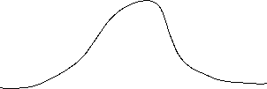



Discret
Probability mass function:
Cumulative distribution function:
Expected value:
Variance:
Continous
Probability density function:
Cumulative distribution function:
Expected value :
Variance:
c

Slide 10






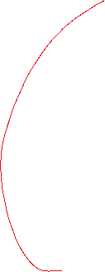




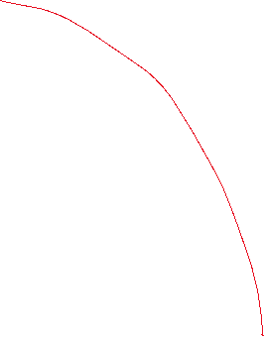

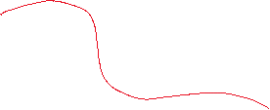




Calculating with Expectated Value and Variance
Constant:
Constant factor:
Linear Transformation:
c

Slide 11
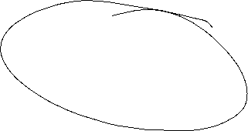




Sample Parameters
Median
Arithmetic mean (first moment)
Geometric mean
Harmonic mean
Range
Mean absolute deviation
Sample Variance: biased and unbiased (second moment)
Standard deviation
Skewness (third moment)
Kurtosis (fourth moment)
c

Slide 12
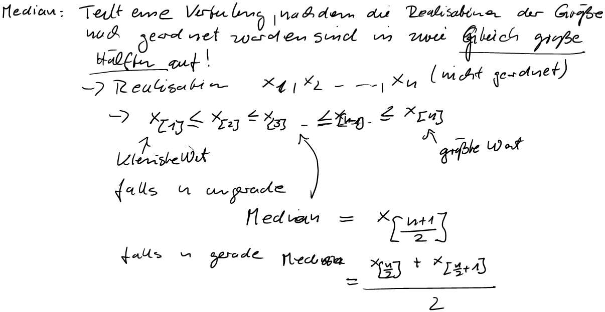
Sample Parameters
Median
Arithmetic mean (first moment)
Geometric mean
Harmonic mean
Range
Mean absolute deviation
Sample Variance: biased and unbiased (second moment)
Standard deviation
Skewness (third moment)
Kurtosis (fourth moment)

Slide 13


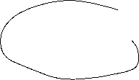












Sample Parameters
Median
Arithmetic mean (first moment)
Geometric mean
Harmonic mean
Range
Mean absolute deviation
Sample Variance: biased and unbiased (second moment)
Standard deviation
Skewness (third moment)
Kurtosis (fourth moment)

Slide 14



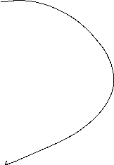








Sample Parameters
Median
Arithmetic mean (first moment)
Geometric mean
Harmonic mean
Range
Mean absolute deviation
Sample Variance: biased and unbiased (second moment)
Standard deviation
Skewness (third moment)
Kurtosis (fourth moment)

Slide 15
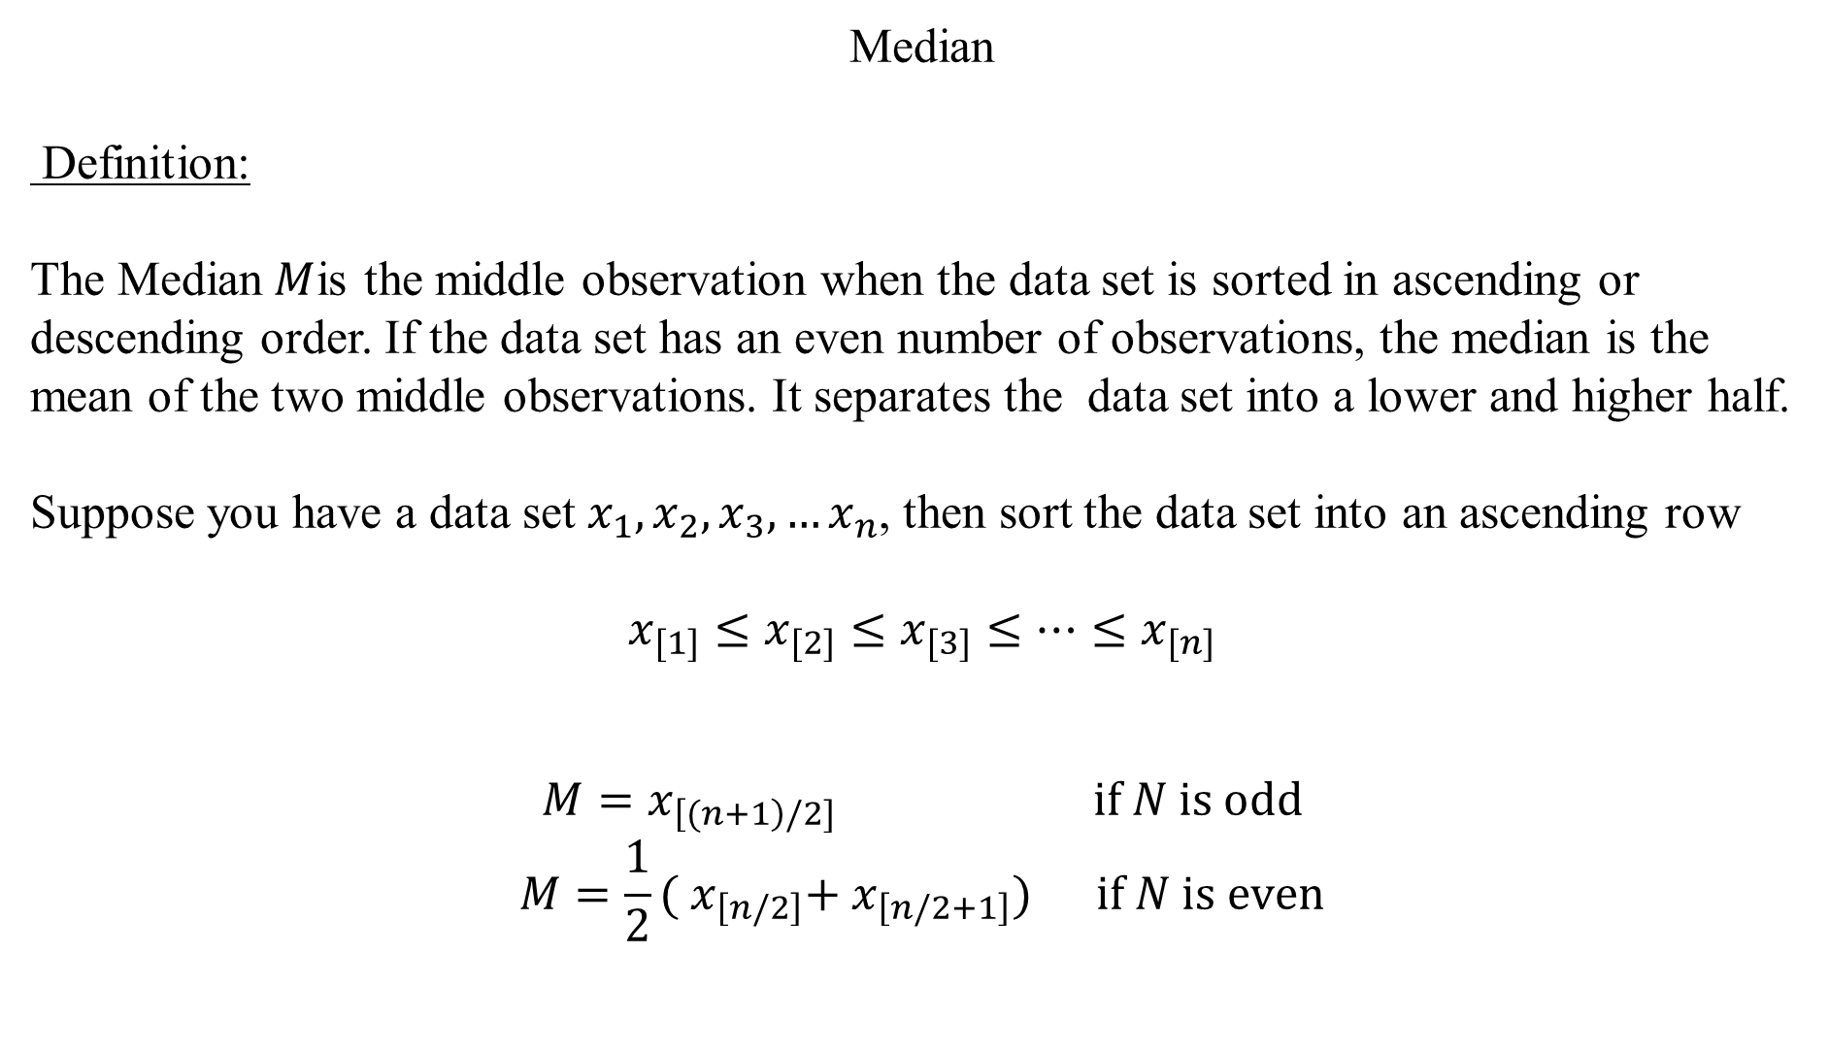
Median
Definition:
The Median$M$is the middle observation when the data set is sorted in ascending or descending order. If the data set has an even number of observations, the median is the mean of the two middle observations. It separates the data set into a lower and higher half.
Suppose you have a data set $x_{1},x_{2},x_{3},…x_{n}$, then sort the data set into an ascending row
$$x_{[1]}≤x_{[2]}≤x_{[3]}≤…{≤x}_{[n]}$$
$$M=x_{\left[(n+1\right)/2]} \text{if} N \text{is} \text{odd}$$
$$M=\frac{1}{2}({ x}_{\left[n/2\right]}+{ x}_{\left[n/2+1\right]}) \text{if} N \text{is} \text{even}$$
c

Slide 16
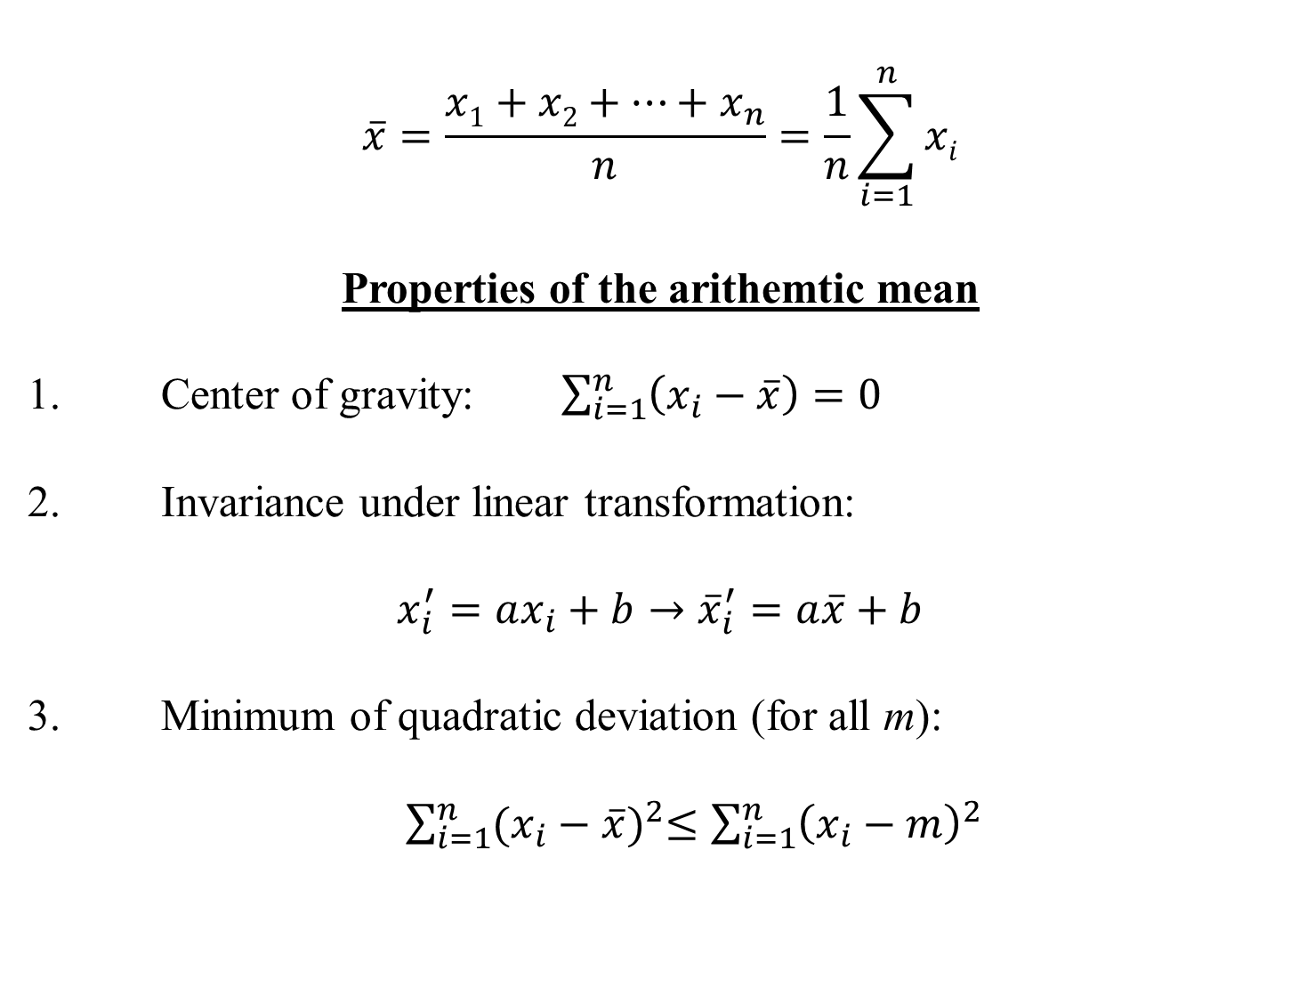
Arithmethic Mean
$$\overline{x}=\frac{x1+x2+…+x_{n}}{n}=\frac{1}{n}\sum_{i=1}^{n}{xi}$$
Properties of the arithemtic mean
1. Center of gravity: $\sum_{i=1}^{n}{\left(x_{i}−\overline{x}\right)=0}$
2. Invariance under linear transformation:
$$x_{i}^{′}=ax_{i}+b→{\overline{x}}_{i}^{′}=a\overline{x}+b$$
3. Minimum of quadratic deviation (for all m):
$\sum_{i=1}^{n}{{(x_{i}−\overline{x})}^{2}≤\sum_{i=1}^{n}{{\left(x_{i}−m\right)}^{2}} }$
c

Slide 17

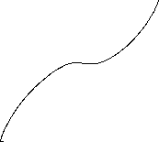
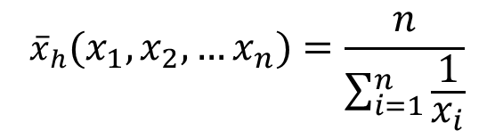
Geometric mean
${\overline{x}}_{g}=\sqrt[n]{{{x_{1}∙x}_{2}∙ … ∙x}_{n}}=({{x_{1}∙x}_{2}∙ … ∙x}_{n})^{\frac{1}{n}}{ x}_{i}>0$
Harmonic mean
$${\overline{x}}_{h}(x_{1},x_{2},…x_{n})=\frac{n}{\sum_{i=1}^{n}{\frac{1}{x_{i}}}}$$
c

Slide 18
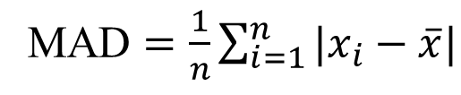
Range
Definition:
The difference between the lowest and highest values of a data set
Mean absolute deviation
c
MAD $=\frac{1}{n}\sum_{i=1}^{n}{|x_{i}−\overline{x}|}$

Slide 19

Variance
  Biased Variance
  $${\tilde{σ}}^{2}=\frac{1}{n}\sum_{i=1}^{n}{{\left(x_{i}−\overline{x}\right)}^{2}}$$
  Unbiased Variance
  $${\hat{σ}}^{2}=\frac{1}{n−1}\sum_{i=1}^{n}{{\left(x_{i}−\overline{x}\right)}^{2}}$$
c

Slide 20



Standard deviation
Uncorrected standard deviation:
$$\tilde{σ}=\sqrt{\frac{1}{n}\sum_{i=1}^{n}{{\left(x_{i}−\overline{x}\right)}^{2}}}$$
Corrected standard deviation:
$$\hat{σ}=\sqrt{\frac{1}{n−1}\sum_{i=1}^{n}{{\left(x_{i}−\overline{x}\right)}^{2}}}$$
c

Slide 21
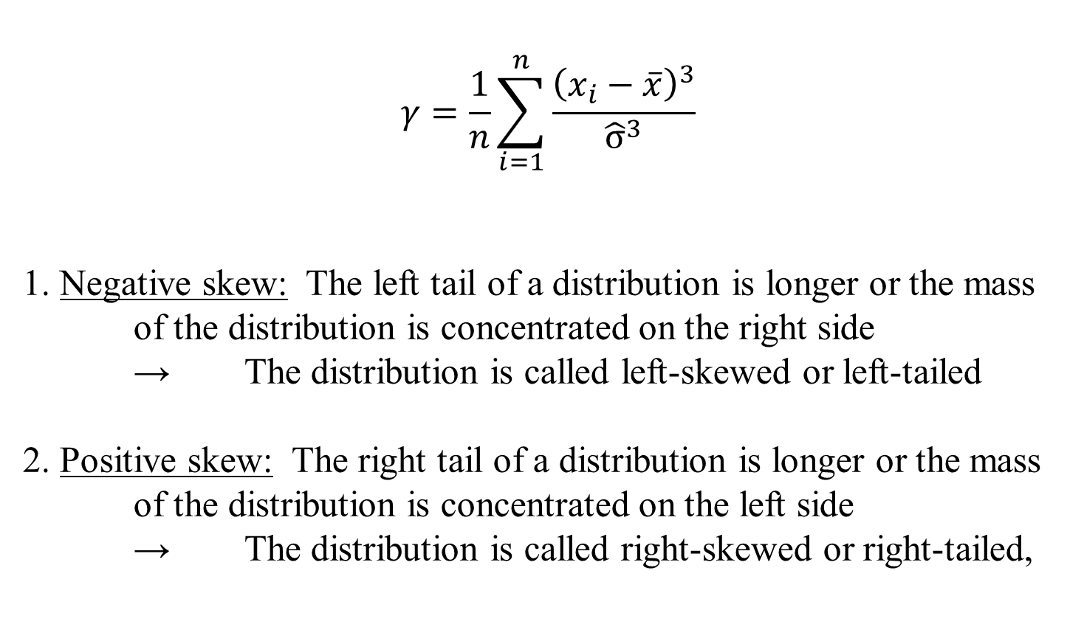
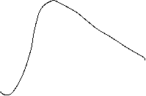
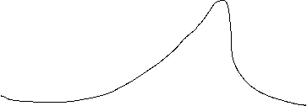


Skewness (third moment)
$$γ=\frac{1}{n}\sum_{i=1}^{n}{\frac{{\left(x_{i}−\overline{x}\right)}^{3}}{{\hat{σ}}^{3}}}$$
1. Negative skew: The left tail of a distribution is longer or the mass of the distribution is concentrated on the right side
→ The distribution is called left-skewed or left-tailed
2. Positive skew: The right tail of a distribution is longer or the mass of the distribution is concentrated on the left side
→ The distribution is called right-skewed or right-tailed,
c

Slide 22

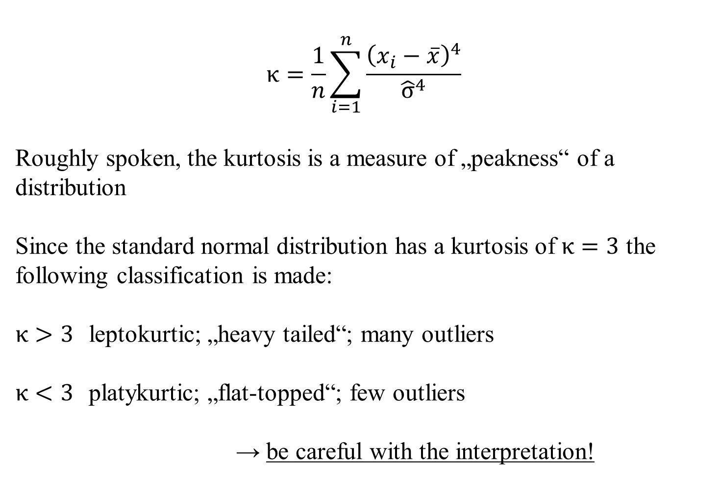

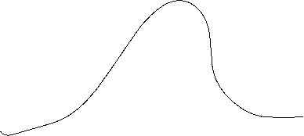




Kurtosis (fourth moment)
$$κ=\frac{1}{n}\sum_{i=1}^{n}{\frac{{\left(x_{i}−\overline{x}\right)}^{4}}{{\hat{σ}}^{4}}}$$
Roughly spoken, the kurtosis is a measure of „peakness“ of a distribution
Since the standard normal distribution has a kurtosis of $κ=3$ the following classification is made:
$κ>3$ leptokurtic; „heavy tailed“; many outliers
$κ<3$ platykurtic; „flat-topped“; few outliers
→ be careful with the interpretation!
c

Slide 23
Scatterplot
Graphical representation of the attributes of two variables within a two-dimensional coordinate-system.
Number | 1 | 2 | 3 | 4 | 5 | 6 | 7 | 8 | 9 | 10 | 11 | 12 | 13 | 14 | 15 | 16 | 17 | 18 | 19 | 20 | 21 | 22
Order | 2 | 4 | 3 | 6 | 2 | 1 | 5 | 3 | 4 | 2 | 2 | 7 | 4 | 3 | 2 | 1 | 5 | 4 | 3 | 3 | 1 | 6
Volume [€] | 36 | 44 | 30 | 67 | 21 | 8 | 62 | 35 | 33 | 37 | 22 | 72 | 65 | 45 | 23 | 17 | 44 | 56 | 32 | 37 | 22 | 48
c

Slide 24
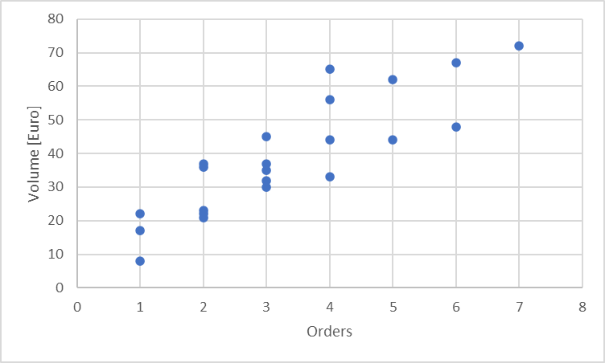
Scatterplot
X-coordinate: order
Y-coordinate: Volume [Euro]
c

Slide 25
Linear Regression
Example 2:
A company wants to know how the sales volume depends on visits of representatives.
The company has collected the following data
c
We also want to answer the question, from a descriptive point of view, which sales volume we can expect, if we increase the visits up to x=30

Slide 26
Linear Regression
Via a linear regression we want to analyse the dependence between two variables
We distinguish between a dependent variable (y) and an independent variable (x)
(x) is also called the explanatory variable
A change of (x) implicates a change (y)
The linear regression defines an empirical relation via a linear function
i.e. y = f(x) = 3 + 2x or generally y = a + bx
c

Slide 27
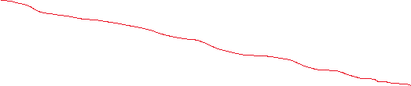



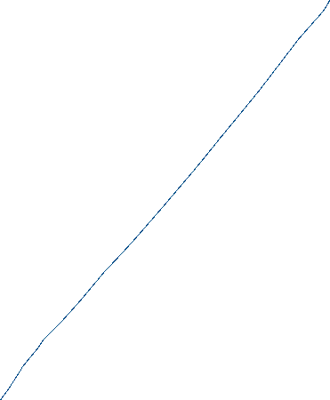
Simple Examples
c
Determine graphically a regression line for the blue and red data points. What kind of
dependence do we have?

Slide 28
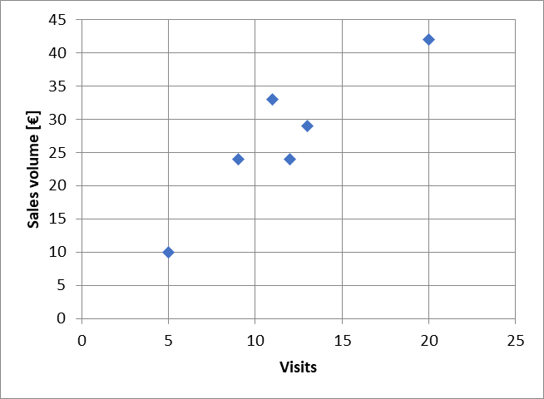






Example
c
Try to fit graphically (by eye) a regression line through the data points

Slide 29







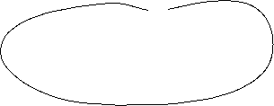
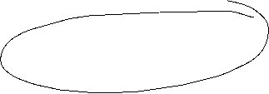
Optimizing problem
How to calculate a regression line $\hat{y}i=a+bx$_{i}?
The coefficients a and b has be calculated from the collected data.
$\hat{y}i$ Value on the regression line
$yi$ collected data point
$εi=$ $yi$- $\hat{y}i$ Difference between the data point and the theoretical value on the regression line
Determine a and b such, that the sum of all quadratic differences $ε_{i}^{2}$is minimized
c

Slide 30







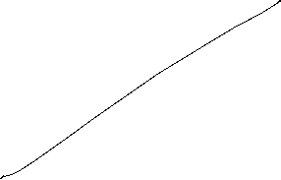












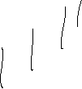



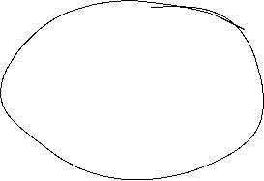




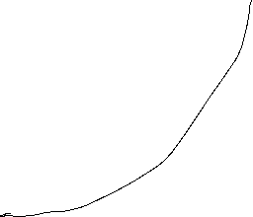





Least squared method
The formal optimizing problem
c

Slide 31
Least squared method
The formal optimizing problem
FOC:
2 dimensional linear system which can directly be solved
c

Slide 32
Least squared method
c

Slide 33
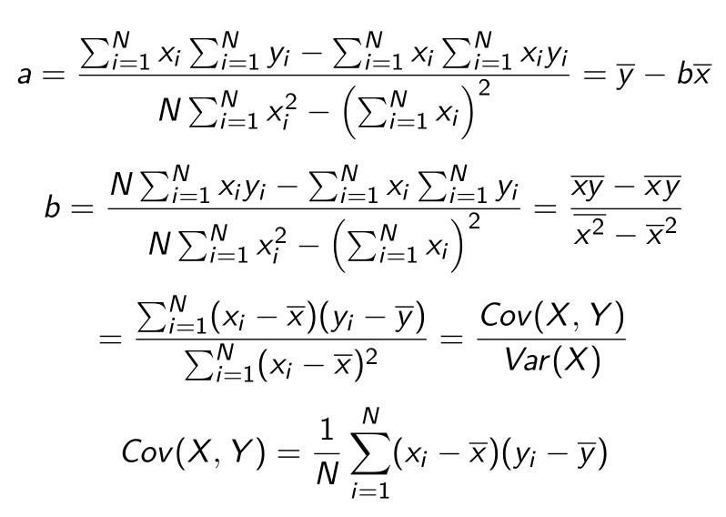










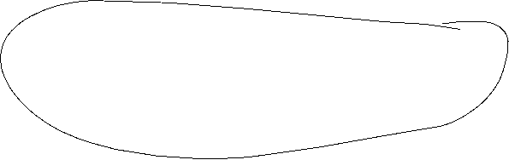










Formulas
:
c

Slide 34
Linear Regression
 | Visits | Sales volume [€]
year | x | y | xy | x^2
2008 | 9 | 24 | 216 | 81
2009 | 11 | 33 | 363 | 121
2010 | 5 | 10 | 50 | 25
2011 | 13 | 29 | 377 | 169
2012 | 20 | 42 | 840 | 400
2013 | 12 | 24 | 288 | 144
c
b=
a=

Slide 35
Extrapolation for x=30
 | Visits | Sales volume [€]
year | x | y | xy | x^2 | yhat
2008 | 9 | 24
2009 | 11 | 33
2010 | 5 | 10
2011 | 13 | 29
2012 | 20 | 42
2013 | 12 | 24
c
yhat(30)=

Slide 36
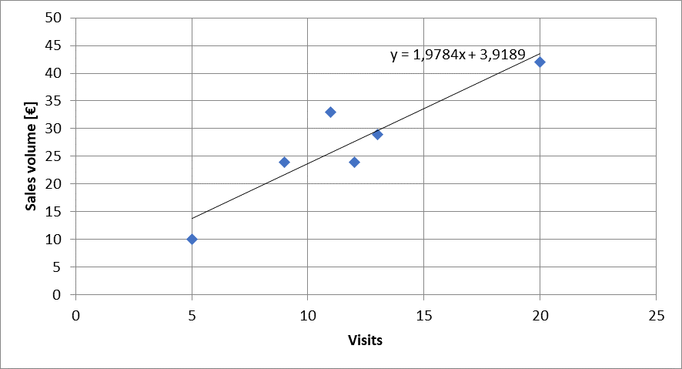
Calulating the regression line from empirical data
$$ei2$$
$\hat{y}i=a+bx$_{i}
c

Slide 37
Regressions coefficients
Regressions coefficient b
  Slope of the regression line.
  Determines the marginal effect of a change of one unit of the independent variable x onto the dependet variable y
Regressions coefficient a
  The value of the dependent variable if the independent variable x=0
    → intercept of the vertical axes
c

Slide 38
Linear regression
Measures the linear dependence between two variables
This dependence can be interpreted, that one variable is quantitatively influencing another variable
The linear regression is an instrument for forecasting
c

Slide 39
Correlation analysis
In principle for all data sets, we can calculate a regression line.
But we are also interested in the question meaningful is this calculated dependence?.
For this, we use the correlation analysis, wich gives the possibility to measure the strength of the dependence
For this, we use the correlation coefficient of Bravais-Pearson which is lying between -1 and +1
c

Slide 40
Covariance
The covariance is a measure of the joint variability of two random variables (X,Y), defined by:
$$\operatorname{cov}\left(X,Y\right)=E\left[\left(X−E\left(X\right)\right)\left(Y−E\left(Y\right)\right)\right]$$
with the unbiased estimator
$${\hat{σ}}_{xy}=\frac{1}{n−1}\sum_{i=1}^{n}{\left(x_{\dot{j}}−\overline{x}\right)\left(y_{i}−\overline{y}\right)}$$
If the greater values of X correspond with the greater values of Y the covariance is positive. In the opposite case, when the greater values of X correspond to the lesser values Y, the covariance is negative. The sign of the covariance shows the tendency in the linear relationship between the variables.
The magnitude of the covariance can hardly be interpreted, since it is not normalized.
Therefore, we use the normalized version, called correlation coefficient, showing the strength of the linear relation.
c

Slide 41
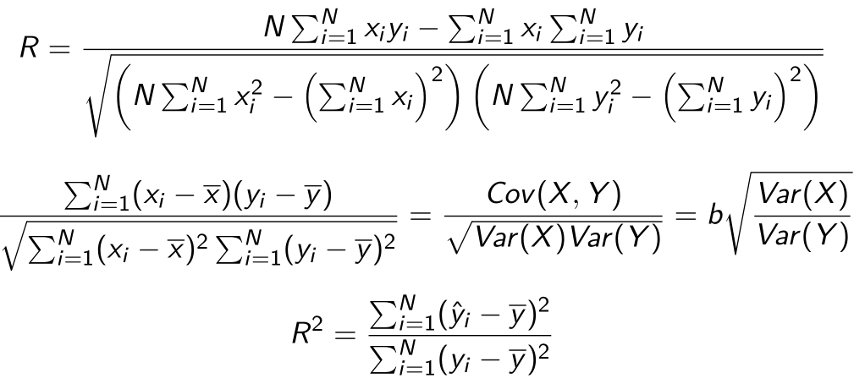
Correlation coefficient
General intervals for R
(0,0;0,2) → almost no dependence
[0,2;0,4) → low dependence
[0,4;0,6) → medium dependence
[0,6;0,8) → high dependence
[0,8;1,0) → almost full dependence
c

Slide 42
Correlation coefficiant examples
R=?
R=?
c
R=?
R=?

Slide 43
Coefficiant of determination R²
The squared correlation coefficiant R² is called coefficiant of determination.
In quantitative analysis, we often use the coefficiant of determination R², because it can be intuitively interpreted
But R² does not distinguish between + and – anymore.
R² is in the interval [0,1]
R² grafical interpretation:
  R² equals the proportion of variance explained by the model in relation to the total variance, i.e. how much percent is explained by the regression line
  (1-R²) equals the proportion of Variance not explained by the model in relation to the total variance, and has to be explained by other influencing factors
c

Slide 44
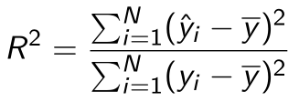
Coefficiant of determination R²
{
${\hat{y}}_{i}−\overline{y}$ explained difference
Total Difference
} Non explained difference
} Explained difference
${y_{i}−\hat{y}}_{i}$ not explained difference
Mean
$y_{i}−\overline{y}$ total difference
$$→\sum_{i=1}^{n}{{{(y}_{i}−\overline{y})}^{2}}=\sum_{i=1}^{n}{{{{(y}_{i}−\hat{y}}_{i})}^{2}}+\sum_{i=1}^{n}{{{(\hat{y}}_{i}−\overline{y})}^{2}}$$
Non explained squared difference y_{i}
total squared difference
explained squared difference
Mean
not explained squared difference
explained squared difference y_{i}
c
Total squared difference of y_{i}

Slide 45
Coefficiant of determination R²
N | x | y | $$\hat{y}$$ | ($\hat{y}$-$\overline{y})2$ | (y-$\overline{y})2$
1 | 9 | 24
2 | 11 | 33
3 | 5 | 10
4 | 13 | 29
5 | 20 | 42
6 | 12 | 24
Gesamt
c
R²= R=

Slide 46
Interpretation of R²
R² measures the strengh of the dependence between two variables X and Y.
R² can be interpreted as the proportion expained by the linear regression.
R² = 0, the linear regression model is given just by the constant a und b=0
  → The change of the independent variable X has no influence on the dependent variable Y
R² = 1, then the regression line fully explains the dependence between X and Y and we have $\hat{y}i=a+bx$_{i} $=yi$
c

Slide 47
Multiple linear Regression
In general we dot have only one variable explaining another variable, but many more (i.e. visits, marketing budget, branches, …). In this case, we make the Ansatz:
y = f(x₁, x₂,…,x_{k})
The linear model ist then:
$$y=β_{0}+β_{1}x_{1}+β_{2}x_{2}…+β_{k}x_{k}$$
In case of $n$ observations we obtain similar to the simple model
$y_{i}=β_{0}+β_{1}x_{i0}+β_{1}x_{i1}…+β_{k}x_{ik}+ε_{i}$ with ($n>k)$
c

Slide 48
Multiple linear Regression: Matrix notation
c

Slide 49

Multiple linear Regression
The estimators $β$ will again be obtained via minimizing the sum of the squared errors:
with
c

Slide 50
Multiple linear Regression
From the first order condition (FOC) we obtain:
c

Slide 51
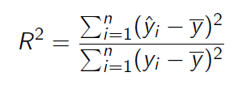

Multiple linear Regression
For the coefficiant of determination we obtain equivalently:
with
and
c

Slide 52
Example
Suppose in our one-dimensional example, we are also interested if our results are transferable to other regions, looking at the sales volume depending on
  number of visits
  how the marketing budget influences sales
  and the impact, if a branch is located in the region or not
Thus we have now three variables, which influences sales
  Question is now, how to quantify the third variable, if a branch is located in the region or not
    Introduction of a dummy variable with
    1 = branch 0 = no branch
c

Slide 53
Example
 | visits | marketing | branch | sales
A | 11 | 33 | 1 | 30
B | 8 | 30 | 0 | 27
C | 6 | 9 | 1 | 12
D | 16 | 27 | 0 | 28
E | 13 | 42 | 1 | 25
F | 11 | 25 | 1 | 17
G | 7 | 18 | 0 | 15
H | 10 | 26 | 1 | 22
c
Calculate ${\hat{β}}_{i}$ and R²

Slide 54
Example
 | visits | marketing | branch | sales
 | x1 | x2 | x3 | y | yhat | (yhat-y)^2 | (yhat-ybar)^2 | (y-ybar)^2
A
B
C
D
E
F
G
H
sum
average
c
beta0 | beta1 | beta2 | beta3

Slide 55
Multiple linear Regression – Hypothesis-Testing
Until now, we have done only descriptive statistics! No causality can be deduced from our calculations!
Caution! Do not mix correlation and causality!
In general we have not a full data set, but only a sample out of the whole population (i.e. survey data)
Question: What kind of conclusions can be drawn from a sample for the whole population?
In general, we want to know if the estimated correlation from the sample is also valid for the whole population.
Under specific assumptions on the error-terms $ε_{i}$ we can make a probability statement about the goodness of a conclusion, that the found dependence for the sample is also valid for the whole population
c

Slide 56
Multiple linear Regression – Hypothesis-Testing – Assumptions
c

Slide 57
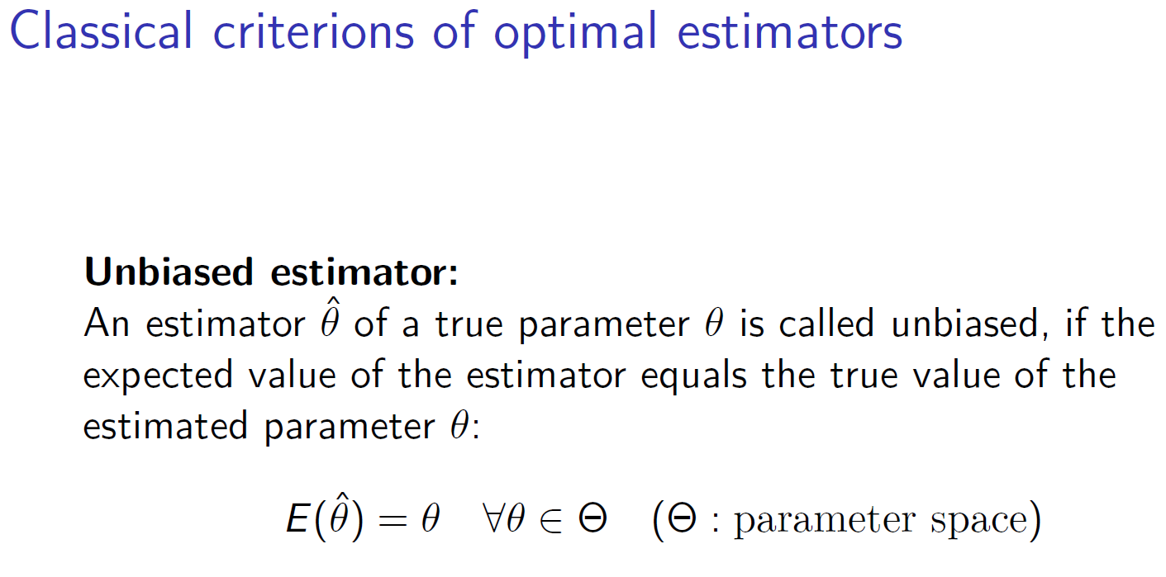
c

Slide 58
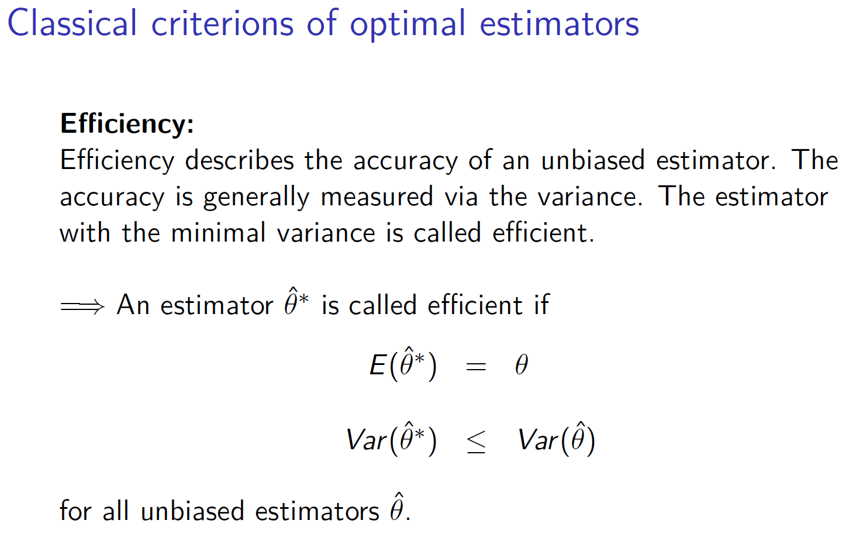
c

Slide 59
Further desired criterions for an estimator
Asymptotically unbiased (if there ist no unbiased candidate)
Consistency (stochastic convergence)
Sufficiency (Estimator should use only the relevant information about the true parameter)
c

Slide 60
Multiple linear Regression – Standard error
Similar to the standard deviation, we can define a standard error for the regression parameters $β_{i}$ calculated from the multiple linear regression
In order to estimate the variances of $β_{i}$ we have to find an estimator for the unkown variance in assumption (iii) for the error terms $ε_{i}$ . A first candidate could be
  $$\frac{n}{n−1} {\tilde{σ}}^{2}=\frac{1}{n−1}\sum_{i=1}^{n}{{\left(ε_{i}\right)}^{2}}$$
but it can be shown that this estimator is still biased.
It can be shown, that
$${\hat{σ}}^{2}=\frac{1}{n−(k+1)}\sum_{i=1}^{n}{{\left(x_{i}−\overline{x}\right)}^{2}}$$
is an unbiased estimator (k+1= number of regression parameters $β_{i}$ )
c

Slide 61
Multiple linear Regression – Standard error
The standard error of estimators ${\hat{β}}_{i}$ can then be estimated via
and is given by the diagonal elements of V. If we define c_{ii} the diagonal elemants of [X^{T}X]⁻¹, we obtain for the standard se($β_{i}$)
se(${\hat{β}}_{i}$)= $\hat{σ}\sqrt{cii}$
and with the assumptions (i) – (v) we can show, that also the estimators ${\hat{β}}_{i}$are normally distributed with
$${\hat{β}}_{i}\sim N(β_{i},{\hat{σ}}^{2}cii)$$
c

Slide 62
c

Slide 63
c

Slide 64
c

Slide 65
c

Slide 68
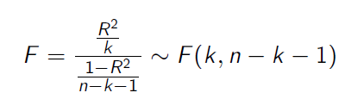

Multiple linear Regression – Hypothesis-Testing
With the assumptions and the derived properties we can calculate the following test statistics:
and
With F and T, we can make probability statements about the goodness of the estimators calculated from the multiple linear regression.
c

Slide 69
Multiple linear Regression – F-Test
Formulate the null hypothesis H₀:
There is no correlation between Y and X_{i}.
This means H₀: $β_{0}=β_{1}=β_{2}=…=β_{k}=0$ then R²=0
The alternative is then H₁: At least one $β_{i}≠0$ then $\text{R}\text{2}≠0$
Determine a reasonable significance level:
If H₀ is true, the test shall with probability $1−\text{α}$ not reject H₀.The significance level $\text{α}$ is the error probability, that we reject although it is true for the whole population.
Standard significance levels are 10%, 5%, 1%, 0,1%.
But be careful in choosing $\text{α}$since i.e. if $\text{α}$is too small H₀ would not be rejected, although it is not true!
Calculate from the regression the empirical F-value
c

Slide 70
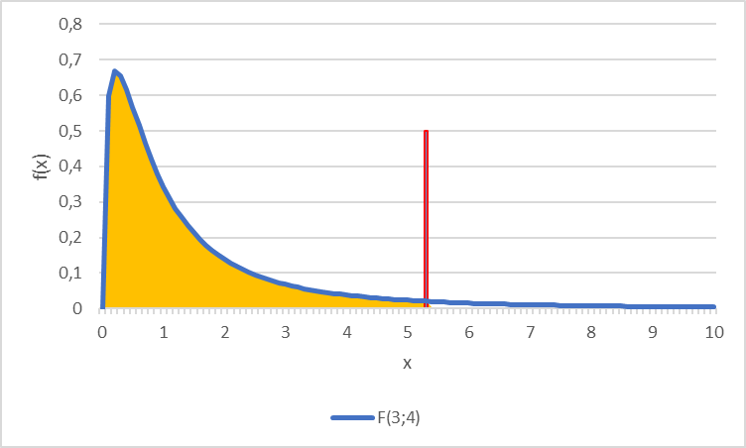
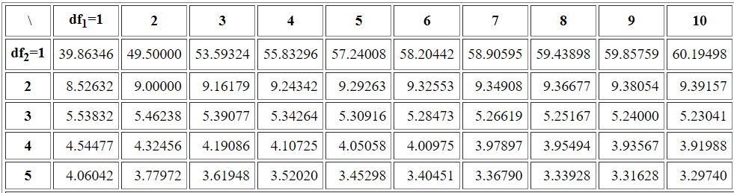
Multiple linear Regression – F-Test
Determine the theoretical F-value
Given the significance level the F-value represents the value for which for which the accumulated probability of an F-distributed variable equals $1−\text{α}$. i.e. in our example we have a
$F\left(k=3;n−k−1=8−3−1=4\right)=F(3,4)$ distribution and thus $F\text{9}\text{0}\text{\%}=5,34$
Compare theoretical and empirical F-value
F_{emp}>F_{theo}
H ₀ is rejected, the existence of a linear dependence between Y and X_{i} is significant to $\text{α}$=10%
F_{emp}≤F_{theo}
H₀ is not rejected. There is no linear dependence to a significance level of $\text{α}$=10%
$$F\text{9}\text{0}\text{\%}=5,34$$
90%
c
Table F-Distribution

Slide 71
Multiple linear Regression – t-Test
Formulate the null hypothesis H₀:
„Some Variable X_{i} has no relevance for Y“.
This means H₀: $β_{i}=0$
The alternative is then H₁: $β_{i}≠0$
(we deal only with this version of a two-sided test!)
Determine a reasonable significance level:
If H₀ is true, the test shall with probability $1−\text{α}$ not reject H₀.The significance level $\text{α}$ is the error probability, that we reject although it is true for the whole population.
Standard significance levels are 10%, 5%, 1%, 0,1%.
But be careful in choosing $\text{α}$since i.e. if $\text{α}$is too small H₀ would not be rejected, although it is not true!
Calculate from the regression the empirical t-values
c

Slide 72
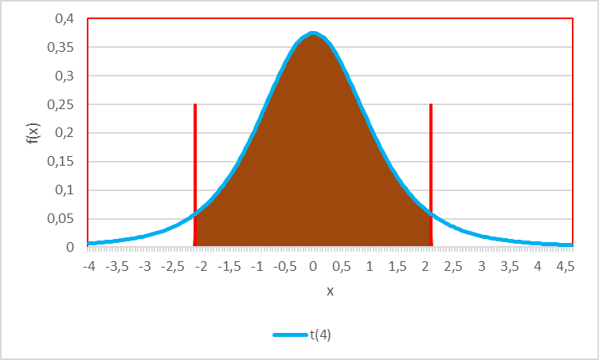
Multiple linear Regression – t-Test
Determine the theoretical t-value
Given the significance level the t-value represents the value for which for which the accumulated probability of an F-distributed variable equals $1−\text{α}$. i.e. in our example we have a t$\left(n−k−1=8−3−1=4\right)=t(4)$ distribution and thus $t\text{9}\text{5}\text{\%}=2,13$
Compare theoretical and empirical F-value
|t_{emp}| ≤ t_{theo}
H₀ is not rejected. The variable X_{i} has no $(β_{i}$=0) influence on Y for a significanse level of $\text{α}$=10%
$$t\text{5}\text{\%}=−2,13$$
$$t\text{9}\text{5}\text{\%}=2,13$$
90%
c
|t_{emp}|>t_{theo}
H₀ is rejected, X_{i} has for a level of $\text{α}$=10% a significant influence on Y with the marginal contribution ${\hat{β}}_{i}$

Slide 73
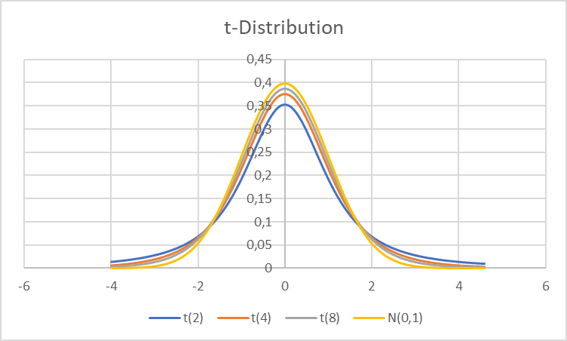
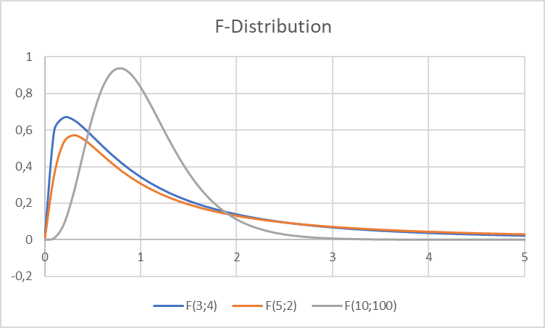
You want to see F an t ??
t-Dirstibution
F-Dirstibution
c

Slide 74
Example
Test the example for $\text{α}=\text{5\%}$ on H₀: $β_{0}=β_{1}=β_{2}=…=β_{k}=0$
Test for all H₀: $β_{i}=0$ and $\text{α}=\text{5\%}$
beta0 | beta1 | beta2 | beta3
10,669 | 1,484 | 0,718 | 9,008
se(b0) | se(b1) | se(b2) | se(b3)
7,579 | 0,911 | 0,199 | 4,150
c

Slide 75
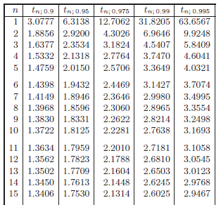
^{t-distribution}
c

Slide 76
F_{95%}
^{F-distribution}
F_{99%}
c

