Slide 1

Statistics A
Wilhelmshaven
This lecture will be recorded and
Subsequently uploaded in the
world-wide-web
Prof. Dr. Bernhard Köster
Jade-Hochschule Wilhelmshaven
http://www.bernhardkoester.de/vorlesungen/inhalt.html

Slide 2






^{Random Variable}
Definition:
A Random Variable X is the mapping of the sample space Ω into the real numbers R. That means every elementary event A_{i} maps onto a real number x_{i} and the probability p_{i} = P(A_{i}) = P(X=x_{i}) = p(x_{i}) is known.
→ p_{i} ist the probality that random variable X equals the outcome x_{i}.

Slide 3





Random Variable – Explainations
Every possible event of a random experiment can be expressed via a random variable.
Random variables are expressed in capital letters.
Example: dice with sample space X is element of {1,2,3,4,5,6}
The realization of a random variable is expressed in lowercase letters:
Example rolling dice: X realizes the value x = 5
Probality in the example of rolling dice:
P(x < 5) = ??

Slide 4


Discrete and continous random variables (RV)
Discrete RV:
RV, which have only a finite or countably infinite realizations.
Continous RV:
RV which can realize within an intervall every possible real number.

Slide 5



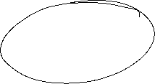


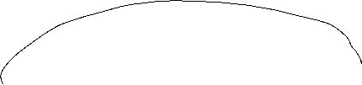

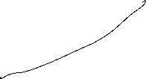

















Discret
Probability mass function:
Cumulative distribution function:
Expectation value:
Variance:
Continous
Probability density function:
Cumulative distribution function:
Expectation value :
Variance:

Slide 6




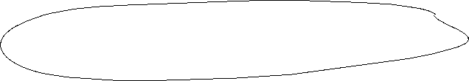





















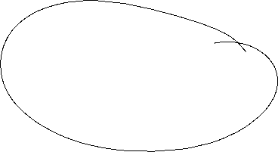



Calculating with Expectation Value and Variance
Constant:
Constant factor:
Linear Transformation:

Slide 7

Probability Axioms
Axiom 1: $P\left(A\right)≥0$ for all $A∈Ω$
Every event has a non negative probability
Axiom 2: $P\left(Ω\right)=1$
The certain event has probability 1
Axiom 3: $P\left(A∪B\right)=P\left(A\right)+P\left(B\right),$ if $A∩B=⌀$
Addition rule for disjoint events

Slide 8







Rules
Rule 1: $P\left(A∪B\right)=P\left(A\right)+P\left(B\right)−P(A∩B)$
Addtion rule for any events
Rule 2: $P\left(A\backslash B\right)=P\left(B\right)−P(A∩B)$
A without B
Rule 3:$P\left(\overline{A}\right)=1−P\left(A\right)$
Probality of complementary events

Slide 9


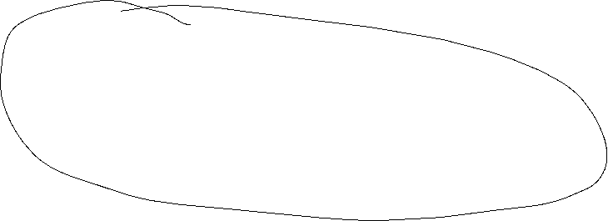

Conditional probability
The conditional probability of an event A is the probablity of the occurence the event A given event B has happened (or happens simultaneously with A)
→ conditional probability of A given: P(A│B).
Definition:
Bayes Theorem:

Slide 10




Example
Suppose the following probabilities are known:
P(A) = 0,5; P(B) = 0,3; P(A∩B) = 0,2
Calculate
Rule 1: $P\left(A∪B\right)=P\left(A\right)+P\left(B\right)−P(A∩B)$
Rule 3:$P\left(\overline{A}\right)=1−P\left(A\right)$
Rule 2: $P\left(A\backslash B\right)=P\left(B\right)−P(A∩B)$

Slide 11




Statistically independent events
P(A|B) = P(A) or P(B|A) = P(B)
→

Slide 12


Total Probability
If the sample space Ω consists of in k disjoint elemtary events A_{i}, then the probability of event B is:
→

Slide 13

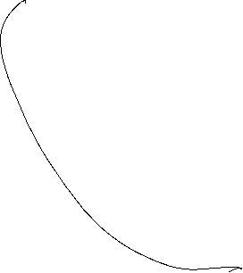
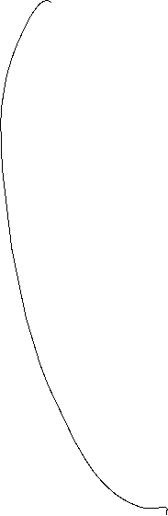
Statistically independent events: Example
Sylvester 1988 in Casino in Konstanz at the roulette table, the event
A = {0,3}occured 9 times in a row. Calculate the probability of this event
Suppose in class two students have birthday at the same day. What is the the minimum number of students in class, that the probability for this event is 50%?

Slide 14



Total Probability: Example
Every day a small village is visited by a postman. If he is in good mood he is in time with probability 90%. If he is in bad mood he is late with probability 40%.
What is the probability that he is late at any day, if he is on average in good at 7 out of 10 days?

Slide 15





Total Probability and Bayes Theorem
Suppose you are testing for a rare illness and you have the following probabilities:
A = {patient is ill}
B = {test is positive}
Since we have a rare illness: P(A) = 0,1%.
Since a test does not have 100% accurancy, from surveys we have:
  P(B|A) = 0,98
  $P(B|\overline{A})$ = 0,03
Suppose your test result is positive. What is the probability, that you are really ill?

Slide 16
Goats and Cars
Suppose in a game show you are sitting infront of 3 doors. You know behind on door you`ll win a car and behind the two other doors you get only a goat
Round 1: You choose a door
After that, the showmaster, knowing the door with the car, opens a door with a goat
Round 2: You`re asked if you want to change doors
What is your decision?
If you don`t believe it, try to simulate this in Excel!

Slide 17










Slide 18
Binomial distribution
A random experiment has two possible outcomes (success and failure).
The random experiment will be repeated n times.
What is the probability to be k times successful within n $≥$k repetions
Every repetition is independent from each other. Within every repetition succes has probability p und failure probability 1-p.

Slide 19


Binomial Distribution
Suppose p of „success“ is known, define the random variable X =„number of succes k“ within n $≥$ k repetitions.
→ X is Binomial distributed with
$$P\left(X=k\right)=\left(\begin{matrix}n \\ k\end{matrix}\right)p^{k}({1−p)}^{n−k}$$

Slide 20











Examples Binomial Distribution
$$P\left(X=k\right)=\left(\begin{matrix}n \\ k\end{matrix}\right)p^{k}({1−p)}^{n−k}$$
Probability within 10 throws of a dice to obtain 3 times a 6?
Probability to move the first time in the game „Mensch ärgere Dich nicht“ (Hombre, no te enfades)?
You play four different statistically independent Lotteries. The probability of success is always 20 %.
  What is the expectated value and the variance and standard deviation?
  What is the expected payoff, if every successs counts 10 Euros?
  Calculate the probability to win exactly two times
  Calculate the probability that you loose at least three times.
c

Slide 21
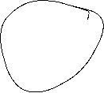
Continous Random Variables
The probability of the realization of X within some specific interval [a,b] is the area below the density function f(x):
c

Slide 22





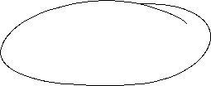
Properties of the density function
Values of f(x) cannot be interpreted!
If the length of the intervall reaches zero (a = b), also the area reaches zero:
→ P(X = x) = 0
The whole area below the density function equals 1 (certain event):
c

Slide 23



Example Density Function
Student Mike is always late in the statistics lecture. His delay is a continous random variable with the following density function
$$f\left(x\right)=\left\{\begin{matrix}\begin{matrix}a−\frac{1}{8}x for 0≤x≤4 \\ 0 otherwise\end{matrix} \\ \end{matrix}\right.$$
What is a?
Sketch the density graphically
Calculate the probability that Mike is between 1 und 2 minutes late at some specific day.
Sketch the cumulative distribution function graphically
Calculate the Expected value and Variance
c

Slide 24















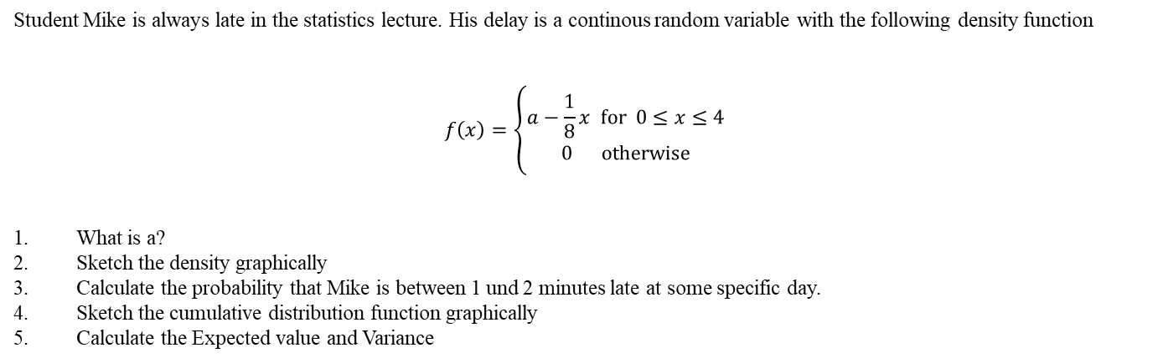
Student Mike is always late in the statistics lecture. His delay is a continous random variable with the following density function
$$f\left(x\right)=\left\{\begin{matrix}\begin{matrix}a−\frac{1}{8}x for 0≤x≤4 \\ 0 otherwise\end{matrix} \\ \end{matrix}\right.$$
What is a?
Sketch the density graphically
Calculate the probability that Mike is between 1 und 2 minutes late at some specific day.
Sketch the cumulative distribution function graphically
Calculate the Expected value and Variance

Slide 25
a [1,2] density, cumulative distribution, E(x), Var(x)
Example Density Function
$$f\left(x\right)=\left\{\begin{matrix}\begin{matrix}a−\frac{1}{8}x for 0≤x≤4 \\ 0 otherwise\end{matrix} \\ \end{matrix}\right.$$
solve( int(a-(1/8)x dx; 0..4)=1,a)
plot(1/2-x/8,0..4)
int(1/2-x/8),0..y
plot(-1/16 (-8 + y) y,0..4)
int(x(1/2-x/8)),0..4
int((x-4/3)^2(1/2-x/8)),0..4
c

Slide 26



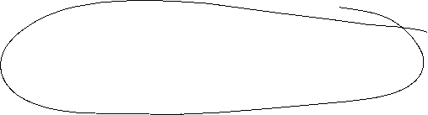

Uniform distribution
The density is constant over a given Interval [a,b]. This means, that every subinterval with same length have same probability
$$f\left(x\right)=\left\{\begin{matrix}\begin{matrix}\frac{1}{b−a}x a≤x≤b \\ 0 otherwise\end{matrix} \\ \end{matrix}\right.$$
c

Slide 27



Uniform distribution
f(x)
F(x)
1/(b-a)
1
c
a
b
a
b

Slide 28
Suppose you are the COP (Chief of Production) within a brewery.
Furthermore the maschine shows a filling quanatity of the bottles is 0,568L. But you suppose, that real filling quantity is uniformly distributed around 0,556L and 0,58L.
What is the probability that the filling quantity is less than 0,56L?
Example
c

Slide 29




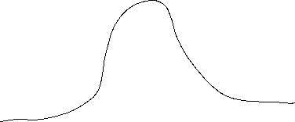














Normal Distribution
The normal distribution or gaussian distribution is the most important distribution.
We write:
The density function is given by:
The cumulative distribution function by:
$$⋅$$
$$f\left(x\right)=\frac{1}{\sqrt{2π}σ}ⅇ^{−\frac{{\left(x−μ\right)}^{2}}{2σ^{2}}}$$
c
$$F\left(x\right)=\frac{1}{\sqrt{2{πσ}^{2}}}\int_{0}^{x}{ⅇ^{−\frac{{\left(t−μ\right)}^{2}}{2σ^{2}}}ⅆt}=\frac{1}{2}\left(1+ⅇrf\left(\frac{x−μ}{\sqrt{2πσ^{2}}}\right)\right)$$
$$\operatorname{erf}\left(x\right)=\frac{2}{\sqrt{π}}\int_{0}^{y}{ⅇ^{−y^{2}}ⅆy}$$
(Error function)

Slide 30
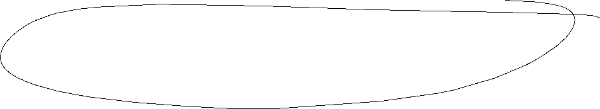


The importance of the normal distribution
Many empirical distributions follow at least approximately the normal distribution
Many discrete distribtions can be approximated by the normal distribution. I.e. Binomial distribution
The distribution of the sample indepent with respect to the underlying true distritibution is approximated by the normal distribution for large sample size N (central limit theorem)
The normal distribution is the basis theoretical models
(i.e. white noise)
c

Slide 31

Normal distribution
[%]
c
Density function μ = 0 und σ = 1
Cumulative distribution function μ = 0 und σ = 1

Slide 32
Properties of the normal distribution
The normal distribution is a 2-parameter-distribution in μ and σ
N(μ, σ²) is symmetrically around x = μ
The density function has turning points at x = μ + σ and x = μ – σ
The density function flattens if the variance goes up.
The density function reaches the x-axes
asymptotically at $+∞$ and $−∞.$
c

Slide 33
The standard normal distribution
Normal distribution with μ=0 σ =1
Maximum at z = 0
Turning points at z = -1 and z = 1
In order to calculate probabilities the cumulative distribution function is tabulated and implemented in every standard spreadsheet programm like excel (MS office) or calc (libreoffice)
Every normally distributed random variable can be transformed in a standard normally distributed random variable (Standardisierung)
c
$$φ\left(z\right)=\frac{1}{\sqrt{2π}}\int_{0}^{z}{ⅇ^{−\frac{1}{2}x^{2}}ⅆx}⋅$$

Slide 34







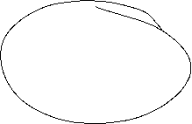






Normal distribution and standard normal distribution
Suppose then
We have
Generally, we obtain:
or
c

Slide 35


Probabilities and areas below the density function
Density function:
Intervall:
P(Z< c)
c

Slide 36






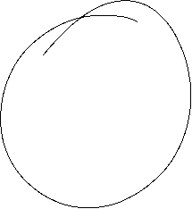











Relevant Values of the standard normal distribution
z | F(z)
-2.58 | 0.5 %
-2.33 | 1 %
-1.96 | 2.5 %
-1.64 | 5 %
-1.23 | 10 %
c

Slide 37
Example
Suppose you are the CEQ (Chief of Quality) in lamp maufactoring company. The life expectancy of a LED-lamp should be normally distributed with μ=25000h and σ= 2000.
Calculate the probability that the LED-Lamp works less than 20000 hours
Calculate the probability that the LED-Lamp works more than 27000 hours
Calculate the probability that the LED-Lamp works within 24000 und 28500 hours.
Show 1.-3. graphically
c

Slide 38

Reproductive property of the normal distribution
The sum of n indepentently normally distributed random variables ist also normally distributed.
The expected value of X equals the sum of the single expected values we obtain
For the variance of X, we obtain the analogous result:
c

Slide 39









Central limit theorem
The sum of n independently identically distributed random variables is approximately normally distriuted, if n is large enough
Consequence: The true distribution can be ignored if n is large enough and you are interested in the distribution of the sample mean:
Mathematically:
$X_{1},X_{2}{,X}_{3}$… iid RV with unknown distribution, but $E\left(X\right)=μ$and Var$\left(X\right)=σ^{2}$ exist.
Than for the first n $X_{i}$ and ${\overline{X}=\frac{1}{n}(X}_{1}{+X}_{2}+…+X_{n})$ we obtain $E\left(\overline{X}\right)=μ$ Var$\left(\overline{X}\right)=$ $σ^{2}/n$
and $Z_{n}=\frac{\overline{X}−μ}{σ}\sqrt{n}$ is for n→∞ standard normally distributed: $Z∽N(0,1)$
oder
$$\lim_{\text{n}\text{→}\text{∞}}{P\left(\frac{\overline{X}−μ}{σ}\sqrt{n}≤z\right)=Φ(z)}$$
c

