Slide 1

Statistics A
Wilhelmshaven
This lecture will be recorded and
Subsequently uploaded in the
world-wide-web
Prof. Dr. Bernhard Köster
Jade-Hochschule Wilhelmshaven
http://www.bernhardkoester.de/vorlesungen/inhalt.html

Slide 2

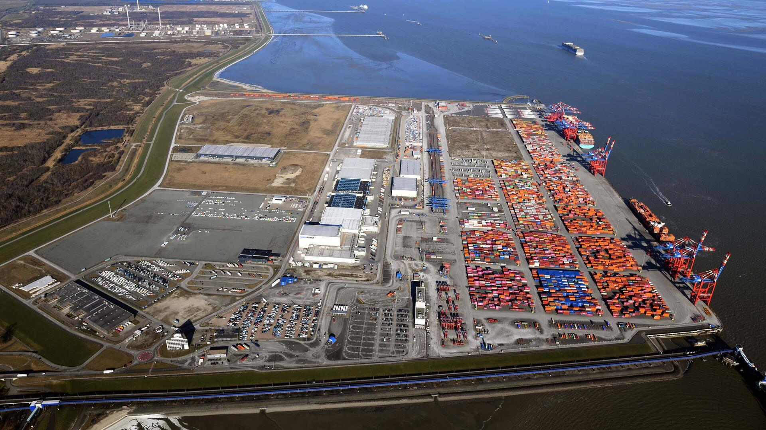
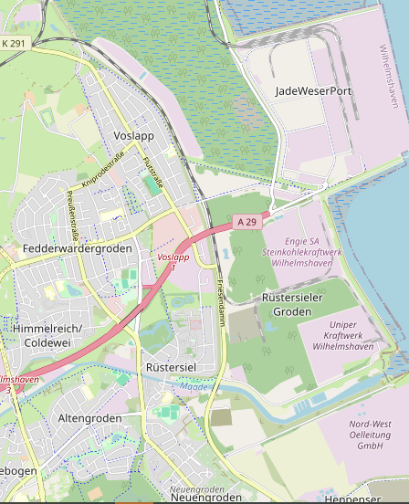
Excursion
Jade Weser Port
Wilhelmshaven
InfoCenter
x
Thursday 22.05.2025 JadeWeserPort InfoCenter
10:30 Uhr – 11:30 Uhr Harbour Tour
11:30 Uhr – 12:00 Uhr Short Presentation
12:00 Uhr – 12:30 Uhr Film about the construction of the JadeWeserPort
12:30 Uhr – 13:00 Uhr Visit to the exhibition in the JadeWeserPort InfoCenter
Kontakt:
Prof. Dr. Bernhard Köster
bernhard.koester@jade-hs.de
JHS
x

Slide 3
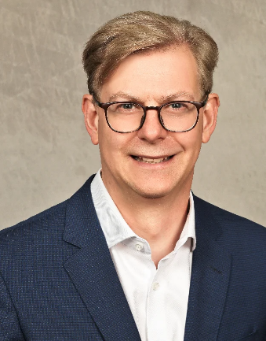
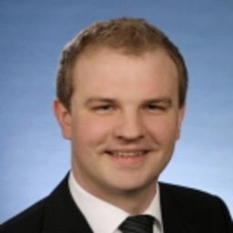
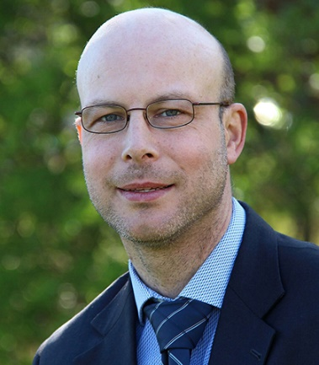
De-Risking and De-coupling in International Economic relation
–
Volatile Times for Investment Decisions
Thursday 15.04.2025
Hybrid: Zoom + Lecture Hall
Jade Hochschule Wilhelmshaven
10:15 – 11:45 Uhr: S123
Wilhelmshaven
Dr. Jörg Rahn
Chief Investment Officer
Tertium Family Office
Dr. Wolfgang Kornprobst
Senior Economist (Strategy)
Siemens AG
Prof. Dr. Bernhard Köster
Economics
Jade Hochschule
Kontakt:
Prof. Dr. Bernhard Köster
bernhard.koester@jade-hs.de
Zoom-link:
https://jade-hs.zoom-x.de/j/69403756953?pwd=u1b9J7DWcCPv1y3abm6Y8N8YkU6hXK.1

Slide 5


c

Slide 6












c

Slide 7







c

Slide 8




c

Slide 9

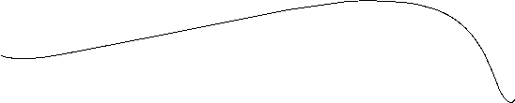


Slide 10
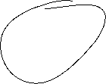



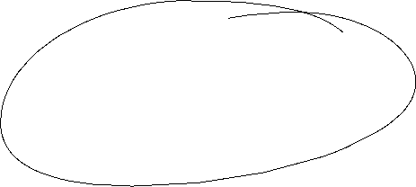
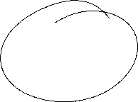



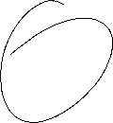





Slide 11






Slide 12


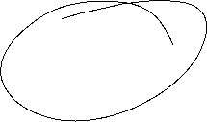

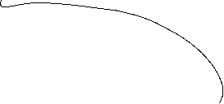


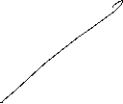
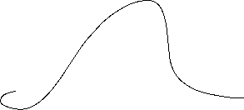




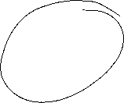
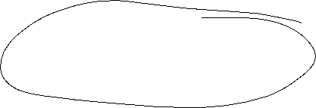













Slide 13
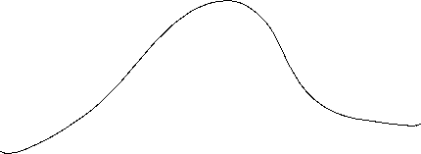



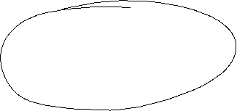


Slide 14






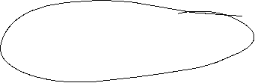

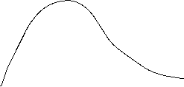

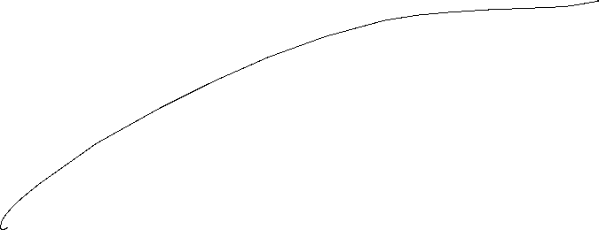











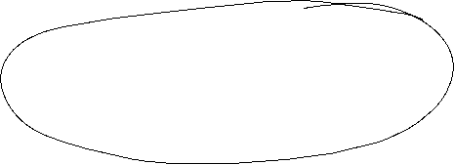






Slide 15
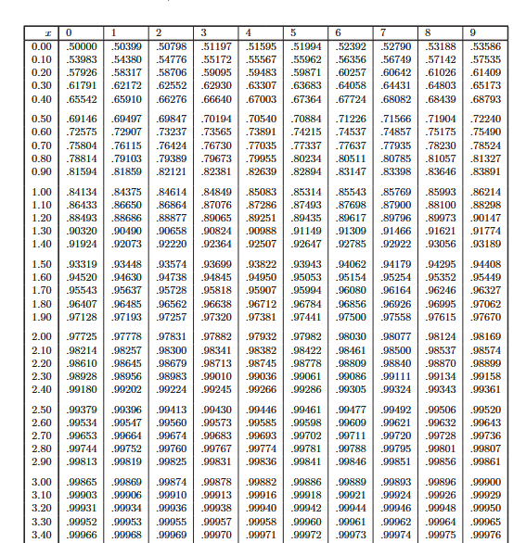







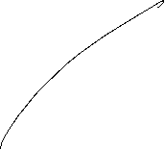




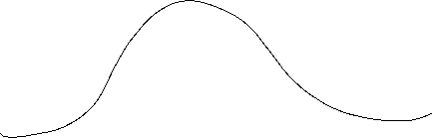





Slide 16













Slide 17
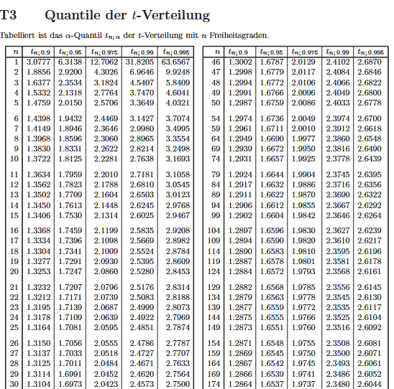

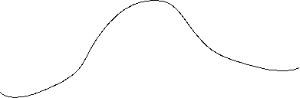









Slide 18






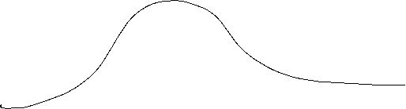







c

Slide 19





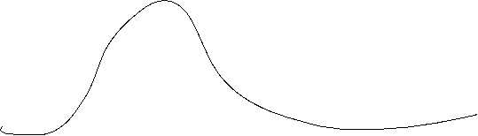



Slide 20

