Slide 1
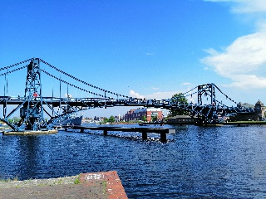
Statistics A
Wilhelmshaven
This lecture will be recorded and
Subsequently uploaded in the
world-wide-web
Prof. Dr. Bernhard Köster
Jade-Hochschule Wilhelmshaven
http://www.bernhardkoester.de/vorlesungen/inhalt.html

Slide 2
Binomial Distribution
Suppose p of „success“ is known, define the random variable X =„number of succes k“ within n $≥$ k repetitions.
→ X is Binomial distributed with
$$P\left(X=k\right)=\left(\begin{matrix}n \\ k\end{matrix}\right)p^{k}({1−p)}^{n−k}$$

Slide 3
Examples Binomial Distribution
Probability within 10 throws of a dice to obtain 3 times a 6?
Probability to move the first time in the game „Mensch ärgere Dich nicht“ (Hombre, no te enfades)?
You play four different statistically independent Lotteries. The probability of success is always 20 %.
What is the expectated value and the variance and standard deviation?
What is the expected payoff, if every successs counts 10 Euros?
Calculate the probability to win exactly two times
Calculate the probability that you loose at least three times.

Slide 4
Examples Binomial Distribution

Slide 5
You play four different statistically independent Lotteries. The probability of success is always 20 %.
What is the expectated value and the variance and standard deviation?
What is the expected payoff, if every successs counts 10 Euros?
Calculate the probability to win exactly two times
Calculate the probability that you loose at least three times

Slide 7
Student Mike is always late in the statistics lecture. His delay is a continous random variable with the following density function
$$f\left(x\right)=\left\{\begin{matrix}\begin{matrix}a−\frac{1}{8}x for 0≤x≤4 \\ 0 otherwise\end{matrix} \\ \end{matrix}\right.$$
What is a?
Sketch the density graphically
Calculate the probability that Mike is between 1 und 2 minutes late at some specific day.
Sketch the cumulative distribution function graphically
Calculate the Expected value and Variance

Slide 8
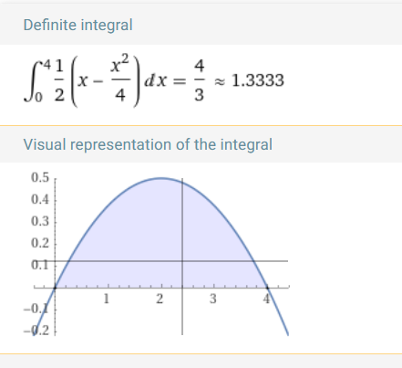
a [1,2] density, cumulative distribution, E(x), Var(x)
Example Density Function
$$f\left(x\right)=\left\{\begin{matrix}\begin{matrix}a−\frac{1}{8}x for 0≤x≤4 \\ 0 otherwise\end{matrix} \\ \end{matrix}\right.$$
solve( int(a-(1/8)x dx; 0..4)=1,a)
plot(1/2-x/8,0..4)
int(1/2-x/8),0..y
plot(-1/16 (-8 + y) y,0..4)
int(x(1/2-x/8)),0..4
int((x-4/3)^2(1/2-x/8)),0..4
c

Slide 9
Suppose you are the COP (Chief of Production) within a brewery.
Furthermore the maschine shows a filling quantity of the bottles is 0,568L. But you suppose, that real filling quantity is uniformly distributed around 0,556L and 0,58L.
What is the probability that the filling quantity is less than 0,56L?
Example
c

Slide 10
Suppose you are the CEQ (Chief of Quality) in lamp maufactoring company. The life expectancy of a LED-lamp should be normally distributed with μ=25000h and σ= 2000.
Calculate the probability that the LED-Lamp works less than 20000 hours
Calculate the probability that the LED-Lamp works more than 27000 hours
Calculate the probability that the LED-Lamp works within 24000 und 28500 hours.
Show 1.-3. graphically
c

