Slide 1

Statistics A
Wilhelmshaven
This lecture will be recorded and
Subsequently uploaded in the
world-wide-web
Prof. Dr. Bernhard Köster
Jade-Hochschule Wilhelmshaven
http://www.bernhardkoester.de/vorlesungen/inhalt.html

Slide 2

(Advanced) Statistics A
Summer term 2024
Prof. Dr. Bernhard Köster

Slide 3
Start is Wednesday, 6 March 2024
Classroom lectures will be streamed, if technically possible, via a zoom-meeting (see moodle)
Lectures will be recored and uploaded on youtube (see my youtube channel und my hompage)
Exam type: Term paper
Youtube-channel Bernhard Köster
Homepage Bernhard Köster
Material will be mainly distributed via my homepage, organisational aspects via moodle
Please bring a laptop or Tablet in calss
Kind regards Bernhard Köster

Slide 4
Prof. Dr. Bernhard Köster
Room: S 113
Street: Friedrich-Paffrath-Straße 101
location: 26389 Wilhelmshaven
Tel. +49 4421 985-2766
Email: bernhard.koester@jade-hs.de
Consultation hour: by arrangement
or just have a look into my office!
or Webex/Zoom …

Slide 5
Literature
Statistics for Business and Economics, Anderson, Sweeney, Williams, Camm, Cochran
Mathematical Statistics for Economics and Business, Mittelhammer
Statistics for Business and Economics, Global Edition, Newbold, Thorne, Carlson
A Guide to Modern Econometrics, Verbeek
Some open resources
  OpenIntro Statistics
  Statistical Thinking for the 21st Century
  MIT OPENCOURSEWARE
-> there is much more!!!

Slide 6
Introduction and Revision
Means and Median
Dispersion: MAD, Variance, Standard Deviation, Coefficiant of Variation
Contingency table and independence
Bayes` Theorem
Random Variable
Probability Distributions, density function and cumulative distribution function
Central limit theorem

Slide 7
Example
Generate in Excel a sample of the length of 15 male students around 175cm and a maximum deviation of 25cm.
Calculate the arithmetic, geometric, harmonic mean and the median of the distribution.
Calculate the MAD, variance, standard deviation, and the coefficient of variation of the distribution.
Generate in Excel a sample of the length of 11 female students around 165cm and a maximum deviation of 20cm.
Calculate the contingency table of the attributes gender and lenght
((0-155),[155,170),[170,185),[185,200] and the marignal distributions
Are the attributes gender and length statistically independent?

Slide 8


Example
Generate in Excel a sample of the length of 15 male students around 175cm and a maximum deviation of 25cm.
Calculate the arithmetic, geometric, harmonic mean and the median of the distribution.

Slide 9

Example
Generate in Excel a sample of the length of 15 male students around 175cm and a maximum deviation of 25cm.
Calculate the arithmetic, geometric, harmonic mean and the median of the distribution.
Calculate the MAD, variance, standard deviation, and the coefficient of variation of the distribution.

Slide 10

Example
Generate in Excel a sample of the length of 15 male students around 175cm and a maximum deviation of 25cm.
Generate in Excel a sample of the length of 11 female students around 165cm and a maximum deviation of 20cm.
Calculate the contingency table of the attributes gender and lenght
((0-155),[155,170),[170,185),[185,200] and the marignal distributions
Are the attributes gender and length statistically independent?

Slide 11










Conditional probability
The conditional probability of an event A is the probablity of the occurence the event A given event B has happened (or happens simultaneously with A)
→ conditional probability of A given: P(A│B).
Definition:
Bayes Theorem:

Slide 12





Goats and Cars
Suppose in a game show you are sitting infront of 3 doors. You know behind on door you`ll win a car and behind the two other doors you get only a goat
Round 1: You choose a door
After that, the showmaster, knowing the door with the car, opens a door with a goat
Round 2: You`re asked if you want to change doors
What is your decision?
If you don`t believe it, try to simulate this in Excel!

Slide 13


Goats and Cars

Slide 14




^{Random Variable}
Definition:
A Random Variable X is the mapping of the sample space Ω into the real numbers R. That means every elementary event A_{i} maps onto a real number x_{i} and the probability p_{i} = P(A_{i}) = P(X=x_{i}) = p(x_{i}) is known.
→ p_{i} ist the probality that random variable X equals the outcome x_{i}.

Slide 15

Random Variable – Explainations
Every possible event of a random experiment can be expressed via a random variable.
Random variables are expressed in capital letters.
Example: dice with sample space X is element of {1,2,3,4,5,6}
The realization of a random variable is expressed in lowercase letters:
Example rolling dice: X realizes the value x = 5
Probality in the example of rolling dice:
P(x < 5) = ??

Slide 16


Discrete and continous random variables (RV)
Discrete RV:
RV, which have only a finite or countably infinite realizations.
Continous RV:
RV which can realize within an intervall every possible real number.

Slide 17






Discret
Probability mass function:
Cumulative distribution function:
Expectation value:
Variance:
Continous
Probability density function:
Cumulative distribution function:
Expectation value :
Variance:

Slide 18




Calculating with Expectation Value and Variance
Constant:
Constant factor:
Linear Transformation:

Slide 19



Probability Axioms
Axiom 1: $P\left(A\right)≥0$ for all $A∈Ω$
Every event has a non negative probability
Axiom 2: $P\left(Ω\right)=1$
The certain event has probability 1
Axiom 3: $P\left(A∪B\right)=P\left(A\right)+P\left(B\right),$ if $A∩B=⌀$
Addition rule for disjoint events

Slide 20




Rules
Rule 1: $P\left(A∪B\right)=P\left(A\right)+P\left(B\right)−P(A∩B)$
Addtion rule for any events
Rule 2: $P\left(A\backslash B\right)=P\left(B\right)−P(A∩B)$
A without B
Rule 3:$P\left(\overline{A}\right)=1−P\left(A\right)$
Probality of complementary events

Slide 21
Conditional probability
The conditional probability of an event A is the probablity of the occurence the event A given event B has happened (or happens simultaneously with A)
→ conditional probability of A given: P(A│B).
Definition:
Bayes Theorem:

Slide 22




Example
Rule 1: $P\left(A∪B\right)=P\left(A\right)+P\left(B\right)−P(A∩B)$
Addtion rule for any events
Rule 2: $P\left(A\backslash B\right)=P\left(B\right)−P(A∩B)$
A without B
Rule 3:$P\left(\overline{A}\right)=1−P\left(A\right)$
Probality of complementary events
Suppose the following probabilities are known:
P(A) = 0,5; P(B) = 0,3; P(A∩B) = 0,2
Calculate

Slide 23




Statistically independent events
P(A|B) = P(A) or P(B|A) = P(B)
→

Slide 24









Statistically independent events: Example
Sylvester 1988 in Casino in Konstanz at the roulette table, the event
A = {0,3}occured 9 times in a row. Calculate the probability of this event
Suppose in class two students have birthday at the same day. What is the the minimum number of students in class, that the probability for this event is 50%?

Slide 25

Total Probability
If the sample space Ω consists of in k disjoint elemtary events A_{i}, then the probability of event B is:
→

Slide 26


Total Probability: Example
Every day a small village is visited by a postman. If he is in good mood he is in time with probability 90%. If he is in bad mood he is late with probability 40%.
What is the probability that he is late at any day, if he is on average in good at 7 out of 10 days?

Slide 27




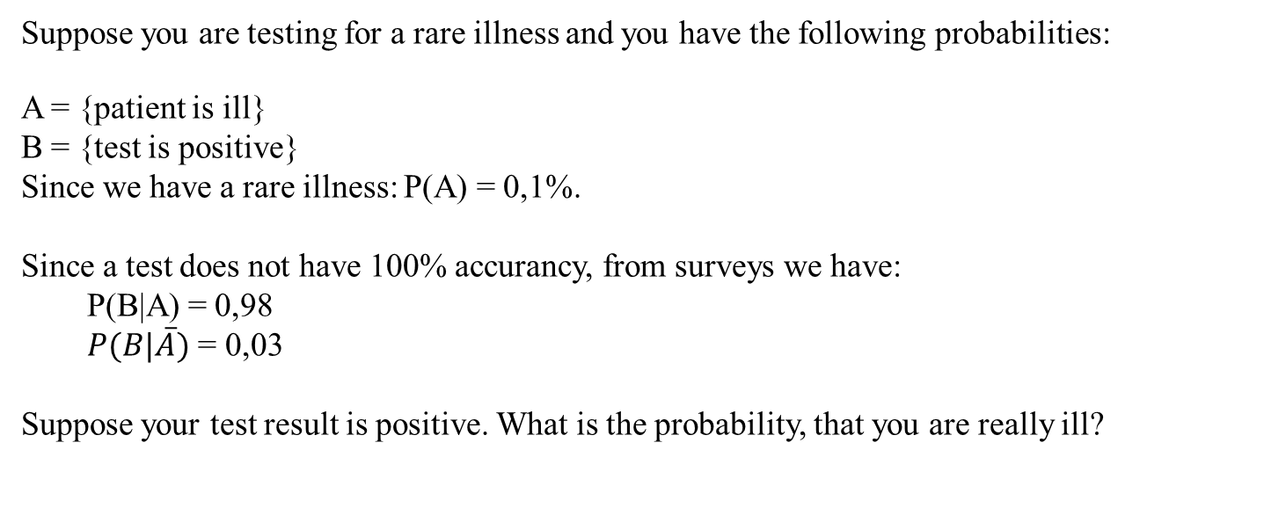






Total Probability and Bayes Theorem
Suppose you are testing for a rare illness and you have the following probabilities:
A = {patient is ill}
B = {test is positive}
Since we have a rare illness: P(A) = 0,1%.
Since a test does not have 100% accurancy, from surveys we have:
  P(B|A) = 0,98
  $P(B|\overline{A})$ = 0,03
Suppose your test result is positive. What is the probability, that you are really ill?

