Slide 1

Statistics A
Wilhelmshaven
This lecture will be recorded and
Subsequently uploaded in the
world-wide-web
Prof. Dr. Bernhard Köster
Jade-Hochschule Wilhelmshaven
http://www.bernhardkoester.de/vorlesungen/inhalt.html

Slide 2
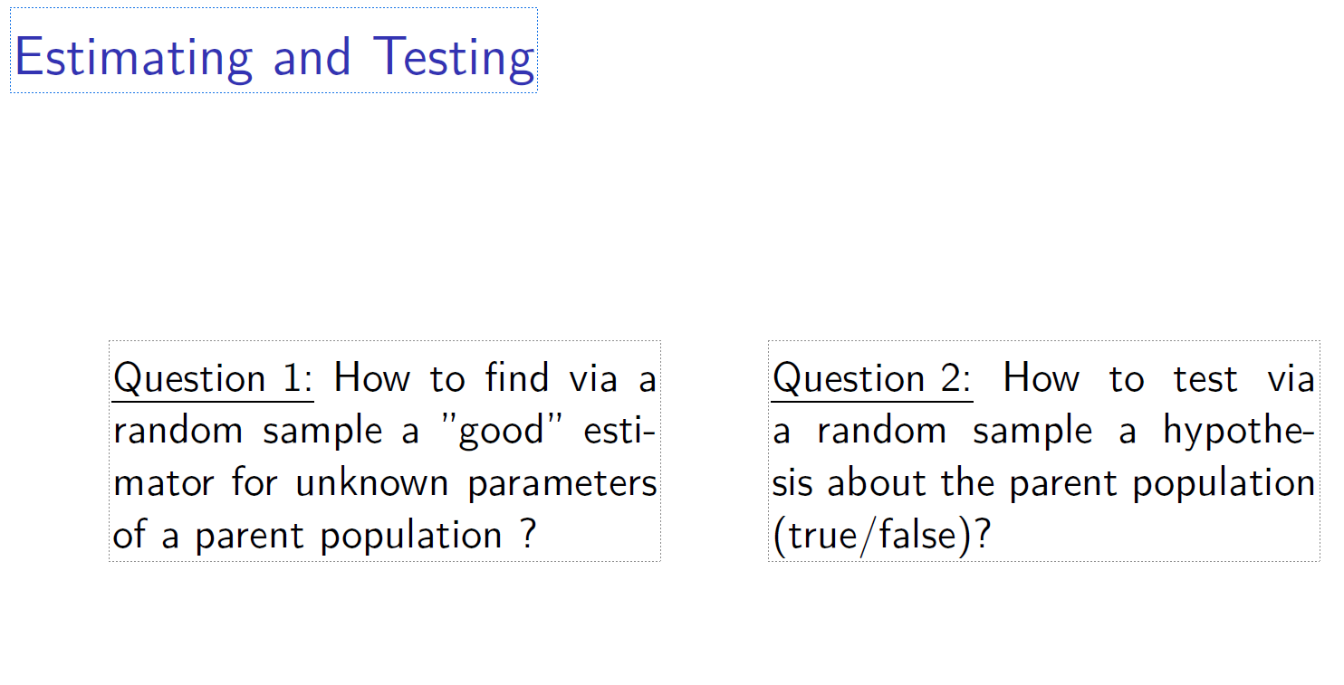
c

Slide 3
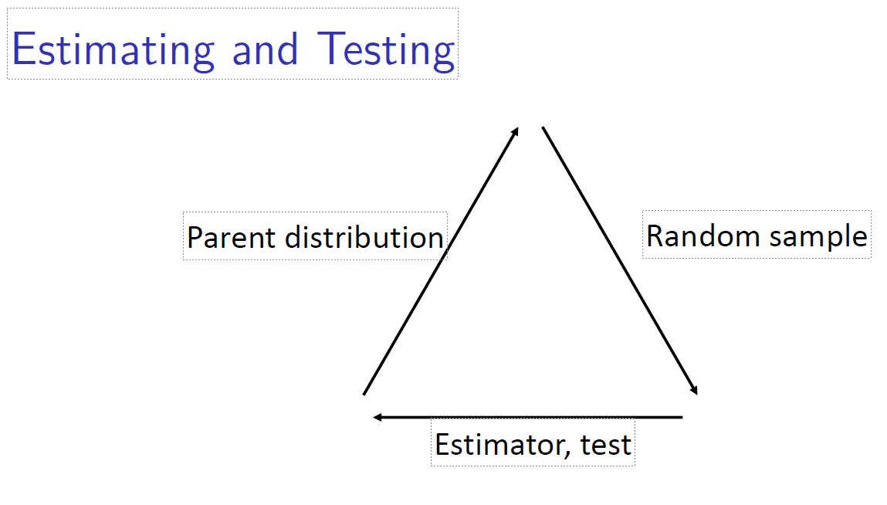
c

Slide 4
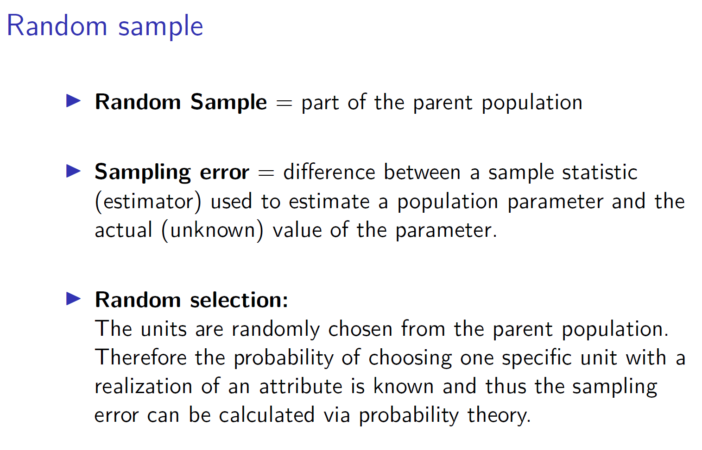
c

Slide 5
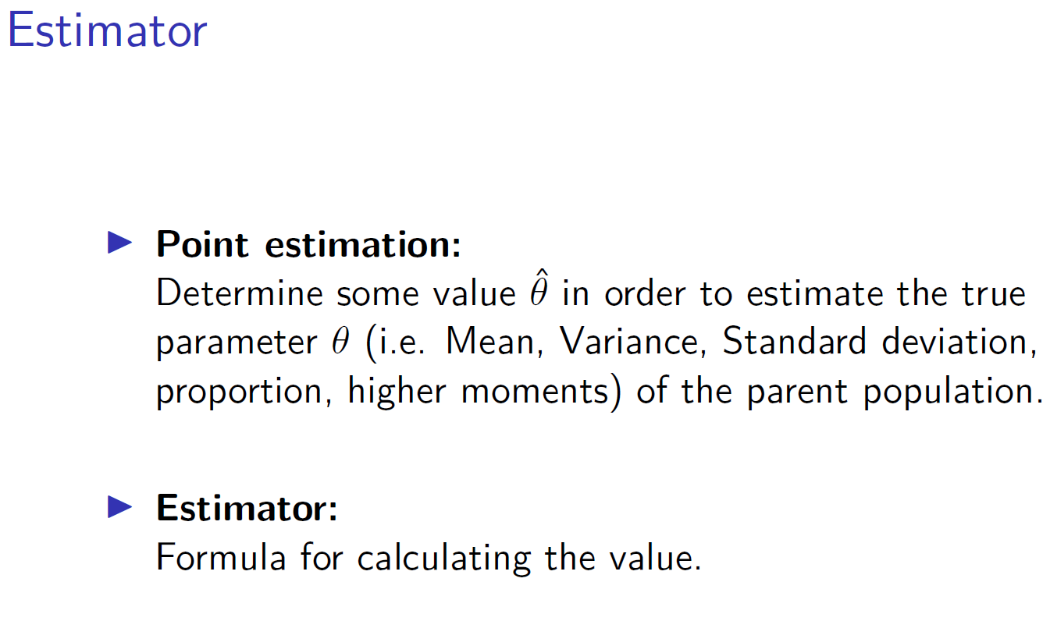
c

Slide 6
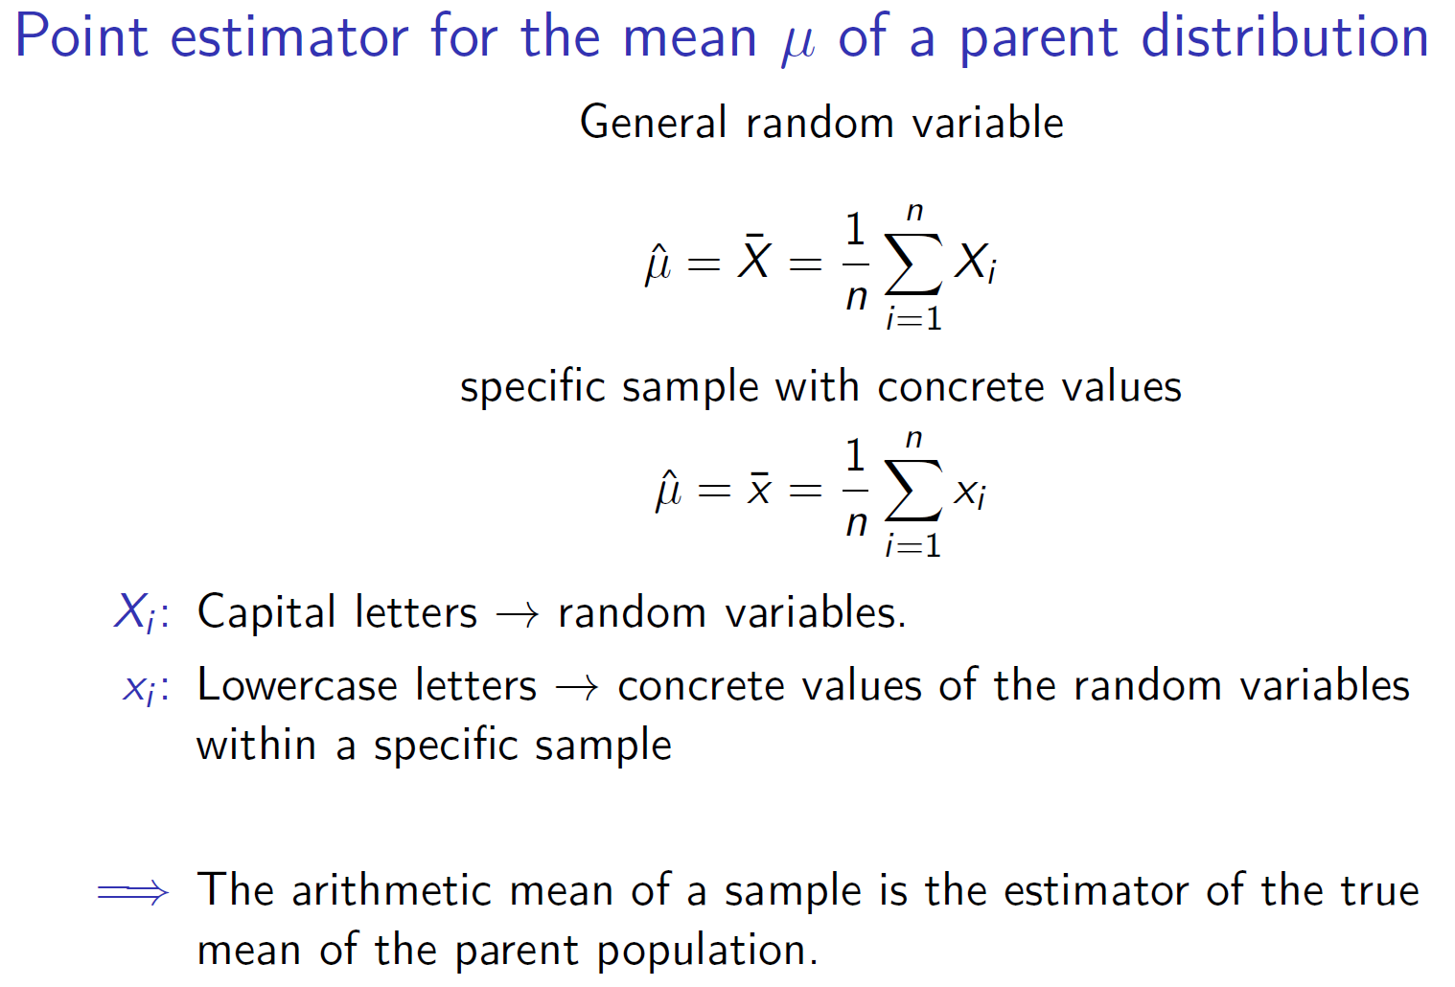
c

Slide 7
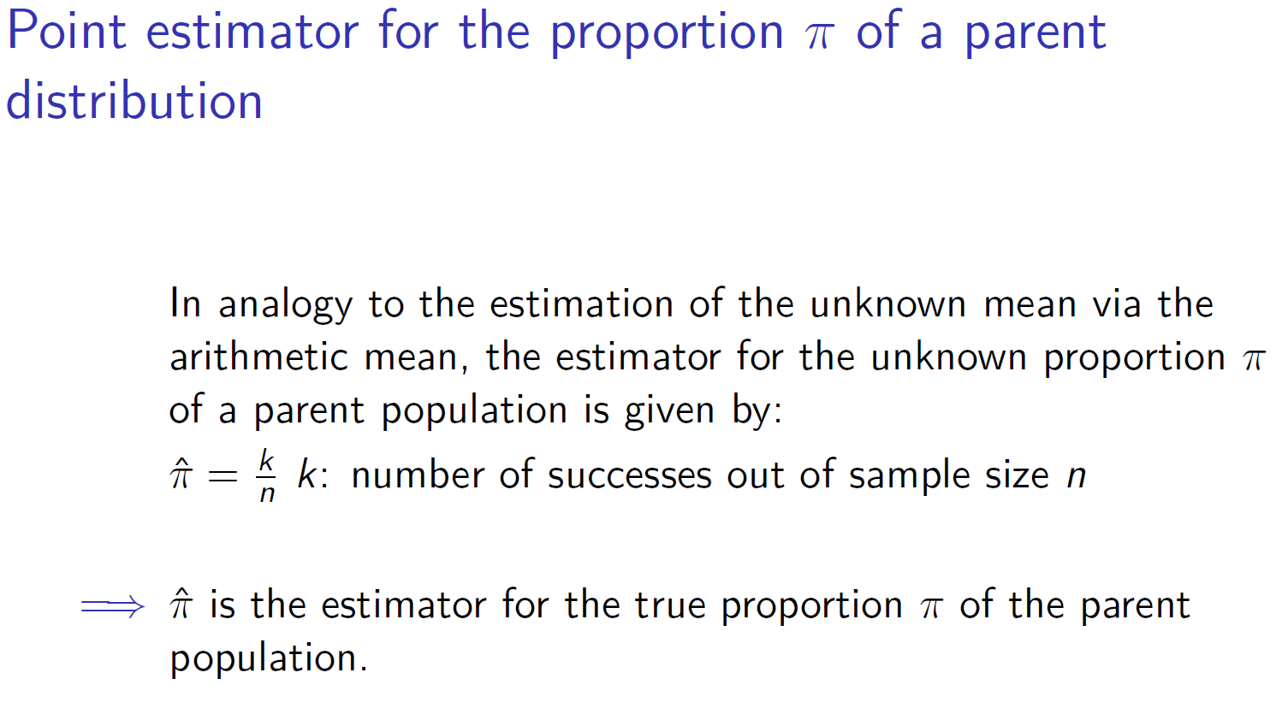
c

Slide 8
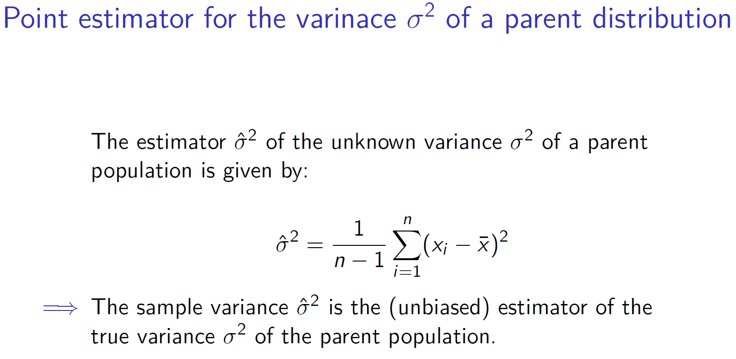
c

Slide 9
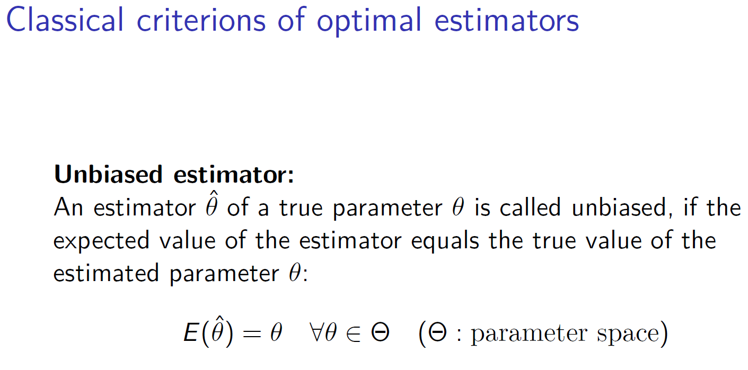
c

Slide 10
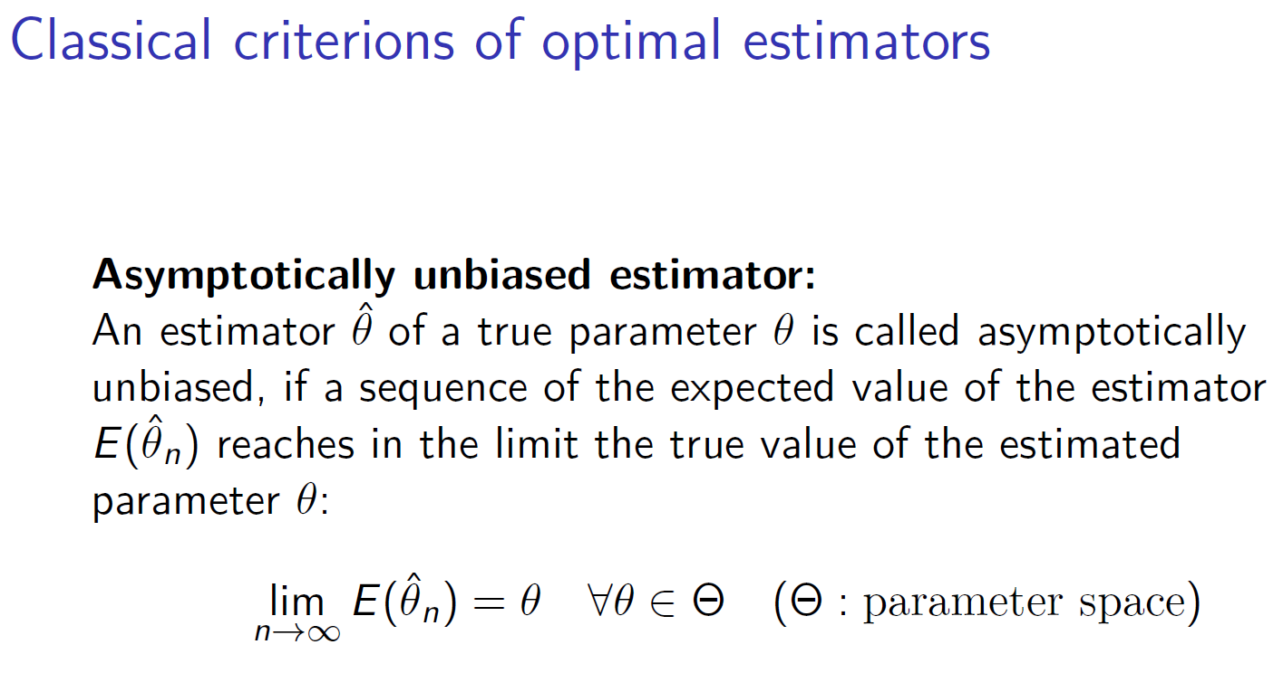
c

Slide 11
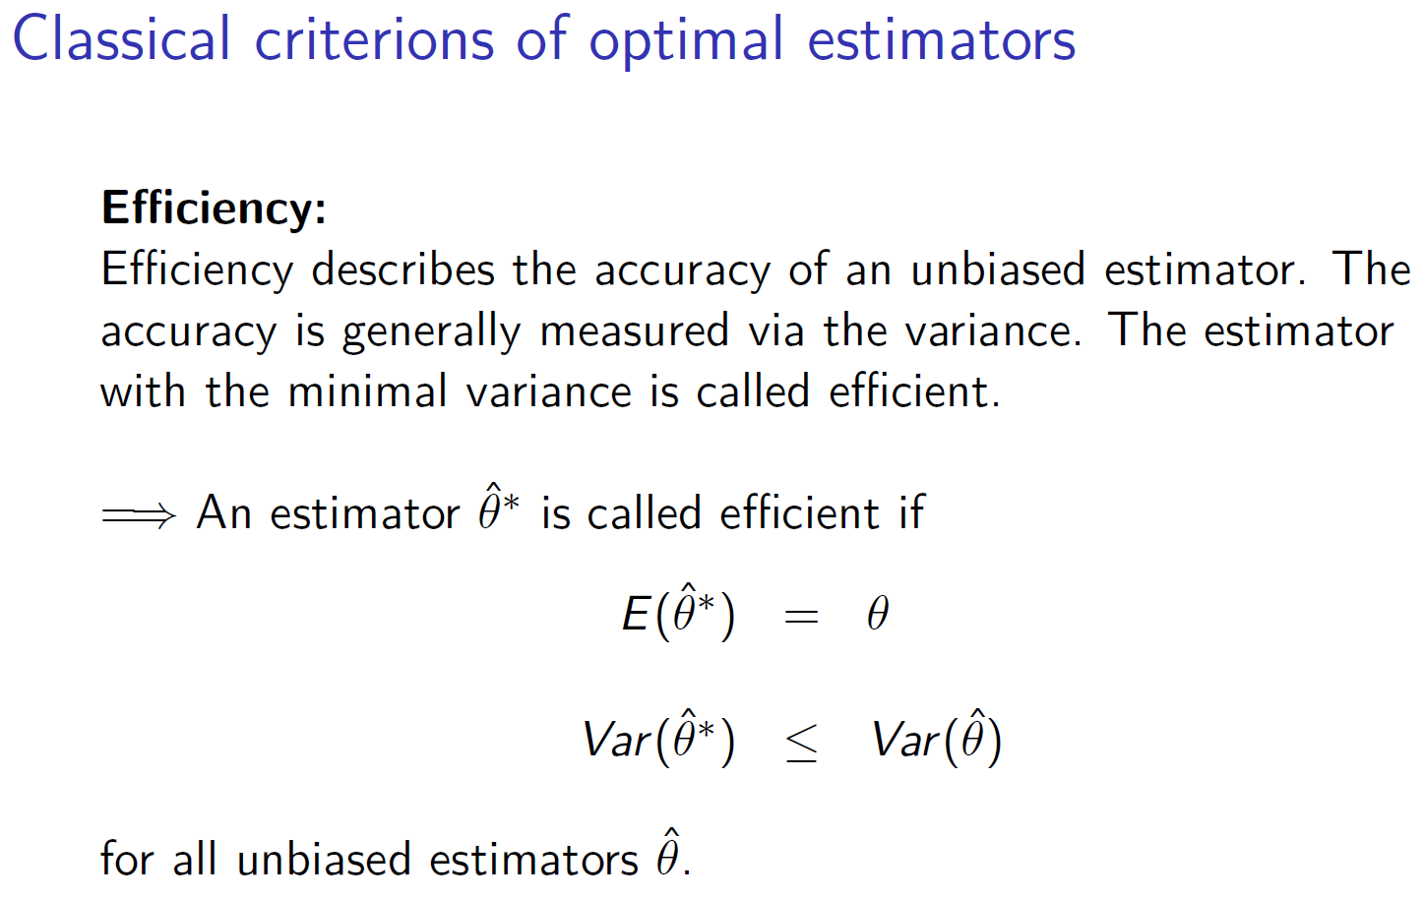
c

Slide 12
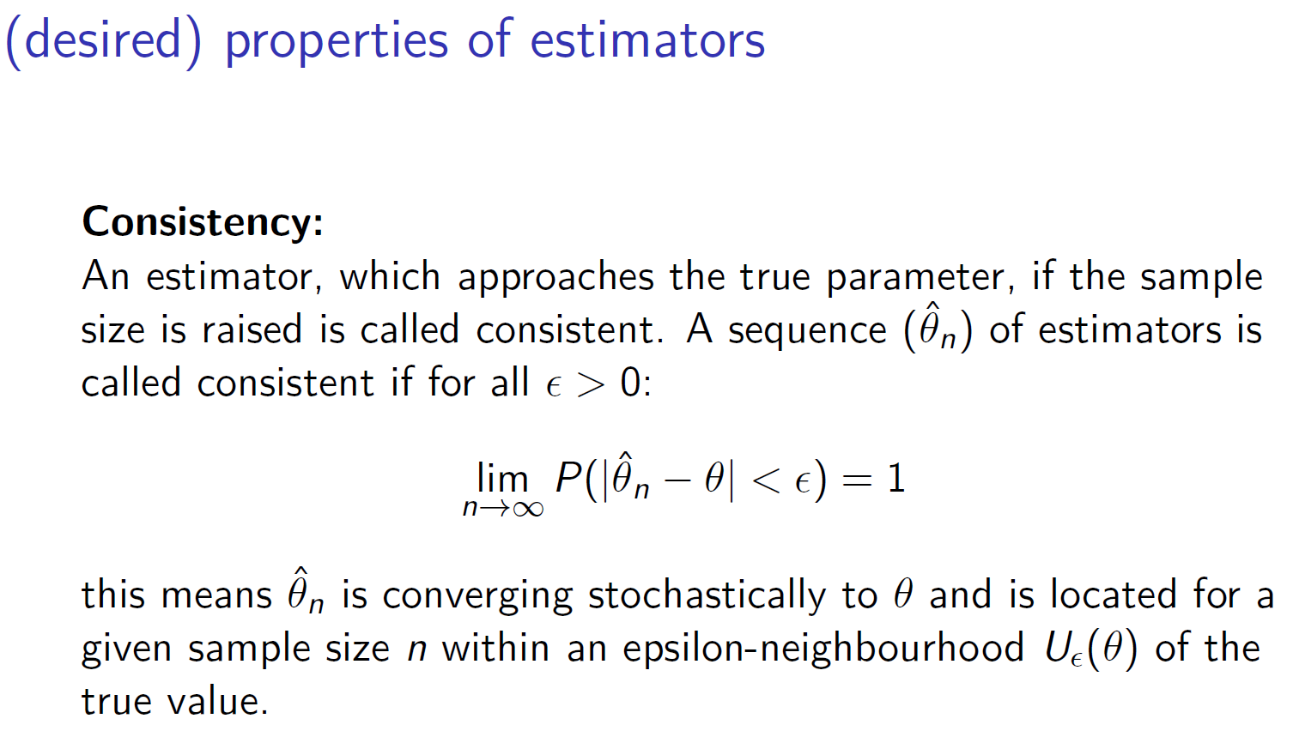
c

Slide 13
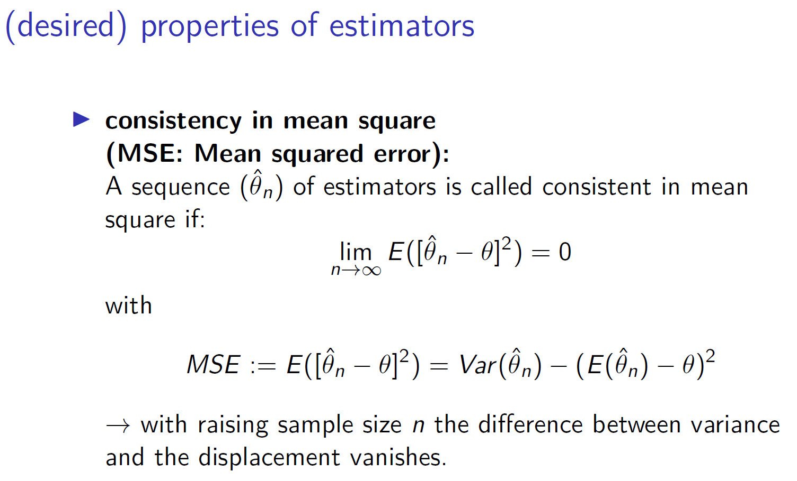
c

Slide 14
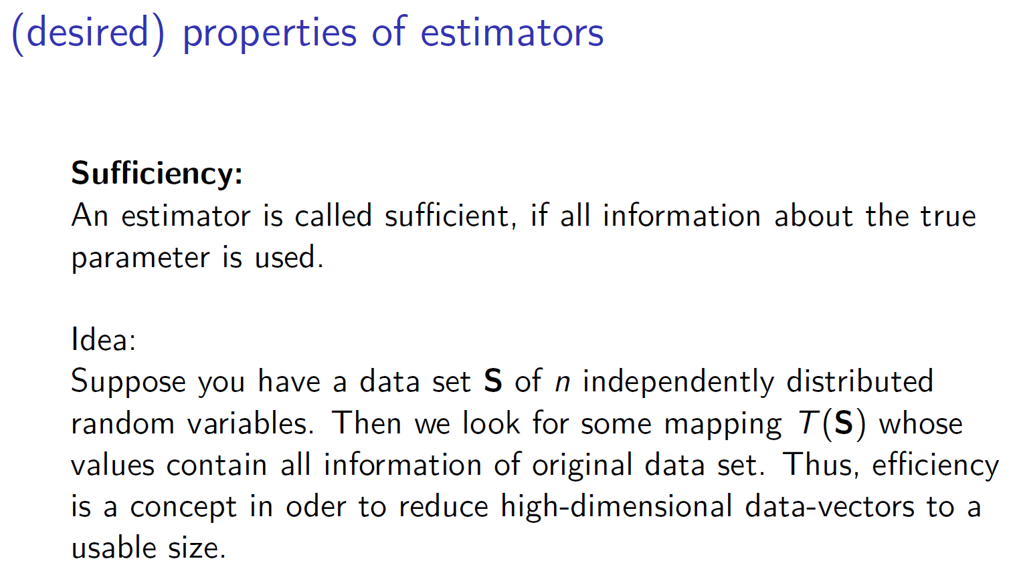
c

Slide 15
c

Slide 16
c

Slide 17
c

Slide 18
c

Slide 19
c

Slide 20
c

Slide 21
c

Slide 22
c

Slide 23
c

Slide 24
c

Slide 25
c

