Slide 1
(Advanced) Statistics A
Summer term 2023
Prof. Dr. Bernhard Köster

Slide 2
c

Slide 3
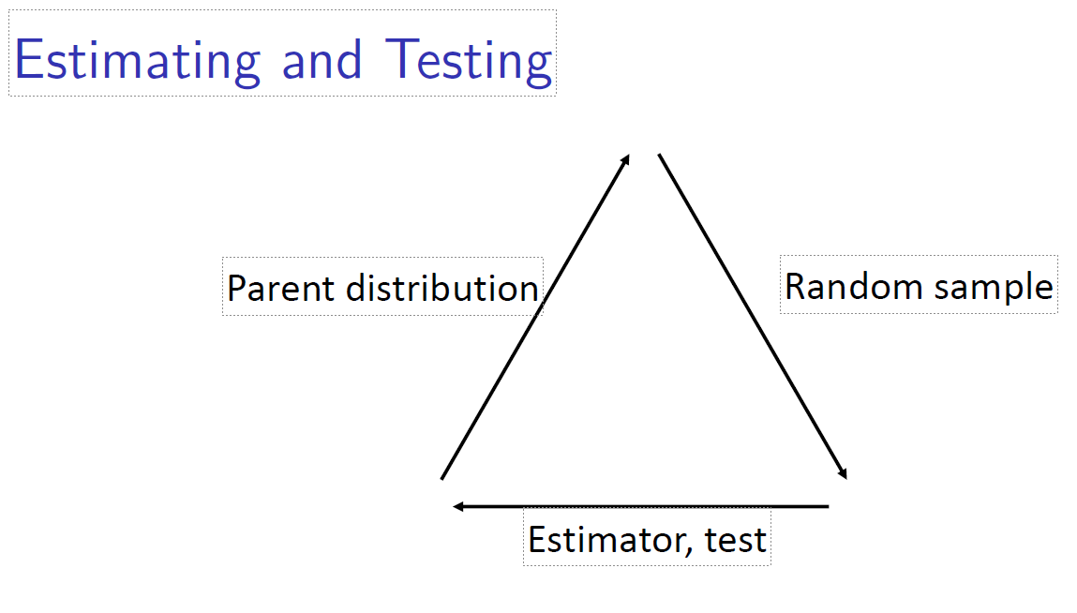
c

Slide 4
c

Slide 5
c

Slide 6
c

Slide 7
c

Slide 8
c

Slide 9
c

Slide 10
c

Slide 11
c

Slide 12
c

Slide 13
c

Slide 14
c

Slide 15
c

Slide 16
c

Slide 17
c

Slide 18
c

