Slide 1

(Advanced) Statistics A
Summer term 2023
Prof. Dr. Bernhard Köster

Slide 2
















Binomial Distribution
Suppose p of „success“ is known, define the random variable X =„number of succes k“ within n $≥$ k repetitions.
→ X is Binomial distributed with
$$P\left(X=k\right)=\left(\begin{matrix}n \\ k\end{matrix}\right)p^{k}({1−p)}^{n−k}$$

Slide 3

$$P\left(X=k\right)=\left(\begin{matrix}n \\ k\end{matrix}\right)p^{k}({1−p)}^{n−k}$$
Examples Binomial Distribution
Probability within 10 throws of a dice to obtain 3 times a 6?
Probability to move the first time in the game „Mensch ärgere Dich nicht“?
You play four different statistically independent Lotteries. The probability of success is always 20 %.
  What is the expectated value and the variance and standard deviation?
  What is the expected payoff, if every successs counts 10 Euros?
  Calculate the probability to win exactly two times
  Calculate the probability that you loose at least three times.

Slide 4


Examples Binomial Distribution
Probability within 10 throws of a dice to obtain 3 times a 6?
Probability to move the first time in the game „Mensch ärgere Dich nicht“?
You play four different statistically independent Lotteries. The probability of success is always 20 %.
  What is the expectated value and the variance and standard deviation?
  What is the expected payoff, if every successs counts 10 Euros?
  Calculate the probability to win exactly two times
  Calculate the probability that you loose at least three times.

Slide 5


Examples Binomial Distribution
You play four different statistically independent Lotteries. The probability of success is always 20 %.
  What is the expectated value and the variance and standard deviation?
  What is the expected payoff, if every successs counts 10 Euros?
  Calculate the probability to win exactly two times
  Calculate the probability that you loose at least three times.
$$P\left(X=k\right)=\left(\begin{matrix}n \\ k\end{matrix}\right)p^{k}({1−p)}^{n−k}$$

Slide 6
Normal Distribution
The normal distribution or gaussian distribution is the most important distribution.
We write:
The density function is given by:
The cumulative distribution function by:
$$⋅$$
$$\operatorname{erf}\left(x\right)=\frac{2}{\sqrt{π}}\int_{0}^{y}{ⅇ^{−y^{2}}ⅆy}$$
(Error function)
$$f\left(x\right)=\frac{1}{\sqrt{2π}σ}ⅇ^{−\frac{{\left(x−μ\right)}^{2}}{2σ^{2}}}$$
$$F\left(x\right)=\frac{1}{\sqrt{2{πσ}^{2}}}\int_{0}^{x}{ⅇ^{−\frac{{\left(t−μ\right)}^{2}}{2σ^{2}}}ⅆt}=\frac{1}{2}\left(1+ⅇrf\left(\frac{x−μ}{\sqrt{2πσ^{2}}}\right)\right)$$

Slide 7
The importance of the normal distribution
Many empirical distributions follow at least approximately the normal distribution
Many discrete distribtions can be approximated by the normal distribution. I.e. Binomial distribution
The distribution of the sample indepent with respect to the underlying true distritibution is approximated by the normal distribution for large sample size N (central limit theorem)
The normal distribution is the basis
theoretical models (i.e. white noise)

Slide 8
Normal distribution
[%]
Density function μ = 0 und σ = 1
Cumulative distribution function μ = 0 und σ = 1

Slide 9
Properties of the normal distribution
The normal distribution is a 2-parameter-distribution in μ and σ
N(μ, σ²) is symmetrically around x = μ
The density function has turning points at x = μ + σ and x = μ – σ
The density function flattens if the variance goes up.
The density function reaches the x-axes asymptotically at $+∞$ and $−∞.$

Slide 10


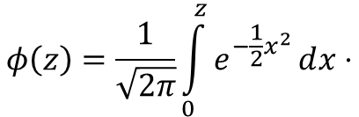
The standard normal distribution
Normal distribution with μ=0 σ =1
Maximum at z = 0
Turning points at z = -1 and z = 1
In order to calculate probabilities the cumulative distribution function is tabulated and implemented in every standard spreadsheet programm like excel (MS office) or calc (libreoffice)
Every normally distributed random variable can be transformed in a standard normally distributed random variable (Standardisierung)
$$φ\left(z\right)=\frac{1}{\sqrt{2π}}\int_{0}^{z}{ⅇ^{−\frac{1}{2}x^{2}}ⅆx}⋅$$

Slide 11




Normal distribution and standard normal distribution
Suppose then
We have
Generally, we obtain:
or

Slide 12
Probabilities and areas below the density function
Density function:
Intervall:
P(Z< c)

Slide 13







Relevant Values of the standard normal distribution
z | F(z)
-2.58 | 0.5 %
-2.33 | 1 %
-1.96 | 2.5 %
-1.64 | 5 %
-1.23 | 10 %

Slide 14
Example
Suppose you are the CEQ (Chief of Quality) in lamp maufactoring company. The life expectancy of a LED-lamp should be normally distributed with μ=25000h and σ= 2000.
Calculate the probability that the LED-Lamp works less than 20000 hours
Calculate the probability that the LED-Lamp works more than 27000 hours
Calculate the probability that the LED-Lamp works within 24000 und 28500 hours.
Show 1.-3. graphically

Slide 15







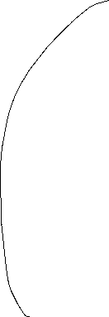

Example

Slide 17









Slide 18






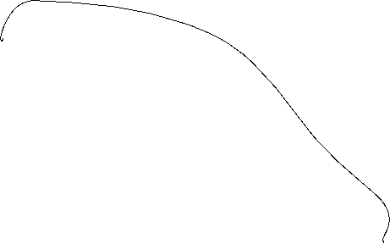


Reproductive property of the normal distribution
The sum of n indepentently normally distributed random variables ist also normally distributed.
The expected value of X equals the sum of the single expected values we obtain
For the variance of X, we obtain the analogous result:

Slide 19




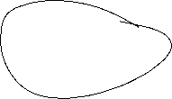





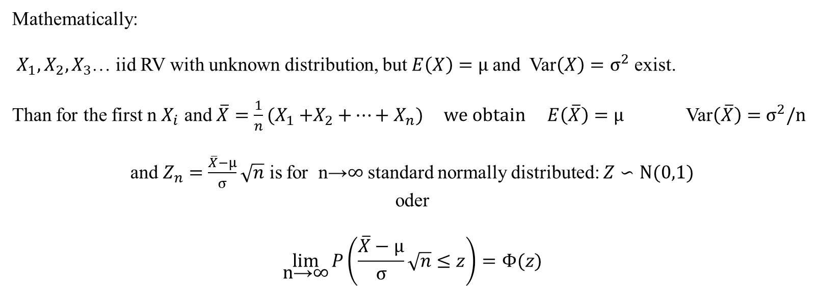

Central limit theorem
The sum of n independently identically distributed random variables is approximately normally distriuted, if n is large enough
Consequence: The true distribution can be ignored if n is large enough and you are interested in the distribution of the sample mean:
Mathematically:
$X_{1},X_{2}{,X}_{3}$… iid RV with unknown distribution, but $E\left(X\right)=μ$and Var$\left(X\right)=σ^{2}$ exist.
Than for the first n $X_{i}$ and ${\overline{X}=\frac{1}{n}(X}_{1}{+X}_{2}+…+X_{n})$ we obtain $E\left(\overline{X}\right)=μ$ Var$\left(\overline{X}\right)=$ $σ^{2}/n$
and $Z_{n}=\frac{\overline{X}−μ}{σ}\sqrt{n}$ is for n→∞ standard normally distributed: $Z∽N(0,1)$
oder
$$\lim_{\text{n}\text{→}\text{∞}}{P\left(\frac{\overline{X}−μ}{σ}\sqrt{n}≤z\right)=Φ(z)}$$

Slide 20



Slide 22

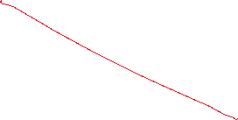


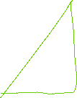

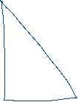









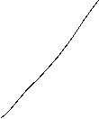
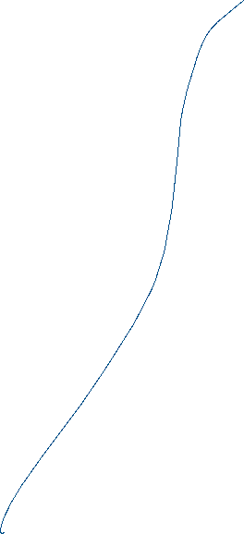
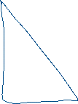








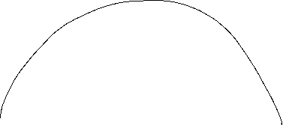

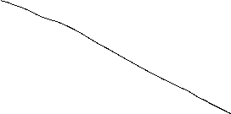
Âufgabe 2 Blatt 1

Slide 23





c

Slide 24



c

Slide 25

























c

Slide 26
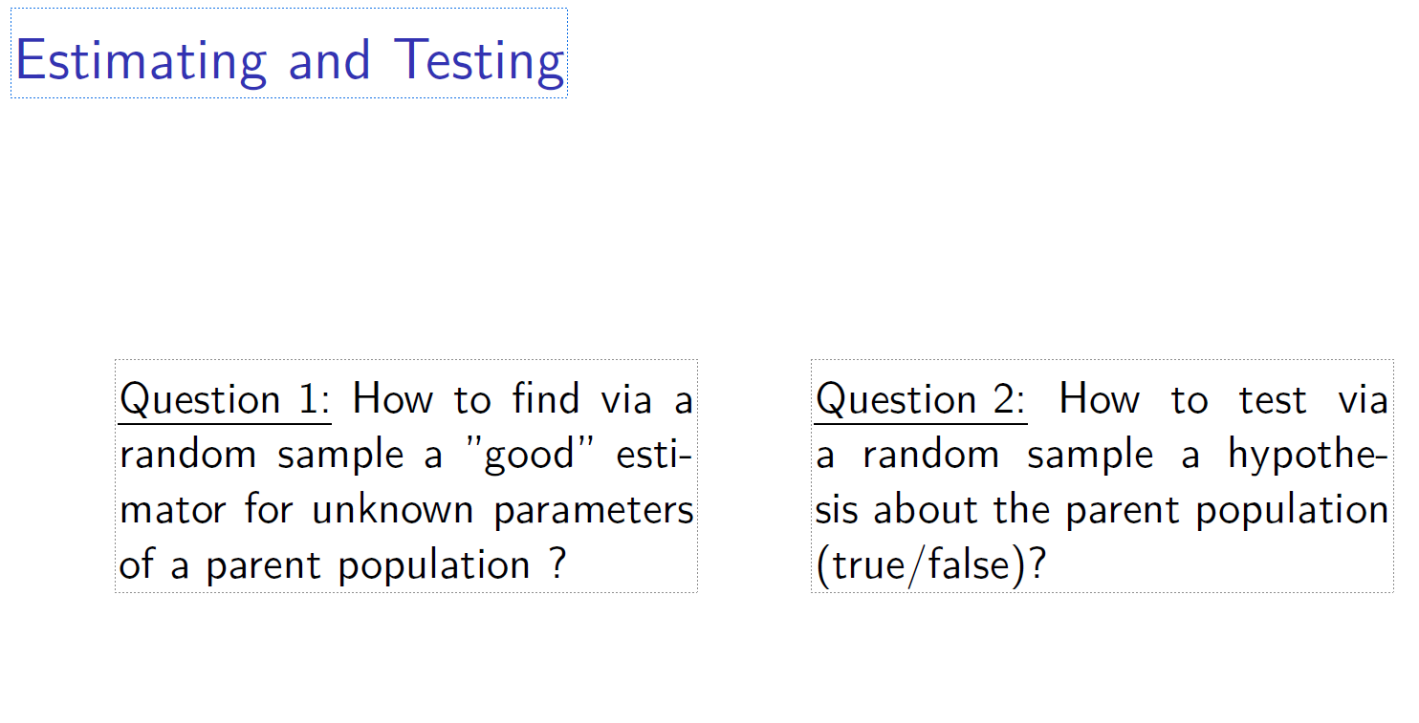
c

Slide 27
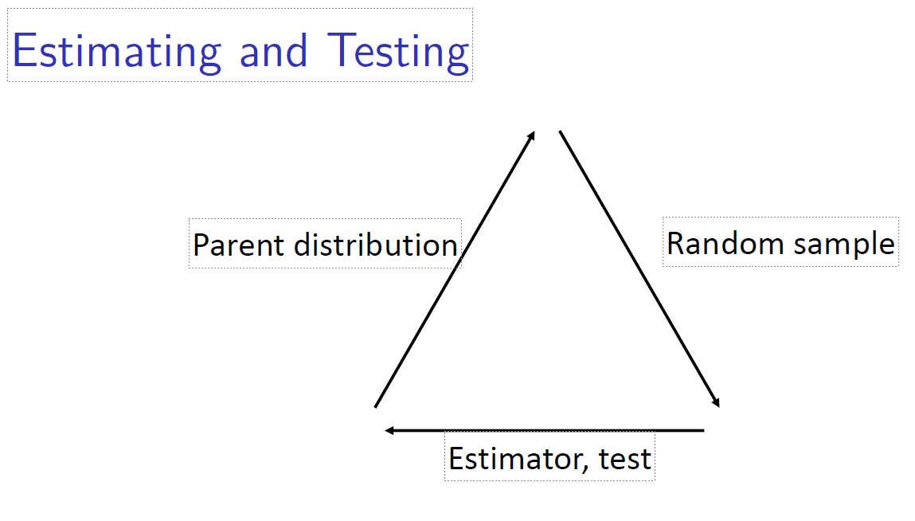
c

Slide 28
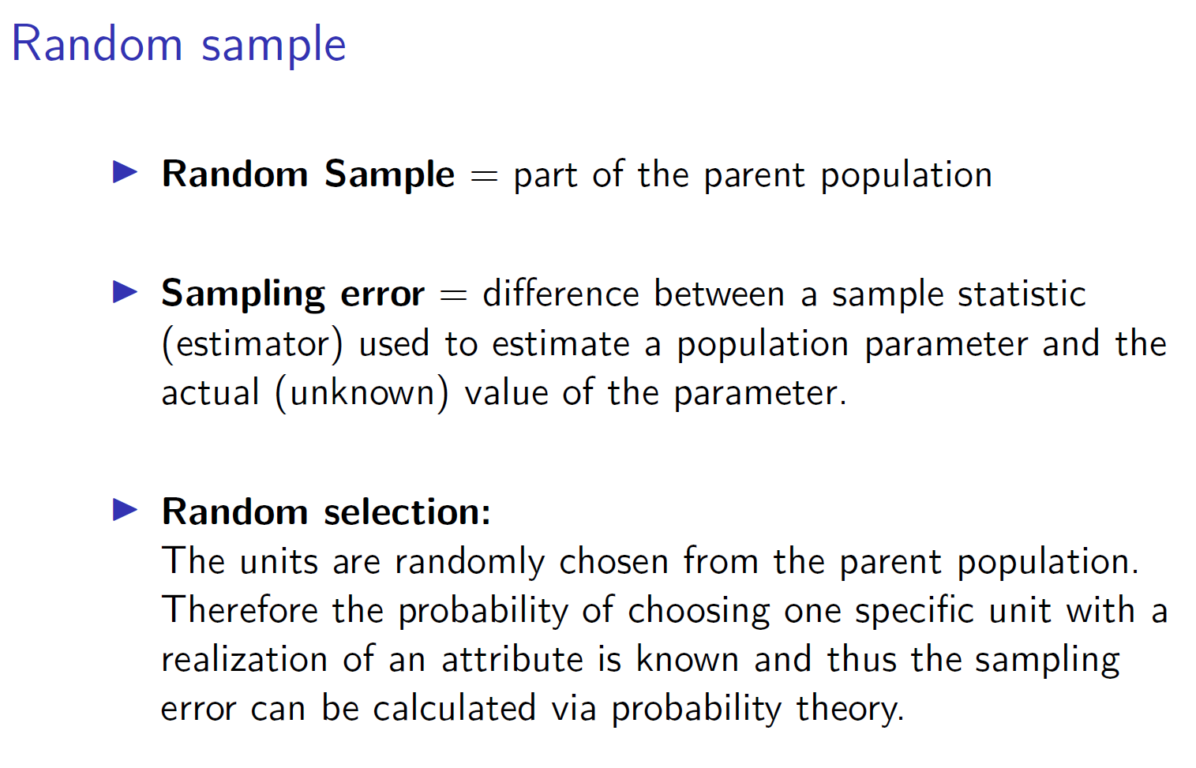
c

Slide 29
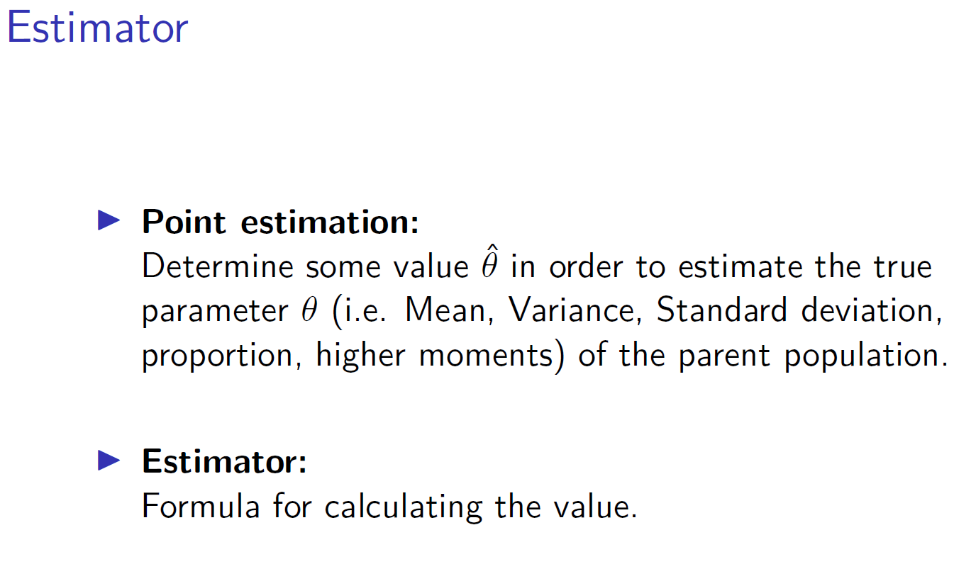
c

Slide 30
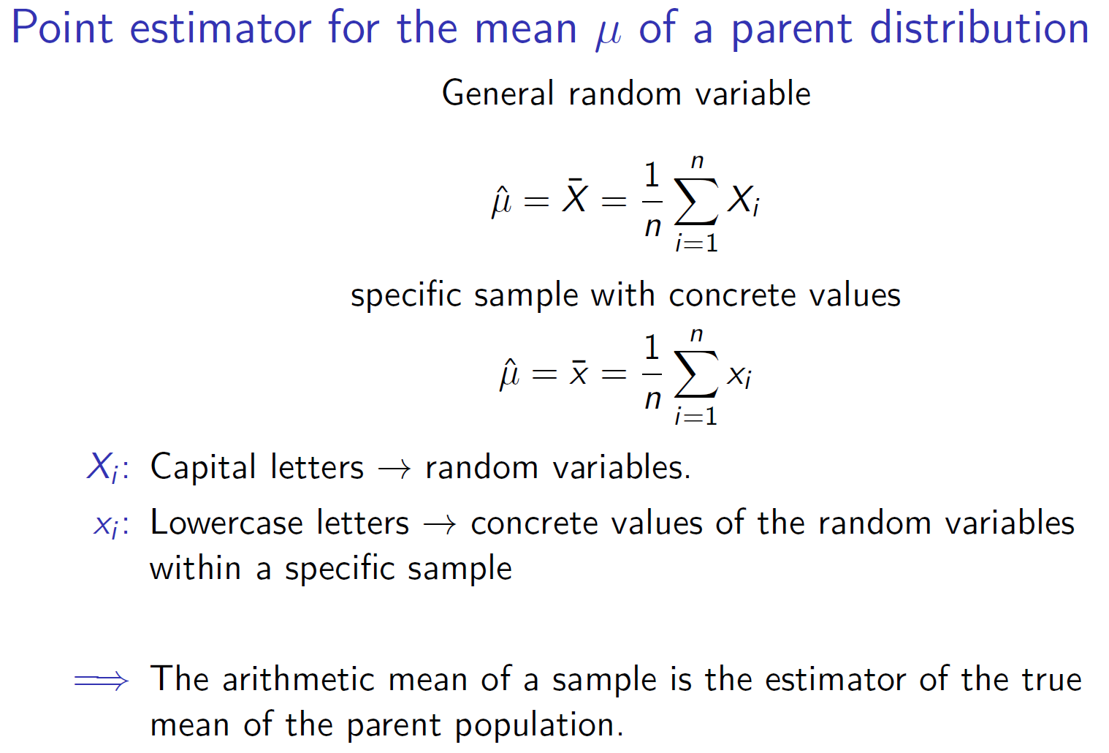
c

Slide 31
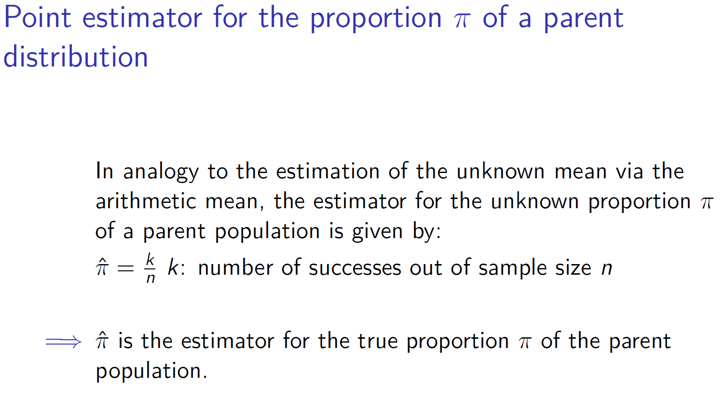
c

Slide 32
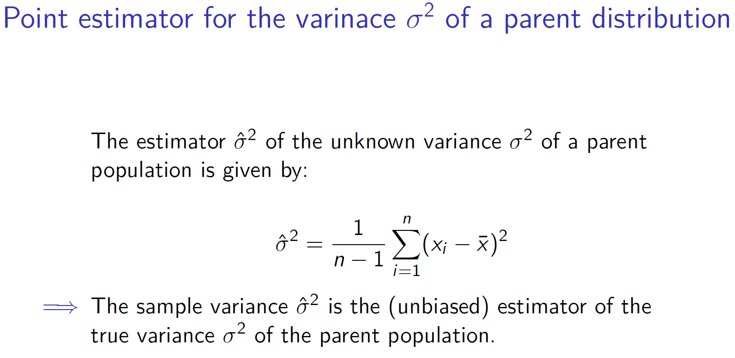
c

Slide 33
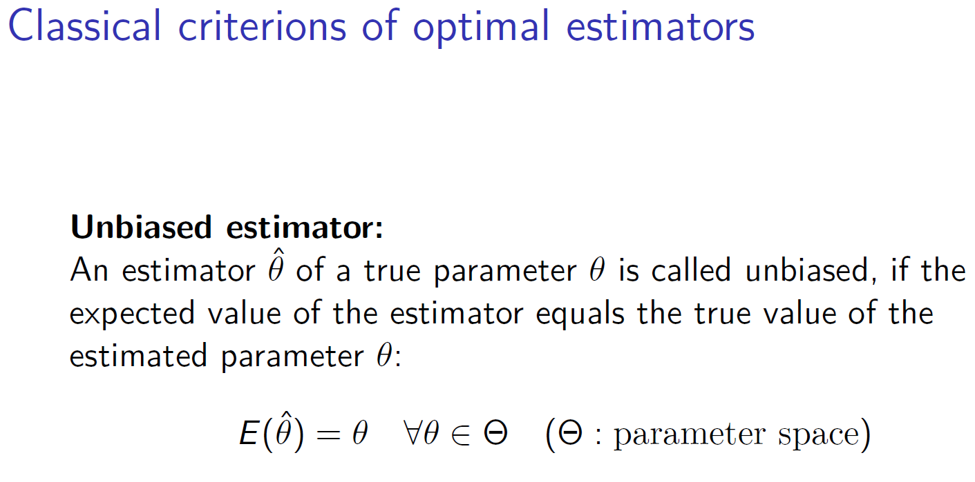
c

Slide 34
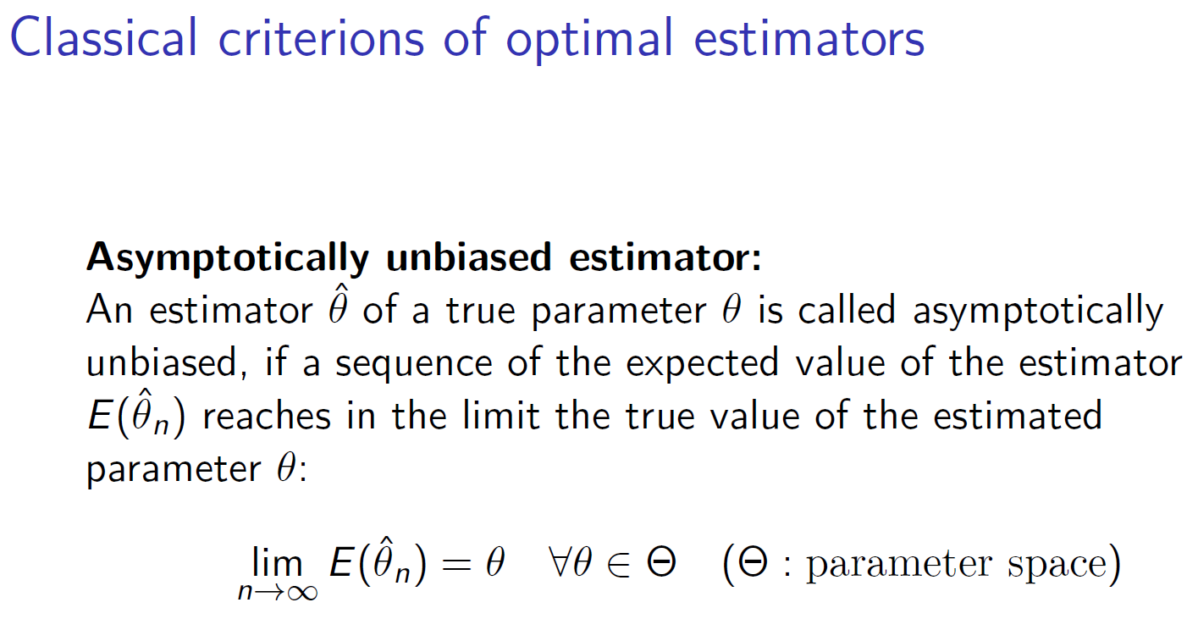
c

Slide 35
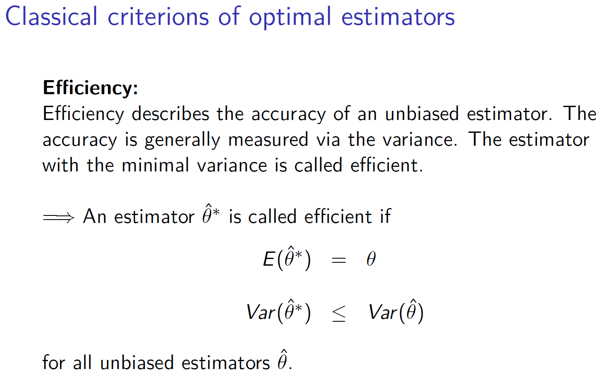
c

Slide 36
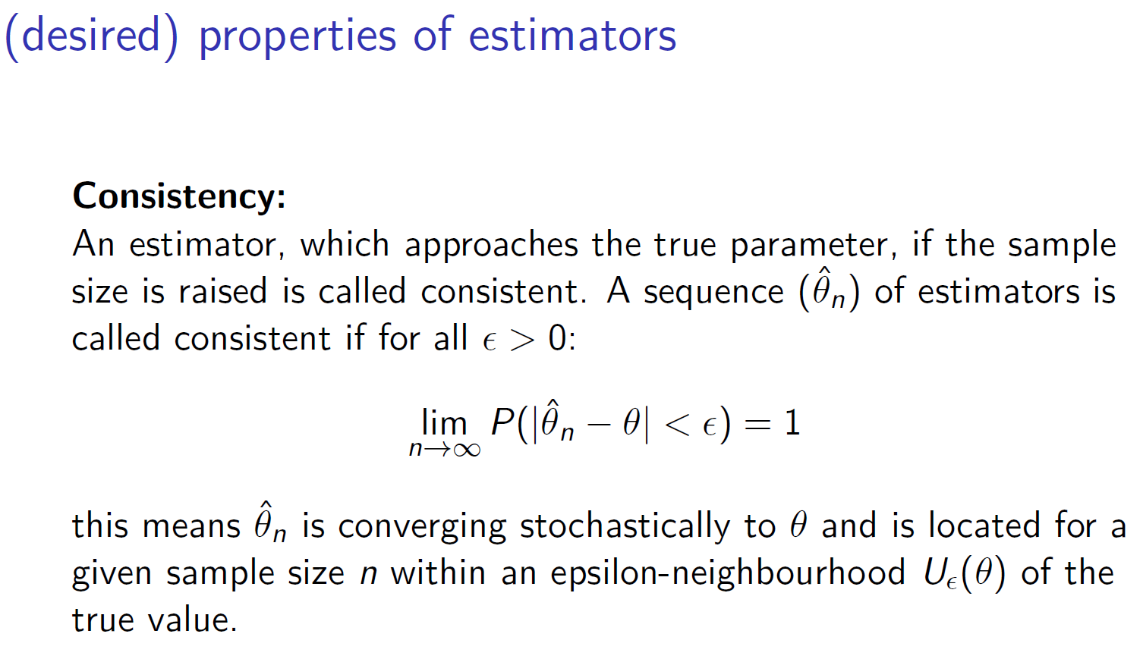
c

Slide 37
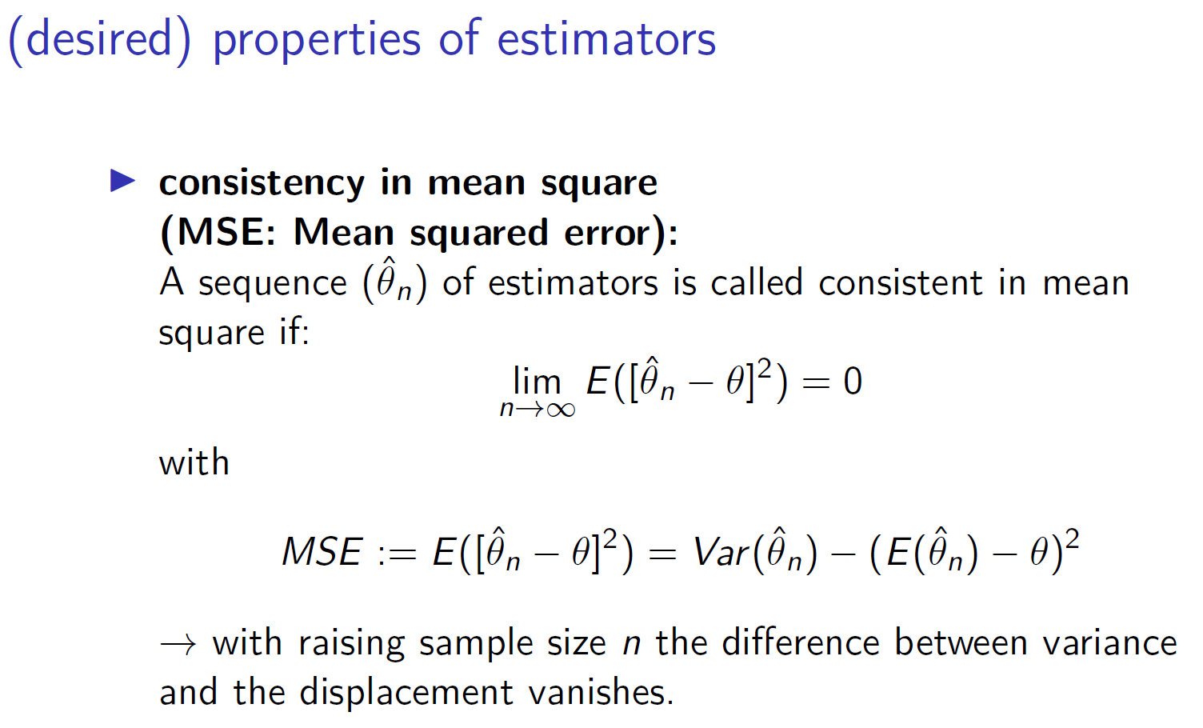
c

Slide 38
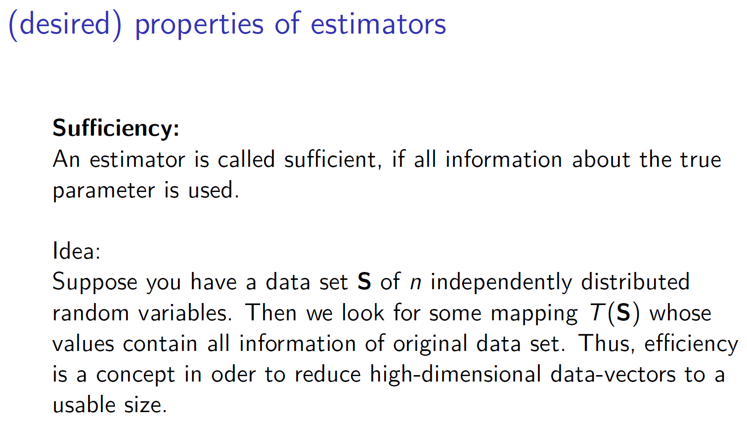
c

Slide 39
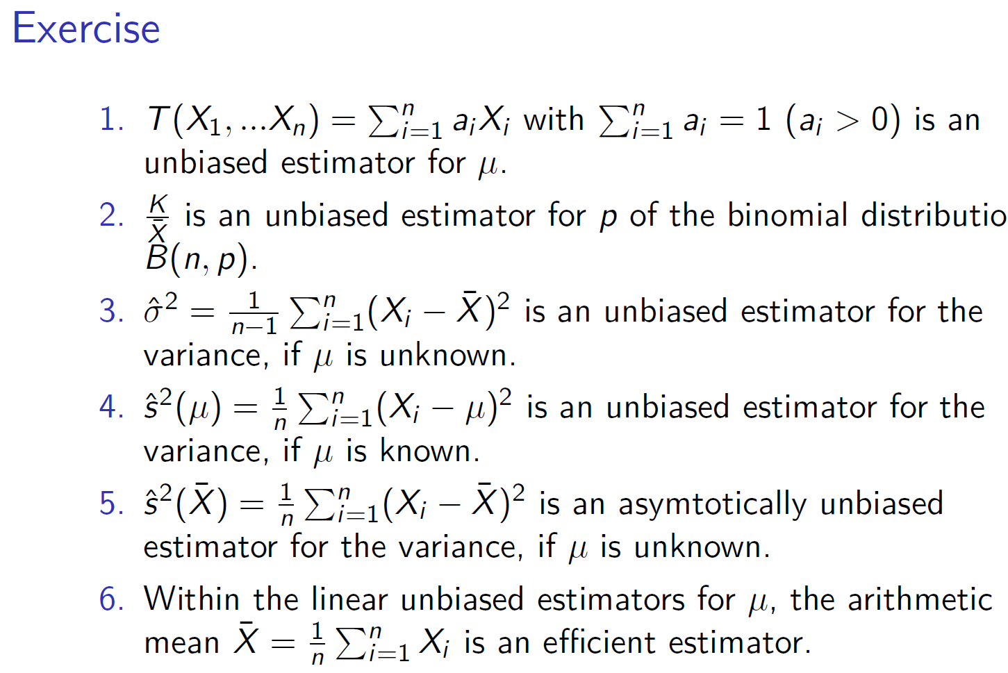
c

Slide 40
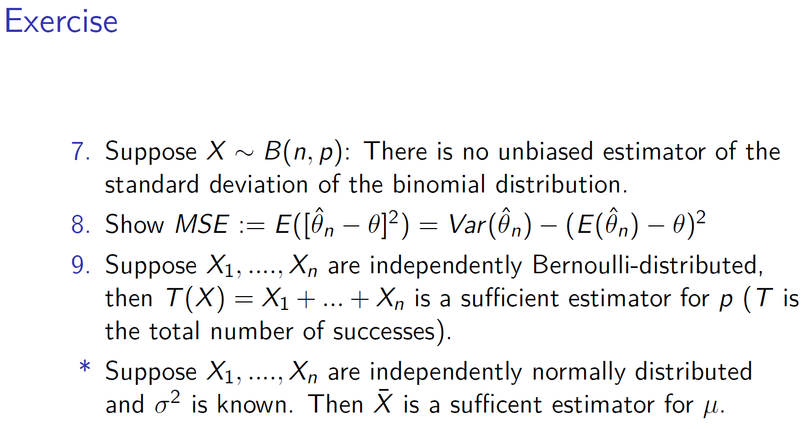
c

