Slide 1

(Advanced) Statistics A
c
Summer term 2023
Prof. Dr. Bernhard Köster

Slide 2
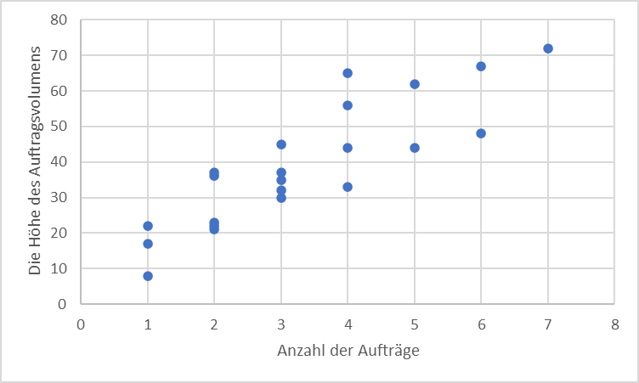

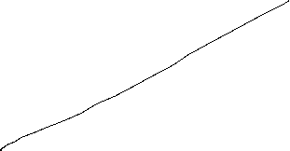

Scatterplot
Graphical representation of the attributes of two variables within a two-dimensional coordinate-system.
Number | 1 | 2 | 3 | 4 | 5 | 6 | 7 | 8 | 9 | 10 | 11 | 12 | 13 | 14 | 15 | 16 | 17 | 18 | 19 | 20 | 21 | 22
Order | 2 | 4 | 3 | 6 | 2 | 1 | 5 | 3 | 4 | 2 | 2 | 7 | 4 | 3 | 2 | 1 | 5 | 4 | 3 | 3 | 1 | 6
Volume [€] | 36 | 44 | 30 | 67 | 21 | 8 | 62 | 35 | 33 | 37 | 22 | 72 | 65 | 45 | 23 | 17 | 44 | 56 | 32 | 37 | 22 | 48
c

Slide 3




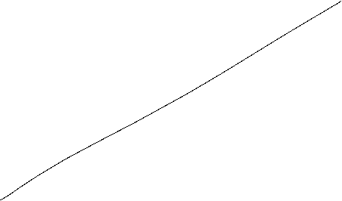

Scatterplot
X-coordinate: order
Y-coordinate: Volume [Euro]
c

Slide 4






Linear Regression
Example 2:
A company wants to know how the sales volume depends on visits of representatives.
The company has collected the following data
c
We also want to answer the question, from a descriptive point of view, which sales volume we can expect, if we increase the visits up to x=30

Slide 5



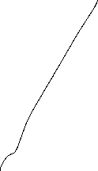


Linear Regression
Via a linear regression we want to analyse the dependence between two variables
We distinguish between a dependent variable (y) and an independent variable (x)
(x) is also called the explanatory variable
A change of (x) implicates a change (y)
The linear regression defines an empirical relation via a linear function
i.e. y = f(x) = 3 + 2x or generally y = a + bx
c

Slide 6

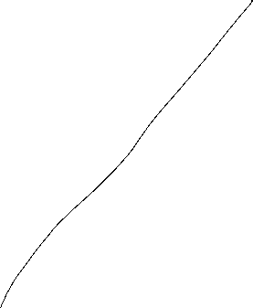


Simple Examples
c
Determine graphically a regression line for the blue and red data points. What kind of
dependence do we have?

Slide 7
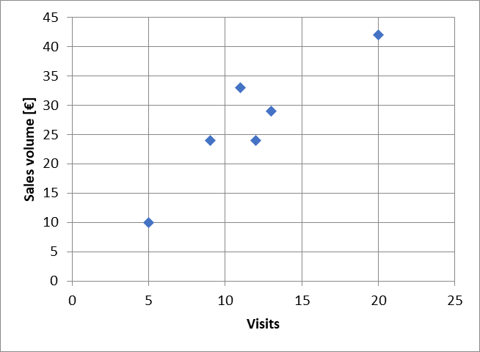







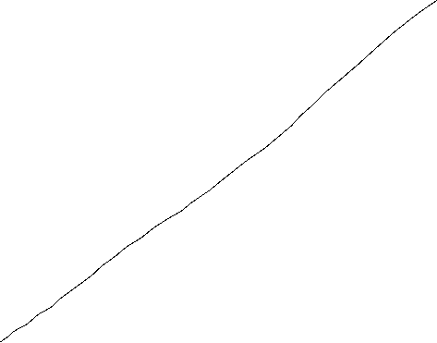

Example
c
Try to fit graphically (by eye) a regression line through the data points

Slide 8








Optimizing problem
How to calculate a regression line $\hat{y}i=a+bx$_{i}?
The coefficients a and b has be calculated from the collected data.
$\hat{y}i$ Value on the regression line
$yi$ collected data point
$εi=$ $yi$- $\hat{y}i$ Difference between the data point and the theoretical value on the regression line
Determine a and b such, that the sum of all quadratic differences $ε_{i}^{2}$is minimized
c

Slide 9
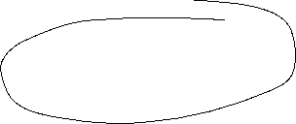







Least squared method
The formal optimizing problem
c

Slide 10

Least squared method
The formal optimizing problem
FOC:
2 dimensional linear system which can directly be solved
c

Slide 11
Least squared method
c

Slide 12
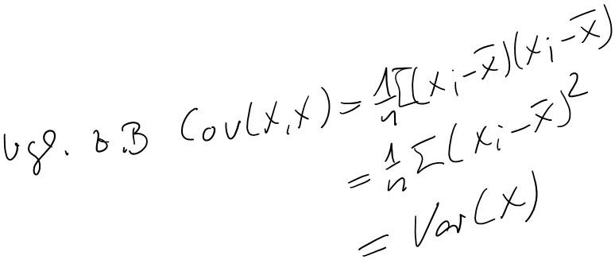

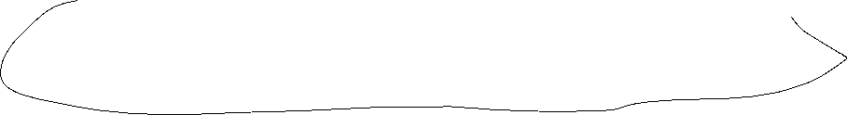





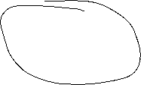


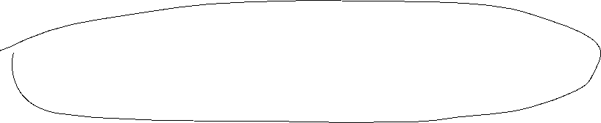

Formulas
:

Slide 13
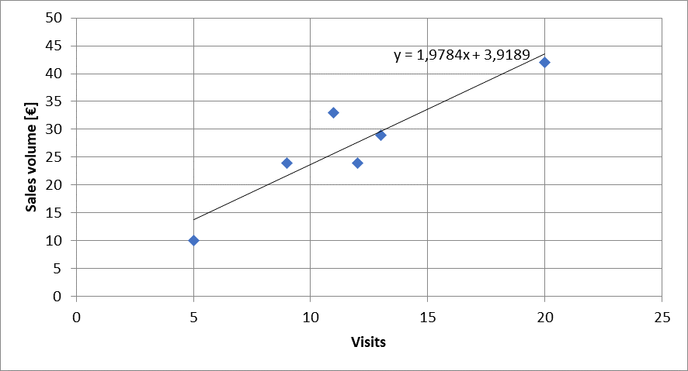
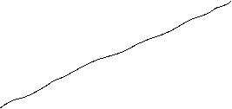



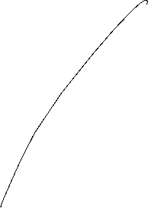




Calulating the regression line from empirical data
$$ei2$$
$\hat{y}i=a+bx$_{i}
c

Slide 14




Lineare Regression
 | Visits | Sales volume [€]
year | x | y | xy | x^2
2008 | 9 | 24 | 216 | 81
2009 | 11 | 33 | 363 | 121
2010 | 5 | 10 | 50 | 25
2011 | 13 | 29 | 377 | 169
2012 | 20 | 42 | 840 | 400
2013 | 12 | 24 | 288 | 144
c
b=
a=

Slide 15



Extrapolation for x=30
 | Visits | Sales volume [€]
year | x | y | xy | x^2 | yhat
2008 | 9 | 24 | 216 | 81 | 21,72
2009 | 11 | 33 | 363 | 121 | 25,68
2010 | 5 | 10 | 50 | 25 | 13,81
2011 | 13 | 29 | 377 | 169 | 29,64
2012 | 20 | 42 | 840 | 400 | 43,49
2013 | 12 | 24 | 288 | 144 | 27,66
c
yhat(30)=

Slide 16





Regressions coefficients
Regressions coefficient b
  Slope of the regression line.
  Determines the marginal effect of a change of one unit of the independent variable x onto the dependet variable y
Regressions coefficient a
  The value of the dependent variable if the independent variable x=0
    → intercept of the vertical axes
c

Slide 17
Linear regression
Measures the linear dependence between two variables
This dependence can be interpreted, that one variable is quantitatively influencing another variable
The linear regression is an instrument for forecasting
c

Slide 18
Correlation analysis
In principle for all data sets, we can calculate a regression line.
But we are also interested in the question meaningful is this calculated dependence?
For this, we use the correlation analysis, wich gives the possibility to measure the strength of the dependence
For this, we use the correlation coefficient (Bravais-Pearson) which is lying between -1 and +1
c

Slide 19





Covariance
The covariance is a measure of the joint variability of two random variables (X,Y), defined by:
$$\operatorname{cov}\left(X,Y\right)=E\left[\left(X−E\left(X\right)\right)\left(Y−E\left(Y\right)\right)\right]$$
with the unbiased estimator
$${\hat{σ}}_{xy}=\frac{1}{n−1}\sum_{i=1}^{n}{\left(x_{\dot{j}}−\overline{x}\right)\left(y_{i}−\overline{y}\right)}$$
If the greater values of X correspond with the greater values of Y the covariance is positive. In the opposite case, when the greater values of X correspond to the lesser values Y, the covariance is negative. The sign of the covariance shows the tendency in the linear relationship between the variables.
The magnitude of the covariance can hardly be interpreted, since it is not normalized.
Therefore, we use the normalized version, called correlation coefficient, showing the strength of the linear relation.
c

Slide 20








Correlation coefficient
General intervals for R
(0,0;0,2) → almost no dependence
[0,2;0,4) → low dependence
[0,4;0,6) → medium dependence
[0,6;0,8) → high dependence
[0,8;1,0) → almost full dependence
c

Slide 21
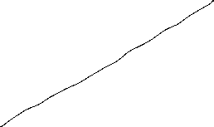



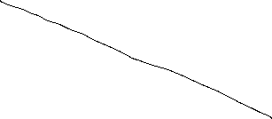



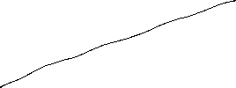
Correlation coefficiant examples
c

Slide 22



Coefficiant of determination R²
The squared correlation coefficiant R² is called coefficiant of determination.
In quantitative analysis, we often use the coefficiant of determination R², because it can be intuitively interpreted
But R² does not distinguish between + and – anymore.
R² is in the interval [0,1]
R² grafical interpretation:
  R² equals the proportion of variance explained by the model in relation to the total variance, i.e. how much percent is explained by the regression line
  (1-R²) equals the proportion of Variance not explained by the model in relation to the total variance, and has to be explained by other influencing factors
c

Slide 23








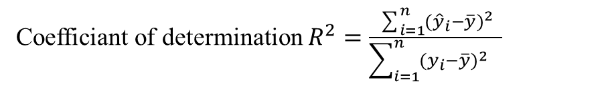






{
} Non explained difference
${\hat{y}}_{i}−\overline{y}$ explained difference
Total Difference
} Explained difference
${y_{i}−\hat{y}}_{i}$ not explained difference
Mean
$y_{i}−\overline{y}$ total difference
$$→\sum_{i=1}^{n}{{{(y}_{i}−\overline{y})}^{2}}=\sum_{i=1}^{n}{{{{(y}_{i}−\hat{y}}_{i})}^{2}}+\sum_{i=1}^{n}{{{(\hat{y}}_{i}−\overline{y})}^{2}}$$
Non explained squared difference y_{i}
total squared difference
explained squared difference
Mean
not explained squared difference
explained squared difference y_{i}
Total squared difference of y_{i}
c
Coefficiant of determination $R^{2}=\frac{\sum_{i=1}^{n}{{{(\hat{y}}_{i}−\overline{y})}^{2}}}{\sum_{i=1}^{n}{{{(y_{i}−\overline{y})}^{2}}^{}}}$

Slide 24

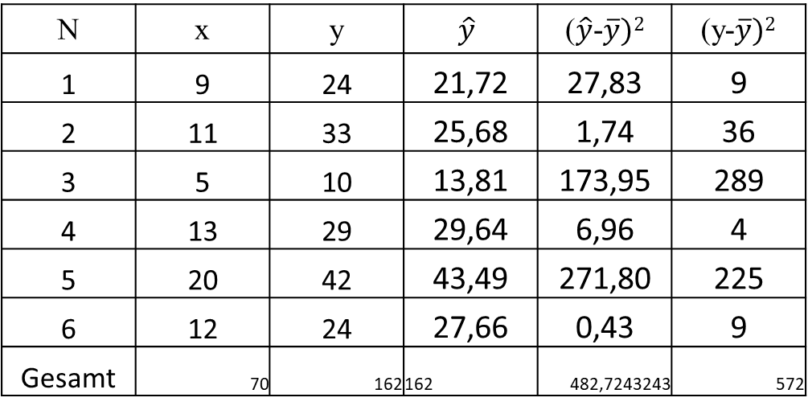





Coefficiant of determination R²
N | x | y | $$\hat{y}$$ | ($\hat{y}$-$\overline{y})2$ | (y-$\overline{y})2$
1 | 9 | 24 | 21,72 | 27,83 | 9
2 | 11 | 33 | 25,68 | 1,74 | 36
3 | 5 | 10 | 13,81 | 173,95 | 289
4 | 13 | 29 | 29,64 | 6,96 | 4
5 | 20 | 42 | 43,49 | 271,80 | 225
6 | 12 | 24 | 27,66 | 0,43 | 9
Gesamt | 70 | 162 | 162 | 482,7243243 | 572
c
R²= R=

Slide 25
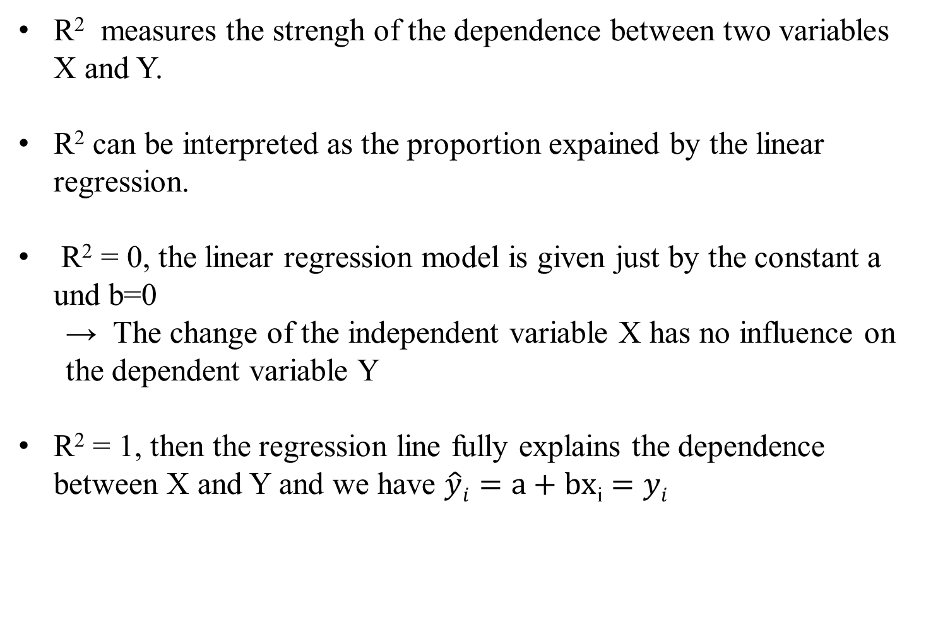
Interpretation of R²
R² measures the strengh of the dependence between two variables X and Y.
R² can be interpreted as the proportion expained by the linear regression.
R² = 0, the linear regression model is given just by the constant a und b=0
  → The change of the independent variable X has no influence on the dependent variable Y
R² = 1, then the regression line fully explains the dependence between X and Y and we have $\hat{y}i=a+bx$_{i} $=yi$
c

Slide 26
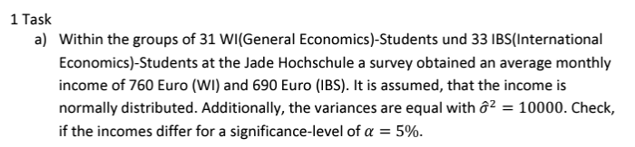
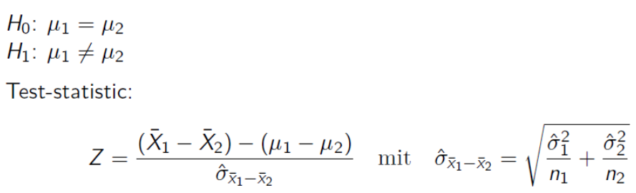
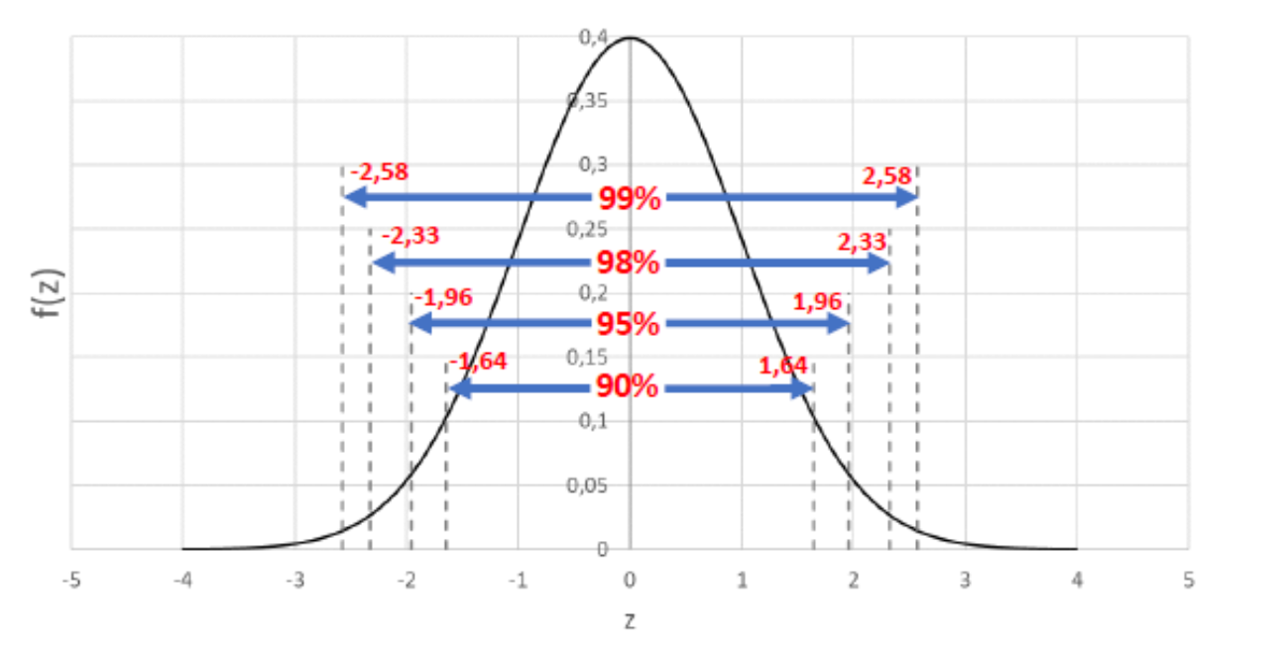
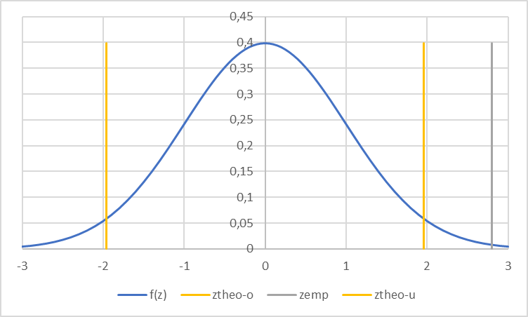






c

Slide 27
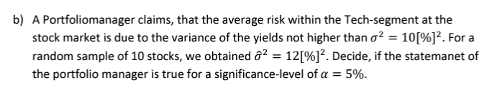




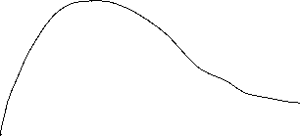

c

Slide 28
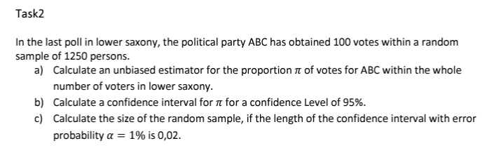

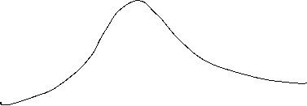
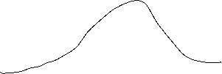
c

Slide 29
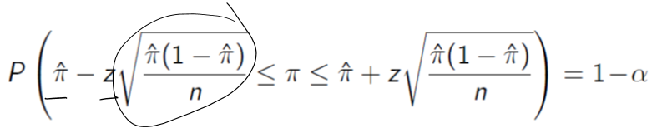











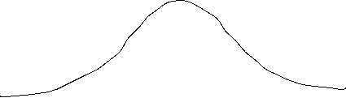
c

Slide 30
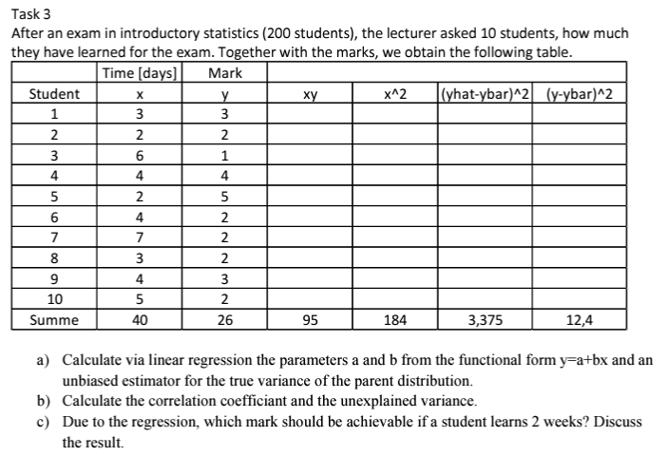
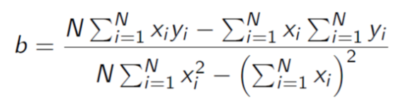









c

Slide 31
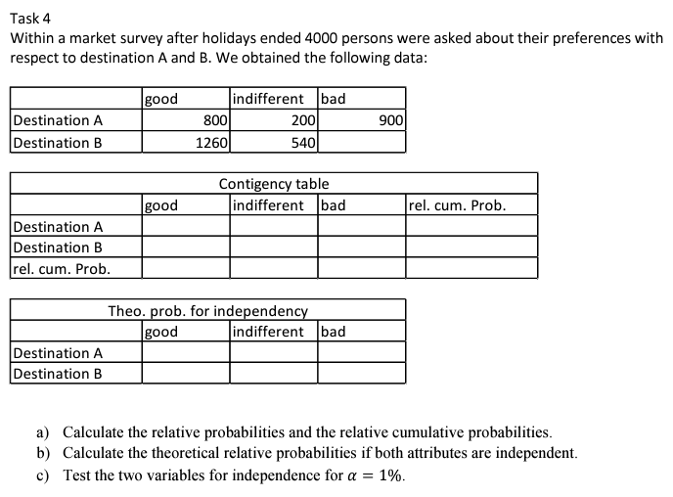
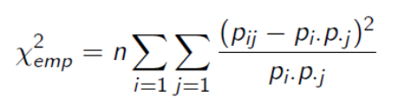





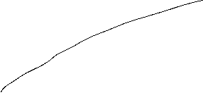





c

Slide 32
Korrektur 4c!!! Bei der Berechnung der Testgröße Chi^2emp wurde durch die theoretische Wahrscheinlichkeit geteilt
Und nicht durch die empirische Wahrscheinlichkeit!
c

