Slide 1

(Advanced) Statistics A
c
Summer term 2023
Prof. Dr. Bernhard Köster

Slide 2




c

Slide 3














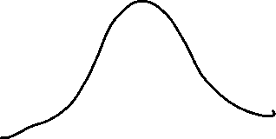





c

Slide 4







Slide 5
















Slide 6













Slide 7





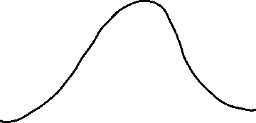










c

Slide 8
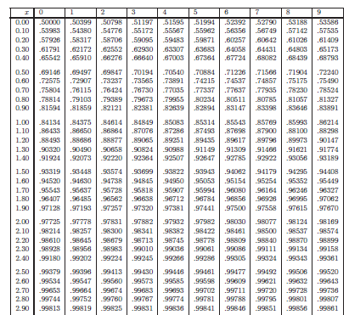







c

Slide 9




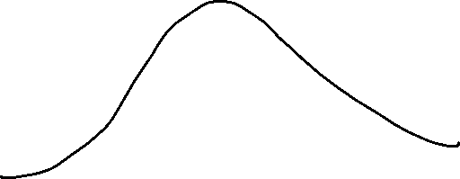









c

Slide 10
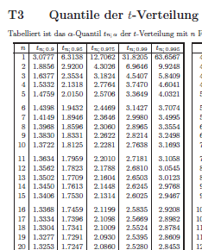



















c

Slide 11




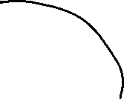





c

Slide 12



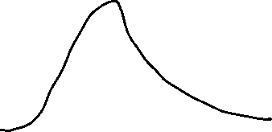










c

Slide 13





c

Slide 14







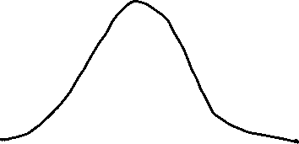
c

Slide 15






c

Slide 16
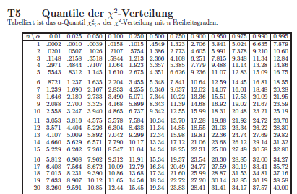
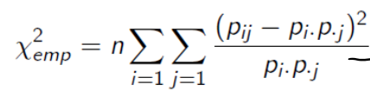












c

Slide 17





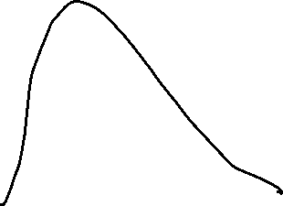
c

