Slide 1

(Advanced) Statistics A
c
Summer term 2023
Prof. Dr. Bernhard Köster

Slide 2

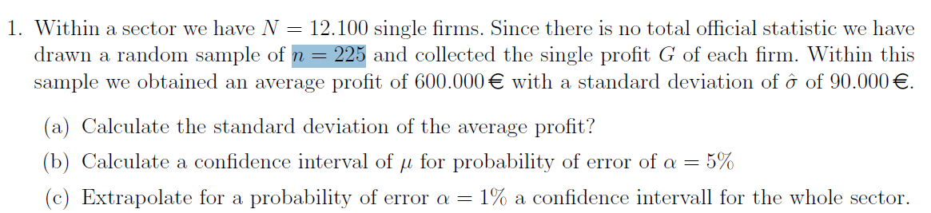
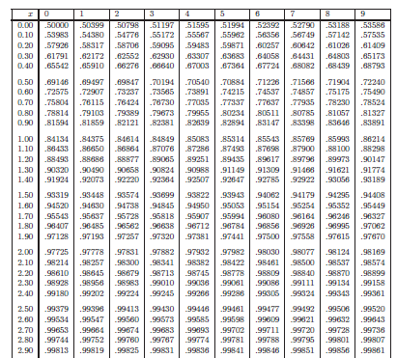









c

Slide 3
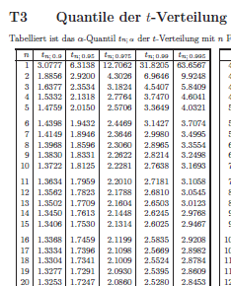
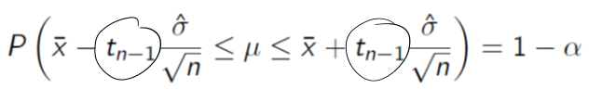
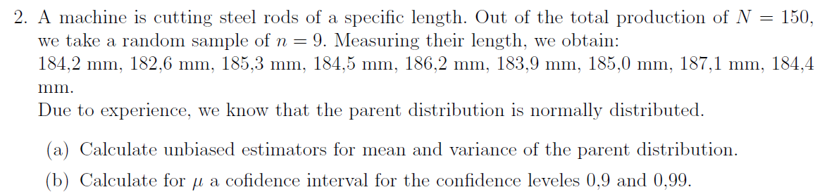







Er
1
an
in
5%
5 90
c

Slide 4
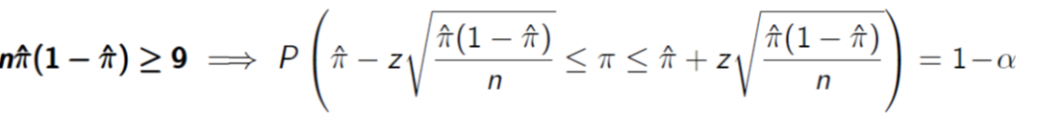
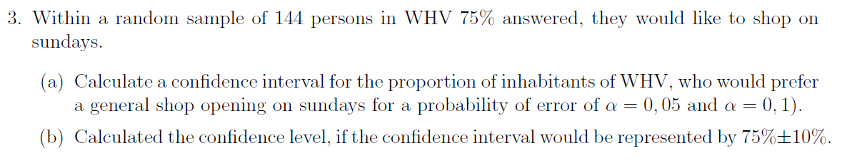
















c

Slide 5
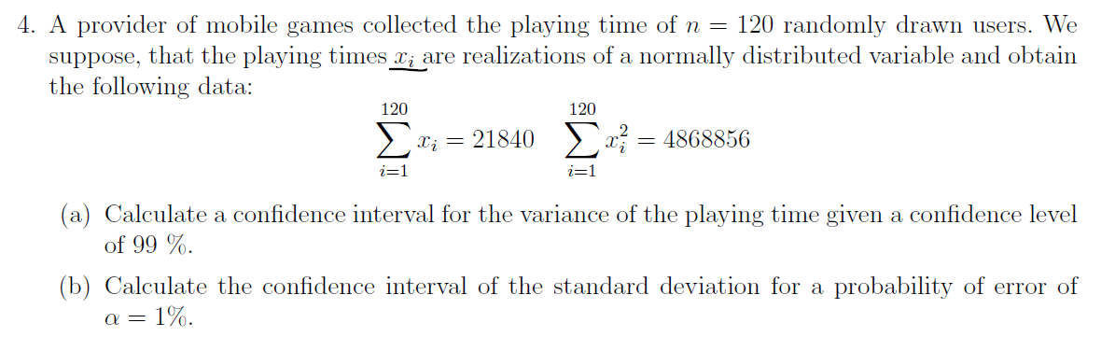






















c

Slide 6
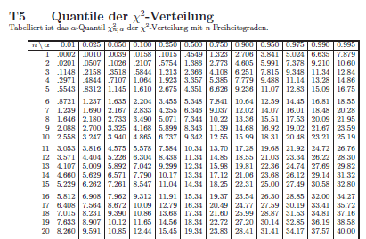
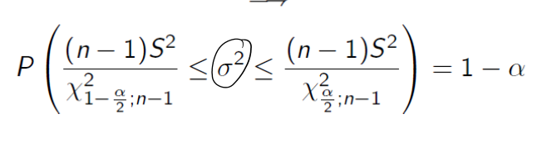



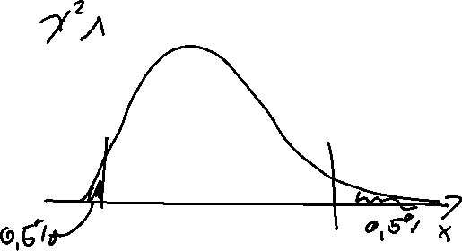
c

Slide 7
c

Slide 8
c

Slide 9
c

Slide 10
c

Slide 11

c

Slide 12








c

Slide 13



c

Slide 14














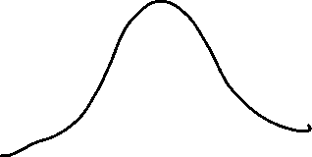





c

Slide 15







Slide 16










Slide 17











Slide 18





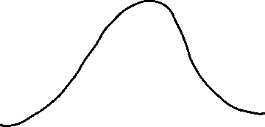










c

Slide 19







c

Slide 20




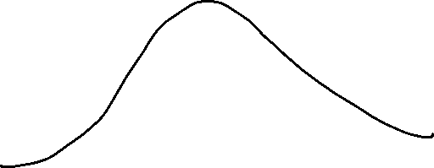









c

Slide 21



















c

Slide 23
c

