Slide 1

(Advanced) Statistics A
Summer term 2023
Prof. Dr. Bernhard Köster

Slide 2
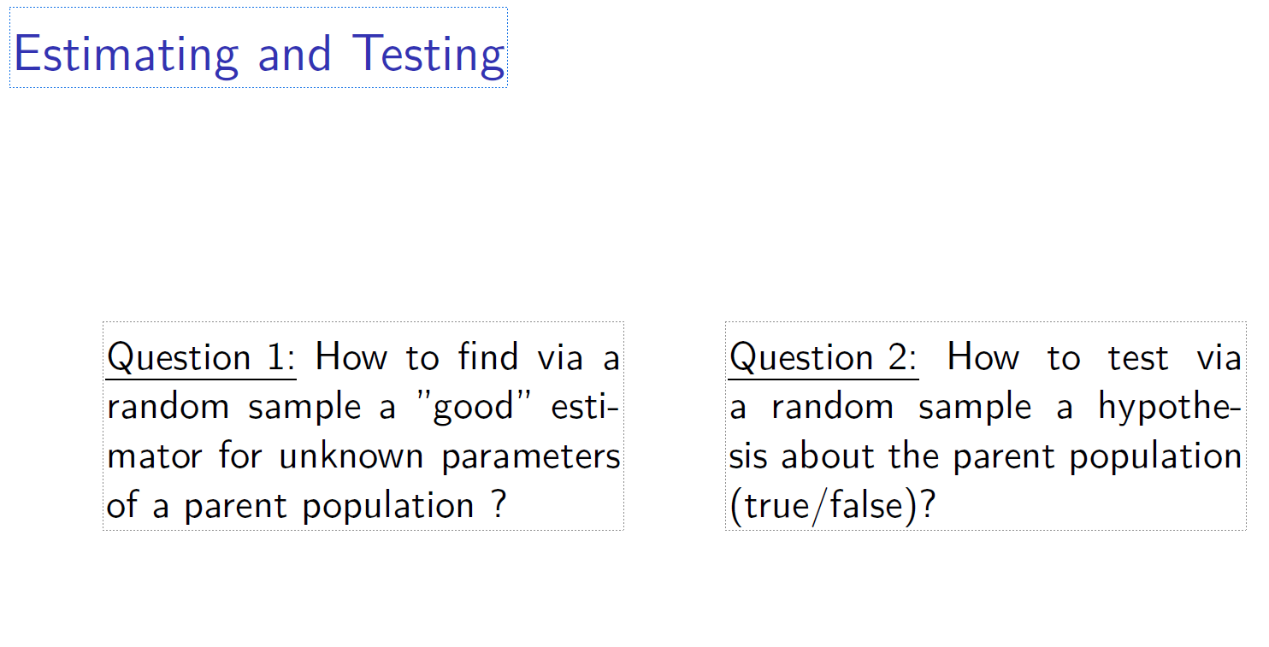

c

Slide 3
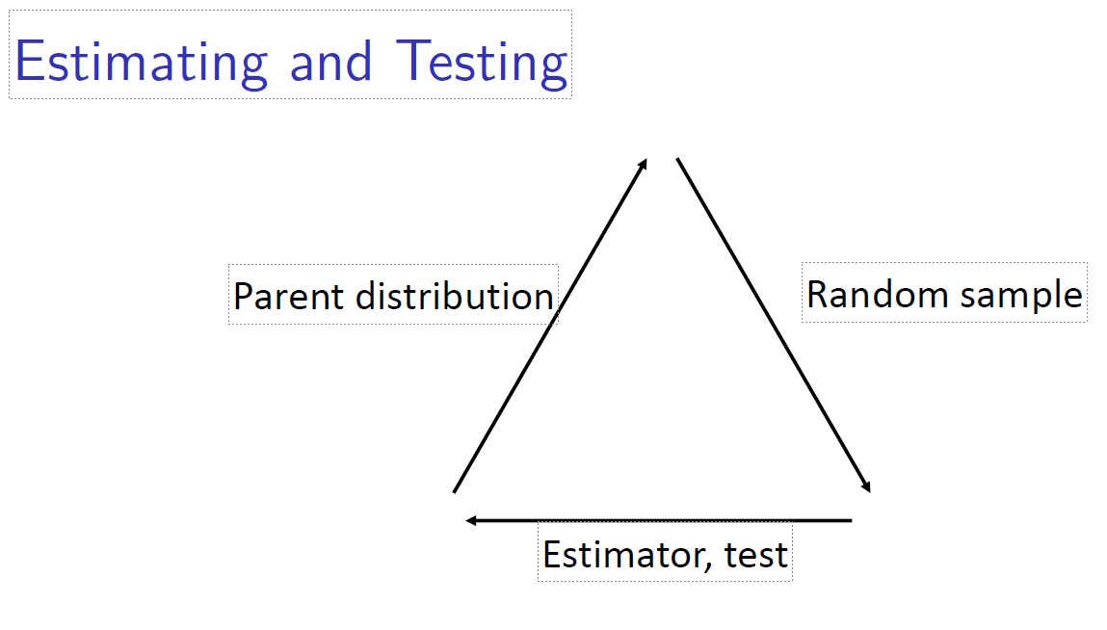
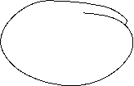


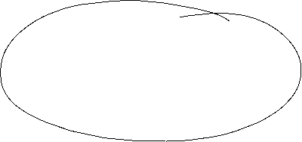

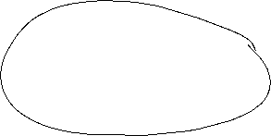
c

Slide 4
c

Slide 5
c

Slide 6
c

Slide 7
c

Slide 8
c

Slide 9
c

Slide 10
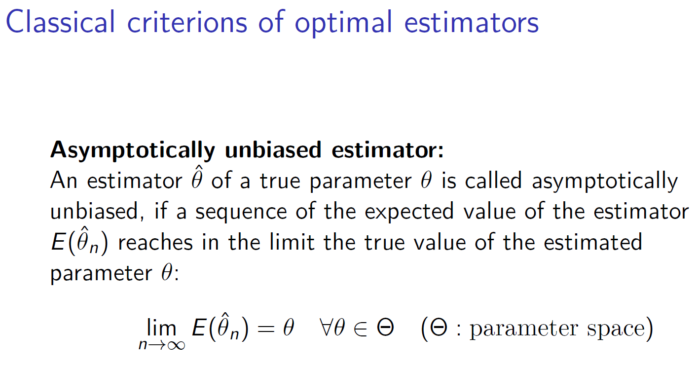



c

Slide 11
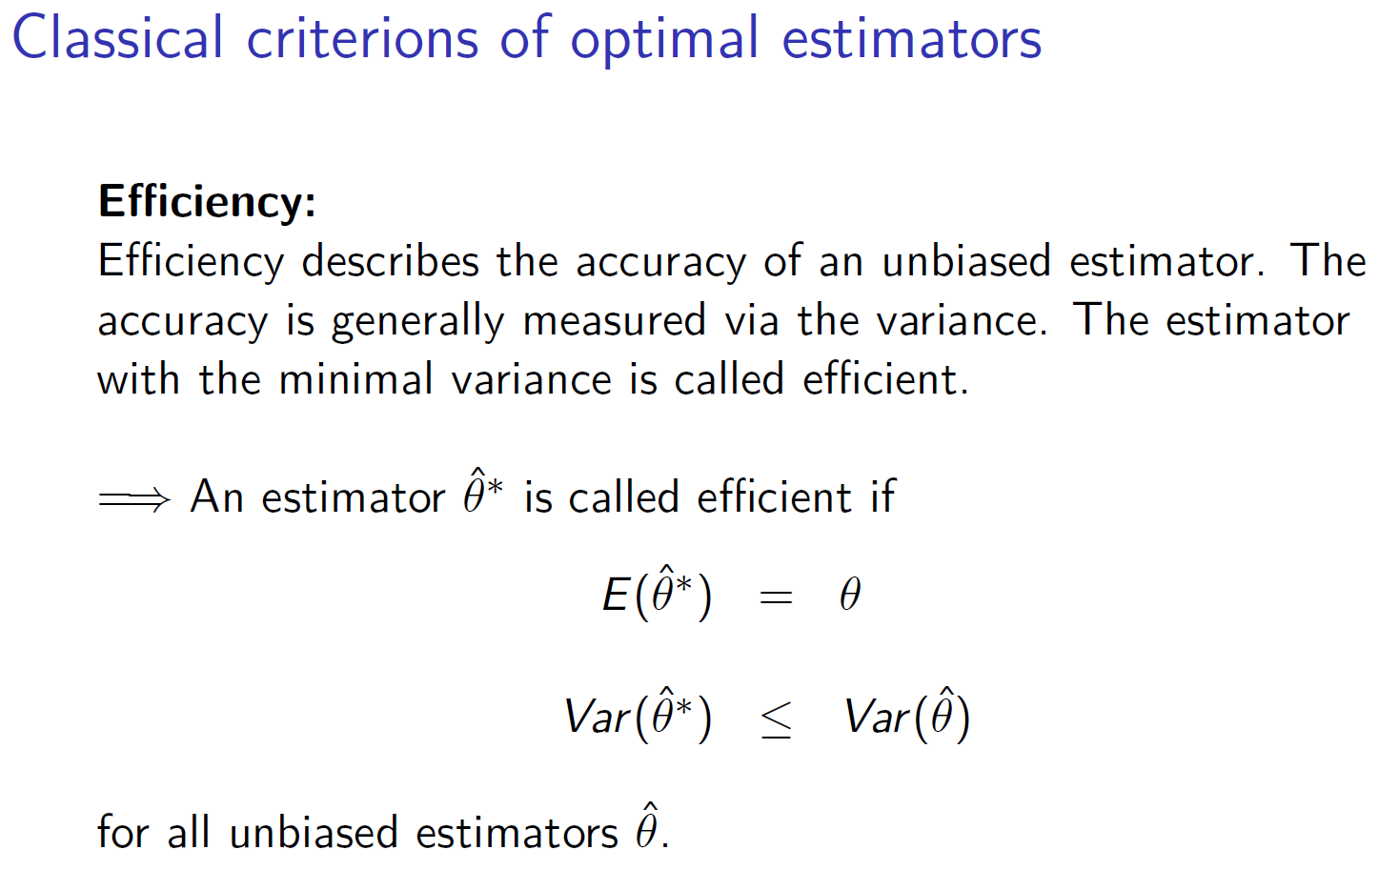





c

Slide 12
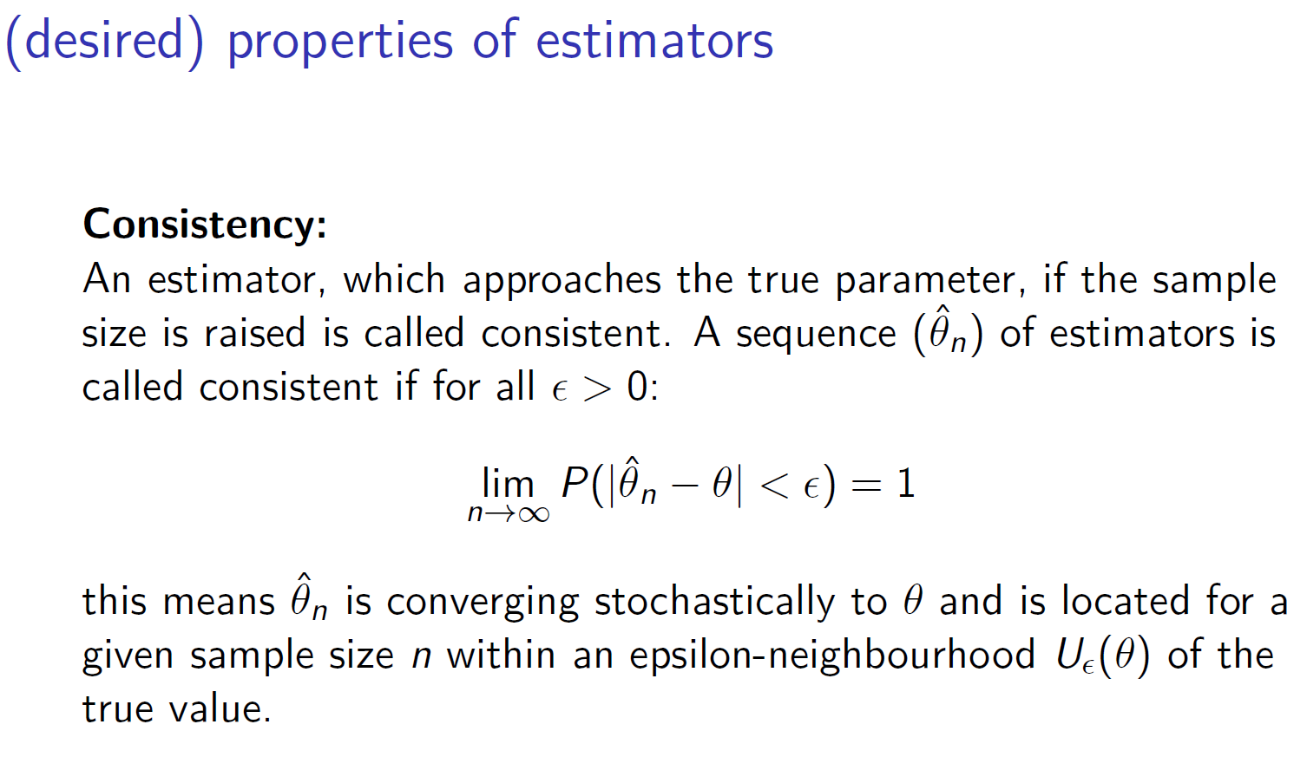



c

Slide 13
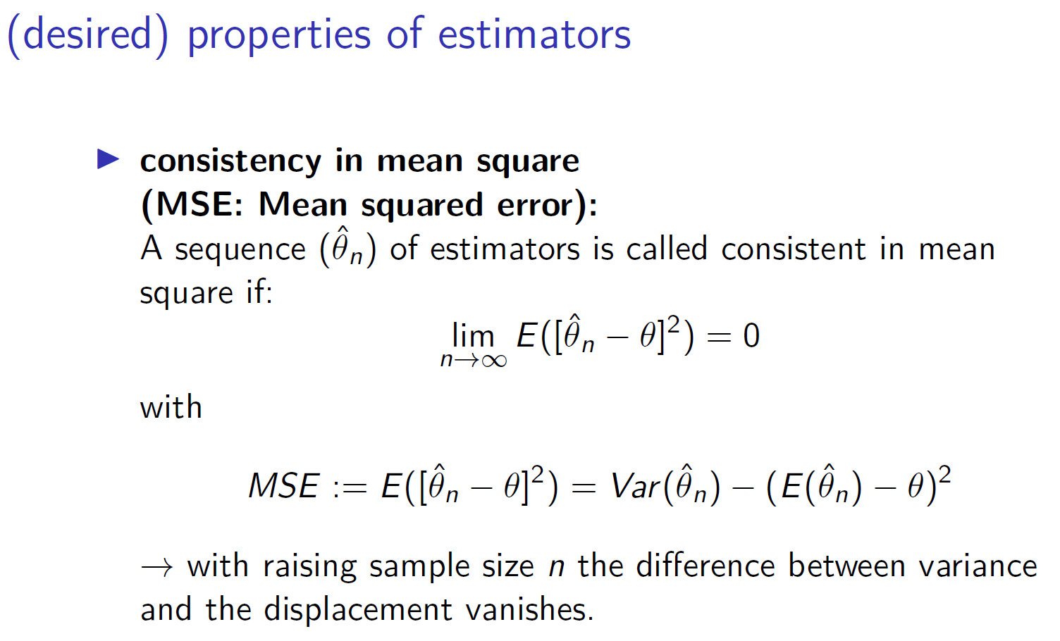


c

Slide 14
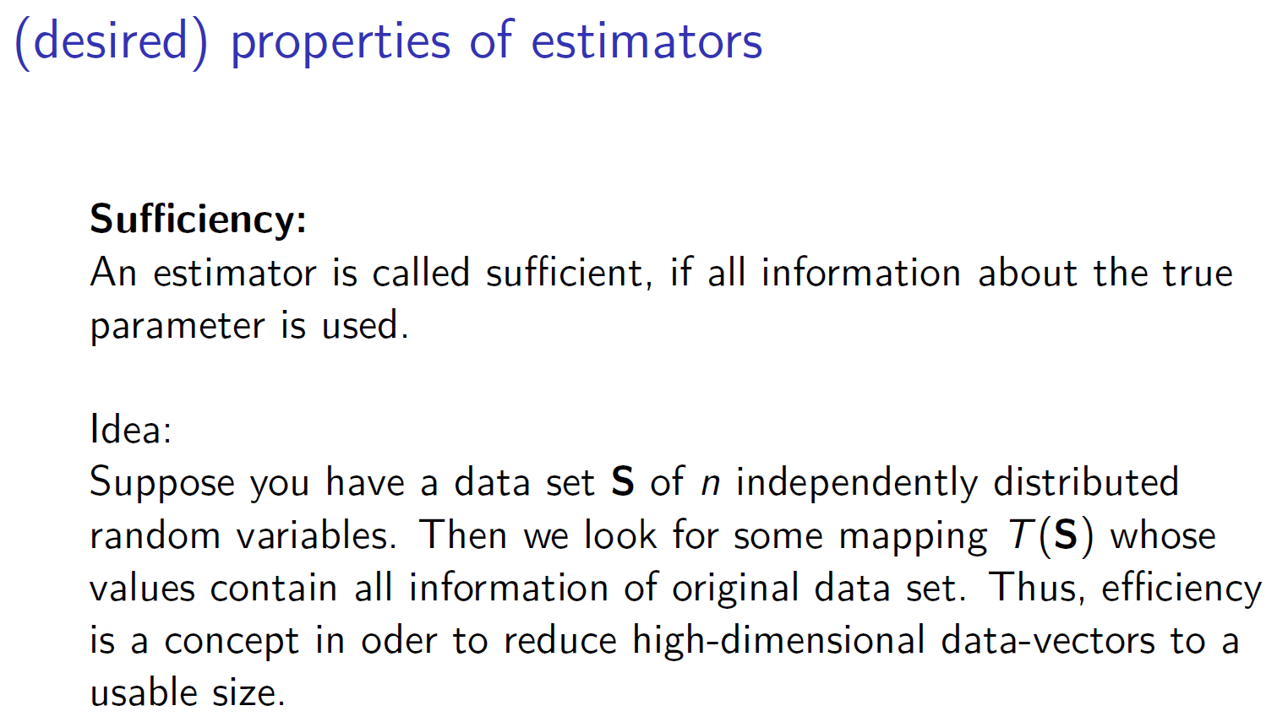



c

Slide 15
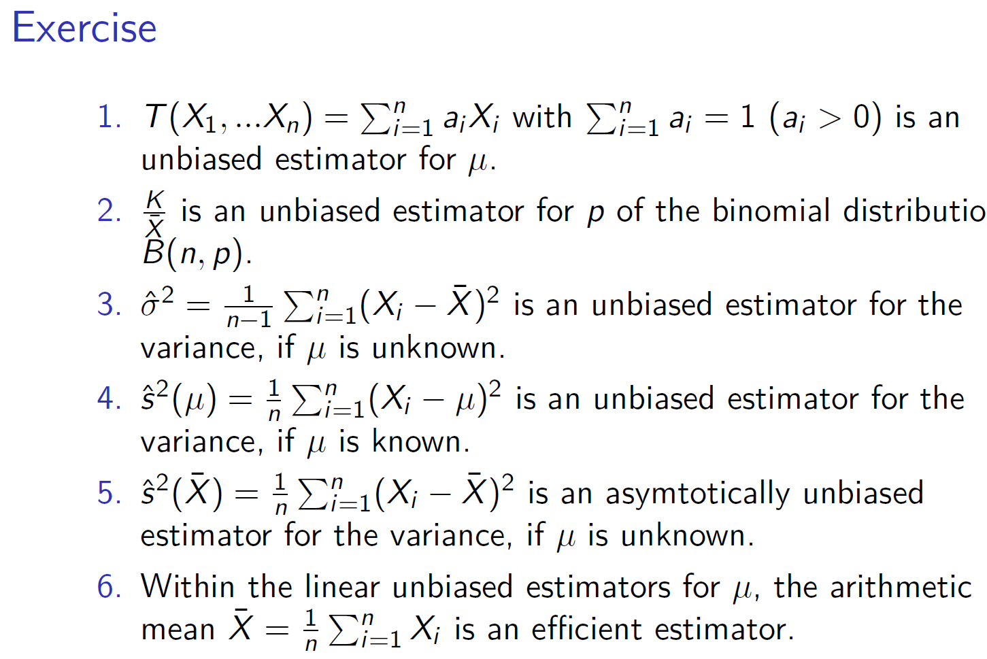

c

Slide 16












c

Slide 17

c

Slide 18









c

Slide 19


c

Slide 20









c

Slide 21
c

Slide 22
c

Slide 23
c

Slide 24




c

Slide 25


c

Slide 26


c

Slide 27




c

Slide 28
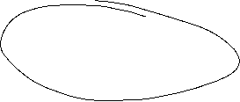


c

Slide 29

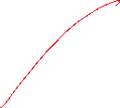

c

Slide 30
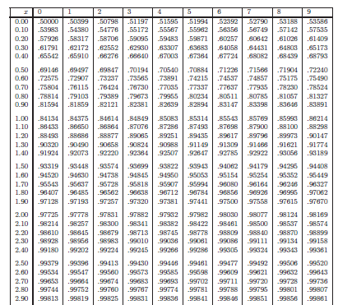
c

Slide 31






c

Slide 32


c

Slide 33

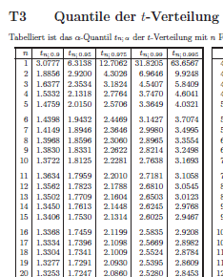

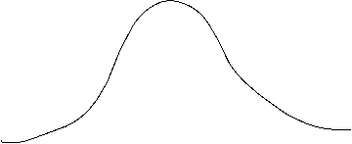


c

Slide 34






c

Slide 35





c

Slide 36
c

Slide 37
c

Slide 38
c

Slide 39
c

Slide 40
c

