Slide 1

Statistics A
Wilhelmshaven
This lecture will be recorded and
Subsequently uploaded in the
world-wide-web
Function translator (webpage)
Function translator Excel 1 (add in)
c
Prof. Dr. Bernhard Köster
Jade-Hochschule Wilhelmshaven
http://www.bernhardkoester.de/vorlesungen/inhalt.html

Slide 2
















Relevant Values of the standard normal distribution
z | F(z)
-2.58 | 0.5 %
-2.33 | 1 %
-1.96 | 2.5 %
-1.64 | 5 %
-1.23 | 10 %
c

Slide 3




c

Slide 4







c

Slide 5




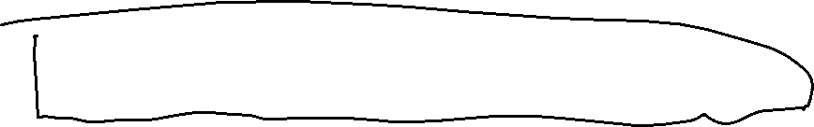






c

Slide 6




























c

Slide 7







c

Slide 8














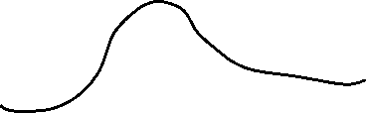


c

Slide 9





c

Slide 10
c

Slide 11
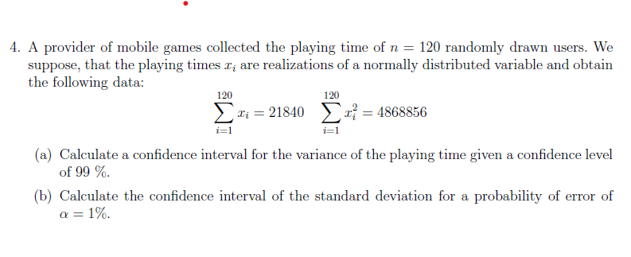























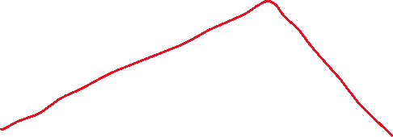







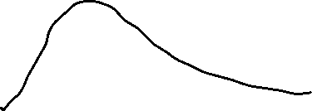

c

Slide 12
c

Slide 13
c

