Slide 1

Statistics A
Wilhelmshaven
This lecture will be recorded and
Subsequently uploaded in the
world-wide-web
Function translator (webpage)
Function translator Excel 1 (add in)
c
Prof. Dr. Bernhard Köster
Jade-Hochschule Wilhelmshaven
http://www.bernhardkoester.de/vorlesungen/inhalt.html

Slide 2









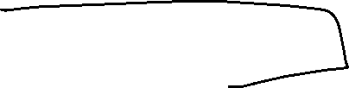
c

Slide 3
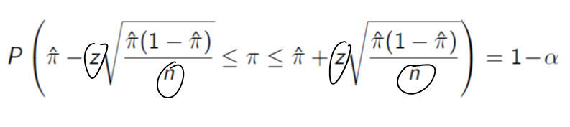










c

Slide 4
















c

Slide 5
c

Slide 6




c

Slide 7
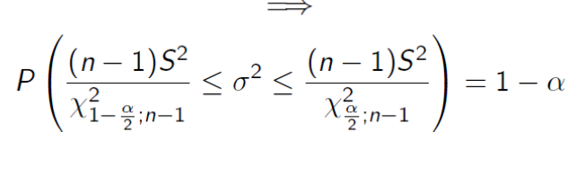















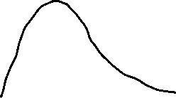


c

Slide 8



























c

Slide 9
c

Slide 10
c

