Slide 1

Statistics A
Wilhelmshaven
This lecture will be recorded and
Subsequently uploaded in the
world-wide-web
Function translator (webpage)
Function translator Excel 1 (add in)
c
Prof. Dr. Bernhard Köster
Jade-Hochschule Wilhelmshaven
http://www.bernhardkoester.de/vorlesungen/inhalt.html

Slide 2
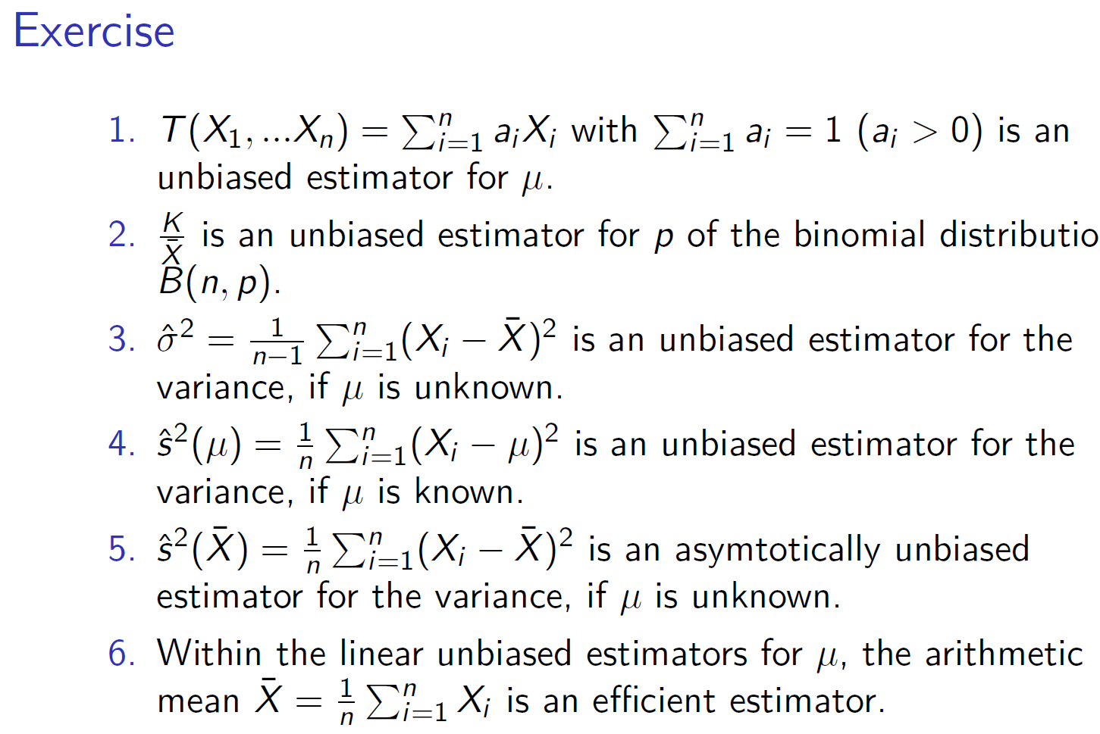




















c

Slide 3






c

Slide 4
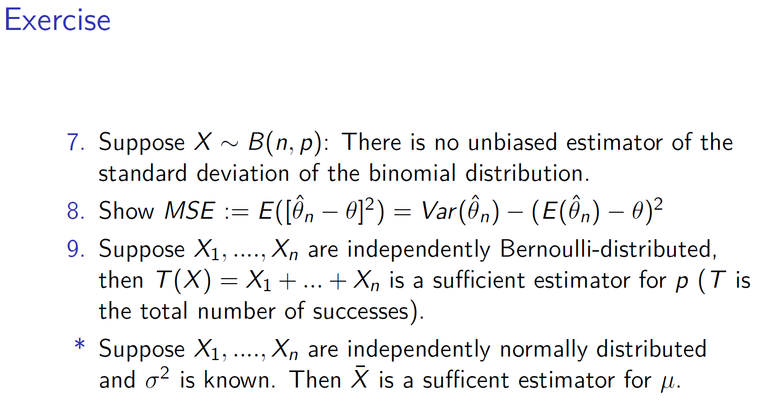



c

Slide 5


c

Slide 6








c

Slide 7
c

Slide 8




















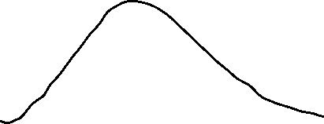
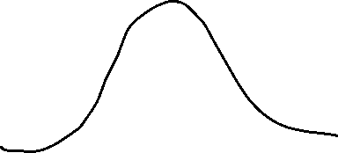


c

Slide 9
c

Slide 10











c

Slide 11


c

Slide 12


















c

Slide 13







c

Slide 14
c

Slide 15
c

Slide 16
c

Slide 17
c

Slide 18
c

