Slide 1

Statistics A
Wilhelmshaven
This lecture will be recorded and
Subsequently uploaded in the
world-wide-web
Function translator (webpage)
Function translator Excel 1 (add in)
c
Prof. Dr. Bernhard Köster
Jade-Hochschule Wilhelmshaven
http://www.bernhardkoester.de/vorlesungen/inhalt.html

Slide 2

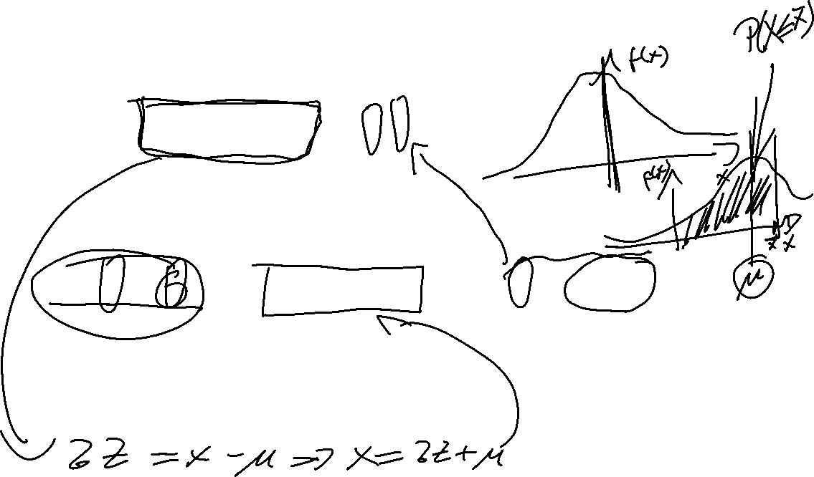
Normal distribution and standard normal distribution
Suppose then
We have
Generally, we obtain:
or
c

Slide 3



Probabilities and areas below the density function
Density function:
Intervall:
P(Z< c)
c

Slide 4

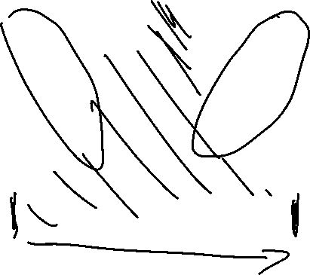
Relevant Values of the standard normal distribution
z | F(z)
-2.58 | 0.5 %
-2.33 | 1 %
-1.96 | 2.5 %
-1.64 | 5 %
-1.23 | 10 %
c

Slide 5
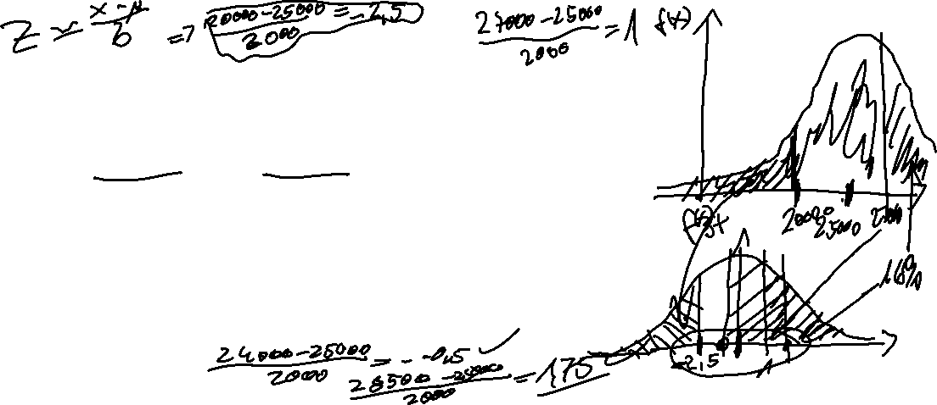
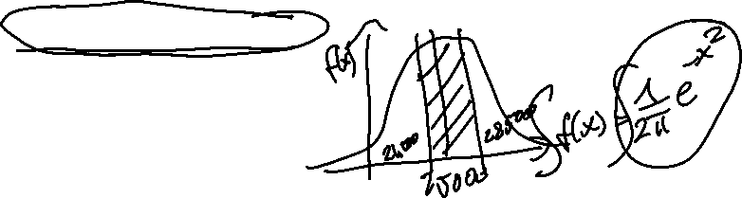
Example
Suppose you are the CEQ (Chief of Quality) in lamp maufactoring company. The life expectancy of a LED-lamp should be normally distributed with μ=25000h and σ= 2000.
Calculate the probability that the LED-Lamp works less than 20000 hours
Calculate the probability that the LED-Lamp works more than 27000 hours
Calculate the probability that the LED-Lamp works within 24000 und 28500 hours.
Show 1.-3. graphically
c

Slide 6

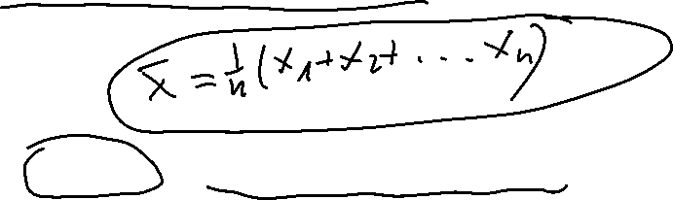
Reproductive property of the normal distribution
The sum of n indepentently normally distributed random variables ist also normally distributed.
The expected value of X equals the sum of the single expected values we obtain
For the variance of X, we obtain the analogous result:
c

Slide 7
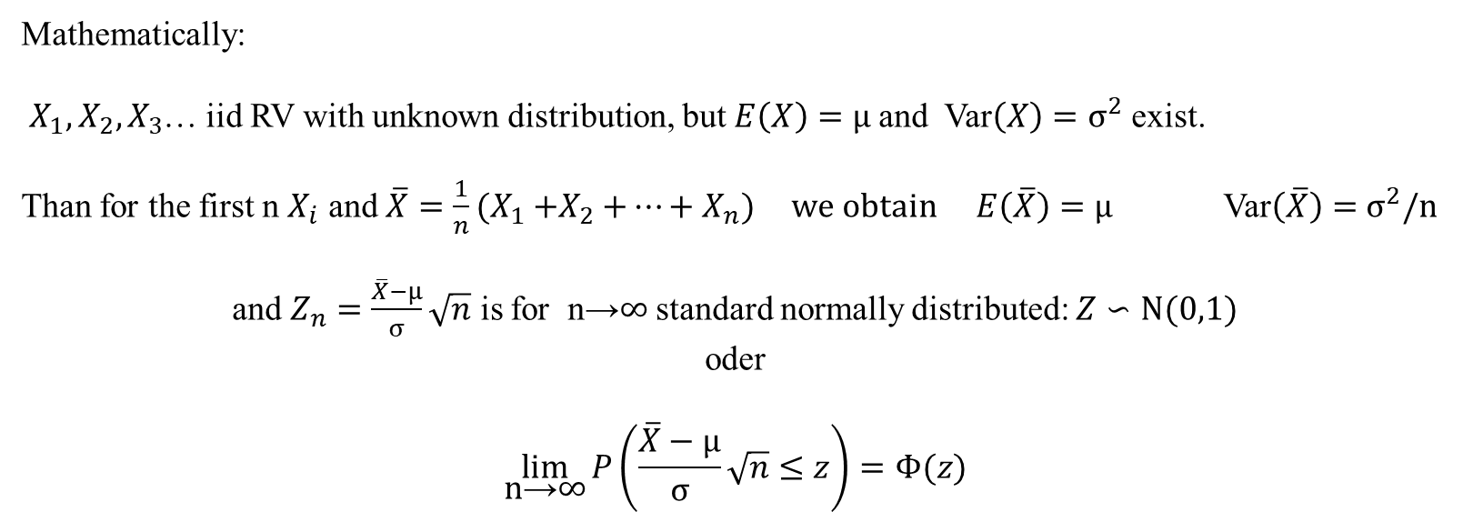
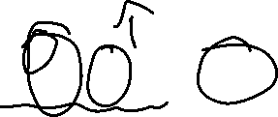
Central limit theorem
The sum of n independently identically distributed random variables is approximately normally distriuted, if n is large enough
Consequence: The true distribution can be ignored if n is large enough and you are interested in the distribution of the sample mean:
Mathematically:
$X_{1},X_{2}{,X}_{3}$… iid RV with unknown distribution, but $E\left(X\right)=μ$and Var$\left(X\right)=σ^{2}$ exist.
Than for the first n $X_{i}$ and ${\overline{X}=\frac{1}{n}(X}_{1}{+X}_{2}+…+X_{n})$ we obtain $E\left(\overline{X}\right)=μ$ Var$\left(\overline{X}\right)=$ $σ^{2}/n$
and $Z_{n}=\frac{\overline{X}−μ}{σ}\sqrt{n}$ is for n→∞ standard normally distributed: $Z∽N(0,1)$
oder
$$\lim_{\text{n}\text{→}\text{∞}}{P\left(\frac{\overline{X}−μ}{σ}\sqrt{n}≤z\right)=Φ(z)}$$
c

Slide 8
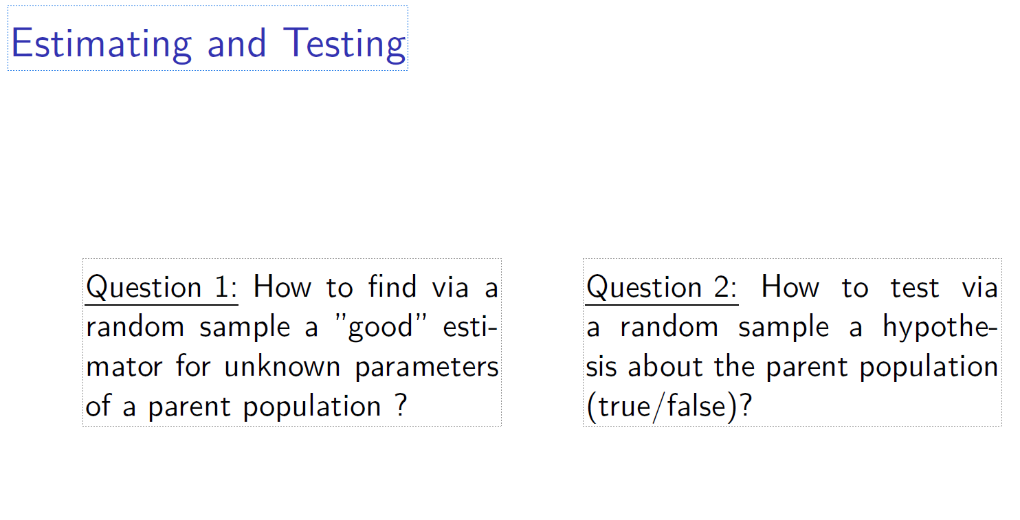

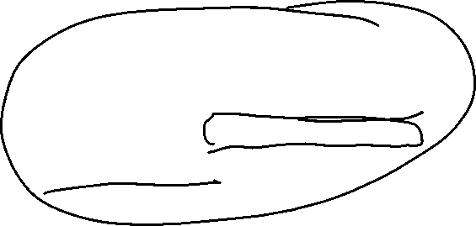
c

Slide 9
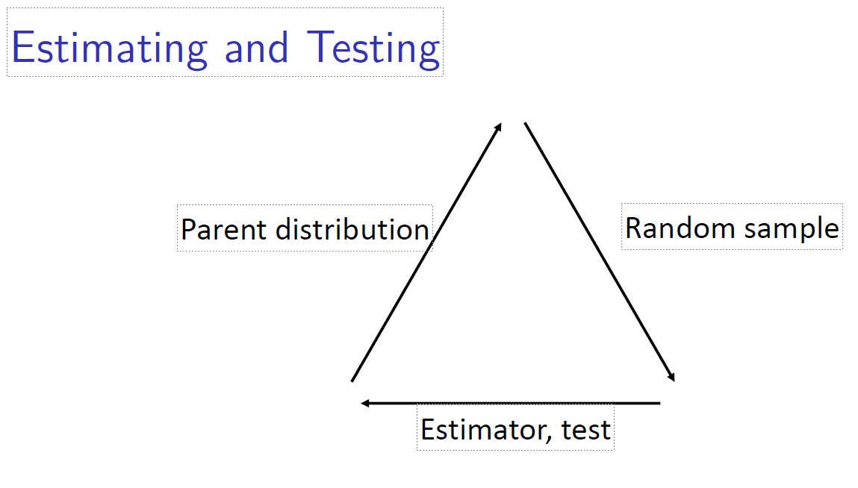

c

Slide 10
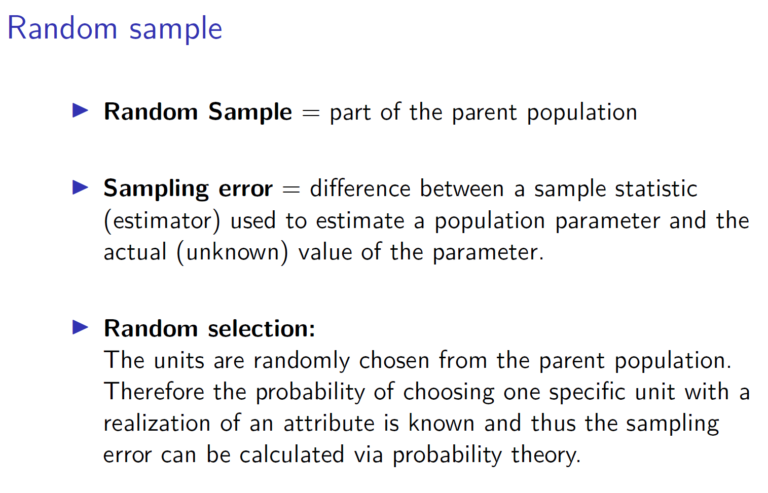

c

Slide 11
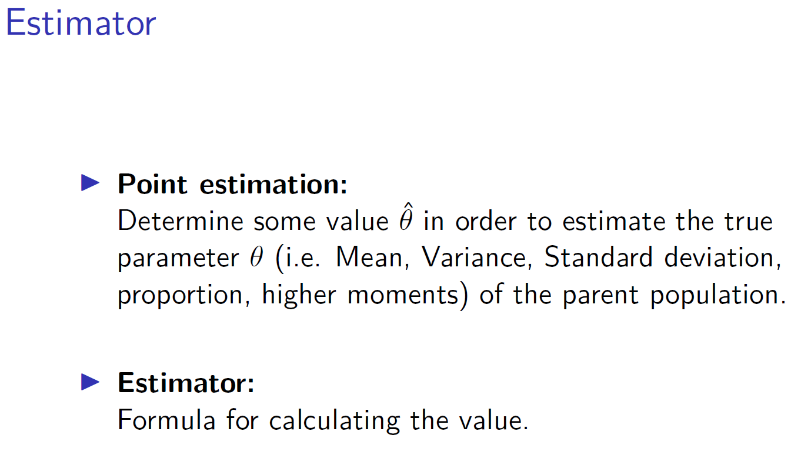
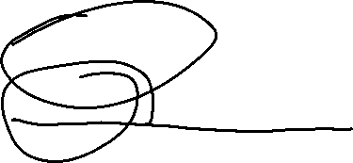
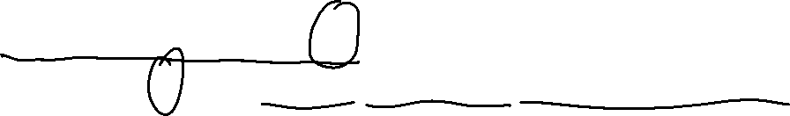
c

Slide 12
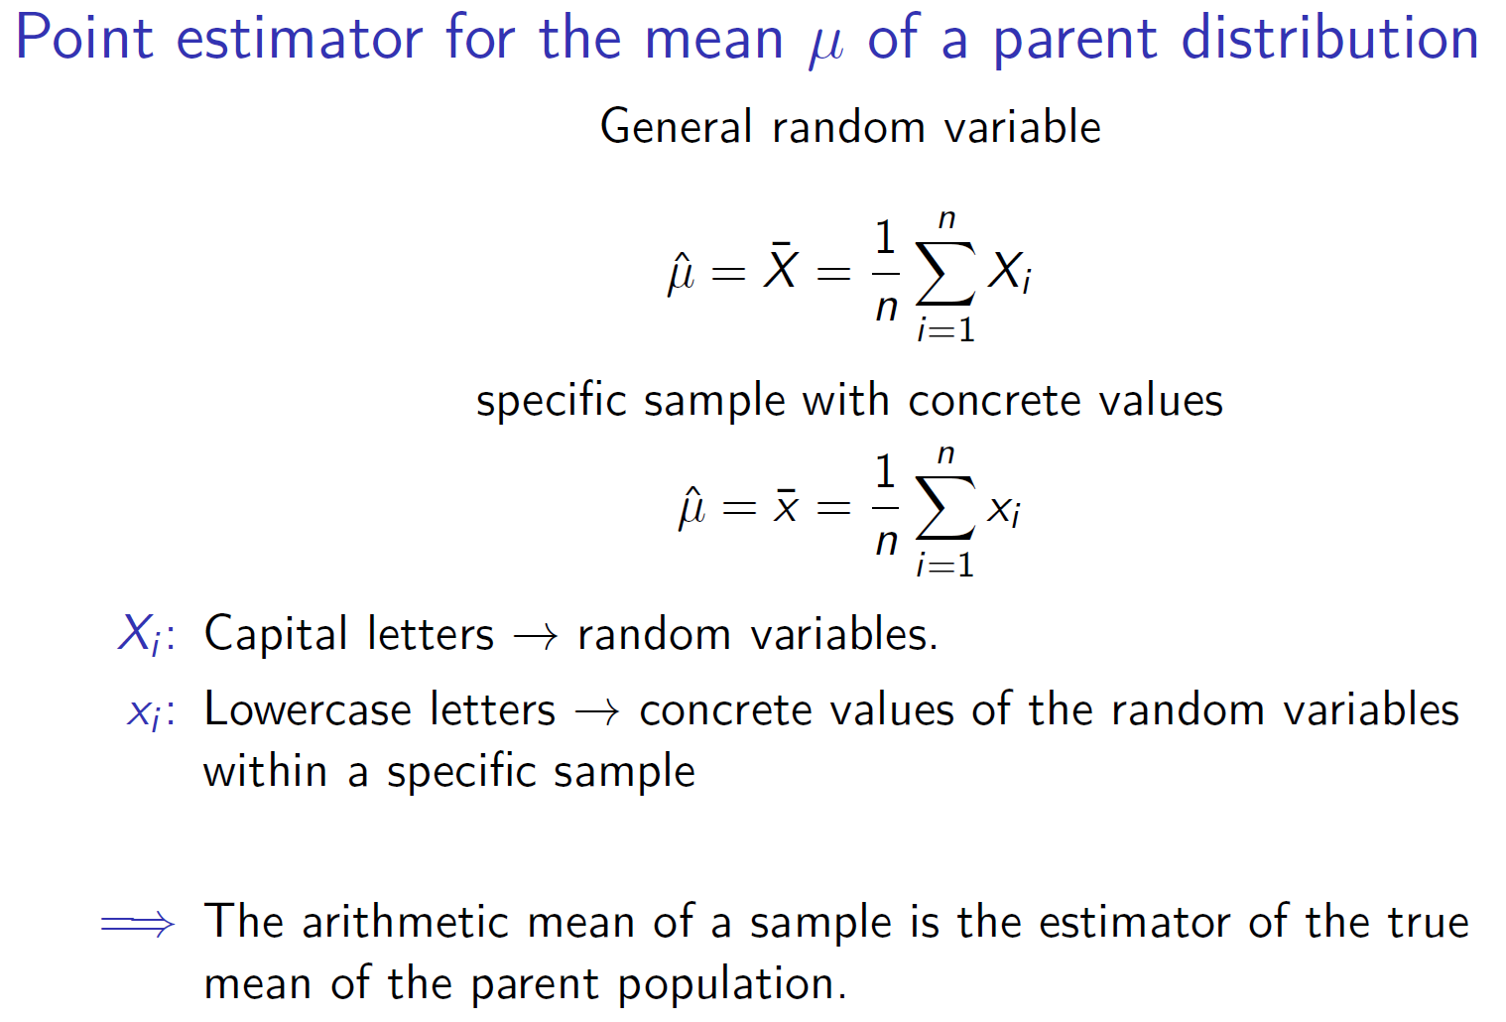
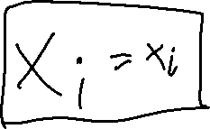


c

Slide 13
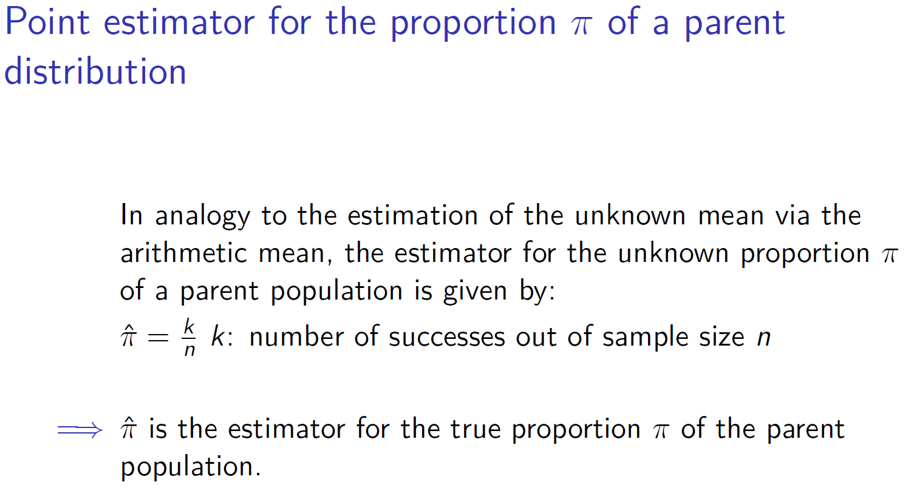

c

Slide 14
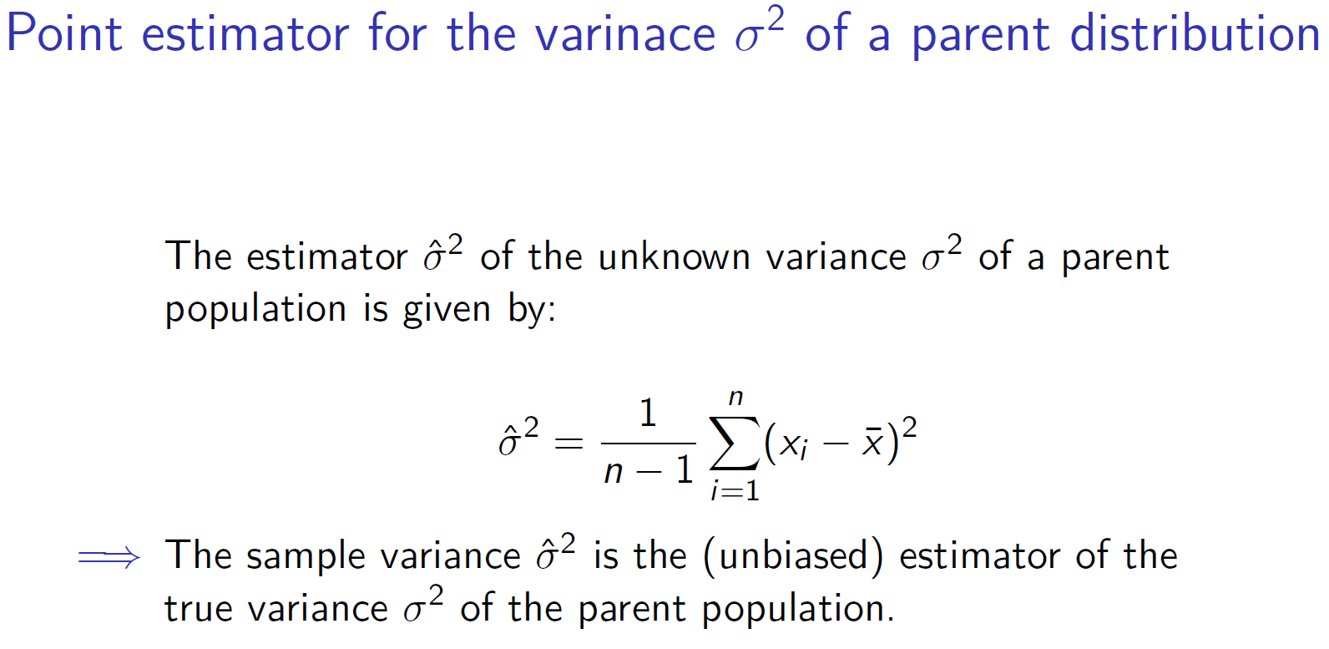

c

Slide 15
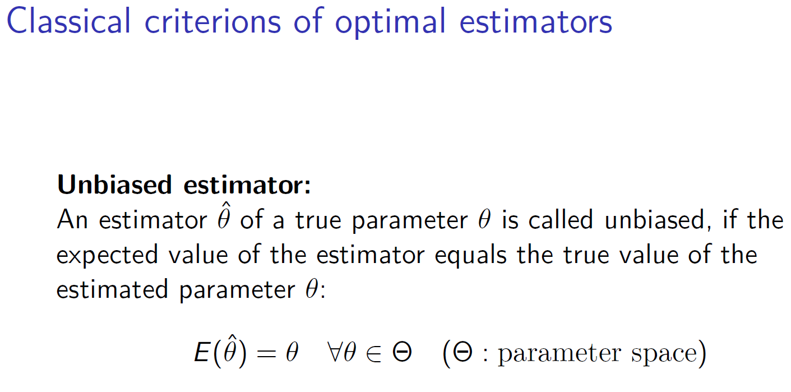
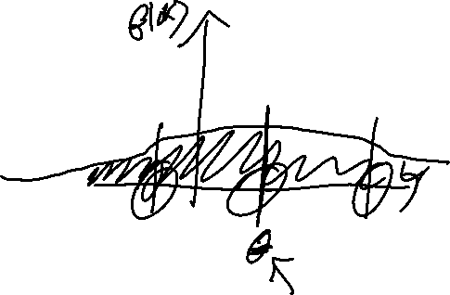
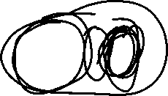

c

Slide 16
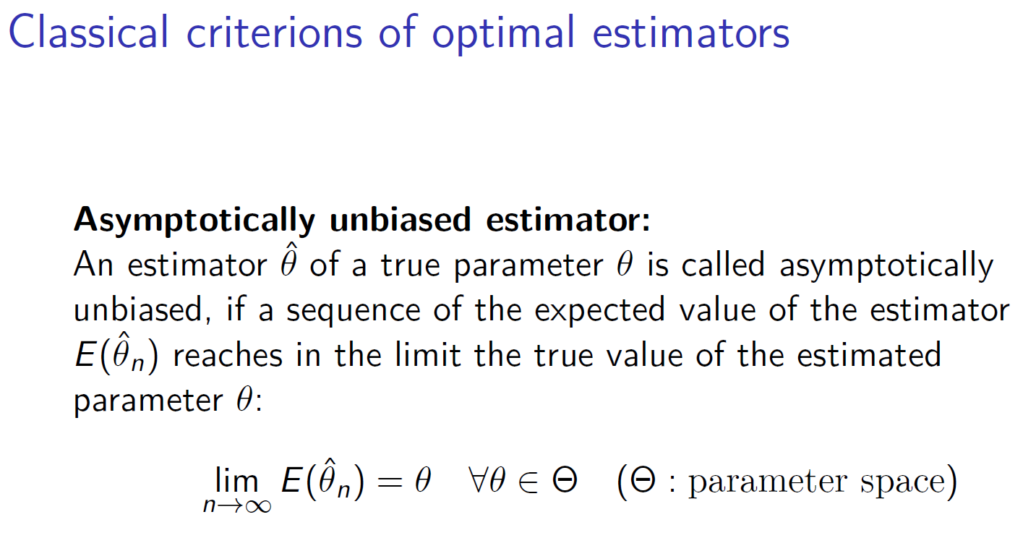
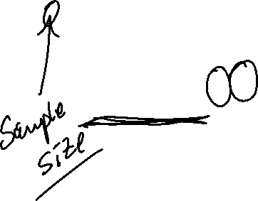
c

Slide 17
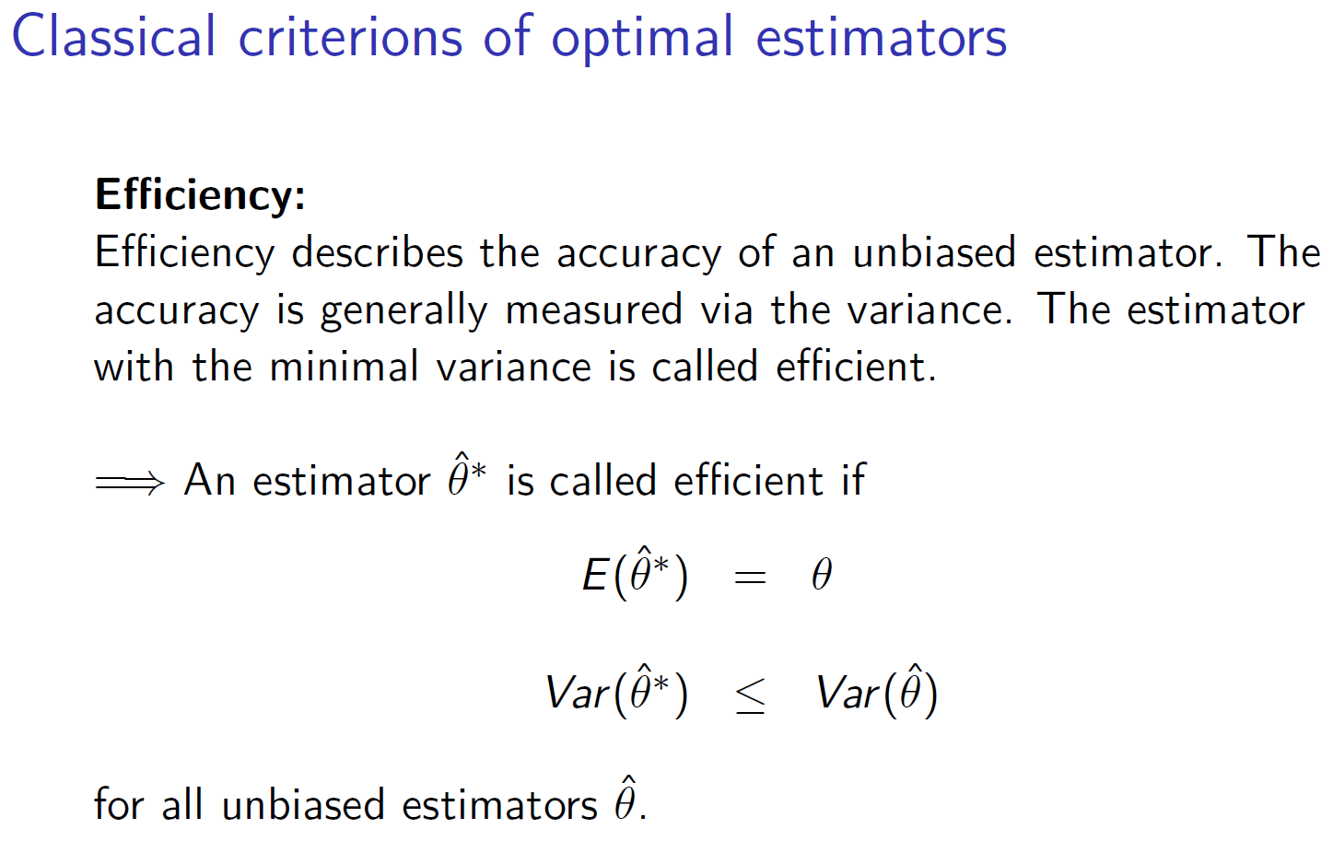

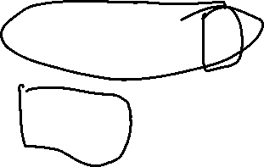
c

Slide 18
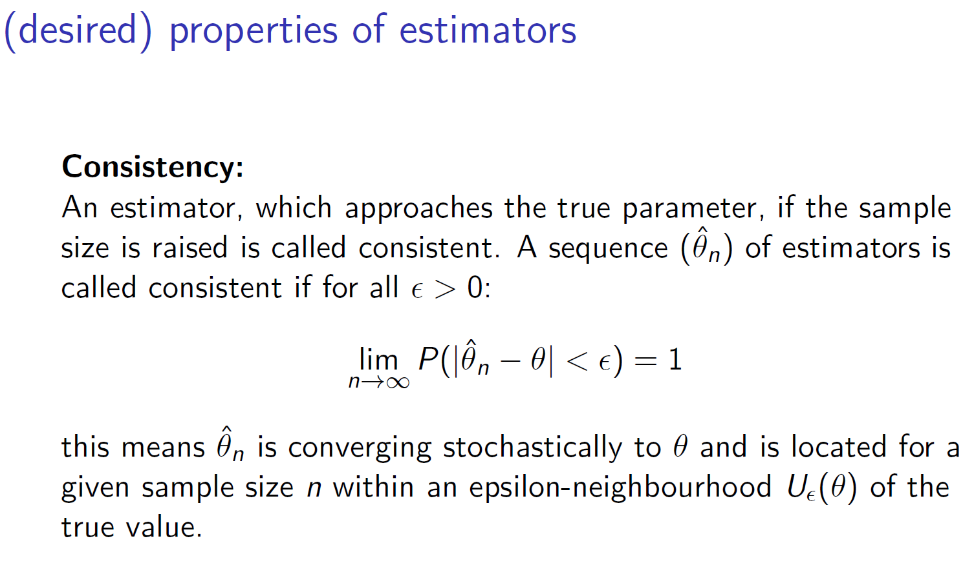
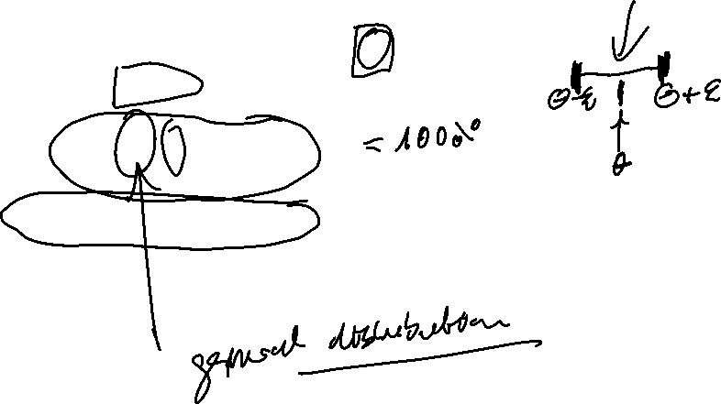

c

Slide 19
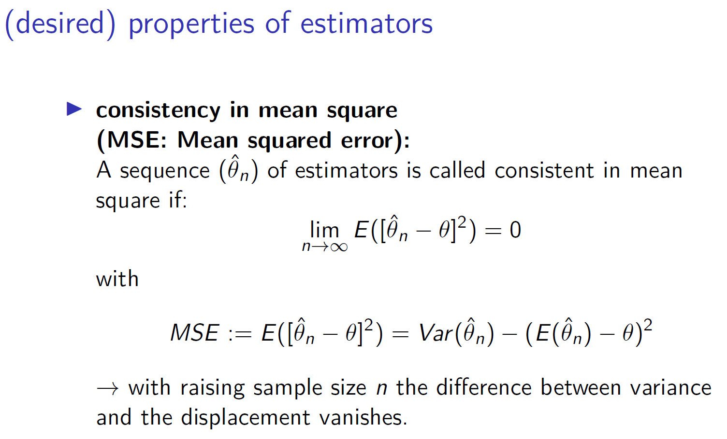
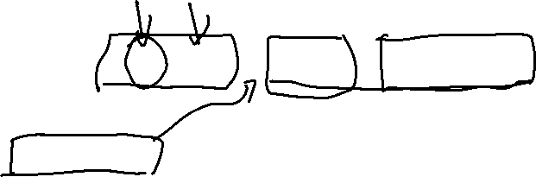

c

Slide 20
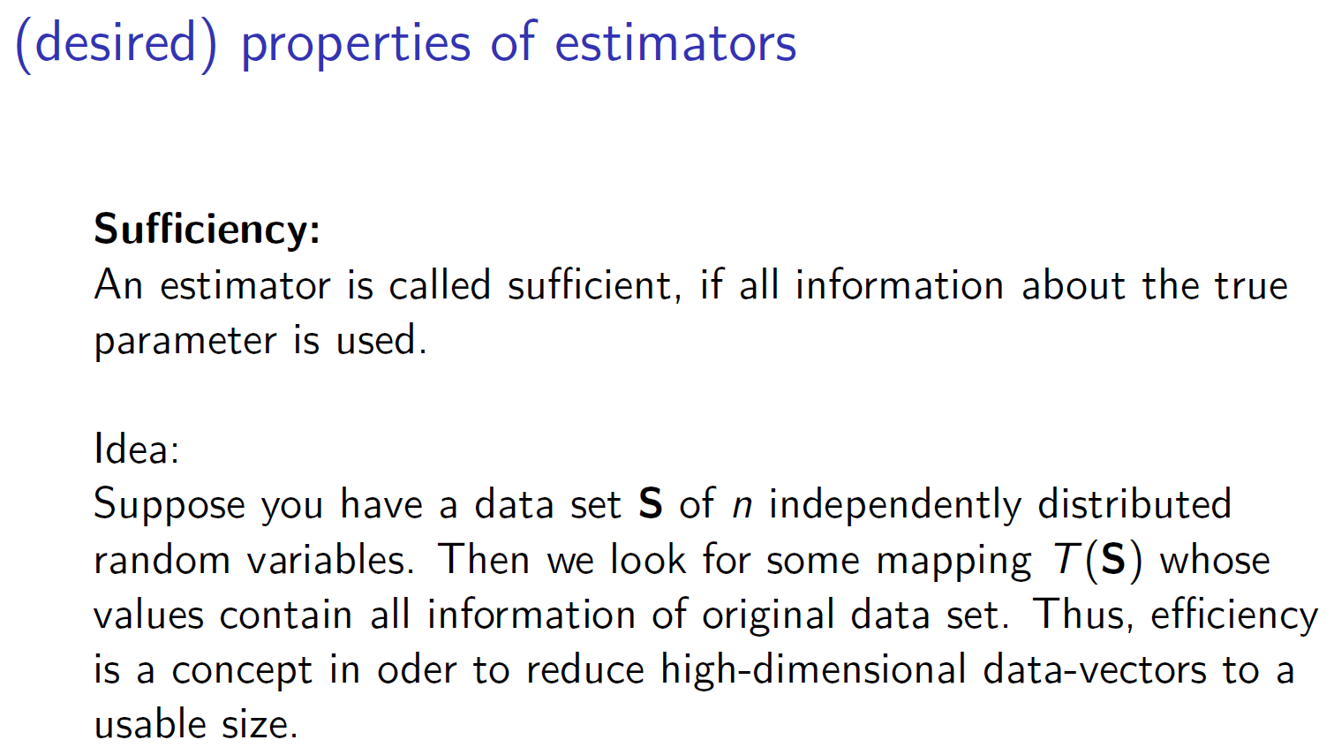




c

Slide 21
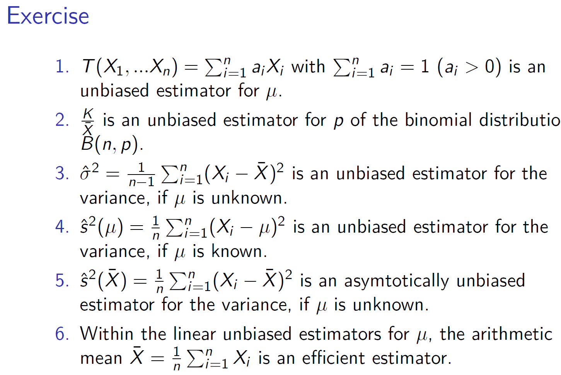

c

Slide 22
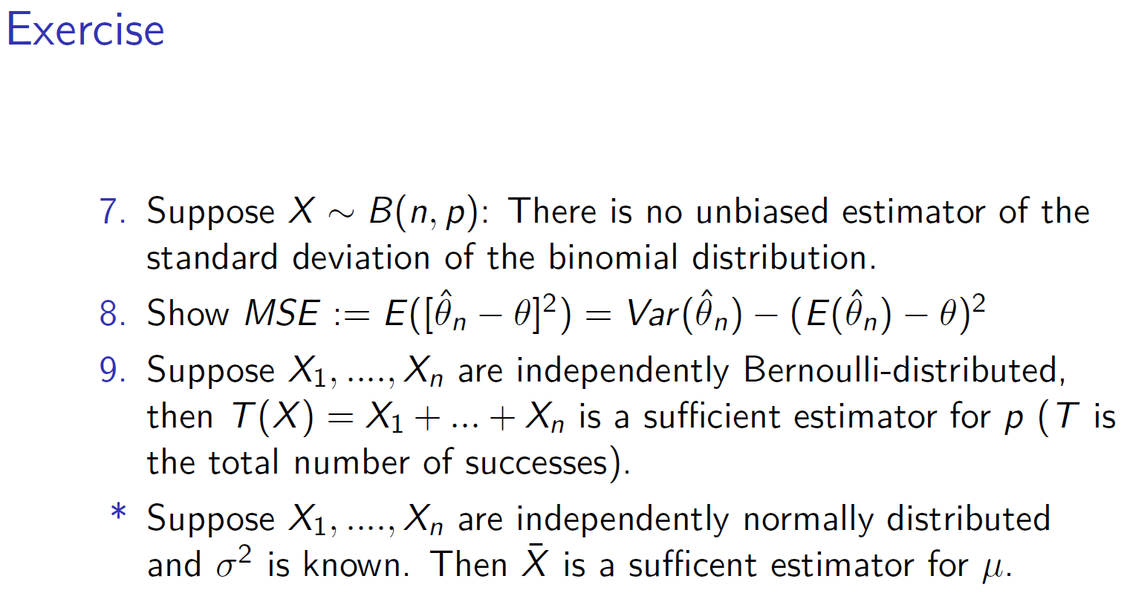

c

