Slide 1

Statistics A
Wilhelmshaven
This lecture will be recorded and
Subsequently uploaded in the
world-wide-web
Function translator (webpage)
Function translator Excel 1 (add in)
c
Prof. Dr. Bernhard Köster
Jade-Hochschule Wilhelmshaven
http://www.bernhardkoester.de/vorlesungen/inhalt.html

Slide 2

Binomial distribution
A random experiment has two possible outcomes (success and failure).
The random experiment will be repeated n times.
What is the probability to be k times successful within n $≥$k repetions
Every repetition is independent from each other. Within every repetition succes has probability p und failure probability 1-p.
c

Slide 3

Binomial Distribution
Suppose p of „success“ is known, define the random variable X =„number of succes k“ within n $≥$ k repetitions.
→ X is Binomial distributed with
$$P\left(X=k\right)=\left(\begin{matrix}n \\ k\end{matrix}\right)p^{k}({1−p)}^{n−k}$$
c

Slide 4
Examples Binomial Distribution
Probability within 10 throws of a dice to obtain 3 times a 6?
Probability to move the first time in the game „Mensch ärgere Dich nicht“ (Hombre, no te enfades)?
You play four different statistically independent Lotteries. The probability of success is always 20 %.
  What is the expectated value and the variance and standard deviation?
  What is the expected payoff, if every successs counts 10 Euros?
  Calculate the probability to win exactly two times
  Calculate the probability that you loose at least three times.
c

Slide 5
Continous Random Variables
The probability of the realization of X within some specific interval [a,b] is the area below the density function f(x):
c

Slide 6
Properties of the density function
Values of f(x) cannot be interpreted!
If the length of the intervall reaches zero (a = b), also the area reaches zero:
→ P(X = x) = 0
The whole area below the density function equals 1 (certain event):
c

Slide 7
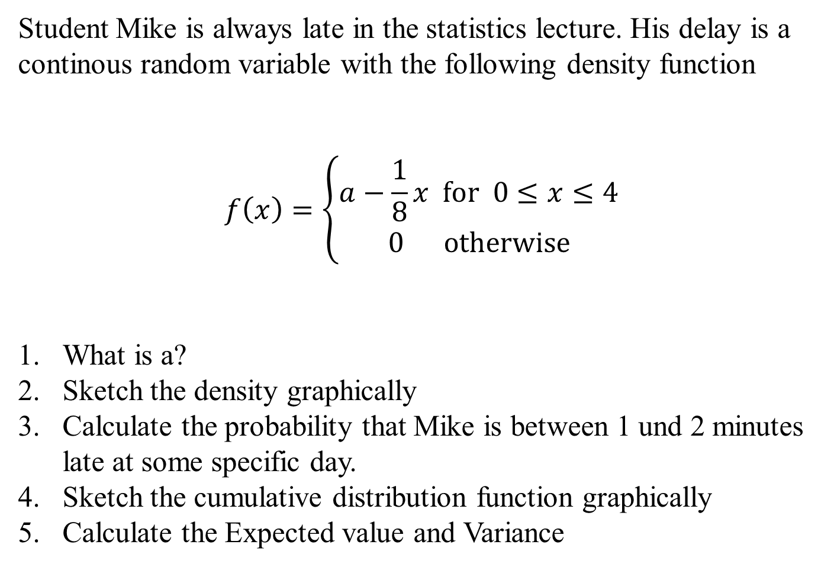
Example Density Function
Student Mike is always late in the statistics lecture. His delay is a continous random variable with the following density function
$$f\left(x\right)=\left\{\begin{matrix}\begin{matrix}a−\frac{1}{8}x for 0≤x≤4 \\ 0 otherwise\end{matrix} \\ \end{matrix}\right.$$
What is a?
Sketch the density graphically
Calculate the probability that Mike is between 1 und 2 minutes late at some specific day.
Sketch the cumulative distribution function graphically
Calculate the Expected value and Variance
c

Slide 8
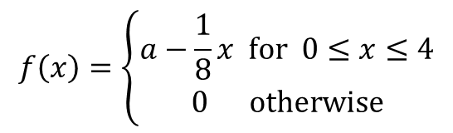
a [1,2] density, cumulative distribution, E(x), Var(x)
Example Density Function
$$f\left(x\right)=\left\{\begin{matrix}\begin{matrix}a−\frac{1}{8}x for 0≤x≤4 \\ 0 otherwise\end{matrix} \\ \end{matrix}\right.$$
solve( int(a-(1/8)x dx; 0..4)=1,a)
plot(1/2-x/8,0..4)
int(1/2-x/8),0..y
plot(-1/16 (-8 + y) y,0..4)
int(x(1/2-x/8)),0..4
int((x-4/3)^2(1/2-x/8)),0..4
c

Slide 9
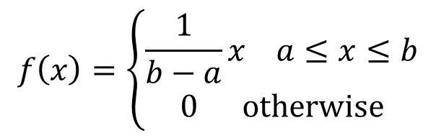
Uniform distribution
The density is constant over a given Interval [a,b]. This means, that every subinterval with same length have same probability
$$f\left(x\right)=\left\{\begin{matrix}\begin{matrix}\frac{1}{b−a}x a≤x≤b \\ 0 otherwise\end{matrix} \\ \end{matrix}\right.$$
c

Slide 10
Uniform distribution
f(x)
F(x)
1/(b-a)
1
c
a
b
a
b

Slide 11
Suppose you are the COP (Chief of Production) within a brewery.
Furthermore the maschine shows a filling quanatity of the bottles is 0,568L. But you suppose, that real filling quantity is uniformly distributed around 0,556L and 0,58L.
What is the probability that the filling quantity is less than 0,56L?
Example
c

Slide 12


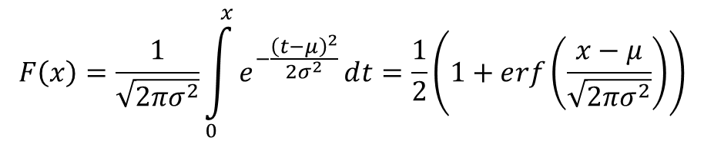
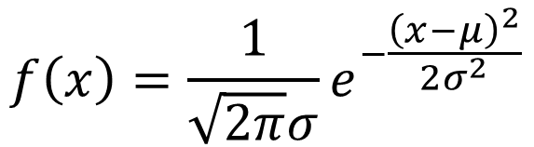
Normal Distribution
The normal distribution or gaussian distribution is the most important distribution.
We write:
The density function is given by:
The cumulative distribution function by:
$$⋅$$
$$f\left(x\right)=\frac{1}{\sqrt{2π}σ}ⅇ^{−\frac{{\left(x−μ\right)}^{2}}{2σ^{2}}}$$
c
$$F\left(x\right)=\frac{1}{\sqrt{2{πσ}^{2}}}\int_{0}^{x}{ⅇ^{−\frac{{\left(t−μ\right)}^{2}}{2σ^{2}}}ⅆt}=\frac{1}{2}\left(1+ⅇrf\left(\frac{x−μ}{\sqrt{2πσ^{2}}}\right)\right)$$
$$\operatorname{erf}\left(x\right)=\frac{2}{\sqrt{π}}\int_{0}^{y}{ⅇ^{−y^{2}}ⅆy}$$
(Error function)

Slide 13
The importance of the normal distribution
Many empirical distributions follow at least approximately the normal distribution
Many discrete distribtions can be approximated by the normal distribution. I.e. Binomial distribution
The distribution of the sample indepent with respect to the underlying true distritibution is approximated by the normal distribution for large sample size N (central limit theorem)
The normal distribution is the basis theoretical models
(i.e. white noise)
c

Slide 14
Normal distribution
[%]
c
Density function μ = 0 und σ = 1
Cumulative distribution function μ = 0 und σ = 1

Slide 15

Properties of the normal distribution
The normal distribution is a 2-parameter-distribution in μ and σ
N(μ, σ²) is symmetrically around x = μ
The density function has turning points at x = μ + σ and x = μ – σ
The density function flattens if the variance goes up.
The density function reaches the x-axes
asymptotically at $+∞$ and $−∞.$
c

Slide 16
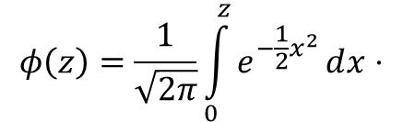
The standard normal distribution
Normal distribution with μ=0 σ =1
Maximum at z = 0
Turning points at z = -1 and z = 1
In order to calculate probabilities the cumulative distribution function is tabulated and implemented in every standard spreadsheet programm like excel (MS office) or calc (libreoffice)
Every normally distributed random variable can be transformed in a standard normally distributed random variable (Standardisierung)
c
$$φ\left(z\right)=\frac{1}{\sqrt{2π}}\int_{0}^{z}{ⅇ^{−\frac{1}{2}x^{2}}ⅆx}⋅$$

Slide 17
Normal distribution and standard normal distribution
Suppose then
We have
Generally, we obtain:
or
c

Slide 18
Probabilities and areas below the density function
Density function:
Intervall:
P(Z< c)
c

Slide 19
Relevant Values of the standard normal distribution
z | F(z)
-2.58 | 0.5 %
-2.33 | 1 %
-1.96 | 2.5 %
-1.64 | 5 %
-1.23 | 10 %
c

Slide 20
Example
Suppose you are the CEQ (Chief of Quality) in lamp maufactoring company. The life expectancy of a LED-lamp should be normally distributed with μ=25000h and σ= 2000.
Calculate the probability that the LED-Lamp works less than 20000 hours
Calculate the probability that the LED-Lamp works more than 27000 hours
Calculate the probability that the LED-Lamp works within 24000 und 28500 hours.
Show 1.-3. graphically
c

Slide 21
Reproductive property of the normal distribution
The sum of n indepentently normally distributed random variables ist also normally distributed.
The expected value of X equals the sum of the single expected values we obtain
For the variance of X, we obtain the analogous result:
c

Slide 22
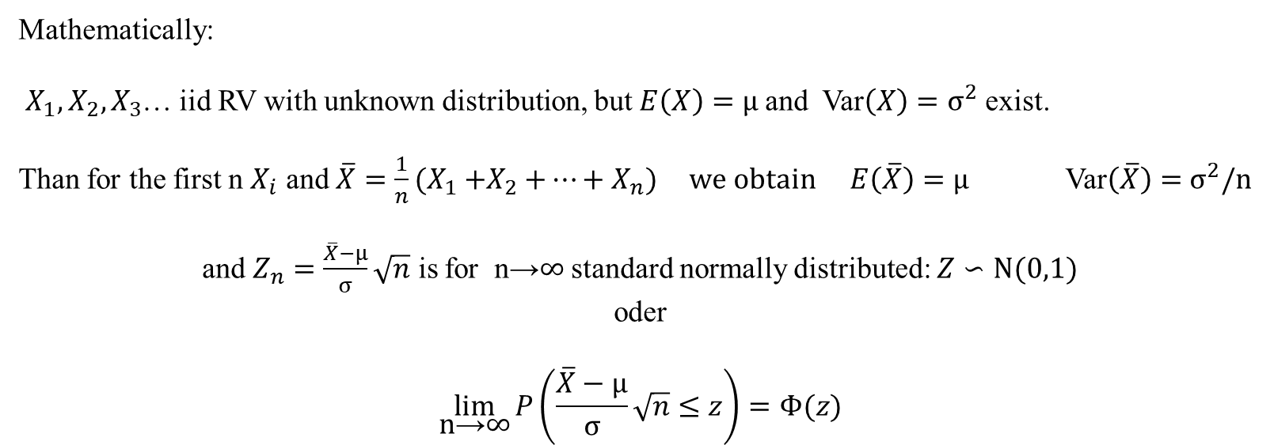
Central limit theorem
The sum of n independently identically distributed random variables is approximately normally distriuted, if n is large enough
Consequence: The true distribution can be ignored if n is large enough and you are interested in the distribution of the sample mean:
Mathematically:
$X_{1},X_{2}{,X}_{3}$… iid RV with unknown distribution, but $E\left(X\right)=μ$and Var$\left(X\right)=σ^{2}$ exist.
Than for the first n $X_{i}$ and ${\overline{X}=\frac{1}{n}(X}_{1}{+X}_{2}+…+X_{n})$ we obtain $E\left(\overline{X}\right)=μ$ Var$\left(\overline{X}\right)=$ $σ^{2}/n$
and $Z_{n}=\frac{\overline{X}−μ}{σ}\sqrt{n}$ is for n→∞ standard normally distributed: $Z∽N(0,1)$
oder
$$\lim_{\text{n}\text{→}\text{∞}}{P\left(\frac{\overline{X}−μ}{σ}\sqrt{n}≤z\right)=Φ(z)}$$
c

