Slide 1

Statistics A
Wilhelmshaven
This lecture will be recorded and
Subsequently uploaded in the
world-wide-web
Function translator (webpage)
Function translator Excel 1 (add in)
Prof. Dr. Bernhard Köster
Jade-Hochschule Wilhelmshaven
http://www.bernhardkoester.de/vorlesungen/inhalt.html

Slide 2






^{Random Variable}
Definition:
A Random Variable X is the mapping of the sample space Ω into the real numbers R. That means every elementary event A_{i} maps onto a real number x_{i} and the probability p_{i} = P(A_{i}) = P(X=x_{i}) = p(x_{i}) is known.
→ p_{i} ist the probality that random variable X equals the outcome x_{i}.

Slide 3



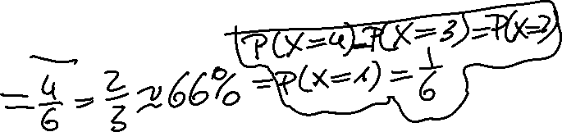
Random Variable – Explainations
Every possible event of a random experiment can be expressed via a random variable.
Random variables are expressed in capital letters.
Example: dice with sample space X is element of {1,2,3,4,5,6}
The realization of a random variable is expressed in lowercase letters:
Example rolling dice: X realizes the value x = 5
Probality in the example of rolling dice:
P(x < 5) = ??

Slide 4











Discrete and continous random variables (RV)
Discrete RV:
RV, which have only a finite or countably infinite realizations.
Continous RV:
RV which can realize within an intervall every possible real number.

Slide 5

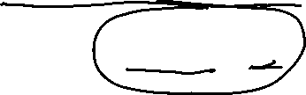
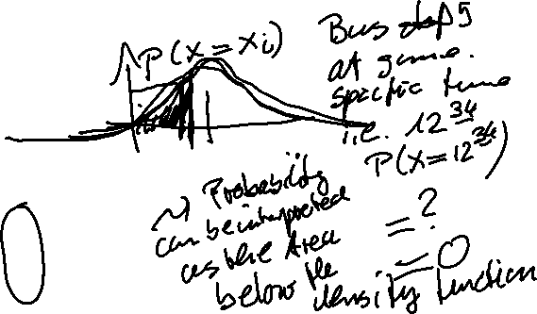




Discret
Probability mass function:
Cumulative distribution function:
Expectated value:
Variance:
Continous
Probability density function:
Cumulative distribution function:
Expectated value :
Variance:

Slide 6
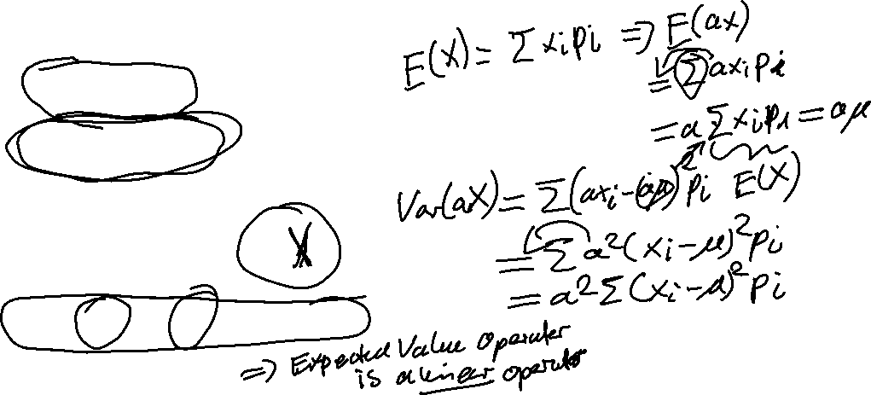



Calculating with the Expectated Value and the Variance
Constant:
Constant factor:
Linear Transformation:

Slide 7



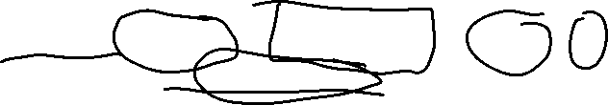
Probability Axioms
Axiom 1: $P\left(A\right)≥0$ for all $A∈Ω$
Every event has a non negative probability
Axiom 2: $P\left(Ω\right)=1$
The certain event has probability 1
Axiom 3: $P\left(A∪B\right)=P\left(A\right)+P\left(B\right),$ if $A∩B=⌀$
Addition rule for disjoint events

Slide 8


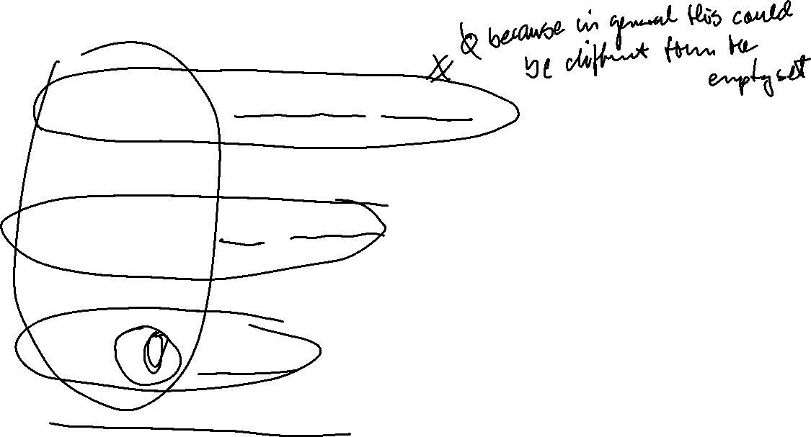
Rules
Rule 1: $P\left(A∪B\right)=P\left(A\right)+P\left(B\right)−P(A∩B)$
Addtion rule for any events
Rule 2: $P\left(A\backslash B\right)=P\left(B\right)−P(A∩B)$
A without B
Rule 3: $P\left(\overline{A}\right)=1−P\left(A\right)$
Probality of complementary events

Slide 9


Conditional probability
The conditional probability of an event A is the probablity of the occurence the event A given event B has happened (or happens simultaneously with A)
→ conditional probability of A given B: P(A│B).
Definition:
Bayes Theorem:

Slide 10
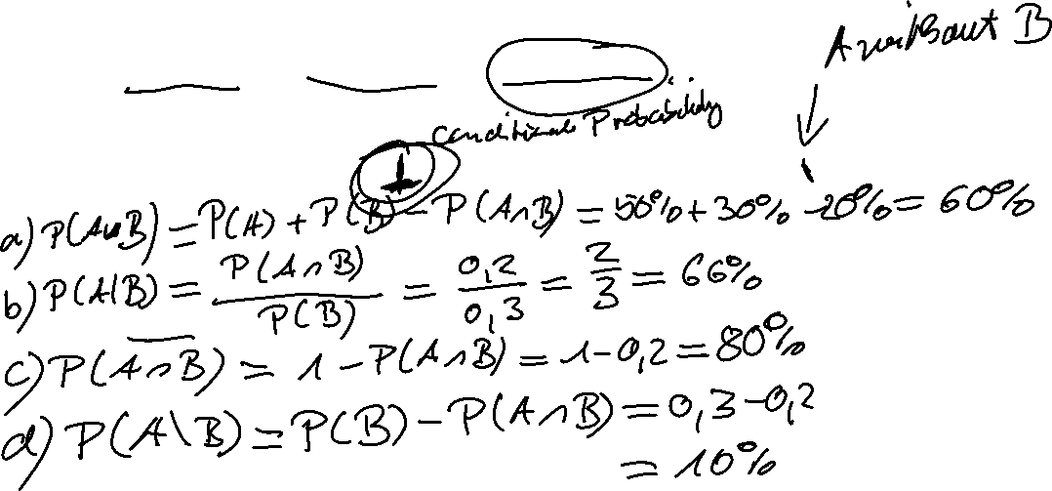
Example
Suppose the following probabilities are known:
P(A) = 0,5; P(B) = 0,3; P(A∩B) = 0,2
Calculate

Slide 11



Statistically independent events
P(A|B) = P(A) or P(B|A) = P(B)
→

Slide 12
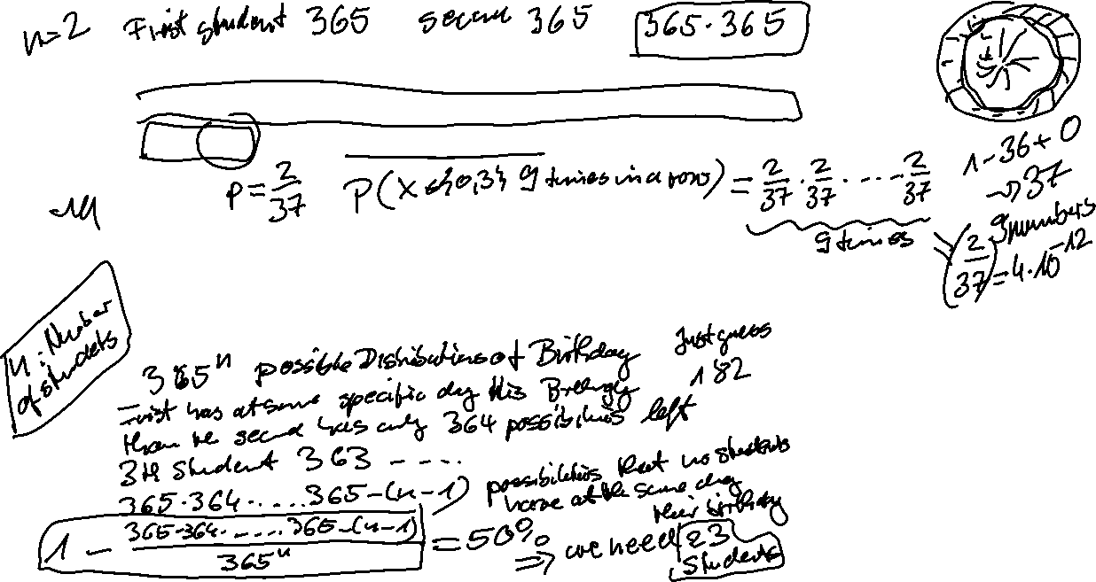
Statistically independent events: Example
Sylvester 1988 in Casino in Konstanz at the roulette table, the event
A = {0,3}occured 9 times in a row. Calculate the probability of this event
Suppose in class two students have birthday at the same day. What is the the minimum number of students in class, that the probability for this event is 50%?

Slide 13



Total Probability
If the sample space Ω consists of in k disjoint elemtary events A_{i}, then the probability of event B is:
→

Slide 14
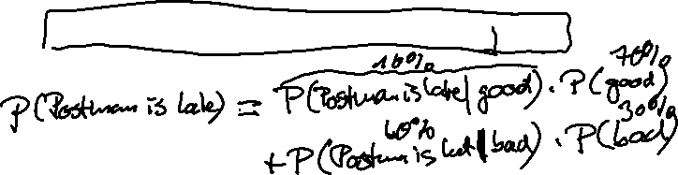
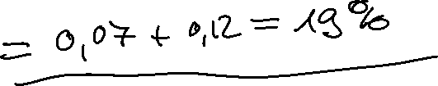
Total Probability: Example
Every day a small village is visited by a postman. If he is in good mood he is in time with probability 90%. If he is in bad mood he is late with probability 40%.
What is the probability that he is late at any day, if he is on average in good at 7 out of 10 days?

Slide 15
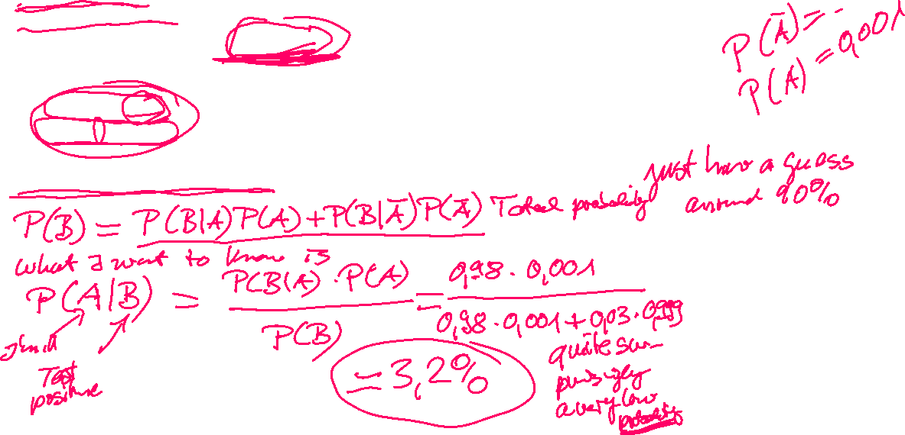


Total Probability and Bayes Theorem
Suppose you are testing for a rare illness and you have the following probabilities:
A = {patient is ill}
B = {test is positive}
Since we have a rare illness: P(A) = 0,1%.
Since a test does not have 100% accurancy, from surveys we have:
  P(B|A) = 0,98
  $P(B|\overline{A})$ = 0,03
Suppose your test result is positive. What is the probability, that you are really ill?

