Slide 1

Statistics A
Wilhelmshaven
This lecture will be recorded and
Subsequently uploaded in the
world-wide-web
Function translator (webpage)
Function translator Excel 1 (add in)
c
Prof. Dr. Bernhard Köster
Jade-Hochschule Wilhelmshaven
http://www.bernhardkoester.de/vorlesungen/inhalt.html

Slide 2












c

Slide 3










c

Slide 4







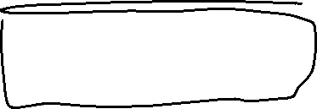















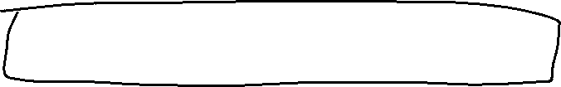


c

Slide 5
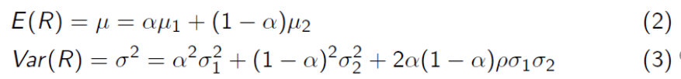


























c

Slide 6



























c

Slide 7










c

Slide 8























c

Slide 9
c

Slide 10
























c

Slide 11




























c

Slide 12

























c

Slide 13

c

Slide 14







c

Slide 15

































































c

Slide 16














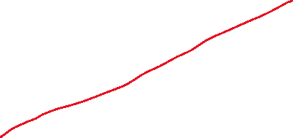



c

Slide 17




















c

Slide 18












c

Slide 19







c

Slide 20


c

Slide 21





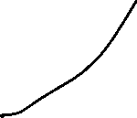


c

Slide 22






























c

Slide 23
c

Slide 24
c

