Slide 1

Statistics A
Wilhelmshaven
This lecture will be recorded and
Subsequently uploaded in the
world-wide-web
Function translator (webpage)
Function translator Excel 1 (add in)
c
Prof. Dr. Bernhard Köster
Jade-Hochschule Wilhelmshaven
http://www.bernhardkoester.de/vorlesungen/inhalt.html

Slide 2

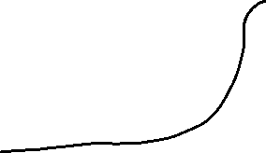







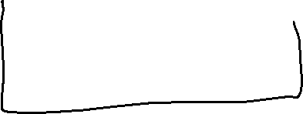
c

Slide 3


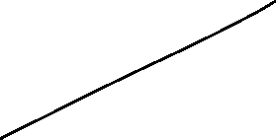









c

Slide 4
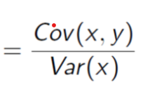



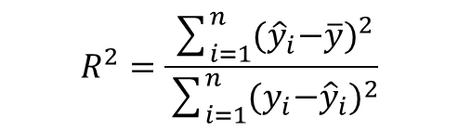



c
(5) Which proportion of the total variance is explained
by the linear regression with a R=-0,93?
$$R^{2}=\frac{\sum_{i=1}^{n}{{{(\hat{y}}_{i}−\overline{y})}^{2}}}{\sum_{i=1}^{n}{{{{(y}_{i}−\hat{y}}_{i})}^{2}}}$$

Slide 5
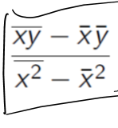





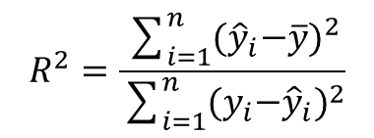




c
$$R^{2}=\frac{\sum_{i=1}^{n}{{{(\hat{y}}_{i}−\overline{y})}^{2}}}{\sum_{i=1}^{n}{{{{(y}_{i}−\hat{y}}_{i})}^{2}}}$$

Slide 6
c

