Slide 1


















Statistics A
Wilhelmshaven
This lecture will be recorded and
Subsequently uploaded in the
world-wide-web
Function translator (webpage)
Function translator Excel 1 (add in)
c
Prof. Dr. Bernhard Köster
Jade-Hochschule Wilhelmshaven
http://www.bernhardkoester.de/vorlesungen/inhalt.html

Slide 2









Correlation analysis
In principle for all data sets, we can calculate a regression line.
But we are also interested in the question meaningful is this calculated dependence?.
For this, we use the correlation analysis, wich gives the possibility to measure the strength of the dependence
For this, we use the correlation coefficient of Bravais-Pearson which is lying between -1 and +1
c

Slide 3
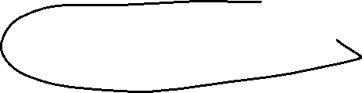












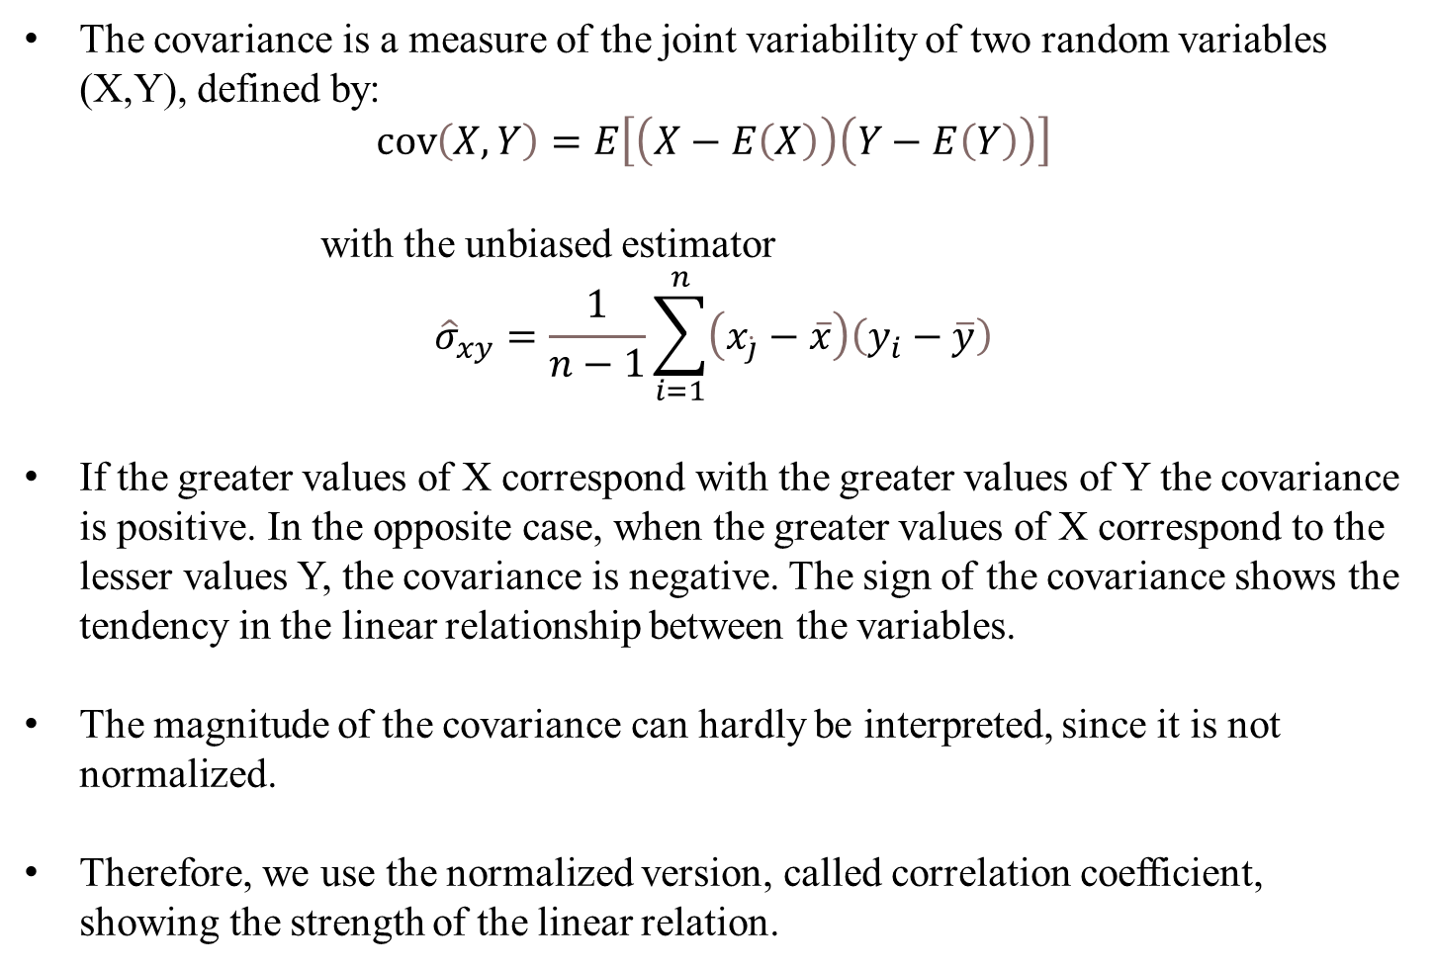
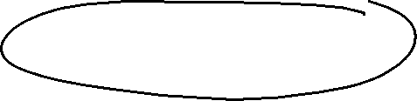

Covariance
The covariance is a measure of the joint variability of two random variables (X,Y), defined by:
$$\operatorname{cov}\left(X,Y\right)=E\left[\left(X−E\left(X\right)\right)\left(Y−E\left(Y\right)\right)\right]$$
with the unbiased estimator
$${\hat{σ}}_{xy}=\frac{1}{n−1}\sum_{i=1}^{n}{\left(x_{\dot{j}}−\overline{x}\right)\left(y_{i}−\overline{y}\right)}$$
If the greater values of X correspond with the greater values of Y the covariance is positive. In the opposite case, when the greater values of X correspond to the lesser values Y, the covariance is negative. The sign of the covariance shows the tendency in the linear relationship between the variables.
The magnitude of the covariance can hardly be interpreted, since it is not normalized.
Therefore, we use the normalized version, called correlation coefficient, showing the strength of the linear relation.
c

Slide 4






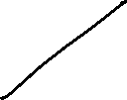




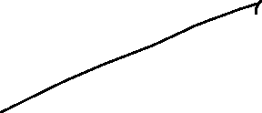










Correlation coefficient
General intervals for R
(0,0;0,2) → almost no dependence
[0,2;0,4) → low dependence
[0,4;0,6) → medium dependence
[0,6;0,8) → high dependence
[0,8;1,0) → almost full dependence
c

Slide 5













Correlation coefficiant examples
c

Slide 6



Coefficiant of determination R²
The squared correlation coefficiant R² is called coefficiant of determination.
In quantitative analysis, we often use the coefficiant of determination R², because it can be intuitively interpreted
But R² does not distinguish between + and – anymore.
R² is in the interval [0,1]
R² grafical interpretation:
R² equals the proportion of variance explained by the model in relation to the total variance, i.e. how much percent is explained by the regression line
(1-R²) equals the proportion of Variance not explained by the model in relation to the total variance, and has to be explained by other influencing factors
c

Slide 7

















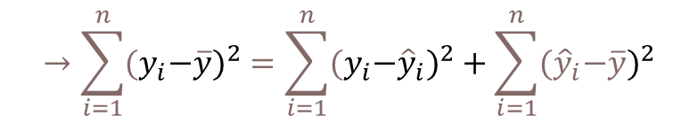




{
} Non explained difference
${\hat{y}}_{i}−\overline{y}$ explained difference
Total Difference
} Explained difference
${y_{i}−\hat{y}}_{i}$ not explained difference
Mean
$y_{i}−\overline{y}$ total difference
$$→\sum_{i=1}^{n}{{{(y}_{i}−\overline{y})}^{2}}=\sum_{i=1}^{n}{{{{(y}_{i}−\hat{y}}_{i})}^{2}}+\sum_{i=1}^{n}{{{(\hat{y}}_{i}−\overline{y})}^{2}}$$
Non explained squared difference y_{i}
total squared difference
explained squared difference
Mean
not explained squared difference
explained squared difference y_{i}
Total squared difference of y_{i}
c
Coefficiant of determination $R^{2}=\frac{\sum_{i=1}^{n}{{{(\hat{y}}_{i}−\overline{y})}^{2}}}{\sum_{i=1}^{n}{{{{(y}_{i}−\hat{y}}_{i})}^{2}}}$

Slide 8
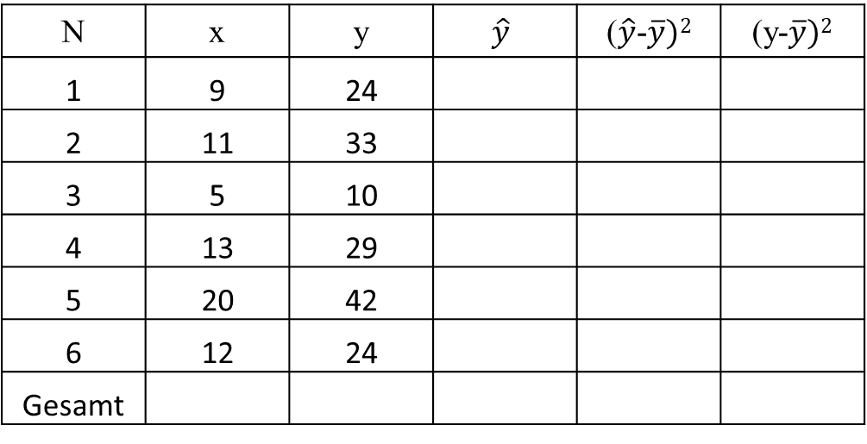
Correlation Coefficiant R^{2C}
N | x | y | $$\hat{y}$$ | ($\hat{y}$-$\overline{y})2$ | (y-$\overline{y})2$
1 | 9 | 24
2 | 11 | 33
3 | 5 | 10
4 | 13 | 29
5 | 20 | 42
6 | 12 | 24
Gesamt
c
R²= R=

Slide 9
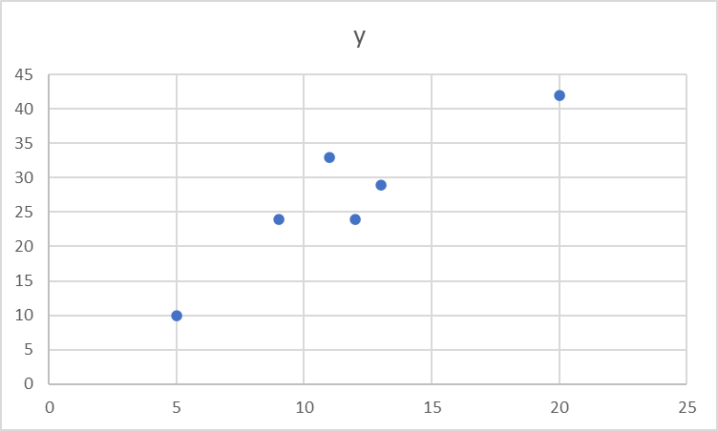







Correlation Coefficiant R
c
R²= R=

Slide 10


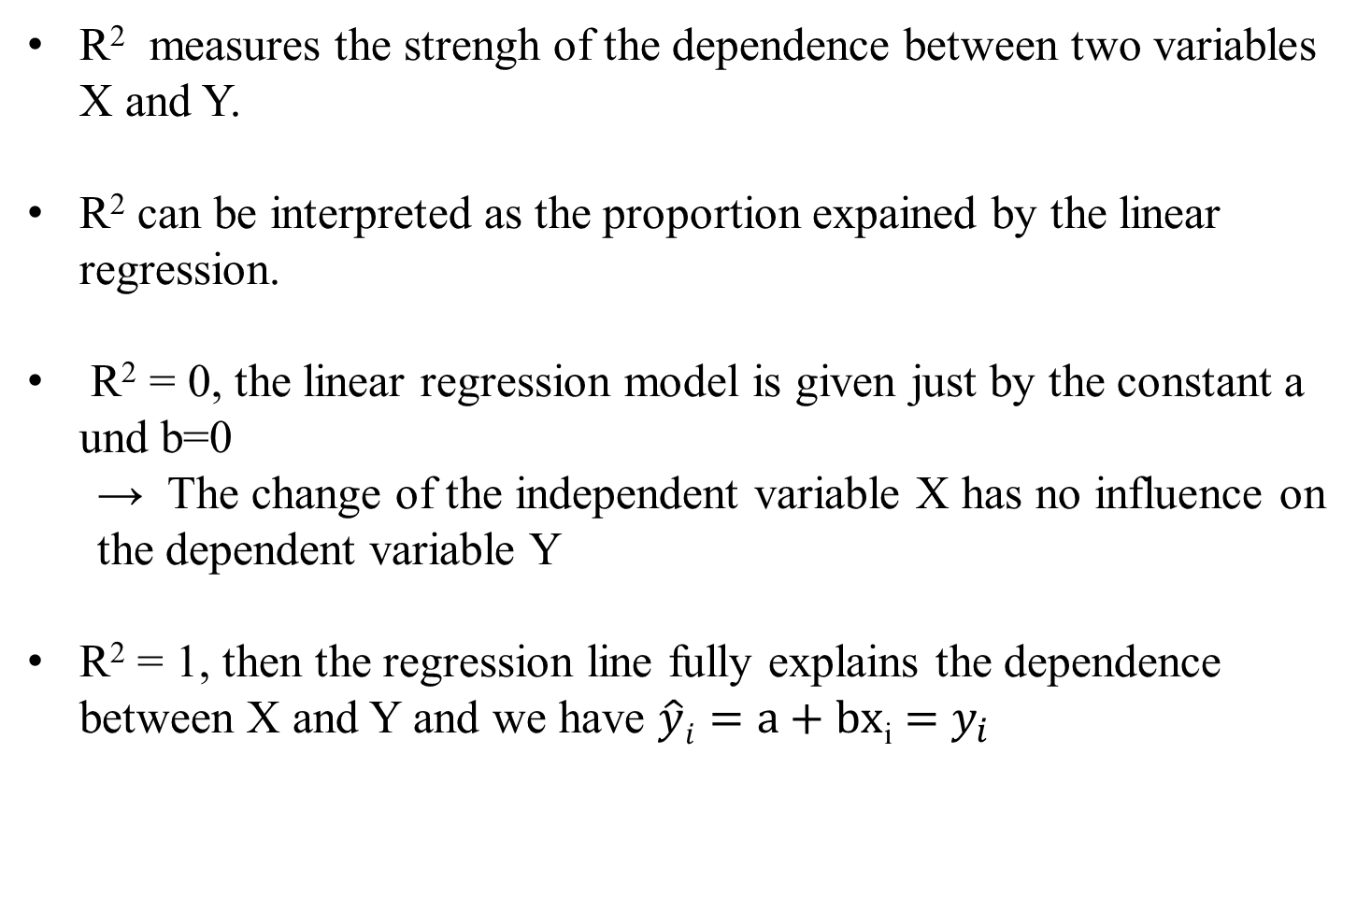





Interpretation of R²
R² measures the strengh of the dependence between two variables X and Y.
R² can be interpreted as the proportion expained by the linear regression.
R² = 0, the linear regression model is given just by the constant a und b=0
→ The change of the independent variable X has no influence on the dependent variable Y
R² = 1, then the regression line fully explains the dependence between X and Y and we have $\hat{y}i=a+bx$_{i} $=$ $y_{i}$
c

Slide 11










Make a forecast for inflation for Germany
First take the oil price the last 5 years (monthly data)
Exchange rate
Calculate the dependence between the energy component of the HCPI and the oilprice
And calculate the total inflation coming from the guessed increase of oil prices in the future due to a possible embargo of Russian oil
c

