Slide 1

Statistics A
Wilhelmshaven
This lecture will be recorded and
Subsequently uploaded in the
world-wide-web
Function translator (webpage)
Function translator Excel 1 (add in)
c
Prof. Dr. Bernhard Köster
Jade-Hochschule Wilhelmshaven
http://www.bernhardkoester.de/vorlesungen/inhalt.html

Slide 2



Scatterplot
Graphical representation of the attributes of two variables within a two-dimensional coordinate-system.
Number | 1 | 2 | 3 | 4 | 5 | 6 | 7 | 8 | 9 | 10 | 11 | 12 | 13 | 14 | 15 | 16 | 17 | 18 | 19 | 20 | 21 | 22
Order | 2 | 4 | 3 | 6 | 2 | 1 | 5 | 3 | 4 | 2 | 2 | 7 | 4 | 3 | 2 | 1 | 5 | 4 | 3 | 3 | 1 | 6
Volume [€] | 36 | 44 | 30 | 67 | 21 | 8 | 62 | 35 | 33 | 37 | 22 | 72 | 65 | 45 | 23 | 17 | 44 | 56 | 32 | 37 | 22 | 48
c

Slide 3
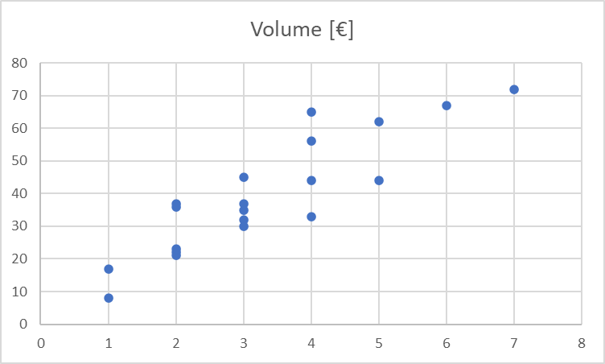



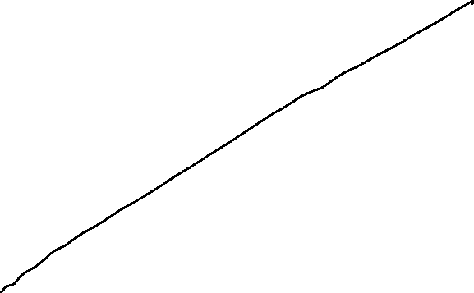



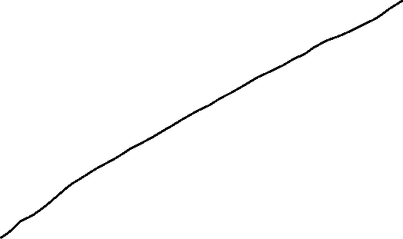





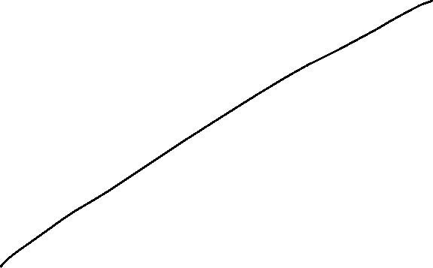
Scatterplot
X-coordinate: order
Y-coordinate: Volume [Euro]
c

Slide 4







Linear Regression
Example 2:
A company wants to know how the sales volume depends on visits of representatives.
The company has collected the following data
c
We also want to answer the question, from a descriptive point of view, which sales volume we can expect, if we increase the visits up to x=30

Slide 5



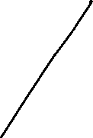





Linear Regression
Via a linear regression we want to analyse the dependence between two variables
We distinguish between a dependent variable (y) and an independent variable (x)
(x) is also called the explanatory variable
A change of (x) implicates a change (y)
The linear regression defines an empirical relation via a linear function
i.e. y = f(x) = 3 + 2x or generally y = a + bx
c

Slide 6




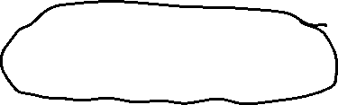



Simple Examples
c
Determine graphically a regression line for the blue and red data points. What kind of
dependence do we have?

Slide 7
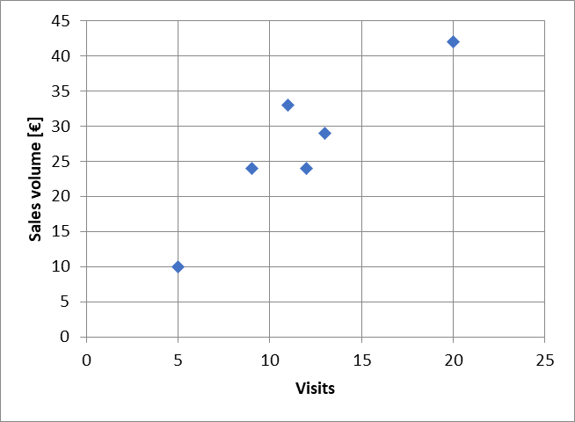

Example
c
Try to fit graphically (by eye) a regression line through the data points

Slide 8










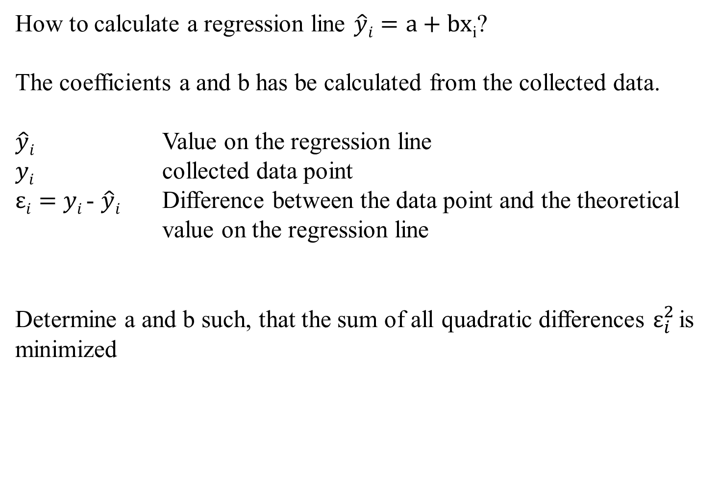



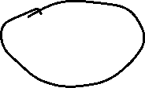




Optimizing problem
How to calculate a regression line $\hat{y}i=a+bx$_{i}?
The coefficients a and b has be calculated from the collected data.
$\hat{y}i$ Value on the regression line
$yi$ collected data point
$εi=$ $yi$- $\hat{y}i$ Difference between the data point and the theoretical value on the regression line
Determine a and b such, that the sum of all quadratic differences $ε_{i}^{2}$is minimized
c

Slide 9



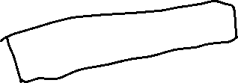



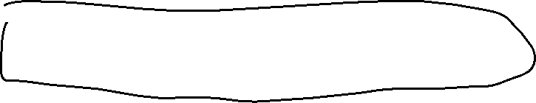






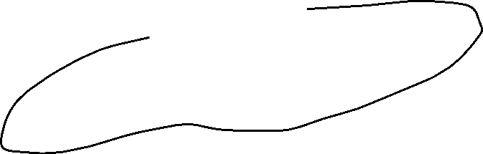





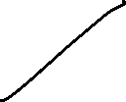








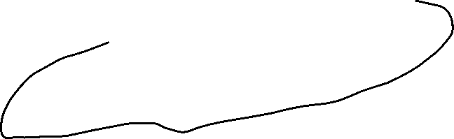


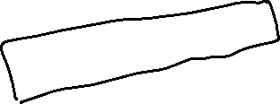




Least squared method
The formal optimizing problem
c

Slide 10



















Least squared method
The formal optimizing problem
c

Slide 11









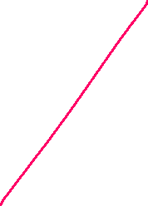






















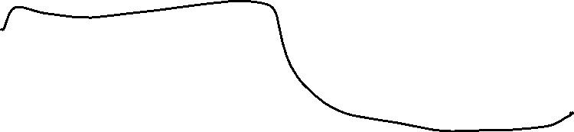






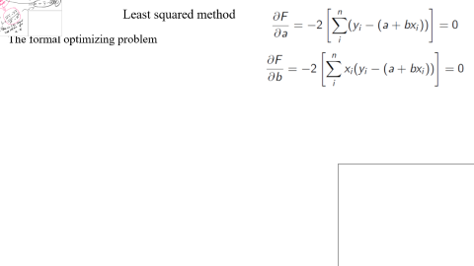

Least squared method
The formal optimizing problem
c

Slide 12




Least squared method
The formal optimizing problem
FOC:
2 dimensional linear system which can directly be solved
c

Slide 13
Least squared method
c

Slide 14







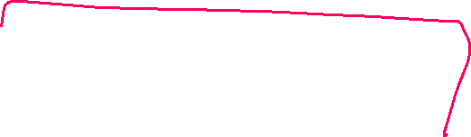










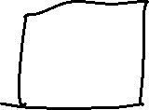

Formulas
:
c

Slide 15
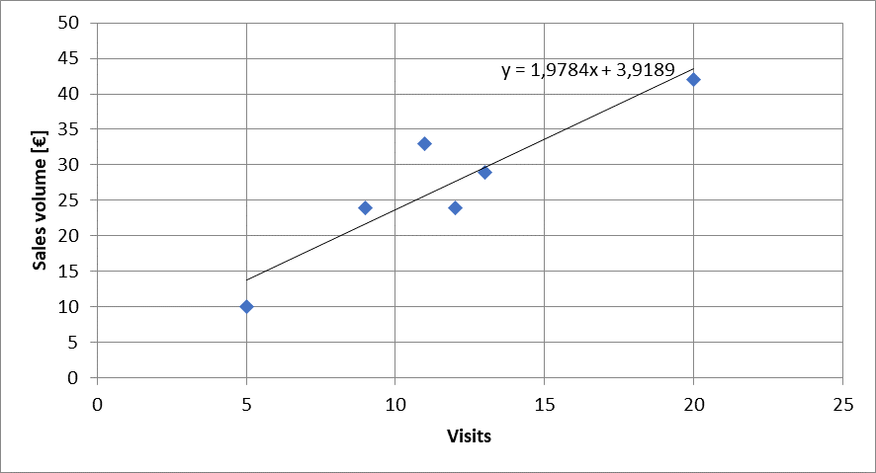







Calulating the regression line from empirical data
$$ei2$$
$\hat{y}i=a+bx$_{i}
c

Slide 16








Lineare Regression
 | Visits | Sales volume [€]
year | x | y | xy | x^2
2008 | 9 | 24
2009 | 11 | 33
2010 | 5 | 10
2011 | 13 | 29
2012 | 20 | 42
2013 | 12 | 24
c
b=
a=

Slide 17
Extrapolation for x=30
 | Visits | Sales volume [€]
year | x | y | xy | x^2 | yhat
2008 | 9 | 24
2009 | 11 | 33
2010 | 5 | 10
2011 | 13 | 29
2012 | 20 | 42
2013 | 12 | 24
c
yhat(30)=

Slide 18
Regressions coefficients
Regressions coefficient b
  Slope of the regression line.
  Determines the marginal effect of a change of one unit of the independent variable x onto the dependet variable y
Regressions coefficient a
  The value of the dependent variable if the independent variable x=0
    → intercept of the vertical axes
c

Slide 19
Linear regression
Measures the linear dependence between two variables
This dependence can be interpreted, that one variable is quantitatively influencing another variable
The linear regression is an instrument for forecasting
c

