Slide 1



Magic Square
Steady and appropriate economic growth
External balance
Price level stability
High level of employment

Slide 2
Gesetz zur Förderung der Stabilität und des Wachstums der Wirtschaft (StabG 1967)
Law on the Promotion of Economic Stability and Growth
§ 1
Bund und Länder haben bei ihren wirtschafts- und finanzpolitischen Maßnahmen die Erfordernisse des gesamtwirtschaftlichen Gleichgewichts zu beachten. Die Maßnahmen sind so zu treffen, dass sie im Rahmen der marktwirtschaftlichen Ordnung gleichzeitig zur Stabilität des Preisniveaus, zu einem hohen Beschäftigungsstand und außenwirtschaftlichem Gleichgewicht bei stetigem und angemessenem Wirtschaftswachstum.
The federal and state governments must take into account the requirements of macroeconomic balance in their economic and fiscal policy. The policy has to be within the framework of the market economy, they simultaneously contribute to price stability, a high level of employment and external economic balance, with steady and appropriate economic growth.

Slide 3








Steady and appropriate economic growth
When measuring overall economic performance, the question arises as to how to deal with a situation in which the value of GDP in monetary units or euros increases solely due to price inflation.
-> Therefor we distinguish between nominal and real economic growth.
Relative change of the nominal GDP compared to the previous period (year)
Difference because of changes in prices
Difference because of changes in quantity
In order to do not count changes in prices, the real GDP is calculated with respect to the prices of the previous year,
Since only a change because higher prices does not count for an increase of overall economic performance!

Slide 4
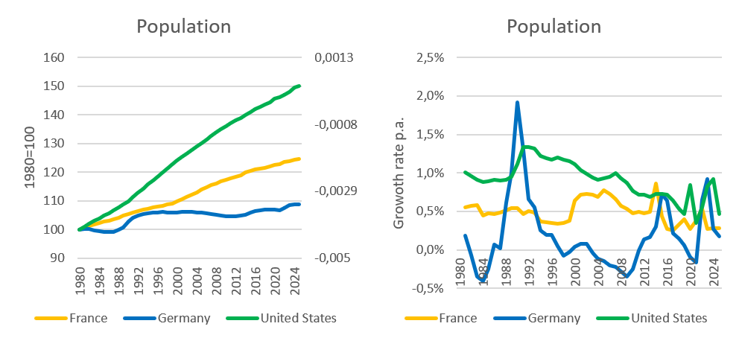
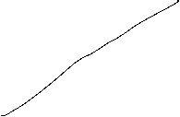







Steady and appropriate economic growth
Indicators
Growth of real GDP
→ change of overall economic performance, not including singular changes in prices (price adjusted GDP)
Growth of real GDP per capita
→ since in general new inhabitants will increase GDP, we also to adjust for population growth
→ In developed countries an growth rate of GDP of roughly 1%-3% p.a. is claimed to be appropriate on average, without high volatily around this traget growth rate.
Source: IMF

Slide 5



















Calculating real GDP
Since 2005 real GDP is calculated via a chain index (caution, in many textbooks and in the web real GDP is explained due to a fixed price bases, but this is wrong!).
Real GDP is the value of final goods and services calculated via constant prices of the previous year. We set a base year in time t wird equal to Index_{real}(t)=100 and the indices of the following years are the calculated recursively
GDP(t+1) in prices of t
Index_{real}(t+1) = Index_{real}(t)
GDP(t) in prices of t
P₁(t)•X₁(t+1)+P₂(t) •X₂(t+1)+…
= Index_{real}(t)
P₁(t) •X₁(t)+P₂(t) •X₂(t)+…
with P₁, P_{2,}… prices of goods an services 1,2,… ;X₁, X₂,… quantities of goods an services 1,2,… and time t

Slide 6



Real economic growth and GDP-Deflator
Real economic change is the realtive change of the chain-index of real GDP:
GDP-Index_{real}(t) – GDP-Index_{real}(t-1)
Real economic growth = g(t)=
GDP-Index_{real}(t-1)
GDP-Index_{nom}(t)
GDP-Deflator(t) = 100
GDP-Index_{real}(t)
The relative change of the BIP-Deflator represents the pure price effectof the realative change of nominal GDP
(in opposite to case, if real GDP would be calculated via a fixed price base, since then, the BIP-Deflator itself represents the price effect, be careful, if you read other text books!)

Slide 7
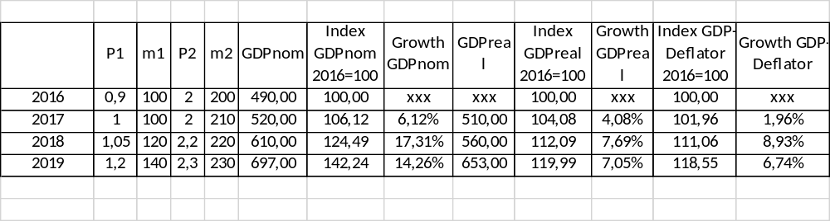
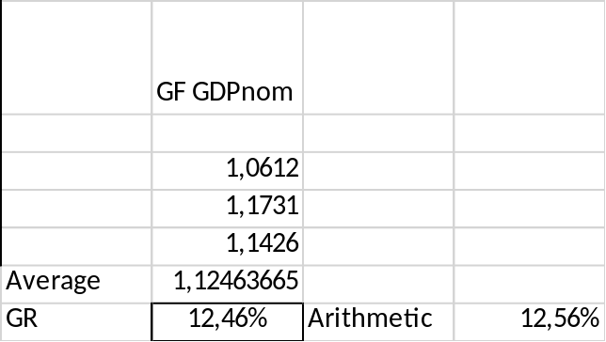









Example

Slide 8
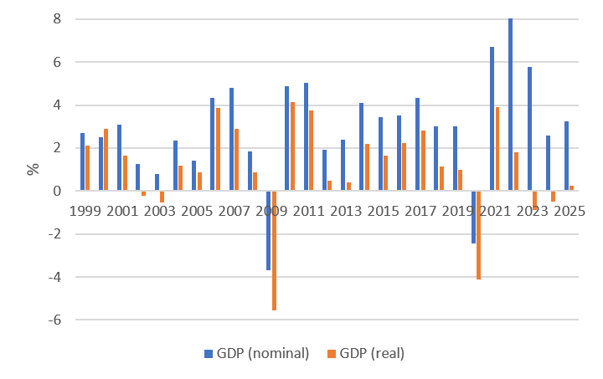



















Nominal and real economic growth (Germany)
Source: Destatis

Slide 9
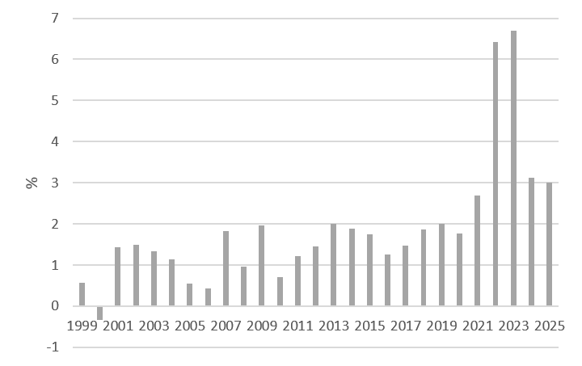



Relative change of the GDP-Deflator (Germany)
Source: Destatis

Slide 10

Nominale GDP/real GDP/GDP-Deflator
The realtive change of nominal GDP represents changes in prices and quantities.
The realtive change of real GDP represents changes in quantities and therefore counts for the change of economic performance
With the realtive change of the GDP-Deflator we can correct nominal growth in order to obtain real growth

Slide 11
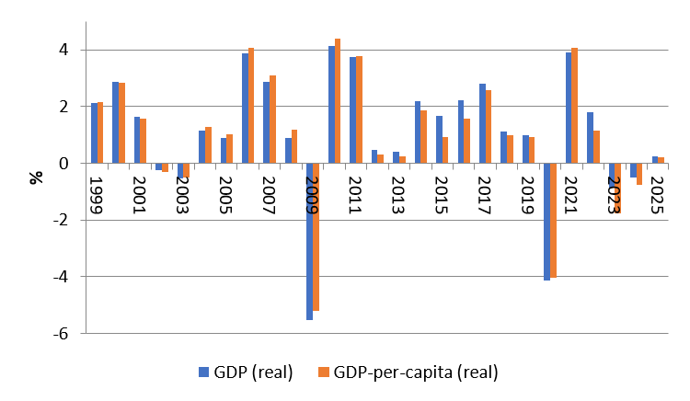









Difference of economic growth measured via real GDP and real GDP per capita (Germany)
Source: Destatis

Slide 12












Why price level stabiliy?
reasons:
In a market economy price give the signal of scarcity of goods and services, therefore the overall price level should not to be to volatile.
preservation of the value of money over time
Avoiding transaction cost because of new price declarations (menue costs)
Injustice in the creditor-debtor relationship
Stable decisions between consumption and saving

Slide 13

Measuring the value of money
In order to determine the puchasing power of money we cannot only look at single prices. Therefore we calculate an average of many prices.
→ The value of money is measured in a price index. This price index is base on representative choice of a basket of single goods.

Slide 14


Calculating Inflation
Choice of the basket of single goods
  Determine the relevant goods and services, a representative household is consuming
  Weighting the goods due to their significanse in the consumption plan of the representative household
Dertermine the prices:
  Looking up the prices of the goods in the chosen basket for a given time t.
Value of the basket:
  Multiply the determined prices with the chosen weight. Summing up give the Value of the basket for the given time t.

Slide 15
Calculating Inflation
Choose a base year t₀ :
  The Price-Index of the base year t₀ is set to 100.
  Index of time t is calculated as value of the basket at time t divided by the value of the basket in t₀ multiplied by 100
Calculating inflation:
  Inflation equals the rate of change of the Price-Index.

Slide 16





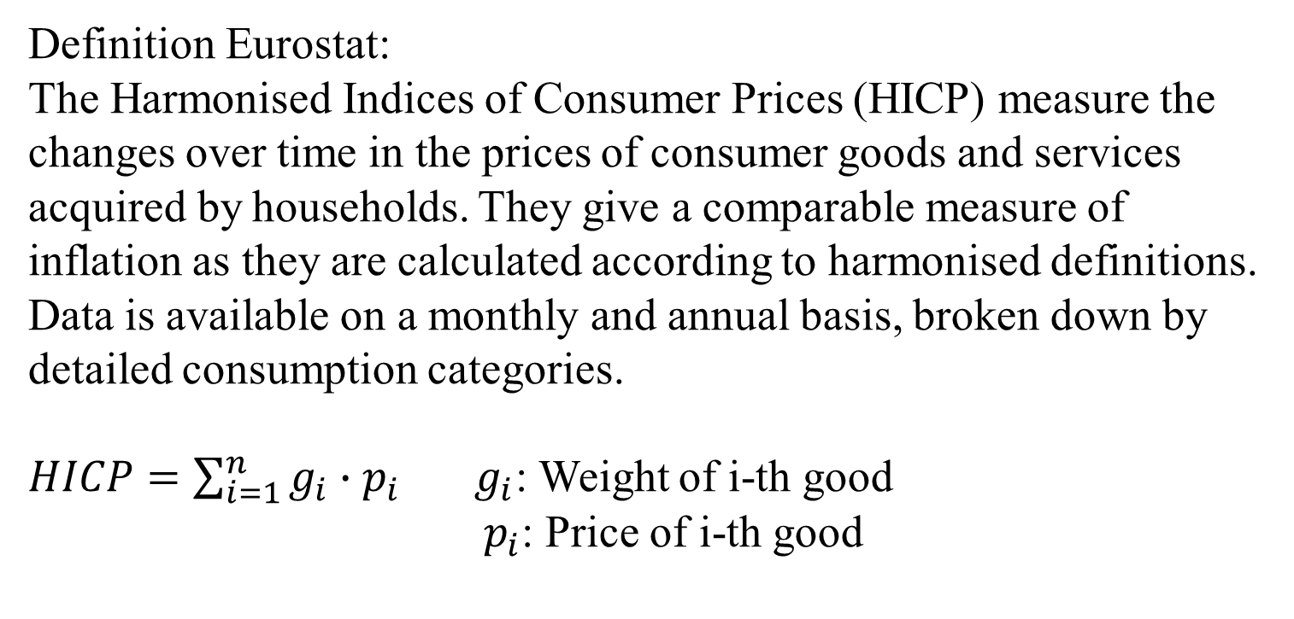

Harmonized Indices of consumer Prices (HICP)
Definition Eurostat:
The Harmonised Indices of Consumer Prices (HICP) measure the changes over time in the prices of consumer goods and services acquired by households. They give a comparable measure of inflation as they are calculated according to harmonised definitions. Data is available on a monthly and annual basis, broken down by detailed consumption categories.
$HICP=\sum_{i=1}^{n}{g_{i}∙p_{i}}$ $g_{i}$: Weight of i-th good
${ p}_{i}$: Price of i-th good
https://service.destatis.de/inflationsrechner/EN/
A personal inflation calculator

Slide 17
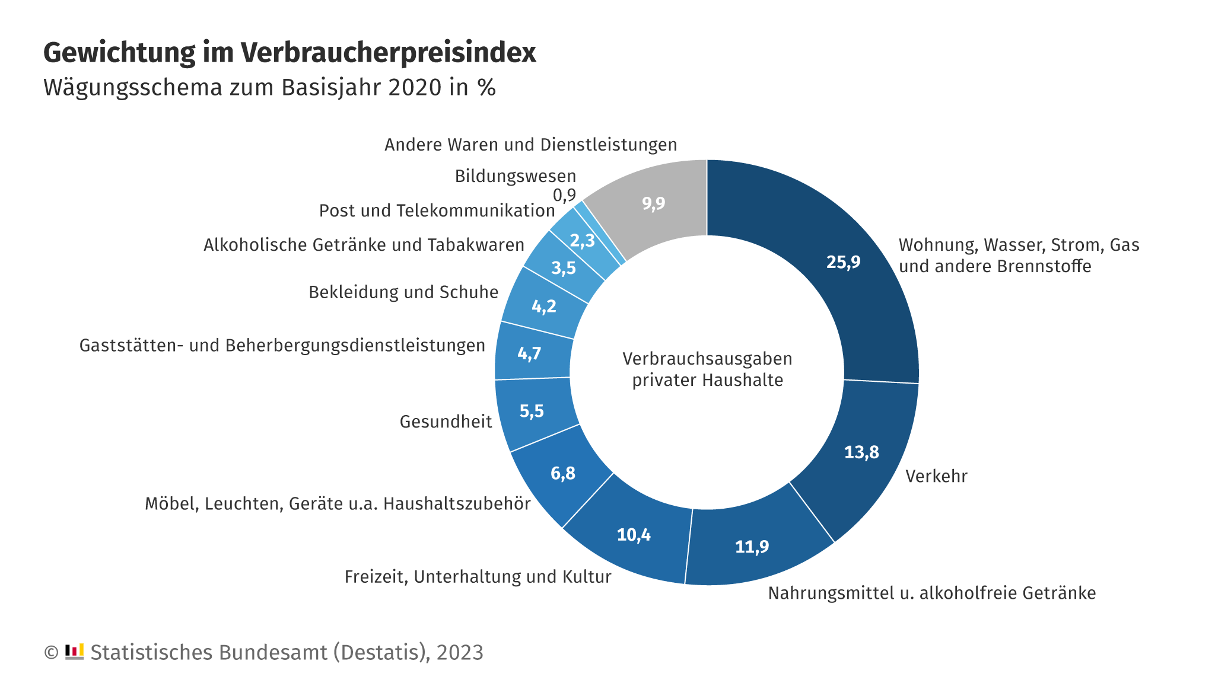
Wägungsschema des Verbraucherpreisindex
Oder das Preiskaleidoskop des Stabu
https://www.destatis.de/DE/Themen/Wirtschaft/Preise/Verbraucherpreisindex/PreisKaleidoskopUebersicht.html
Hier könnt Ihr eure eigene Inflationsrate ausrechnen
https://www.destatis.de/DE/Service/Statistik-Visualisiert/persoenlicher-inflationsrechner-uebersicht.html
Video Destatis
https://www.destatis.de/DE/Themen/Wirtschaft/Preise/Verbraucherpreisindex/inflation.html

Slide 18
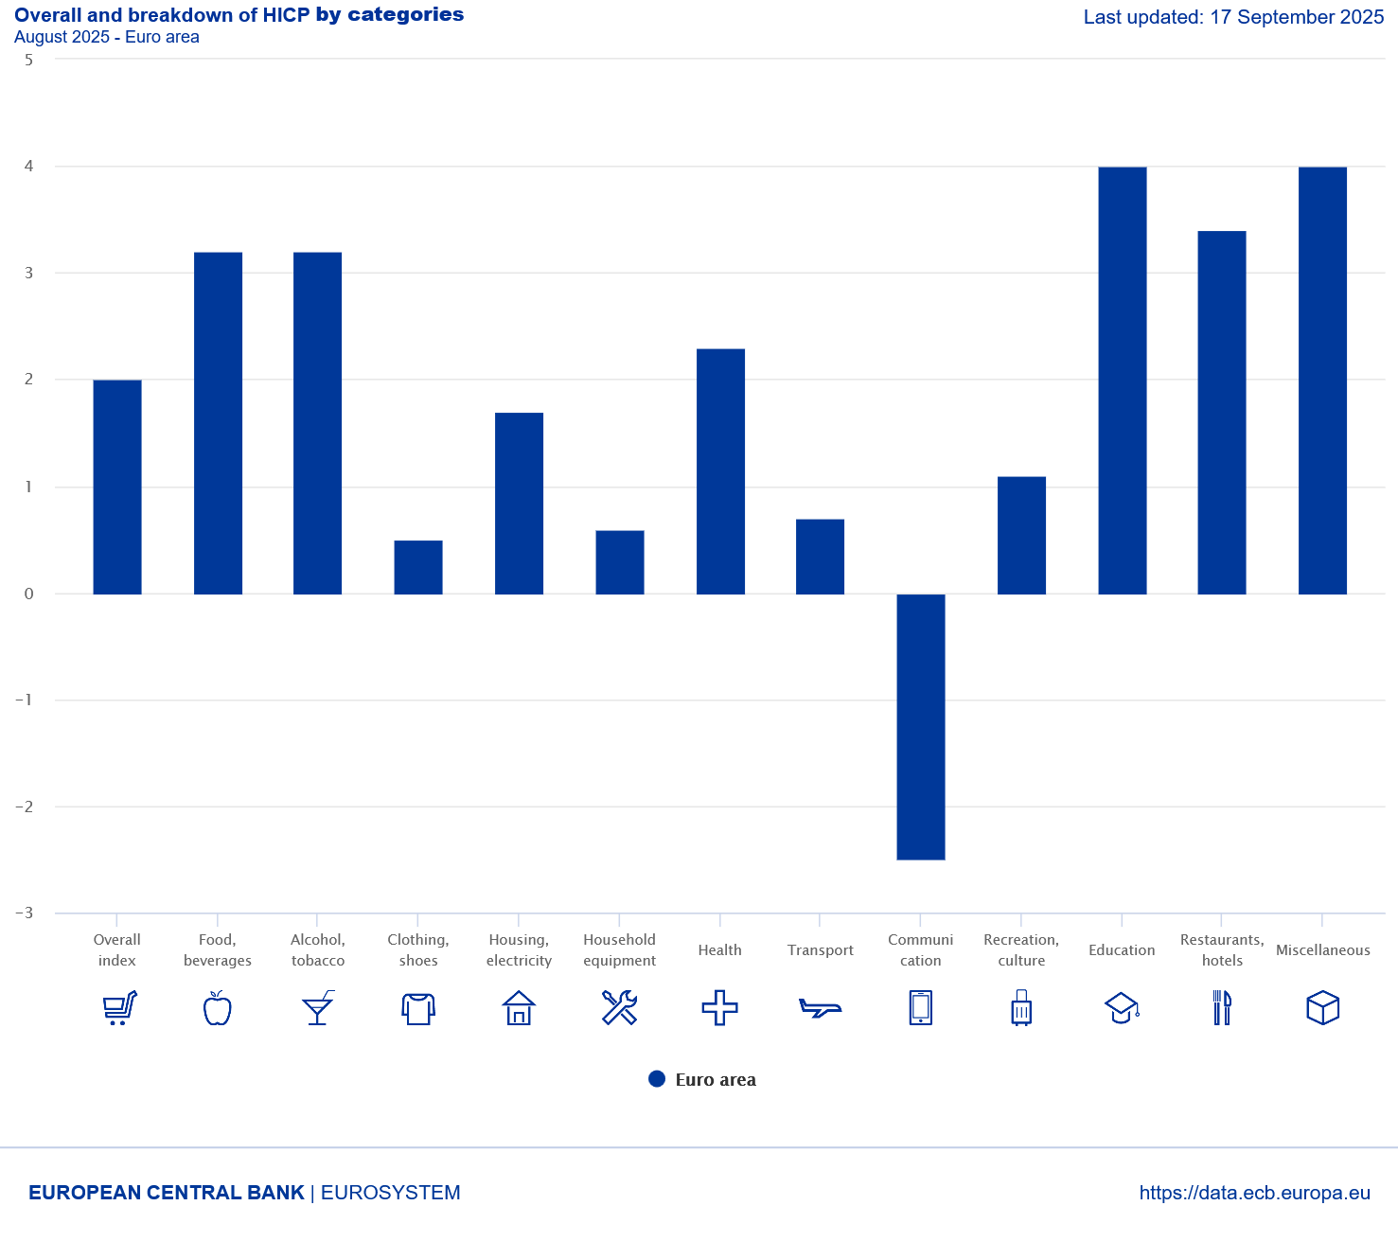
Weighting scheme of the HCPI
https://www.ecb.europa.eu/stats/macroeconomic_and_sectoral/hicp/html/index.en.html

Slide 19


Price level stability
Price level stability is in general calculated via the consumer price index (CPI) or in the Eurozone the harmonized consumer price index (HCPI).
Definition of price level stability of the European central bank:
The ECB’s Governing Council considers that price stability is best maintained by aiming for 2% inflation over the medium term. Inflation is measured by the Harmonised Index of Consumer Prices (HICP). The Governing Council’s commitment to the 2% target is symmetric. This means that we consider negative and positive deviations from the target to be equally undesirable.

Slide 20



Inflation
The inflation rate is the relative change of CPI with respect to the previous year. :
$Inflation\left(t\right)=\frac{CPI(t)−CPI(t−1) }{CPI(t−1)}$ t: time index

Slide 21
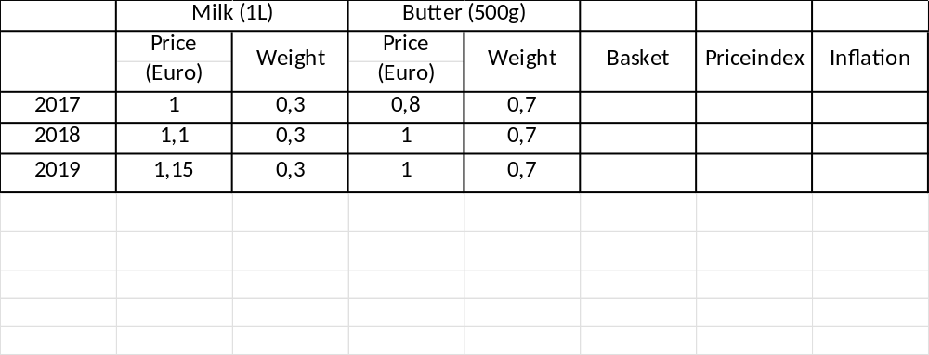













Calcuate the price index 2017 – 2019 (2017=100)
Inflation rates 2018 und 2019, and the average inflation 2018 – 2019.
Beispiel

Slide 22

Different Preisindices
Consumer price index → general inflation, relevant for private consumption
GDP-Deflator → Index for the whole economy, scope of distirbution in wage negotiations
Export- and Import prices → Indices for international trade (relevant for „imported“ inflation)
Wolesale price index→ Whole sale trade is some kind of an early indicator for inflation based on CPI.

Slide 23
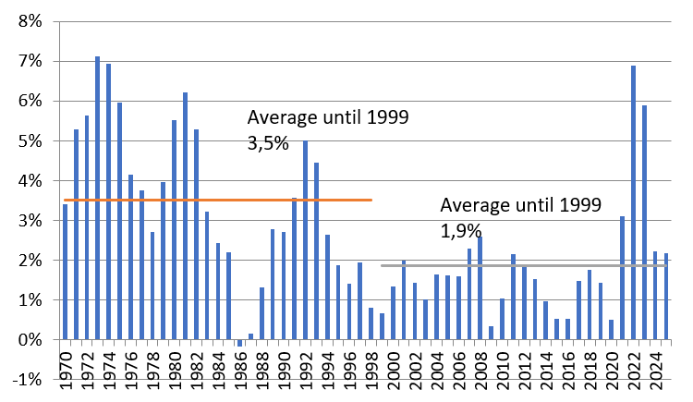
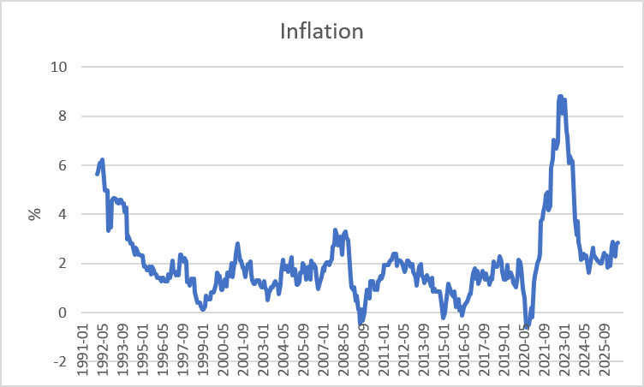












Inflation Germany
Yearly
Monthy p.a.
Source: Destatis

Slide 24
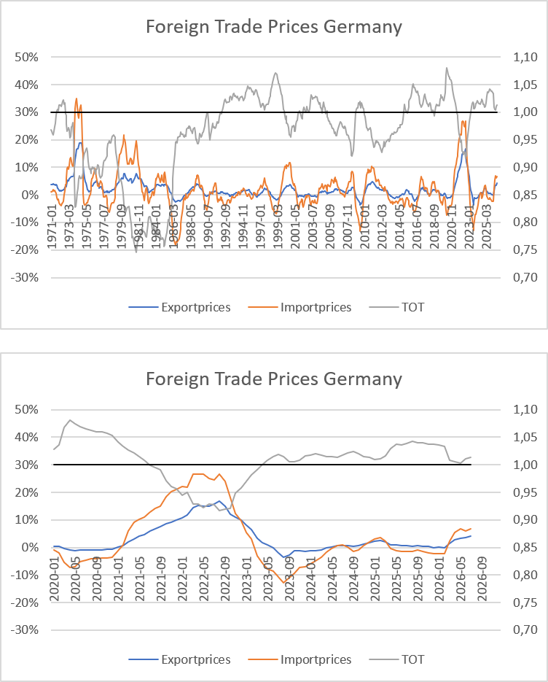

Foreign Trade Prices Germany
Source: Destatis, YoY

Slide 25
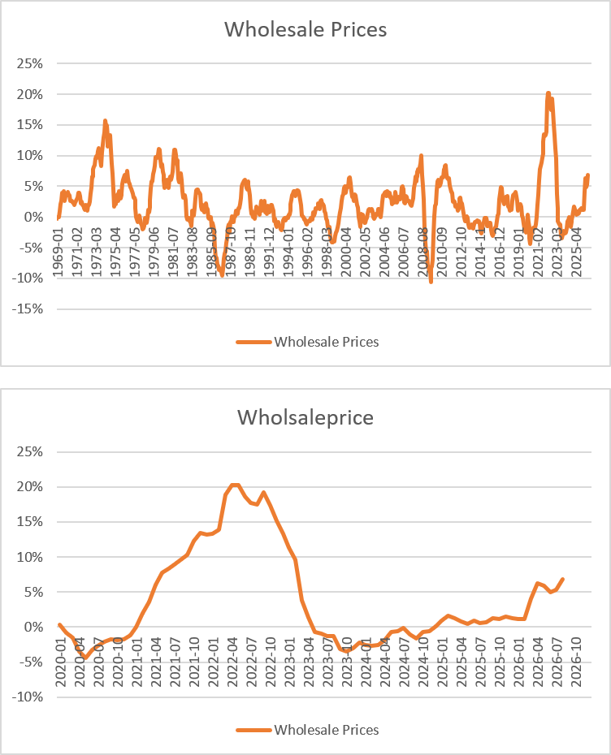



Wholesale Prices Germany
Source: Bundesbank, YoY

Slide 26
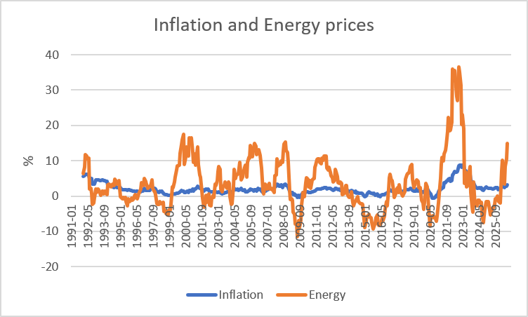


CPI and the Energy component (Germany)
Source: Bundesbank

Slide 27
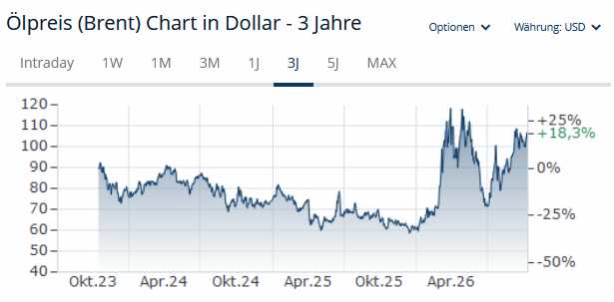





Energy and Inflation
The weight of the energy component is roughly 10% in CPI.
Calculate inflation, if energy price have risen by 30% and all other prices stayed the same.

Slide 28





High level of employment
Principal aim is to reach a state of full employment.
→ every person willing has a job.
The general variable to measure unemployment is the unemployment rate.
In Germany a level of 3%-4% unemployment rate is considered as a state of full employment.

Slide 29



Unemployment definition BA
(registered unemployed people)
Age between 15 – 65 (67) years
Defined by the Social Code, Book III (SGB III), the unemployed include all those who are
temporarily not employed or work in a job for fewer than 15 hours per week,
seek employment subject to social insurance contributions for at least 15 hours per week,
and in the process are available for placement efforts undertaken by the employment agencies or institutions administering basic security benefits for job-seekers
and have registered there as unemployed.

Slide 30

Unemployment definition ILO
Unemployed is any person aged between 15 and 74 years
who was not in employment, but actively sought work over the four weeks preceding the survey
and would be available for starting a job within two weeks.
In this context, it is irrelevant whether the persons concerned are registered with a government authority and receive social benefits from there

Slide 31
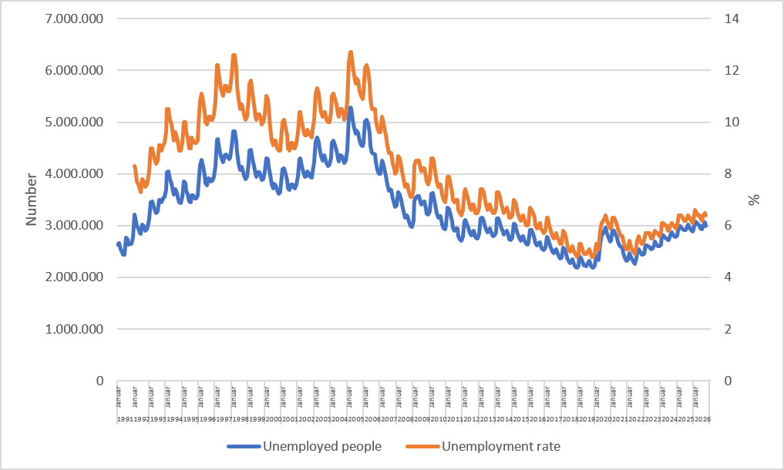
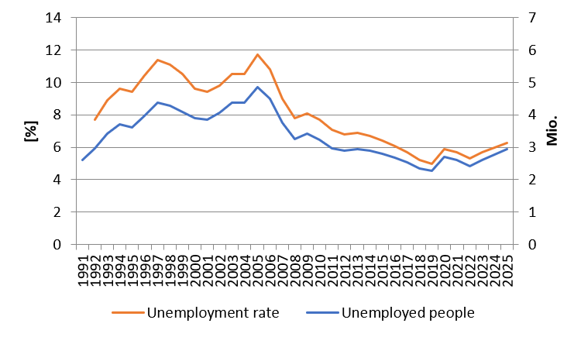




Monthly development of unemployment in Germany
Source: BA

Slide 32

Types of unemployment
Short-term: seasonal and frictional unemployment
Medium-term: cyclical unemployment
Long-term: structural unemployment

Slide 33


Short term unemployment
seasonal unemployment:
Fluctuation in production during a year i.e. in the agricultural sector or the construction sector
Fluctuations in demand during the year i.e. in Tourism sector because of the weather or because of school holidays
Hiring cycles
frictional unemployment :
Incomplete information in the labour market causes a mismatch between job seeking poeple and poeple seeking enterprises
  Transition time between on job and another new job
  Additional time because of moving from one location to another

Slide 34




Medium- and long-term unemployment
Cyclical unemployment:
Within the business cycle we have an under utilization of potential output → causing a decrease in labor demand
Structural unemployment :
Sectoral change, i.e. legislative amendment (Change in Energy politics)
→ job loss in the coal industry or the nuclear sector
Technological change, i.e. digitalization of many process will change the labor market dramatically (i.e. AI)
              → new skills are neede in the future
Regional descrepancy in job demand and supply specially because of the demographic change in the rural area

Slide 35
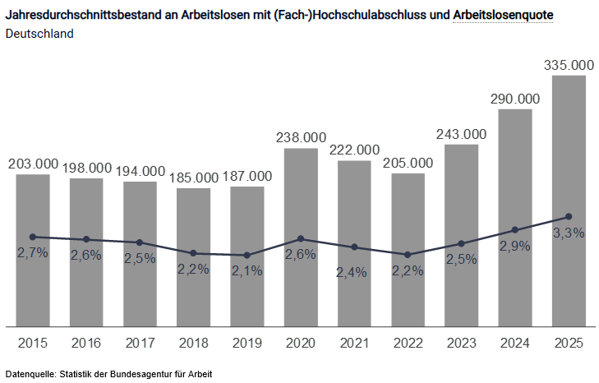
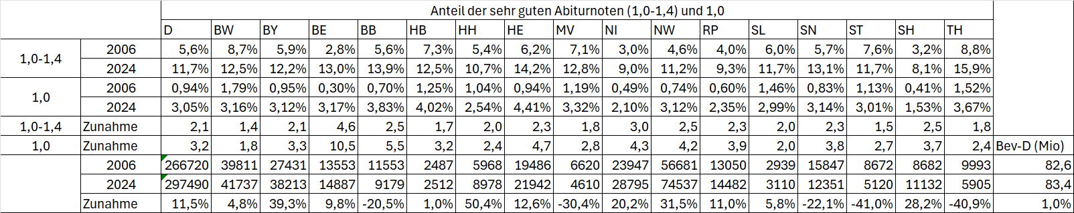
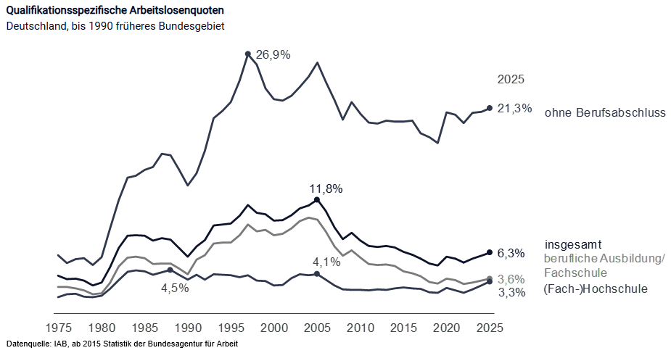
Exkurs: Graduate Unemployment (Source: BA)

Slide 36
Hidden unemployment
People in qualification programs
Early retirement
Short time work
Job creation sheme

Slide 37
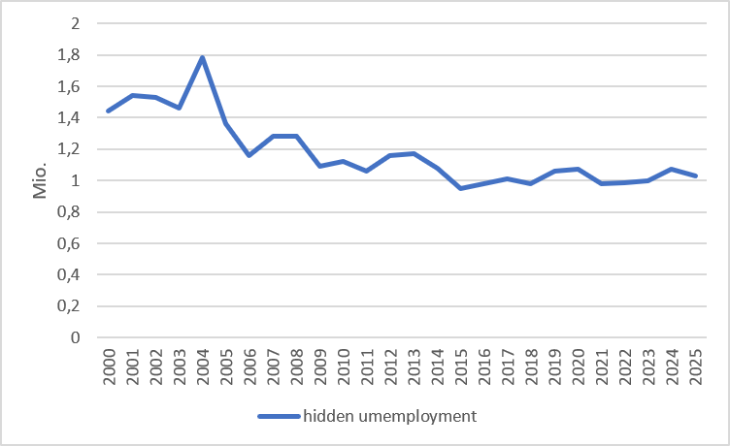
Hidden unemployment Germany
Hidden reserve in programs:
Neither employed nor registered as unemployed. Examples: further education, language courses, early retirement
Hidden reserve in the narrower sense:
Not currently looking for work, but fundamentally willing to take up employment
Source: IAB

Slide 38
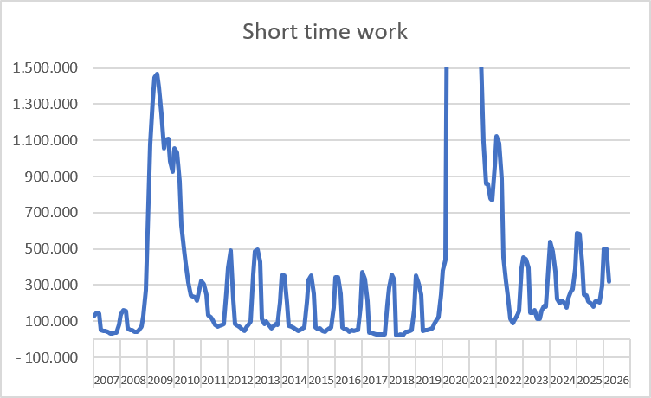
Short time work: Germany
Source: BA

Slide 39
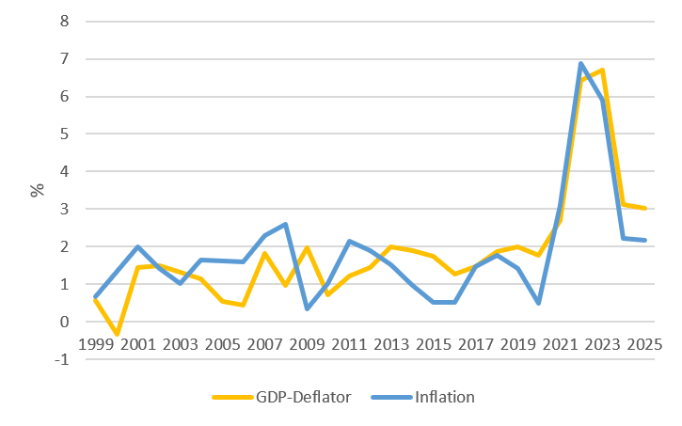
Importance of CPI und GDP-Deflator for the Labour market
Source: Destatis,

Slide 40
External balance
There is no generally accepted definition!
This aim has to be understood within the historical context. Until 1973 we had a system of fixed exchange rates in the world. Every convertible currency was fixed in realtion to the US-Dollar → In such a framework it is suitable to balance i.e. the current accout or the trade balance, because otherwise the own currency can be out under pressure
But in 1973 the system of Bretton woods collapsed! Since the, we have free floating currencies, and therefore there is no need anymore for a balanced current account. Nevertheless you find in textbooks the following aims:
Andere Interpretationen:
Balanced trade balance
Balanced current account
Low fluctuating currency
Low susceptibility from foreign economies

Slide 41
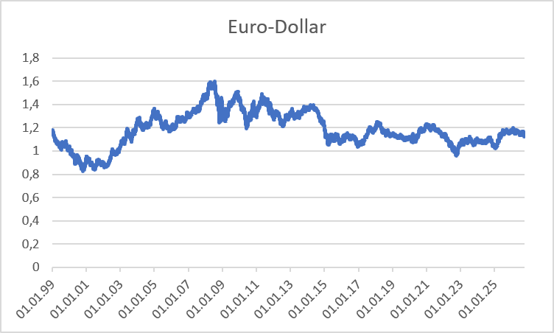
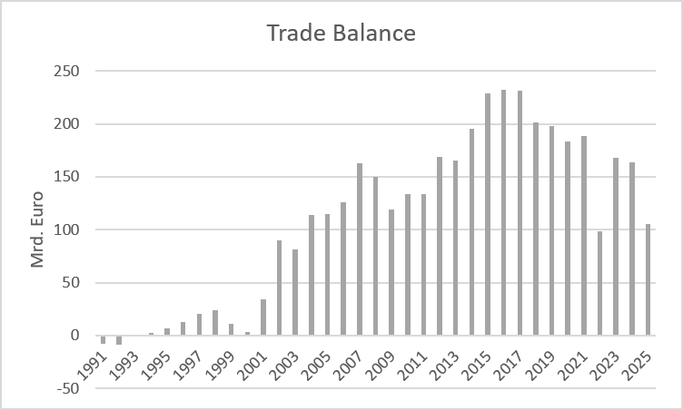
International economic relationships Germany
Source: Bundesbank
Exchange rate Euro – Dollar
Trade balance

Slide 42
Balance of Payments
Definition of Balance of Payments:
The balance of payments is a summary of all the international transactions of a country and its citizens during a specified period of time. This period is usually of one year, though many countries have now started preparing the quarterly accounts for the purposes of forecasting.
Caution:
In the balance of payments we count flow, while usually in a balance sheet you report stocks!
Notes:
42

Slide 43
Balance ofpayments
A. Current Account
B.Capital account
C. Financial account
A1. Balance of goods
A2. Balance of services
A3. Primary income (payments form work (wages) oder inverstments (dividends)
A4. Secondary income (payments from government (tax, refunds) or one way transfers i.e. disaster relief)
B1. Capital transfers
B1. Direct investment
B2. Porfolio investment
B3. Financial derivative
B4. Reserve investement
B5. Other investment
Notes:
43

Slide 44
Further economic goals
Fair balanced income distribution → German constitution Art. 72 Satz 2 GG
Sustainable ecological conditions → German constitution Art. 20a GG
Sustainable public financial budget → German constitution Art. 109 Satz 3 GG
→ Maastricht criteria 3% Deficit
60% government debt ratio

Slide 45
Fair balanced income distribution
Art. 72 Satz 2 GG
(2) Due to article 74 Abs. 1 Nr. 4, 7, 11, 13, 15, 19a, 20, 22, 25 and 26 the federal government has legislative power if and to the extent that the establishment of equivalent living conditions within the federal territory or the preservation of legal or economic unity in the national interest requires federal legislation.

Slide 46
Sustainable ecological conditions
Art. 20a GG
The state shall also protect the natural foundations of life and animals in accordance with the constitutional order through legislation and, in accordance with the law and justice, through the executive power and the judiciary, in responsibility for future generations.

Slide 47
Sustainable public financial budget
(1) The Federation and the Länder shall be autonomous and independent of each other in their budgetary management.(2) The Federation and the Länder shall jointly fulfill the obligations of the Federal Republic of Germany under European Community legal acts based on Article 104 of the Treaty establishing the European Community to maintain budgetary discipline and, within this framework, shall take into account the requirements of overall economic balance.(3) The budgets of the Federation and the Länder shall, in principle, be balanced without revenue from loans. The Federation and the Länder may provide for rules to take account symmetrically, in times of economic expansion and contraction, of the effects of economic developments that deviate from the normal situation, as well as for an exception for natural disasters or exceptional emergency situations that are beyond the control of the state and significantly affect the state's financial position. A corresponding repayment arrangement must be provided for the exemption. The details are regulated for the federal budget in Article 115, with the proviso that sentence 1 is complied with if the revenue from loans does not exceed 0.35 percent in relation to nominal gross domestic product. The amount by which defense expenditures, federal expenditures for civil protection and civil defense, as well as for intelligence services and for the protection of information technology systems, exceed the amount of revenues from loans to be taken into account shall be deducted from the amount of revenues from loans to be taken into account. The amount by which defense spending, federal spending on civil protection and civil defense, intelligence services, IT systems protection, and aid to states attacked in violation of international law exceeds 1 percent of nominal gross domestic product shall be deducted from the revenue from loans to be taken into account. The states as a whole shall comply with sentence 1 if the revenue from loans generated by them does not exceed 0.35 percent in relation to nominal gross domestic product. The distribution of the borrowing permitted for the states as a whole in accordance with sentence 6 among the individual states shall be regulated by a federal law with the consent of the Bundesrat. The details for the budgets of the states shall be regulated by the states within the framework of their constitutional powers. Existing state regulations that fall short of the borrowing limit specified in sentence 7 shall cease to have effect.

Slide 48
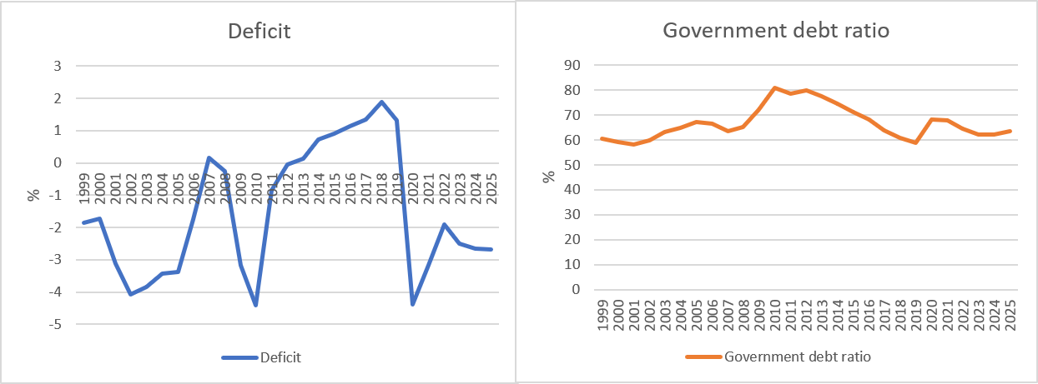
Development of the public budget and debt (Germany)
Cource: Destatis, Bundesbank
Deficit: Public Budget in relation to GDP
Government debt ratio : governemnt debt in relation to GDP

